Slide 1



Fine Tuning

Slide 2
Reparametrization-based methods- LoRA
Courtesy:, deeplearning.ai ,
Notes:
Reparameterization-based PEFT refers to a category of parameter-efficient fine-tuning (PEFT) techniques that modify or reparameterize parts of the pre-trained model's architecture to inject learnable components, while keeping the majority of the model frozen.

Slide 3
Reparametrization-based methods
Reparameterization refers to transforming or reformulating the parameters of a model in a way that simplifies certain aspects of the training or optimization process.
This can involve:
Simplifying the Optimization Landscape: Making the parameter space easier to navigate during training.
Improving Efficiency: Reducing the number of parameters or computations required.
Introducing Constraints: Incorporating prior knowledge or constraints more naturally into the model.
Leverage low-rank representations to minimize the number of trainable parameters
Basic intuition: neural networks have low dimensional representations
Common approaches
LoRA
QLoRA
Intrinsic SAID
Notes:
Neural networks operate in high-dimensional space, but they learn low-dimensional, meaningful structures that reflect the true complexity of the data.
How many directions in parameter space are truly needed to optimize a pre-trained model on a new task,

Slide 4
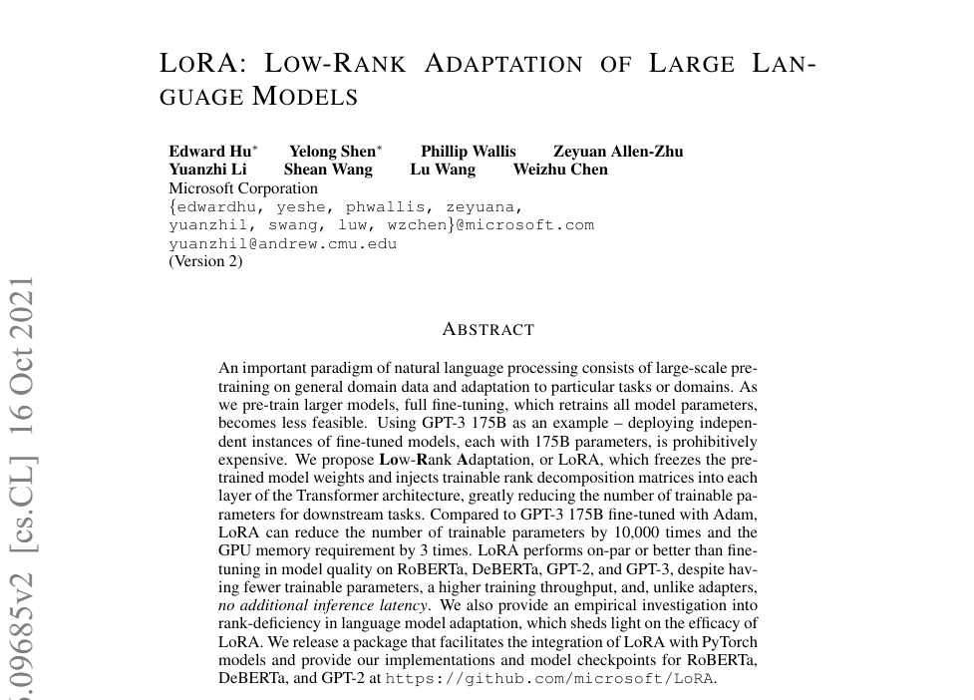

Slide 5
Low-Rank Adaptation, or LoRA
Low-Rank Adaptation, or LoRA, freezes the pretrained model weights and injects trainable rank decomposition matrices into each layer of the Transformer architecture, greatly reducing the number of trainable parameters for downstream tasks
Compared to GPT-3 175B fine-tuned with Adam, LoRA can reduce the number of trainable parameters by 10,000 times and the GPU memory requirement by 3 times.
LoRA performs on-par or better than finetuning in model quality on RoBERTa, DeBERTa, GPT-2, and GPT-3, despite having fewer trainable parameters,
a higher training throughput, and, unlike adapters, no additional inference latency*
*Inference latency refers to the time it takes for a model to process an input and produce an output. It's a crucial factor in real-time applications where quick responses are necessary

Slide 6
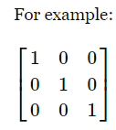
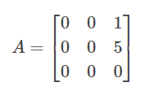
Rank of a Matrix
The rank of the matrix gives the number of linearly independent column vectors of the matrix and this number also means the dimension of the linear space these vectors span.
For example:
This matrix has 3 column vectors which span the 3 dimensional space, they are it's trivial base vectors, so they are linearly independent...
Row-Echelon Form : A non-zero matrix is said to be in a row-echelon form if all zero rows occur as bottom rows of the matrix and if the first non-zero element in any lower row occurs to the right of the first non-zero entry in the higher row.
Rank of a matrix is equal to the number of non-zero rows if it is in Echelon Form.

Slide 7

The "rank" of a matrix is the dimension of that space spanned by the vectors it contains.
If we put the two vectors [7, 3, 5] and [-2, -1, 5] into a matrix:
the rank of the matrix is the dimension of the space that you get by taking all combinations of the vectors. We've already done that, and saw that the space spanned by [7, 3, 5] and [-2, -1, 5] was a plane. In this case, the rank is 2 (because a plane is 2 dimensional).

Slide 8


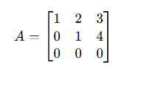
Conditions for Row Echelon Form (REF)
A matrix is in row echelon form if:
All nonzero rows are above any rows of all zeros (i.e., zero rows go to the bottom)
The leading entry (pivot) of each non-zero row is strictly to the right of the leading entry of the row above it
The entries below each leading entry (pivot) are zeros
Rank -3
Rank -3
Rank -2
Rank of a matrix is equal to the number of non-zero rows if it is in Echelon Form.

Slide 9

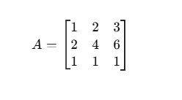
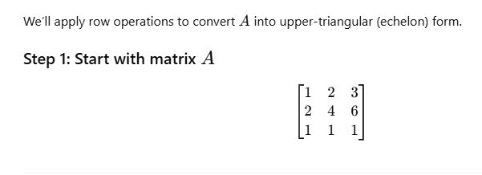
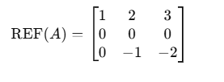
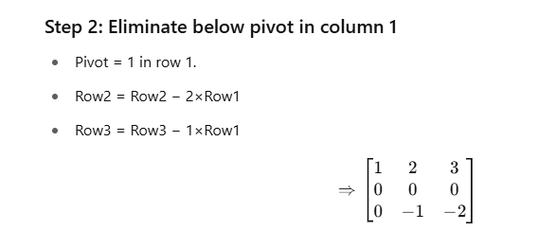
What is rank of the matrix?
Row 1: non-zero
Row 2: all zero
Row 3: non-zero
2 rows contain at least one non-zero entry
Rank= 2
Notes:
Use the following elementary row operations to transform the matrix into Row Echelon Form:
Swap two rows.
Multiply a row by a non-zero scalar.
Add or subtract a multiple of one row from another row.
👉 In REF, each leading entry (pivot) of a non-zero row is to the right of the leading entry in the row above it, and all entries below a pivot are zero.

Slide 10
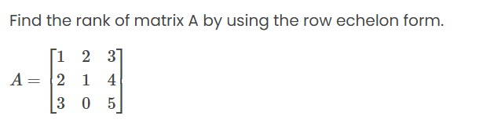
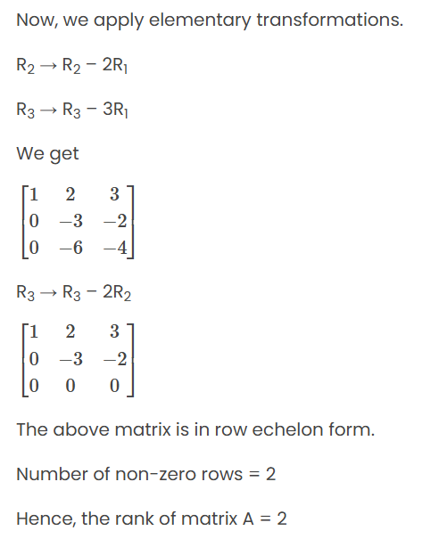

Slide 11
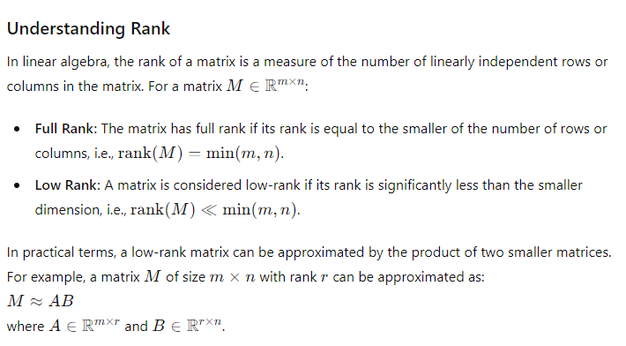

Slide 12
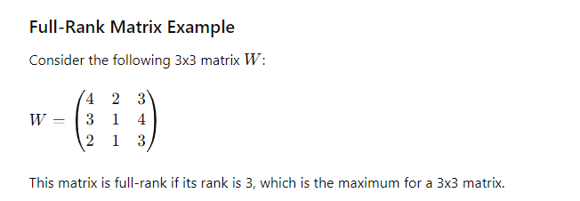
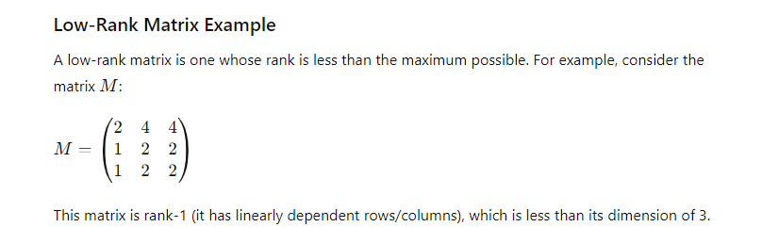

Slide 13
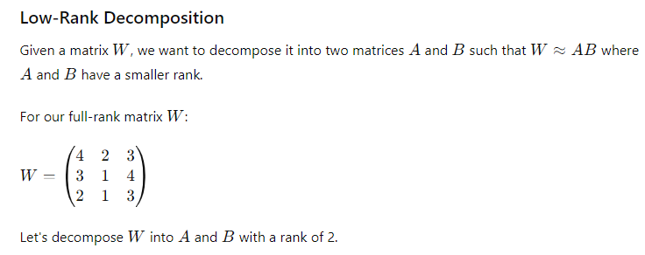

Slide 14

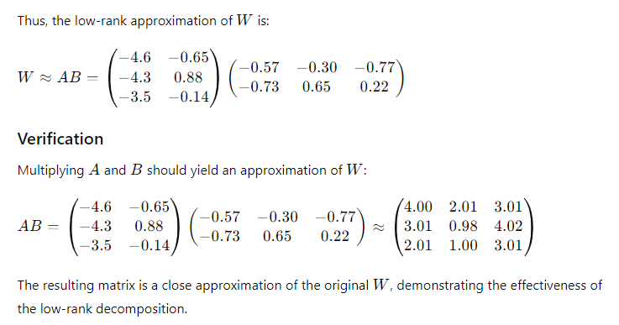
LORA

Slide 15
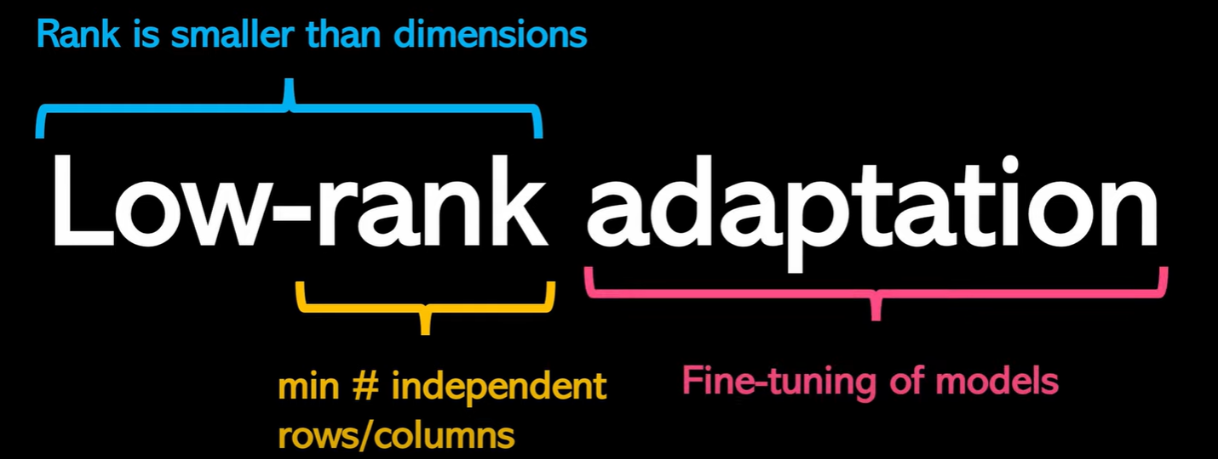
LoRA

Slide 16
LoRA: Low-Rank Adaptation of Large Language Models
Try to achieve a small number of task-specific parameters
While the weights of a pre-trained model have full rank on the pre-trained tasks, the LoRA authors point out that pre-trained large language models have a low “intrinsic dimension”* when they are adapted to a new task
Decompose the weight changes, ΔW, into a lower-rank representation
*The intrinsic dimension refers to the minimum number of parameters required to effectively represent the information in a model.

Slide 17













LoRA - Working
Now, we use the same concept of matrix decomposition
while finetuning an LLM.
Update
Scaling parameter
Decomposed matrices
matrix
Initial LLM
Weights
Rank of
𝐵𝐴
Remember, we are decomposing the update matix (Δ𝑊), and not the original weights 𝑊₀.
d is dimensionality of the weight matrix being adapted
40

Slide 18
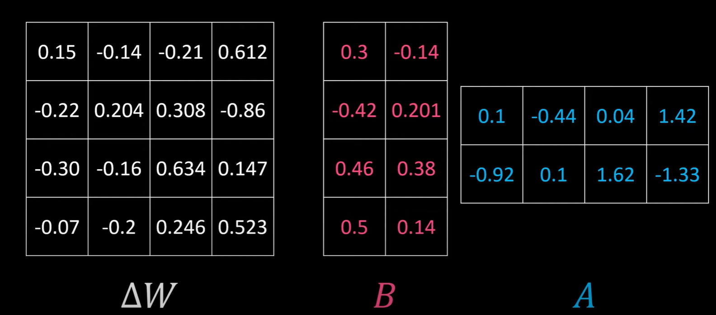
LoRA

Slide 19
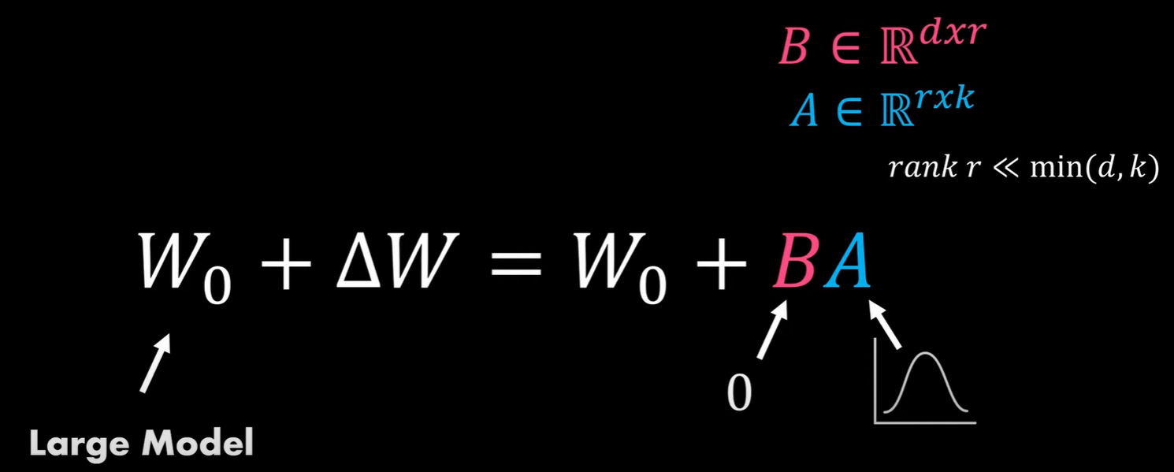
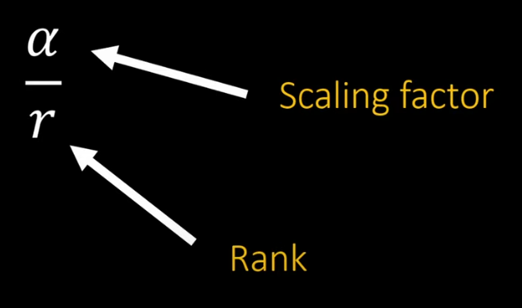
LoRA - Working
42
Notes:
1. Stabilize Update Magnitude
Without scaling, ABA BAB might produce values too large or too small depending on the rank rrr, affecting training dynamics.
The factor αr\frac{\alpha}{r}rα​ normalizes the contribution of the low-rank update so that its magnitude is comparable to standard full-rank updates.
2. Control Adaptation Strength
α\alphaα controls how much influence the LoRA adapters have on the model's behavior.
A small α\alphaα means gentle adaptation (safe for generalization); a large α\alphaα lets adapters override the base model more strongly.
3. Decouples Rank from Scale
Since ABA BAB is a product of two low-rank matrices, its magnitude naturally scales with rrr.
Using 1r\frac{1}{r}r1​ counters that, ensuring the update size stays consistent even when rank changes.
This lets you increase rrr for better expressivity without blowing up the update.

Slide 20














LoRA - Working
ℎ
Pretrained Weights
_{W ε ℝ}𝑑×𝑑
𝐵 = 0
𝑟
A = 𝛮(0, 𝜎²)
𝑑
X
Notice how the reparameterization (LoRA) runs parallel to the
original model.
Protopapas

Slide 21






LoRA - Working
Forward Pass
ℎ
Backward Pass
𝐵 = 0
During the backward pass, we don’t use the pre- trained weights and the gradients only flow through the adapters.
Pretrained Weights
_{W ε ℝ}𝑑×𝑑
𝑟
But W0​ is never updated, and ΔW is not computed as a gradient — it is parameterized directly as BA
A = 𝛮(0, 𝜎²)
𝑑
X

Slide 22





LoRA - Working
At inference time, the update matrix can be merged with the original model weights to make the process efficient.
ℎ
Pretrained Weights
_{W ε ℝ}𝑑×𝑑
𝐵 = 0
𝑟
A = 𝛮(0, 𝜎²)
𝑑
X
Notice how the reparameterization (LoRA) runs parallel to the
original model.
Protopapas

Slide 23
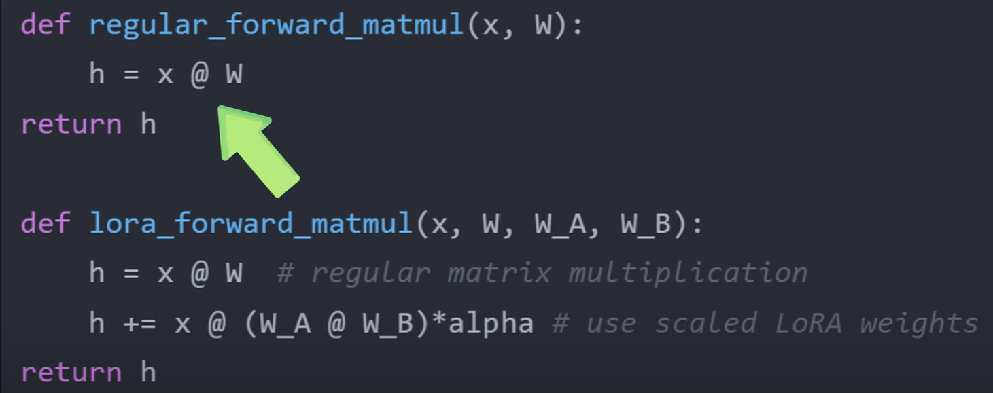

Slide 24
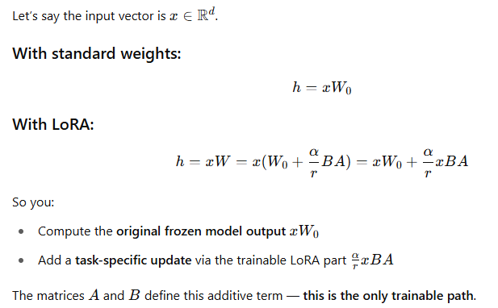
Forward Pass

Slide 25
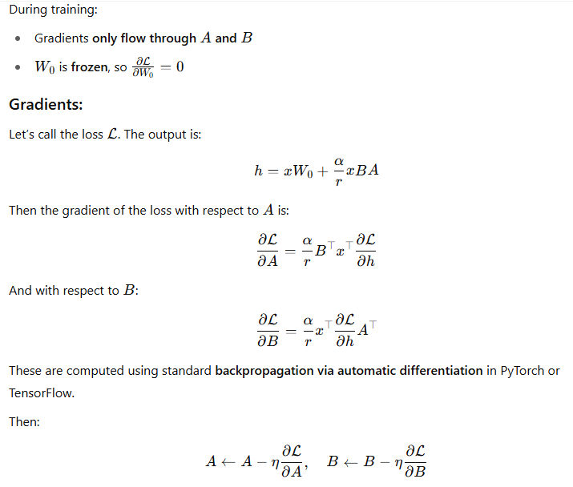
Backward Pass

Slide 26
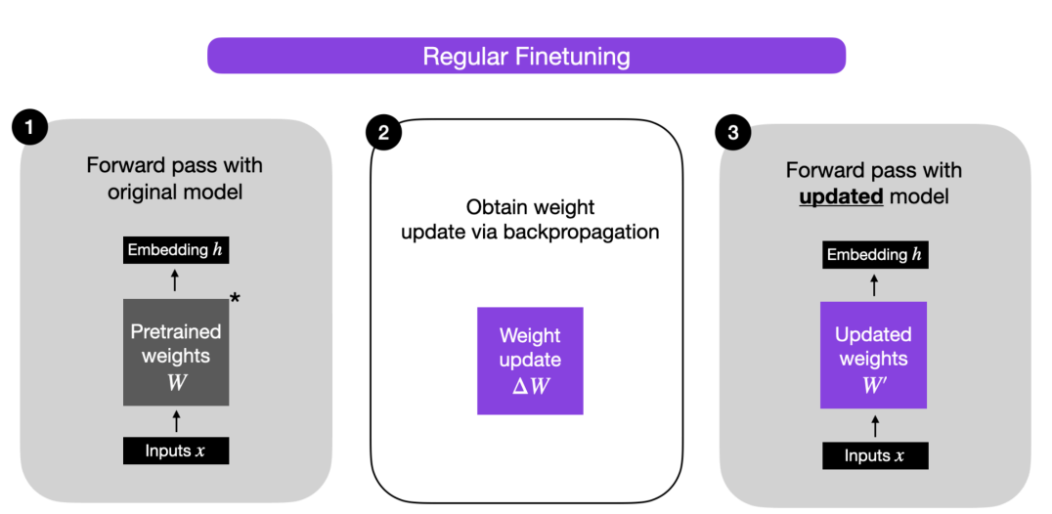
people.cs.umass.edu/~miyyer/cs685/slides/multilingual.pdf

Slide 27
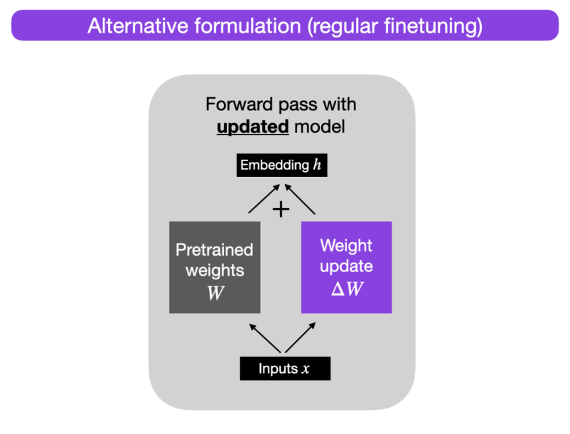
Pre-trained language models have a low intrinsic dimension
Possible to learn efficiently with a low-dimensional parameterization

Slide 28
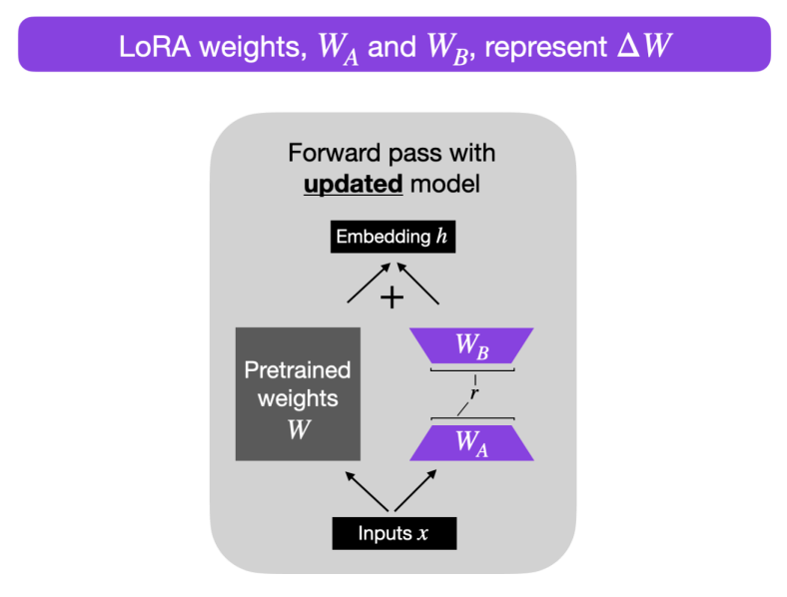
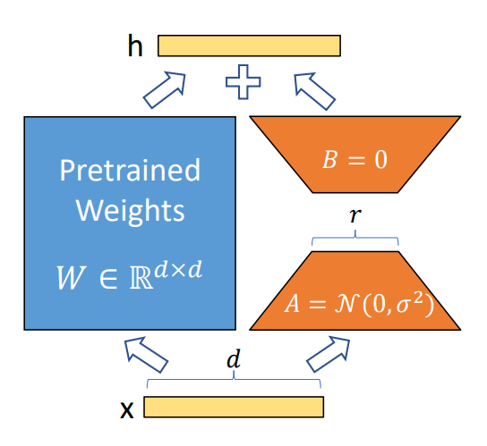
Hu, Edward J., et al. "Lora: Low-rank adaptation of large language models." arXiv preprint arXiv:2106.09685 (2021).

Slide 29


LoRA - Intuition
Let’s explore the scale at which LoRA can help reduce the number of parameters needed to achieve comparable performance!

Slide 30
LoRA - Intuition
Number of trainable parameters
Rank | Model 7B | Model 13B | Model 70B | Model 180B
1 | 167K | 228K | 529K | 849K
2 334k 456k 1M 2M
8 1M 2M 4M 7M
16 3M 4M 8M 14M
512 86M 117M 270M 434M
1024 171M 233M 542M 869M
8192 1.4B 1.8B 4.3B 7B
Full 7B 13B 70B 180B

Slide 31
LoRA - Intuition
Number of trainable parameters
Rank | Model 7B | Model 13B | Model 70B | Model 180B
1 | 167K | 228K | 529K | 849K
2 | 334K | 456K | 1M | 2M
8 1M 2M 4M 7M
16 3M 4M 8M 14M
512 86M 117M 270M 434M
1024 171M 233M 542M 869M
8192 1.4B 1.8B 4.3B 7B
Full 7B 13B 70B 180B

Slide 32
LoRA - Intuition
Number of trainable parameters
Rank | Model 7B | Model 13B | Model 70B | Model 180B
1 | 167K | 228K | 529K | 849K
2 | 334K | 456K | 1M | 2M
8 | 1M | 2M | 4M | 7M
16 3M 4M 8M 14M
512 86M 117M 270M 434M
1024 171M 233M 542M 869M
8192 1.4B 1.8B 4.3B 7B
Full 7B 13B 70B 180B

Slide 33

LoRA - Intuition
Number of trainable parameters
Rank | Model 7B | Model 13B | Model 70B | Model 180B
1 | 167K | 228K | 529K | 849K
2 | 334K | 456K | 1M | 2M
8 | 1M | 2M | 4M | 7M
16 | 3M | 4M | 8M | 14M
512 | 86M | 117M | 270M | 434M
1024 | 171M | 233M | 542M | 869M
8192 | 1.4B | 1.8B | 4.3B | 7B
Full | 7B | 13B | 70B | 180B
This is a generalization considering an LLM of one layer. LLMs are made up of multiple layers.

Slide 34
LoRA - Summary
LoRA reduces the trainable parameters and memory requirements while maintaining good performance.
LoRA adds pairs of rank decomposition weight matrices (called update matrices) to each layer of the LLM.
Only the update matrices, which have significantly fewer parameters than the original model weights, are trained.
Protopapas
60

Slide 35
The major downside of fine-tuning is that the new model contains as many parameters as in the original model
LoRA possesses several key advantages.
• A pre-trained model can be shared and used to build many small LoRA modules for different tasks. We can freeze the shared model and efficiently switch tasks by replacing the matrices A and B , reducing the storage requirement and task-switching overhead significantly.
• LoRA makes training more efficient and lowers the hardware barrier to entry by up to 3 times when using adaptive optimizers since we do not need to calculate the gradients or maintain the optimizer states for most parameters. Instead, we only optimize the injected, much smaller low-rank matrices.
• Simpler linear design allows us to merge the trainable matrices with the frozen weights when deployed, introducing no inference latency compared to a fully fine-tuned model, by construction.
• LoRA is orthogonal to many prior methods and can be combined with many of them, such as prefix-tuning

Slide 36
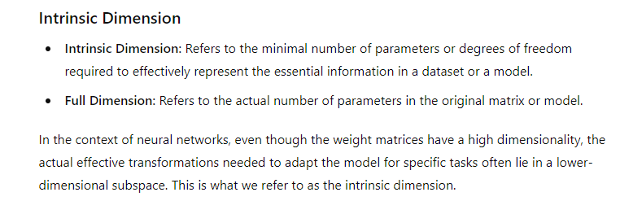
Intrinsic Dimension

Slide 37
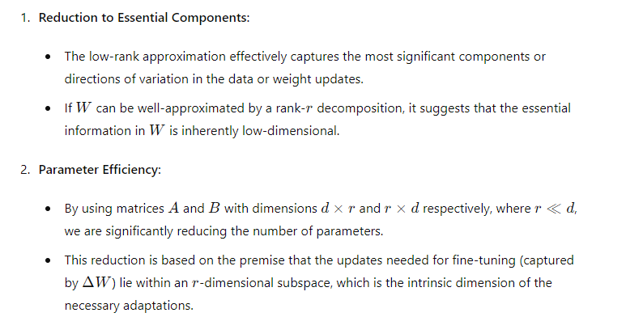
LORA Aligns with Intrinsic Dimension

Slide 38
The intrinsic dimension represents the minimal effective degrees of freedom.
By using a low-rank approximation, we are modeling the updates using only the essential parameters (aligned with the intrinsic dimension).
This approach avoids the redundancy of full-rank matrices and focuses on the core components that contribute most to the task-specific adaptation.

Slide 39
QLoRA
Courtesy:, deeplearning.ai ,
https://arxiv.org/pdf/2305.14314

Slide 40
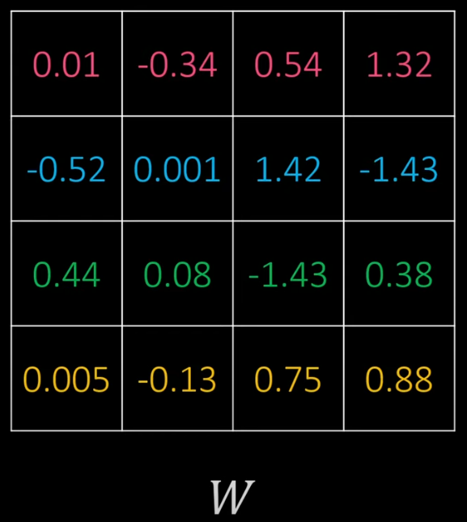
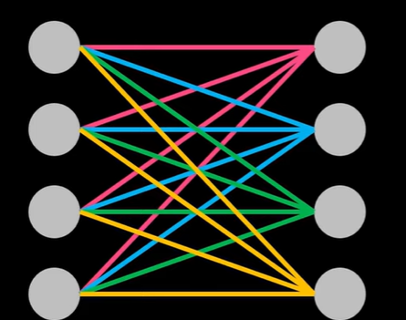
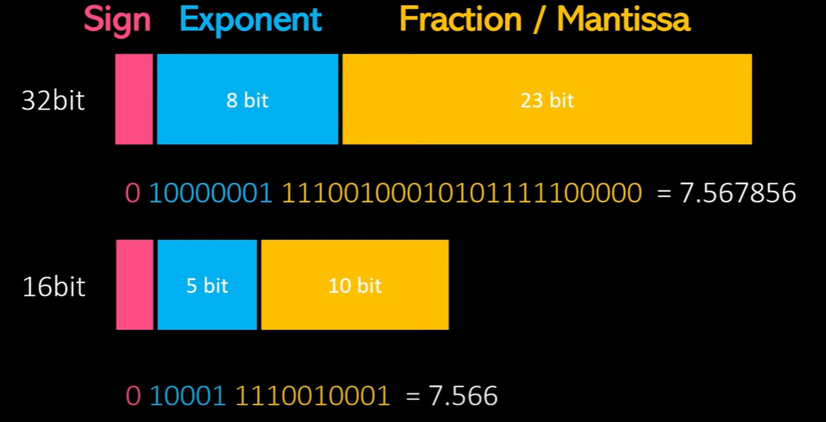

Slide 41
what does Computation mean?
Computation refers to the mathematical operations that are performed on the weights and activations of the network during both the forward pass (when making predictions) and the backward pass (when updating the weights during training).
In a typical neural network, these computations are performed using 32-bit floating- point numbers. This is because 32-bit floating-point numbers provide a good balance between precision (the ability to represent numbers accurately) and range (the range of numbers that can be represented). Using 32-bit floating-point numbers for all computations can be memory-intensive.
This is where quantization comes in.
Quantization is a technique to reduce the precision of the numbers used in the model. In the case of 4-bit quantization, the weights and activations of the network are compressed from 32-bit floating-point numbers to 4-bit integers. A 4-bit integer can range from -8 to 7.

Slide 42
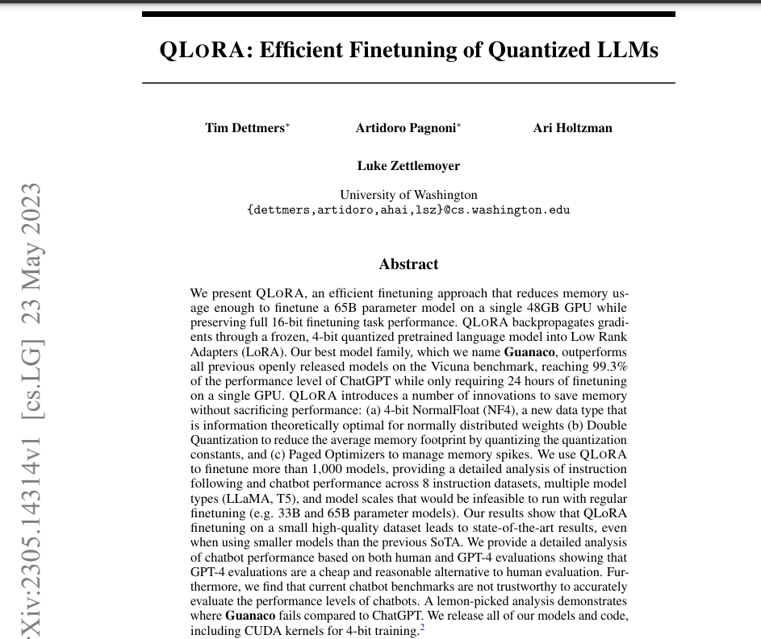
QLoRA extends LoRA to enhance efficiency by quantizing weight values of the original network, from high-resolution data types, such as Float32, to lower-resolution data types like int4. This leads to reduced memory demands and faster calculations.
Our best model family, which we name Guanaco, outperforms all previous openly released models on the Vicuna benchmark, reaching 99.3% of the performance level of ChatGPT while only requiring 24 hours of finetuning
on a single GPU
https://arxiv.org/pdf/2305.14314

Slide 43
QLoRA
QLoRA is the extended version of LoRA which works by quantizing the precision of the weight parameters in the pre trained LLM to 4-bit precision. Typically, parameters of trained models are stored in a 32-bit format, but QLoRA compresses them to a 4-bit format. This reduces the memory footprint of the LLM, making it possible to finetune it on a single GPU. This method significantly reduces the memory footprint, making it feasible to run LLM models on less powerful hardware, including consumer GPUs.
According to QLoRA paper:
QLORA introduces multiple innovations designed to reduce memory use without sacrificing performance:
4-bit NormalFloat, an information theoretically optimal quantization data type for normally distributed data that yields better empirical results than 4-bit Integers and 4-bit Floats.
Double Quantization, a method that quantizes the quantization constants, saving an average of about 0.37 bits per parameter (approximately 3 GB for a 65B model).
Paged Optimizers, using NVIDIA unified memory to avoid the gradient checkpointing memory spikes that occur when processing a mini-batch with a long sequence length.

Slide 44
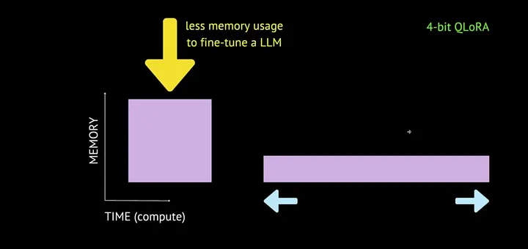

Slide 45


Block-wise k-bit Quantization
Block-wise k-bit Quantization: Quantization is the process of discretizing an input from a representation that holds more information to a representation with less information. It often means taking a data type with more bits and converting it to fewer bits, for example from 32-bit floats to 8-bit Integers. To ensure that the entire range of the low-bit data type is used, the input data type is commonly rescaled into the target data type range through normalization by the absolute maximum of the input elements, which are usually structured as a tensor. For example, quantizing a 32-bit Floating Point (FP32) tensor into a Int8 tensor with range [−127, 127]:
where c is the quantization constant or quantization scale. Dequantization is the inverse:

Slide 46
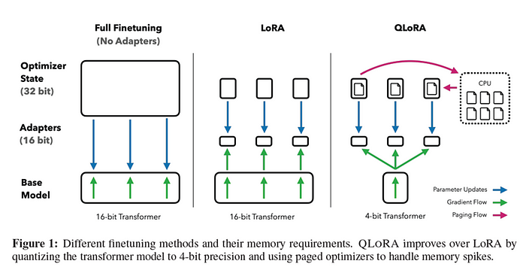

Slide 47
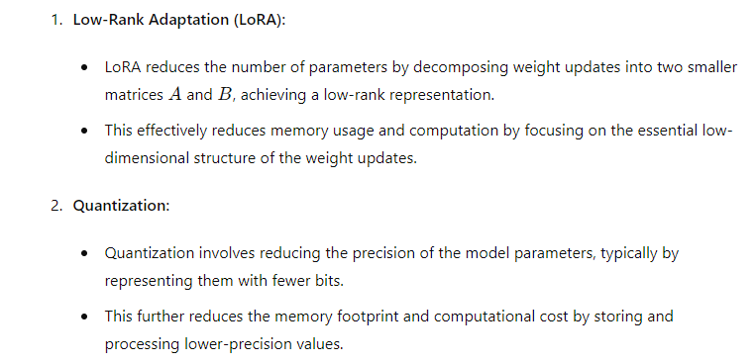
QLoRA ( Quantized LoRA)

Slide 48
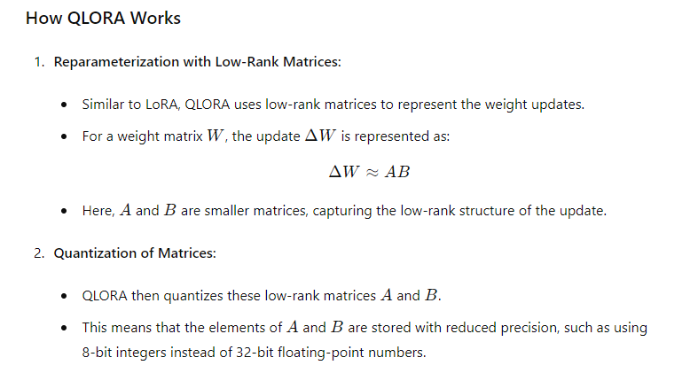

Slide 49
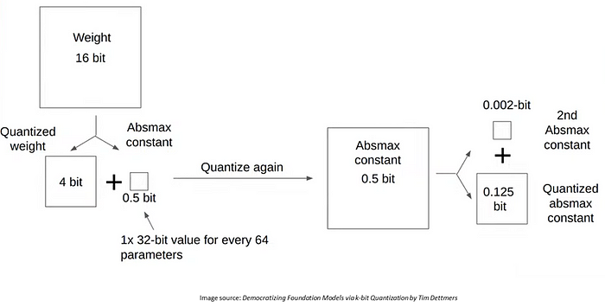
QLORA Finetuning

Slide 50
QLoRA Steps
Normalisation
Quantization
Dequantization
Double Quantization
First Level Quantization
Quantizing the quantization constants
Dequantize the constants
Dequantize the parameters using dequantized constants
Unified Memory Paging/Paged Optimisers

Slide 51
Normalisation
QLoRA Steps
Normalization
The weights of the model are first normalized to have zero mean and unit variance. This ensures that the weights are distributed around zero and fall within a certain range.

Slide 52
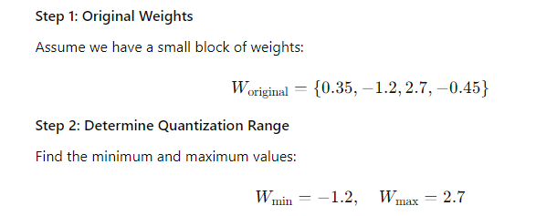
Quantization
QLoRA Steps

Slide 53
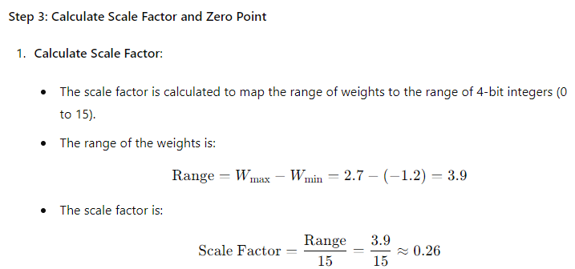
Quantization
QLoRA Steps

Slide 54
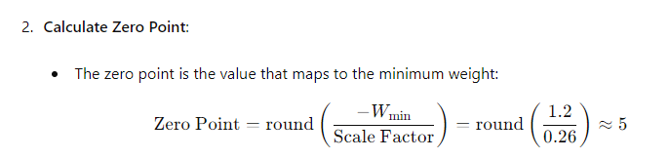
Quantization

Slide 55
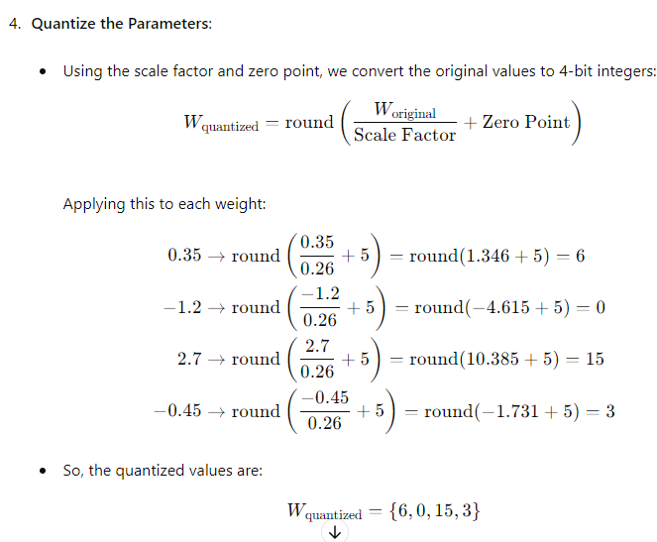
Quantization
QLoRA Steps

Slide 56
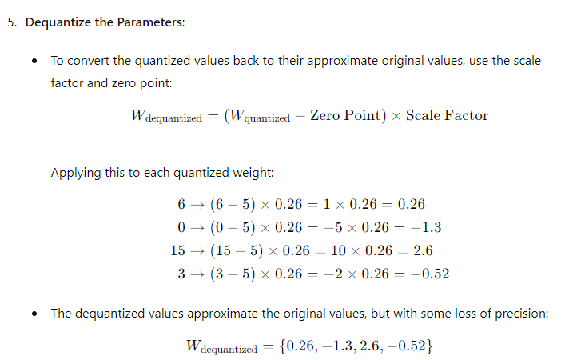

Quantization
QLoRA Steps

Slide 57
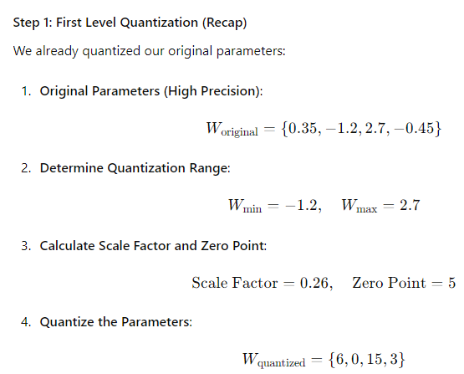
Double Quantization
QLoRA Steps

Slide 58
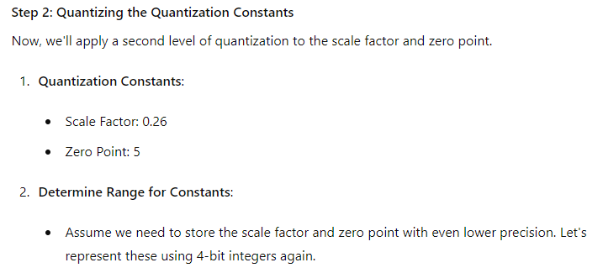
Double Quantization
QLoRA Steps

Slide 59
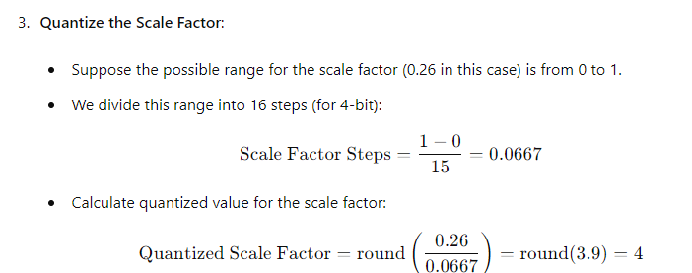
QLoRA Steps
Double Quantization

Slide 60
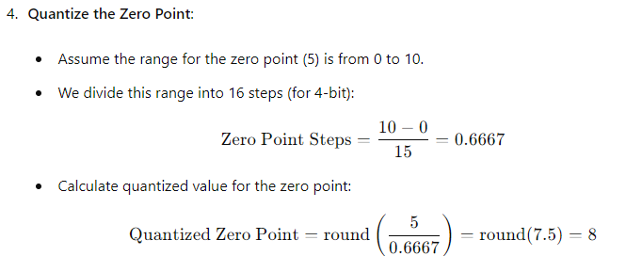
QLoRA Steps
Double Quantization

Slide 61
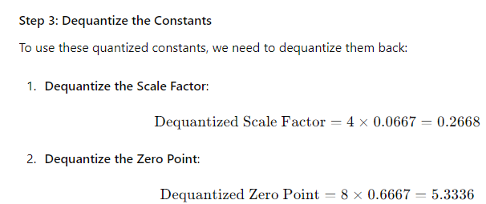
QLoRA Steps
Double Quantization

Slide 62
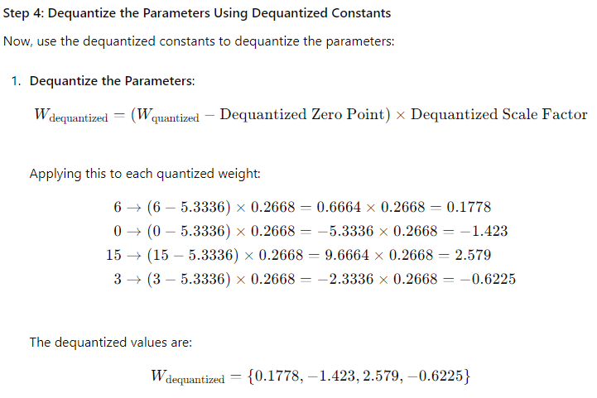
Double Quantization
QLoRA Steps

Slide 63
Paged Optimisers/Unified Memory paging
Paged optimizers are designed to efficiently manage memory usage, especially when training large models with long sequence lengths. They leverage memory paging techniques and NVIDIA's unified memory to avoid out-of-memory (OOM) errors and optimize performance

Slide 64
Paged Optimisers
QLoRA Steps
Memory Challenges in Training LLMs
Training large language models involves handling massive amounts of data and numerous parameters, which can lead to significant memory usage. The main memory challenges include:
Memory Spikes: These occur during gradient calculations, especially with long sequences, causing temporary peaks in memory usage.
Gradient Checkpointing: This technique saves intermediate activations at specific points to reduce memory usage but can still cause spikes.

Slide 65
How Paged Optimizers Work
QLoRA Steps
Unified Memory: Paged optimizers utilize NVIDIA's unified memory, which allows a GPU to use both its own VRAM and the system RAM. This approach provides a larger memory pool, reducing the risk of OOM errors when the GPU's VRAM is insufficient.
Paging System: Similar to how operating systems manage memory, paged optimizers use a paging system to dynamically allocate and deallocate memory. When processing a mini-batch, only the required portions of the model and data are loaded into the GPU memory, while the rest remain in the system RAM.

Slide 66
How Paged Optimizers Help
1. Avoiding Memory Spikes: By spreading the memory usage more evenly between the GPU memory and system RAM, paged optimizers help in mitigating memory spikes. This approach ensures that large models and long sequences can be processed without causing sudden peaks in memory usage that could lead to OOM errors.
2. Efficiency in Training: The optimizer dynamically pages data in and out of GPU memory, ensuring that the GPU is not overwhelmed by large memory demands at any given time. This dynamic management makes it possible to handle larger models or longer sequences than what would typically fit into the GPU's VRAM alone.

Slide 67
Benefits of Paged Optimizers
Increased Model Size: Allows for training larger models than what the GPU VRAM alone would permit.
Handling Long Sequences: Enables processing of longer sequences without running into OOM errors.
Efficient Memory Use: Optimizes memory allocation dynamically, improving training efficiency.

Slide 68
Namah Shivaya

Slide 69
https://medium.com/@shravankoninti/decoding-strategies-of-all-decoder-only-models-gpt-631faa4c449a#:~:text=In%20the%20previous%20blog%20we,steps%20and%20it%20generates%20outputs.
https://medium.com/@shravankoninti/generative-pretrained-transformer-gpt-4b94d017a3f9
https://medium.com/@shravankoninti/generative-pretrained-transformer-gpt-pre-training-fine-tuning-different-use-case-c93bb0553ffc
https://medium.com/@shravankoninti/generative-pretrained-transformer-gpt-4b94d017a3f9
https://medium.com/@YanAIx/step-by-step-into-gpt-70bc4a5d8714
https://jalammar.github.io/illustrated-gpt2/
https://learn.deeplearning.ai/courses/finetuning-large-language-models/lesson/1/introduction

