Slide 1
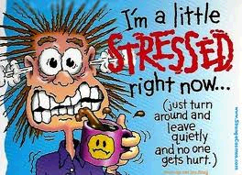
STRESS MANAGEMENT

Slide 2
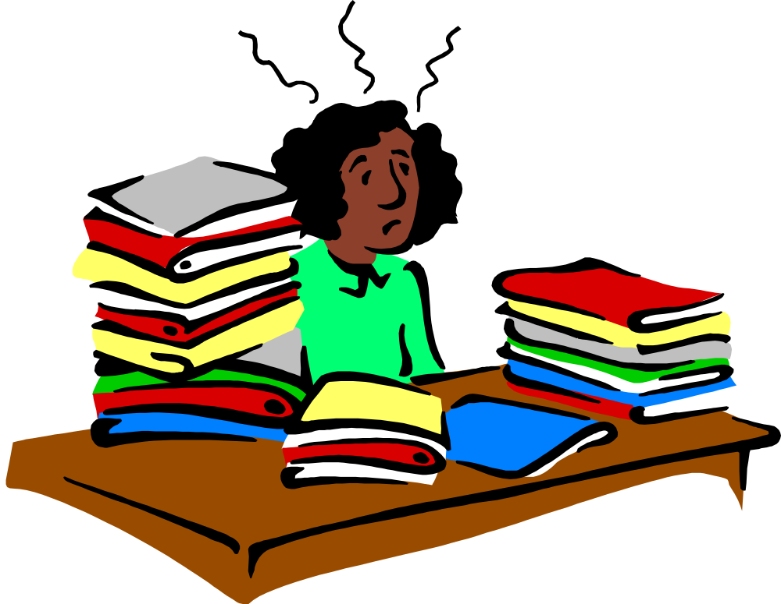
WHAT IS STRESS?
Stress can be defined as our mental, physical, emotional, and behavioral reactions to any perceived demands or threats.
Notes:
We say we feel "burned out," stressed out, overwhelmed, angry, irritable, depressed, anxious, and on the verge of "losing it."

Slide 3
WHAT IS STRESSFUL TO YOU?
Work | Roommate | Legal matters
Classes | Childcare | Mental health
Studying | Finances | Law violation
Relationship with partner | Appearance | Spiritual/Religious issues
Relationship with family | Physical Health | Major/Career decisions
Relationship with friends | Not “fitting in” | Attitudes/thoughts
Trauma | Getting married | Buying a house
Change in residence | Change to a new school | Change in amount of recreation
Change in amount of social activities | Change in eating habits | Death of friend/family member

Slide 4
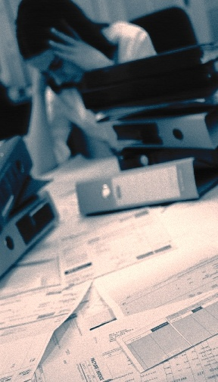
WHY DO WE "STRESS OUT"?
For two major reasons:
    We perceive a situation as dangerous, difficult, or painful.
    We don't believe we have the resources to cope.
Notes:
Our Perceptions = How Stressed We Feel
We often identify specific events, people, or situations that seem to make us feel stressed. It's as if these things automatically cause us feel stressed out. In reality, it's how we perceive an event, the meaning we give to it, that leads us to feel stressed or not stressed about it.
The interesting thing about stress is that it begins with our own perceptions of things!
Have you ever noticed that some people can feel quite stressed out about a particular event while others don't seem to be bothered by it at all? For instance, if three of your friends all get a poor grade on a test, you might notice some different reactions. One friend may seem mildly annoyed for an hour or so. Another friend doesn't seem to be bothered at all. The third friend, however, might become quite alarmed by this poor grade. She can't get it off her mind, she vows to study three times as hard next time, she can't concentrate on her other work, and she might even find it difficult to fall asleep that evening. She might become increasingly concerned about all the grades she'll make this semester, and wonder whether her GPA will suffer.
In a case such as this, a poor grade on a test means something different for each of your friends. The same situation has happened to all three, but each person feels more or less stressed about it because of what it means to him or her.

Slide 5
Suggestions
for
Reducing Stress

Slide 6

1. Find a support system
Find someone to talk to about your feelings and experiences.
Notes:
Speak to friends, family, a teacher, a minister, or a counselor. Sometimes we just need to "vent" or get something "off our chest." Expressing our feelings can be relieving, we can feel supported by others, and it can help us work out our problems.

Slide 7

2. Change your attitude
Find other ways to think about stressful situations.
  "Life is 10% what happens to us, and 90% how we react to it."
Notes:
Talk to yourself positively. Remember, "I can handle it, " "this will be over soon," or "I have handled difficult things before, and I can do it again." Also, practice acceptance. We need to learn to accept things we cannot change without trying to exert more control over them.

Slide 8
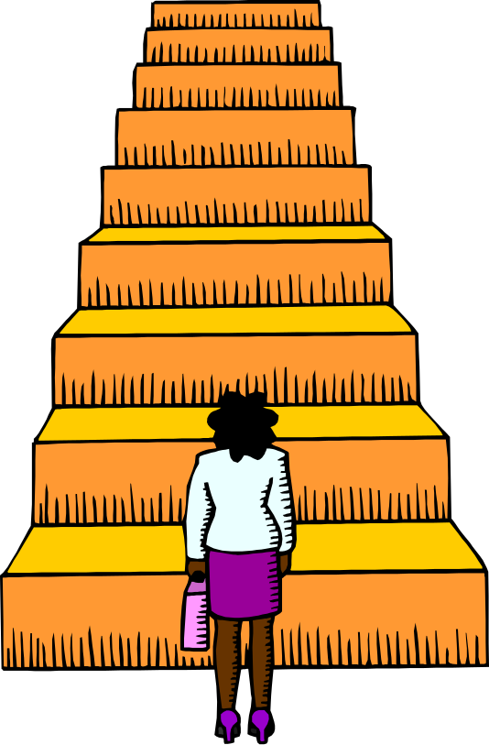
3. Be realistic
Set practical goals for dealing with situations and solving problems.
  Develop realistic expectations of yourself and others.
Notes:
Setting our expectations or goals high may seem like a useful way to push ourselves and get things done, but we may also set ourselves up for disappointment and continued stress. Find the courage to recognize your limits

Slide 9
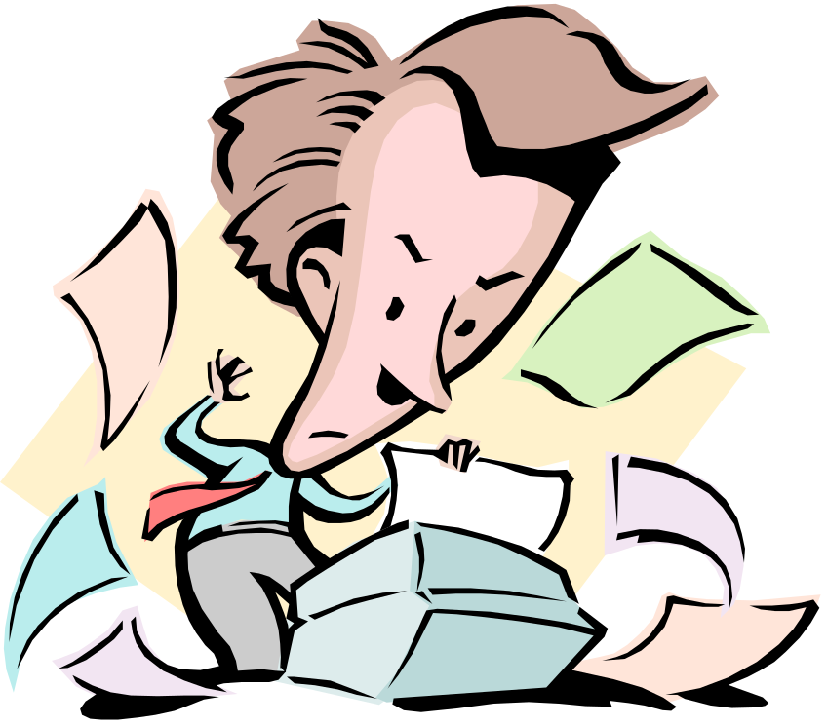
4. Get organized and take charge
Being unorganized or engaging in poor planning often leads to frustration or crisis situations, which most always leads to feeling stressed.
  Plan your time, make a schedule, establish your priorities.
Notes:
Do this regularly until it becomes a productive habit. Take responsibility for your life. Be proactive. Problem solve and look for solutions rather than worry.

Slide 10
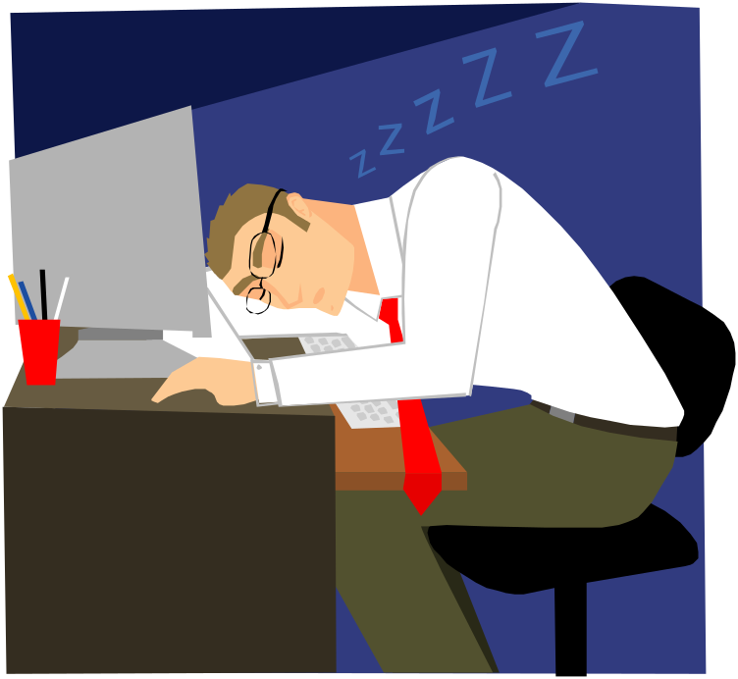
5. Take breaks, give yourself "me time."
Learn that taking time to yourself for rejuvenation and relaxation is just as important as giving time to other activities.
  At minimum, take short breaks during your busy day.
Notes:
You might purposely schedule time in your day planner just for yourself so that you can recharge for all the other things you need to do. Learn your "red flags" for stress, and be willing to take time to do something about it.

Slide 11

6. Take good care of yourself
Eat properly, get regular rest, keep a routine. Allow yourself to do something you enjoy each day.
  Paradoxically, the time we need to take care of ourselves the most, when we are stressed, is the time we do it the least.
Notes:
When we feel overwhelmed we tend to eat poorly, sleep less, stop exercising, and generally push ourselves harder. This can tax the immune system and cause us to become ill more easily. If we take good care of ourselves to begin with, we will be better prepared to manage stress and accomplish our tasks in the long run.

Slide 12

7. Learn to say "no."
Learn to pick and choose which things you will say "yes" to and which things you will not.
  Protect yourself by not allowing yourself to take on every request or opportunity that comes your way.
Notes:
It is okay to decline a request for a favor. Saying "no" does not mean you are bad, self-centered, or uncaring. Learn skills of assertiveness so that you can feel more confident and have effective ways of saying "no."

Slide 13

8. Get regular exercise.
Exercising regularly can help relieve some symptoms of depression and stress, and help us to maintain our health.
Notes:
Exercise can build confidence, self-esteem, and self-image.
It is also a great way to take time for yourself, blow off steam, and release physical tension.

Slide 14

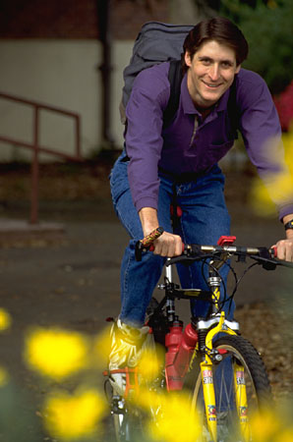

9. Get a hobby, do something different. For a balanced lifestyle, play is as important as work.
Notes:
Leisure activities and hobbies can be very enjoyable and inspiring, and they can offer an added sense of accomplishment to our lives. For ideas on new hobbies, browse through a bookstore or a crafts store, surf the internet, look up local organizations, see what classes or courses are available in your community or from a nearby college or university. Don't quickly dismiss new opportunities.

Slide 15

10. Slow down
Know your limits and cut down on the number of things you try to do each day, particularly if you do not have enough time for them or for yourself.
  Be realistic about what you can accomplish effectively each day.
  Monitor your pace. Rushing through things can lead to mistakes or poor performance. Take the time you need to do a good job.
    Poorly done tasks can lead to added stress.

Slide 16
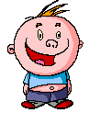
11. Laugh, use humor
Do something fun and enjoyable such as seeing a funny movie, laughing with friends, reading a humorous book, or going to a comedy show.

Slide 17

12. Learn to relax
Develop a regular relaxation routine.
  Try yoga, meditation, or some simple quiet time.
Notes:
Relaxation techniques are skills that need to be developed with patience and practice so that we can use them effectively during difficult times of stress later on.

Slide 18

13. RELAXATION EXERCISES
Many different kinds, but some are:
  Deep Breathing
  Visualization: Visualization is a nice way of giving our minds and bodies a "mini vacation.“
  Muscle Relaxation
Notes:
When we feel stressed, it is common for our rate of breathing to increase. We also tend to breath in a shallow manner, more highly in our chest. A deep breathing exercise allows us to take fuller, slower breaths that reflect a true relaxed state
It involves using imagery to fully immerse ourselves in a pleasant scene, noticing the sights, sounds, smells, and tactile sensations.

