Slide 1
Same Words, Different Bets
10–20 minute presentation
Human vote distributions under scarce labels
Anurag Prasad · Research project
Two separate strands: original tiny-BERT benchmark and controlled TF-IDF soft-target study
Same Words, Different Bets · 01/15

Slide 2
Research motivation
Majority labels collapse multiple human judgments into one class.
Soft targets preserve empirical annotator-vote proportions.
Question: does this help when labeled data are scarce?
Same Words, Different Bets · 02/15

Slide 3
What is the gap?
Soft-label learning and label-distribution learning are established prior work.
The contribution is a controlled budget-by-dataset comparison with human-vote targets.
Measure distributional alignment and report hard-label/calibration trade-offs.
Same Words, Different Bets · 03/15

Slide 4
Research questions
Does human soft-target training reduce JS divergence vs majority CE?
Do effects vary by budget, dataset, or DynaSent round?
Do distributional gains correspond to accuracy, macro-F1, or calibration?
How does null augmentation behave as a separate data-composition ablation?
Same Words, Different Bets · 04/15

Slide 5
Datasets and eligibility
DynaSent Round 1: 3,600 test examples; four vote categories.
DynaSent Round 2: 720 test examples; same four-category scheme.
SentiMP-En: 337/48/95 train/dev/test; only 95 test examples.
MVSC/PRemo/FinLin remain gated; hard-label datasets are not vote-distribution substitutes.
Same Words, Different Bets · 05/15

Slide 6
Experimental design
Budgets: 25, 50, 100, 200, 300; seeds 0–9.
Matched conditions: majority CE, human soft targets, label smoothing.
DynaSent also has null-augmented soft targets; SentiMP-En has tie-inclusive condition.
Extra conditions alter training composition and are not objective-only contrasts.
Same Words, Different Bets · 06/15

Slide 7
Targets and metrics
Human soft target = normalized empirical annotator-vote proportions.
Primary: JS divergence in bits to human vote distribution; lower is better.
Contrast ΔJS = JS(soft) − JS(majority); negative favors soft targets.
Secondary: soft Brier, accuracy, macro-F1, ECE, training time.
Same Words, Different Bets · 07/15

Slide 8
Statistical protocol
15 primary dataset/round-by-budget comparisons.
Paired seed-level exact sign-flip tests with Holm correction.
Two-level bootstrap: resample seeds and test examples; 10,000 replicates.
Bootstrap intervals are unadjusted; do not conflate them with Holm-adjusted p-values.
Same Words, Different Bets · 08/15

Slide 9
Main result
All 15 mean JS differences are negative.
Only DynaSent Round 2 at budget 300 survives Holm correction.
Holm-adjusted p = 0.029297.
Directional consistency is promising but does not establish universal superiority.
Same Words, Different Bets · 09/15

Slide 10
DynaSent budget trend
Mean JS decreases with larger training budgets in both rounds.
Human soft targets have lower mean JS than majority CE at all tested budgets.
Round 1 and Round 2 differ in size and annotation characteristics; report separately.
(Insert regenerated plot from canonical CSVs for final defense.)
Same Words, Different Bets · 10/15

Slide 11
SentiMP-En results
Human soft targets show lower mean JS than majority CE across the five budgets.
Test set contains only 95 examples, so estimates are imprecise.
No SentiMP-En comparison survives the 15-test Holm correction.
Treat this as supporting evidence, not decisive confirmation.
Same Words, Different Bets · 11/15

Slide 12
Validation and provenance
DynaSent: 400/400 expected metric combinations; 864,000 prediction rows; zero reported validation errors.
SentiMP-En: 200 metric rows; 19,000 predictions.
Independent JS recomputation covered 883,000 rows within 1e−6 tolerance.
Numerical consistency does not validate all modeling or data decisions.
Same Words, Different Bets · 12/15

Slide 13
What did not settle?
No universal corrected advantage.
Fixed test sets limit population-level uncertainty.
Null-augmented and tie-inclusive conditions change training composition.
Literature search is targeted/exploratory; closest sentiment-LDL work needs full audit.
Same Words, Different Bets · 13/15

Slide 14
Conclusions and next steps
Narrow conclusion: promising, context-dependent distribution-alignment signal.
Freeze source revision, manifests, raw predictions, metrics and checksums.
Regenerate figures/tables; audit initialization/feature fitting; expand validated datasets.
Supervisor review and venue-specific formatting before submission.
Same Words, Different Bets · 14/15

Slide 15
Selected literature
Potts et al. (2021), DynaSent, ACL Anthology.
Fornaciari et al. (2021), annotator disagreement via soft-label multi-task learning.
Jamison & Gurevych (2023), soft labels from annotations.
Solorio et al. (2023), direct training vs aggregation.
Viering & Loog (2023), learning-curve review; verify all final metadata.
Same Words, Different Bets · 15/15

Slide 16
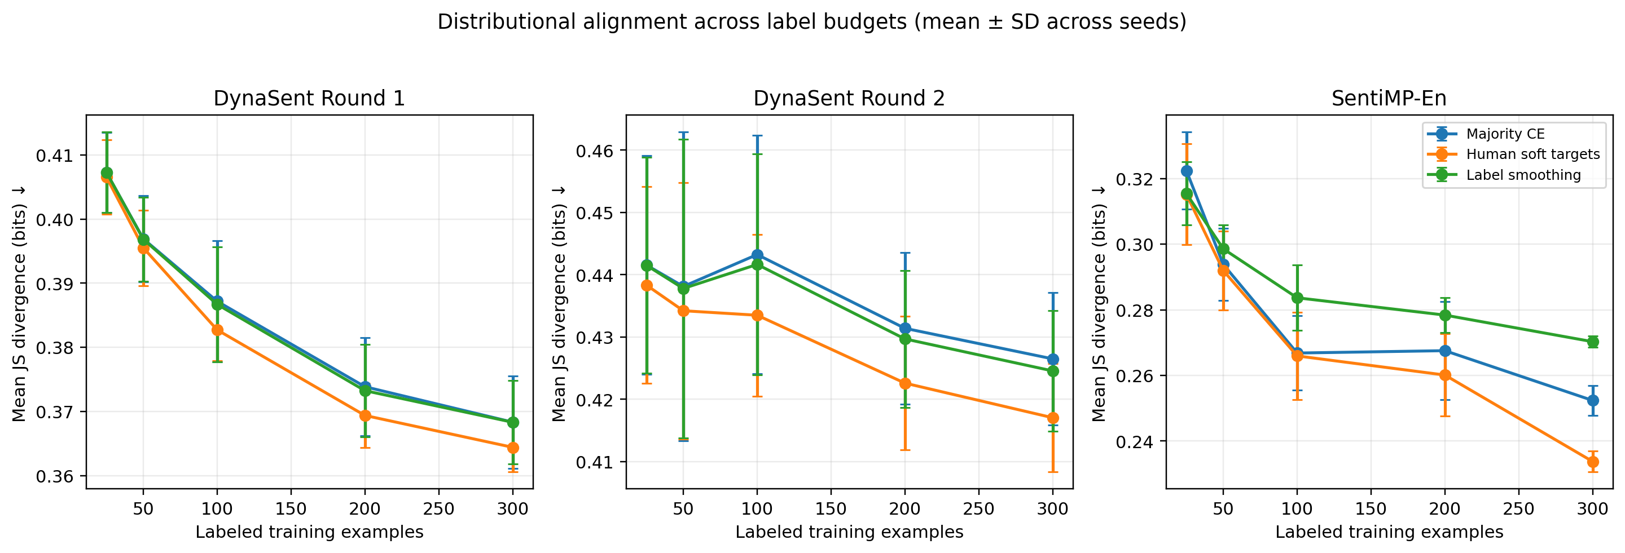
Primary results: distributional alignment
Controlled TF-IDF study • DynaSent Round 1/2 and SentiMP-En
Human soft targets reduce mean JS divergence in 15/15 matched dataset/round-by-budget comparisons.
Only 1 of 15 comparisons survives paired seed-level exact sign-flip tests with Holm correction.
Significant comparison: DynaSent Round 2 at 300 labels (adjusted p=0.0293).
Interpretation: consistent direction, limited corrected inferential evidence; results remain exploratory.

Slide 17
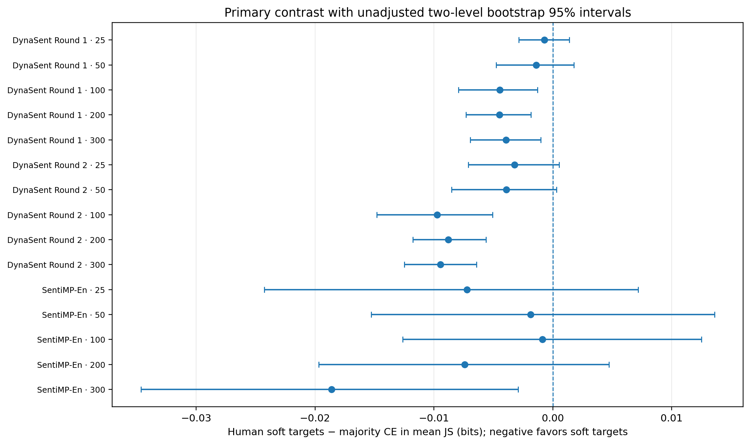
Paired primary contrast
ΔJS = JS(human soft targets) − JS(majority CE); negative values favour soft targets
Bootstrap intervals are unadjusted and are not the same as the seed-level sign-flip tests.
Holm correction covers 15 primary comparisons.
Avoid treating an unadjusted interval excluding zero as proof of corrected significance.

Slide 18
Takeaways and reporting guardrails
Use the canonical CSVs as the source of truth
Primary metric: JS divergence against observed human vote distributions; lower is better.
Classification metrics are secondary and do not always move in the same direction.
Null-augmented and tie-inclusive conditions change training composition; report as ablations.
TF-IDF learning curves and the Tiny-BERT 100-label pilot are separate experiments.
Next: freeze protocol, reproduce configs, then run a prospective confirmatory cycle.

