Slide 1
Same Words, Different Bets
Lexicons, static embeddings and contextual pre-training for sentiment classification under scarce labels and ambiguity
How should a small unlabeled corpus be used: static embeddings or contextual pre-training?
SST-2 + IMDb | CPU only | 3 seeds | Anurag Prasad
Notes:
[Slide 1 - Title | 0:00-0:45]
Good morning. I compare ways to use a small unlabeled corpus: train static embeddings or a tiny contextual model with MLM. I also include VADER as a separate external sentiment lexicon that uses no task labels and does not consume that corpus.
The CPU-only pipeline compares those approaches with TF-IDF, a tiny BERT with and without pre-training, and public checkpoints.
Beyond accuracy, I also look at robustness and - the twist - where models succeed or fail under ambiguity. Ten minutes, then five for questions.

Slide 2
The problem: eight questions, shared evaluation
Shared splits and tests; model-specific features and tokenizers
RQ1-2
Does pre-training help, and how robust is it?
RQ3-4
How much pre-training is enough, and what does it cost?
RQ5
How far do public checkpoints move the picture?
RQ6
Which method best uses the available unlabeled corpus?
RQ7
How do polarity strength and confidence relate to errors?
RQ8
How well does each model transfer across domains?
Notes:
[Slide 2 - Problem | 0:45-1:45]
Eight questions share a set of evaluation splits and test procedures. Model-specific tokenizers, features, and optimization settings differ where necessary; VADER is an external lexicon, while fastText and MLM use the same unlabeled corpus. RQ8 adds finance and airline transfer to the original SST-2 experiments.

Slide 3
Approach: six model families
Shared evaluation sets; model-specific features and training procedures
VADER lexicon
0 task labels
TF-IDF word/char
+ LogReg/NB/SVM
word2vec / fastText
same 1.2M words
Tiny-BERT
random init
Tiny-BERT
+MLM pre-train
BERT-Tiny /
DistilBERT
public
Evaluated on: clean SST-2, typos (10/30%), word-drop (20/40%), out-of-domain IMDb, and - new - ambiguity strata from fine-grained SST-5 labels (strong vs weak polarity), confidence calibration, and linguistic markers (contrast, negation).
Tiny-BERT: 2 layers, hidden 128, 1,173,248 params. MLM pre-training: 5,000 steps, 13 min, on 1.2M unlabeled IMDb words. Sparse-model regularisation is tuned on dev; the public-checkpoint learning rates are fixed, and embedding-family settings are not exhaustively tuned.
Notes:
[Slide 3 - Approach | 1:45-2:45]
Six families, one protocol. A VADER sentiment lexicon that never sees a training label. TF-IDF with word or character n-grams. word2vec and fastText - static embeddings trained on the exact same 1.2 million unlabeled words as our MLM pre-training. Our tiny BERT, with and without that pre-training. And public BERT-Tiny and DistilBERT.
Everything is evaluated on clean data, typos, word-drop, out-of-domain IMDb reviews, and - new for this version - ambiguity strata built from fine-grained SST-5 labels, confidence calibration, and simple linguistic markers like contrast words.
The tiny BERT has 1.17 million parameters and pre-trains in 13 minutes on one CPU.

Slide 4
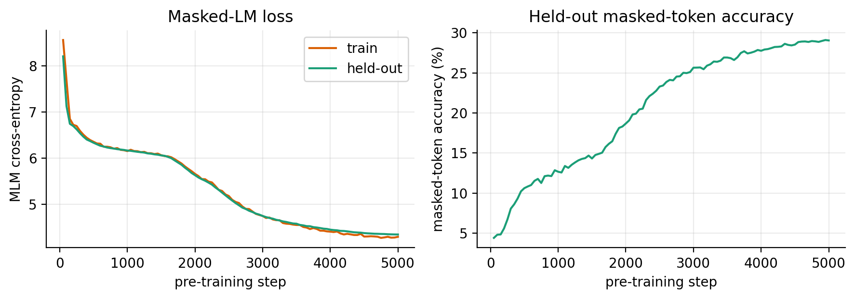
Pre-training starts with a long plateau
Held-out masked-LM loss and accuracy over 5,000 steps
ppl 77
final held-out perplexity (from ~3,660)
29%
First ~1,500 steps: loss stuck near the unigram entropy
Only then does attention start to use context
masked-token accuracy
Notes:
[Slide 4 - Plateau | 2:45-3:15]
Quick sanity check before results. For the first 1,500 of 5,000 pre-training steps, the loss sits near the unigram entropy - the model is only learning word frequencies. It breaks out after that, ending at perplexity 77 and 29 percent masked-token accuracy. So pre-training is doing something real; the question is whether it helps.

Slide 5
Pre-training did not help; TF-IDF wins
SST-2 test accuracy (%), mean of 3 seeds
MLM vs random init: -0.3 to -4.5 pts at every budget (CIs exclude 0 at n=300,1k,3k)
TF-IDF beats the pre-trained model by 3.9-4.8 pts from n=300 on
Notes:
[Slide 5 - Verdict | 3:15-4:00]
Here's the headline. From 300 labels on, the pre-trained model falls behind its own untrained twin - by 0.3 to 4.5 points, and the confidence intervals exclude zero at three of five budgets. TF-IDF then overtakes both. At laptop scale, this pre-training recipe did not pay off in the usual sense. But that's not the whole story - the next two slides are why.

Slide 6
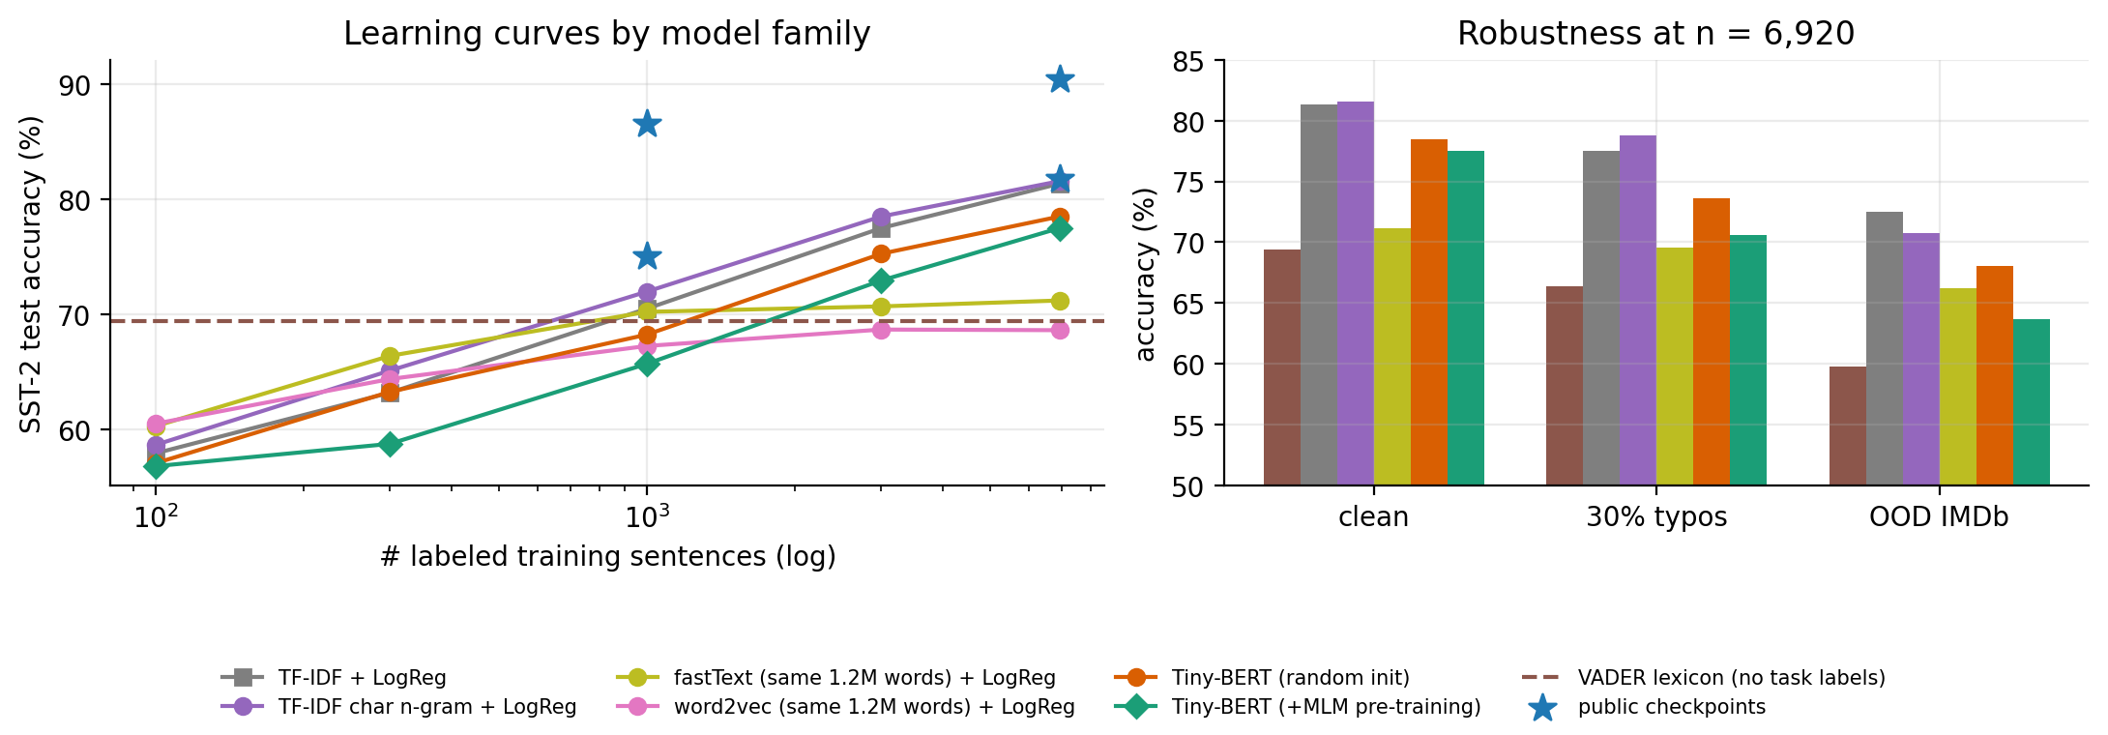
RQ6: the best bet depends on the label budget
SST-2 accuracy by model family (mean of 3 seeds)
fastText (same 1.2M words) is the best TRAINABLE model at 100-300 labels; it beats MLM at n=1000 (70.2 vs 65.7), then plateaus at 71.2%
VADER (0 task labels): 69.4% - worth ~840 TF-IDF labels
Character n-grams: best typo robustness (78.7% at 30% typos)
Notes:
[Slide 6 - Families | 4:00-5:00]
Among methods trained on the shared unlabeled corpus, fastText is the best trainable option at 100-300 labels and still beats MLM at 1,000 labels (70.2 versus 65.7 percent). It plateaus around 71 percent while TF-IDF and the transformers keep climbing. VADER is separate: it is an external lexicon using no task labels and does not consume this corpus; its 69.4 percent is equivalent to about 840 TF-IDF labels.
And character n-grams give the best typo robustness of any classical model.

Slide 7
A currency for comparison: label-equivalence
How many TF-IDF labels is each model worth? (interpolated on the TF-IDF curve)
Model | n = 1,000 | n = 6,920
VADER (0 labels) | ~840 | --
fastText (same words) | ~960 | ~1,120
Tiny-BERT +MLM (ours) | ~450 | ~3,000
BERT-Tiny (public) | ~2,040 | >6,920
DistilBERT (public) | >6,920 | >6,920
0.45x
6.9x
our pre-trained tiny BERT: 1,000 labels ~ 450 TF-IDF labels
DistilBERT with 1,000 labels beats TF-IDF with all 6,920
Notes:
[Slide 7 - Label-equivalence | 5:00-5:30]
To make these gaps concrete, I read every model's accuracy off the TF-IDF curve and asked: how many TF-IDF labels is this worth? Our pre-trained model at 1,000 labels is worth about 450 - less than half its own labels. DistilBERT at 1,000 labels beats TF-IDF with all 6,920 - almost a sevenfold saving. This is consistent with benefits from larger-scale pre-training, but the public checkpoint also differs in corpus, vocabulary and training recipe, so scale is not isolated.

Slide 8
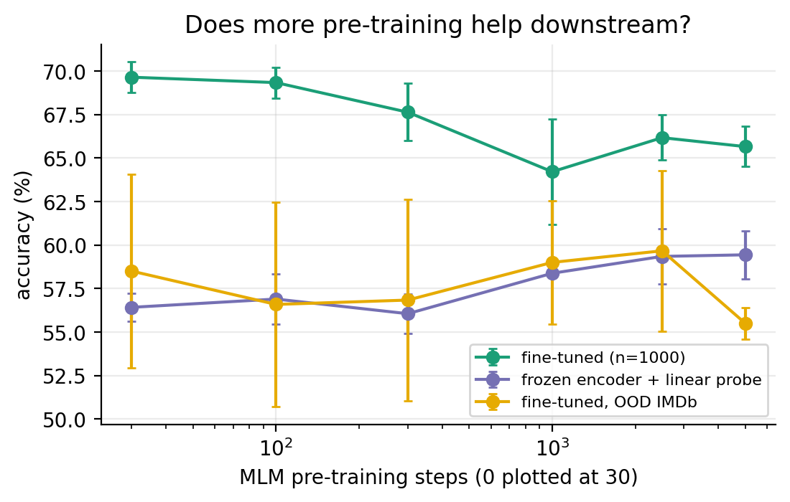
RQ3: the probe improves, fine-tuning does not
Checkpoints after 0-5,000 MLM steps; n = 1,000 labels; 3 seeds
56.4 -> 59.4
frozen linear probe: MLM does store sentiment info
69.7 -> 65.7
fine-tuned accuracy falls with pre-training
A probe alone would have predicted a benefit.
Notes:
[Slide 8 - Decoupling | 5:30-6:15]
Why the negative result? I tested each pre-training checkpoint two ways: fine-tune it, or freeze it and train only a linear probe. They disagree. The probe rises from 56.4 to 59.4 percent - MLM does add sentiment-relevant information. But fine-tuned accuracy falls, from 69.7 to 65.7. Our pre-trained weights are a better representation but a worse starting point for fine-tuning. The next slide shows exactly where that plays out.

Slide 9
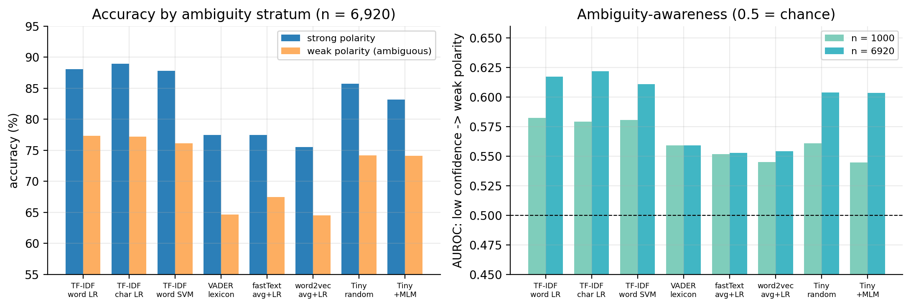
RQ7: a conditional polarity-strength effect
SST-5 strength is a proxy, not direct annotator disagreement
At n=1000: -4.7 pts on strong-polarity vs -1.3 on weak-polarity examples; weak-stratum CI includes zero
Best ambiguity-awareness AUROC across ALL models: 0.62 (chance = 0.5) - nobody's confidence tracks ambiguity well
Transformers on 1,000 labels are badly overconfident: ECE 23-26% vs 3-6% for TF-IDF
Notes:
[Slide 9 - Ambiguity | 6:15-7:15]
Here's the twist. I split test sentences by polarity strength, using fine-grained SST-5 labels: strong, clearly positive or negative, versus weak, mild and closer to neutral. At 1,000 labels, the estimated deficit is 4.7 points on STRONG-polarity sentences and 1.3 on WEAK-polarity sentences. The weak-stratum interval includes zero, which is inconclusive, not evidence that the effect disappears. The interaction is significant at this budget. Strong/weak polarity is an intensity proxy, not direct annotator disagreement.
And across every model I tried, confidence barely tracks ambiguity - the best AUROC for flagging a weak-polarity sentence from low confidence is 0.62, barely above chance. Worse, transformers trained on 1,000 labels are badly overconfident - calibration error of 23 to 26 percent, versus 3 to 6 for TF-IDF. You cannot trust a small transformer's confidence to tell you when it's unsure.

Slide 10
RQ2: typos and domain shift
Accuracy (%) at n = 6,920 labeled sentences
30% typos: transformers lose 4.9-7.1 pts vs 3.8 for TF-IDF
OOD: pre-training did not help ours; no public model beat TF-IDF
Notes:
[Slide 10 - Robustness | 7:15-8:00]
Typos hurt every transformer more than TF-IDF - likely because WordPiece fragments misspelled words. And out-of-domain, on IMDb reviews, pre-training did not help our model, and no public checkpoint beat TF-IDF either.

Slide 11
Public checkpoints perform better
SST-2 accuracy (%); public models differ in corpus, vocabulary and training recipe
BERT-Tiny has OUR depth and width: +9.3 pts at n=1k over our pre-trained model
DistilBERT: +16/+9 pts over TF-IDF, ~26 min to fine-tune vs 37 s
Consistent with a pre-training-scale benefit, but scale is not isolated here
Notes:
[Slide 11 - Twist | 8:00-8:45]
Public BERT-Tiny shares our depth and width but differs in pre-training corpus, vocabulary, and training recipe; it scores 9.3 points above our model at 1,000 labels. This is consistent with benefits from larger-scale pre-training, but it does not isolate scale as the cause.

Slide 12
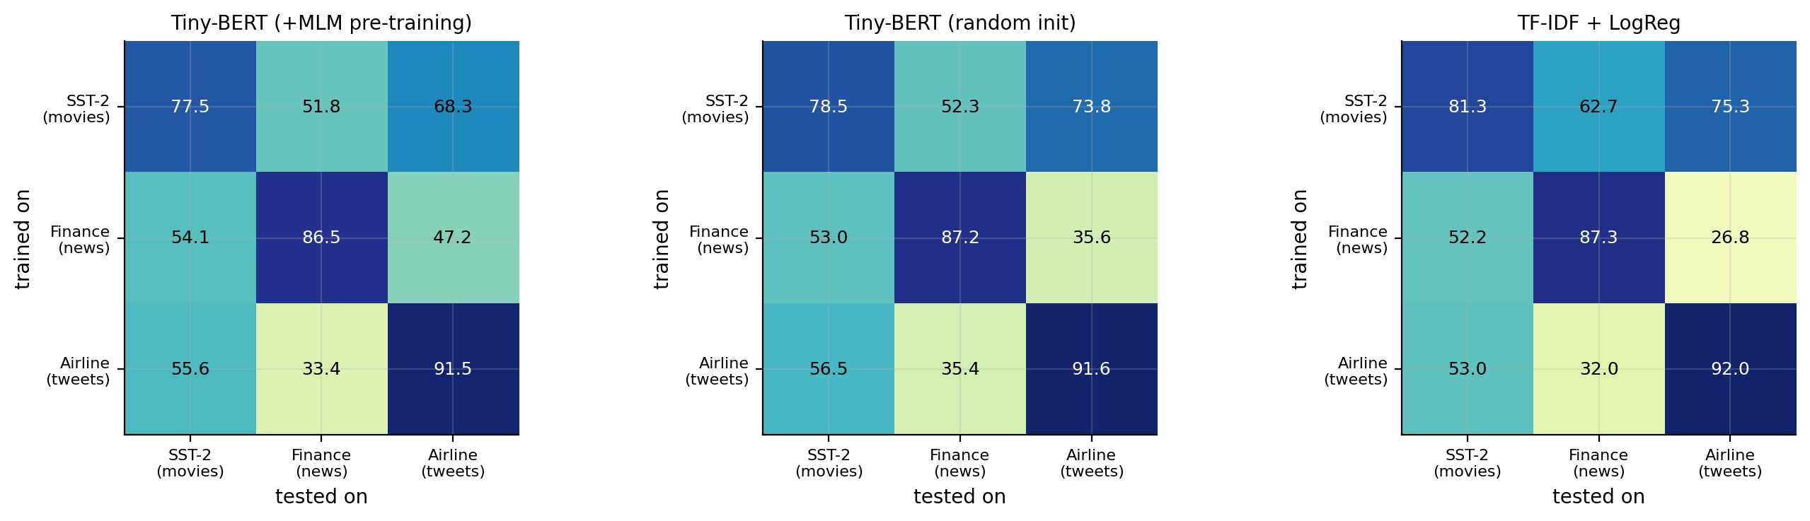
RQ8: does it travel? Cross-domain generalisation
Financial PhraseBank (finance news, real agreement) + Twitter Airline (tweets, real confidence)
Low-budget results are descriptive: fastText +3.2 pts over MLM at airline n=100; paired intervals need rerun
Full-data means are close, but no claim of equivalence without reproducible paired tests
Transfer is directional: scratch Tiny SST-2->airline -4.7 pts; airline->SST-2 -35.1; finance TF-IDF->airline -60.5
Macro-F1 matters: finance agreement strata drop 6-9 pts; airline confidence strata drop 16-19 pts (signals differ)
Notes:
[Slide 11b - Cross-domain | 8:45-9:30]
Does any of this generalise beyond movies? I repeated the two sharpest findings on two more domains with REAL ambiguity signals - finance news with actual annotator agreement tiers, and airline tweets with actual crowd-worker confidence scores.
At n=100 on airline, fastText has a 3.2-point higher accuracy estimate than +MLM; +MLM trails random initialization by about 1.8 points. The archive does not currently reproduce the paired confidence intervals previously reported for these domain comparisons, so treat these as descriptive until the new bootstrap script is run.
Full-data point estimates are close in finance and airline, but the current artifacts do not support a reproducible claim of statistical equivalence. Cross-domain transfer is directional: scratch Tiny-BERT drops 4.7 points SST-2-to-airline and 35.1 points airline-to-SST-2; TF-IDF finance-to-airline drops 60.5 points. Interpret accuracy alongside Macro-F1 because the class distributions differ sharply.

Slide 13
Takeaways
Three findings, one field guide
It depends
Where it differs
Be cautious
fastText wins <1k labels; TF-IDF wins after; MLM never does
larger estimated deficit on strong-polarity examples
confidence weakly detects the polarity-strength proxy
Field guide: few hundred labels -> fastText; few thousand -> TF-IDF; public checkpoint available -> use it
Public checkpoints perform better, but the comparison does not isolate corpus scale from vocabulary and recipe
Next: tuned checkpoints, more seeds, larger OOD tests and direct annotator-disagreement labels
Notes:
[Slide 12 - Takeaways | 8:45-10:00]
Three findings. One: the best trainable use of the shared unlabeled corpus depends on label budget - fastText early, TF-IDF later; VADER is a separate external baseline. Two: at n=1000 the pre-training deficit is larger on strong-polarity examples, while the weak-stratum estimate is inconclusive. Three: confidence is a weak detector of this polarity-strength proxy, and small transformers are overconfident.
Field guide: a few hundred labels, fastText is a strong trainable option; with more labels, TF-IDF is competitive; public checkpoints perform well but the scale effect is not isolated. The three-domain base pipeline runs with one command, while public-checkpoint benchmarks are optional. Thank you - happy to take questions.

Slide 14
Backup: cost of each model
BACKUP
Single CPU thread; seed-0 full-data models
Model | Size (MB) | Latency (ms) | Sent./s | Acc. (%)
Tiny random init, FP32 | 4.71 | 1.03 | 4,914 | 78.3
Tiny +MLM, FP32 | 4.71 | 1.02 | 5,073 | 76.1
Tiny +MLM, INT8 dynamic | 3.54 | 1.71 | 3,196 | 75.9
TF-IDF + LogReg | 2.72 | 0.31 | 48,388 | 81.3
fastText + LogReg (est.) | ~0.5 | ~0.5 | ~10,000 | 71.2
INT8: -25% file size, accuracy unchanged within noise (single model)
fastText row is an order-of-magnitude estimate, not separately measured
Notes:
[Backup B1 - Cost | Q&A]
Use if asked about efficiency. INT8 dynamic quantization cuts the tiny model's file by 25 percent with unchanged accuracy. TF-IDF is smaller, faster and more accurate than any transformer here. The fastText row is an estimate, not a separate measurement, and I say so if asked.

Slide 15
Backup: statistical evidence
BACKUP
SST-2 paired sentence bootstrap; intervals conditional on the saved seeds
Comparison | n=1000 | n=6920
+MLM - random init, STRONG sentences | -4.7* [-7.2,-2.2] | -2.6* [-4.8,-0.2]
+MLM - random init, WEAK sentences | -1.3 [-3.4,+0.8] | -0.1 [-2.2,+1.9]
+MLM - random init, TF-IDF LR (overall) | -2.5* [-4.2,-1.0] | -1.0 [-2.6,+0.5]
Interaction (strong - weak) at n=1000: -3.5 [-6.7,-0.3], CI excludes 0
Method: resample 1,821 test sentences 2,000 times after averaging paired per-sentence correctness differences over matched seeds; this does not capture retraining variability
Notes:
[Backup B2 - Statistics | Q&A]
The interaction test - is the strong-polarity gap bigger than the weak-polarity gap - has a 95 percent interval of -3.5 to -0.3 at n=1000. The weak-stratum interval itself includes zero; polarity strength is not direct annotator disagreement.

Slide 16
Backup: limitations and threats to validity
BACKUP
What the results do and do not show
Ambiguity proxy is SST-5 polarity STRENGTH, not annotator disagreement; 'weak' covers 62.8% of sentences
Only 2 public checkpoints (BERT-Tiny, DistilBERT), untuned learning rates, predictions not stored (no paired tests for them)
Embedding families untuned (fixed dim/epochs/pooling); no CNN/BiLSTM baseline
3 seeds; full 872-sentence dev set for early stopping even at n=100
One task and one language (English sentiment), across three domains
Notes:
[Backup B3 - Limitations | Q&A]
Be upfront: the ambiguity signal measures polarity strength, not real annotator disagreement, and covers most of the dataset as 'weak', so it's a coarse proxy. Public checkpoints used untuned learning rates and their predictions weren't stored, so no paired tests exist for them yet. Everything else is standard caveats: three seeds, one task, one language.

Slide 17
Backup: reproducibility
BACKUP
Three-domain base study; public checkpoints optional
bash run_all.sh # clean run of SST-2 + finance + airline
python run_experiments.py --stage families # VADER, SVM, char n-gram, word2vec/fastText
python ambiguity.py # SST-5 strata, AUROC, ECE
python hf_benchmark.py --models ladder --tune # size ladder, tuned lr
Resumable runs and saved predictions; paired SST-2 tests plus an explicit optional multi-domain bootstrap
Deliverables: code, technical docs, main report, 2-page report, ACM paper, this deck
Notes:
[Backup B4 - Reproducibility | Q&A]
The default command runs the three-domain base study. The public-checkpoint benchmark remains optional because it needs model downloads and additional CPU time. Saved predictions support regeneration of the reported tables and the separate multi-domain bootstrap.

