Slide 1
Same Words, Different Bets
Lexicons, static embeddings and contextual pre-training for sentiment classification under scarce labels and ambiguity
Given 1.2M unlabeled words: ignore them, distil them, or pre-train on them?
SST-2 + IMDb | CPU only | 3 seeds | Anurag Prasad
Notes:
[Slide 1 - Title | 0:00-0:45]
Good morning. Given the same small amount of unlabeled text, what's the best bet - ignore it, turn it into a lexicon, distil it into static embeddings, or spend it on contextual pre-training?
I built a CPU-only pipeline to answer this for sentiment classification, comparing a rule-based lexicon, TF-IDF, static word embeddings trained on the same text, a tiny BERT with and without pre-training, and public checkpoints.
Beyond accuracy, I also look at robustness and - the twist - where models succeed or fail under ambiguity. Ten minutes, then five for questions.

Slide 2
The problem: seven questions, one protocol
Same data, same head, same evaluation for every model
RQ1-2
Does pre-training help? How robust is it?
RQ3-4
How much pre-training is enough, and what does it cost?
RQ5
How far do public checkpoints move the picture?
RQ6
Given the same text, what's the best family to use it with?
RQ7
Where do errors concentrate under ambiguity, and do models know when they're unsure?
Notes:
[Slide 2 - Problem | 0:45-1:45]
Seven questions under one protocol. RQ1 and 2: does masked-language-model pre-training beat random init and TF-IDF, and how robust is it? RQ3 and 4: how does the benefit change with pre-training length, and what does it cost in size and speed? RQ5: what happens with real public checkpoints? RQ6, the new one: given the same unlabeled text, is contextual pre-training even the best way to use it, compared to a lexicon or static embeddings? RQ7, also new: where do errors concentrate on ambiguous sentences, and do models know when they're unsure?
Same data subsets, same classifier head, same evaluation sets for every single model - that's what makes the comparison fair.

Slide 3
Approach: six families, one protocol
Every model - lexicon to transformer - fine-tuned/fit and evaluated identically
VADER lexicon
0 task labels
TF-IDF word/char
+ LogReg/NB/SVM
word2vec / fastText
same 1.2M words
Tiny-BERT
random init
Tiny-BERT
+MLM pre-train
BERT-Tiny /
DistilBERT
public
Evaluated on: clean SST-2, typos (10/30%), word-drop (20/40%), out-of-domain IMDb, and - new - ambiguity strata from fine-grained SST-5 labels (strong vs weak polarity), confidence calibration, and linguistic markers (contrast, negation).
Tiny-BERT: 2 layers, hidden 128, 1,173,248 params. MLM pre-training: 5,000 steps, 13 min, on 1.2M unlabeled IMDb words. All decisions (regularisation, embedding choices) tuned on dev only.
Notes:
[Slide 3 - Approach | 1:45-2:45]
Six families, one protocol. A VADER sentiment lexicon that never sees a training label. TF-IDF with word or character n-grams. word2vec and fastText - static embeddings trained on the exact same 1.2 million unlabeled words as our MLM pre-training. Our tiny BERT, with and without that pre-training. And public BERT-Tiny and DistilBERT.
Everything is evaluated on clean data, typos, word-drop, out-of-domain IMDb reviews, and - new for this version - ambiguity strata built from fine-grained SST-5 labels, confidence calibration, and simple linguistic markers like contrast words.
The tiny BERT has 1.17 million parameters and pre-trains in 13 minutes on one CPU.

Slide 4
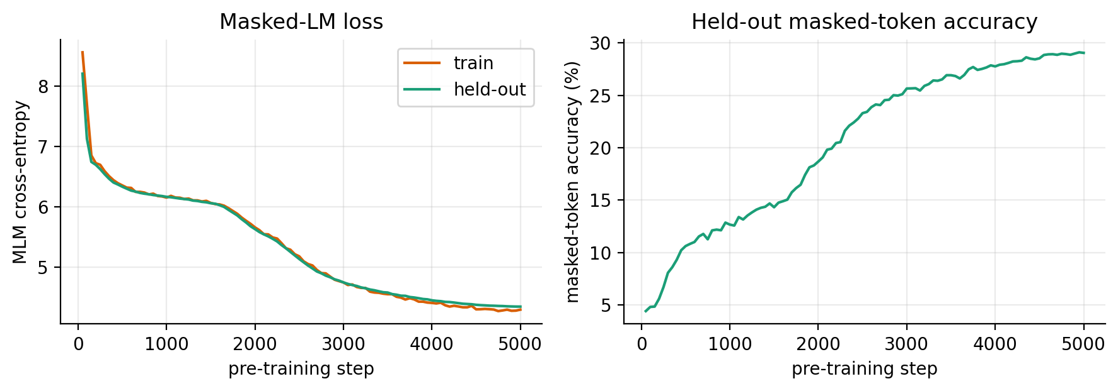
Pre-training starts with a long plateau
Held-out masked-LM loss and accuracy over 5,000 steps
ppl 77
final held-out perplexity (from ~3,660)
29%
First ~1,500 steps: loss stuck near the unigram entropy
Only then does attention start to use context
masked-token accuracy
Notes:
[Slide 4 - Plateau | 2:45-3:15]
Quick sanity check before results. For the first 1,500 of 5,000 pre-training steps, the loss sits near the unigram entropy - the model is only learning word frequencies. It breaks out after that, ending at perplexity 77 and 29 percent masked-token accuracy. So pre-training is doing something real; the question is whether it helps.

Slide 5
Pre-training did not help; TF-IDF wins
SST-2 test accuracy (%), mean of 3 seeds
MLM vs random init: -0.3 to -4.5 pts at every budget (CIs exclude 0 at n=300,1k,3k)
TF-IDF beats the pre-trained model by 3.9-4.8 pts from n=300 on
Notes:
[Slide 5 - Verdict | 3:15-4:00]
Here's the headline. From 300 labels on, the pre-trained model falls behind its own untrained twin - by 0.3 to 4.5 points, and the confidence intervals exclude zero at three of five budgets. TF-IDF then overtakes both. At laptop scale, this pre-training recipe did not pay off in the usual sense. But that's not the whole story - the next two slides are why.

Slide 6
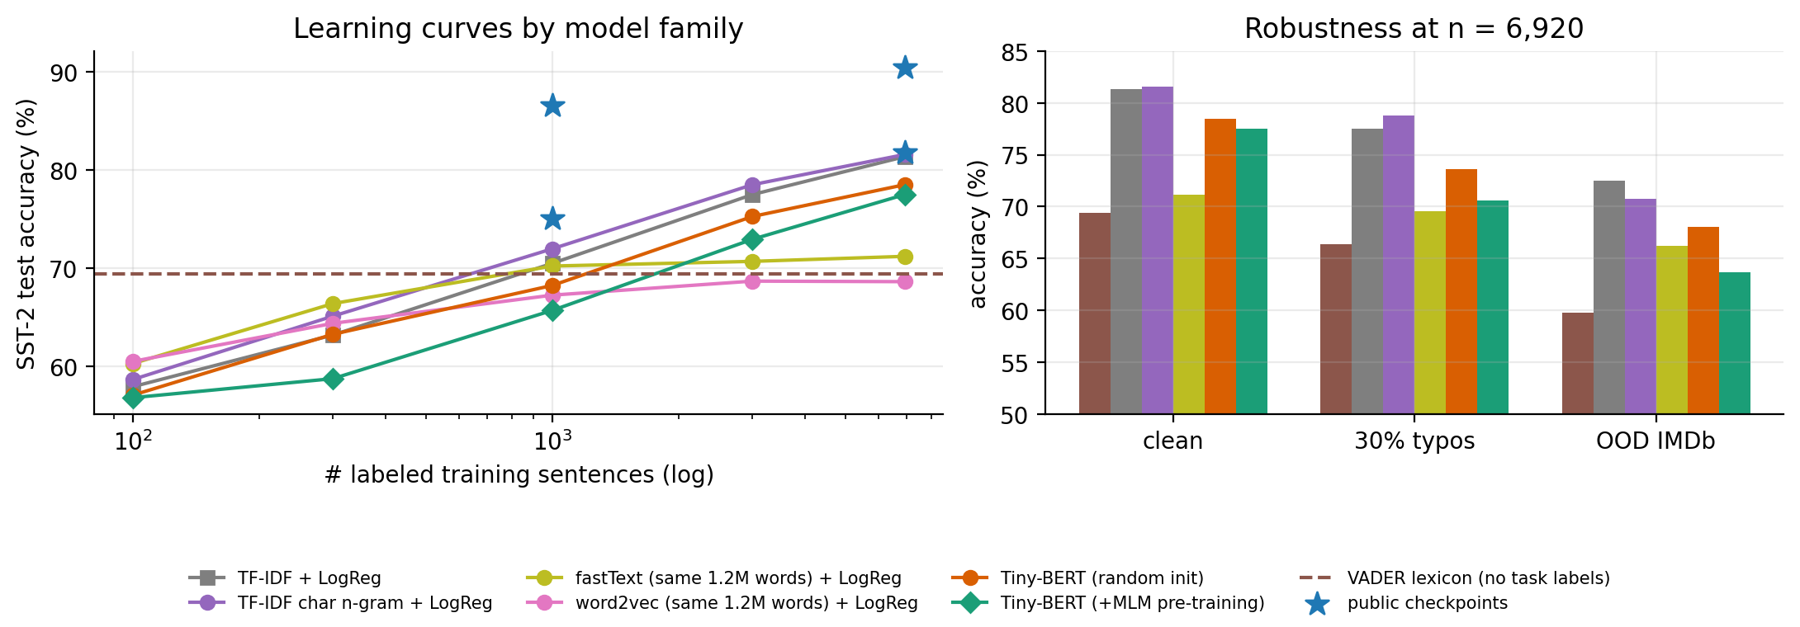
RQ6: the best bet depends on the label budget
SST-2 accuracy by model family (mean of 3 seeds)
fastText (same 1.2M words) is the BEST model at 100-300 labels, beats MLM at n=1000 (70.2 vs 65.7) - then plateaus at 71.2%
VADER (0 task labels): 69.4% - worth ~840 TF-IDF labels
Character n-grams: best typo robustness (78.7% at 30% typos)
Notes:
[Slide 6 - Families | 4:00-5:00]
Given the same unlabeled text, what's the best bet? It depends on how many labels you have. fastText embeddings, trained on the exact same words as our MLM run, are the best model overall at 100 and 300 labels, and still beat MLM pre-training at 1,000 labels - 70.2 versus 65.7 percent. But fastText plateaus around 71 percent while TF-IDF and the transformers keep climbing.
A sentiment lexicon with zero task labels reaches 69.4 percent - worth about 840 TF-IDF labels, a useful number when deciding whether to collect more labels at all.
And character n-grams give the best typo robustness of any classical model.

Slide 7
A currency for comparison: label-equivalence
How many TF-IDF labels is each model worth? (interpolated on the TF-IDF curve)
Model | n = 1,000 | n = 6,920
VADER (0 labels) | ~840 | --
fastText (same words) | ~960 | ~1,120
Tiny-BERT +MLM (ours) | ~450 | ~3,000
BERT-Tiny (public) | ~2,040 | >6,920
DistilBERT (public) | >6,920 | >6,920
0.45x
6.9x
our pre-trained tiny BERT: 1,000 labels ~ 450 TF-IDF labels
DistilBERT with 1,000 labels beats TF-IDF with all 6,920
Notes:
[Slide 7 - Label-equivalence | 5:00-5:30]
To make these gaps concrete, I read every model's accuracy off the TF-IDF curve and asked: how many TF-IDF labels is this worth? Our pre-trained model at 1,000 labels is worth about 450 - less than half its own labels. DistilBERT at 1,000 labels beats TF-IDF with all 6,920 - almost a sevenfold saving. This already hints that scale, not the recipe, is what's missing.

Slide 8
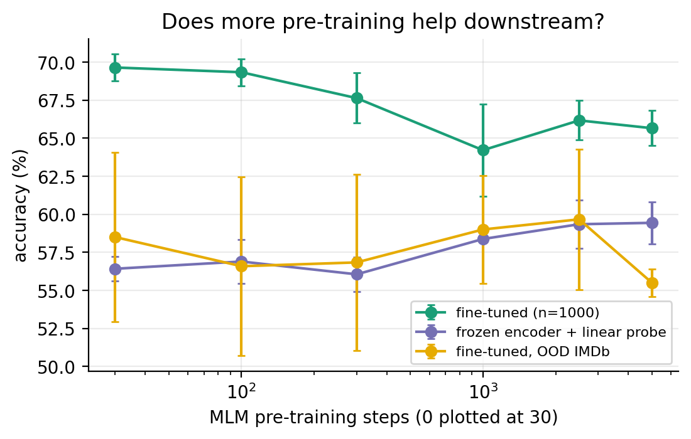
RQ3: the probe improves, fine-tuning does not
Checkpoints after 0-5,000 MLM steps; n = 1,000 labels; 3 seeds
56.4 -> 59.4
frozen linear probe: MLM does store sentiment info
69.7 -> 65.7
fine-tuned accuracy falls with pre-training
A probe alone would have predicted a benefit.
Notes:
[Slide 8 - Decoupling | 5:30-6:15]
Why the negative result? I tested each pre-training checkpoint two ways: fine-tune it, or freeze it and train only a linear probe. They disagree. The probe rises from 56.4 to 59.4 percent - MLM does add sentiment-relevant information. But fine-tuned accuracy falls, from 69.7 to 65.7. Our pre-trained weights are a better representation but a worse starting point for fine-tuning. The next slide shows exactly where that plays out.

Slide 9
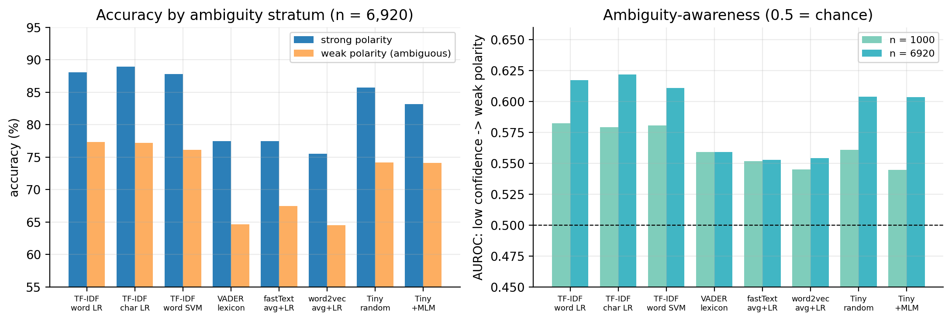
RQ7: the deficit hides in plain sight
Where does pre-training lose, and does confidence track difficulty?
-4.7 pts on STRONG (clear) sentences; only -1.3 on WEAK (ambiguous) ones - the deficit is concentrated on the easy cases
Best ambiguity-awareness AUROC across ALL models: 0.62 (chance = 0.5) - nobody's confidence tracks ambiguity well
Transformers on 1,000 labels are badly overconfident: ECE 23-26% vs 3-6% for TF-IDF
Notes:
[Slide 9 - Ambiguity | 6:15-7:15]
Here's the twist. I split test sentences by polarity strength, using fine-grained SST-5 labels: strong, clearly positive or negative, versus weak, mild and closer to neutral. At 1,000 labels, pre-training costs 4.7 points on STRONG sentences but only 1.3 - not significant - on WEAK ones. The interaction is significant: pre-training's damage is concentrated on the sentences that were already easy.
And across every model I tried, confidence barely tracks ambiguity - the best AUROC for flagging a weak-polarity sentence from low confidence is 0.62, barely above chance. Worse, transformers trained on 1,000 labels are badly overconfident - calibration error of 23 to 26 percent, versus 3 to 6 for TF-IDF. You cannot trust a small transformer's confidence to tell you when it's unsure.

Slide 10
RQ2: typos and domain shift
Accuracy (%) at n = 6,920 labeled sentences
30% typos: transformers lose 4.9-7.1 pts vs 3.8 for TF-IDF
OOD: pre-training did not help ours; no public model beat TF-IDF
Notes:
[Slide 10 - Robustness | 7:15-8:00]
Typos hurt every transformer more than TF-IDF - likely because WordPiece fragments misspelled words. And out-of-domain, on IMDb reviews, pre-training did not help our model, and no public checkpoint beat TF-IDF either.

Slide 11
The twist: pre-training is a scale phenomenon
SST-2 accuracy (%), same fine-tuning code, 3 seeds
BERT-Tiny has OUR depth and width: +9.3 pts at n=1k over our pre-trained model
DistilBERT: +16/+9 pts over TF-IDF, ~26 min to fine-tune vs 37 s
So: scale, not the recipe, is the missing ingredient
Notes:
[Slide 11 - Twist | 8:00-8:45]
If the architecture were the problem, public BERT-Tiny - same depth, same width - would fail too. It doesn't: 9.3 points above our pre-trained model at 1,000 labels. DistilBERT is further ahead still. So the negative result is about scale - 1.2 million words, 13 minutes - not about pre-training as a method.

Slide 12
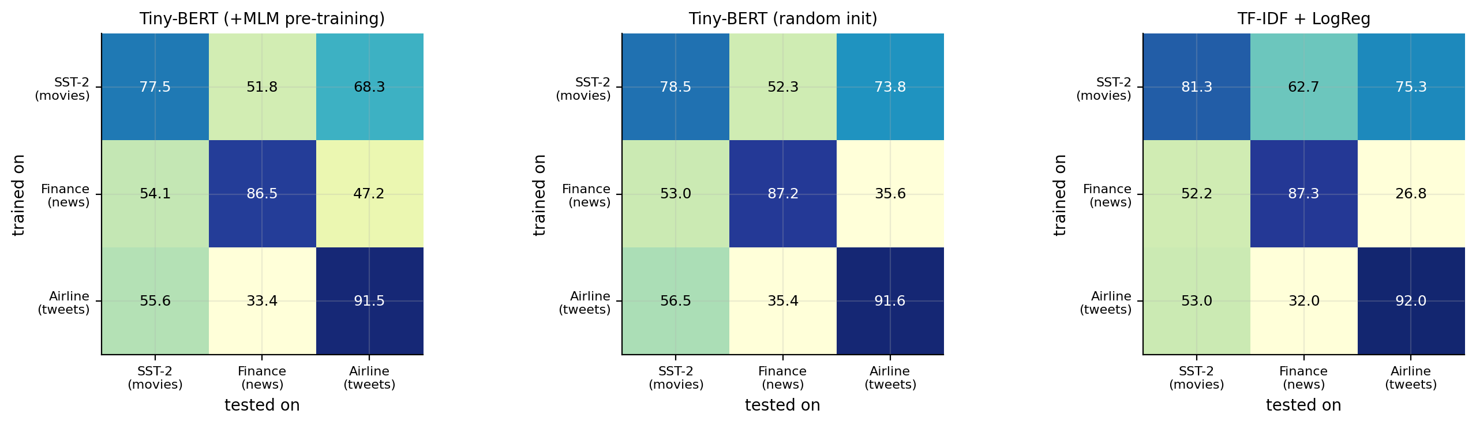
RQ8: does it travel? Cross-domain generalisation
Financial PhraseBank (finance news, real agreement) + Twitter Airline (tweets, real confidence)
Small-budget result REPLICATES: fastText beats +MLM by +3.2 pts [+2.3,+4.1] at n=100 (airline); +MLM significantly WORSE than random init (-1.9 [-2.5,-1.2])
Full-data result does NOT replicate: TF-IDF's SST-2 edge vanishes - all 3 families tie once a domain has enough labels
Cross-domain transfer costs 15-60 pts everywhere; TF-IDF travels best (62.7% movies->finance); pre-training does not close the gap
Notes:
[Slide 11b - Cross-domain | 8:45-9:30]
Does any of this generalise beyond movies? I repeated the two sharpest findings on two more domains with REAL ambiguity signals - finance news with actual annotator agreement tiers, and airline tweets with actual crowd-worker confidence scores.
The small-budget story replicates, even more sharply: on airline at 100 labels, fastText beats pre-training by 3.2 points, and pre-training is SIGNIFICANTLY WORSE than random init.
But the full-data story does not replicate. On SST-2, TF-IDF keeps a significant edge even at full data. In finance and airline, all three families - TF-IDF, random init, pre-trained - become statistically indistinguishable once there are enough labels. So TF-IDF's advantage was partly a movie-review-specific result, not a universal one.
And cross-domain transfer is uniformly poor - every model loses 15 to 60 points moving to a different domain, TF-IDF travels best, and pre-training does not help close that gap at all.

Slide 13
Takeaways
Three findings, one field guide
It depends
Where it fails
Don't trust it
fastText wins <1k labels; TF-IDF wins after; MLM never does
pre-training's damage sits on the EASY sentences
no model's confidence tracks ambiguity (AUROC <=0.62)
Field guide: few hundred labels -> fastText; few thousand -> TF-IDF; public checkpoint available -> use it
Scale, not the recipe, explains our negative result (BERT-Tiny, same architecture, does help)
Next: more public checkpoints (code supports BERT-Mini/Small, MiniLM, TinyBERT, ELECTRA), tuned lr, second dataset
Notes:
[Slide 12 - Takeaways | 8:45-10:00]
Three findings. One: the best bet for unlabeled text depends on how many labels you have - fastText under a thousand, TF-IDF after, and our pre-training recipe never wins outright. Two: pre-training's damage concentrates on sentences that were already easy, and roughly disappears on ambiguous ones. Three: no model's confidence is a good ambiguity detector, and small transformers are dangerously overconfident.
Field guide: a few hundred labels, use fastText; a few thousand, TF-IDF; if you have a public checkpoint, use it. The whole pipeline is one command and fully reproducible. Thank you - happy to take questions.

Slide 14
Backup: cost of each model
BACKUP
Single CPU thread; seed-0 full-data models
Model | Size (MB) | Latency (ms) | Sent./s | Acc. (%)
Tiny random init, FP32 | 4.71 | 1.03 | 4,914 | 78.3
Tiny +MLM, FP32 | 4.71 | 1.02 | 5,073 | 76.1
Tiny +MLM, INT8 dynamic | 3.54 | 1.71 | 3,196 | 75.9
TF-IDF + LogReg | 2.72 | 0.31 | 48,388 | 81.3
fastText + LogReg (est.) | ~0.5 | ~0.5 | ~10,000 | 71.2
INT8: -25% file size, accuracy unchanged within noise (single model)
fastText row is an order-of-magnitude estimate, not separately measured
Notes:
[Backup B1 - Cost | Q&A]
Use if asked about efficiency. INT8 dynamic quantization cuts the tiny model's file by 25 percent with unchanged accuracy. TF-IDF is smaller, faster and more accurate than any transformer here. The fastText row is an estimate, not a separate measurement, and I say so if asked.

Slide 15
Backup: statistical evidence
BACKUP
Paired bootstrap, 95% CI over test sentences, seeds pooled; * = CI excludes 0
Comparison | n=1000 | n=6920
+MLM - random init, STRONG sentences | -4.7* [-7.2,-2.2] | -2.6* [-4.8,-0.2]
+MLM - random init, WEAK sentences | -1.3 [-3.4,+0.8] | -0.1 [-2.2,+1.9]
+MLM - random init, TF-IDF LR (overall) | -2.5* [-4.2,-1.0] | -1.0 [-2.6,+0.5]
Interaction (strong - weak) at n=1000: -3.5 [-6.7,-0.3], CI excludes 0
Method: resample 1,821 test sentences 2,000 times; correctness difference averaged over seeds
Notes:
[Backup B2 - Statistics | Q&A]
The interaction test - is the strong-sentence gap bigger than the weak-sentence gap - has a 95 percent interval of -3.5 to -0.3, which excludes zero at n=1000. That's the statistical backbone of the ambiguity claim.

Slide 16
Backup: limitations and threats to validity
BACKUP
What the results do and do not show
Ambiguity proxy is SST-5 polarity STRENGTH, not annotator disagreement; 'weak' covers 62.8% of sentences
Only 2 public checkpoints (BERT-Tiny, DistilBERT), untuned learning rates, predictions not stored (no paired tests for them)
Embedding families untuned (fixed dim/epochs/pooling); no CNN/BiLSTM baseline
3 seeds; full 872-sentence dev set for early stopping even at n=100
One task, one dataset, one language (SST-2, English)
Notes:
[Backup B3 - Limitations | Q&A]
Be upfront: the ambiguity signal measures polarity strength, not real annotator disagreement, and covers most of the dataset as 'weak', so it's a coarse proxy. Public checkpoints used untuned learning rates and their predictions weren't stored, so no paired tests exist for them yet. Everything else is standard caveats: three seeds, one task, one language.

Slide 17
Backup: reproducibility
BACKUP
Everything regenerates from logged runs
bash run_all.sh # clean run of the whole study
python run_experiments.py --stage families # VADER, SVM, char n-gram, word2vec/fastText
python ambiguity.py # SST-5 strata, AUROC, ECE
python hf_benchmark.py --models ladder --tune # size ladder, tuned lr
Resumable, stored predictions, paired statistics throughout
Deliverables: code, technical docs, main report, 2-page report, ACM paper, this deck
Notes:
[Backup B4 - Reproducibility | Q&A]
One command runs everything. Every stage is resumable and stores its predictions, so statistics and the ambiguity analysis can always be regenerated or extended.

