Slide 1
Data Science
Final Project Presentation
Analyzing NASA's Technology Projects: Trends and Predictions
Anuj Kumar Shah
Mohit Kosekar
Prudhvi Krishna Dadi

Slide 2
Introduction
NASA, the forefront of aerospace innovation, undertakes numerous projects that push the boundaries of science and technology. These projects range from developing advanced propulsion systems to exploring new forms of energy utilization in space. Analyzing the data from NASA's technology projects offers a unique opportunity to glean insights into the direction of aerospace technology and its evolving trends.

Slide 3
Research Objective
Objective: To utilize machine learning to classify NASA's technology projects and predict future trends based on project descriptions and classifications. This analysis aims to:
Identify the dominant themes within NASA's portfolio of technology projects.
Classify projects into relevant technological categories.
Forecast emerging trends that could dictate the focus of future aerospace technology projects.

Slide 4
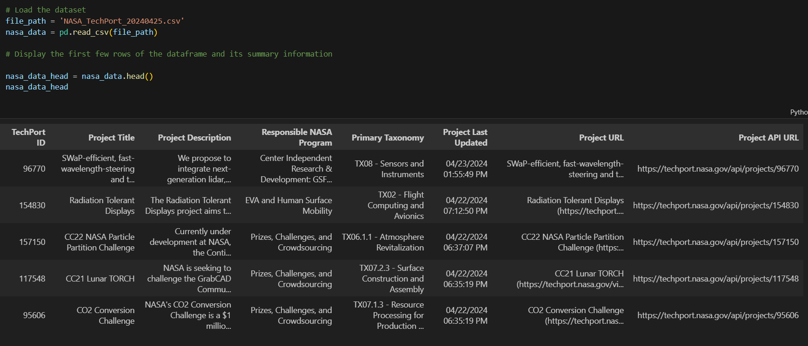
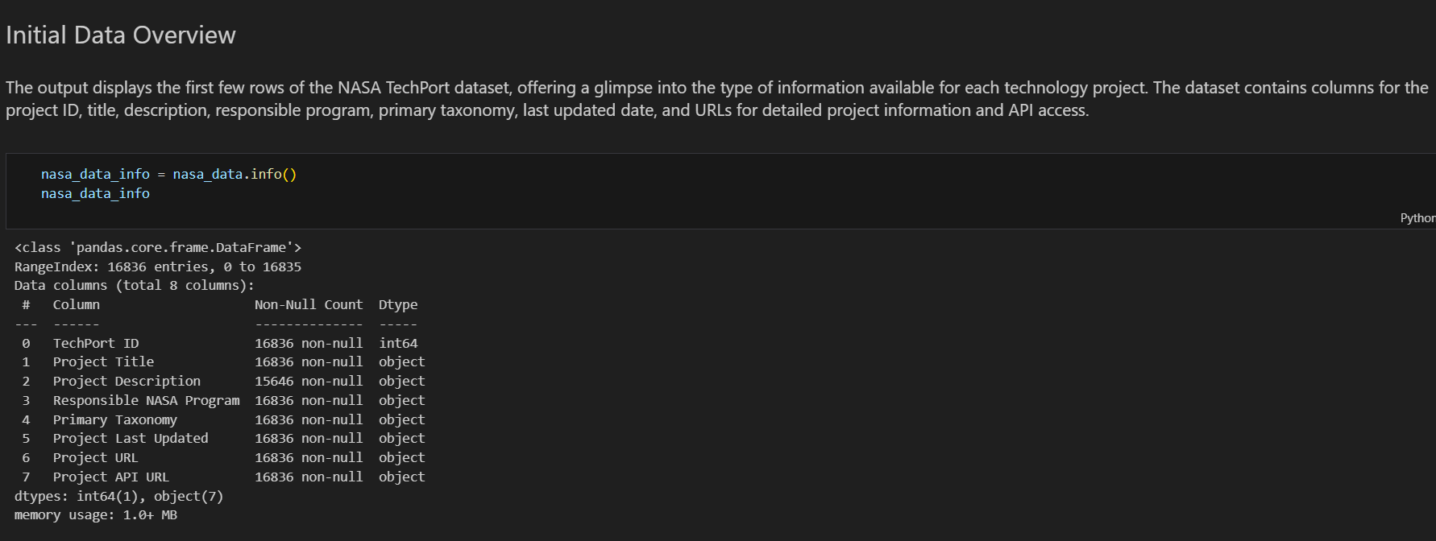
Data Preparation
Name: NASA TechPort
Description: NASA TechPort is a searchable database of technical innovations developed by NASA and its partners. The data includes information on over 4,000 technologies, including their applications, benefits, and potential markets.

Slide 5
Exploratory Data Analysis
The exploratory data analysis (EDA) phase provided valuable insights into the NASA project data, shedding light on the distribution of projects over time, the top NASA programs, the most common technology taxonomies, and the thematic focus of project titles.
Distribution of Projects Over Time:
Line chart showing the annual count of projects since 2018 to 2024.
Helps identify periods of high and low number of project activity.

Slide 6
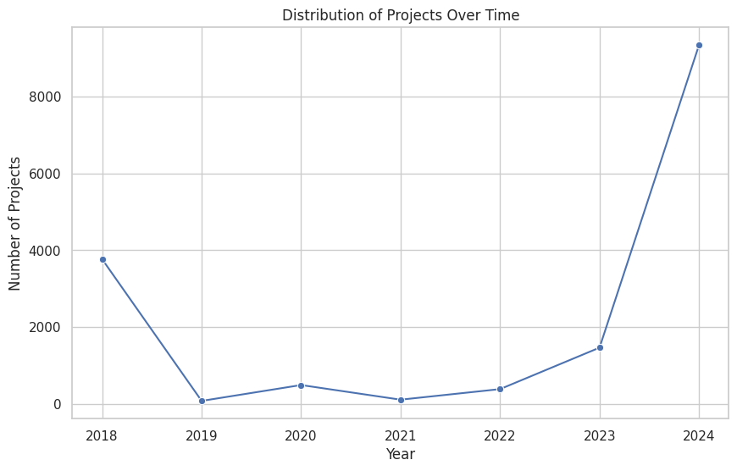
Fig: Distribution of Projects Over Time.

Slide 7
Exploratory Data Analysis
Top NASA Programs:
Bar chart displaying the number of projects associated with each NASA program.
Highlights the programs with the most significant contributions.

Slide 8
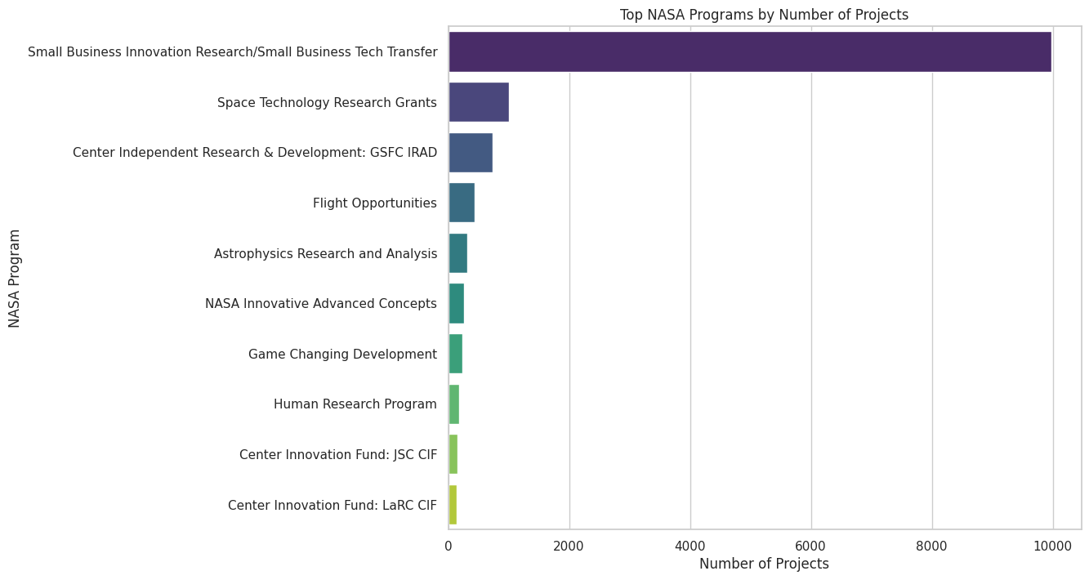
Fig: Top NASA Programs by Number of Projects

Slide 9
Exploratory Data Analysis
Most Common Technology Taxonomies:
Bar chart showing the frequency of different technology taxonomies assigned to projects.
Provides an overview of the technological areas NASA focuses on.

Slide 10
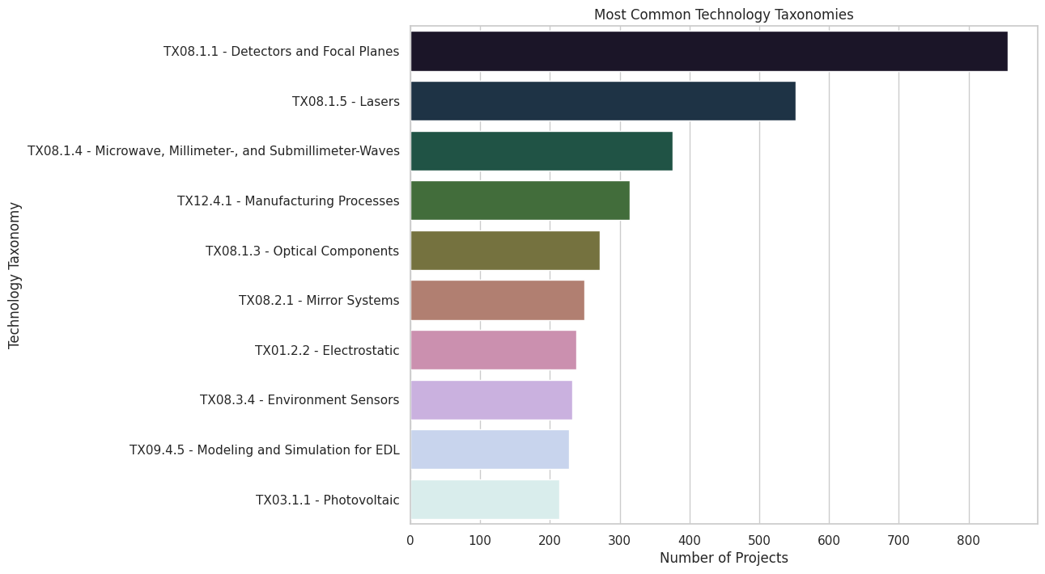
Fig: Most Common Technology Taxonomies

Slide 11
Exploratory Data Analysis
Thematic Focus of Project Titles:
Word cloud illustrating the most frequent words in Project Titles and Project Descriptions.
Helps identify dominant themes and trends in NASA's technology projects.
These visualizations offer a comprehensive understanding of the NASA project portfolio, enabling us to pinpoint key areas for further investigation and analysis.

Slide 12
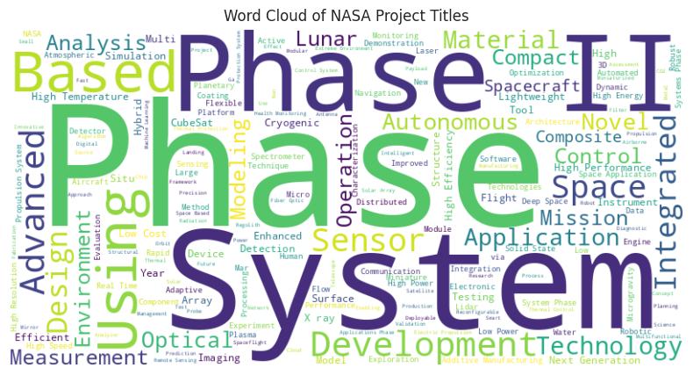
Fig: Word Cloud of NASA Project Titles

Slide 13
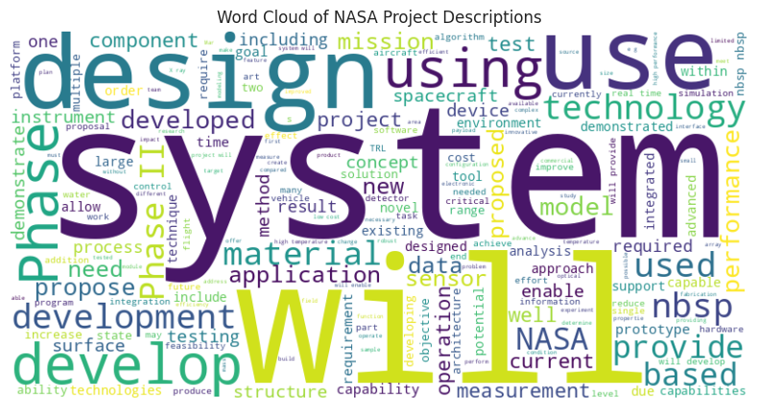
Fig: Word Cloud of NASA Project Descriptions

Slide 14
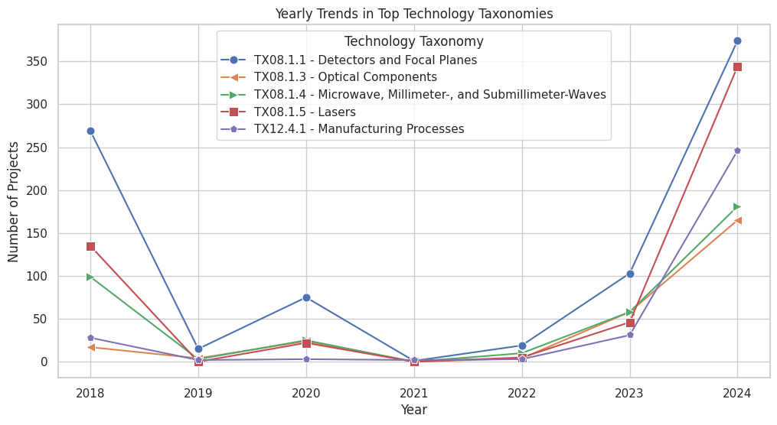

Slide 15
Data Preparation
The dataset summary reveals that, which consists of 16,836 total records with a mixture of numerical and textual data types. Notably, the 'Project Description' column has some missing values (15,646 non-null entries out of 16,836), indicating the need for handling missing data during the data preparation phase.
Removing Missing Data: We drop rows where 'Project Description' is missing, as these entries lack critical information needed for text analysis.
Date Conversion: Convert 'Project Last Updated' into a proper datetime format to facilitate time-series analysis.
Removing Duplicates: We remove duplicate entries based on 'TechPort ID' to ensure each project is represented only once.

Slide 16
Data Preprocessing
Text Cleaning and Normalization: Standardize text data for uniform analysis.
Tokenization: Prepare text for natural language processing.
Stop Words Removal: Eliminate common words that may skew the analysis.
Feature Engineering - TF-IDF: Quantify the importance of words in document collections.
Categorical Data Encoding: Convert categorical text data into numerical format.
Handling Missing Data: Ensure completeness of the dataset for analysis.

Slide 17
Text Cleaning and Normalization
Objective of Text Cleaning: Ensure consistency and clarity in textual data for analysis.
Steps Taken:
Lowercasing:
Converted all text in 'Project Description' and 'Primary Taxonomy' fields to lowercase.
Purpose: Achieve uniformity across text data, removing case sensitivity in processing.
Removing Special Characters:
Stripped out all non-alphanumeric characters from textual data.
Purpose: Simplify text by removing punctuation and special symbols which may hinder text analysis.

Slide 18
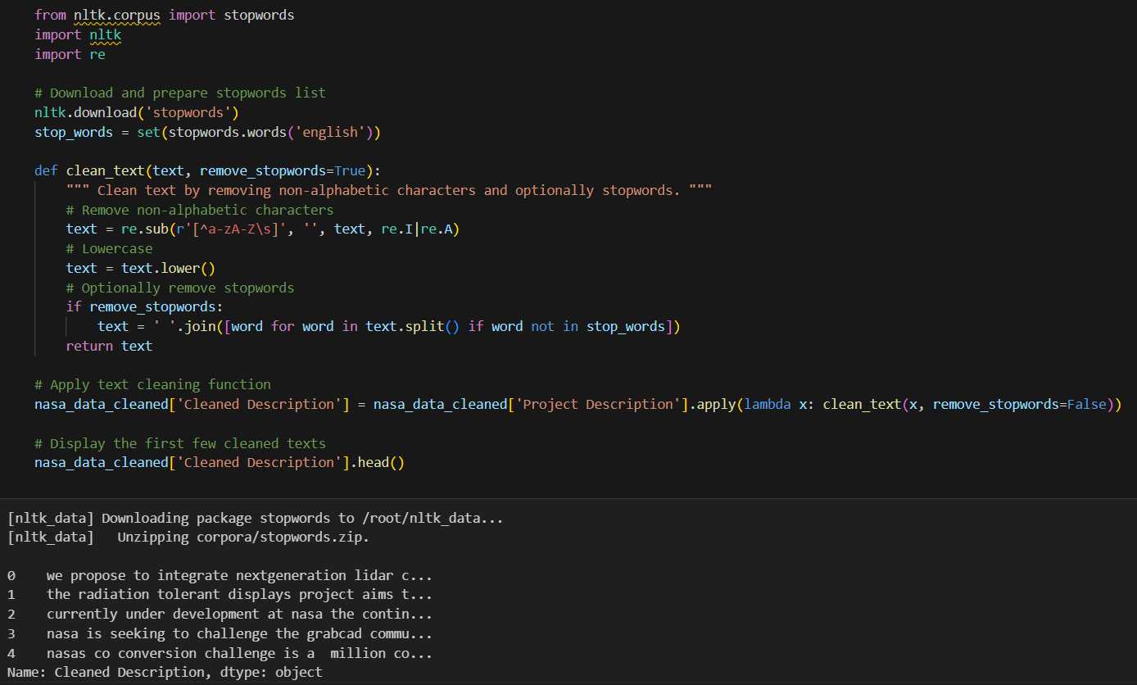
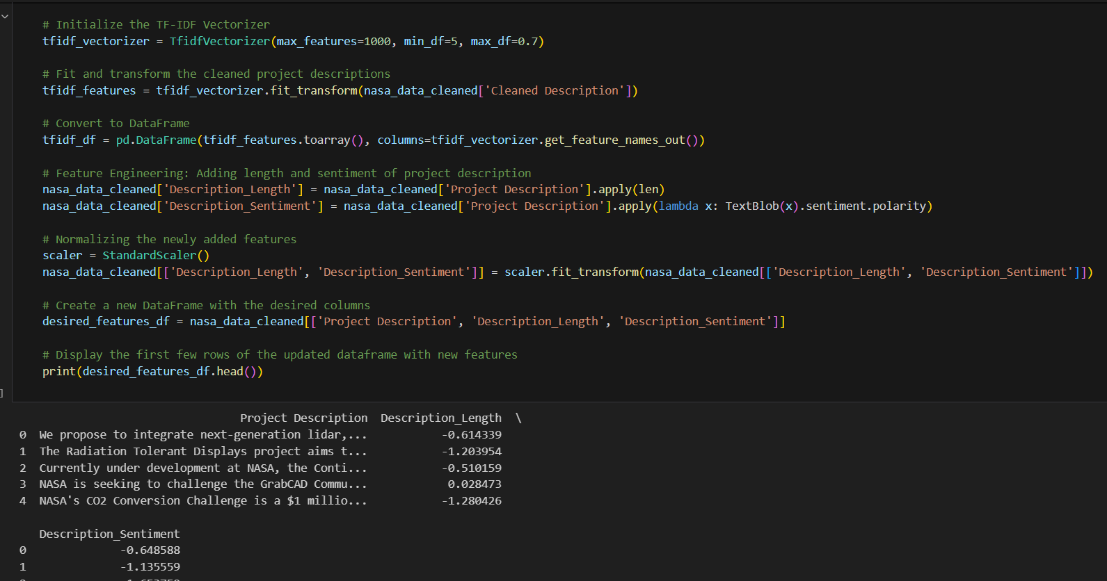
After Normalization:
'nasas co2 conversion challenge'
'project title advanced spectroscopic analysis asa'
Before Normalization:
'NASA’s CO2 Conversion Challenge!'
'Project Title: Advanced Spectroscopic Analysis (ASA).'

Slide 19
Tokenization and Stop Words Removal
Objective of Tokenization and Stop Words Removal:
Focus analysis on meaningful words by breaking down text and eliminating common words.
Steps Taken:
Tokenization:
Text from 'Project Description' is broken into individual words or "tokens".
Purpose: Simplifies text analysis by isolating each word.
Stop Words Removal:
Common words such as 'and', 'the', and 'is' are removed from tokens.
Purpose: Prevents common words from overshadowing unique information in text data.

Slide 20
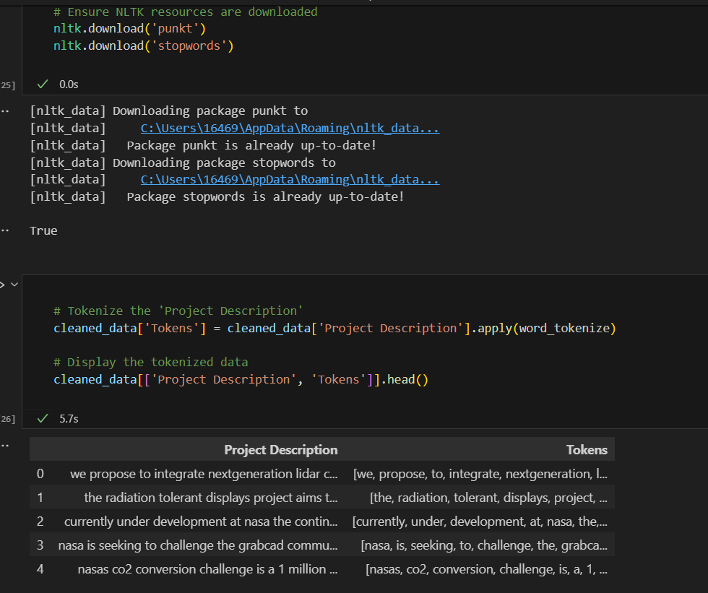
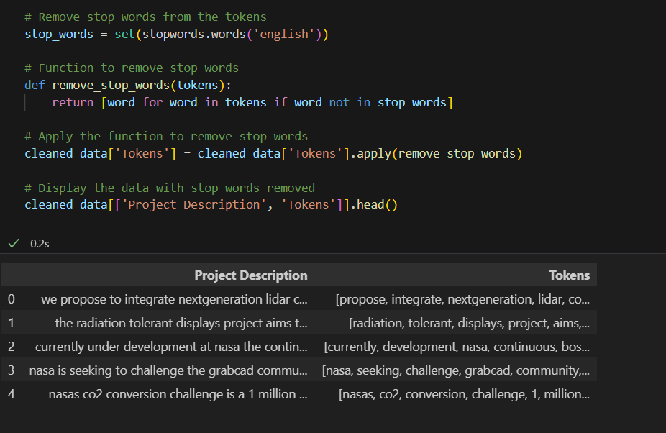
Examples of Process:
Before:
"NASA is developing new technology for Mars."
After Tokenization:
['NASA', 'is', 'developing', 'new', 'technology', 'for', 'Mars']
After Stop Words Removal:
['NASA', 'developing', 'new', 'technology', 'Mars']

Slide 21
Feature Engineering - TF-IDF and Additional Features
Objective of Feature Engineering:
Enhance data with features that provide more depth and context for analysis.
Steps Taken:
TF-IDF Vectorization:
Apply TF-IDF to transform the tokenized text into a weighted numerical format.
Purpose: Emphasizes words that are important to the document but not common across all documents.
Adding Features:
Additional features such as text length and sentiment are included.
Normalization: These features are standardized to match the scale of other numerical data.
Impact:
These steps enhance model accuracy and provide deeper insights into the textual data.

Slide 22
Encoding and Final Data Preparation
Objective of Encoding and Data Concatenation:
Prepare a comprehensive dataset by encoding categorical data and merging all features.
Steps Taken:
Categorical Encoding:
Transform 'Responsible NASA Program' and 'Primary Taxonomy' into a numerical format using one-hot encoding.
Data Concatenation:
Merge TF-IDF features with encoded categorical data to create a unified dataset.

Slide 23
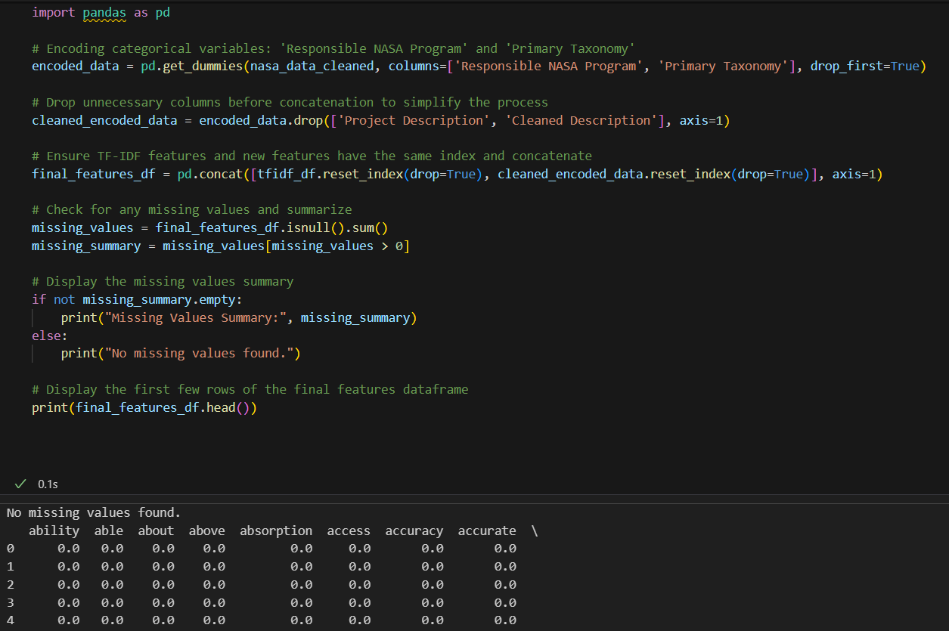
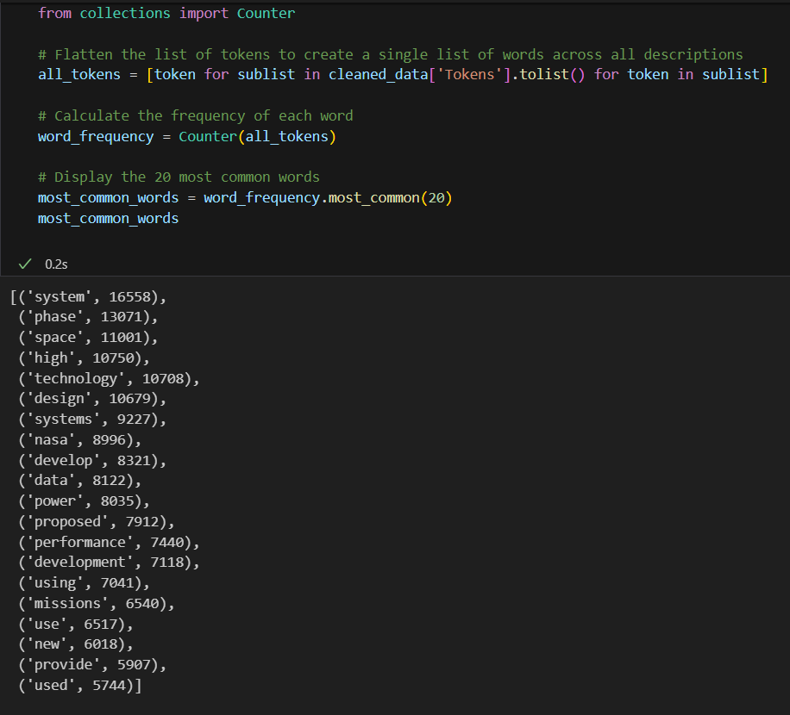
Below code snippet calculates and displays the twenty most frequent words in our dataset, providing insights into the common themes across NASA's project descriptions.
Here, we finalize the feature set by concatenating TF-IDF vectors with encoded categorical data and ensure the integrity of our dataset by checking for and confirming the absence of any missing values.

Slide 24
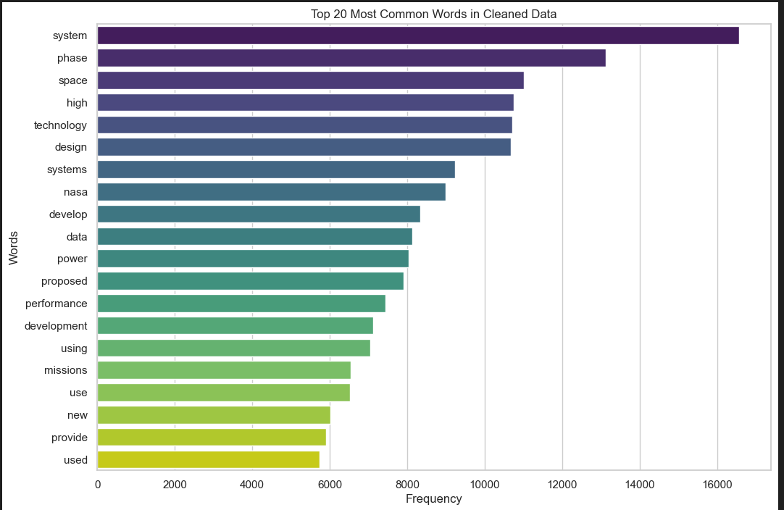

Slide 25
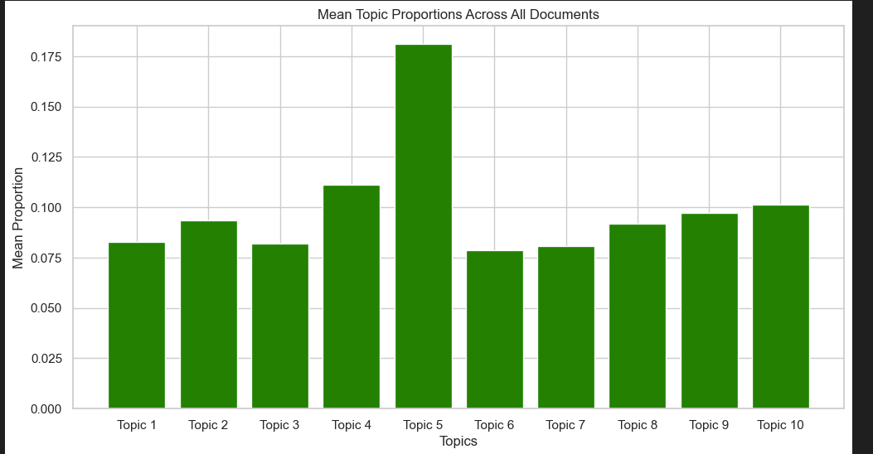
Topic Modeling with LDA
Uncovering Themes in NASA's Technology Projects
Introduction to Topic Modeling
Purpose: To discover hidden thematic structures within the NASA project descriptions.
Method Used: Latent Dirichlet Allocation (LDA).
Objective: Identify common topics that occur in our dataset to understand focus areas in NASA’s research and development.
LDA Model Overview
Initialized with 10 topics to extract.
Fitted on TF-IDF transformed text data from project descriptions.

Slide 26
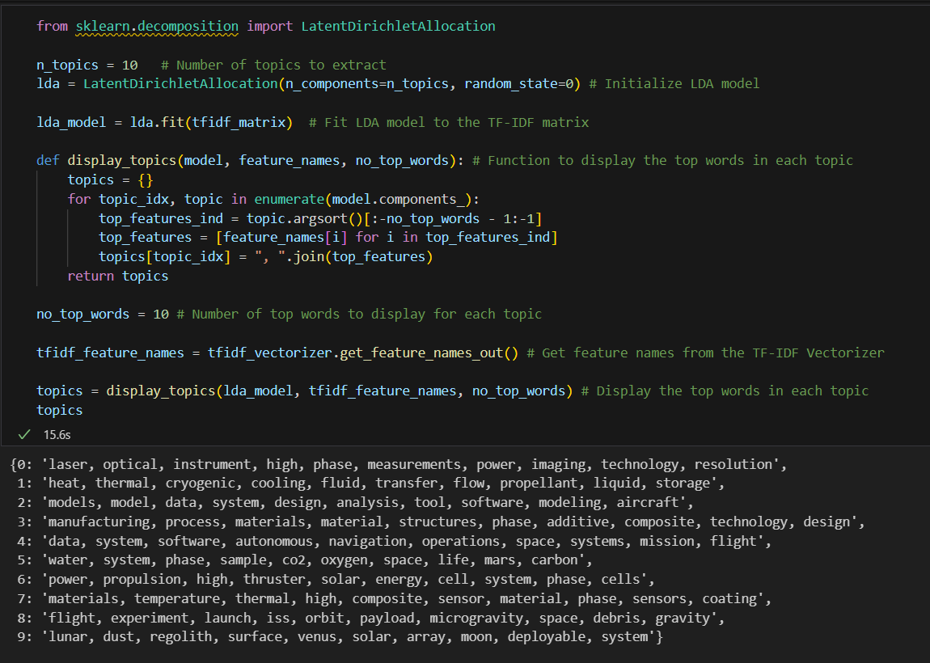
Key Topics and Their Significance
Topic 0: 'laser, optical, instrument' - Focus on precision instruments.
Topic 4: 'data, system, software' - Emphasis on software and data systems.
Topic 9: 'lunar, dust, regolith' - Related to lunar exploration and surface studies.
Utility of Topic Modeling
Simplifies understanding of complex datasets.
Highlights focus areas in NASA’s R&D efforts.

Slide 27
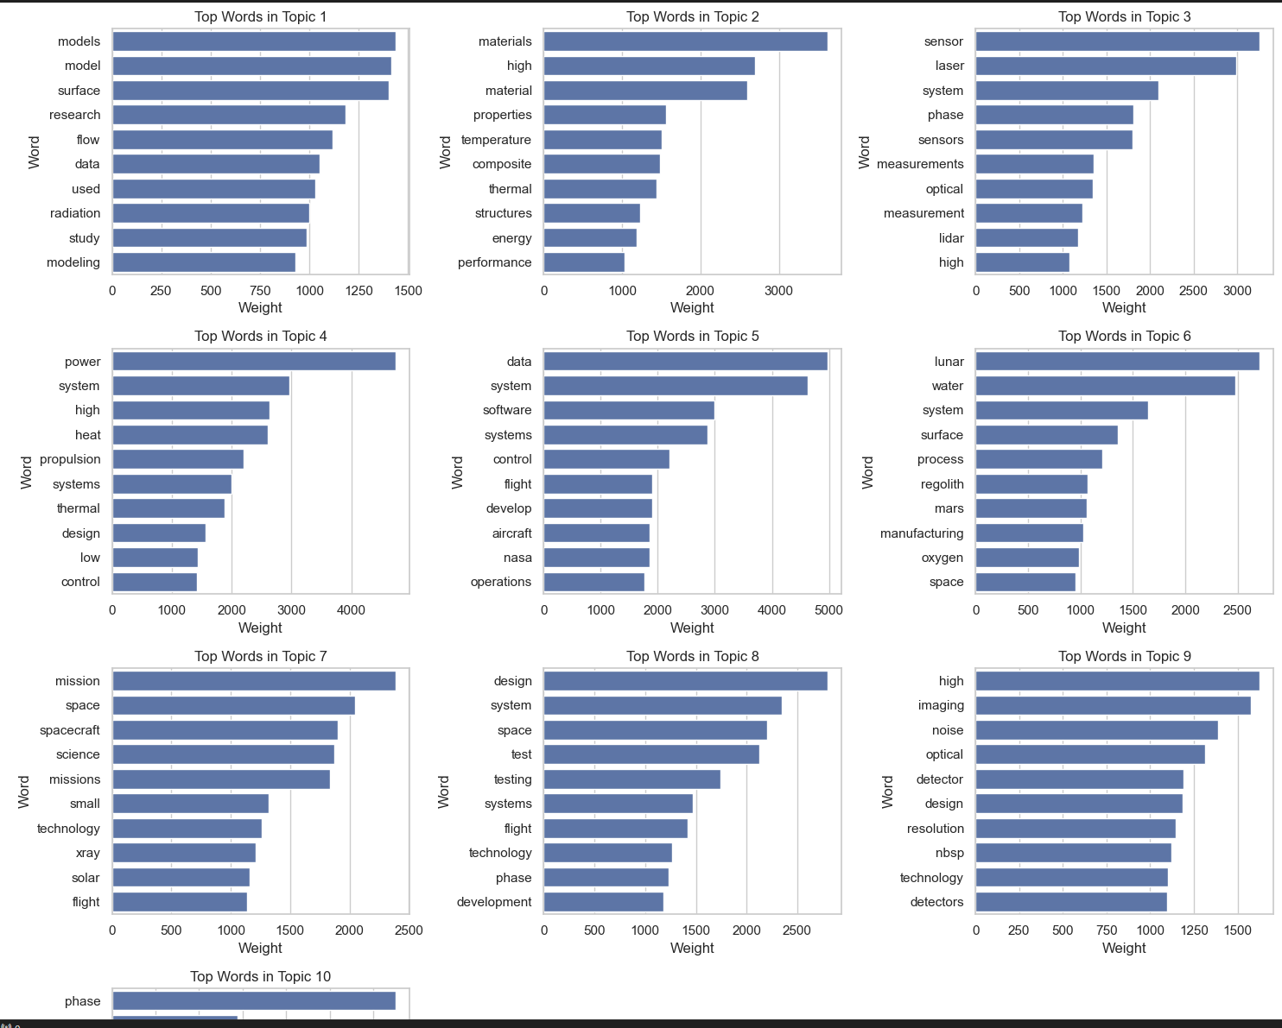
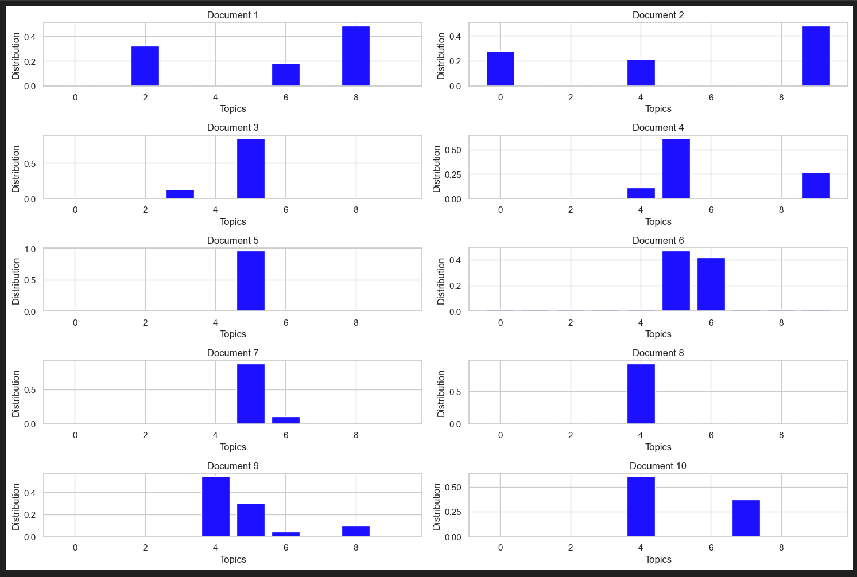

Slide 28
Model Training, Testing and Evaluation
Once our features are prepared, we proceed to the crucial steps of training and testing:
Data Splitting: The dataset is split into training and testing subsets, ensuring a 20% holdout for testing to validate the model performance accurately.
Model Training: A Multinomial Naive Bayes classifier is trained on the processed features. This model is suitable for classification tasks with discrete feature sets like ours.
Prediction: Using the trained model, we predict the taxonomies of the test set.
Classification Report: A detailed report including precision, recall, and F1-score for each category is generated, providing insights into the model's effectiveness.

Slide 29
Model 1- Naive Bayes Classifier
The Naive Bayes Classifier demonstrated promising performance in predicting the primary taxonomies of NASA projects. By analyzing the classification report, we can observe the model's strengths and areas for improvement.
The report provides valuable metrics such as precision, recall, and F1-score for each category, allowing us to identify which taxonomies the model excels at classifying and where further refinement might be necessary.

Slide 30
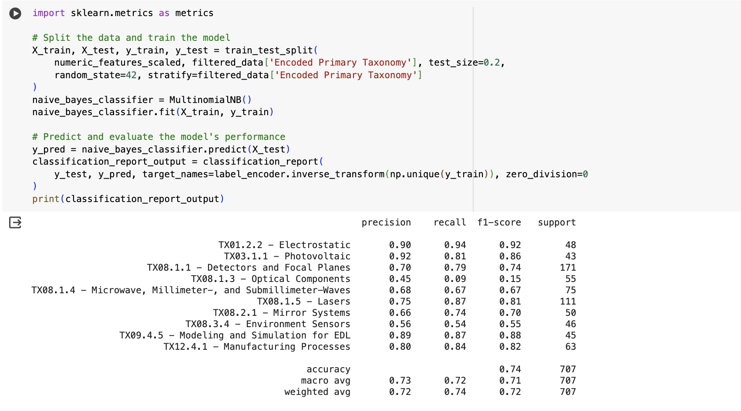

Slide 31
Model 2- SVM Classifier
The SVM classifier with a linear kernel was trained on the preprocessed and scaled feature set.
The trained SVM model was used to predict the taxonomies of the test set.
The classification report for the SVM model provides detailed metrics such as precision, recall, and F1-score for each category.
The classification report allows for a direct comparison of the performance between the Naive Bayes and SVM models.
By analyzing the classification reports for both models, we can identify which model performs better for different categories and explore potential areas for improvement.

Slide 32
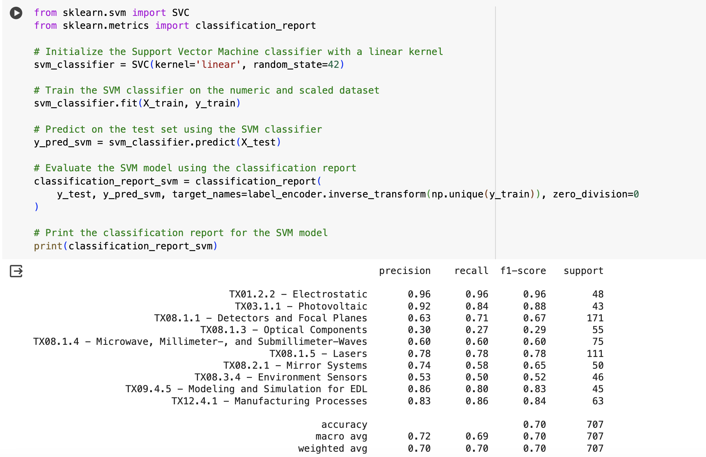

Slide 33
Model 3- Random Forest Classifier
The Random Forest classifier exhibited remarkable performance in classifying NASA project taxonomies, achieving an overall accuracy of 73%. This impressive result underscores the model's ability to learn complex patterns and relationships within the data.
Upon closer examination of the classification report, we observe that the model excelled in identifying certain categories with high precision, recall, and F1-score. For instance, in the 'TX01.2.2 - Electrostatic' category, the model achieved a perfect score, correctly classifying all instances.

Slide 34
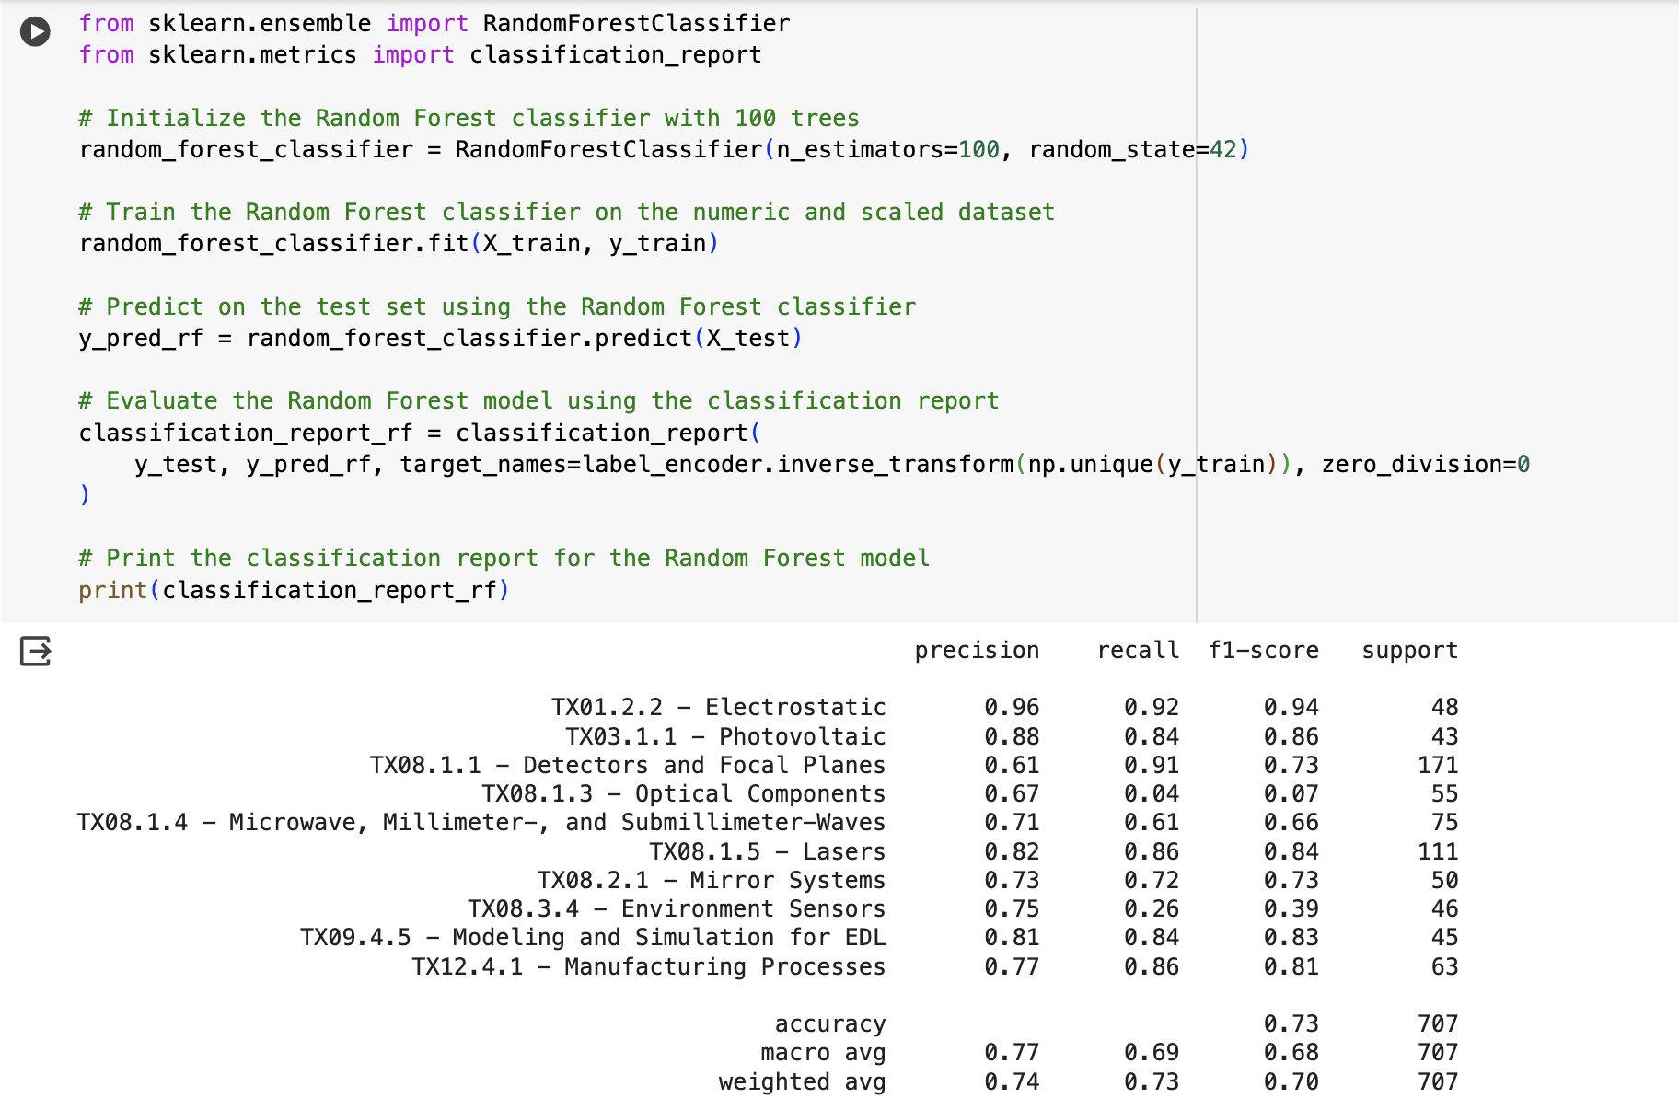

Slide 35
Ensemble Model for Taxonomy Classification
Ensemble modeling is a technique used to improve predictive accuracy and stability by combining the predictions of multiple individual classifiers.
Approach:
We implemented an ensemble approach using majority voting, which combines predictions from three distinct models:
Support Vector Machine (SVM): Effective in high-dimensional spaces.
Random Forest: Constructs multiple decision trees at training time.
Naive Bayes: A simple probabilistic classifier based on Bayes' theorem.

Slide 36
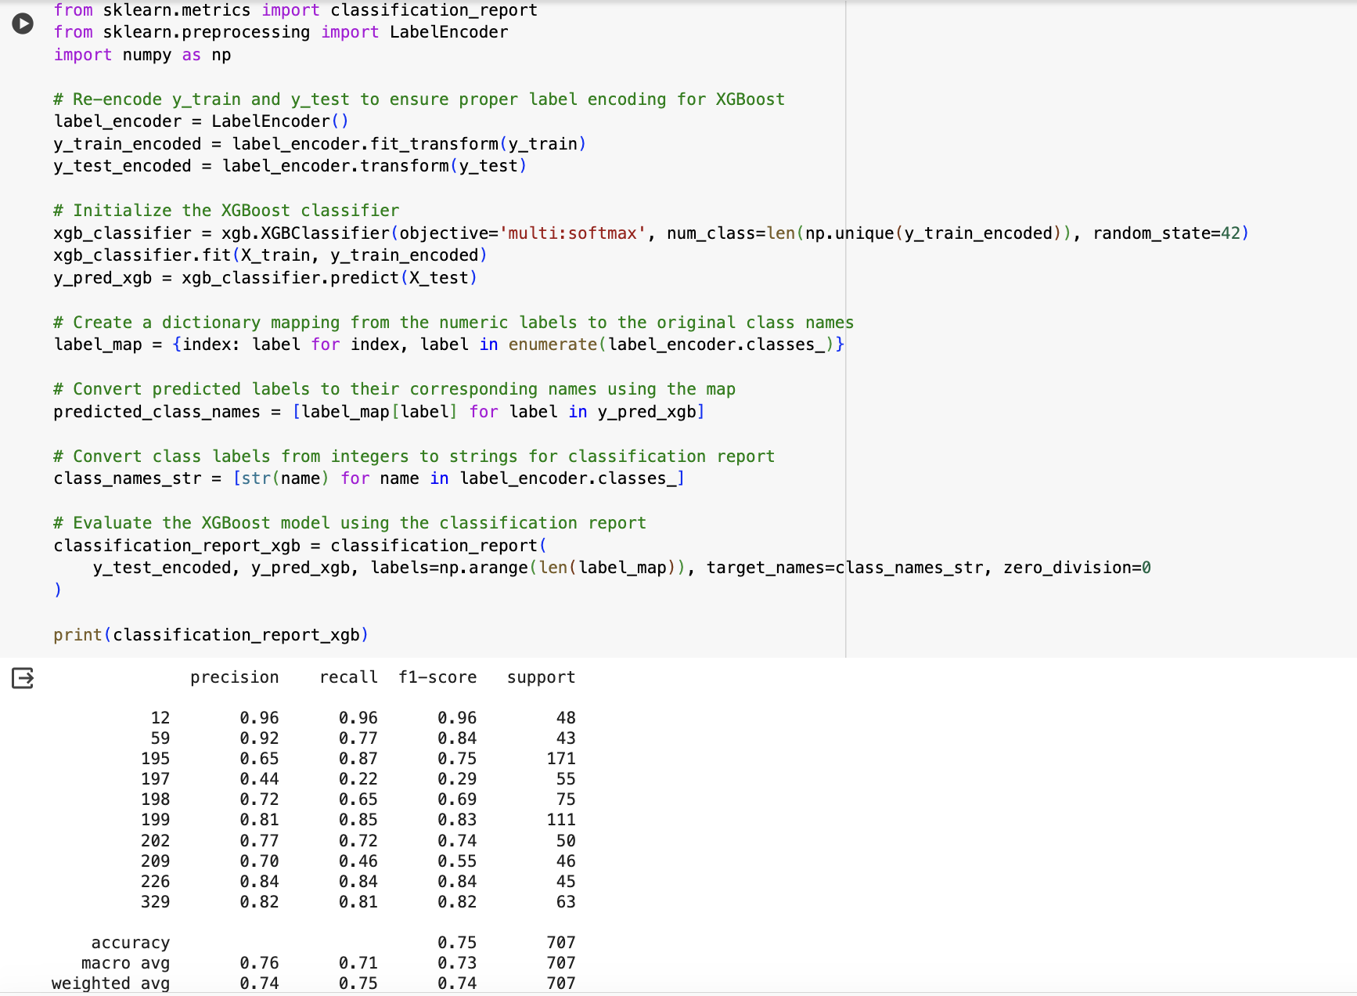

Slide 37
Model 4- XGBoost Classifier
Label Encoding: Ensuring proper encoding of training and testing labels (y_train and y_test) to fit XGBoost model requirements, necessitating numerical input for labels.
Model Initialization: Initializing the XGBoost classifier with the multi:softmax objective, suitable for multi-class classification tasks, and specifying the number of classes derived from the encoded labels.
Model Training: Training the classifier on the preprocessed numeric and scaled dataset, utilizing all available computational resources to expedite training.
Prediction: Utilizing the trained model to predict the classes of the test dataset, aiming to evaluate its generalization capabilities.
Evaluation: Assessing the model's performance using a classification report, providing detailed insights into precision, recall, and F1-score for each class based on the model's predictions.

Slide 38
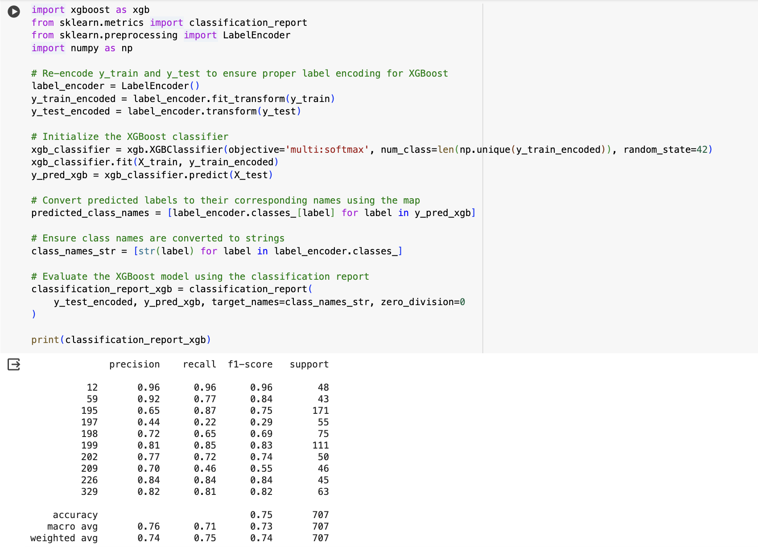

Slide 39
XGBoost Model Performance Evaluation
The classification report generated by evaluating the XGBoost model provides detailed metrics that help us understand its performance across various classes:
Precision and Recall: These metrics are crucial to gauge how well the model can identify each class, indicating the model's accuracy and its ability to handle imbalanced data.
F1-Score: Given as the harmonic mean of precision and recall, the F1-score offers a single metric that balances both recall and precision, useful for comparing model performance across different classes.
Support: The number of actual occurrences of each class in the dataset, which helps in understanding the class distribution's impact on the model's metrics.
Overall Performance: The overall accuracy and weighted averages for the metrics tell us how well the model performs across all classes, providing a holistic view of its effectiveness.

Slide 40
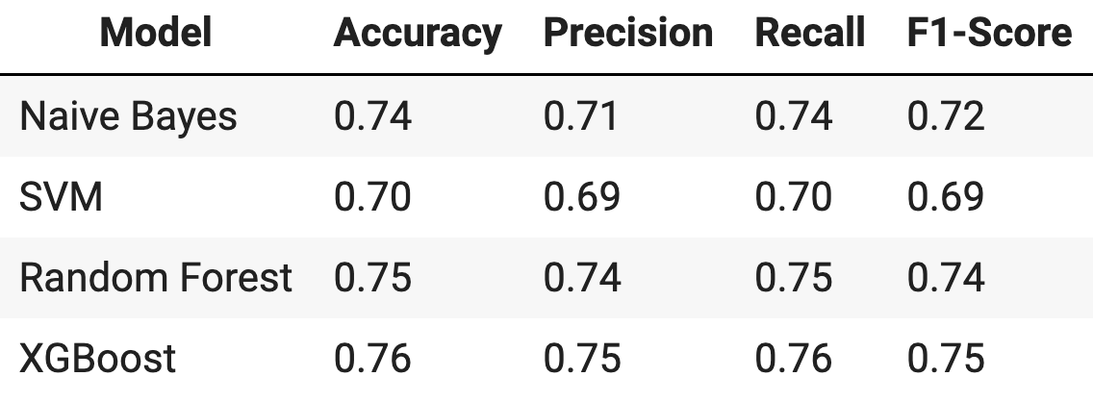
Model Comparison and Final Selection

Slide 41
Future Work
While the project achieved notable successes, there are several areas for further development:
Data Collection: Expanding the dataset with more diverse project examples from other similar agencies could enhance the model's robustness and applicability.
Feature Engineering: Investigating more complex features, such as sentiment analysis or named entity recognition, could provide deeper insights into the data.
Model Exploration: Testing newer or more complex models, such as deep learning approaches, might uncover patterns missed by traditional machine learning techniques.
Real-Time Analysis: Developing a real-time predictive system that could help NASA monitor ongoing projects and adjust their strategies promptly based on model predictions.

Slide 42
Conclusion
This project applied various machine learning models to analyze and classify NASA's technology projects, aiming to identify and predict key technological trends. Through rigorous data preparation, exploratory data analysis, and extensive model testing, the XGBoost model demonstrated superior performance in terms of accuracy and F1-score, supported by ensemble techniques that further enhanced predictive capabilities.
The analysis has provided valuable insights into the predominant themes and emerging trends within NASA's projects, offering a data-driven foundation for strategic decision-making and resource allocation.

Slide 43
References
Dataset- https://data.nasa.gov/Aerospace/NASA-TechPort/bq5k-hbdz/about_data
NASA Projects- https://techport.nasa.gov/home
Scikit-Learn- https://scikit-learn.org/stable/user_guide.html
XGBoost- https://xgboost.readthedocs.io/en/latest/
MatPlotLib- https://matplotlib.org/stable/users/index.html
Seaborn- https://seaborn.pydata.org/
Pandas- https://pandas.pydata.org/pandas-docs/stable/index.html
https://www.python.org/doc/
Github link: https://github.com/anuzz999/Analyzing-NASA-s-Technology-Projects

