Slide 1
Using machine learning to help inform diagnosis of diabetes
By Vithia An

Slide 2
Use these tools
JDBC driver manager to connect to MySQL database , Eclipse IDE to develop in Java, Swing components to make Graphic User Interface (GUI)
The algorithms - Borrow source code from Weka library.
Support vector machine
Neural network
Decision tree

Slide 3
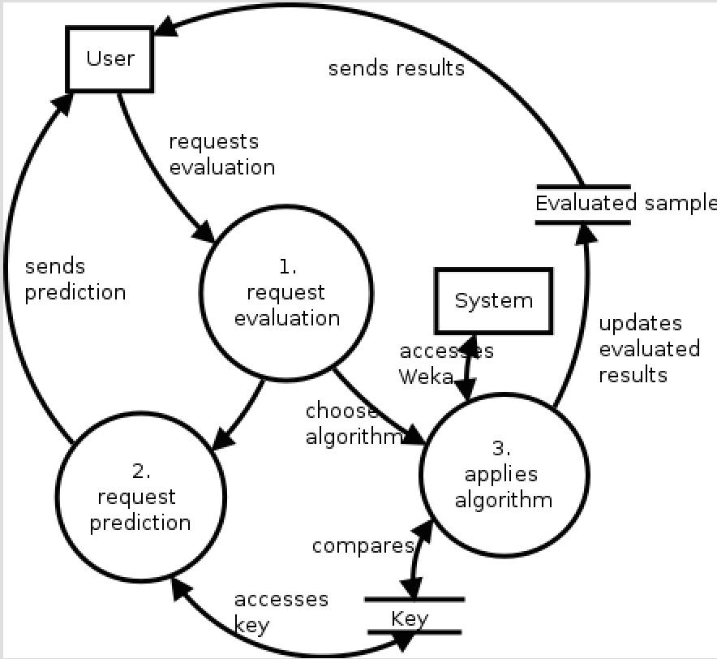
Data flow

Slide 4
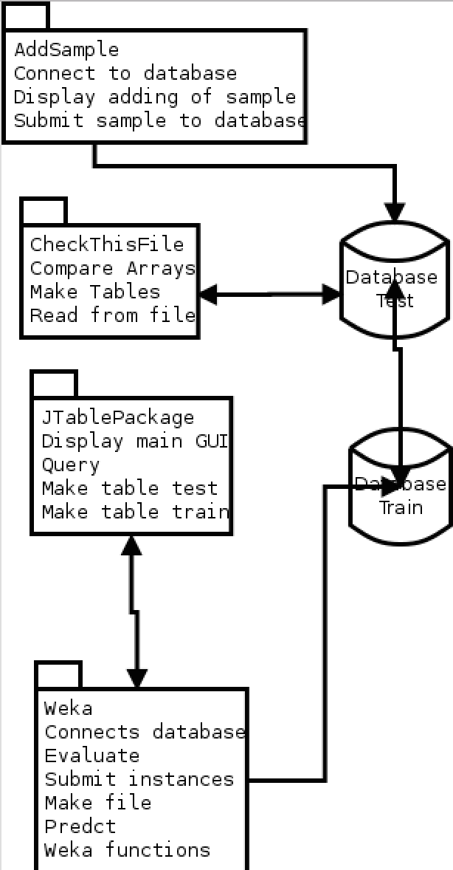
UML – High level

Slide 5
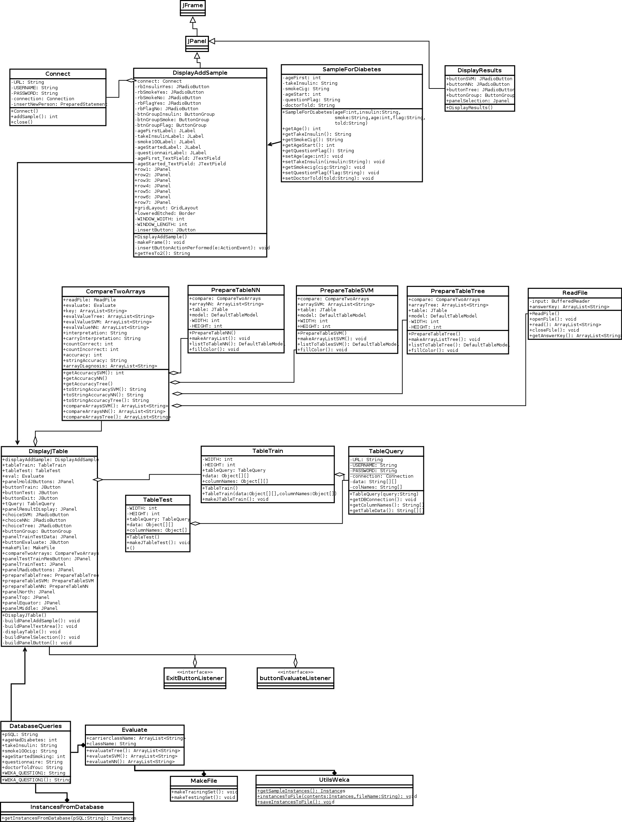
UML – low level

Slide 6
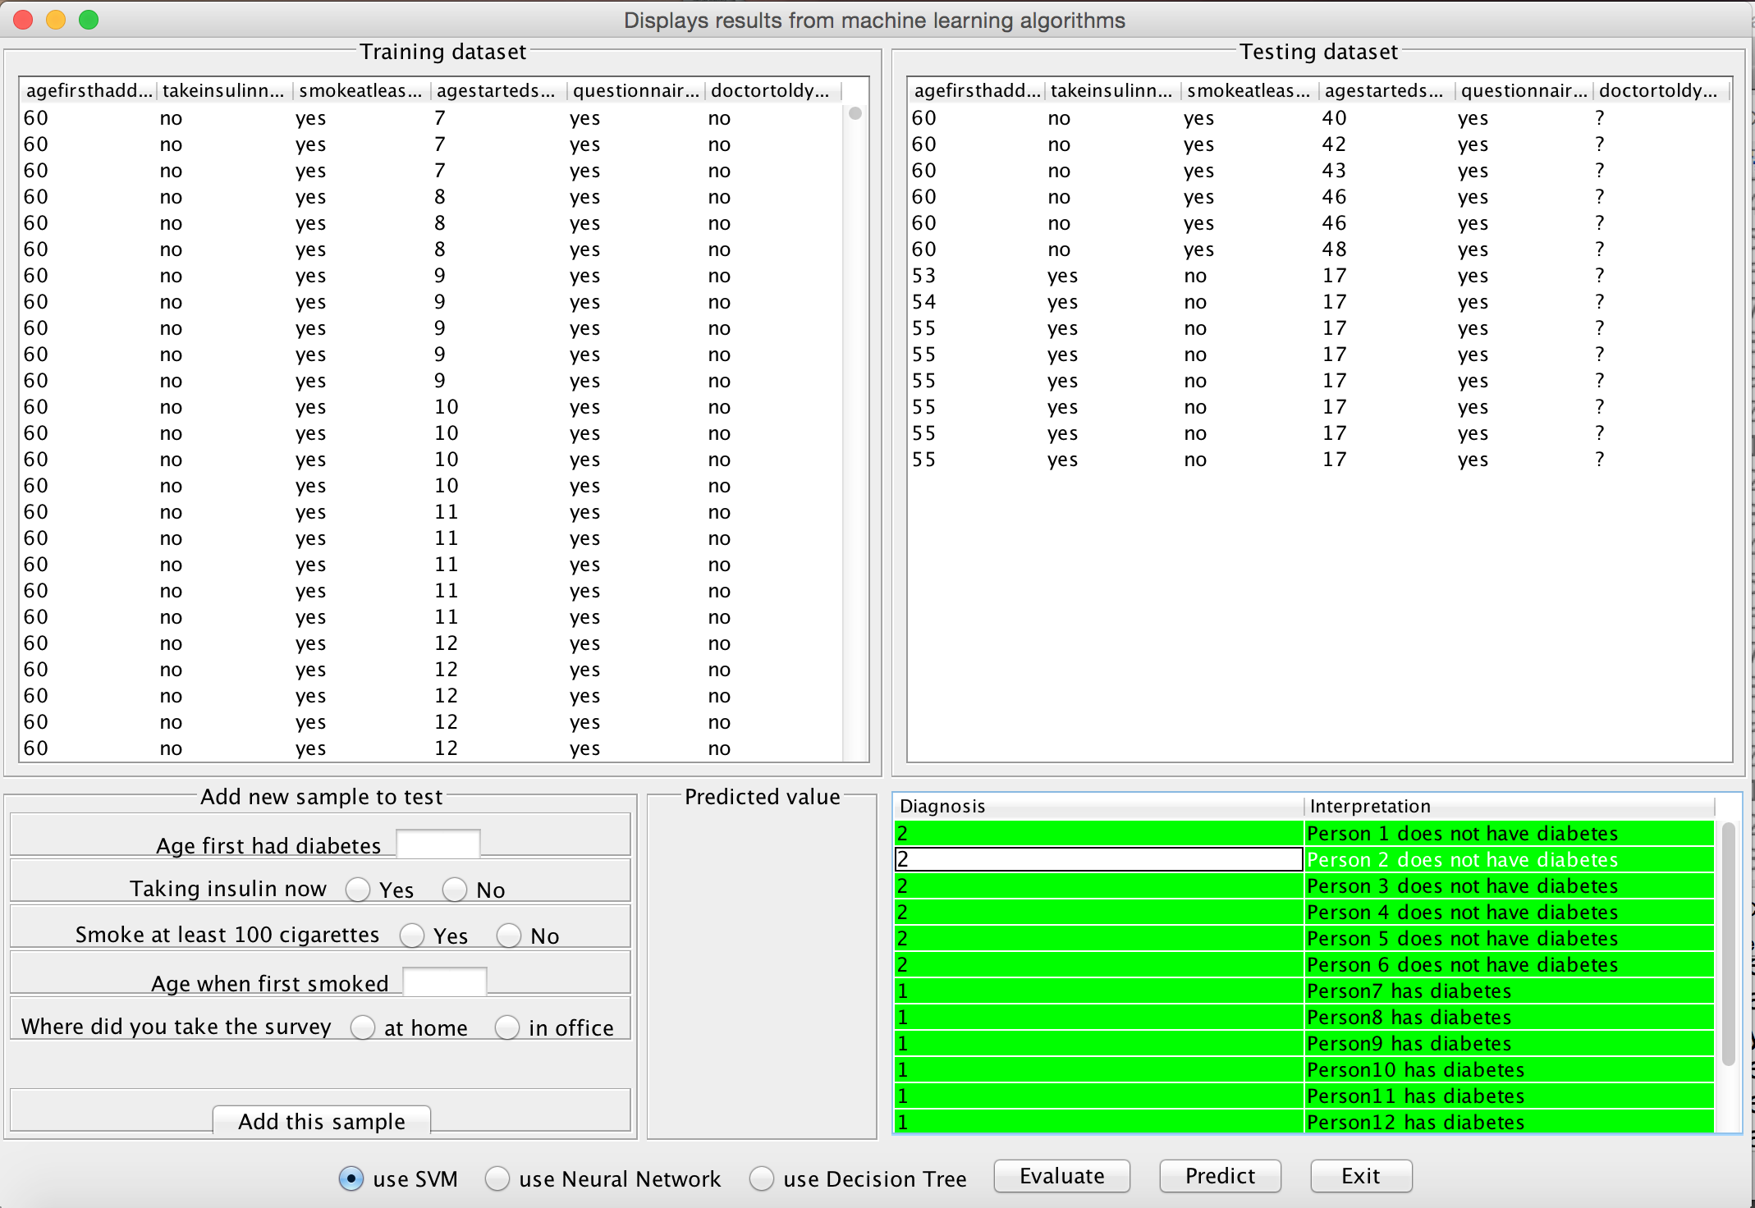
GUI
Tested negative
Class name
indicated
numerically
Tested positive

Slide 7
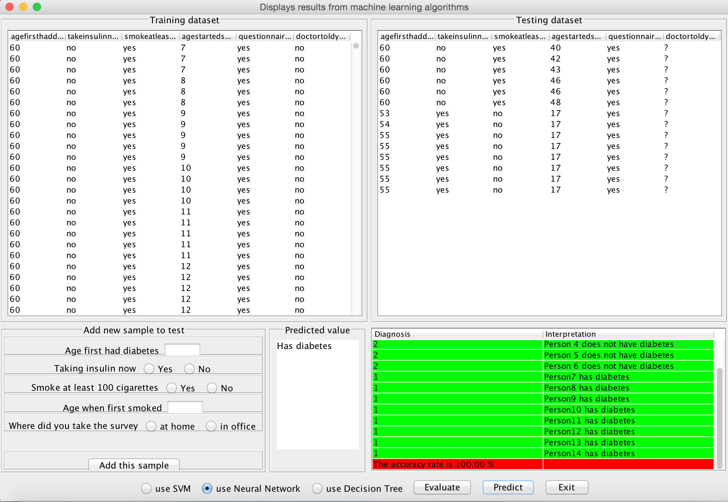
GUI
Accuracy is given

Slide 8
GUI
Testing
Dataset
Retrieved
From database
Training
Dataset
Retrieved
From database
Tested negative
Class name
indicated
numerically
Tested positive

Slide 9
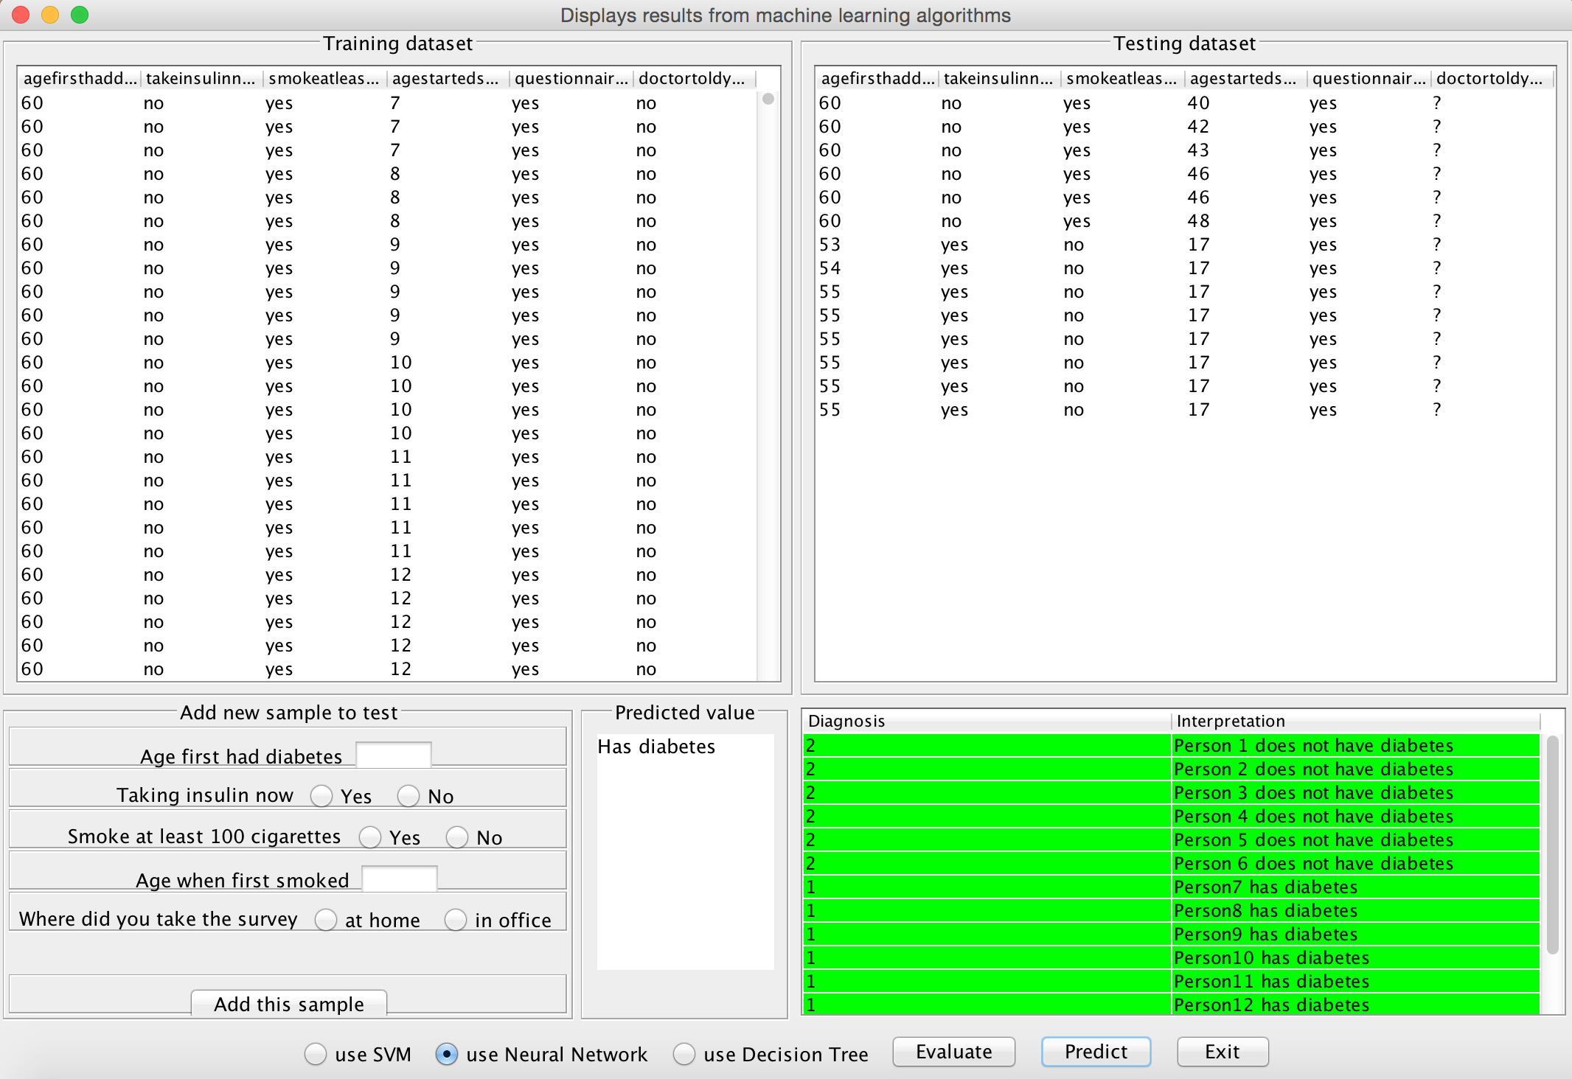
GUI
New Sample
Could be added
Prediction
Is made

Slide 10
Thank you

