Slide 1
15-744: Computer Networking
L-4 TCP

Slide 2
TCP Basics
TCP reliability
Congestion control basics
TCP congestion control
Assigned reading
  [JK88] Congestion Avoidance and Control
  [CJ89] Analysis of the Increase and Decrease Algorithms for Congestion Avoidance in Computer Networks
  [FF96] Simulation-based Comparisons of Tahoe, Reno, and SACK TCP
  [FHPW00] Equation-Based Congestion Control for Unicast Applications

Slide 3
Key Things You Should Know Already
Port numbers
TCP/UDP checksum
Sliding window flow control
  Sequence numbers
TCP connection setup

Slide 4
Overview
TCP reliability: timer-driven
TCP reliability: data-driven
Congestion sources and collapse
Congestion control basics
TCP congestion control
TCP modeling

Slide 5
Introduction to TCP
Communication abstraction:
  Reliable
  Ordered
  Point-to-point
  Byte-stream
  Full duplex
  Flow and congestion controlled
Protocol implemented entirely at the ends
  Fate sharing
Sliding window with cumulative acks
  Ack field contains last in-order packet received
  Duplicate acks sent when out-of-order packet received

Slide 6
Evolution of TCP
1975
Three-way handshake
Raymond Tomlinson
In SIGCOMM 75
1984
Nagel’s algorithm
to reduce overhead
of small packets;
predicts congestion collapse
1987
Karn’s algorithm
to better estimate round-trip time
1990
4.3BSD Reno
fast retransmit
delayed ACK’s
1983
BSD Unix 4.2
supports TCP/IP
1986
Congestion collapse
observed
1988
Van Jacobson’s algorithms
congestion avoidance and congestion control
(most implemented in 4.3BSD Tahoe)
1974
TCP described by
Vint Cerf and Bob Kahn
In IEEE Trans Comm
1982
TCP & IP
RFC 793 & 791
1975
1980
1985
1990

Slide 7
TCP Through the 1990s
1994
T/TCP
(Braden)
Transaction
TCP
1996
SACK TCP
(Floyd et al)
Selective Acknowledgement
1993
TCP Vegas
(Brakmo et al)
real congestion avoidance
1994
ECN
(Floyd)
Explicit
Congestion
Notification
1996
Hoe
Improving TCP startup
1996
FACK TCP
(Mathis et al)
extension to SACK
1993
1994
1996

Slide 8
What’s Different From Link Layers?
Logical link vs. physical link
  Must establish connection
Variable RTT
  May vary within a connection
Reordering
  How long can packets live → max segment lifetime
Can’t expect endpoints to exactly match link
  Buffer space availability
Transmission rate
  Don’t directly know transmission rate

Slide 9
Timeout-based Recovery
Wait at least one RTT before retransmitting
Importance of accurate RTT estimators:
  Low RTT → unneeded retransmissions
  High RTT → poor throughput
RTT estimator must adapt to change in RTT
  But not too fast, or too slow!
Spurious timeouts
  “Conservation of packets” principle – more than a window worth of packets in flight

Slide 10
Initial Round-trip Estimator
Round trip times exponentially averaged:
  New RTT = α (old RTT) + (1 - α) (new sample)
  Recommended value for α: 0.8 - 0.9
    0.875 for most TCP’s
Retransmit timer set to β RTT, where β = 2
  Every time timer expires, RTO exponentially backed-off
  Like Ethernet
Not good at preventing spurious timeouts

Slide 11
Jacobson’s Retransmission Timeout
Key observation:
  At high loads round trip variance is high
Solution:
  Base RTO on RTT and standard deviation or RRTT
  rttvar =  * dev + (1- )rttvar
    dev = linear deviation
    Inappropriately named – actually smoothed linear deviation

Slide 12
Retransmission Ambiguity
A
B
A
B
Original transmission
Original transmission
X
RTO
RTO
ACK
Sample
RTT
Sample
RTT
retransmission
retransmission
ACK

Slide 13
Karn’s RTT Estimator
Accounts for retransmission ambiguity
If a segment has been retransmitted:
  Don’t count RTT sample on ACKs for this segment
  Keep backed off time-out for next packet
  Reuse RTT estimate only after one successful transmission

Slide 14
Timestamp Extension
Used to improve timeout mechanism by more accurate measurement of RTT
When sending a packet, insert current timestamp into option
  4 bytes for seconds, 4 bytes for microseconds
Receiver echoes timestamp in ACK
  Actually will echo whatever is in timestamp
Removes retransmission ambiguity
  Can get RTT sample on any packet

Slide 15
Timer Granularity
Many TCP implementations set RTO in multiples of 200,500,1000ms
Why?
  Avoid spurious timeouts – RTTs can vary quickly due to cross traffic
  Make timers interrupts efficient

Slide 16
Delayed ACKS
Problem:
  In request/response programs, you send separate ACK and Data packets for each transaction
Solution:
  Don’t ACK data immediately
  Wait 200ms (must be less than 500ms – why?)
  Must ACK every other packet
  Must not delay duplicate ACKs

Slide 17
Overview
TCP reliability: timer-driven
TCP reliability: data-driven
Congestion sources and collapse
Congestion control basics
TCP congestion control
TCP modeling

Slide 18
TCP Flavors
Tahoe, Reno, Vegas → differ in data-driven reliability
TCP Tahoe (distributed with 4.3BSD Unix)
  Original implementation of Van Jacobson’s mechanisms (VJ paper)
  Includes:
    Slow start
    Congestion avoidance
    Fast retransmit

Slide 19
Fast Retransmit
What are duplicate acks (dupacks)?
  Repeated acks for the same sequence
When can duplicate acks occur?
  Loss
  Packet re-ordering
  Window update – advertisement of new flow control window
Assume re-ordering is infrequent and not of large magnitude
  Use receipt of 3 or more duplicate acks as indication of loss
  Don’t wait for timeout to retransmit packet

Slide 20
Fast Retransmit
Retransmission
X
Duplicate Acks
Sequence No
Time

Slide 21
Multiple Losses
X
X
Now what?
X
Retransmission
X
Sequence No
Duplicate Acks
Time

Slide 22
Tahoe
X
X
X
X
Sequence No
Time

Slide 23
TCP Reno (1990)
All mechanisms in Tahoe
Addition of fast-recovery
  Opening up congestion window after fast retransmit
Delayed acks
Header prediction
  Implementation designed to improve performance
  Has common case code inlined
With multiple losses, Reno typically timeouts because it does not receive enough duplicate acknowledgements

Slide 24
Reno
X
X
X
Now what? → timeout
X
Sequence No
Time

Slide 25
NewReno
The ack that arrives after retransmission (partial ack) should indicate that a second loss occurred
When does NewReno timeout?
  When there are fewer than three dupacks for first loss
  When partial ack is lost
How fast does it recover losses?
  One per RTT

Slide 26
NewReno
X
X
X
Now what? → partial ack
recovery
X
Sequence No
Time

Slide 27
SACK
Basic problem is that cumulative acks provide little information
  Ack for just the packet received
    What if acks are lost? → carry cumulative also
    Not used
  Bitmask of packets received
    Selective acknowledgement (SACK)
How to deal with reordering

Slide 28
SACK
X
X
X
Now what? – send
retransmissions as soon
as detected
X
Sequence No
Time

Slide 29
Performance Issues
Timeout >> fast rexmit
  Need 3 dupacks/sacks
  Not great for small transfers
    Don’t have 3 packets outstanding
  What are real loss patterns like?

Slide 30
Overview
TCP reliability: timer-driven
TCP reliability: data-driven
Congestion sources and collapse
Congestion control basics
TCP congestion control
TCP modeling

Slide 31
Congestion
10 Mbps
1.5 Mbps
100 Mbps
Different sources compete for resources inside network
Why is it a problem?
  Sources are unaware of current state of resource
  Sources are unaware of each other
  In many situations will result in < 1.5 Mbps of throughput (congestion collapse)

Slide 32
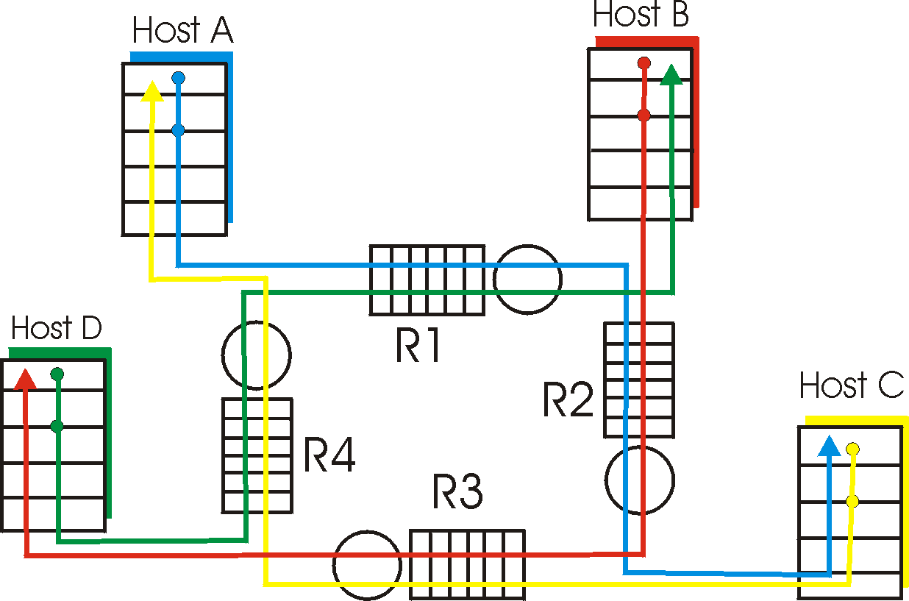
Causes & Costs of Congestion
Four senders – multihop paths
Timeout/retransmit
Q: What happens as rate increases?

Slide 33

Causes & Costs of Congestion
When packet dropped, any “upstream transmission capacity used for that packet was wasted!

Slide 34
Congestion Collapse
Definition: Increase in network load results in decrease of useful work done
Many possible causes
  Spurious retransmissions of packets still in flight
    Classical congestion collapse
    How can this happen with packet conservation
    Solution: better timers and TCP congestion control
  Undelivered packets
    Packets consume resources and are dropped elsewhere in network
    Solution: congestion control for ALL traffic

Slide 35
Other Congestion Collapse Causes
Fragments
  Mismatch of transmission and retransmission units
  Solutions
    Make network drop all fragments of a packet (early packet discard in ATM)
    Do path MTU discovery
Control traffic
  Large percentage of traffic is for control
    Headers, routing messages, DNS, etc.
Stale or unwanted packets
  Packets that are delayed on long queues
  “Push” data that is never used

Slide 36
Where to Prevent Collapse?
Can end hosts prevent problem?
  Yes, but must trust end hosts to do right thing
  E.g., sending host must adjust amount of data it puts in the network based on detected congestion
Can routers prevent collapse?
  No, not all forms of collapse
  Doesn’t mean they can’t help
  Sending accurate congestion signals
  Isolating well-behaved from ill-behaved sources

Slide 37
Congestion Control and Avoidance
A mechanism which:
  Uses network resources efficiently
  Preserves fair network resource allocation
  Prevents or avoids collapse
Congestion collapse is not just a theory
  Has been frequently observed in many networks

Slide 38
Overview
TCP reliability: timer-driven
TCP reliability: data-driven
Congestion sources and collapse
Congestion control basics
TCP congestion control
TCP modeling

Slide 39
Objectives
Simple router behavior
Distributedness
Efficiency: X_{knee} = Σx_{i}(t)
Fairness: (Σx_{i})²/n(Σx_{i}²)
Power: (throughput^{α}/delay)
Convergence: control system must be stable

Slide 40
Basic Control Model
Let’s assume window-based control
Reduce window when congestion is perceived
  How is congestion signaled?
    Either mark or drop packets
  When is a router congested?
    Drop tail queues – when queue is full
    Average queue length – at some threshold
Increase window otherwise
  Probe for available bandwidth – how?

Slide 41
Linear Control
Many different possibilities for reaction to congestion and probing
  Examine simple linear controls
  Window(t + 1) = a + b Window(t)
  Different a_{i}/b_{i} for increase and a_{d}/b_{d} for decrease
Supports various reaction to signals
  Increase/decrease additively
  Increased/decrease multiplicatively
  Which of the four combinations is optimal?

Slide 42
Phase plots
Simple way to visualize behavior of competing connections over time
Fairness Line
User 2’s Allocation x₂
Efficiency Line
User 1’s Allocation x₁

Slide 43
Phase plots
What are desirable properties?
What if flows are not equal?
Fairness Line
Overload
User 2’s Allocation x₂
Optimal point
Underutilization
Efficiency Line
User 1’s Allocation x₁

Slide 44
Additive Increase/Decrease
Both X₁ and X₂ increase/decrease by the same amount over time
  Additive increase improves fairness and additive decrease reduces fairness
Fairness Line
T₁
User 2’s Allocation x₂
T₀
Efficiency Line
User 1’s Allocation x₁

Slide 45
Multiplicative Increase/Decrease
Both X₁ and X₂ increase by the same factor over time
  Extension from origin – constant fairness
Fairness Line
T₁
User 2’s Allocation x₂
T₀
Efficiency Line
User 1’s Allocation x₁

Slide 46
Convergence to Efficiency
Fairness Line
x^{H}
User 2’s Allocation x₂
Efficiency Line
User 1’s Allocation x₁

Slide 47
Distributed Convergence to Efficiency
a=0
b=1
Fairness Line
x^{H}
User 2’s Allocation x₂
Efficiency Line
User 1’s Allocation x₁

Slide 48
Convergence to Fairness
Fairness Line
x^{H}
User 2’s Allocation x₂
x^{H’}
Efficiency Line
User 1’s Allocation x₁

Slide 49
Convergence to Efficiency & Fairness
Fairness Line
x^{H}
User 2’s Allocation x₂
x^{H’}
Efficiency Line
User 1’s Allocation x₁

Slide 50
Increase
Fairness Line
User 2’s Allocation x₂
x^{L}
Efficiency Line
User 1’s Allocation x₁

Slide 51
Constraints
Distributed efficiency
  I.e.,  Window(t+1) >  Window(t) during increase
    a_{i} > 0 & b_{i} ≥ 1
    Similarly, a_{d} < 0 & b_{d} ≤ 1
Must never decrease fairness
  a & b’s must be ≥ 0
  a_{i}/b_{i} > 0 and a_{d}/b_{d} ≥ 0
Full constraints
  a_{d} = 0, 0 ≤ b_{d} < 1, a_{i} > 0 and b_{i} ≥ 1

Slide 52
What is the Right Choice?
Constraints limit us to AIMD
  Can have multiplicative term in increase (MAIMD)
  AIMD moves towards optimal point
x₁
Fairness Line
x₀
User 2’s Allocation x₂
x₂
Efficiency Line
User 1’s Allocation x₁

Slide 53
Overview
TCP reliability: timer-driven
TCP reliability: data-driven
Congestion sources and collapse
Congestion control basics
TCP congestion control
TCP modeling

Slide 54
TCP Congestion Control
Motivated by ARPANET congestion collapse
Underlying design principle: packet conservation
  At equilibrium, inject packet into network only when one is removed
  Basis for stability of physical systems
Why was this not working?
  Connection doesn’t reach equilibrium
  Spurious retransmissions
  Resource limitations prevent equilibrium

Slide 55
TCP Congestion Control - Solutions
Reaching equilibrium
  Slow start
Eliminates spurious retransmissions
  Accurate RTO estimation
  Fast retransmit
Adapting to resource availability
  Congestion avoidance

Slide 56
TCP Congestion Control
Changes to TCP motivated by ARPANET congestion collapse
Basic principles
  AIMD
  Packet conservation
  Reaching steady state quickly
  ACK clocking

Slide 57
AIMD
Distributed, fair and efficient
Packet loss is seen as sign of congestion and results in a multiplicative rate decrease
  Factor of 2
TCP periodically probes for available bandwidth by increasing its rate
Rate
Time

Slide 58
Implementation Issue
Operating system timers are very coarse – how to pace packets out smoothly?
Implemented using a congestion window that limits how much data can be in the network.
  TCP also keeps track of how much data is in transit
Data can only be sent when the amount of outstanding data is less than the congestion window.
  The amount of outstanding data is increased on a “send” and decreased on “ack”
  (last sent – last acked) < congestion window
Window limited by both congestion and buffering
  Sender’s maximum window = Min (advertised window, cwnd)

Slide 59
Congestion Avoidance
If loss occurs when cwnd = W
  Network can handle 0.5W ~ W segments
  Set cwnd to 0.5W (multiplicative decrease)
Upon receiving ACK
  Increase cwnd by (1 packet)/cwnd
    What is 1 packet? → 1 MSS worth of bytes
    After cwnd packets have passed by → approximately increase of 1 MSS
Implements AIMD

Slide 60
Congestion Avoidance Sequence Plot
Sequence No
Packets
Acks
Time

Slide 61
Congestion Avoidance Behavior
Congestion
Window
Time
Packet loss
+ Timeout
Cut
Congestion
Window
and Rate
Grabbing
back
Bandwidth

Slide 62
Packet Conservation
At equilibrium, inject packet into network only when one is removed
  Sliding window and not rate controlled
  But still need to avoid sending burst of packets → would overflow links
    Need to carefully pace out packets
    Helps provide stability
Need to eliminate spurious retransmissions
  Accurate RTO estimation
  Better loss recovery techniques (e.g. fast retransmit)

Slide 63
TCP Packet Pacing
Congestion window helps to “pace” the transmission of data packets
In steady state, a packet is sent when an ack is received
  Data transmission remains smooth, once it is smooth
  Self-clocking behavior
P_{b}
P_{r}
Sender
Receiver
A_{s}
A_{r}
A_{b}

Slide 64
Reaching Steady State
Doing AIMD is fine in steady state but slow…
How does TCP know what is a good initial rate to start with?
  Should work both for a CDPD (10s of Kbps or less) and for supercomputer links (10 Gbps and growing)
Quick initial phase to help get up to speed (slow start)

Slide 65
Slow Start Packet Pacing
How do we get this clocking behavior to start?
  Initialize cwnd = 1
  Upon receipt of every ack, cwnd = cwnd + 1
Implications
  Window actually increases to W in RTT * log₂(W)
  Can overshoot window and cause packet loss

Slide 66
Slow Start Example
One RTT
0R
1
One pkt time
1R
1
2
3
2R
2
3
4
6
5
7
3R
4
5
6
7
8
10
12
14
9
11
13
15

Slide 67
Slow Start Sequence Plot
.
.
.
Sequence No
Packets
Acks
Time

Slide 68
Return to Slow Start
If packet is lost we lose our self clocking as well
  Need to implement slow-start and congestion avoidance together
When timeout occurs set ssthresh to 0.5w
  If cwnd < ssthresh, use slow start
  Else use congestion avoidance

Slide 69
TCP Saw Tooth Behavior
Congestion
Window
Timeouts
may still
occur
Slowstart
to pace
packets
Time
Initial
Slowstart
Fast
Retransmit
and Recovery

Slide 70
How to Change Window
When a loss occurs have W packets outstanding
New cwnd = 0.5 * cwnd
  How to get to new state?

Slide 71
Fast Recovery
Each duplicate ack notifies sender that single packet has cleared network
When < cwnd packets are outstanding
  Allow new packets out with each new duplicate acknowledgement
Behavior
  Sender is idle for some time – waiting for ½ cwnd worth of dupacks
  Transmits at original rate after wait
    Ack clocking rate is same as before loss

Slide 72
Fast Recovery
Sent for each dupack after
W/2 dupacks arrive
Sequence No
X
Time

Slide 73
NewReno Changes
Send a new packet out for each pair of dupacks
  Adapt more gradually to new window
Will not halve congestion window again until recovery is completed
  Identifies congestion events vs. congestion signals
Initial estimation for ssthresh

Slide 74
Rate Halving Recovery
Sent after every
other dupack
Sequence No
X
Time

Slide 75
Delayed Ack Impact
TCP congestion control triggered by acks
  If receive half as many acks → window grows half as fast
Slow start with window = 1
  Will trigger delayed ack timer
  First exchange will take at least 200ms
  Start with > 1 initial window
    Bug in BSD, now a “feature”/standard

Slide 76
Overview
TCP reliability: timer-driven
TCP reliability: data-driven
Congestion sources and collapse
Congestion control basics
TCP congestion control
TCP modeling

Slide 77
TCP Modeling
Given the congestion behavior of TCP can we predict what type of performance we should get?
What are the important factors
  Loss rate
    Affects how often window is reduced
  RTT
    Affects increase rate and relates BW to window
  RTO
    Affects performance during loss recovery
  MSS
    Affects increase rate

Slide 78
Overall TCP Behavior
Let’s concentrate on steady state behavior with no timeouts and perfect loss recovery
Window
Time

Slide 79
Simple TCP Model
Some additional assumptions
  Fixed RTT
  No delayed ACKs
In steady state, TCP losses packet each time window reaches W packets
  Window drops to W/2 packets
  Each RTT window increases by 1 packet→W/2 * RTT before next loss
  BW = MSS * avg window/RTT = MSS * (W + W/2)/(2 * RTT) = .75 * MSS * W / RTT

Slide 80
Simple Loss Model
What was the loss rate?
  Packets transferred = (.75 W/RTT) * (W/2 * RTT) = 3W²/8
  1 packet lost → loss rate = p = 8/3W²
  W = sqrt( 8 / (3 * loss rate))
BW = .75 * MSS * W / RTT
  BW = MSS / (RTT * sqrt (2/3p))

Slide 81
TCP Friendliness
What does it mean to be TCP friendly?
  TCP is not going away
  Any new congestion control must compete with TCP flows
    Should not clobber TCP flows and grab bulk of link
    Should also be able to hold its own, i.e. grab its fair share, or it will never become popular
How is this quantified/shown?
  Has evolved into evaluating loss/throughput behavior
  If it shows 1/sqrt(p) behavior it is ok
  But is this really true?

Slide 82
TCP Performance
Can TCP saturate a link?
Congestion control
  Increase utilization until… link becomes congested
  React by decreasing window by 50%
  Window is proportional to rate * RTT
Doesn’t this mean that the network oscillates between 50 and 100% utilization?
  Average utilization = 75%??
  No…this is *not* right!

Slide 83

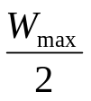
TCP Congestion Control
Rule for adjusting W
  If an ACK is received: W ← W+1/W
  If a packet is lost: W ← W/2
Only W packets
may be outstanding
Source
Dest
Window size
t

Slide 84
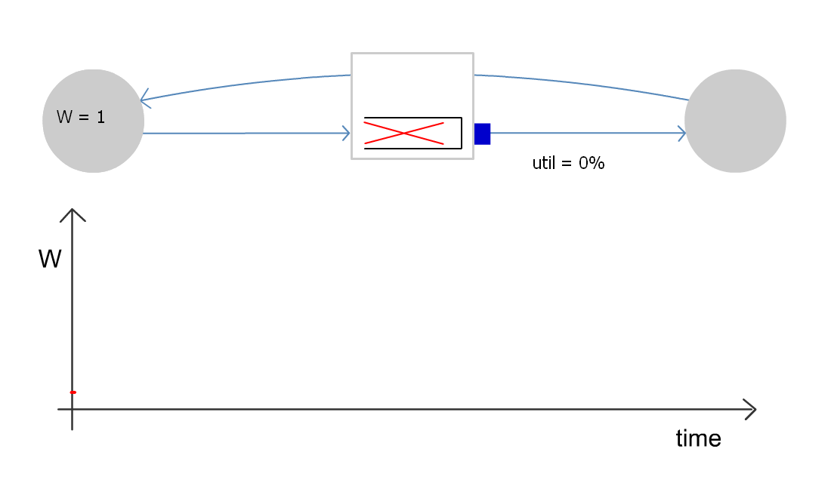
Single TCP Flow
Router without buffers

Slide 85
Summary Unbuffered Link
W
Minimum window for full utilization
t
The router can’t fully utilize the link
  If the window is too small, link is not full
  If the link is full, next window increase causes drop
  With no buffer it still achieves 75% utilization

Slide 86
TCP Performance
In the real world, router queues play important role
  Window is proportional to rate * RTT
    But, RTT changes as well the window
  Window to fill links = propagation RTT * bottleneck bandwidth
    If window is larger, packets sit in queue on bottleneck link

Slide 87
TCP Performance
If we have a large router queue → can get 100% utilization
  But, router queues can cause large delays
How big does the queue need to be?
  Windows vary from W → W/2
    Must make sure that link is always full
    W/2 > RTT * BW
    W = RTT * BW + Qsize
    Therefore, Qsize > RTT * BW
  Ensures 100% utilization
  Delay?
    Varies between RTT and 2 * RTT

Slide 88
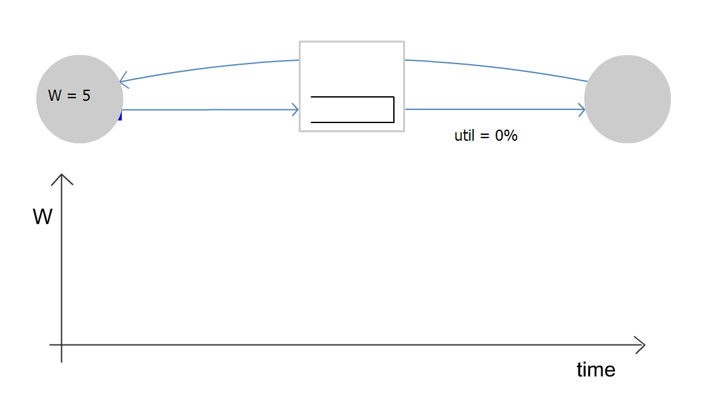
Single TCP Flow
Router with large enough buffers for full link utilization

Slide 89
Summary Buffered Link
W
Buffer
Minimum window for full utilization
t
With sufficient buffering we achieve full link utilization
  The window is always above the critical threshold
  Buffer absorbs changes in window size
    Buffer Size = Height of TCP Sawtooth
    Minimum buffer size needed is 2T*C
  This is the origin of the rule-of-thumb

Slide 90
Example
10Gb/s linecard
  Requires 300Mbytes of buffering.
  Read and write 40 byte packet every 32ns.
Memory technologies
  DRAM: require 4 devices, but too slow.
  SRAM: require 80 devices, 1kW, $2000.
Problem gets harder at 40Gb/s
  Hence RLDRAM, FCRAM, etc.

Slide 91
Rule-of-thumb
Rule-of-thumb makes sense for one flow
Typical backbone link has > 20,000 flows
Does the rule-of-thumb still hold?

Slide 92

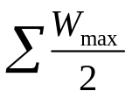

If flows are synchronized
t
Aggregate window has same dynamics
Therefore buffer occupancy has same dynamics
Rule-of-thumb still holds.

Slide 93

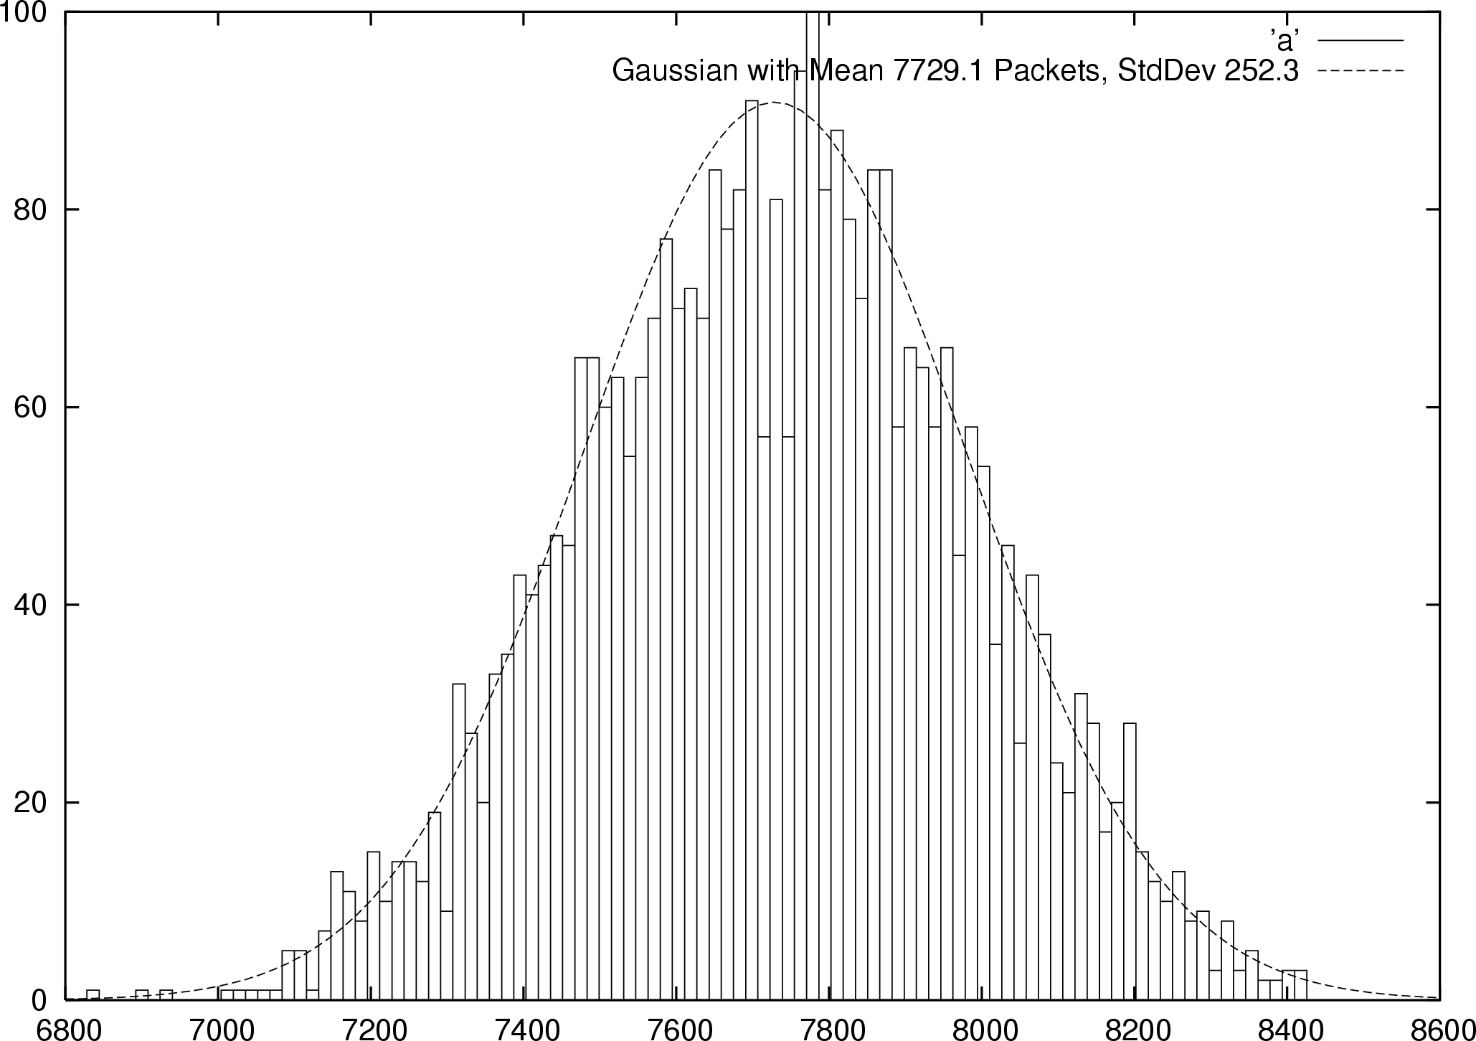
If flows are not synchronized
B
0
Buffer Size
Probability
Distribution

Slide 94

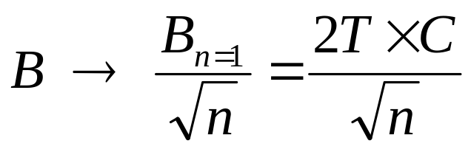
Central Limit Theorem
CLT tells us that the more variables (Congestion Windows of Flows) we have, the narrower the Gaussian (Fluctuation of sum of windows)
  Width of Gaussian decreases with
  Buffer size should also decreases with

Slide 95
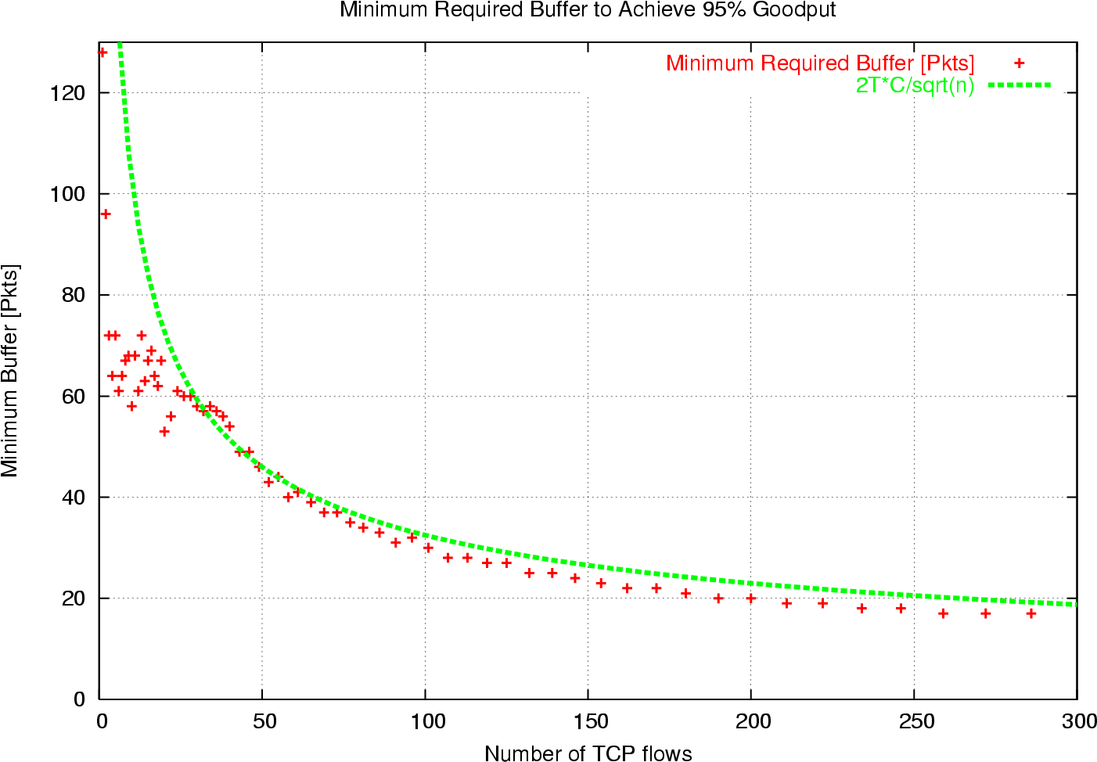
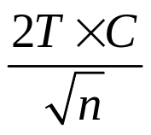
Required buffer size
Simulation

Slide 96
Important Lessons
How does TCP implement AIMD?
  Sliding window, slow start & ack clocking
  How to maintain ack clocking during loss recovery → fast recovery
Modern TCP loss recovery
  Why are timeouts bad?
  How to avoid them? → fast retransmit, SACK
How does TCP fully utilize a link?
  Role of router buffers

Slide 97
Next Lecture
TCP Vegas/alternative congestion control schemes
RED
Fair queuing
Core-stateless fair queuing/XCP
Assigned reading
  [BP95] TCP Vegas: End to End Congestion Avoidance on a Global Internet
  [FJ93] Random Early Detection Gateways for Congestion Avoidance
  [DKS90] Analysis and Simulation of a Fair Queueing Algorithm, Internetworking: Research and Experience
  [SSZ98] Core-Stateless Fair Queueing: Achieving Approximately Fair Allocations in High Speed Networks
  [KHR02] Congestion Control for High Bandwidth-Delay Product Networks

Slide 98
EXTRA SLIDES
The rest of the slides are FYI

Slide 99
Integrity & Demultiplexing
Port numbers
  Demultiplex from/to process
  Servers wait on well known ports (/etc/services)
Checksum
  Is it sufficient to just checksum the packet contents?
  No, need to ensure correct source/destination
    Pseudoheader – portion of IP hdr that are critical
    Checksum covers Pseudoheader, transport hdr, and packet body
UDP provides just integrity and demux

Slide 100
TCP Header
Source port
Destination port
Sequence number
Flags:
SYN
FIN
RESET
PUSH
URG
ACK
Acknowledgement
HdrLen
0
Flags
Advertised window
Checksum
Urgent pointer
Options (variable)
Data

Slide 101
TCP Flow Control
TCP is a sliding window protocol
  For window size n, can send up to n bytes without receiving an acknowledgement
  When the data is acknowledged then the window slides forward
Each packet advertises a window size
  Indicates number of bytes the receiver has space for
Original TCP always sent entire window
  Congestion control now limits this

Slide 102
Window Flow Control: Send Side
window
Sent but not acked
Not yet sent
Sent and acked
Next to be sent

Slide 103
Window Flow Control: Receive Side
Receive buffer
Acked but not
delivered to user
Not yet
acked
window

Slide 104
TCP Persist
What happens if window is 0?
  Receiver updates window when application reads data
  What if this update is lost?
TCP Persist state
  Sender periodically sends 1 byte packets
  Receiver responds with ACK even if it can’t store the packet

Slide 105
Connection Establishment
A and B must agree on initial sequence number selection
  Use 3-way handshake
A
B
SYN + Seq A
SYN+ACK-A + Seq B
ACK-B

Slide 106
Sequence Number Selection
Why not simply chose 0?
Must avoid overlap with earlier incarnation

Slide 107
Connection Setup
CLOSED
active OPEN
create TCB
Snd SYN
passive OPEN
CLOSE
create TCB
delete TCB
LISTEN
CLOSE
delete TCB
rcv SYN
SEND
SYN
RCVD
snd SYN ACK
snd SYN
SYN
SENT
rcv SYN
snd ACK
rcv ACK of SYN
Rcv SYN, ACK
Snd ACK
CLOSE
Send FIN
ESTAB

Slide 108
Connection Tear-down
Normal termination
  Allow unilateral close
TCP must continue to receive data even after closing
Cannot close connection immediately
  What if a new connection restarts and uses same sequence number?

Slide 109
Tear-down Packet Exchange
Sender
Receiver
FIN
FIN-ACK
Data write
Data ack
FIN
FIN-ACK

Slide 110
Connection Tear-down
CLOSE
ESTAB
send FIN
CLOSE
rcv FIN
send FIN
send ACK
FIN
WAIT-1
CLOSE
WAIT
rcv FIN
snd ACK
CLOSE
rcv FIN+ACK
snd FIN
FIN WAIT-2
CLOSING
LAST-ACK
snd ACK
rcv ACK of FIN
rcv ACK of FIN
TIME WAIT
CLOSED
rcv FIN
Timeout=2msl
snd ACK
delete TCB

Slide 111
Detecting Half-open Connections
TCP A
TCP B
(CRASH)
CLOSED
SYN-SENT → <SEQ=400><CTL=SYN>
(!!) ← <SEQ=300><ACK=100><CTL=ACK>
SYN-SENT → <SEQ=100><CTL=RST>
SYN-SENT
SYN-SENT → <SEQ=400><CTL=SYN>
(send 300, receive 100)
ESTABLISHED
(??)
ESTABLISHED
→ (Abort!!)
CLOSED
→

Slide 112
Observed TCP Problems
Too many small packets
  Silly window syndrome
  Nagel’s algorithm
Initial sequence number selection
Amount of state maintained

Slide 113
Silly Window Syndrome
Problem: (Clark, 1982)
  If receiver advertises small increases in the receive window then the sender may waste time sending lots of small packets
Solution
  Receiver must not advertise small window increases
  Increase window by min(MSS,RecvBuffer/2)

Slide 114
Nagel’s Algorithm
Small packet problem:
  Don’t want to send a 41 byte packet for each keystroke
  How long to wait for more data?
Solution:
  Allow only one outstanding small (not full sized) segment that has not yet been acknowledged

Slide 115
Why is Selecting ISN Important?
Suppose machine X selects ISN based on predictable sequence
Fred has .rhosts to allow login to X from Y
Evil Ed attacks
  Disables host Y – denial of service attack
  Make a bunch of connections to host X
  Determine ISN pattern a guess next ISN
  Fake pkt1: [<src Y><dst X>, guessed ISN]
  Fake pkt2: desired command

Slide 116
Time Wait Issues
Web servers not clients close connection first
  Established → Fin-Waits → Time-Wait → Closed
  Why would this be a problem?
Time-Wait state lasts for 2 * MSL
  MSL is should be 120 seconds (is often 60s)
  Servers often have order of magnitude more connections in Time-Wait

Slide 117
TCP Extensions
Implemented using TCP options
  Timestamp
  Protection from sequence number wraparound
  Large windows

Slide 118
Protection From Wraparound
Wraparound time vs. Link speed
    1.5Mbps: 6.4 hours
    10Mbps: 57 minutes
    45Mbps: 13 minutes
    100Mbps: 6 minutes
    622Mbps: 55 seconds → < MSL!
    1.2Gbps: 28 seconds
Use timestamp to distinguish sequence number wraparound

Slide 119
Large Windows
Delay-bandwidth product for 100ms delay
    1.5Mbps: 18KB
    10Mbps: 122KB > max 16bit window
    45Mbps: 549KB
    100Mbps: 1.2MB
    622Mbps: 7.4MB
    1.2Gbps: 14.8MB
Scaling factor on advertised window
  Specifies how many bits window must be shifted to the left
  Scaling factor exchanged during connection setup

Slide 120
Maximum Segment Size (MSS)
Exchanged at connection setup
  Typically pick MTU of local link
What all does this effect?
  Efficiency
  Congestion control
  Retransmission
Path MTU discovery
  Why should MTU match MSS?

