Slide 1



Title
Aldel Education Trust’s
St. John College of Engineering and Management, Palghar
NAAC Accredited with Grade A+
Department of AIML
Solar Power Analysis
Anvay Churi [AF0474292]
Hrudansh Churi [AF0480321]
Mr. Ajay Sir | Project Presentation
March 12, 2025
1

Slide 2
Contents
Abstract
Introduction
Motivation
Problem Statement
Objectives
Scope
Implementation
Screenshots of the output with description
Technologies Used
Result and Discussion
Conclusion
2

Slide 3
Abstract
Solar power is a sustainable and renewable energy source that has gained significant attention due to its environmental and economic benefits. This analysis explores the efficiency, cost-effectiveness, and future potential of solar energy in various applications. Key factors such as solar panel technology, energy storage, geographical impact, and policy incentives are examined. The study also highlights advancements in photovoltaic cells, grid integration challenges, and emerging trends in solar power adoption. By evaluating real-world case studies and data-driven insights, this presentation aims to provide a comprehensive understanding of solar power’s role in the transition to clean energy.
3

Slide 4
Introduction
Motivation
Renewable & Sustainable – Solar energy is an infinite resource, reducing dependence on fossil fuels.
Eco-Friendly – Drastically cuts carbon emissions, contributing to a cleaner environment.
Energy Independence – Reduces reliance on non-renewable energy sources and enhances energy security.
Cost-Effective – Decreasing costs of solar panels and incentives make it an economical choice.
Technological Advancements – Continuous improvements in efficiency, storage, and smart grid integration.
Growing Market – Increasing global adoption, policy support, and investment opportunities.
Low Maintenance – Once installed, solar panels require minimal maintenance and have long lifespans.
4

Slide 5
Introduction
Problem Statement
The increasing global energy demand and dependence on fossil fuels have led to environmental concerns, including climate change and pollution. While solar power presents a sustainable alternative, its widespread adoption faces challenges such as efficiency limitations, high initial costs, energy storage issues, and grid integration complexities. This study aims to analyze the current state of solar power, identify key barriers to its implementation, and explore potential technological and policy-driven solutions to enhance its efficiency, affordability, and accessibility for a sustainable energy future.
5

Slide 6
Introduction
Objectives
Analyze Solar Energy Potential – Assess the efficiency and effectiveness of solar power in different geographical locations.
Evaluate Technological Advancements – Study improvements in photovoltaic cells, battery storage, and grid integration.
Identify Challenges – Investigate barriers such as high initial costs, intermittency, and land requirements.
Explore Sustainable Solutions – Propose strategies to enhance solar energy efficiency and adoption.
Promote Environmental Benefits – Highlight solar power’s role in reducing carbon emissions and mitigating climate change.
Encourage Policy Recommendations – Suggest policies for promoting solar energy deployment and investments.
6

Slide 7
Introduction
Scope
This project explores the technological advancements, economic viability, and environmental impact of solar power. It assesses solar panel efficiency, battery storage, and grid integration while analyzing cost trends, return on investment, and government incentives. The research also examines geographical feasibility, policy frameworks, and challenges such as high initial costs and energy intermittency. Additionally, it compares solar energy with other sources and investigates future innovations to enhance adoption. The findings aim to provide insights into the potential of solar power in achieving a sustainable energy transition.
7

Slide 8
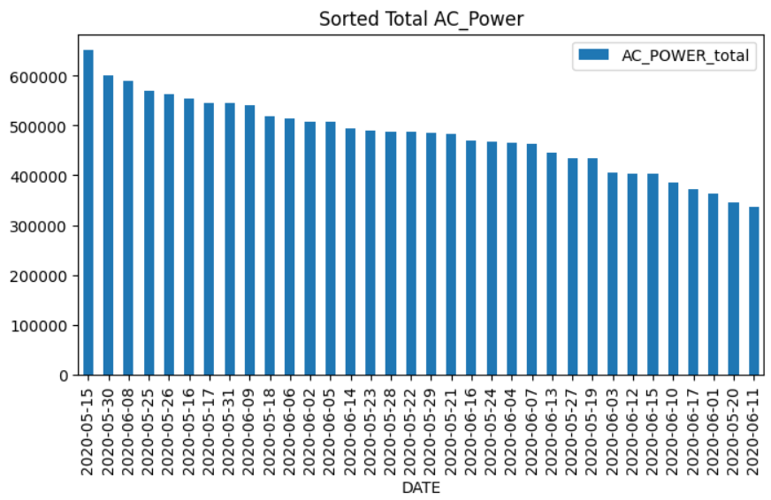
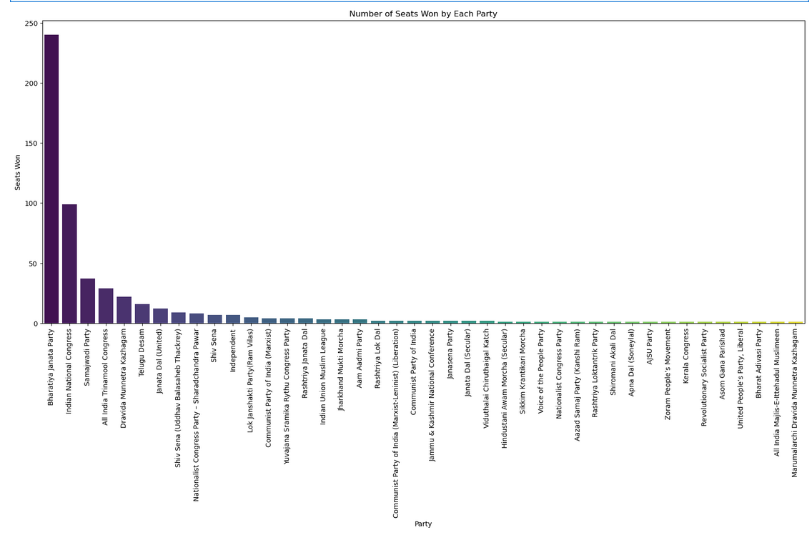
Implementation
Screenshots of the output with description
'Number of Seats Won by Each Party
Fig: Sorted Total AC Power
8

Slide 9
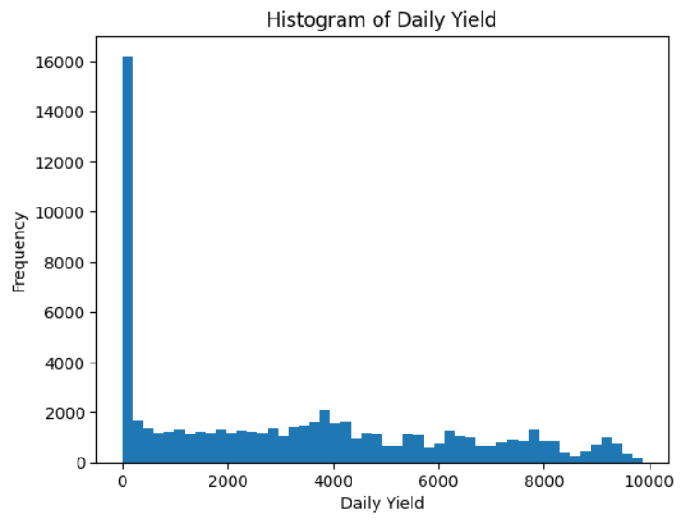
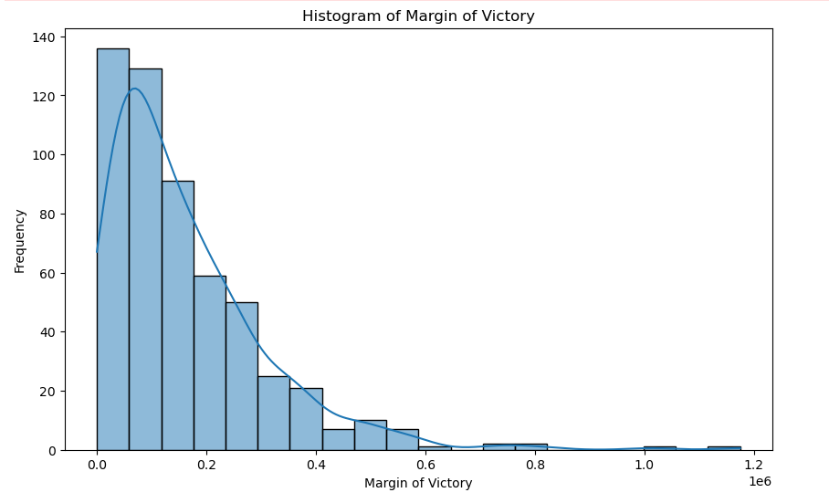
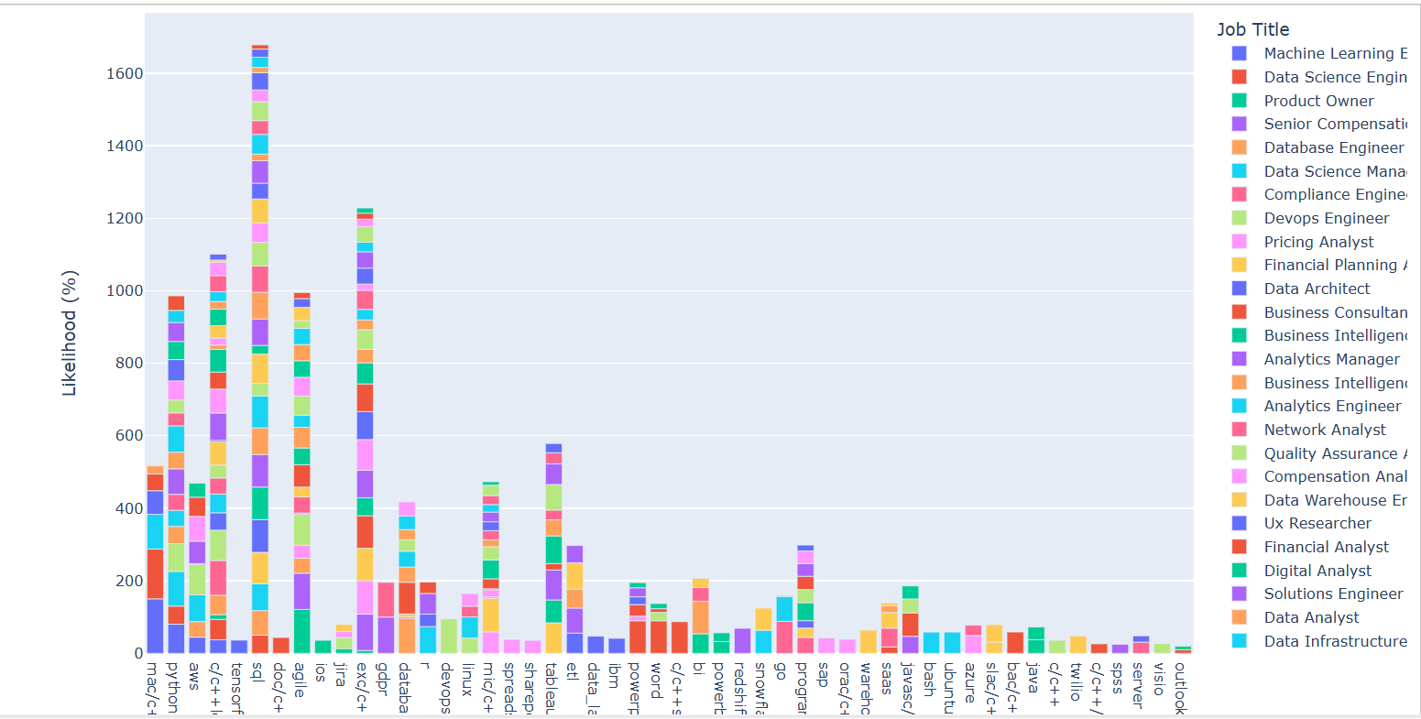
Implementation
Margin of Victory
Fig : Histogram of Daily Yield
9

Slide 10
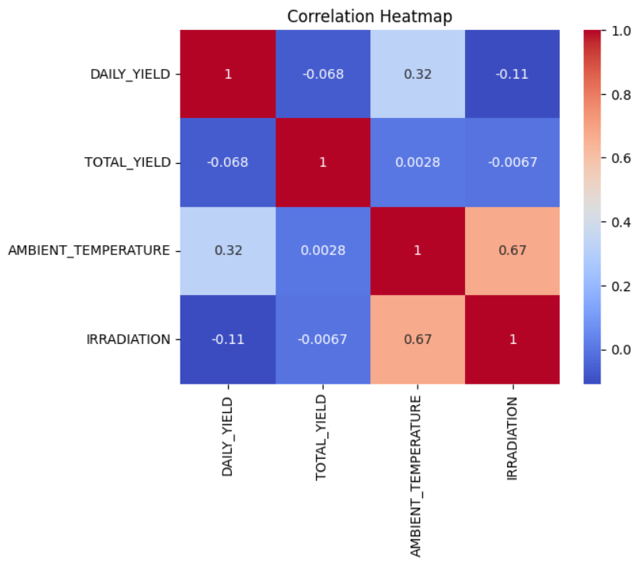
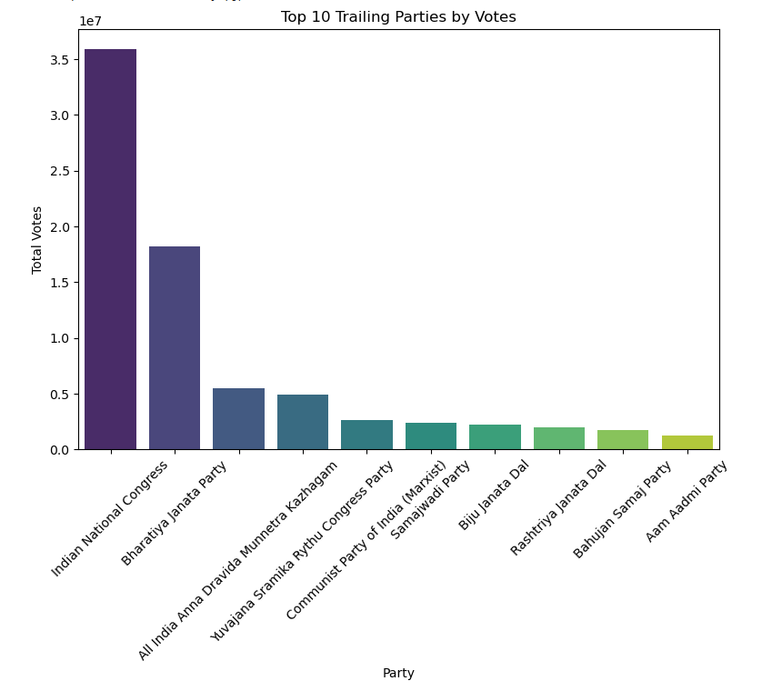
Implementation
Top 10 Trailing Parties by Votes
Fig : Correlation Heatmap
10

Slide 11
Technologies Used
Hardware Requirements:
Windows 11
64-bit operating system, x65-based processor
Software Requirements:
Jupyter Notebook
Python
11

Slide 12
Results and Discussion
Solar power is increasingly efficient and cost-effective, with policy support driving adoption. Challenges like intermittency and grid integration persist, but battery storage and smart grids offer solutions. Continued innovation and investment are key to maximizing its sustainability impact.
12

Slide 13
Conclusion
Conclusion
Solar power has emerged as a sustainable and increasingly cost-effective energy source, driven by advancements in photovoltaic technology, energy storage, and policy incentives. Despite challenges such as intermittency, land use, and grid integration, innovations in battery storage and smart grids are improving its reliability. Solar energy is becoming a competitive alternative to fossil fuels, with its adoption accelerating globally. Continued research, investment, and supportive policies are essential to overcoming existing barriers and maximizing solar power’s potential in the transition toward a cleaner and more sustainable energy future.
13

Slide 14
Thank You !!!
14

