Slide 12
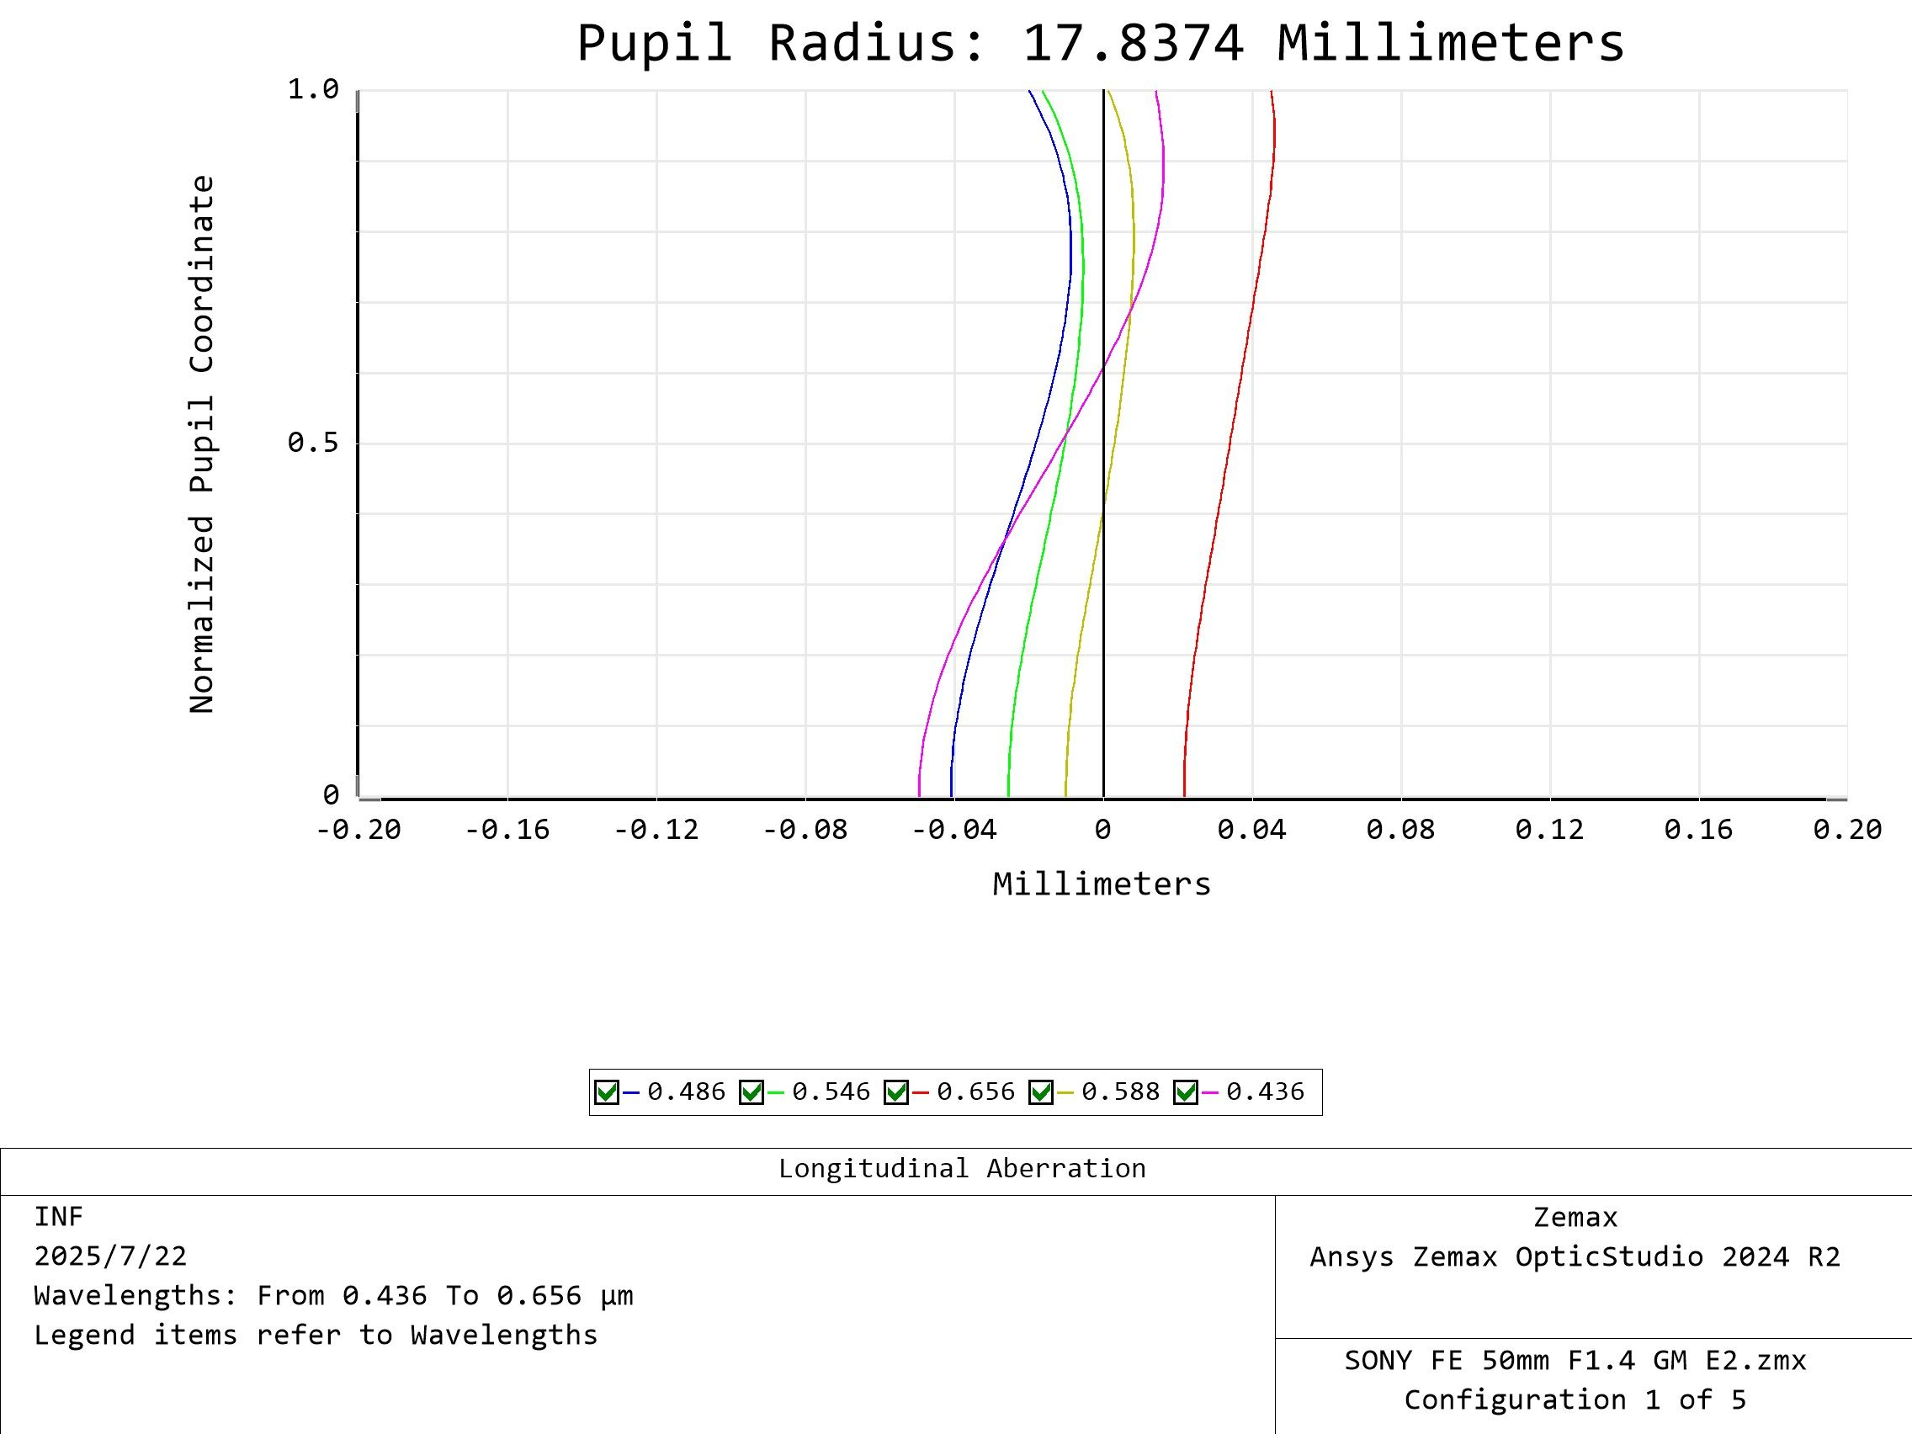



Longitudinal Aberration
F1.45
SONY
$$β=$$
$$0.00$$
$$−$$
FE 50mm F1.4 GM
F1.45
1.0
0.8
0.6
归一化光瞳坐标
0.4
0.2
0
-0.20
-0.16
-0.13
-0.08
-0.04
0
0.04
0.08
0.13
0.16
0.20
Millimeters
435.8nm
486.1nm
546.1nm
587.6nm
656.3nm

Slide 13

Longitudinal Aberration
$$67μm$$
SONY
FE 50mm F1.4 GM
F1.45
1.0
0.8
0.6
归一化光瞳坐标
0.4
0.2
0
-0.20
-0.16
-0.13
-0.08
-0.04
0
0.04
0.08
0.13
0.16
0.20
Millimeters
435.8nm
486.1nm
546.1nm
587.6nm
656.3nm

Slide 14
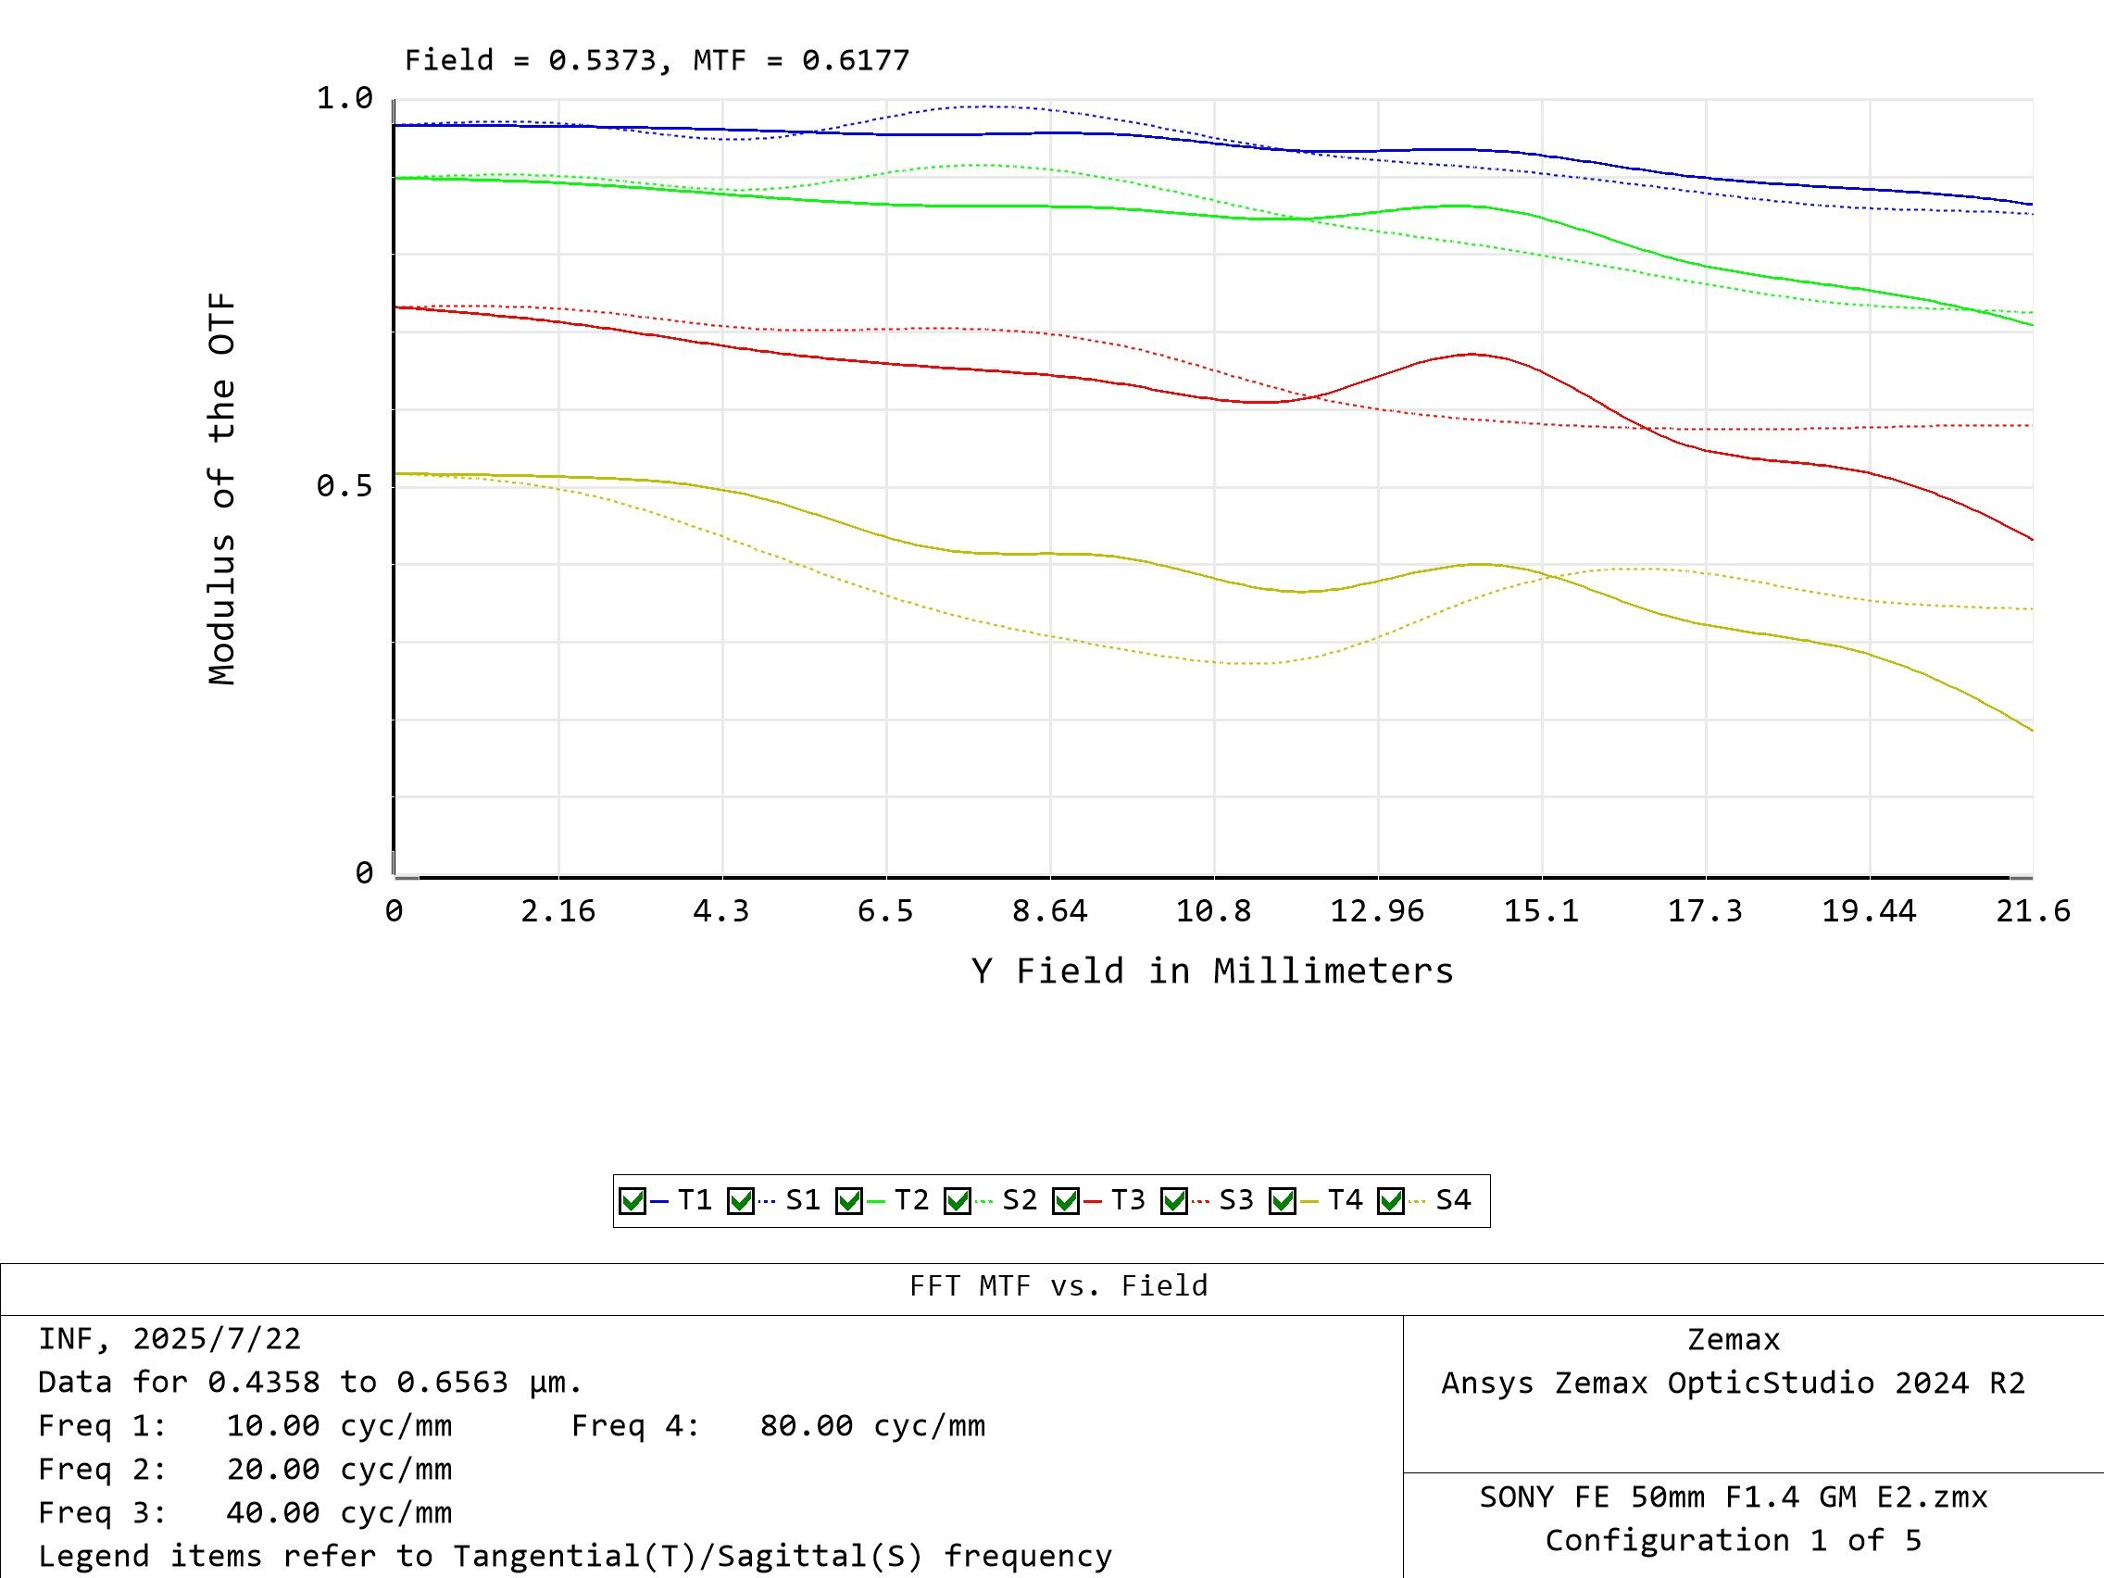



FFT MTF vs Field
@INF F1.45
SONY
$$β=$$
$$0.00$$
$$−$$
FE 50mm F1.4 GM
1.0
Tangential
0.8
Sagittal
0.6
Modulus of OTF
MTF 50%
0.4
0.2
0
2.16
4.3
6.5
8.64
10.8
12.96
15.1
17.3
19.44
21.6
10lp/mm
20lp/mm
40lp/mm
80lp/mm
Y Field in mm

Slide 15


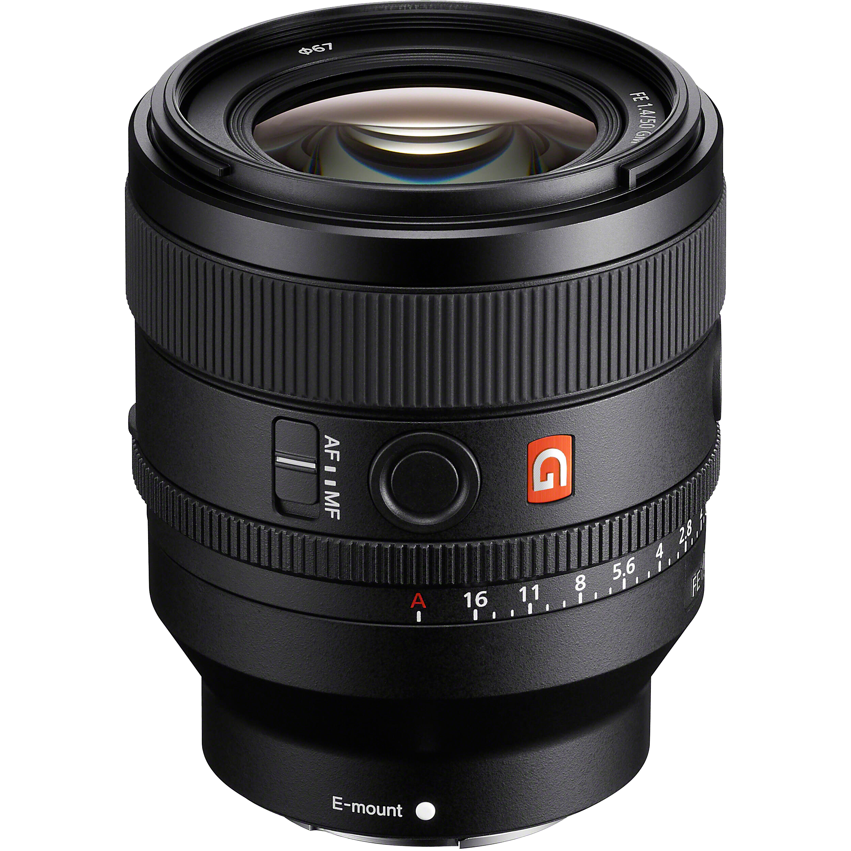
Or
FE 50mm F1.4

Slide 16
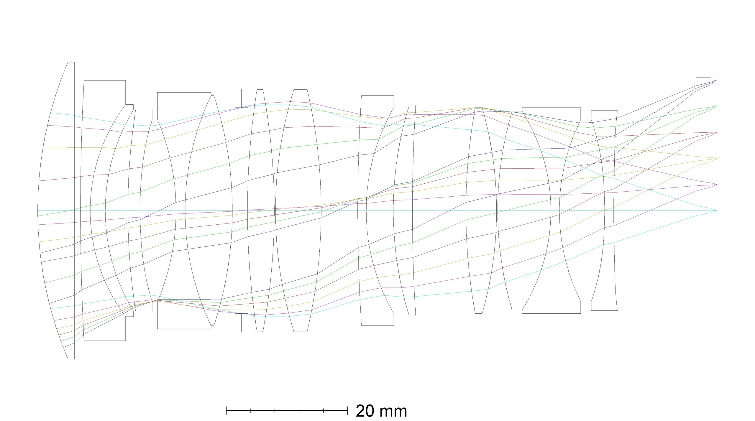
SONY FE 50mm F1.4 GM

Slide 18
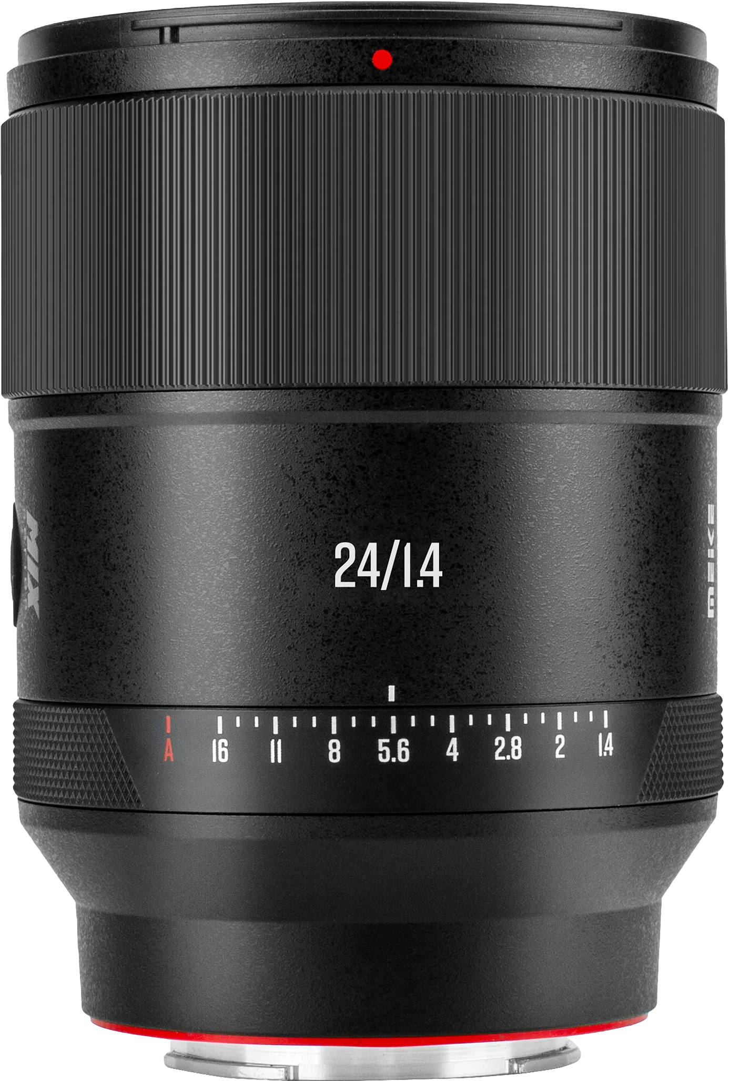
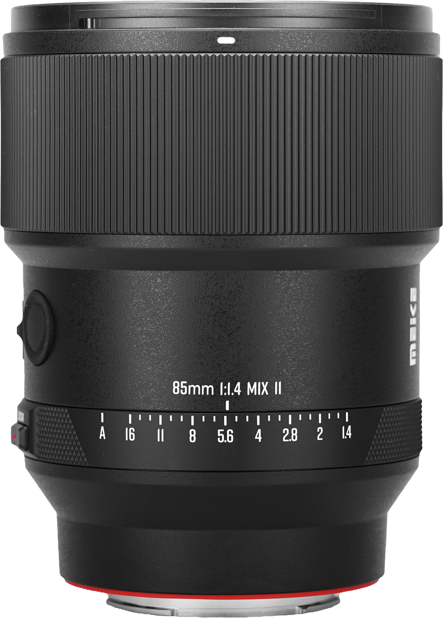
MEIKE AF 24mm F1.4 MIX
MEIKE AF 85mm F1.4 MIX II
Since 2025.08.22
Since 2026.05.20

