Slide 1
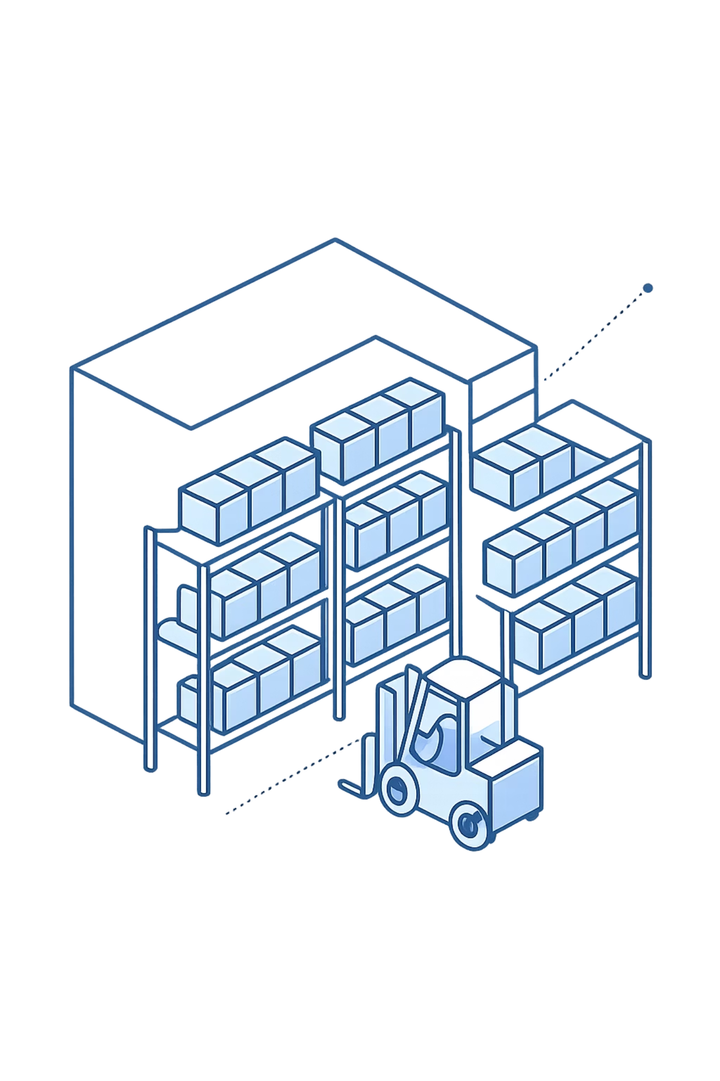
Vendor Performance & Revenue Concentration Analysis
BY: Harsh Anvekar

Slide 2





Executive Summary
Revenue Concentration
Bulk Purchasing Impact
Top vendors drive majority of sales, creating procurement dependency with ~65.7% concentration
Significant unit cost reductions through volume-based procurement strategies
Consolidation Opportunity
Pricing Optimization
Low-performing vendors add operational complexity with minimal revenue contribution
Cost control drives margins more than pricing in competitive market environment

Slide 3

Business Problem
Current vendor mix creates operational inefficiencies that directly impact profitability, inventory turnover rates, and pricing strategy effectiveness.
Critical Questions
Which vendors drive revenue and profit margins?
Where do operational inefficiencies exist?
Can bulk purchasing improve gross margins?
How should vendor relationships be optimized?

Slide 4

KPI Snapshot
$451.6M
$321.9M
Total Sales
Total Purchases
Revenue generated across all vendor relationships
Procurement spend with vendor partners
$129.7M
9M
Gross Profit
Units Sold
Margin available for optimization
Volume flowing through distribution network
Strong top-line performance indicates healthy demand, but profit optimization depends on strategic vendor management and procurement efficiency

Slide 5
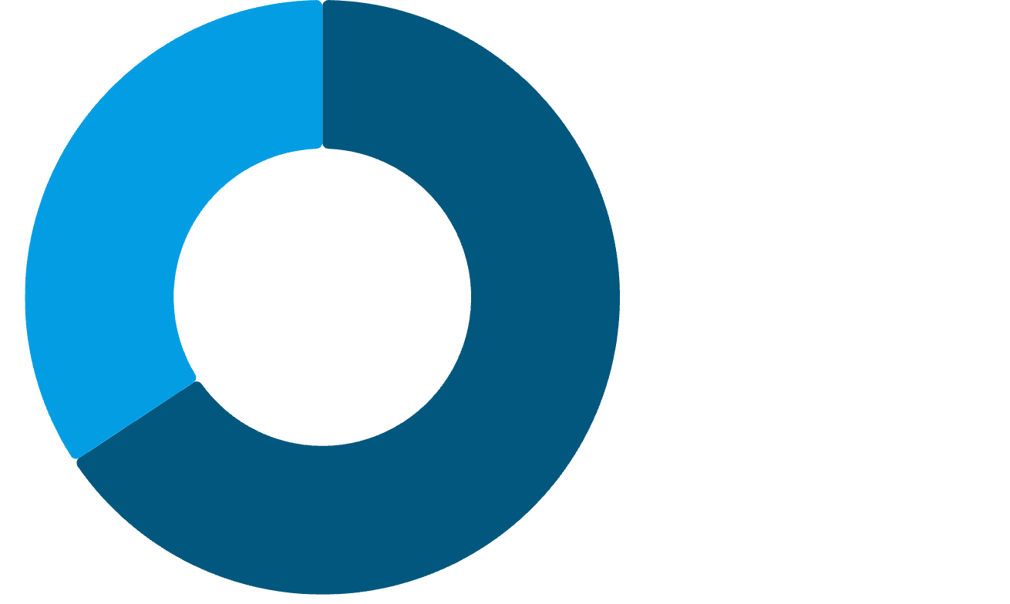
Revenue Concentration
Pareto Principle in Action
Top 10 vendors contribute approximately 65.7% of total purchases, while over 100 remaining vendors contribute only ~34%.
Remaining 100 vendors
Business is highly dependent on a small set of strategic partners, creating both opportunity and risk.
Top 10 Vendors

Slide 6

Top Vendor Performance
Leading Vendor
1
Contributes over $70M in sales alone, representing ~15% of total revenue
Sharp Drop-off
2
Significant revenue decline after top 2-3 vendors, demonstrating power-law distribution
Revenue Backbone
3
Top vendors form the strategic foundation of procurement operations

Slide 7

Bottom Vendor Performance
Performance Profile
Extremely low revenue contribution
Long tail distribution pattern
High operational overhead relative to value
Minimal procurement volume
Vendor rationalization opportunity exists for low-performing partners

Slide 8
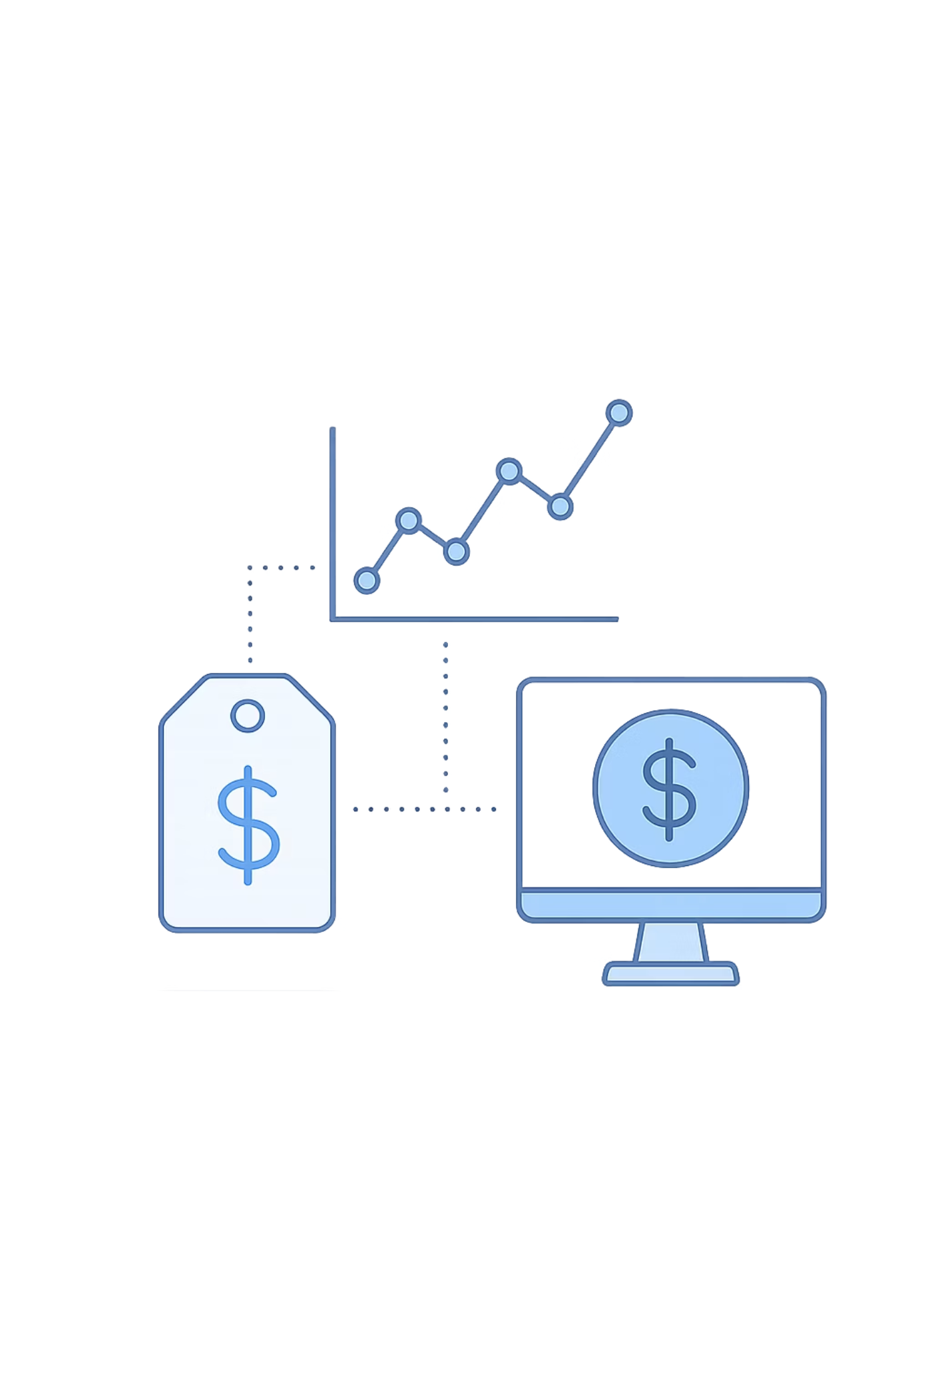
Pricing & Profitability Insights
Weak Correlation
Negligible relationship between price and sales volume or profit contribution
Negative Trend
Higher prices correlate with lower margins in competitive market environment
Market Reality
Pricing power limited by competition; margins driven more by cost control than price increases

Slide 9
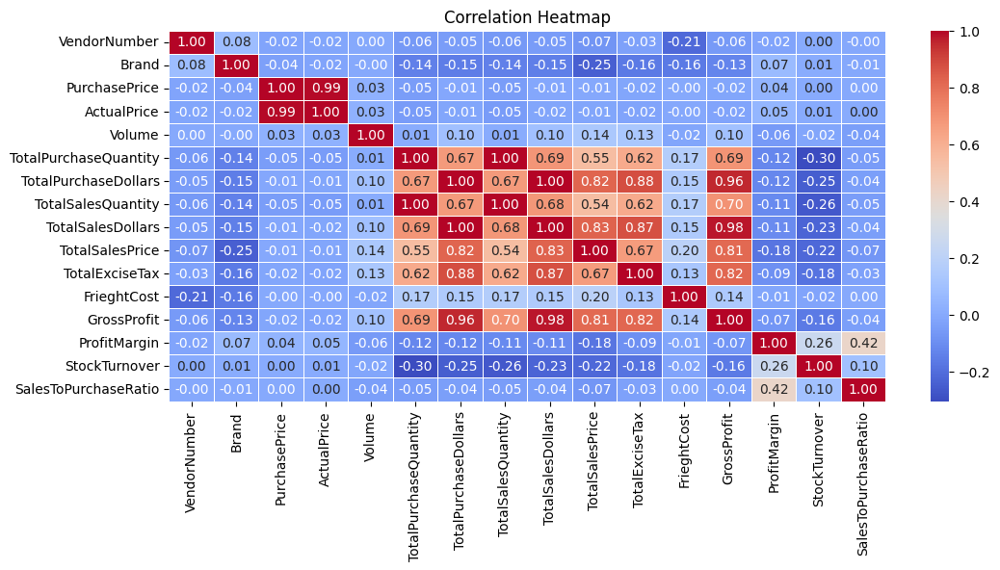
Bulk Purchasing Impact
Volume-Sales Correlation
Strong positive correlation (~1.0) between order size and unit
cost efficiency
Strategic Implications
Scale purchasing with top vendors
Negotiate volume-based discounts
Consolidate orders for better pricing
Reduce transaction frequency

Slide 10
Strategic Recommendations
01
02
03
Vendor Consolidation
Strategic Partnerships
Bulk Procurement
Reduce low-performing vendors and focus procurement on top 10-20 strategic partners
Strengthen relationships with high-volume vendors through long-term contracts
Increase order sizes with top vendors to achieve lower unit costs
04
05
Pricing Strategy
Inventory Efficiency
Avoid aggressive price increases; focus on cost-side optimization instead
Align procurement patterns with high-turnover vendors to optimize working capital

