Slide 1
UNIT – III
Exception handling and Multithreading

Slide 2
CONCEPTS OF EXCEPTION HANDLING
An Exception is a run time error, which occurs during the execution of a program, that disrupts the normal flow of the program's instructions.
It is an unwanted or unexpected event, which occurs during the execution of a program, i.e. at run time, that disrupts the normal flow of the program’s instructions.
Exceptions can be caught and handled by the program.
When an exception occurs within a method, it creates an object.
This object is called the exception object.
It contains information about the exception, such as the name and description of the exception and the state of the program when the exception occurred.

Slide 3
Major reasons why an exception Occurs
Invalid user input
Device failure
Loss of network connection
Physical limitations (out of disk memory)
Code errors
Opening an unavailable file
Errors
Errors represent irrecoverable conditions such as Java virtual machine (JVM) running out of memory, memory leaks, stack overflow errors, library incompatibility, infinite recursion, etc.
Errors are usually beyond the control of the programmer, and we should not try to handle errors.
Exception Handling is a mechanism to handle runtime errors such as ClassNotFoundException, IOException, SQLException, RemoteException, etc.

Slide 4
EXCEPTION HANDLING IN JAVA
The Exception Handling in Java is one of the powerful feature to handle the runtime errors so that normal flow of the application can be maintained.
Exception Handling is used to convert system error message into user friendly error message.
Let's take a scenario:
statement 1;
statement 2;
statement 3;
statement 4;
statement 5; //Exception occurs
statement 6;
statement 7;
statement 8;
statement 9;
statement 10;
Suppose there are 10 statements in your program and there occurs an exception at statement 5, the rest of the code will not be executed i.e. statement 6 to 10 will not be executed.
If we perform exception handling, the rest of the statement will be executed. That is why we use exception handling in Java.

Slide 5
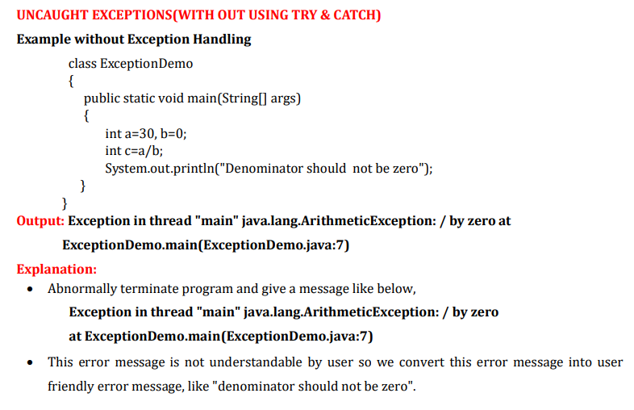

Slide 6
BENEFITS OF EXCEPTIONHANDLING
1. Provision to Complete Program Execution
2. Easy Identification of Program Code and Error-Handling Code
3. Propagation of Errors
4. Meaningful Error Reporting
5. Identifying Error Types
Java's exception model is built on five keywords:
  try, catch, throw, throws, finally

Slide 7
TERMINATION OR RESUMPTIVE MODELS
In java, there are two exception models. Java programming language has two models of exception handling. The exception models that java supports are as follows.
Termination Model
Resumptive Model
Termination Model
In the termination model, when a method encounters an exception, further processing in that method is terminated and control is transferred to the nearest catch block that can handle the type of exception encountered.
In other words we can say that in termination model the error is so critical there is no way to get back to where the exception occurred.

Slide 8
Resumptive Model
The alternative of termination model is resumptive model.
In resumptive model, the exception handler is expected to do something to stable the situation, and then the faulting method is retried.
In resumptive model we hope to continue the execution after the exception is handled.
In resumptive model we may use a method call that want resumption like behavior.
We may also place the try block in a while loop that keeps re-entering the try block until the result is satisfactory.

Slide 9
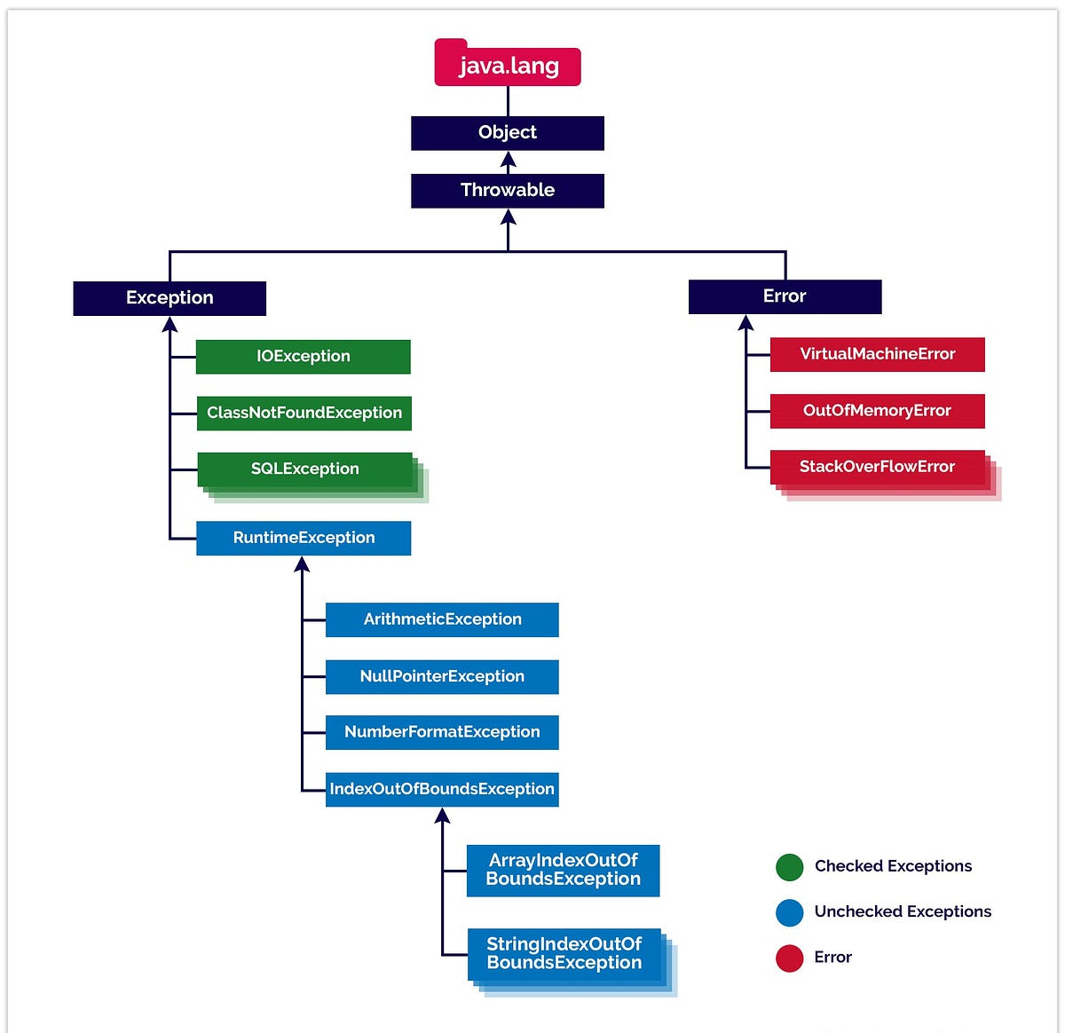
EXCEPTION
HIERARCHY

Slide 10
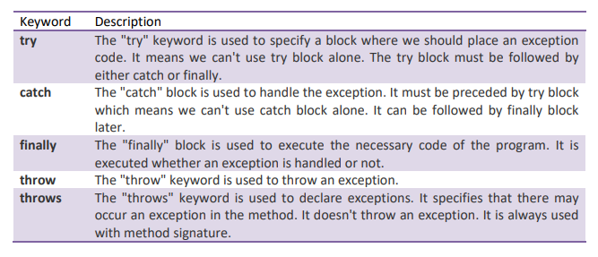
HOW TO HANDLE THE EXCEPTION
Use Five keywords for Handling the Exception
try
catch
throw
throws
finally

Slide 11
1. try Block
The try block contains a set of statements where an exception can occur.
In other words, the try block always contains problematic statements.
A try block is always followed by a catch block, which handles the exception that occurs in the associated try block. A try block must be followed by catch blocks or a finally block or both.
Syntax
try {
//statements that may cause an exception
}

Slide 12
2. catch Block
A catch block is where we handle the exceptions; this block must follow the try block.
A single try block can have multiple catch blocks associated with it. We can catch different exceptions in different catch blocks.
When an exception occurs in the try block, the corresponding catch block that handles that particular exception executes.
For example, if an arithmetic exception occurs in the try block, then the statements enclosed in the catch block for arithmetic exception execute.

Slide 13
Syntax of try-catch in Java:
try
{
// statements causes problem at run time
}
catch(type of exception-1 object-1)
{
// statements provides user friendly error message
}
catch(type of exception-2 object-2)
{
// statements provides user friendly error message
}

Slide 14
Example 1: ArithmeticException
package exceptionhandling;
class ArithmeticExceptionExample
{
public static void main(String[] args)
{
int a=30, b=0;
try
{
int c=a/b;
}
catch (ArithmeticException e)
{
System.out.println("Denominator should not be zero");
}
}
}

Slide 15
Example 2: NullPointer
class NullPointer_Demo
{
public static void main(String args[])
{
try
{
String a = null; // null value
System.out.println(a.charAt(0));
}
catch(NullPointerException e)
{
System.out.println("NullPointerException..");
}
}
}

Slide 16
Example 3: FileNotFoundException
import java.io.File;
import java.io.FileNotFoundException;
import java.io.FileReader;
class File_notFound_Demo
{
public static void main(String args[])
{
try
{
// Following file does not exist
File file = new File("E://file.txt");
FileReader fr = new FileReader(file);
}
catch(FileNotFoundException e)
{
System.out.println("File does not exist");
}
}
}

Slide 17
Multiple catch Blocks
We can write multiple catch blocks for generating multiple user friendly error messages to make our application strong.
catch(NullPointerException e)
{
System.out.println("Enter valid number");
}
catch(ArithmeticException e)
{
System.out.println("Denominator not be zero");
}
}
}
package exceptionhandling;
class MultipleCatchBlocks
{
public static void main(String[] args)
{
int a=30, b=0;
try
{
int c=a/b;
System.out.println("Result: "+c);
}

