Slide 1

Team AIIAN
Anveshkumar Pandey
Aayush Deshmukh
Krishna Tripathi
Balark Singhal
Nitish Rana
Problem Statement:M7 Open Innovation
( Object Seeker)

Slide 2
Why we choose this project?
We often put our things here and there and also forget them by putting somewhere else.
And when we need them, we didn’t get them on time and due to this we get late for the work.
And often we forget our mobile, book, tie, hat, mouse, scissors, remote, etc.

Slide 3
In today‘s world by the help of advance technology we can make our work simpler and easier.
We have solve the problem of finding the things by using machine learning approach.
Basically our project Object seeker helps user to find the misplace item within the space.
User can find the item by just writing it’s name and our Object seeker starts searching it.
The main feature of our project is that it is capable of finding the things even in a messy room.

Slide 4
Technical Part
This project is made in python language.
Opencv is the library which we have used till now for object recognition in real time.
We will try to train our model in such a way by which our system can find out where was the targeted object previously placed and what are the objects currently present on those places.
Our system will scan the whole room and locate the desirable object which user wants to find.

Slide 5
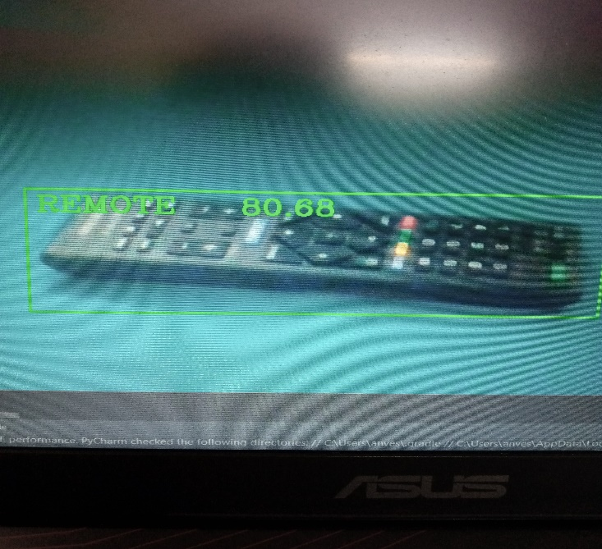
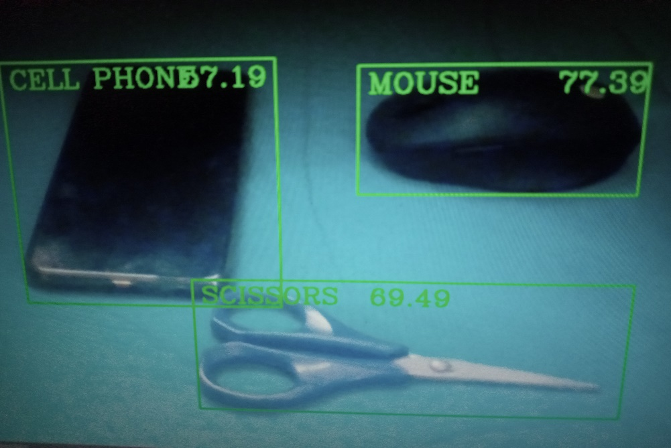
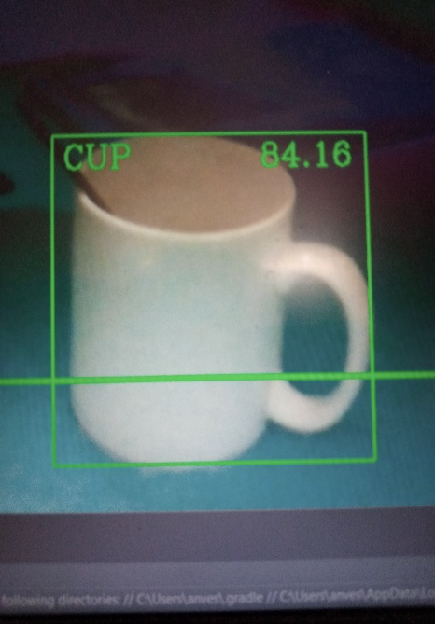
Images of Working model

Slide 6


