Slide 1
OMIS 694 Social Media Analysis By Anvesh Muttavarapu Sankeerth Koppuravuri Bharadwaj Sai

Slide 2



Analyzing Social Media Strategies of leading Airlines
Overview:
The Airline industry today helps drive nearly $1.5 trillion in US economic activity and more than 11 million US jobs. So, we have chosen Airlines industry for our analysis and considered Delta Airlines, Southwest Airlines and Virgin America Airlines for Social Media analysis.’
Goal: Analyzing social media strategy of three competing airlines
Analyzing social media engagement.
Analyzing user sentiments on the social media with respect to Airlines.
Analyzing promotional strategies on social media.
Scope for future alliances.

Slide 3




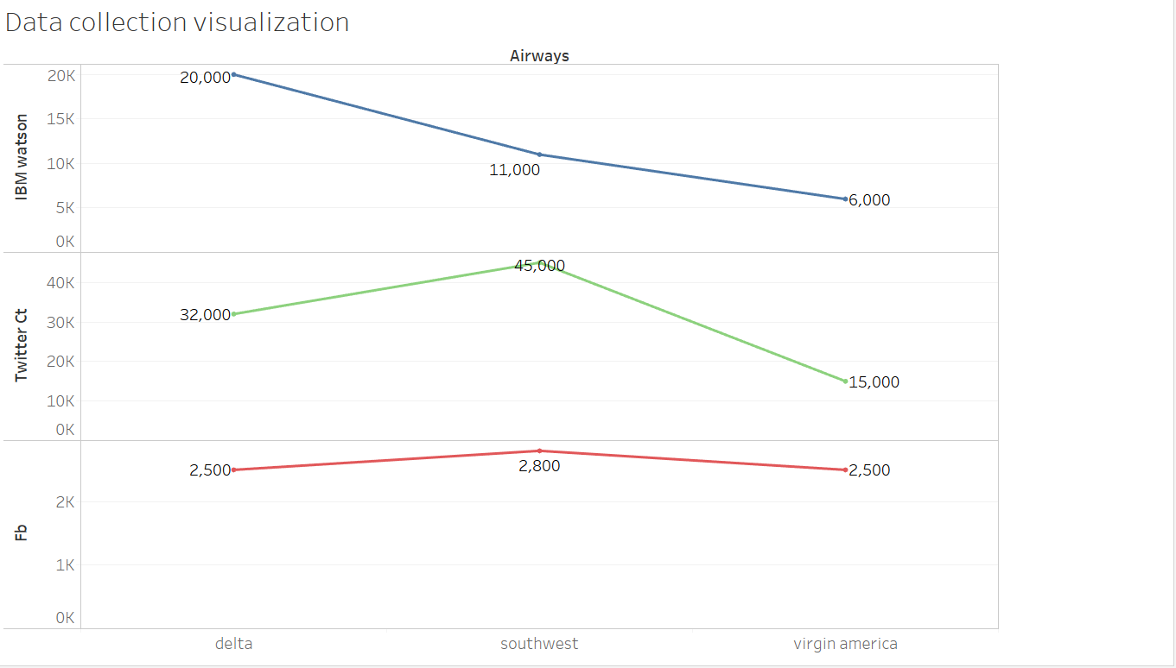
Data Collection

Slide 4
Social Media Engagement Insights
Video Posts on an average tend to get more shares compared to Photo or link.
Dashboard which displays the twitter activity of people about the airlines.
A trend graph helps in identifying in any sudden variations over a period of time.
Most active users, top sources can be identified through which companies can customize their marketing strategy.
Most popular tweets are identified and can be analyzed to understand why they are so.

Slide 5



Insights from sentiment Analysis.
Most of the tweets are in neutral sentiment for all the airlines.
There are more negative tweets than positive tweets for Delta and South West Airlines. However there are more positive tweets for Virgin America .
Further analysis of negative tweets of Delta and South West airlines shows that
Delta:
South West

Slide 6
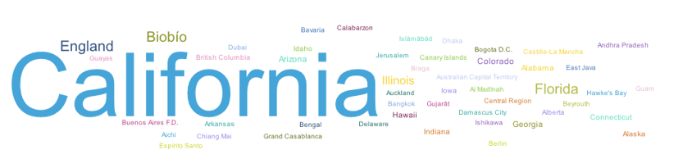
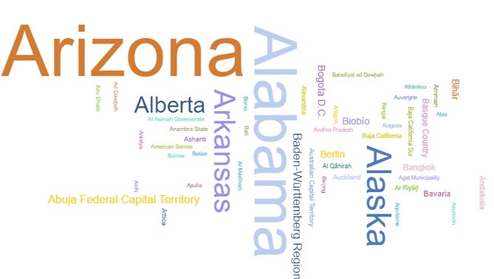
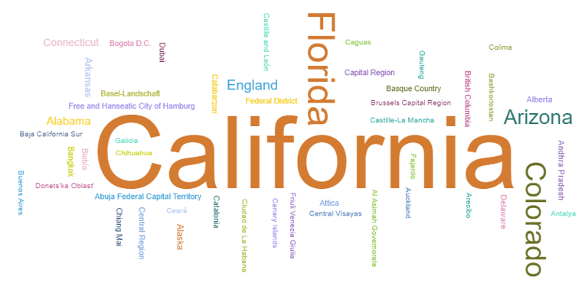
Most popular states for the airlines
Virgin America
Delta
South West

Slide 7




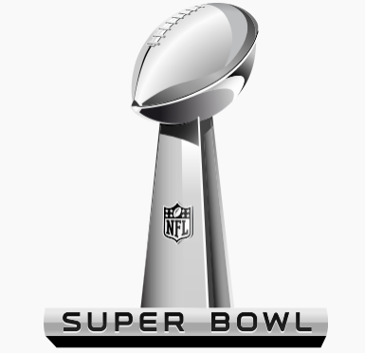

Popular Partners on social media
Delta
South West Air

Slide 8
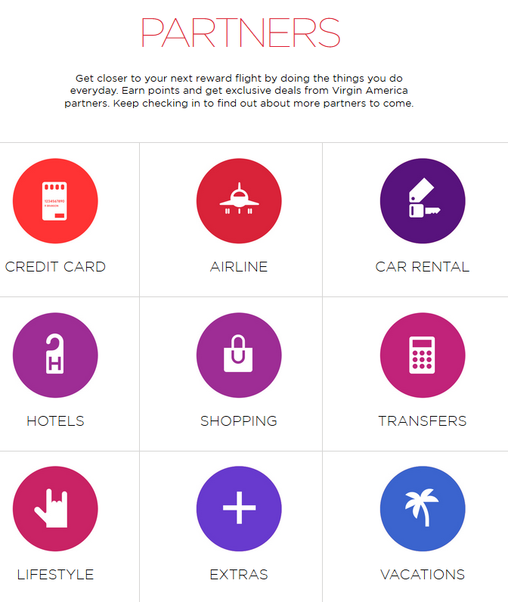

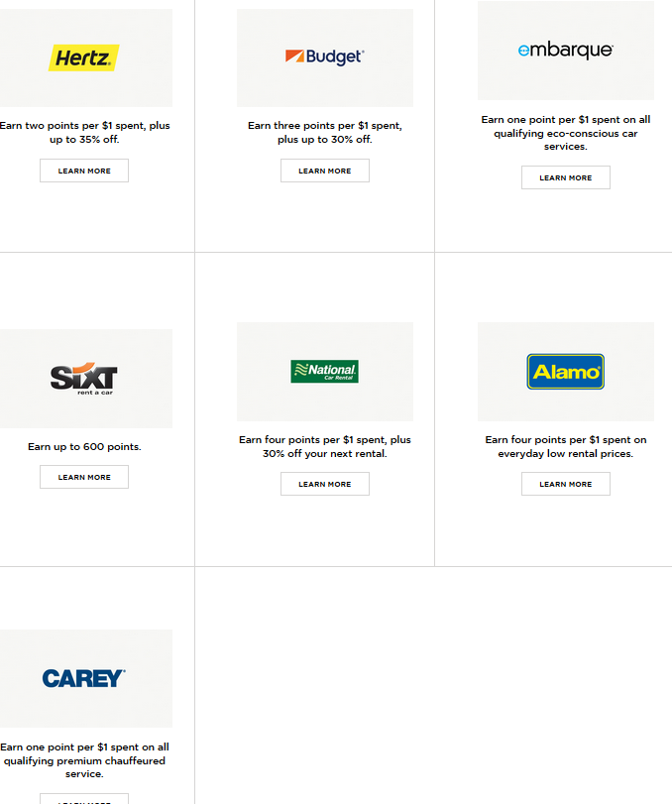
Popular Partners on social media
Virgin America

Slide 9
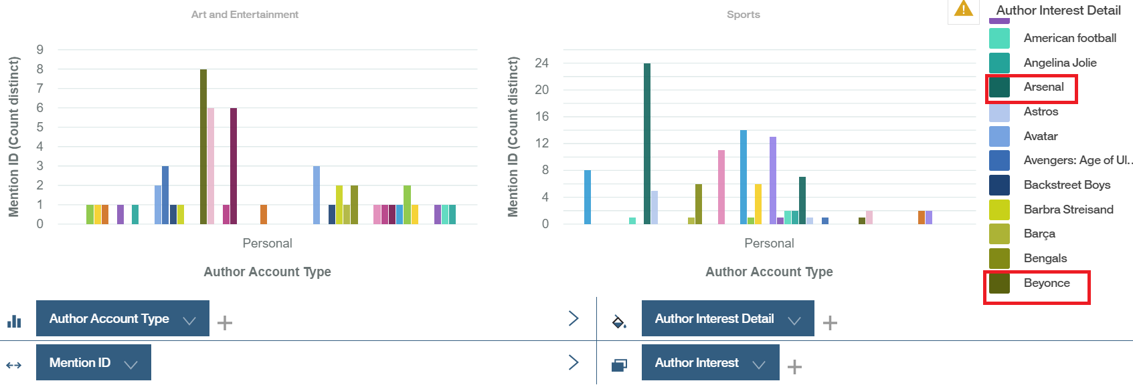
Potential future partnerships
Delta

Slide 10
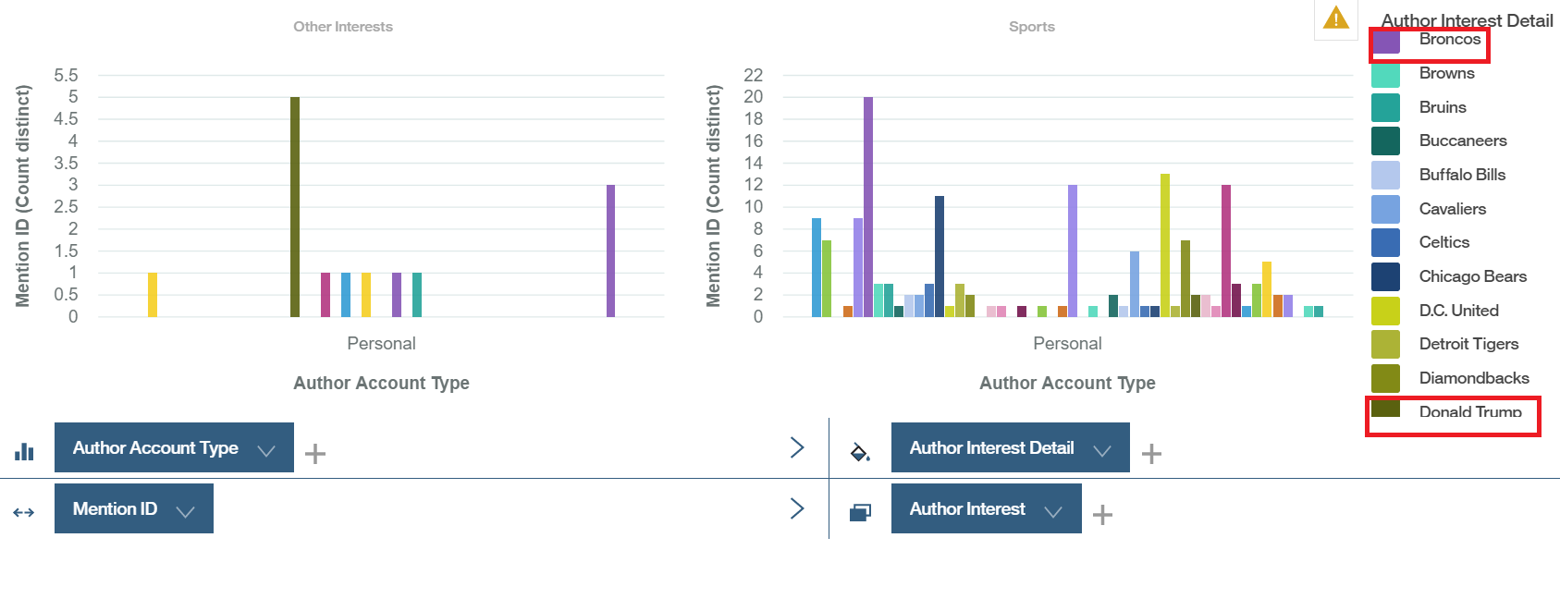
Potential future partnerships
South West Airlines

Slide 11
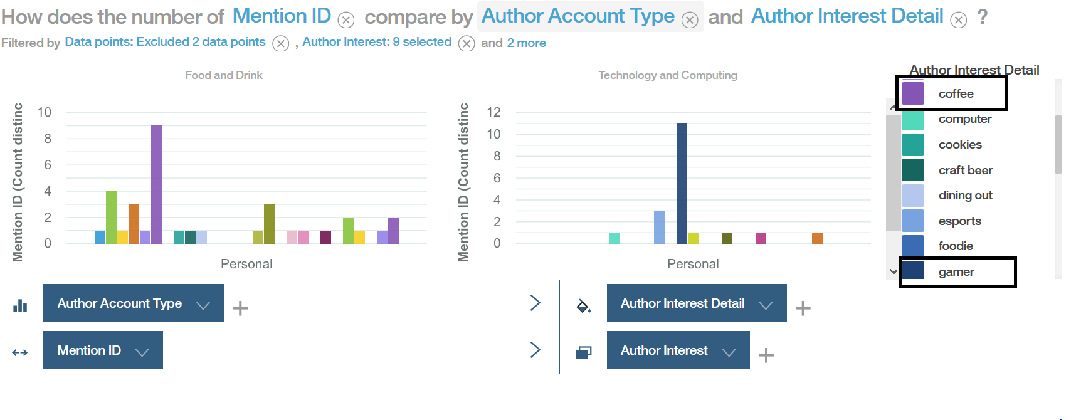
Potential future partnerships
Virgin America

Slide 12
