Slide 1

A Presentation On
“Egg Incubation System”
Presented By
Subudhi Anvesh – 17ECE123
Dinesh Kumar Patnaik – 17ECE108
Sriram Setty Shanmukha – 17ECE121
In partial fulfillment for the award of the degree of
BACHELOR OF TECHNOLOGY
in
Electronics and Communication Engineering
Under the esteemed guidance of
Mr. GAUTAM

Slide 2
Table of Contents
Introduction – “What is our Project”
Problem Statement – “Problem Definition”
Literature Review – “Survey Knowledge On Topic”
Objective – “Plan of Achievements In project”
Components – “Component Details”
Working – “How it Works”
Technical Specification – “Technical Working”
User Interface – “Our Application”
Conclusion – “Summarization of Project”
Future Scope – “Extension of Project”
Reference

Slide 3
Introduction
IOT based egg hatching system is a system which will help farmers to incubate the eggs automatically without the need of human intervention, by keeping the physical quantities such as temperature and humidity at required level, so that the fetuses inside them will grow and incubates without the presence of mother with monitoring system.
Egg incubator will not only improve the poultry production considerably but will also help in the regularity of income making, enabling the farmers to be able to get transition into possible rural entrepreneurship.

Slide 4
Problem Statement
We found that the needs of chicken raise from day to day in this country. So with this, we settled on an idea to create an innovative product and a high-tech modernization comparable to that enjoyed by the world today to help the country in the food industry sector.
Product named egg hatching machine which is able to warm up eggs as a chicken do in its nest. This egg hatching machine is designed to improve the available eggs incubator in order to change the traditional farming method to advance and modern farming method

Slide 5
Literature Review
Types of Incubator
Still Air Incubator:
In a still air incubator, there is no fan, the heat stratifies (forms layers) inside the incubator so the temperature is different between the top and bottom of the incubator.
Forced Air Incubator:
In forced air incubators, a fan circulates the air around the incubator which keeps the temperature constant in all parts of the incubator.

Slide 6
Objectives
To built the systems that can easily monitored by farmers.
“Egg Hatching Machine” was produced.
To make egg incubation process more orderly, safe and quality.
Design and build up a machine that can help to produce more chicks at one time.

Slide 7
Components Required
NodeMCU
16X2 LCD I2C Display
Relay Module
100W Bulbs
2 Cooling Fans
Gear Motors
DHT 11 Temperature and Humidity Sensor
Humidifier

Slide 8
Temperature Control
When the temperature is below 35 °C, the bulb goes on.
When the temperature is equal to the 37 °C, the bulb goes off and fan goes on.
Humidity Control
When the humidity is below the optimum value, the humidifier goes on.
When the humidity reaches the maximum value, the humidifier goes off.
Egg Rotation
Eggs in the system get rotated 4 times every day to equally distribute the heat and humidity for 18 days.
The LCD Display is used to display the temperature and humidity.
The whole process continues for 21-22 days without any human interference, and it is controlled by NodeMCU with the help of Sensors and Relays.
In our project the webpage which was created, it was for local(which means the
Wi-Fi connected to same network of NodeMCU).
Now with the help of ngrok the whole will become global(which means whole webpage can be accessed and seen by everyone and everyplace).
Working

Slide 9
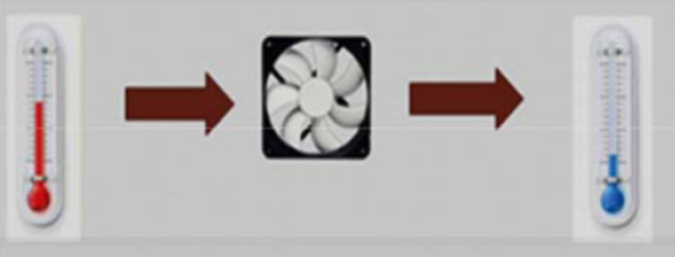
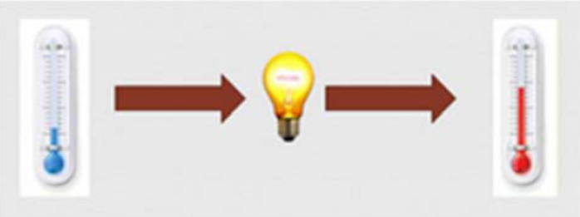
Technical Specification
In automatic mode, when the temperature is below the optimum temperature, the light goes on. The goal is that the temperature will rise to the optimum temperature. When the temperature is above the optimal temperature, the fan will turn on to lower the temperature. Whereas when it reaches the optimum temperature, fan and lights will be off.
Fig. shows the time during fan will be turn on. The current temperature is above the desired temperature, the fan will turn on to decrease the temperature in Egg Incubator.
Fig. shows the time during lamp will be turn on. When the temperature is below the desired temperature, the light will be turn on to increase the temperature in Egg Incubator.

Slide 10
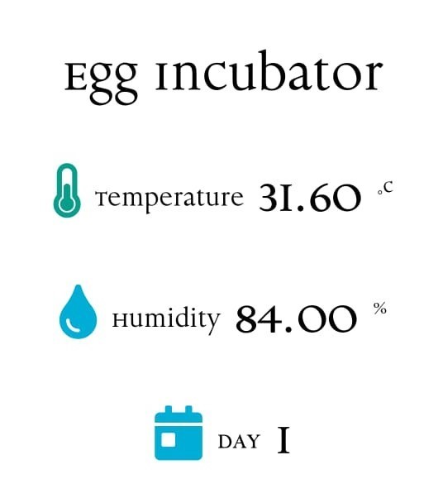
We have implemented a simple application that allows us to see the temperature and humidity of incubator and also display how many days the incubation process had been stated in any mobile, PC, or in any desktop. This webpage can be accessed by everyone and everywhere.
Our Application

Slide 11
Conclusion
This incubator was conceptualized, designed and constructed keeping in mind the sole intention of having a large scale/ small scale hatcher at affordable cost, not only of the incubator, but also that of its running cost with substantial survival/ hatch rate at near natural hatching state. This incubator is prepared for chicken and duck eggs. The current incubator combines the incubator and brooder in the same room. The exact parameters within the incubator will be displayed on the LCD screen. Egg incubator monitoring has been developed and implemented by IoT and successfully implemented in this case. During the hatching test, the eggs were collected from breeders, free from infection or infertility problems, and the chickens were found to be in good health, good size, and 100% incubated.

Slide 12
References
M. A. Kabir., M. A. Abedin., “Design and Implementation of A Microcontroller Based Forced Air Egg Incubator,” International Conference On Advancement in Electrical and Electronic Engineering 22-24 November, 2018, Gazipur, Bangladesh.
IDOKO E., OGBEH G.O., IKULE F.T., “Design and Implementation of Automatic Fixed Factors Egg Incubator,” International journal for Innovative research in multidisciplinary Field, ISSN: 2455-0620 Volume - 5, Issue - 6, June – 2019 Monthly.
Ammar A. Aldair., Abdulmuttalib T. Rashid., Mastaneh Mokayef., “Design And Implementation of Intelligent Control System for Egg Incubator Based on IoT Technology,” Proceedings of 2018 4th International Conference on Electrical, Electronics And System Engineering.

Slide 13
Thank You

