Slide 1

A Presentation on
“EGG INCUBATOR”
Submitted by
Subudhi Anvesh (17ECE123)
Sriram Setty Shanmukha(17ECE121)
Dinesh Kumar Patnaik(17ECE108)
in partial fulfillment for the award of the degree of
BACHELOR OF TECHNOLOGY
in
Electronics and Communication Engineering
Under the esteemed guidance of
Mr. GAUTAM

Slide 2
INTRODUCTION:
IOT based egg hatching system is a system which will help farmers to incubate the eggs automatically without the need of human intervention, by keeping the physical quantities such as temperature and humidity at required level, so that the fetuses inside them will grow and incubates without the presence of mother with monitoring system.
Egg incubator will not only improve the poultry production considerably but will also help in the regularity of income making, enabling the farmers to be able to get transition into possible rural entrepreneurship.

Slide 3
Incubation:
It is the process by which birds hatch their eggs, and to the development of the embryo within the egg.
Automatic Egg Incubator:
Fully automatic incubator will automatically turn the eggs throughout
the incubation period of 21-22 days.
Automatic incubators usually use rotating egg trays, moving floors,
or a cradle in which the full incubator will sit.

Slide 4
COMPONENTS REQUIRED
NodeMCU
16X2 LCD I2C Display
Relay Module
100W Bulbs
2 Cooling Fans
Gear Motors
DHT 11 Temperature and Humidity Sensor
Humidifier

Slide 5
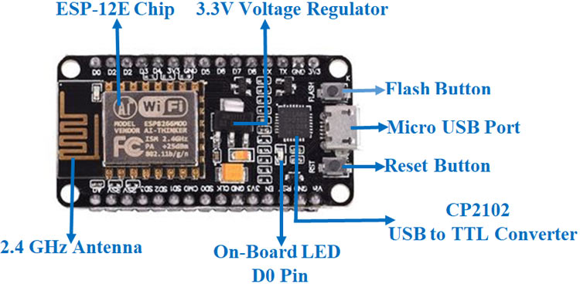
NodeMCU-
The NodeMCU (Node Micro Controller Unit) is an open-source software and hardware development environment built around an inexpensive System-on-a-Chip (SoC) called the ESP8266 which makes it an excellent choice for the Internet of Things (IoT) projects of all kinds.
The ESP8266 is an independent Wi-Fi module solution that provides seamless connectivity.
It acts as a host or allows other host to be downloaded to the system.
Node MCU is utilized to keep the relevant data such as humidity, temperature, rotation of eggs and ventilation onto the memory and serves to post this feature on a cloud server for ease of access.

Slide 6
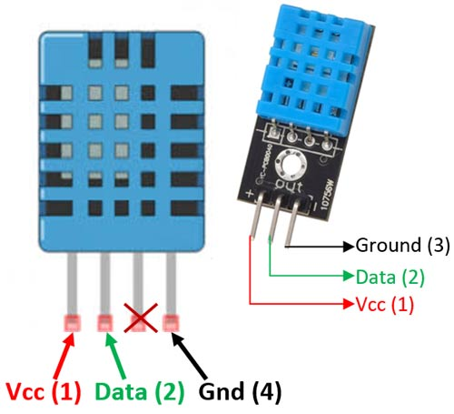
DHT11 Temperature and Humidity Sensor:
The DHT11 is a basic, ultra-low-cost digital temperature and humidity sensor.
It uses a capacitive humidity sensor and a thermistor to measure the surrounding air,
and spits out a digital signal on the data pin (no analog input pins needed).
It’s fairly simple to use, but requires careful timing to grab data.
It’s power range is 3-5V and I/O and consists of 3 pins.
Temperature and humidity, being the main factors for healthy hatching, the DHT11 sensor plays a crucial role.
The primary role is to quantify the temperature and humidity.
It has a humidity range between 40% to 99% (± 5%) and temperature varies between 30°C to 40°C ( ±1°C).

Slide 7
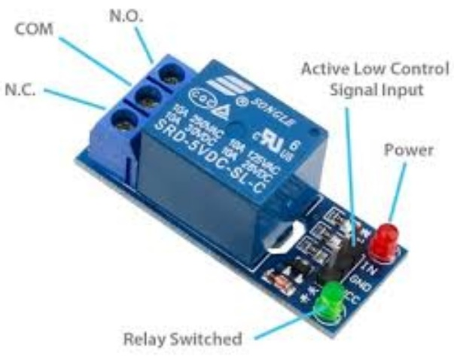
Relay Module-
A Relay Module is an electronic switching device that switches on or off when an external voltage (AC or DC) is applied across its control terminals.
It have fast switching speeds compared with electromechanical relays, and have no physical contacts to wear out.
It has 3 pins-
1.Common pin
2.Normally open
3.Normally closed

Slide 8
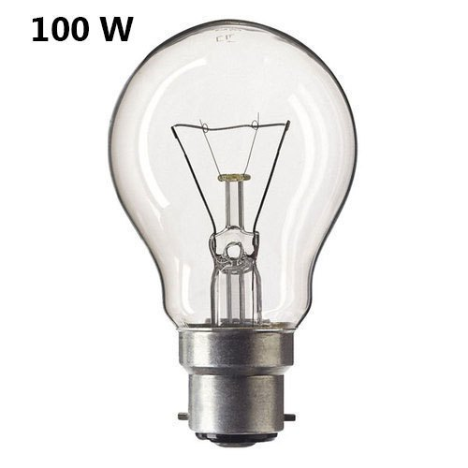
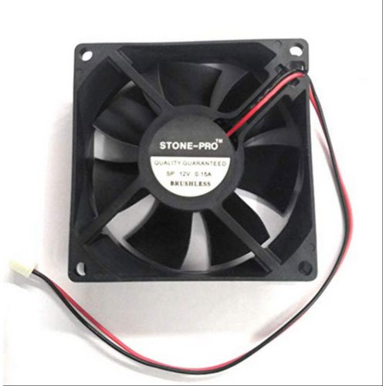
100W Bulbs-
The incandescent bulb consists of a sealed glass bulb with a filament inside. When electricity is passed through the filament, the filament gets hot. Depending on the temperature of the filament, radiation is emitted from the filament.
We use bulbs for increase the temperature and humidity in the incubator.
CPU Cooling Fans:
A computer fan is any fan inside, or attached to, a computer case used for active cooling.
Fans are used to draw cooler air into the case from the outside, expel warm air from inside and move air across a heat sink to cool a particular component.
We use fans to reduce the temperature and humidity in the incubator.

Slide 9
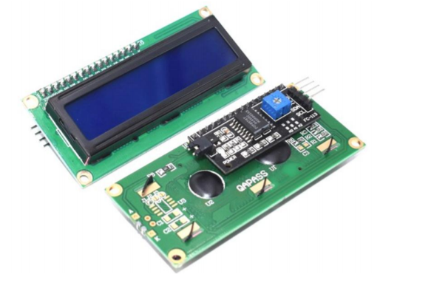
I2C interface 16x2 LCD display module:
I2C interface 16x2 LCD display module, a high-quality 2 line 16 character LCD module
with on-board contrast control adjustment, blue backlight and I2C communication interface.
The LCD Display is used to display the temperature and humidity.
I2C Address:0x38-0x3F (0x3F default)
Supply voltage: 5V
Interface: I2C to 4bits LCD data and control lines.
Contrast Adjustment: built-in Potentiometer.
Backlight Control: Firmware or jumper wire.
Board Size: 80x36 mm.

Slide 10
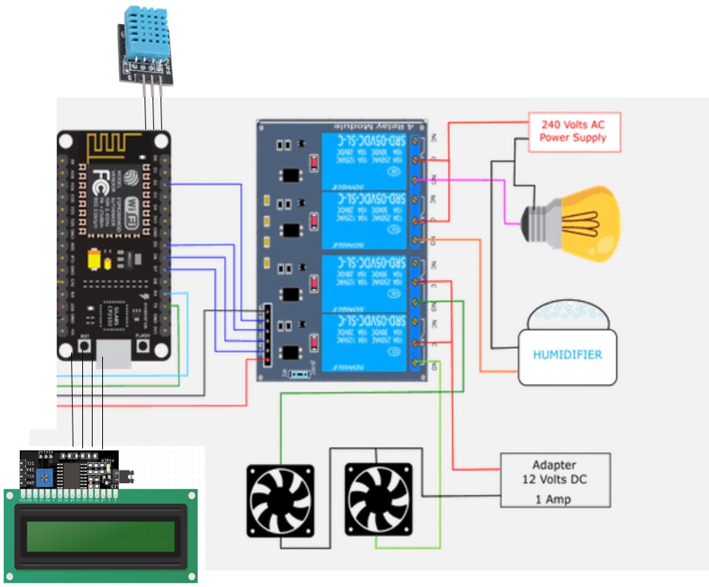
CIRCUIT DIAGRAM

Slide 11
WORKING
Temperature Control
When the temperature is below 35 °C, the bulb goes on.
When the temperature is equal to the 37 °C, the bulb goes off and fan goes on.
Humidity Control
When the humidity is below the optimum value, the humidifier goes on.
When the humidity reaches the maximum value, the humidifier goes off.
Egg Rotation
Eggs in the system get rotated 4 times every day to equally distribute the heat and humidity for 18 days.
The LCD Display is used to display the temperature and humidity.
The whole process continues for 21-22 days without any human interference, and it is controlled by NodeMCU with the help of Sensors and Relays.
In our project the webpage which was created, it was for local(which means the Wi-Fi connected to same network of NodeMCU).
Now with the help of ngrok the whole will become global(which means whole webpage can be accessed and seen by everyone and everyplace).

Slide 12
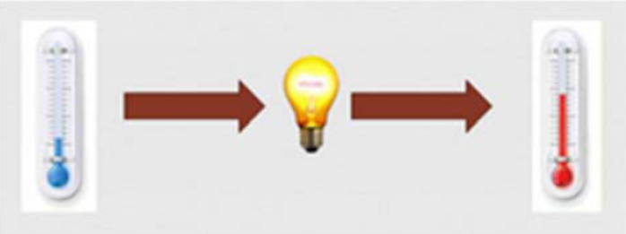
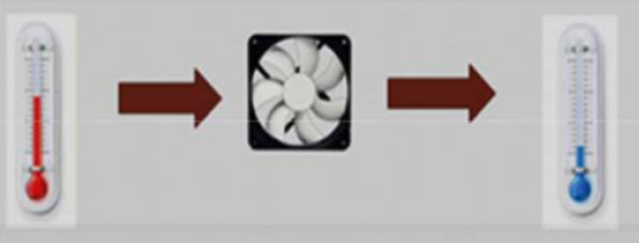
TECHNICAL SPECIFICATIONS
In automatic mode, when the temperature is below the optimum temperature, the light goes on. The goal is that the temperature will rise to the optimum temperature. When the temperature is above the optimal temperature, the fan will turn on to lower the temperature. Whereas when it reaches the optimum temperature, fan and lights will be off.
Fig. shows the time during lamp will be turn on. When the temperature is below the desired temperature, the light will be turn on to increase the temperature in Egg Incubator.
Fig. shows the time during fan will be turn on. The current temperature is above the desired temperature,
the fan will turn on to decrease the temperature in Egg Incubator.

Slide 13
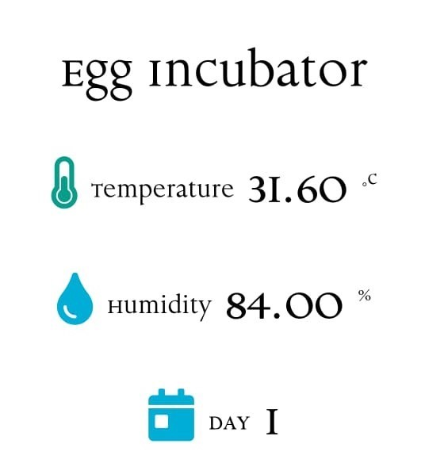
OUR APPLICATION
We have implemented a simple application that allows us to see the temperature and humidity of incubator and also display how many days the incubation process had been stated in any mobile, PC, or in any desktop. This webpage can be accessed by everyone and everywhere.

Slide 14
CONCLUSION
This incubator was conceptualized, designed and constructed keeping in mind the sole intention of having a large scale/ small scale hatcher at affordable cost, not only of the incubator, but also that of its running cost with substantial survival/ hatch rate at near natural hatching state. This incubator is prepared for chicken and duck eggs. The current incubator combines the incubator and brooder in the same room. The exact parameters within the incubator will be displayed on the LCD screen. Egg incubator monitoring has been developed and implemented by IoT and successfully implemented in this case. During the hatching test, the eggs were collected from breeders, free from infection or infertility problems, and the chickens were found to be in good health, good size, and 100% incubated. Farmers of this incubator can confidently rely on poultry farming on a small scale and can also be used in egg embryo research and laboratory work.

