Slide 1

NAME OF THE PROPOSAL NAME OF INCUBATOR | SMART BLIND ASSISTANT GANDHI INSTITUTE OF MANAGEMENT STUDIES
NAME OF INCUBITEE | Mr. SUBUDHI ANVESH Ms. AKANCHA
MENTOR | Mr. SUBHRAJIT PRADHAN
BENEFICIARY | THE BLIND PEOPLE
PROPOSED COST | 5.35
CATEGORY OF TECHNOLOGY | MODIFIED

Slide 2

MARKET PLAN
To spread awareness about the
obstacles faced by the blind people.
253 million people are visually
impaired, among them 36 million
people are blind, that counts to 13.8%.
The blind people all over the world
face this problem.
Source:
https://www.scienceabc.com/eyeopeners/why-do-blind-people-wear-dark-glasses.html
http://www.who.int/news-room/fact-sheets/detail/blindness-and-visual-impairment

Slide 3
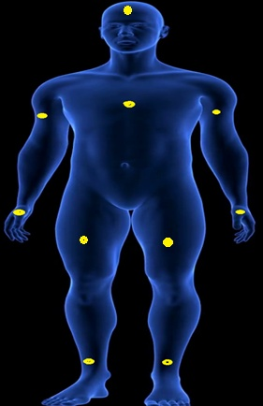
TECHNOLOGY/ PROGRESS SOLUTION
Sensor based stripe.
Use of Ear plugs
This sensor stripe is independent of size.
It will assist the blind people from obstacles.
Source:
https://www.videoblocks.com/video/blue-human-anatomy-body-3d-scan-render---rotating-seamless-loop-sbortfxw-j33kwtxz

Slide 4
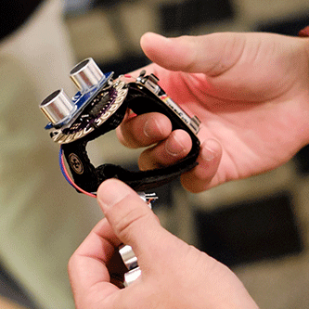
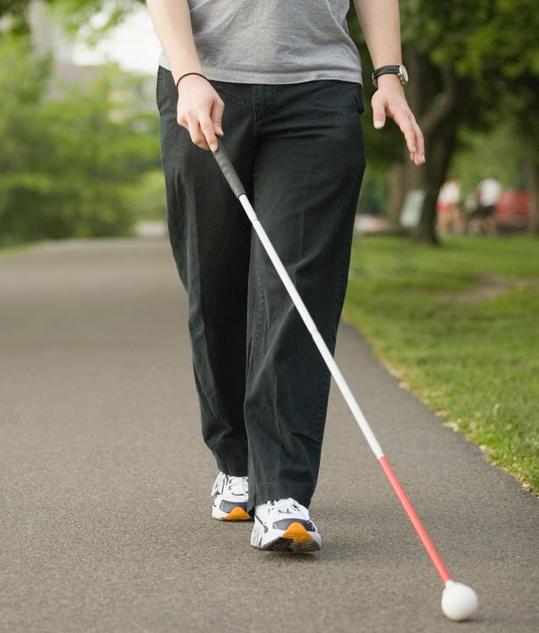
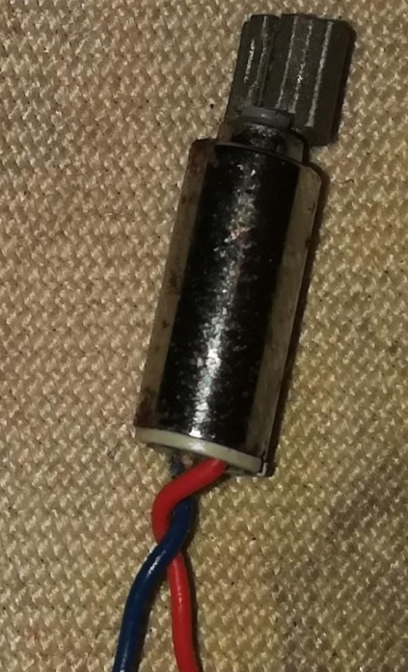
VALUE PROPOSITION
To overcome problems regarding blind stick.
The product is an electronic device that helps the blind person to walk like ordinary people.
The blind person will be self-dependent.
Source:
https://2nznub4x5d61ra4q12fyu67t-wpengine.netdna-ssl.com/wp-content/uploads/2014/11/sonar-helper1.png
https://www.rednewswire.com/blind-engineer-designs-new-facebook-sharing-system/

Slide 5
Sensor
Stripe
Home
Environment
Easy Life
Hope of
Living
No
Blind Stick
Benefits

Slide 6


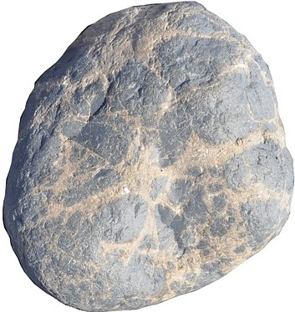
PROCESS

Slide 7

MARKET
The blind people all over the world.
The target is to make our device reach to every blind person.
To cope up with the increasing sales of our device in the market.
Source:
https://www.canstockphoto.com/3d-colorful-different-people-around-17031616.html

Slide 8
CHANNELS
To avoid barriers , we will carry out word of mouth marketing .
Through advertisement sources such as Newspapers , TV, Social media etc.
It is a type of business directly dealing with customers.

Slide 9
REVENUE MODEL
Years | No of stripes | Cost Price | Sell Price | Profit
* | 1 | 7000 | 10000 | 3000
1 | 50 | 350000 | 500000 | 150000
2 | 100 | 700000 | 1000000 | 300000
3 | 200 | 1400000 | 2000000 | 600000
4 | 300 | 2100000 | 3000000 | 900000
5 | 500 | 3500000 | 5000000 | 1500000

Slide 10
MSME BREAK DOWN
Sl no. | Groups as per guideline | Budget in lakhs | MSME support in lakhs | Own contribution in lakhs
1 | Technology fee | 2.15 | 1.8275 | 0.3225
2 | Telephone | 0.2 | 0.17 | 0.03
3 | Machinery | 0.8 | 0.68 | 0.12
4 | Guidance fee per mentors/ hand holding person | 0.8 | 0.68 | 0.12
5 | Electricity, Accommodation charges | 1.4 | 1 | 0.4
Total project cost |  | 5.35 | 4.375 | 0.9925
Funding from MSME |  | 4.375
Incubatee Contribution |  | 0.9925

