Slide 1
GIET UNIVERSITY
Project name:
SMART WASTE MANGEMENT SYSTEM
Submitted by:
Subudhi Anvesh(17ece123)
Sriram Setty Shanmukha(17ece121)

Slide 2
INTRODUCTION:
Things that are connected to internet and sometimes these devices can be controlled from the internet is commonly called as internet of things. The internet of things (iot) is a concept in which surrounding objects are connected through wired and wireless networks without user intervention. In the field of iot, the objects communicate and exchange information to provide advanced intelligent services for users. Owing to the recent advances in mobile devices equipped with various sensors and communication modules, together with communication network technologies such as wi-fi and LTE, the iot has gained considerable academic interests.
Owing to the characteristics and merits of iot services, waste management has also become a significant issue in academia, industry, and government as major iot application fields. An indiscriminate and illegal discharge of waste, an absence of waste disposal and management systems, and inefficient waste management policies have caused serious environmental problems and have incurred considerable costs for waste disposal.
In our system, the smart dust bins are connected to the internet to get the real time information of the smart dustbins. In the recent years, there was a rapid growth in population which leads to more waste disposal. So a proper waste management system is necessary to avoid spreading some deadly diseases. Managing the smart bins by monitoring the status of it and accordingly taking the decision. This waste is further picked up by the municipal corporations to finally dump it in dumping areas and landfills.

Slide 3
OBJECTIVES:
In this proposed system, waste is managed in two different waste accordingly i.e. dry and wet. In this system the speed of the network does not matter as MQTT is a very light weight protocol which will work with low internet speed also with a high speed transfer of data. Automation i.e. machine to machine communication without any involvement of the human.
The dustbin indication is done by 3 different LED’s.
If the dustbin is full then LED will be on and this information is directly sent to described office’s.
COMPONENTS USED:
1.Raspberry Pi 3 B+Model
2.Ultrasonic Sensor
3.NodeMCU
4.LED’s

Slide 4
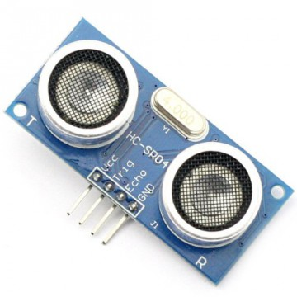
COMPONENTS DESCRIPTION ALONG WITH IMAGES:-
Ultrasonic Sensor:
ultrasonic sensors are a type of acoustic sensor divided into three broad categories: transmitters, receivers and transceivers. Transmitters convert electrical signal into ultrasound , receivers convert ultrasound into electrical signals, and transceivers can both transmit and receive ultrasound.
In a similar way to radar and sonar , ultrasonic transducer are used in systems which evaluate targets by interpreting the reflected signals. For example, by measuring the time between sending a signal and receiving an echo the distance of an object can be calculated. Passive ultrasonic sensors are basically microphones that detect ultrasonic noise that is present under certain conditions.
It consists of 4 different pins: VCC, ground, Trigger pin, Echo pin.
Ultrasonic sensor trig signals and when it find any object it reflect back the signal and receives through the echo pin.
The distance is measured by the formula:
distance = (duration*.0343)/2;

Slide 5
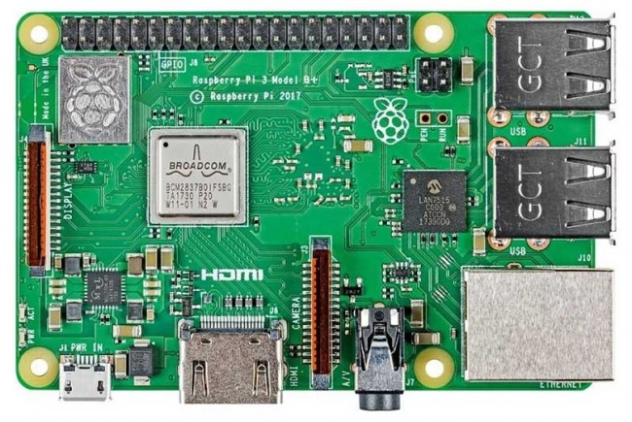
Raspberry pi 3 B+ model:
The latest Raspberry Pi 3 Model B+ has a faster 64-bit 1.4GHz quad core processor, 1GB of RAM, faster dual-band 802.11 b/g/n/ac wireless LAN, Bluetooth 4.2, and significantly faster 300Mbit/s ethernet.
Improved thermals on the Pi 3 B+ means that the CPU on the BCM2837 SoC can now run at 1.4GHz, a 17% increase on the previous Pi 3 model (which ran at 1.2GHz)
The Pi 3 B+ has significantly faster wired networking, thanks to an upgraded USB/LAN chip, and you should see speeds that are 3-5x faster than on previous models of the Pi, at least 300Mbit/s.
1.4GHz 64-bit quad-core ARM Cortex-A53 CPU (BCM2837)
1GB RAM (LPDDR2 SDRAM)
On-board wireless LAN - dual-band 802.11 b/g/n/ac (CYW43455)
On-board Bluetooth 4.2 HS low-energy (BLE) (CYW43455)
4 x USB 2.0 ports
300Mbit/s ethernet
40 GPIO pins
Full size HDMI 1.3a port
Combined 3.5mm analog audio and composite video jack
Camera interface (CSI)
Display interface (DSI)
microSD slot
VideoCore IV multimedia/3D graphics core @ 400MHz/300MHz
It consists of 40 GPIO pins.

Slide 6
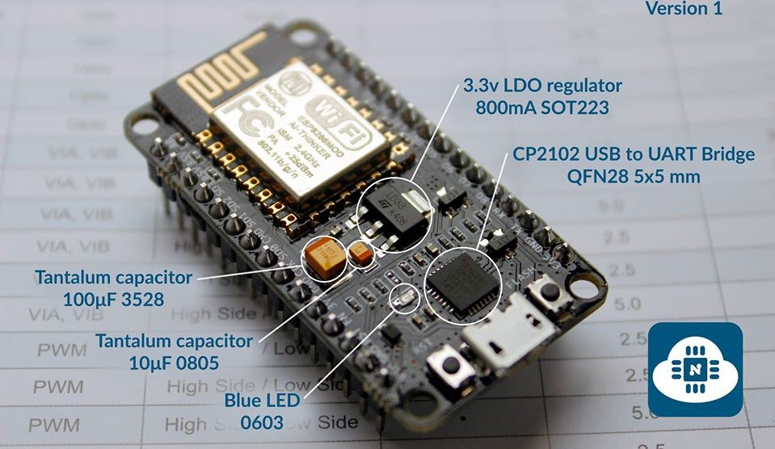
NodeMCU:
NodeMCU is an open-source firmware and development kit that helps you to prototype or build IoT product. It includes firmware which runs on the ESP8266 Wi-Fi SoC from Espressif Systems, and hardware which is based on the ESP-12 module. The firmware uses the Lua scripting language. It is based on the eLua project, and built on the Espressif Non-OS SDK for ESP8266.
We usually use Arduino IDE to execute the nodeMCU programs. This makes it very convenient to use the ESP8266 chip as we will be using the well-known Arduino IDE.
• Voltage:3.3V.
• Wi-Fi Direct (P2P), soft-AP.
• Current consumption: 10uA~170mA.
• Flash memory attachable: 16MB max (512K normal).
• Integrated TCP/IP protocol stack.
• Processor: Tensilica L106 32-bit.
• Processor speed: 80~160MHz.
• RAM: 32K + 80K.
• GPIOs: 17 (multiplexed with other functions).
• Analog to Digital: 1 input with 1024 step resolution.
• +19.5dBm output power in 802.11b mode

Slide 7
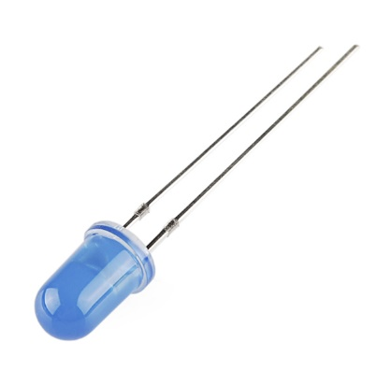
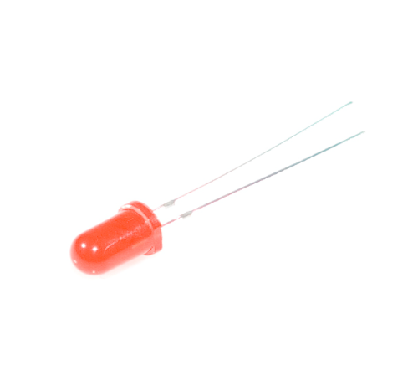
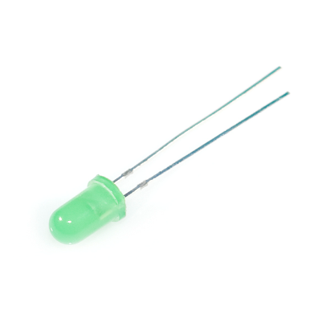
LED’S:
A light-emitting diode is a semiconductor light source that emits light when current flows through it. Electrons in the semiconductor recombine with electron holes, releasing energy in the form of photons.
Here we use 3 different LED’s . They are RED,GREEN,BLUE colour.
RED led indicates that the dustbin is full.
GREEN led indicates that the dustbin is half filled.
BLUE led indicates that the dustbin is empty.

Slide 8

Power supply
Raspberry Pi
LED’s
BLOCK DIAGRAM:
cloud
Power supply
Nodemcu
Dustbin with Ultrasonic sensor

Slide 9
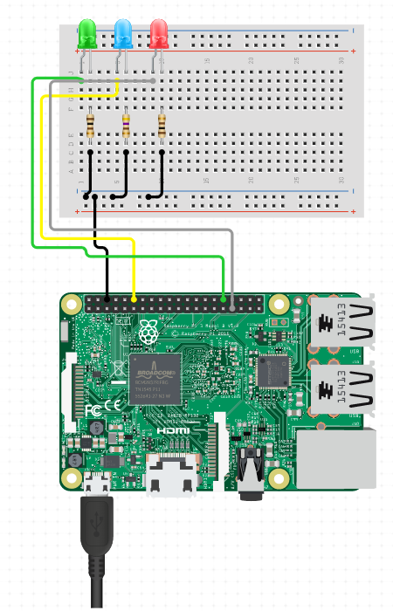
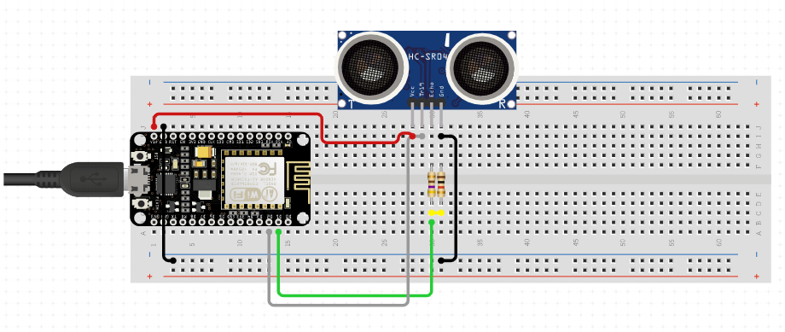
CIRCUIT DIAGRAM:
Publisher part
Subscriber part

Slide 10
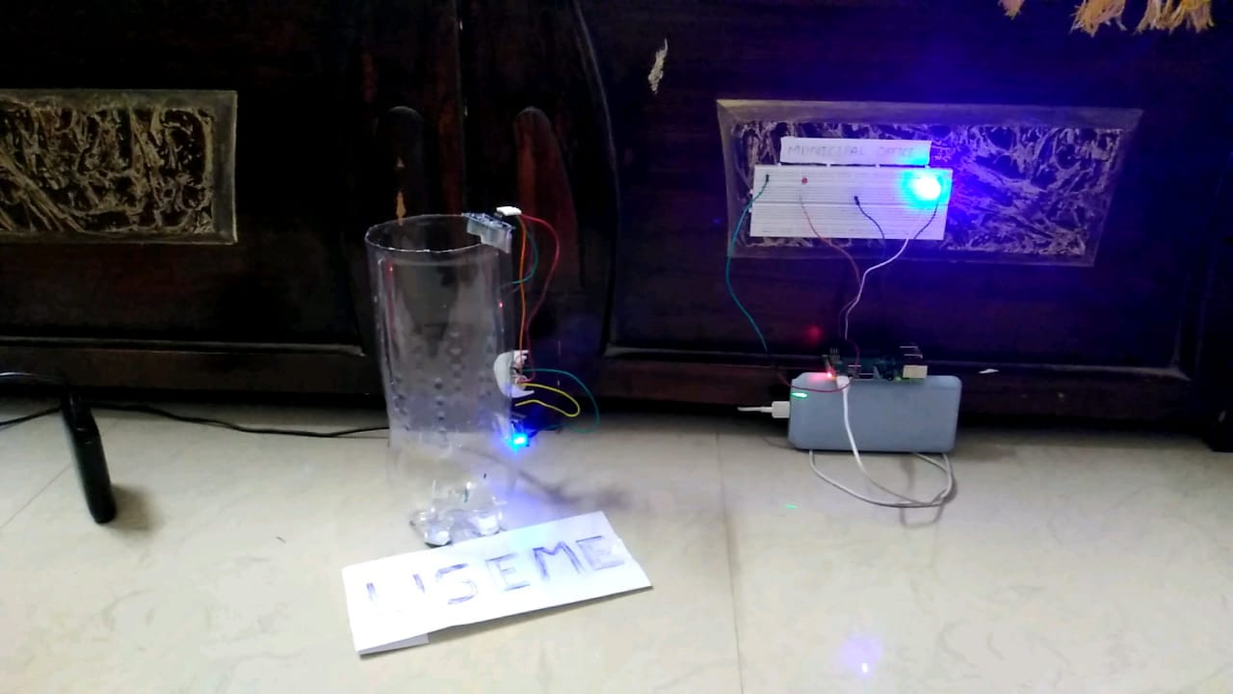
Setup

Slide 11
Conclusion:
We have implemented real time waste management system by using dustbin to check the fill level of smart dustbin whether the dustbin are filled or not.In this system the information off all smart dustbin can be accesed from anywhere and anytime by the concern person and he can take decision accordingly.By implementing the proposed system the reductiin,resource optimisation,effective usage of smart dustbin can be done.This system indirectly reducing traffic in the city.In major cities the bgarbage collection vehicles visit the everydaytwice or thrice depends on the population of the particular area and sometimes these dustbinmay not be full.Our sustem will inform the status of the dustbinin real time so that the concern authority can send the garbage collection vehicles onlywhen the dustbin is full.The scope for the future work is the system can be implemented with the time stamp in which real time clock shown to the concern personat what time dustbin is full and at what time the waste is collected from the smart dustbin.

