Slide 1

A Presentation on
“AUTOMATIC WIRELESS WATER LEVEL INDICATOR
AND CONTROLLER”
Submitted by
Subudhi Anvesh (17ECE123)
Sriram Setty Shanmukha(17ECE121)
Dinesh Kumar Patnaik(17ECE108)
in partial fulfillment for the award of the degree of
BACHELOR OF TECHNOLOGY
in
Electronics and Communication Engineering
Under the esteemed guidance of
Mr. GAUTAM

Slide 2
INTRODUCTION:
The Water Level Indicator employs a simple mechanism to detect and indicate the water level in an overhead tank or any other water container. In this project we show the water level indicator using 10 transistors which conducts as level rises, a relay is also added which will automatically start the water pump as the water level becomes minimum detection level.
With the help of this project, we not only show the level of water with the help of seven segment display but also controlled the water pump based upon the water level.
The wireless connection is used between Transmitter and Receiver circuits. Transmitter and receiver circuit are used at tank and motor switch/control panel respectively.

Slide 3
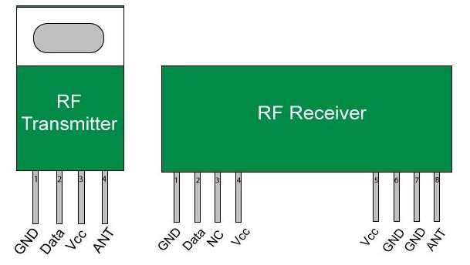
433MHz Radio Frequency Transmitter and Receiver:
RF module is a combination of RF Transmitter and RF Receiver. The transmitter/receiver (Tx/Rx) pair operates at a frequency of 433 MHz . The RF transmitter receives serial data and transmits it wirelessly through its RF antenna.
The RF receiver receives the transmitted data and it is operating at the same frequency as that of the transmitter.
A transmitter can only send information and a Receiver and can only receive it.
The RF Transmitter module consists of three pins namely Vcc, Din and ground as shown above.
The RF receiver module has four pins namely Vcc , Dout , Linear out and Ground.

Slide 4
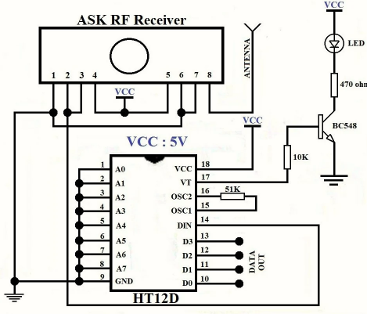
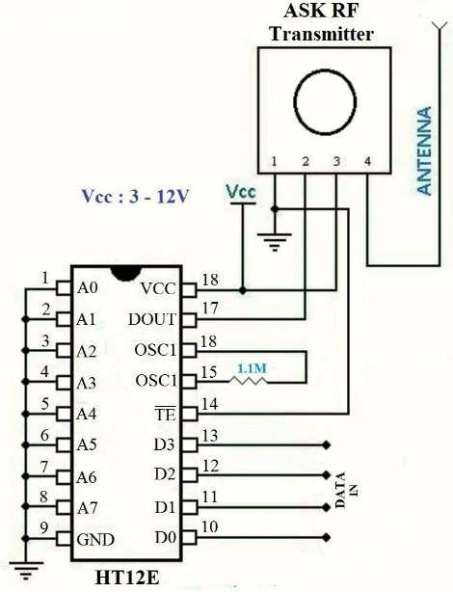
RF Transmitter Circuit Diagram RF Receiver Circuit Diagram

Slide 5
Decoders and Encoders-
The HT12D and HT12E are 4-data bit encoder and decoder modules. These are 18 pin IC’s which can operate between 3V to 12V input power supply. They have 4-data bit and 8-addresss bit which has to be set same on both the encoder and decoder to make them work as a pair.
The HT12E is an encoder IC that converts the 4-bit parallel data from the 4 data pins into serial data in order to transmit over RF link using transmitter.
The HT12D is a decoder IC that converts the 4-bit serial data from the 4 data pins into parallel data and drives the output accordingly.
The RF modules can also function without the need of Encoder and Decoder modules.

Slide 6
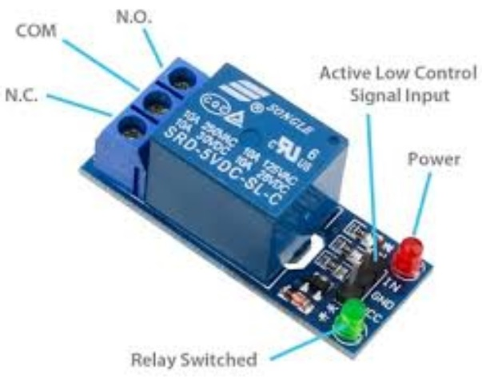
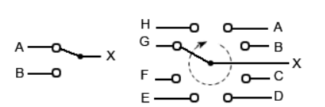
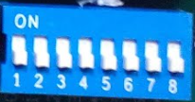
Relay Module-
A Relay Module is an electronic switching device that switches on or off when an external voltage (AC or DC) is applied across its control terminals.
It have fast switching speeds compared with electromechanical relays, and have no physical contacts to wear out.
It has 3 pins-
1.Common pin
2.Normally open
3.Normally closed
Address Selector-
It is an electronics device that selects single data with multiple inputs.
It mainly used to select the address of HT12D & HT12E in our project.
It is also used to set the MDL of the over-head tank.

Slide 7
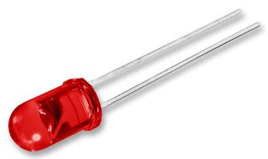
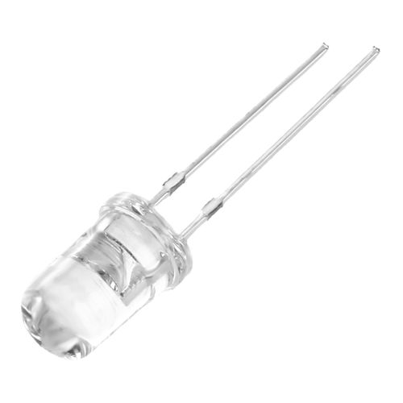
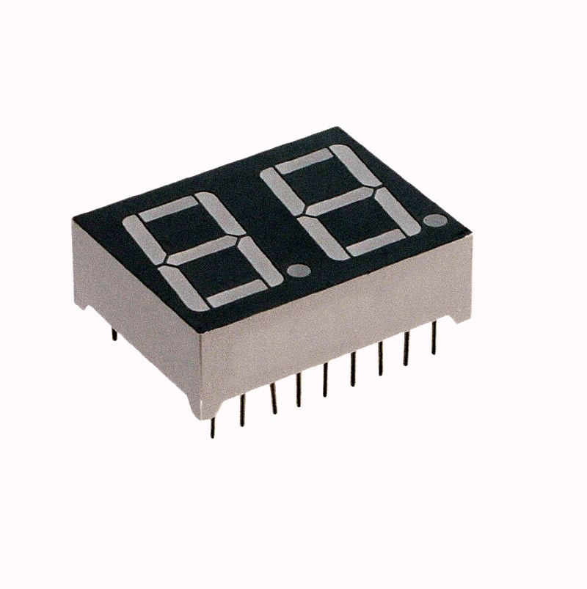
LED-
A light-emitting diode is a semiconductor light source that emits light when current flows through it.
GREEN led indicates that establishment of wireless connection between both Tx and Rx circuits will be displayed.
WHITE led indicates the status of motor of the water tank.
3 Digit 7-Segment LED Display-
A 3 digit seven-segment display is a form of electronic display device for displaying decimal numerals that is an alternative to the more complex dot matrix displays.
This display has nothing more than 8 LED inside it. These 8 LEDs are separated into each segments.
Here we use to used for indication of the tank level.

Slide 8
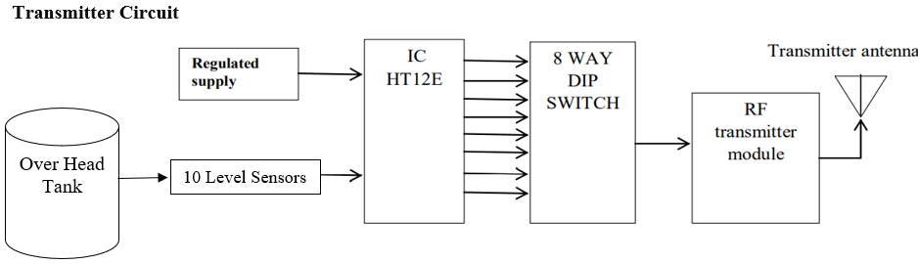
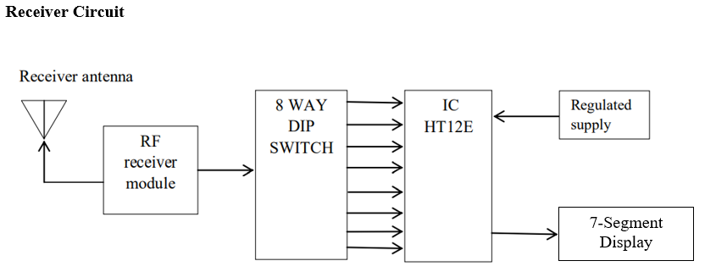
Block Diagram of Tx & Rx Circuit:

Slide 9
OPERATION
The operation of this project is very simple and can be understood easily.
In our project “water level indicator” there are 3 main conditions:
1. There is no water available in the source tank or water is below 3rd level.
2. Intermediate level i.e., either of 4th to 9th level.
3. There is ample amount of water available in the source tank.

Slide 10
APPLICATIONS
It can be used in Hotels, Factories, Homes Apartments, Commercial Complexes, Drainage, etc.
It can be fixed for single phase motor, Single Phase Submersibles, Three Phase motors and open well, Bore well and Sump.
Automatic water level controller will automatically START the pump set as soon as the water level falls below the predetermined level (usually 1/2 tank) and shall SWITCH OFF the pump set as soon as tank is full.
We can control two motor and two sumps and two overhead tanks by single unit.
Fuel level indicator in vehicles
Liquid level indicator in the huge containers in the companies.

