Slide 1
Reactjs Introduction

Slide 2
Overview
React is a CLIENT side framework
Uses Component architecture
Think custom HTML tags
Combines View Model, Controller, and View in the same file
Usually creates a Single Page App (SPA)
Uses react-router module to navigate on the browser
Uses MVC (in the browser)
Uses new language, JSX (JavaScript with XML)
Must use a compiler to translate into JavaScript
Use babel to translate (trans-compiler)
Uses AJAX to communicate with server

Slide 3
Components
Each Component has
Model – stored in the this.state hash property
View – called by React via the render() method
Controller – called by the view when an event occurs
Actually, think View ➔ Controller ➔ Model
The View collects User Input (mouse clicks, etc), passes event to the Controller (methods in the Component)
The Controller calls the business logic, updates the Model
Uses this.setState( { name: value } );
React AUTOMATICALLY notices notices the Model changed and renders() the View

Slide 4
Client Side Framework
It is a Client side framework
In the HTML
Use <script> tag to load modules
‘react’ – the main code
‘react-dom’ – accesses the browser’s DOM
‘react-router’ -- creates the page’s topology
‘babel/browser.js’ – converts the JSX to JS
‘components.js’ – my JSX code – transpiled
Contains the React application code

Slide 5
React Example 1 – fullPage.html
File ➔ javascripts/fullPage.js – contains the React app
<!DOCTYPE html> <html lang="en"> <head> <meta charset="UTF-8"> <title>TODO List</title> <link rel="stylesheet" href="stylesheets/style.css"> </head> <body> <div id="fullPage"></div> <script src="components/jquery/dist/jquery.js"></script> <script src="components/react/react.js"></script> <script src="components/react/react-dom.js"></script> <script src="components/babel/browser.js"></script> <script src="javascripts/fullPage.js" type="text/babel"></script> </body> </html>
Where to deploy the React app
The React source code

Slide 6
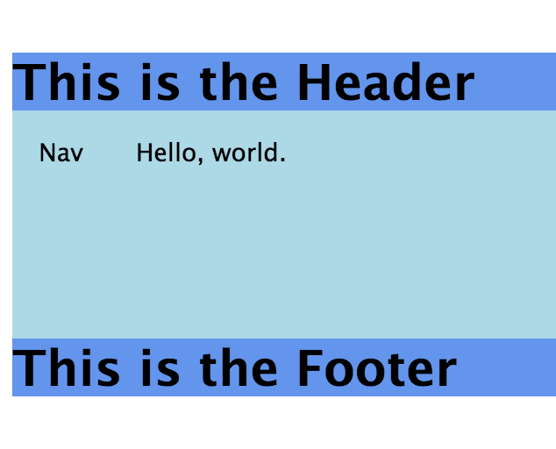
React Example 1:
File → javascripts/fullPage.js
The React app looks like this
Has multiple Components, <Header>, <Footer>, <Nav>, <Middle>
Parent passes text to the Children

Slide 7
React Example 1: fullPage.js
var Header = React.createClass( { render() { return ( <div className="header"><h1>{this.props.header}</h1></div> ); } }); var Footer = React.createClass( { render() { return ( <div className="footer"><h1>{this.props.footer}</h1></div> ); } }); var Nav = React.createClass( { render() { return ( <div className="nav">{this.props.nav}</div> ); } });

Slide 8
React Example 1:
The render() method is on the next page
var Middle = React.createClass( { render() { return ( <div className="middle">{this.props.text}</div> ); } }); var FullPage = React.createClass({ getInitialState() { return { header: 'This is the Header', footer: 'This is the Footer', nav: 'Nav' }; },
Continued on the next page…

Slide 9
React Example 1:
render() { return ( <div className="fullPageBox"> <Header header={this.state.header}/> <div className="middle"> <div className="half"> <Nav nav={this.state.nav}/> </div> <div className="half"> <Middle text="Hello, world."/> </div> </div> <Footer footer={this.state.footer} /> </div> ); } }); ReactDOM.render( <FullPage />, document.getElementById('fullPage') );
Where to deploy

Slide 10
React Example 2 – index.html
<!DOCTYPE html> <html lang="en"> <head> <meta charset="UTF-8"> <title>TODO List</title> <link rel="stylesheet" href="stylesheets/style.css"> </head> <body> <div id="todoListBox"></div> <script src="components/jquery/dist/jquery.js"></script> <script src="components/react/react.js"></script> <script src="components/react/react-dom.js"></script> <script src="components/babel/browser.js"></script> <script src="javascripts/components.js" type="text/babel"></script> </body> </html>

Slide 11
Array.prototype.map()
An aside… here’s what map() does...
Array.prototype.map() returns a new array with the same size
It changes each element by calling an anonymous function
var todos = ['first', 'second', 'third']; var views = todos.map( function( item, idx ) { return 'views-' + item; }); // views ==> ['views-first','views-second','views-third']

Slide 12
Javascripts/components.js
var TodoListBox = React.createClass({ render() { var todos = ['Eat Lunch', 'Walk the Dog', 'Sleep']; var views = todos.map(function(item, idx){ return <div key={idx}>{item}</div>; }); return ( <div className="todo-list-box"> <h1>Todo List</h1> {views} </div> ); } }); ReactDOM.render( <TodoListBox />, document.getElementById('todoListBox') );

Slide 13
Javascripts/components.js – ES6 / JS2015
class TodoListBox extends React.Component { render() { const todos = ['Eat Lunch', 'Walk the Dog', 'Sleep']; let views = todos.map( (item, idx) => <div key={idx} >{item}</div> ); return ( <div className="todo-list-box"> <h1>Todo List</h1> {views} </div> ); } } ReactDOM.render( <TodoListBox />, document.getElementById('todoListBox') );

Slide 14
Model
Each Component has
Model – stored in the this.state hash property
View – called by React via the render() method
Controller – called by the view when an event occurs
Standard methods in the Component
constructor() – method to initialize the state data
Must call super() first thing – ES6 only
setState( { key: value } ) – changes the state variable
getInitialState() – returns initial state object – non-ES6
React re-renders the Component when
Page refreshed
State property changes -- use setState() method

Slide 15
Model - Example
var TodoListBox = React.createClass({ getInitialState() { return { todos: ['Eat Lunch', 'Walk the Dog', 'Sleep'], current: '' }; }, render() { var views = this.state.todos.map((item, idx) => <div key={idx}>{item}</div>); return ( <div className="todo-list-box"> <h1>Todo List</h1> {views} </div> ); } });

Slide 16
Controller
The Controller handles events from the DOM
The Controller methods live in the Component
The render() method outputs the view
The HTML uses normal ‘on-’ properties to define the event handler
Use { } to reference the Component methods

Slide 17
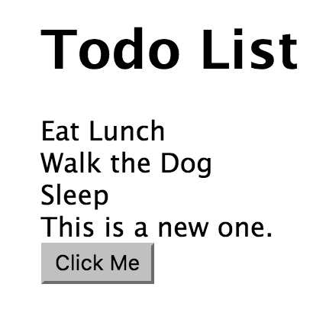
Controller Example
render() { var views = this.state.todos.map((item, idx) => <div key={idx}>{item}</div>); return ( <div className="todo-list-box"> <h1>Todo List</h1> {views} <button onClick={this.click} >Click Me</button> </div> ); }, click: function( event ) { event.preventDefault(); this.setState( {'todos': this.state.todos.concat('This is a new one.')}); }

Slide 18
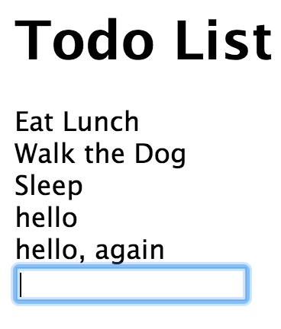
Controller Example 2 - <input>
render() { var views = this.state.todos.map((item, idx) => <div key={idx}>{item}</div>); return ( <div className="todo-list-box"> <h1>Todo List</h1> {views} <form onSubmit={this.addOne}> <input type="text" onChange={this.change} value={this.state.current}/> </form> </div> ); }, change: function (event) { event.preventDefault(); this.setState({'current': event.target.value}); }, addOne: function( event ) { event.preventDefault(); var item = this.state.current.trim(); if (item.length > 0) { this.setState( {'todos': this.state.todos.concat( item ), 'current': ''}); } },

Slide 19
Combining Components
Combine Components just like you would other HTML tags
Data is ALWAYS passed from the parent to the child tag
If the child MUST update some model property in the parent
Pass in an object or function that the client can call
In the parent render() method
Simply use a child component like any other HTML tag
Pass data as an ATTRIBUTE on the child tag
In the child component
Access attribute data using this.props.<attributeName>’
Data will be any type the parent passes.

Slide 20
Combining Components - Example
var TodoItem = React.createClass( { render() { return ( <div> {this.props.content} </div> ); } }); var TodoListBox = React.createClass({ getInitialState() { return { todos: ['Eat Lunch', 'Walk the Dog', 'Sleep'], current: '' }; }, render() { return ( <div className="todo-list-box"> <h1>Todo List</h1> <TodoItem content="Walk the dog." /> <TodoItem content="Walk the spouse." /> <form onSubmit={this.addOne}> <input type="text" onChange={this.change} value={this.state.current}/> </form> </div> ); },

Slide 21
Virtual DOM
React notices the Model has changed (with setState())
React calls render() of the component
React puts the HTML into an in-memory copy of the DOM
Called the Virtual DOM
If it updated the DOM for each component, it is SLOW
After rendering ALL components (that need it)
It updates differences between the Virtual DOM and the DOM
MUCH faster
Many components have sub components that must change also

Slide 22
AJAX
The React app often uses AJAX to communicate with the server
One of the following sections describes this in great detail.
The most important point is that the AJAX updates the state variable and React automatically re-renders the Components

Slide 23
Summary
React is a Client (browser) framework.
It uses a Component Architecture
Each Component becomes a custom tag in HTML
Each Component has its own MVC (usually in the same file)
Uses a new language, JSX, which combines JavaScript with the view
React compiles the JSX file into JS using babel on the client side
NOTE: we did everything manually in the section
In the following sections, we will use Kraken and its build tools

Slide 24
Lab Exercise
Review the lab instructions in /instructions/react-intro.docx
Use the /lab folder which already contains an Express app
Install the node modules with
npm install
Edit the /lab/javascripts/components.js file.
Create the <TodoListBox> and <TodoItem> components
Run the application using
npm start
View the page in
http://localhost:3000/react.html
Add some todo items

