Slide 1
React Component Communications

Slide 2
Overview
Decompose an HTML document into React components
Describes the interface between the parent and child components
Extract the business logic from the display logic

Slide 3
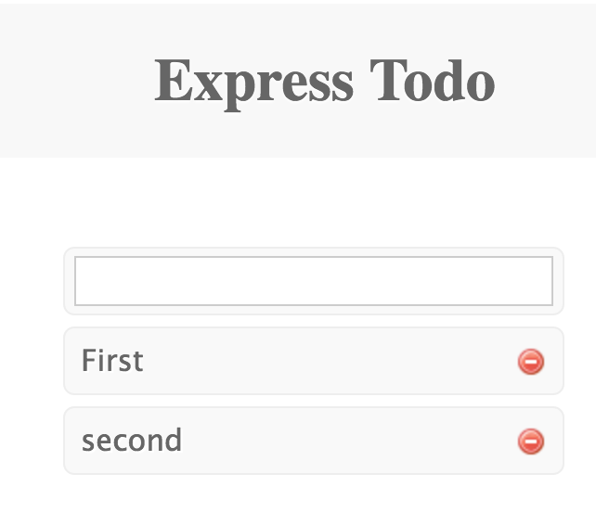
The Goal
Convert an HTML document into a React app
First, define the components based on the View
In this case, there are three
TodoList
TodoInput
TodoItem

Slide 4
The HTML
<div id="layout"> <h1 id="page-title">Express Todo</h1> <div id="list">
<form action="/create" method="post" > <div class="item-new"> <input type="text" name="content" class="input"> </div> </form>
<div class="item"> <a href="/edit/f47b6329-e3db-4af2-e2a1-6fd818ab08ac" title="Update this todo item" class="update-link">First</a> <a href="/delete/f47b6329-e3db-4af2-e2a1-6fd818ab08ac" title="Delete this todo item" class="del-btn">Delete</a> </div> </div> </div>

Slide 5
Converting HTML to React JSX
In React
No class attribute – Use className instead
In a <form>
No action attribute – Use onSubmit() event handlers instead
No method attribute – Not needed
In an <a>
No href attribute – Use onClick() event handler instead

Slide 6
<form> Conversion
From HTML
<form action="/create" method="post" > <div class="item-new"> <input type="text" name="content" class="input"> </div> </form>
To JSX
<form onSubmit={this.submit}> <div className="item-new"> <input type="text" name="content" className="input"/> </div> </form>

Slide 7
DOM Event Handlers
submit: function (e) { e.preventDefault(); var content = e.target.elements[0].value; e.target.elements[0].value = ''; }
Input parameter is DOM Event object
e.target – The DOM element on which event occurred
If target is a <form>, target.elements is an ARRAY of input elements
If DOM element is an <input>, element.value represents the value
Can be assigned which updates the DOM element
e.preventDefault() – stops DOM from handling event
If target is a <form>, then NO SUBMIT is done

Slide 8
Parent / Child Communication
To send information from the Parent to the Child
Parent puts data in an HTML Attribute
Child reads the attribute with this.props.<attributeName>
To send information from the Child to the Parent
Parent puts a callback (a function or object) in the attribute
Child calls the callback in an event handler, passing the data back

Slide 9
Example: <TodoInput>
<TodoInput> has parent <TodoList>
Parent <TodoList>
renders ➔ <TodoInput create={this.create} />
contains ➔
create: function( content ) { controller.create( content, this.done ); },
Child <TodoInput>
Renders → <form onSubmit={this.submit}>
Contains ➔
submit: function(e) { …. this.props.create( content ) }

Slide 10
TodoInput Component
var TodoInput = React.createClass({ render: function render() { return ( <form onSubmit={this.submit}> <div className="item-new"> <input type="text" name="content" className="input"/> </div> </form> ) }, submit: function (e) { e.preventDefault(); var content = e.target.elements[0].value; e.target.elements[0].value = ''; this.props.create( content ); } });

Slide 11
Summary
With multiple components
Parents must send data to children
Use attributes to pass data down to children
Children MAY have to return data / results to Parents
Pass functions as attributes to children
Occasionally sibling components may have to access the same data
React flux describes that in another section

Slide 12
Lab Exercise
Review the lab instructions in
/instructions/react-components.docx
Use the /lab folder which already contains a Kraken app
Create the following components:
<TodoList> -- The outermost block
<TodoInput> -- Allows user to input a new todo
<TodoItem> -- Renders one todo item

