Slide 1
Communicating with the Server

Slide 2
Overview
React is a CLIENT side framework
Assume the server provides a REST interface
HTTP interface
Communicates with JSON objects
From the React app
Use XML Http Request (XHR)
Too Hard
Use jQuery (or any other JS client framework)
$.getJSON(‘/api/todos’, function( todos ) { // stuff }
$.post(‘/api/todos’, { id: ??, content: ‘hello’}, function( todos ) ..

Slide 3
Problems with Client Side Frameworks
Can’t run on the server
Require a window object
Uses globals from the window object
When server renders the page
Server runs JS to create the page
Errors encountered
Solution
Only execute the Client Side framework when on the client… duh..
Life cycle
componentDidMount() – only runs on brower, not server

Slide 4
Problems – AJAX is Asynchronous
Must use asynchronous techniques
Callbacks – update the state when it returns
Promises – update the state on the then()
Async – update the state at the end
NOTE: you must update the components state
Use setState( { key: value } );
Tells React to re-render the component

Slide 5
TodoList
var TodoList = module.exports = React.createClass({ getInitialState() { return { todos: [] } }, componentDidMount() { controller.findAll( this.done ); }, done: function( todos ) { this.setState( { todos: todos }); }, render: function render() { var self = this;
Initialize as empty array
Update only in the browser
Update view model

Slide 6
Server Side Model
File → /models/todos.js
Sent to client from server
Notice the _csrf property
'use strict'; module.exports = function TodosModel() { return { name: 'todos', todos: [ { id: '1', content: 'First'}], _csrf: '' }; };

Slide 7
Todo-controller
File → /js/todo-controller.js
var $ = require('jquery'); var _csrf = ''; module.exports = { create: function (content, callback) { $.post('/api/todos',{ content: content, _csrf: _csrf }, function( model ) { _csrf = model._csrf; callback( model.todos ); }); }, findAll: function ( callback ) { $.get( '/api/todos', function( model ) { _csrf = model._csrf; callback( model.todos ); }); },
Import the client side library
Keep track of the CSRF token
Return the array of todos

Slide 8
Server Side Rendering
Kraken automatically renders on server side
Build tools create bundle
Bundle sent to browser for client side rendering
When URL indicates page (e.g., refresh a page)
Kraken will:
Look in router.jsx
Find the route
Render the page as a string
Send the page to the browser
React will:
Recognize the page and display it

Slide 9
Node Routes
/controllers/index.js
module.exports = function (router) { var model = new IndexModel(); router.get('/*', function (req, res) { // res.send('<code><pre>' + JSON.stringify(model, null, 2) + '</pre></code>'); res.render( req.url, model ); }); };
For example: incoming URL might be /todos
Route is /* -- All routes
Render the incoming URL

Slide 10
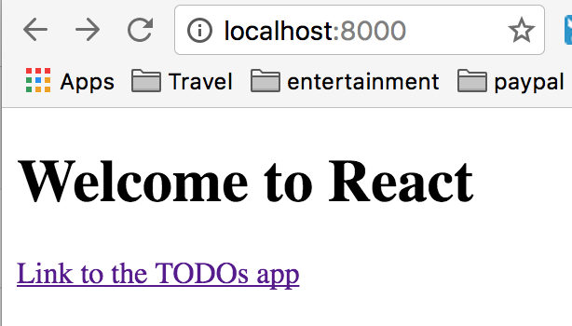
Demo
Here is the main page
Click on the link

Slide 11
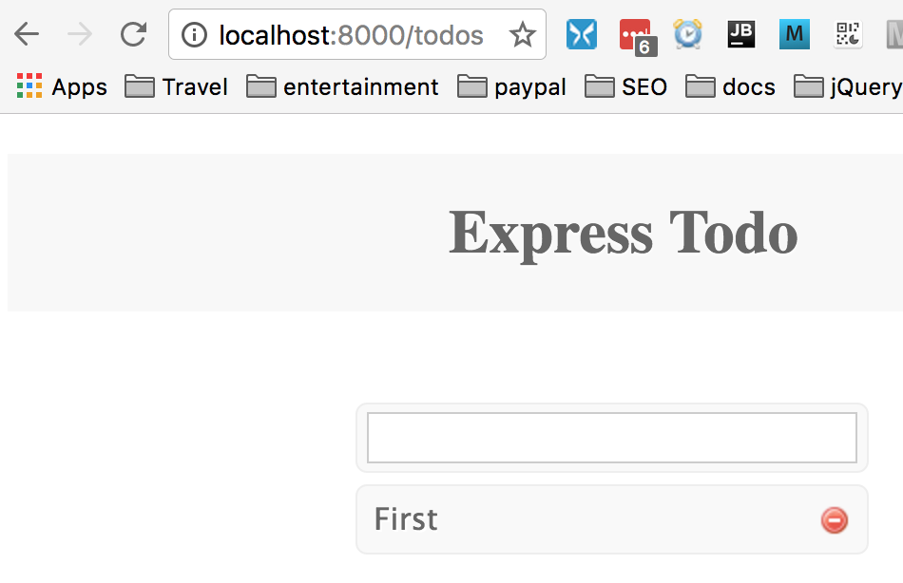
The URL is /todos
Notice the URL
Refresh the page
It works…

Slide 12
Summary
React works well with AJAX
Be careful of the client side framework when rendering on the server
Load client side framework with require() like normal
Only EXECUTE the client side framework when on the browser, not the server
Use componentDidMount() to contain client side only code.

Slide 13
Lab Exercise
Use existing Kraken app
Convert the /public/js/todo-controller.js to use AJAX
Instead of in-memory model
Fix the server side rendering
Update the /controllers/index.js
Refactor the /public/views/todos.jsx
Only use the client side framework on the client

