Slide 1
React (i18n) Internationalization

Slide 2
Overview
I18N
Allows translation of strings to multiple languages
Access appropriate string properties files
Uses ‘anemone-lingua’ to do the translations
Reads all the properties files
Bundles them and saves to the ‘res.locals.messages’ object
Extract the bundles for each page
Send the bundle to the browser as this.props.messages
React injects the bundle messages into the Components

Slide 3
I18N Process
‘anemone-lingua’
Get the current locale from:
Is JS object with properties: language and country
Hash: res.locals.contextLocality
Hash: res.locals.context.locality
Loads ALL the properties files for the current locale
Calls module, ‘bundalo’,
Reads the properties files for current locale
Saves the bundle to ‘res.locals.messages’
Is a JS object, key / value pairs (as strings)
On client, referenced as ‘this.props.messages’
Server ‘res.locals’ sent to client as mixins for ‘this.props’

Slide 4
Kraken Configuration
The Kraken config/config.json contains:
"reactContentLoader": { "priority": 100, "enabled": true, "module": { "name": "anemone-lingua", "arguments": [ { "contentPath": "path:./locales", "fallback": "en-US" } ] } }

Slide 5
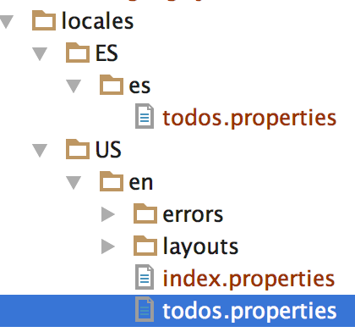
Properties File
File /locales/ES/es/todos.properties
Contents:
greeting=Desata el Kraken!
File /locales/US/en/todos.properties
Contents:
greeting=Unleash the Kraken!

Slide 6
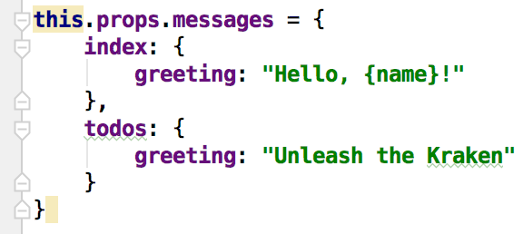
Messages Object
The hash is:
‘index.properties’ file
‘todos.properties’ file
‘greeting’ key

Slide 7
React Component render()
The Component render() method generates the markup
The messages are in this.props.messages[‘todos’]
‘todos’ is from the ‘todos.properties’ file name
‘greeting’ is the key in the properties file.
render: function render() { var self = this; var msg = this.props.messages || {}; msg = msg.todos || { greeting: 'Unknown message: greeting'}; return ( <div id="layout"> <h1 id="page-title">{msg.greeting}</h1> <div id="list">
Translation for ALL properties
files
Translation for key, greeting

Slide 8
Summary
In PayPal, Internationalization (i18n) means
Language / country translations
Translated strings are stored in ‘properties’ files
The module, anemone-lingua,
Reads the properties files
Extracts the correct language / country set of strings
On server stored as res.locals.messages
On Browser stored as this.props.messages
The React components inject the translated strings

