Slide 1
D8 · BOARD PRESENTATION
Approve ₹15 crore and 6 AEs to reach ₹526 crore ARR by FY29, and accept a slower FY27
₹14.95 cr
₹526 cr
13.2%
FY27 investment, inside the ₹15 cr envelope
FY29 ARR vs ₹522 cr board path and ₹389 cr if we do nothing
FY27 growth: ₹5.6 cr short of 15%, by choice
Revenue Strategy Lead · Board meeting, Week 9 FY27 · Strata Sense Technologies is fictional; data synthetic
Notes:
One ask, one trade-off. We invest ₹15 crore, stay inside every guardrail but one, and reach the board’s FY29 ARR. The price is a slower FY27, which I think is cheaper than buying growth we cannot ramp in time.

Slide 2
WHY WE ARE HERE (D1)
Growth is stalling because we lose on price and packaging to Helix, sell to the wrong accounts, and discount without winning
Root cause | ARR at stake / yr | Fixable by sales?
Helix bundle (retention + new logo) | ₹34.0 cr | Partly: packaging decision needed
Expansion stall, non-Helix accounts | ₹9.9 cr | Yes
Wrong accounts, single-threaded deals | ₹8.0 cr | Yes
Discount creep | ₹3.1 cr | Yes
27% → 17%
win rate FY24 → FY26
118% → 99%
net revenue retention, same period
₹389 cr
FY29 ARR if nothing changes
Source: D1 diagnostic memo; DR1 cleaned CRM; DR2/DR3.
Strata Sense (fictional) · D8
Notes:
Doing nothing is not flat: the base still grows but falls ₹133 crore short of the board path by FY29.

Slide 3
THE PLAN (D2–D6)
Five programmes, each tied to a number in the model
Programme | FY27 ₹ cr | Moves | FY26 → FY29
Target the right 400 + 1,100 accounts | existing budget | Win mix; pipeline supply | +2.9 pts; 392 → 470 deals
Win-rate and price discipline | 1.9 | Win rate; discount; cycle | 17.1% → 22.5%; 19.3% → 15%
Retention and Helix defence (incl. Vajra) | 5.6 | Churn; expansion | 5.9% → 4.0%; 8.1% → 10.5%
AE capacity: hire to pipeline, retain | 3.0 | Ramped AEs; attrition | 64 → 83; 29% → 20%
Selective channel: SEA, Gulf, OEM | 2.8 | Partner ARR | ₹2.6 → 19.7 cr
RevOps, forecasting, sensor-agnostic readiness | 1.6 | Forecast; hardware mix | MAPE 27% → 16%
Source: D7 Investment and Assumptions sheets.
Strata Sense (fictional) · D8
Notes:
Every programme has a driver in the model and a trigger at Q2.

Slide 4
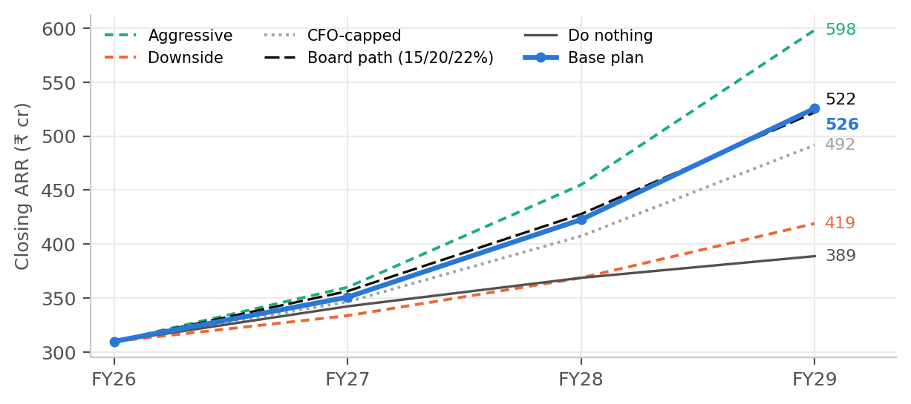
WHAT IT DELIVERS (D7)
The plan reaches the board’s FY29 ARR; FY27 falls short because Q1 was already locked and new AEs take a year to ramp
 | FY27 | FY28 | FY29
ARR ₹ cr | 351 | 423 | 526
Growth | 13.2% | 20.4% | 24.3%
Board path | 15% | 20% | 22%
NRR | 99.1% | 101.9% | 103.8%
EBITDA ₹ cr | (25.9) | 2.6 | 52.6
+3 pts of win rate alone lifts FY27 to 14.9%.
Source: D7 ARR_bridge, Scenarios.
Strata Sense (fictional) · D8
Notes:
FY27 gap ₹5.6 cr. Closing it costs the extra ₹3 cr, which does not pay back within 15 months.

Slide 5
EXACT APPROVAL REQUESTED
The ask: ₹14.95 crore, 6 AEs, 3 channel roles, and a gated reserve
Item | Amount | Timing | Condition
Programmes (retention, win-rate, AE retention, RevOps, readiness) | ₹7.3 cr | From Q2 FY27 | Approved now
Channel foundation + partner incentives | ₹2.8 cr | From Q2 FY27 | Approved now
6 net new AEs | ₹2.0 cr | Start Q3 FY27 | Offers by 31 Aug
Vajra retention plan (Inject 4) | ₹0.9 cr | Now | Defensive
Reserve: 2nd retention squad + SE pilots | ₹1.9 cr | Q3 FY27 | Only if Q2 triggers met
Total FY27 | ₹14.95 cr |  | Envelope ₹15 cr
Exception | Q1 FY27 CAC payback 31.0 months |  | Quarter already locked
Source: D7 Investment sheet.
Strata Sense (fictional) · D8
Notes:
FY28 and FY29 hiring are not approved today; they are released against the 90% capacity-use rule.

Slide 6
EXECUTION
First 90 days, and what we stop doing
30 / 60 / 90 days
• 30: tiers in territories; discount cap 15%; Commit = stage 5; P05/P11 restricted; Vajra CEO meeting
• 60: retention squad live; value-selling training; 3 partners signed; AE offers out
• 90: Q2 review gate: release or hold reserve; Vajra business review delivered
We stop
• AEs on 1,600 low-touch accounts
• Discounts above 15% without CFO; matching “free”
• Commit calls before stage 5
• Planning on a 6-month ramp
• Dormant partners; partner margin hidden in S&M
• Hiring AEs to quota rather than pipeline
Strata Sense (fictional) · D8
Notes:
The stop list is where the real behaviour change is.

Slide 7
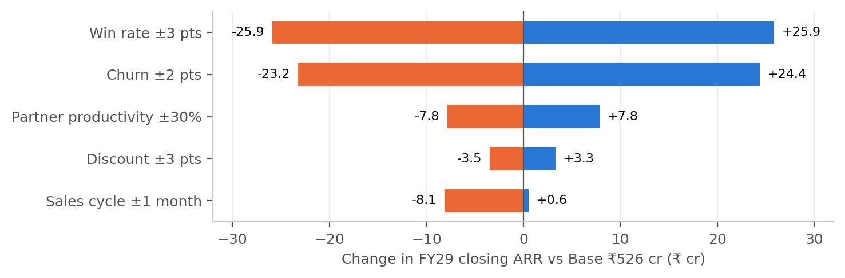
RISK
Three largest risks, and the fallback for each
Risk | Probability | Impact | Fallback
Helix pressure deeper (churn +2 pts) | 35% | −₹23 cr FY29 ARR | Second squad; win-back Apr 2027; sensor-agnostic tier
Win-rate programme stalls (−3 pts) | 30% | −₹26 cr; payback breach at −0.7 pts | Hold reserve; CFO-capped path
Hardware mix does not fall | 35% | GM 64.5% by FY29 (floor 66%) | Hardware price floor; software-led expansion; sensor-agnostic tier
Strata Sense (fictional) · D8
Notes:
Win rate and churn dominate; hardware mix is the margin risk nobody priced.

Slide 8
GOVERNANCE
Measures that tell the board to continue, adjust or stop at Q2 FY27
Measure | Q2 threshold | If missed
Qualified win rate (rolling 2 quarters) | ≥ 18.0% | Hold ₹1.9 cr reserve
New qualified direct deals | ≥ 95 | Delay Q3 hires
Churn + contraction, H1 | ≤ ₹13.5 cr | Re-deploy squads
Expansion ARR, H1 | ≥ ₹12.5 cr | Re-scope top-30
Quarterly CAC payback | ≤ 30 months | CFO-capped path
Forecast error | ≤ 15% | Recalibrate
Vajra | Not shortlisted on price | CEO escalation
Stop rule: win rate below 17% and payback above 32 months at Q2 → no Q3 hires; return to board.
Strata Sense (fictional) · D8
Notes:
All thresholds come from the plan path in the model.

Slide 9
LIMITS OF THE EVIDENCE
What I am least sure of
Honest limits
• Least sure: hardware attach falling from ₹1.48 to ₹1.05 per ₹1 of ARR; it alone decides the margin floor
• Driver sizes are judgements anchored in D1–D6, not controlled tests; the plan still pays back if a third of the improvement arrives, but payback guardrails break below 78%
• Interviews and external benchmarks are still being completed
• Q1 forecast (₹8.71 cr) is locked and will be scored against actuals
• All data synthetic
Strata Sense (fictional) · D8
Notes:
Say this before the board does.

Slide 10
CLOSE
Why believe the plan over doing nothing
+₹137 cr
8 months
1 of 12
FY29 ARR vs do-nothing
payback of ₹62 cr three-year investment (10.5 on the strict test)
guardrails breached, disclosed, with exception requested
Decision today: approve ₹14.95 cr, 6 AEs from Q3, 3 channel roles, the Q1 payback exception, and the Q2 gate.
Strata Sense (fictional) · D8
Notes:
End on the decision.

