Slide 1










THINK AI 4.0
PS 10: AI-Powered Accessibility Assistant
Team Name: Team Vaachak
Notes:
NIMISHA: Good morning. We are Team Vaachak, problem statement 10, the AI-powered accessibility assistant. Vaachak means 'the reader': it reads any bill, medicine strip or message and tells an elderly person, in their own language, exactly what to do.

Slide 2

Meet The Team
A
M
N
J
Anvesh Chafle
Maulik Parshionikar
Nimisha Jain
Jiya Khut
Backend, AI Pipeline &
Safety Rule Engine
Frontend, UI/UX &
Accessibility
Presenter · Research
& Live Demo
Presenter · Pitch
& User Testing
Notes:
NIMISHA: Anvesh built the backend: the Gemini pipeline and the rule engine that checks every answer. Maulik designed the large, high-contrast interface for weak eyes. Jiya and I researched the problem, tested with elderly users, and will run the live demo. (To add photos: right-click a circle > Format Shape > Fill > Picture.)

Slide 3
DOMAIN | ACCESSIBILITY · ELDER SAFETY
PROBLEM STATEMENT
149 M
Indians aged 60+ today, 347 M by 2050
UNFPA India Ageing Report 2023
Prakash-kaka can hear the bill.
Nobody tells him what to do.
68%
of women aged 60–75 cannot read
UNFPA India Ageing Report 2023
13.8%
of Indians aged 50+ have visual impairment
National Blindness & VI Survey 2015–19
68, cataract, reads only Marathi. The MSEDCL bill, a new medicine strip and bank SMSes arrive in English jargon and small print while his children are at work. He guesses, misses due dates, takes expired medicine, or trusts a fake 'power will be cut tonight' SMS. Google Lens reads the text aloud, but only if he knows what to ask.
₹22,495 Cr
lost to cyber fraud in 2025; fake bill SMS target elders
I4C data, via Moneylife
Elders need a decision they can trust, not text read aloud.
Notes:
NIMISHA: Meet Prakash-kaka, 68, from Thane. Cataract, reads only Marathi. Bills, medicine strips and bank SMSes arrive while his children are at work. He is one of 149 million Indians over 60; two in three elderly women cannot read; one in seven over 50 has a vision problem; and fraudsters target exactly them. Existing tools read the text aloud. Nobody tells him what to do.

Slide 4





PROPOSED SOLUTION
VAACHAK वाचक
A voice-first reader that tells elders what to do, and keeps them safe.
Instead of reading text aloud and waiting for the right question, Vaachak turns any bill, medicine strip, notice or message into one spoken action card: what it is, what to do, by when, how much, and the danger.
01
ANY
INPUT
02
AI
READS
03
RULES
VERIFY
04
SPEAKS
& ACTS
Photo with a voice-guided camera, screenshot, PDF, link, pasted SMS or a spoken question.
Gemini fills a 5-field card: what it is, what to do, by when, how much, warning.
No AI here: ₹ and date must be in the print, a 2nd OCR must agree, scam and expiry checks.
Indian voice in ~1.5 s in Marathi, Hindi or English. Pay, remind, call 1930, ask family.
NEVER GUESSES: UNSURE → "PLEASE ASK SOMEONE"
KEY IDEA
Vaachak turns a document from text read aloud into a decision: what to do, by when, and what is dangerous.
Notes:
NIMISHA: Vaachak works in four steps. Any input: a photo, a screenshot or PDF, a link or a pasted message. Gemini reads it into five fields. Then a rule engine with no AI checks those answers against the printed text, with a second OCR engine, a scam score and an expiry check. Finally it speaks in an Indian voice and gives one-tap actions: pay, remind, call 1930 on a scam, or ask family. And when it is not sure, it says so. Over to Jiya for the live proof.

Slide 5
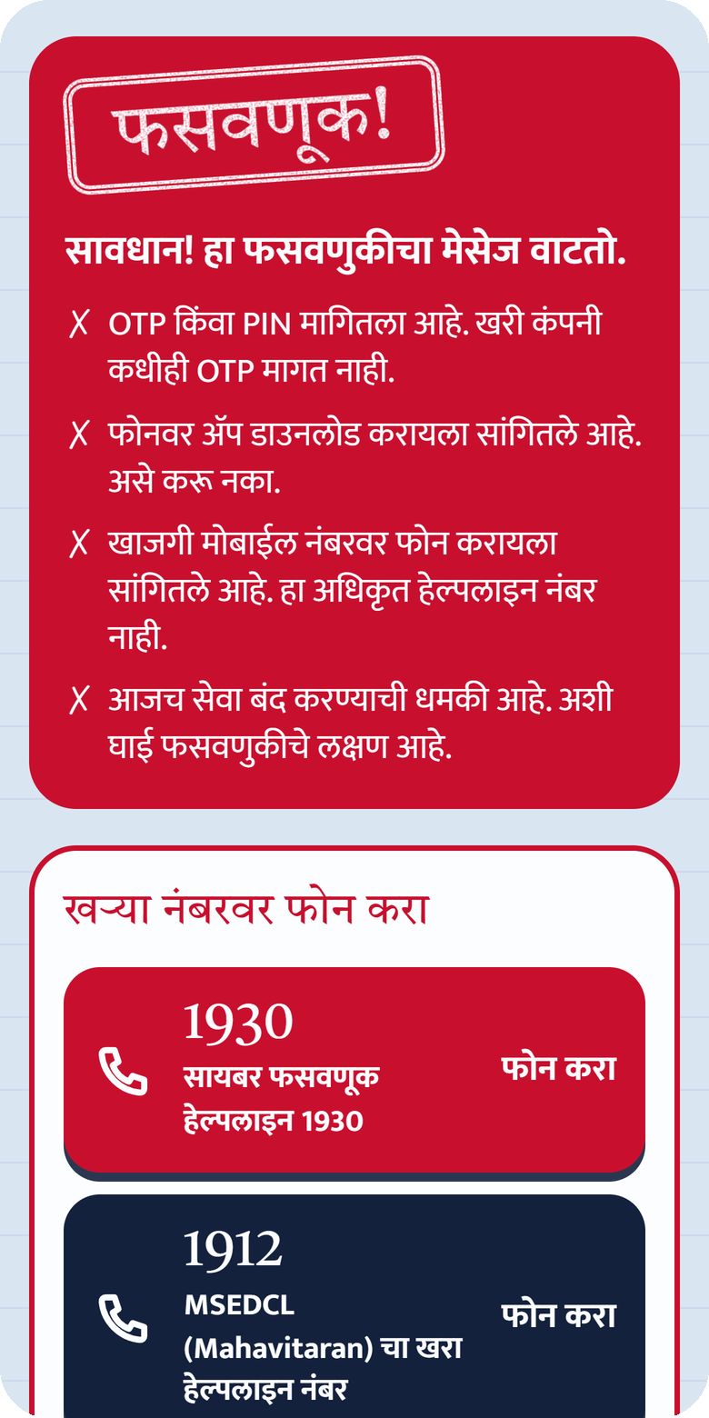
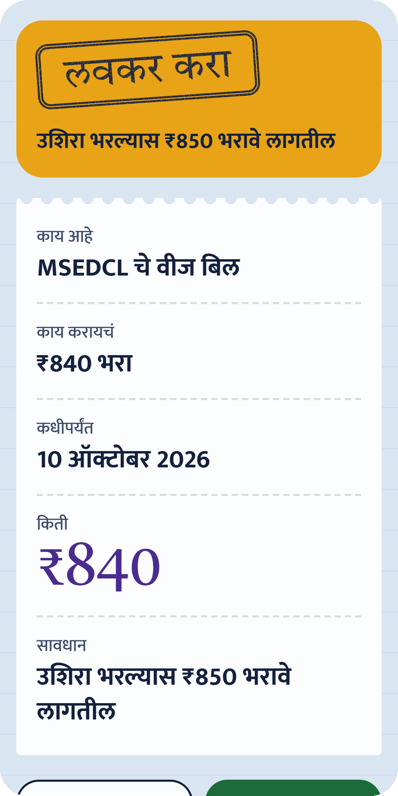
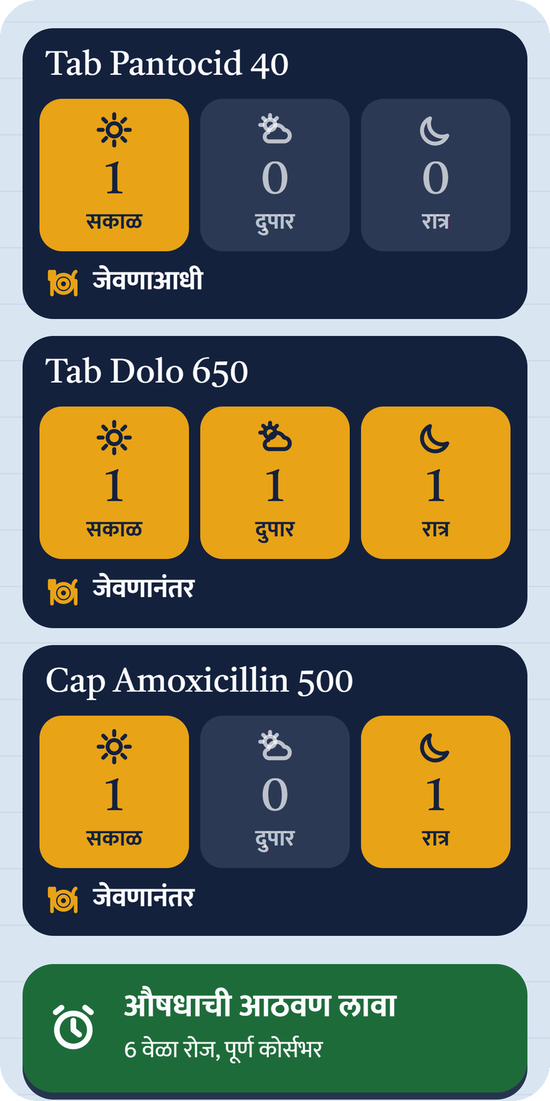
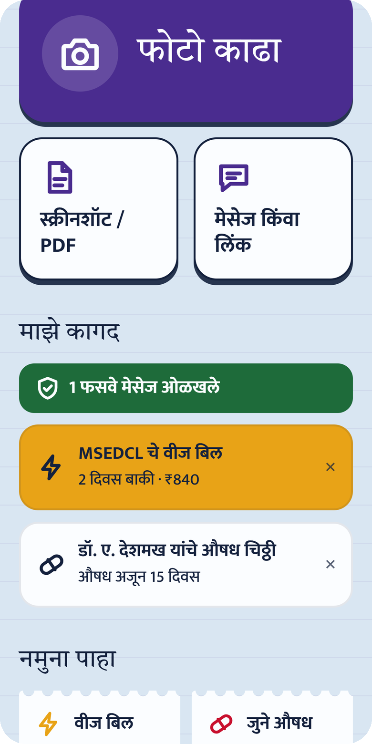
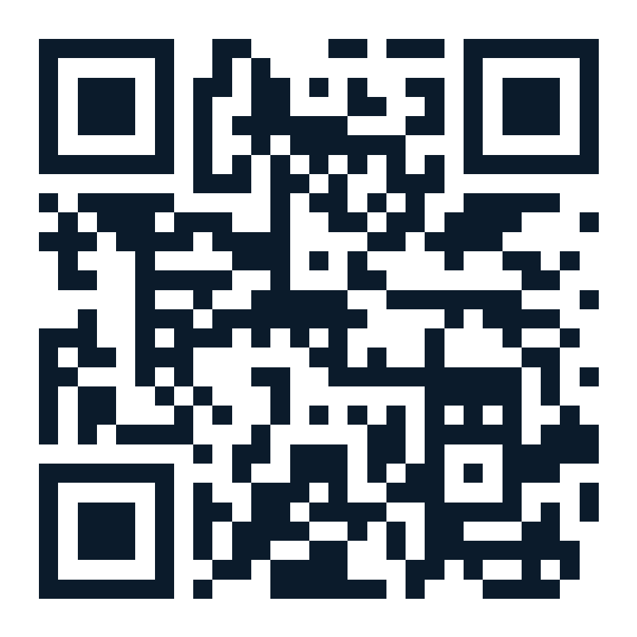
BUILT & RUNNING TODAY
LIVE PROTOTYPE
MEASURED ON THE LIVE APP · 8 OCT 2026
≈ 2 s
pasted SMS → spoken card
≈ 4 s
bill photo → verified card
≈ 1.5 s
until the voice starts
4 / 4
test scams caught · 0 real SMS flagged
58
automated tests on the rules
3
languages: मराठी · हिंदी · English
PROTECT
Fake power-cut SMS
Red scam card, one tap to 1930
VERIFY
MSEDCL bill
₹840 by 10 Oct, found in the print
REMIND
3 medicines
One schedule each, into the calendar
REMEMBER
My papers
What is due, scams caught
Scan & try it
vaachak-zeta.vercel.app
Tap a sample: works even with Wi-Fi off.
Notes:
JIYA: This is the live app, not a mock-up; scan the QR and try it. A fake 'power will be cut tonight' SMS becomes a red scam card in about two seconds, with reasons in Marathi and one tap to call 1930. An MSEDCL bill becomes 'pay 840 rupees by 10 October', both checked against the print. A three-medicine prescription gets one schedule per medicine and every dose goes into the calendar. And the home screen remembers what is due. We measured all of this on the live app. LIVE DEMO: paste the scam SMS and let the judges hear the voice.

Slide 6











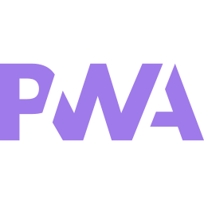








Tech Stack
System Diagram
AI / MODEL LAYER
Reads documents, answers questions, speaks.
Elder's phone
camera · PDF · link · SMS · voice
photo / text
card + voice
Gemini 3.8
Sarvam voice
7-model fallback
Voice Q&A
VAACHAK
AI reads · rules decide · voice acts
SAFETY LAYER · NO AI
Checks every ₹, date and scam. Tested.
Gemini read
Rule engine
Action card
Sarvam voice
Rule engine
Tesseract OCR
Scam shield
50 medicines
photo → 5-field JSON
₹ · date · scam · expiry
5 fields + flags
MP3, first words ~1.5 s
APP LAYER
Elder-first PWA: giant text, voice, offline.
On-phone OCR cross-check · offline rules
React
Vite
Tailwind
PWA
One-tap actions
PLATFORM & ACTIONS
Serverless in Mumbai; acts in one tap.
Pay a verified biller
Dose & bill reminders
Call 1930 on a scam
Ask family on WhatsApp
Node.js
Vercel
WhatsApp
Calendar
Notes:
JIYA (Anvesh takes technical questions): AI reads, rules decide. Gemini 3.8 Flash turns the document into a structured card, with a seven-model fallback if it is busy. Then a rule engine with no AI checks the amount and date against the printed text, compares with on-phone Tesseract OCR, scores scam signals and checks expiry. The same rules run in the browser, so it works offline. Sarvam's Indian voice speaks the card, and every action is one tap.

Slide 7





USP
Future Scope
Phase
1
Live today
Bills, medicines, scams and reminders in Marathi, Hindi, English.
Acts, not just reads
Pay, remind, call 1930 or ask family in one tap.
Never guesses
₹ and date checked against the print; unsure means "ask someone".
Phase
2
22 languages + WhatsApp bot
Forward any document to Vaachak; Sarvam / Bhashini voices.
Scam shield for India
Fake power-cut SMS, KYC, OTP, AnyDesk, personal UPI.
Looks after you
Whole-course dose reminders, due dates in My papers, cheaper generic.
Phase
3
Family & payments
Caregiver alerts for due bills and scams; BBPS verified payments.
Works offline
On-phone OCR, 50 medicines and the same safety rules.
Your language & voice
Marathi, Hindi, English; spoken tour; giant UI.
Future
Fully offline Vaachak
On-device AI model; government-scheme notices as checklists.
Prototype Link
live, tested, open on any phone
vaachak-zeta.vercel.app
Tap a sample (works offline) · tap ? for a spoken tour · paste a scam SMS
Notes:
JIYA: Six things make Vaachak different: it acts, it never guesses, it knows Indian scams, it keeps looking after you, it works offline, and it speaks your language. Today it is live in three languages. Next: 22 Indian languages and a WhatsApp bot, then family alerts and verified BBPS payments, and finally a fully offline model. Scan the code and try it now. Back to Nimisha.

Slide 8
Thank You
Gemini answers questions. Vaachak never needs one.
Team Vaachak · vaachak-zeta.vercel.app
Notes:
NIMISHA: Gemini answers questions. Vaachak never needs one, because Prakash-kaka should not have to know what to ask. Thank you; we are happy to take your questions.

