Slide 1
Machine Learning-Based Sentiment Analysis of Mastodon Data
C. Anvesh 16XJ1A0508

Slide 2
Problem Statement:
The community-orientation strongly impacts the moderation procedures. The contents and the topics people judge to be inappropriate depend on the community they belong to, meaning that the perception of what may hurt people’s feelings is influenced by the surrounding social context. In this project, we delve into different aspects of user and community beliefs to train a model which labels a posted online content as inappropriate or appropriate. This can be further extended to create an extension tool which warns social media users against posting inappropriate content.

Slide 3
Implementation :
Mastodon Data Set Retrieval.
Data Visualization.
Preprocessing the Data.
Word Embeddings.
Baseline Model and Prediction.
Actual Model and Prediction.

Slide 4
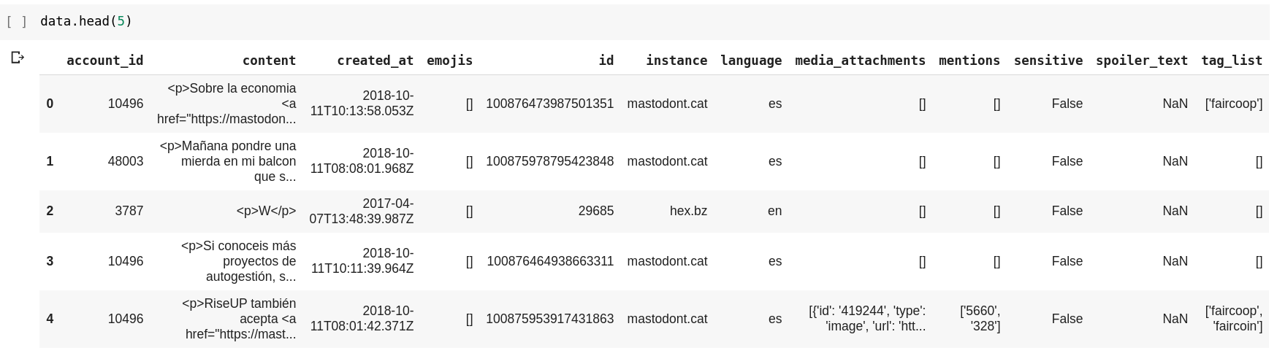
Mastodon Dataset:

Slide 5
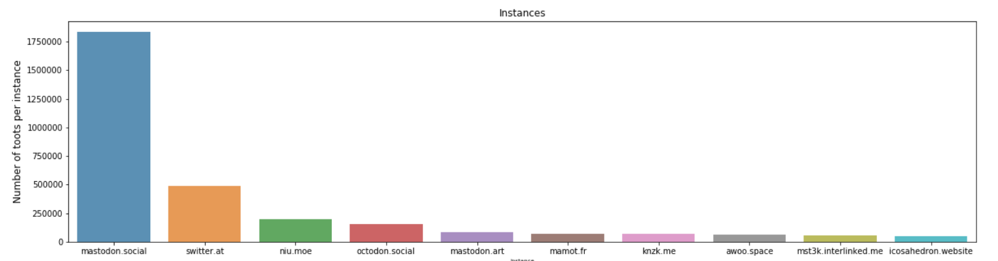
Data Visualization

Slide 6
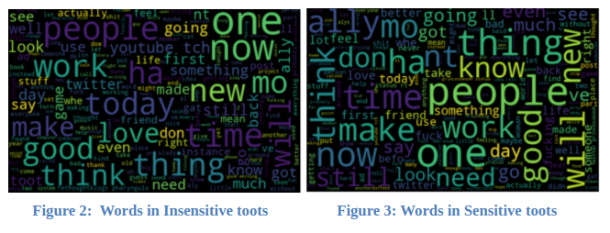
Data Visualization

Slide 7
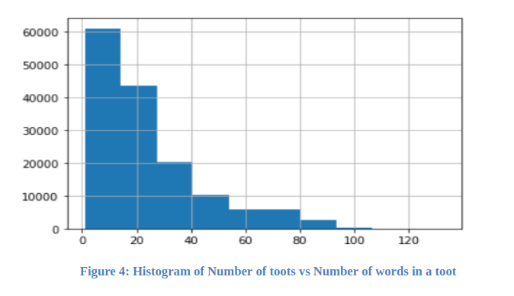
Data Visualization

Slide 8
Preprocessing the Data
Converting the data from JSONL to CSV.
HTML tag removal: we have used Beautiful Soup library 7.
Tokenization:Splitting data based on whitespace and punctuation.
Normalization: we converted all the tokens to lowercase.
stop-words removal: We used the stopwords module of
NLTK 8.
lemmatization: We used the WordNetLemmatizer module
of NLTK to bring back each word to its base or dictionary
form.
Non-English words removal.

Slide 9
Word Embeddings
We have generated embeddings for each word using Word2vec model.
Embeddings are generated by training it on our own Dataset.
We have also used the pre-trained GoogleNews vectors embeddings.
But the word embeddings that are generated by training it on our own Dataset yielded better results.

Slide 10
Implementation of Baseline Model
We have implemented a Support Vector Classifier(SVC) as a baseline model. The results turned out to be very bad as shown in Figure 6. As the majority of toots belong to insensitive label, the classifier learned in such a way that it predicts every toot as insensitive in order to increase the accuracy of the model. Therefore the true negatives are 0.

Slide 11
Class Imbalance Problem
As the dataset is highly imbalanced where the dataset contains 90 percent of the toots which are appropriate or insensitive and only 10 percent of the toots which are inappropriate or sensitive. Therefore we have balanced it by assigning weights to the classes i.e we have assigned more weight to the minority class and assigned a less weight to majority class. This way the model gives a lot of importance to the minority class.

Slide 12
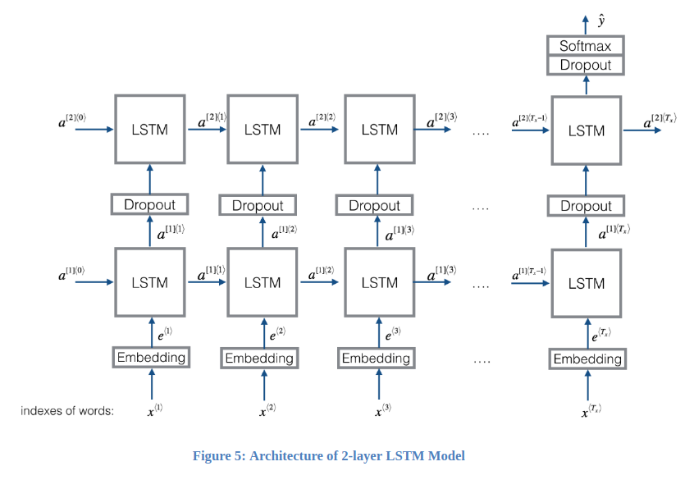
Model Architecture

Slide 13
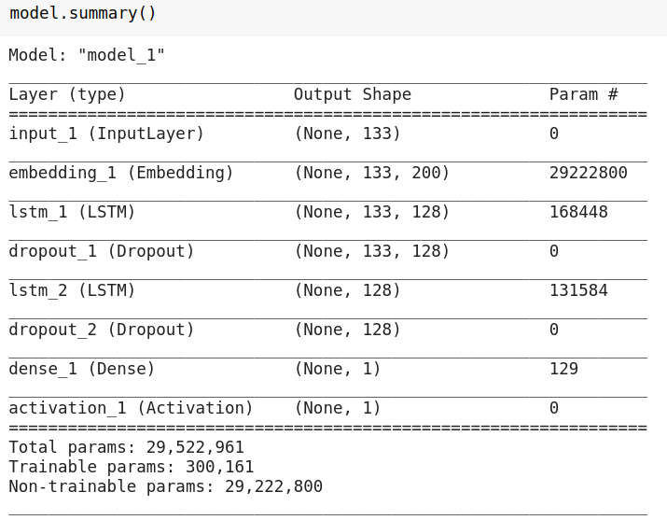
Model Architecture

Slide 14
Implementation of the LSTM model
As our model is biased to the majority class, We debiased it to some extent by assigning class weights(“0”:4.44 , “1” : 0.56 in our case) and training the 2-Layer LSTM model for 30 Epochs on this dataset. There is a significant rise in True Negatives as you can see in the figure 7.

Slide 15
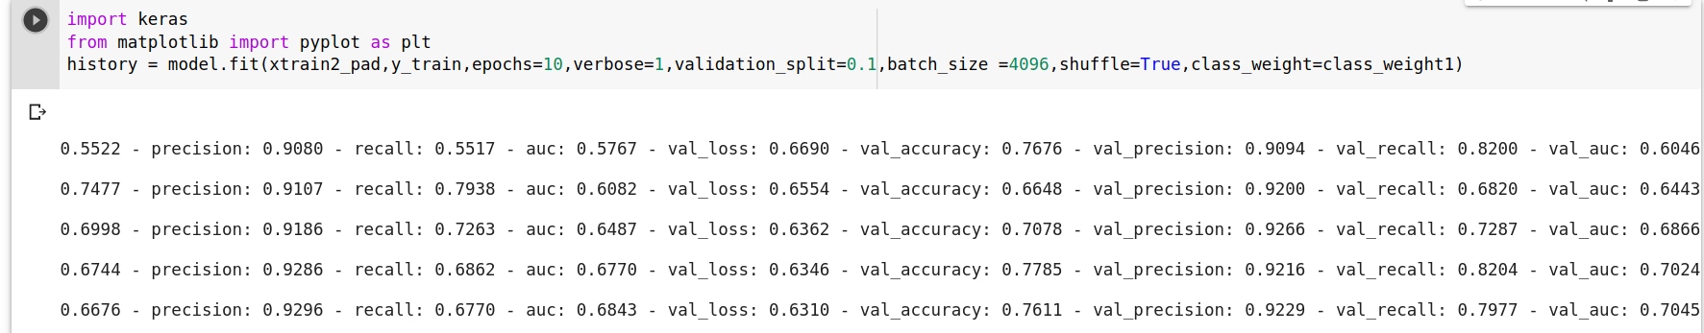
Model and Prediction
The 2-layer LSTM model yielded the best results.
The Specificity of the Model is around 0.52.
The validation accuracy after 30 epochs is 77%

Slide 16
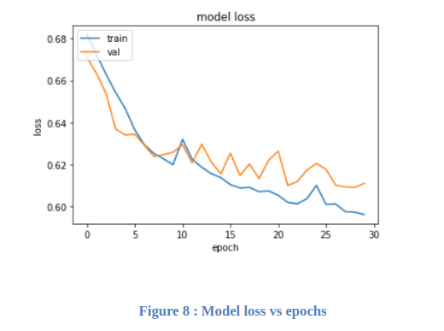
Results
The below Figure(Figure 8) is the plot of model Training and Validation loss vs number of epochs.

Slide 17
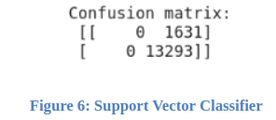
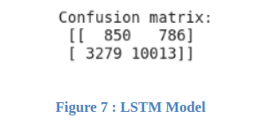
Results
Confusion matrix of the Baseline Model.
Confusion matrix of the LSTM Model.

Slide 18
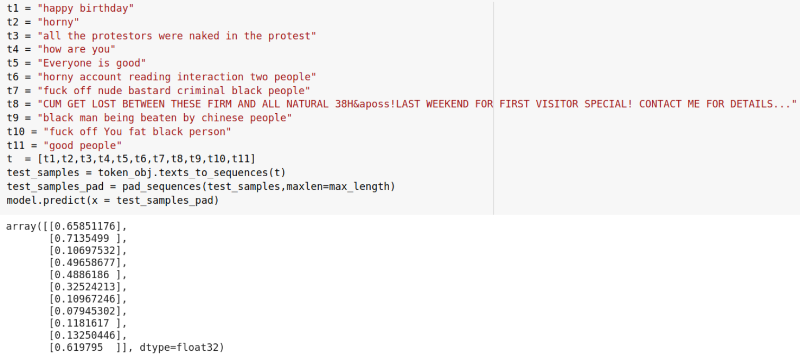
Results

Slide 19

Conclusion
In general Precision and Recall are solely considered in order to evaluate the model
But this dataset is highly imbalanced so here Specificity comes to play.
Our objective is to increase “True Negatives”. Therefore more the value of Specificity more is the number of True Negatives.

Slide 20
Conclusion
As the precision and recall are high for both the baseline model and LSTM model, the specificity has increased significantly from “0”(baseline SVC model) to “0.52”(LSTM model).
Finally, the 2-Layer LSTM model does a lot better in handling the imbalanced dataset and the predictions of this model on unseen data is really impressive.

Slide 21
Future work
Create an extension tool which warns social media users against posting inappropriate content.
Train the model on all the instances and create a comprehensive tool.
To Publish a paper on this project.

Slide 22
Problems Faced
Dataset issues.
Computation.
Non-english words removal.

Slide 23
THANK YOU

