Slide 1
Machine-Aware Atomic Broadcast Trees for Multicores
Presented By
Anvesh Muppeda

Slide 2
Problems addressed
This paper addressed the problem of efficiently communicating between cores on modem multi-cores machines.
The performance of parallel programs on multicore machines are mostly hardware dependent.
Important to address because parallel programming with message-passing used widely.
Different machines show radically different optimal layouts.

Slide 3
Smelt
Smelt, a software library which builds efficient multicast trees without manual tuning.
Smelt servers as a fundamental building block for higher-level operations such as atomic broadcast, barriers and consensus protocols.

Slide 4
Motivation

Slide 5
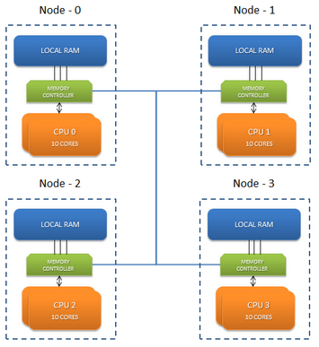
NUMA (Non-uniform memory access)
Modem high-end servers are large NUMA multiprocessors.
Accessing local memory is faster than accessing remote memories.
NUMA message passing mechanisms uses chache coherency.
Link

Slide 6
Group Communication Primitives
Message passing – building block for higher-level distributed operations like atomic broadcast, reductions, barriers or agreement.
Messages to be sent to different cores and becomes critical for complex memory hierarchy.
Both the topology and the order to send messages to a node’s children are critical for performance.
Cost of sending message between cores of different nodes is high.

Slide 7
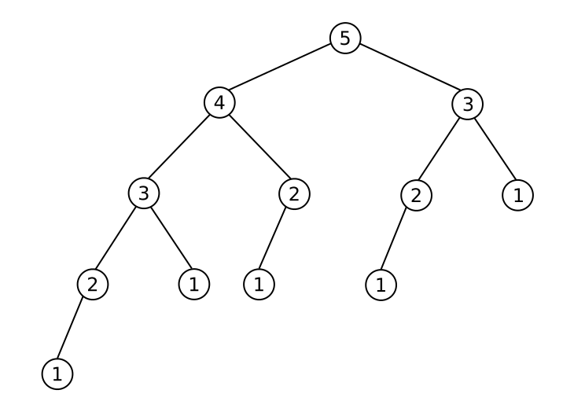
Common tree topologies
Binary trees
Fibonacci trees
Sequential trees
Minimum Spanning Trees
Cluster
Fibonacci Tree

Slide 8
Design

Slide 9
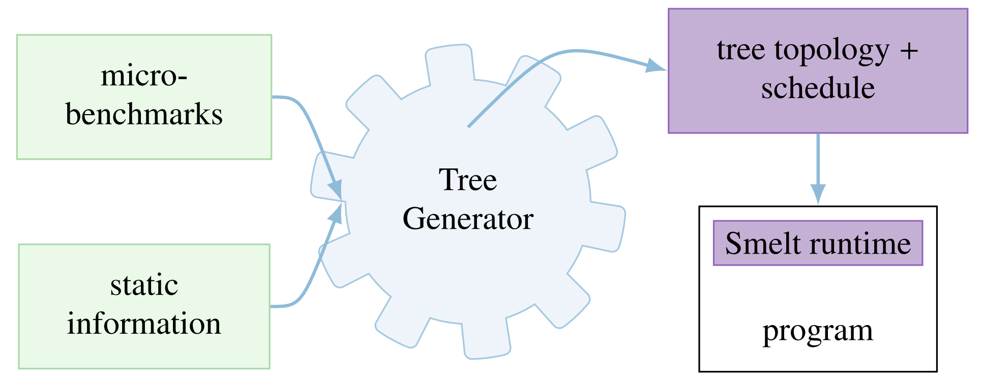
Basic Design

Slide 10
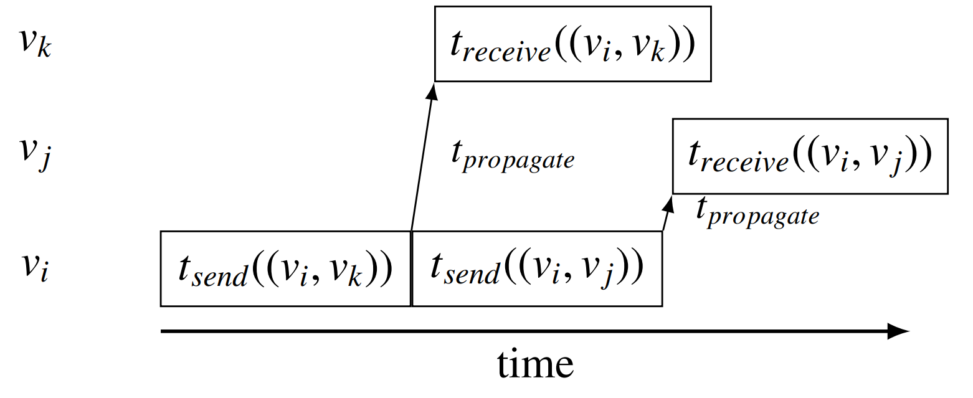
Send Operation

Slide 11
Modelling Broadcast on Multicores
Communication modelled as a fully connected graph G(V,E) –
Vertices v_{i} correspond to threads(cores).
Edges e = (v_{i} , v_{j}) model communication between threads v_{i} and v_{j}
Edge Weight as a tuple w(e) = (t_{send} , t_{receive})
Desired Output
A root v_{root}
A tree T = (V, E’ ) with E’ ⊆ E, where T is a spanning tree of G
Edge priorities w’(v) representing the order in which a vertex v sends messages to its children
T is to be chosen such that the latency lat(T) is minimal

Slide 12
Populating the machine model
The pairwise send (t_{send}) and receive (t_{receive} ) latencies are measured for all hardware threads in the system.
A batch of 8 messages is sent for each pair and the average cost is taken to compensate for the possible existence of a hardware write buffer.
This allows to predict the time a core is busy sending or receiving a message and when it will becomes idle again.

Slide 13
Tree generation: adaptive Tree
The Heuristics for the Base Algorithms are –
Remote cores first – Local communication can be done later
Avoid expensive communication links
No redundancy – both core and node does not receive a message twice
Parallelism – Preferring unbalanced trees with appropriate ordering
Classification-
A core is active if it has received the message , otherwise inactive
A node is active if any of its core is active ,otherwise inactive.

Slide 14
Algorithm 1 Smelt’s Adaptive tree
C_{all} //Set of cores
A_{nodes} ← node_of(c_{root}) //Active nodes
A_{cores} ← c_{root} //Active cores
function PICK_MOST_EXPENSIVE(C, i)
return arg max_{x∈C}(t_{send}(i, x) + t_{receive}(i, x))
end function
function PICK_CHEAPEST(C, i)
return arg min_{x∈C}(t_{send}(i, x))
end function
function ADAPTIVE_TREEE //Run for core c_{self}
while C_{all} ∩ A_{cores} != ∅ do
if c_{self} ∈ A_{cores} then
NODE_IDLE(c_{self})
else
WAIT_MESSAGE
end if
end while
end function

Slide 15
Algorithm 1 Smelt’s Adaptive tree(cont.)
function NODE_IDLE(i) //Executed for active idle node i
C_{inactive} ← C_{all} ∩ (A_{cores} - CORES_OF(A_{nodes}) )
c_{next} ← PICK_MOST_EXPENSIVE(C_{inactive}, i)
if SAME_NODE(i, c_{next}) then //Local
SEND(c_{next})
A_{cores} ← A_{cores} ∪ c_{next} // Mark core active
else
C_{eligible} ← NODE_OF(c_{next}) //All cores on node
c_{next} ← PICK_CHEAPEST(C_{eligible}, i)
SEND(c_{next}) //Send remotely
A_{nodes} ← A_{nodes}∪ NODE_OF(c_{next})
A_{cores} ← A_{cores} ∪ c_{next}
end if
end function

Slide 16
Incremental Optimization
Reordering sends according to most expensive subtree
Shuffling
Some threads already terminate the broadcast and become idle
Adding extra cross-NUMA links from these threads can reduce global latency
v_{i} is a thread that has terminated and v_{j} is an inactive thread in another node
t_{slack} is the time taken after v’s termination for v to become active
T_{send} + t_{receive} is the cost of cross-NUMA link between v_{i} and v_{j}
If t_{send} + t_{receive} < t_{slack} cross-NUMA link is added between v_{i} and v_{j}

Slide 17
Implementation

Slide 18
SmeltRT
The Smelt runtime (SmeltRT) is available as a open source C++ library.
Easy to implement machine optimized higher level protocols
Available at
https://github.com/libsmelt/libsmelt

Slide 19
Layers
Structured in two layers
Transport layer
Provide send/receive functionality
Collective layer
Supports group communication like broadcast and reduce

Slide 20
Transport layer
Point to point message passing
Responsible for send() , receive() and OS independent controls
Uses bi-directional queuepair for message passing.

Slide 21
Queuepair
Properties:
Reliability:
Message sent over a queuepair is never lost or corrupted and will be received eventually.
Ordering :
Two messages send over the same queuepair will be received in the same order
A queuepair can hold a pre-defined number of messages.

Slide 22
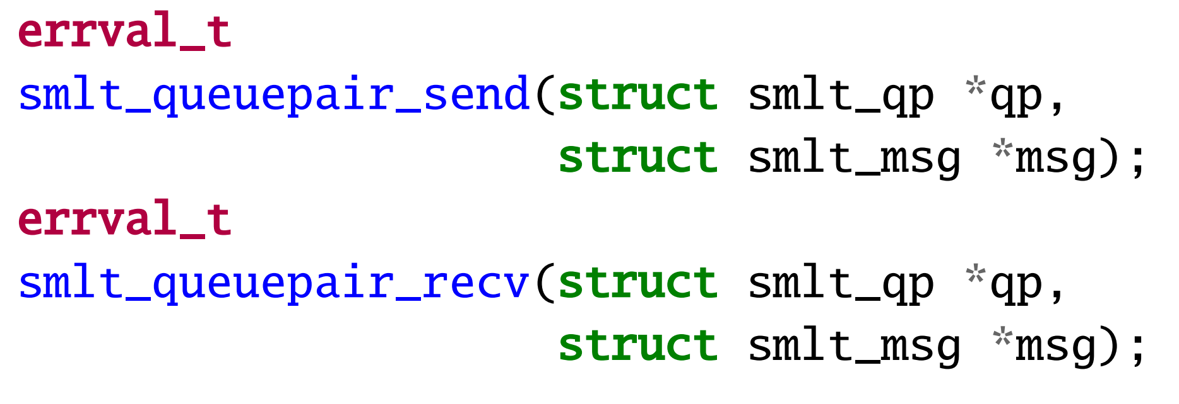
Interface
Message and its length is encapsulated using Smelt-messages and sent over the queuepair
The send and receive operations may block if the queuepair is full or empty respectively
The state of a queuepair can be queried to avoid unnecessary blocking.

Slide 23
Collective Layer
Built upon transport layer
Provides machine aware, optimized group communication primitives such as broadcast() and reduce()
It rely on core concepts of topologies and contexts.

Slide 24
Topology:
It is the communication structure for collective operation.
It defines which participants are part of the communication group(multicast)
Each topology has a root node where all broadcasts are initiated and all reductions end.
Contexts
The context identifies the location in the tree of the calling thread and defines the operations being executed
Smelt takes topology as input and creates the required transport links which are encapsulated in a context.

Slide 25
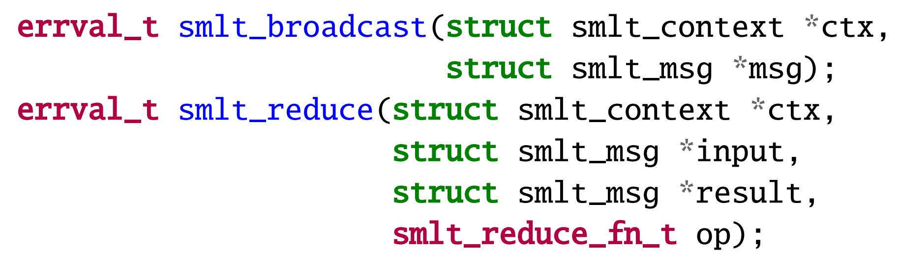
Collective operations
The reduction takes an operation argument which is a function pointer to implement the reduction operation
In reduction, the result parameter at the root contains the gathered value.

Slide 26
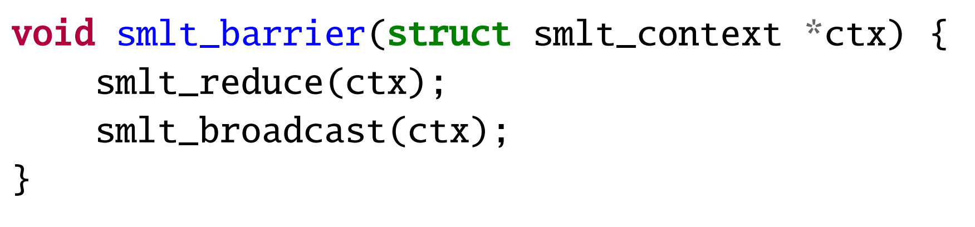
Barriers
Using basic reduce and broadcast with zero payload, barrier can be implemented.
Here we measure the cost on each node and take the maximum.

Slide 27
Evaluation
Evaluate performance of smelt’s adaptive tree against the tree topologies.
Motivate that no single static topology works well across all machines.
Understand why smelt matches/improves over performance of best static topology known.
Compare performance of Smelt with well known and widely used run-times.

Slide 28
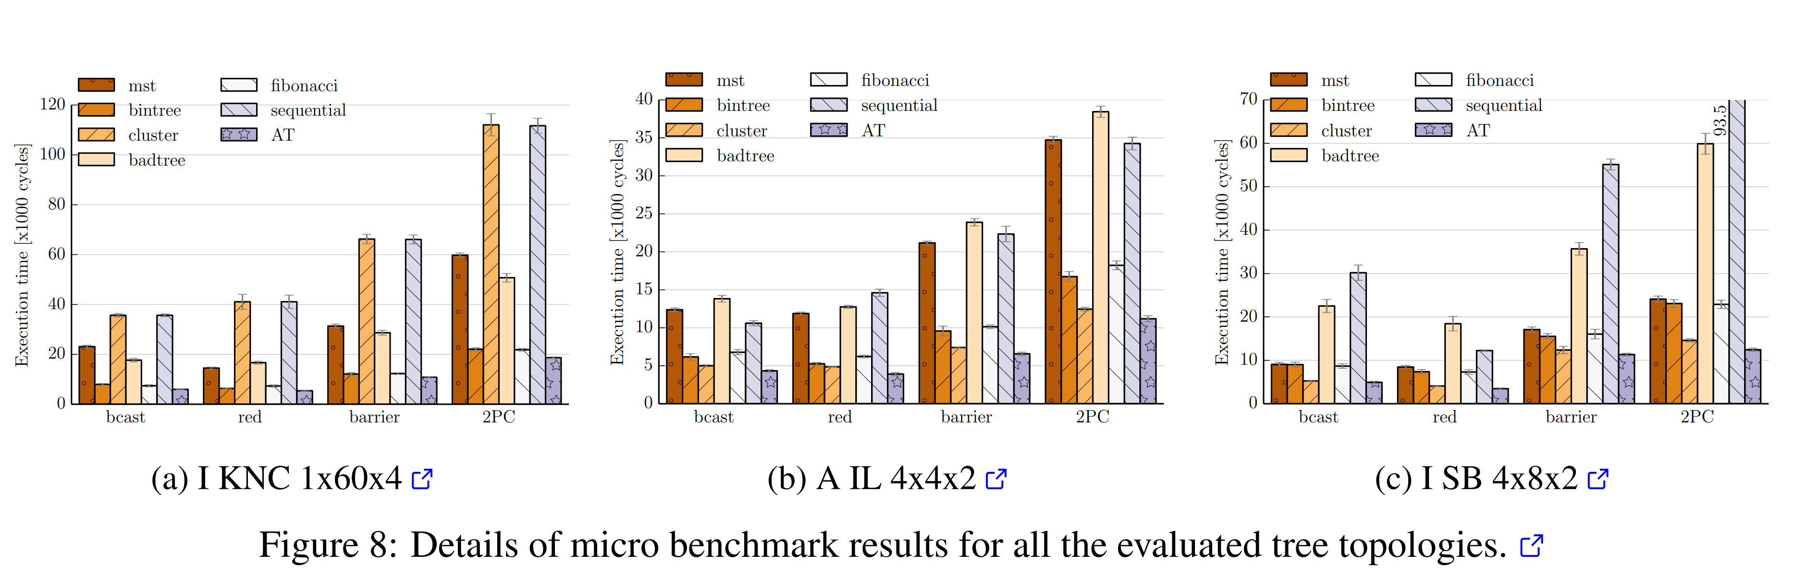
Breakdown for selected machines

Slide 29
Observations
Best static topology depends upon the machine, No clear winner.
Sequential sending results in significant slow down.
Hardware oblivious trees suffer from cross-NUMA links.
Cluster topology relies on machine’s hierarchy
MST does not exploit machine’s parallelism.

Slide 30
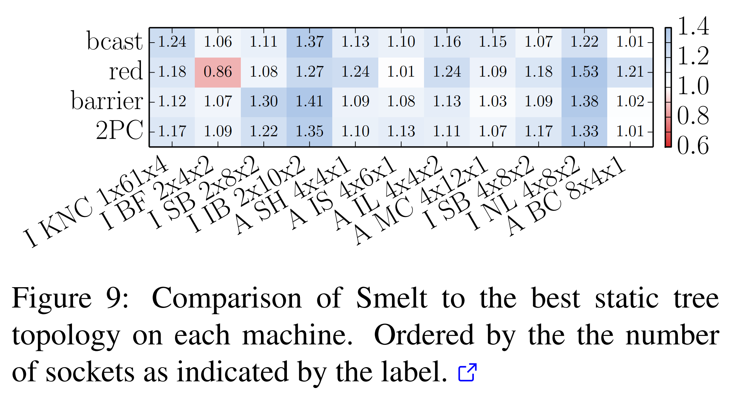
Comparison with best other topologies

Slide 31
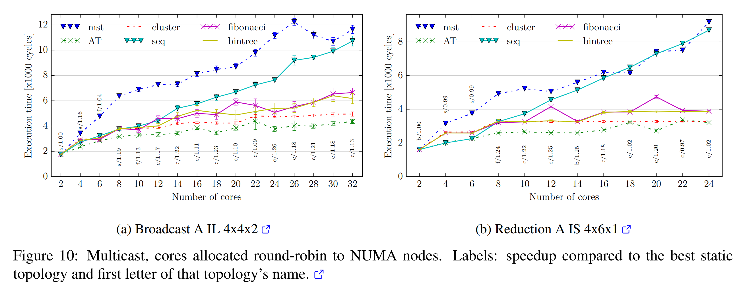
Multicast topologies

Slide 32
Observations
Low number of cores, updates to replicated data, sequential trees better.
Cluster approach starts performing well with increase in number of cores.
Hence, performance is also dependant on multicast group used.
Performance benefit with Smelt is higher in intermediate configurations.

Slide 33
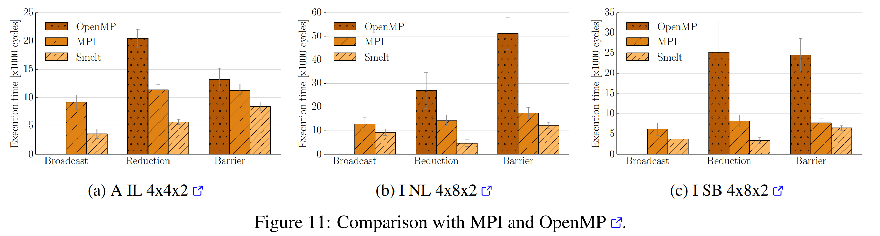
Comparison with MPI and OpenMP

Slide 34
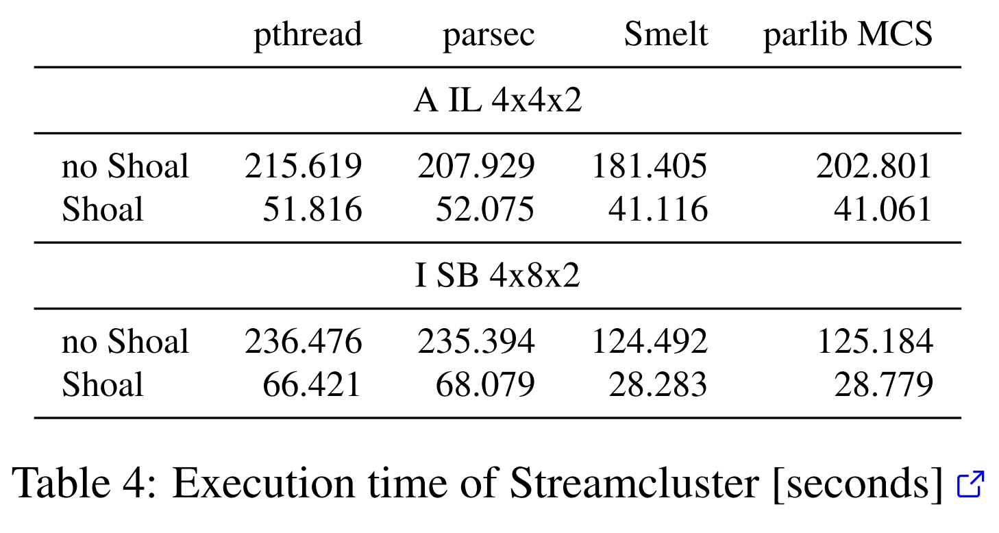
Streamcluster

Slide 35
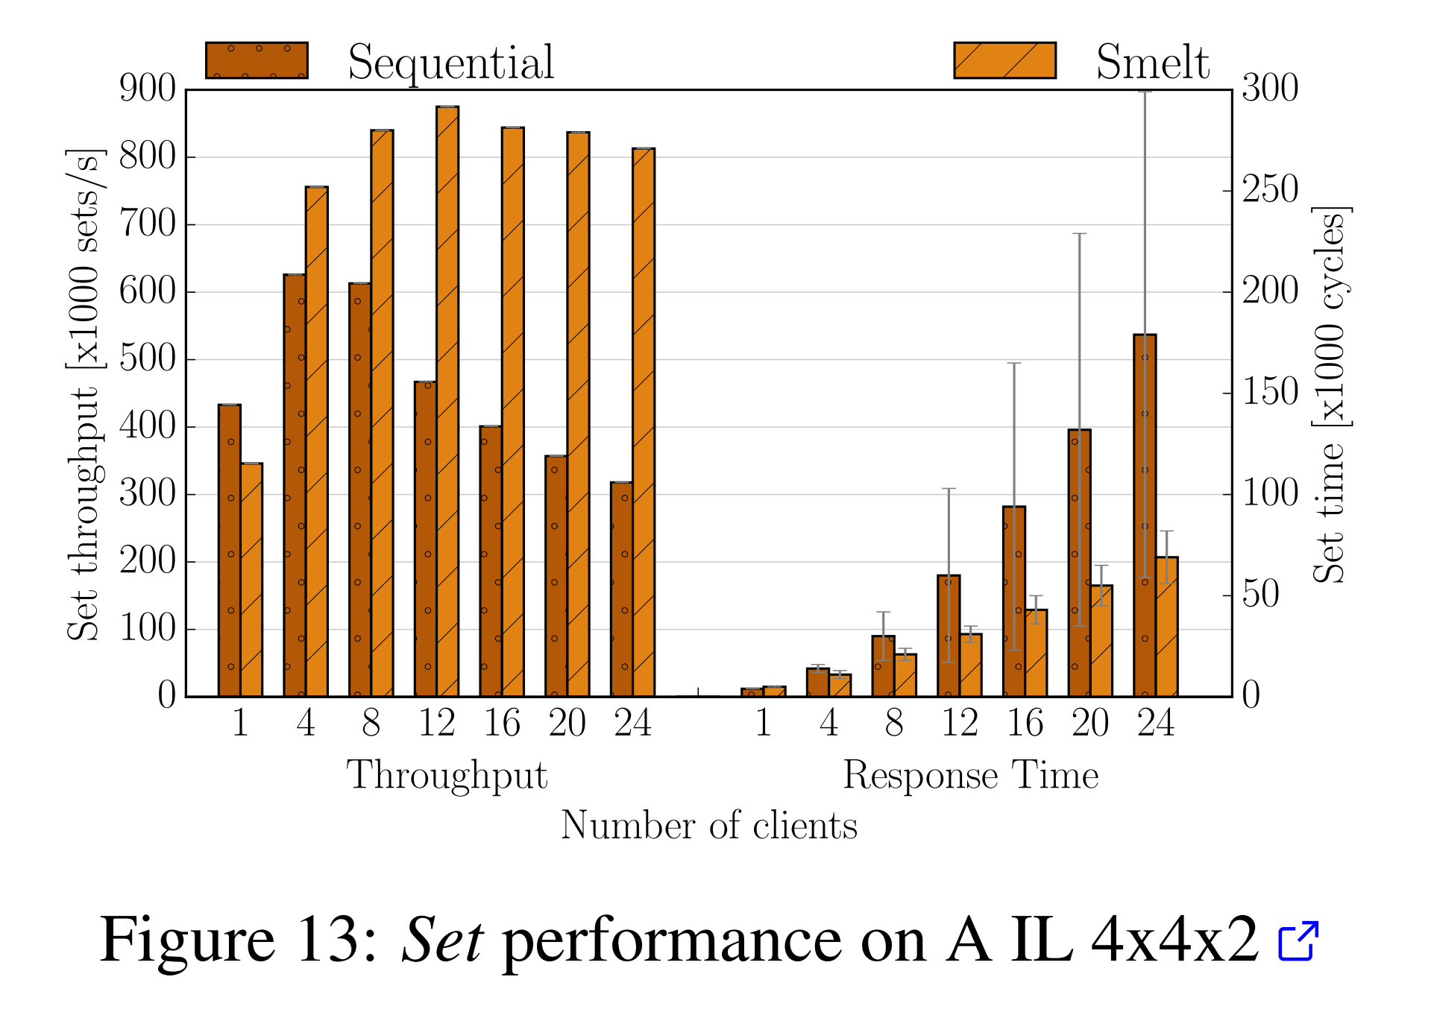
Key-value Store
Nearest replica responds to clients request.
Supports a get/set interface.
Get results are omitted as they are served locally.

Slide 36
Thank You

