Slide 1
Machine-Aware Atomic Broadcast Trees for Multicores
Presented By
Anvesh Muppeda

Slide 2
Problems addressed
This paper addressed the problem of efficiently communicating between cores on modem multi-cores machines.
The performance of parallel programs on multicore machines are mostly hardware dependent.
Important to address because parallel programming with message-passing used widely.
Different machines show radically different optimal layouts.

Slide 3
Smelt
Smelt, a software library which builds efficient multicast trees without manual tuning.
Smelt servers as a fundamental building block for higher-level operations such as atomic broadcast, barriers and consensus protocols.

Slide 4
Related Work
Tree-based broadcast algorithms: A set of broadcast algorithms that consistently and efficiently convey messages using a tree-based topology is known as tree-based broadcast algorithms.
Algorithms for logical reliable broadcast: Another popular broadcast algorithm, logical reliable broadcast ensures effective and dependable message delivery in dispersed systems.
Hardware-aware broadcast algorithms: To increase performance and reliability, hardware-aware broadcast algorithms take advantage of the hardware-level capabilities of contemporary multicore processors.

Slide 5
Related applications
Distributed systems
Parallel computing
Cluster computing
Cloud computing
High-performance computing

Slide 6
Motivation

Slide 7
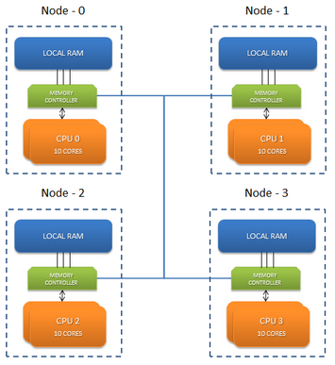
NUMA (Non-uniform memory access)
Modern high-end servers are large NUMA multiprocessors.
Accessing local memory is faster than accessing remote memories.
NUMA message passing mechanisms uses chache coherency.
Link

Slide 8
Group Communication Primitives
Message passing – building block for higher-level distributed operations like atomic broadcast, reductions, barriers or agreement.
Messages to be sent to different cores and becomes critical for complex memory hierarchy.
Both the topology and the order to send messages to a node’s children are critical for performance.
Cost of sending message between cores of different nodes is high.

Slide 9
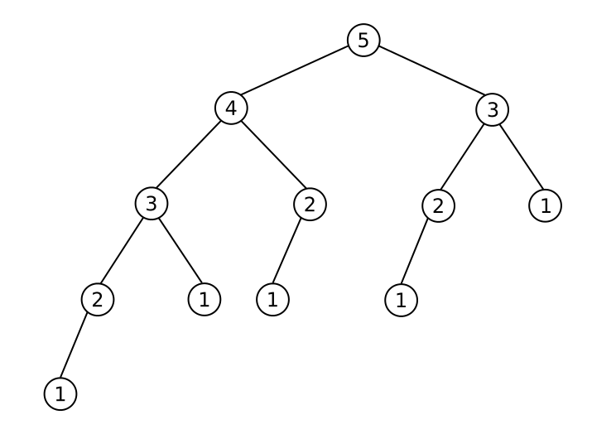
Common tree topologies
Binary trees
Fibonacci trees
Sequential trees
Minimum Spanning Trees
Cluster
Fibonacci Tree

Slide 10
Design

Slide 11
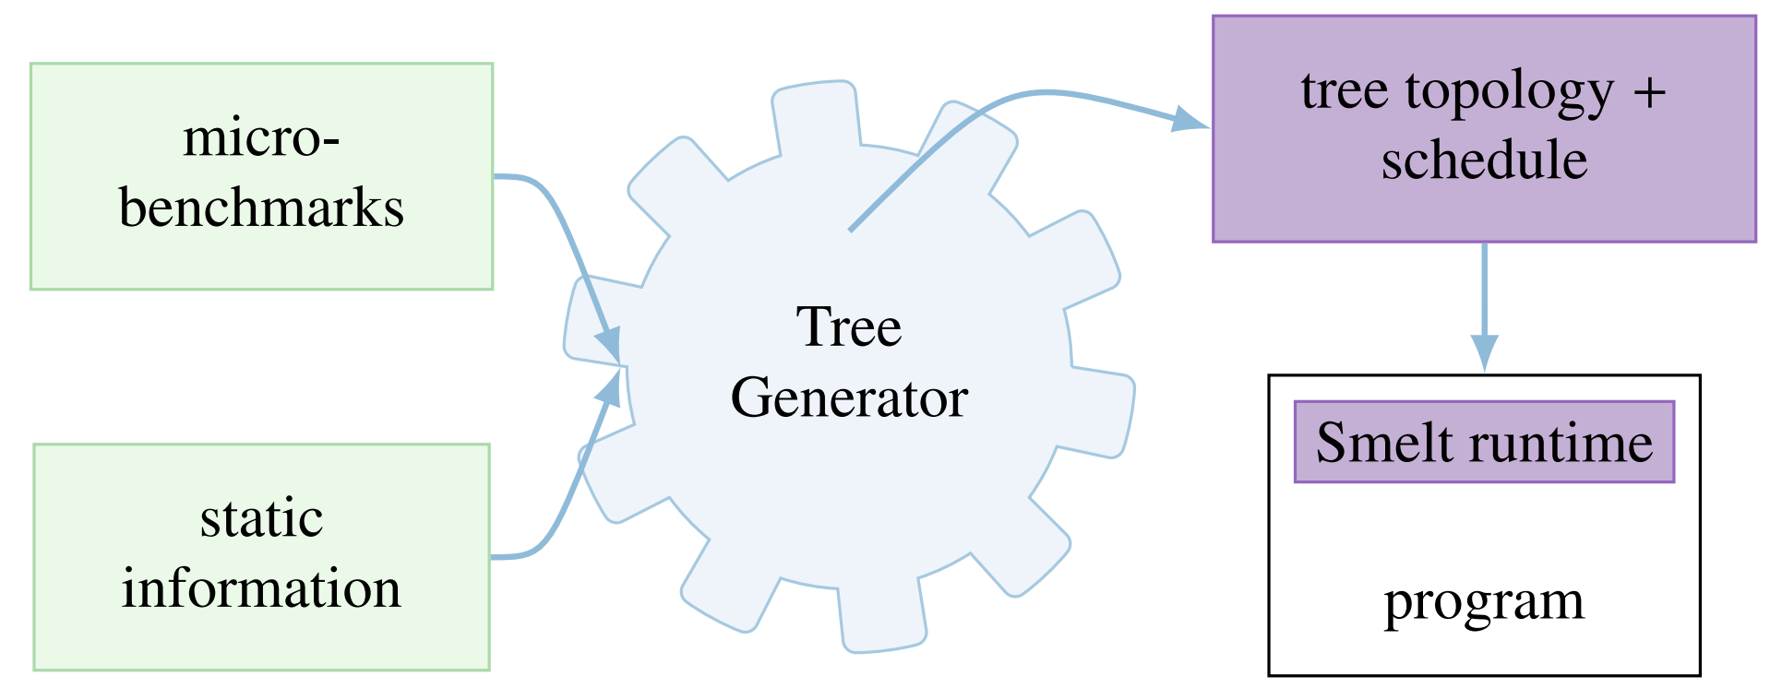
Basic Design

Slide 12
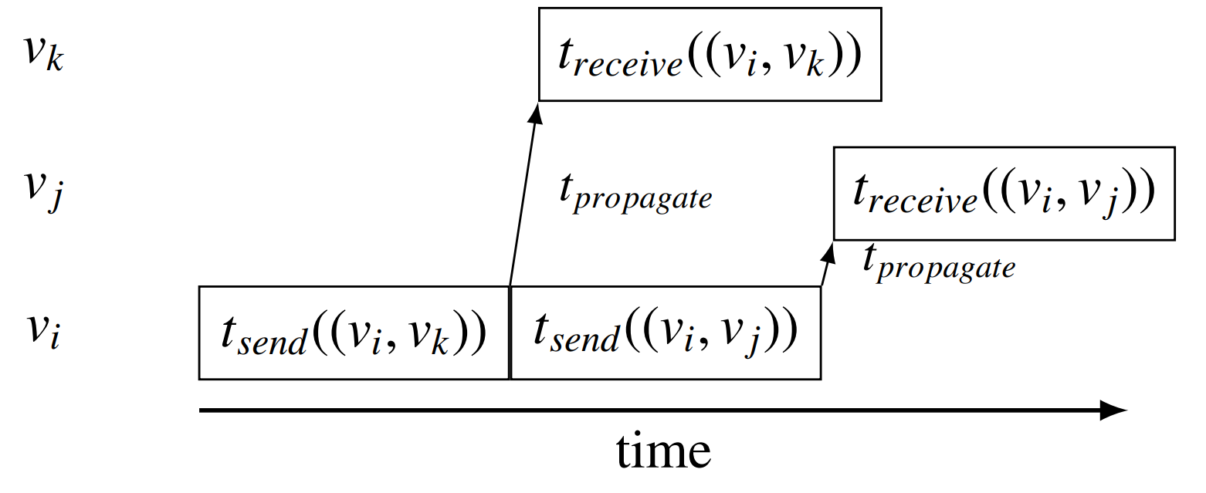
Send Operation

Slide 13
Modelling Broadcast on Multicores
Communication modelled as a fully connected graph G(V,E) –
Vertices v_{i} correspond to threads(cores).
Edges e = (v_{i} , v_{j}) model communication between threads v_{i} and v_{j}
Edge Weight as a tuple w(e) = (t_{send} , t_{receive})
Desired Output
A root v_{root}
A tree T = (V, E’ ) with E’ ⊆ E, where T is a spanning tree of G
Edge priorities w’(v) representing the order in which a vertex v sends messages to its children
T is to be chosen such that the latency lat(T) is minimal

Slide 14
Populating the machine model
The pairwise send (t_{send}) and receive (t_{receive} ) latencies are measured for all hardware threads in the system.
A batch of 8 messages is sent for each pair and the average cost is taken to compensate for the possible existence of a hardware write buffer.
This allows to predict the time a core is busy sending or receiving a message and when it will becomes idle again.

Slide 15
Tree generation: adaptive Tree
The Heuristics for the Base Algorithms are –
Remote cores first – Local communication can be done later
Avoid expensive communication links
No redundancy – both core and node does not receive a message twice
Parallelism – Preferring unbalanced trees with appropriate ordering
Classification-
A core is active if it has received the message , otherwise inactive
A node is active if any of its core is active ,otherwise inactive.

Slide 16
Algorithm 1 Smelt’s Adaptive tree
C_{all} //Set of cores
A_{nodes} ← node_of(c_{root}) //Active nodes
A_{cores} ← c_{root} //Active cores
function PICK_MOST_EXPENSIVE(C, i)
return arg max_{x∈C}(t_{send}(i, x) + t_{receive}(i, x))
end function
function PICK_CHEAPEST(C, i)
return arg min_{x∈C}(t_{send}(i, x))
end function
function ADAPTIVE_TREEE //Run for core c_{self}
while C_{all} ∩ A_{cores} != ∅ do
if c_{self} ∈ A_{cores} then
NODE_IDLE(c_{self})
else
WAIT_MESSAGE
end if
end while
end function

Slide 17
Algorithm 1 Smelt’s Adaptive tree(cont.)
function NODE_IDLE(i) //Executed for active idle node i
C_{inactive} ← C_{all} - (A_{cores} ∪ CORES_OF(A_{nodes}) )
c_{next} ← PICK_MOST_EXPENSIVE(C_{inactive}, i)
if SAME_NODE(i, c_{next}) then //Local
SEND(c_{next})
A_{cores} ← A_{cores} ∪ c_{next} // Mark core active
else
C_{eligible} ← NODE_OF(c_{next}) //All cores on node
c_{next} ← PICK_CHEAPEST(C_{eligible}, i)
SEND(c_{next}) //Send remotely
A_{nodes} ← A_{nodes}∪ NODE_OF(c_{next})
A_{cores} ← A_{cores} ∪ c_{next}
end if
end function

Slide 18
Implementation

Slide 19
SmeltRT
The Smelt runtime (SmeltRT) is available as a open source C++ library.
Easy to implement machine optimized higher level protocols
Available at
https://github.com/libsmelt/libsmelt

Slide 20
Layers
Structured in two layers
Transport layer
Provide send/receive functionality
Collective layer
Supports group communication like broadcast and reduce

Slide 21
Transport layer
Point to point message passing
Responsible for send() , receive() and OS independent controls
Uses bi-directional queuepair for message passing.

Slide 22
Queuepair
Properties:
Reliability:
Message sent over a queuepair is never lost or corrupted and will be received eventually.
Ordering :
Two messages send over the same queuepair will be received in the same order
A queuepair can hold a pre-defined number of messages.

Slide 23
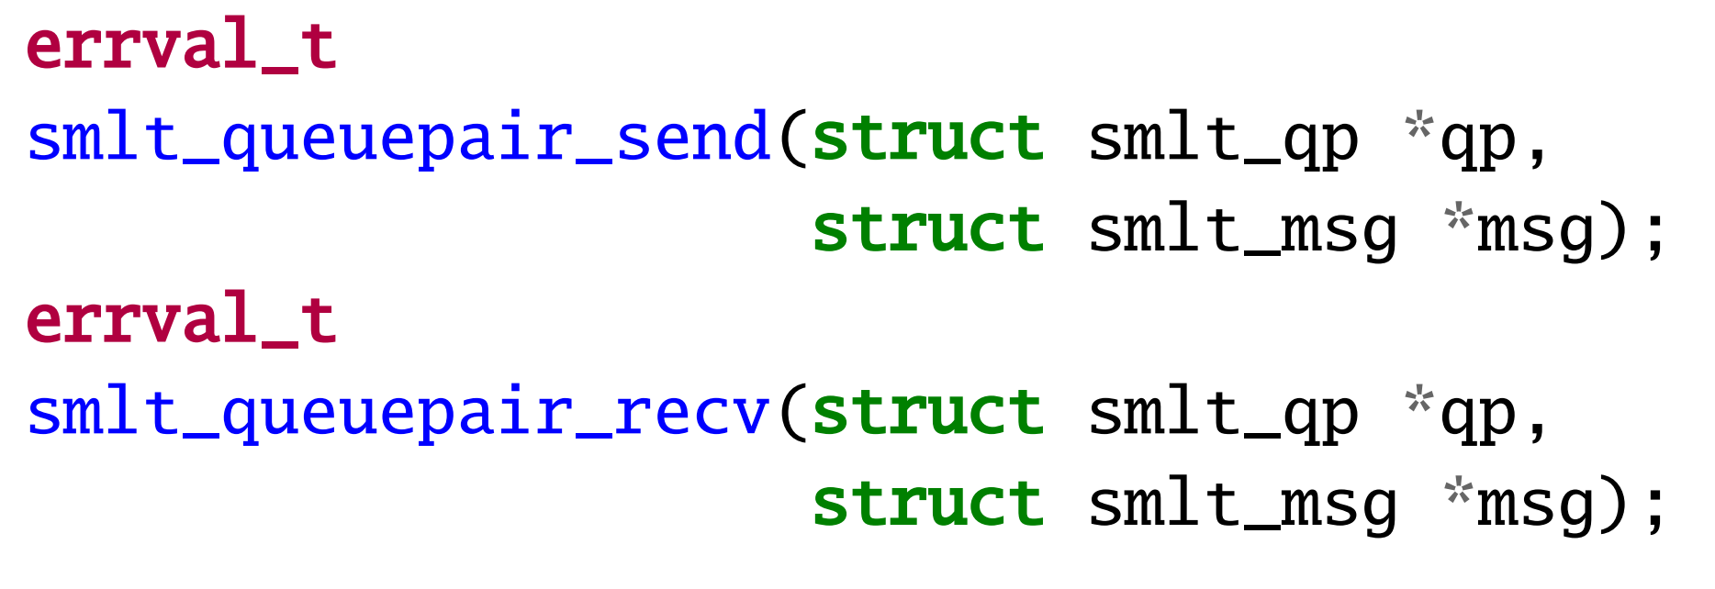
Interface
Message and its length is encapsulated using Smelt-messages and sent over the queuepair
The send and receive operations may block if the queuepair is full or empty respectively
The state of a queuepair can be queried to avoid unnecessary blocking.

Slide 24
Collective Layer
Built upon transport layer
Provides machine aware, optimized group communication primitives such as broadcast() and reduce()
It rely on core concepts of topologies and contexts.

Slide 25
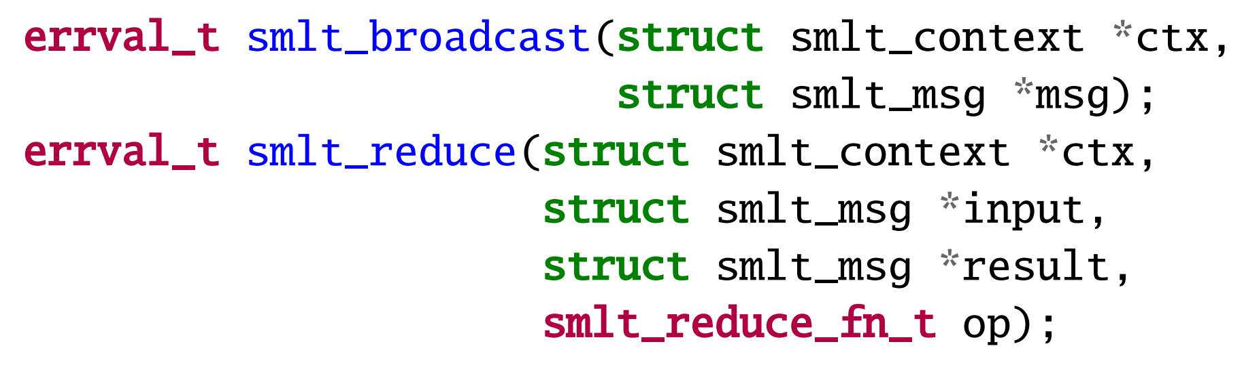
Collective operations
The reduction takes an operation argument which is a function pointer to implement the reduction operation
In reduction, the result parameter at the root contains the gathered value.

Slide 26
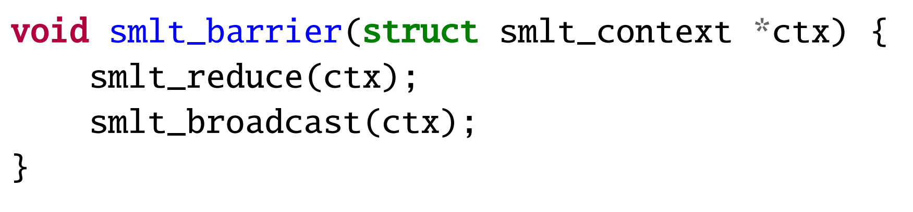
Barriers
Using basic reduce and broadcast with zero payload, barrier can be implemented.
Here we measure the cost on each node and take the maximum.

Slide 27
Evaluation
Evaluate performance of smelt’s adaptive tree against the tree topologies.
Motivate that no single static topology works well across all machines.
Understand why smelt matches/improves over performance of best static topology known.
Compare performance of Smelt with well known and widely used run-times.

Slide 28
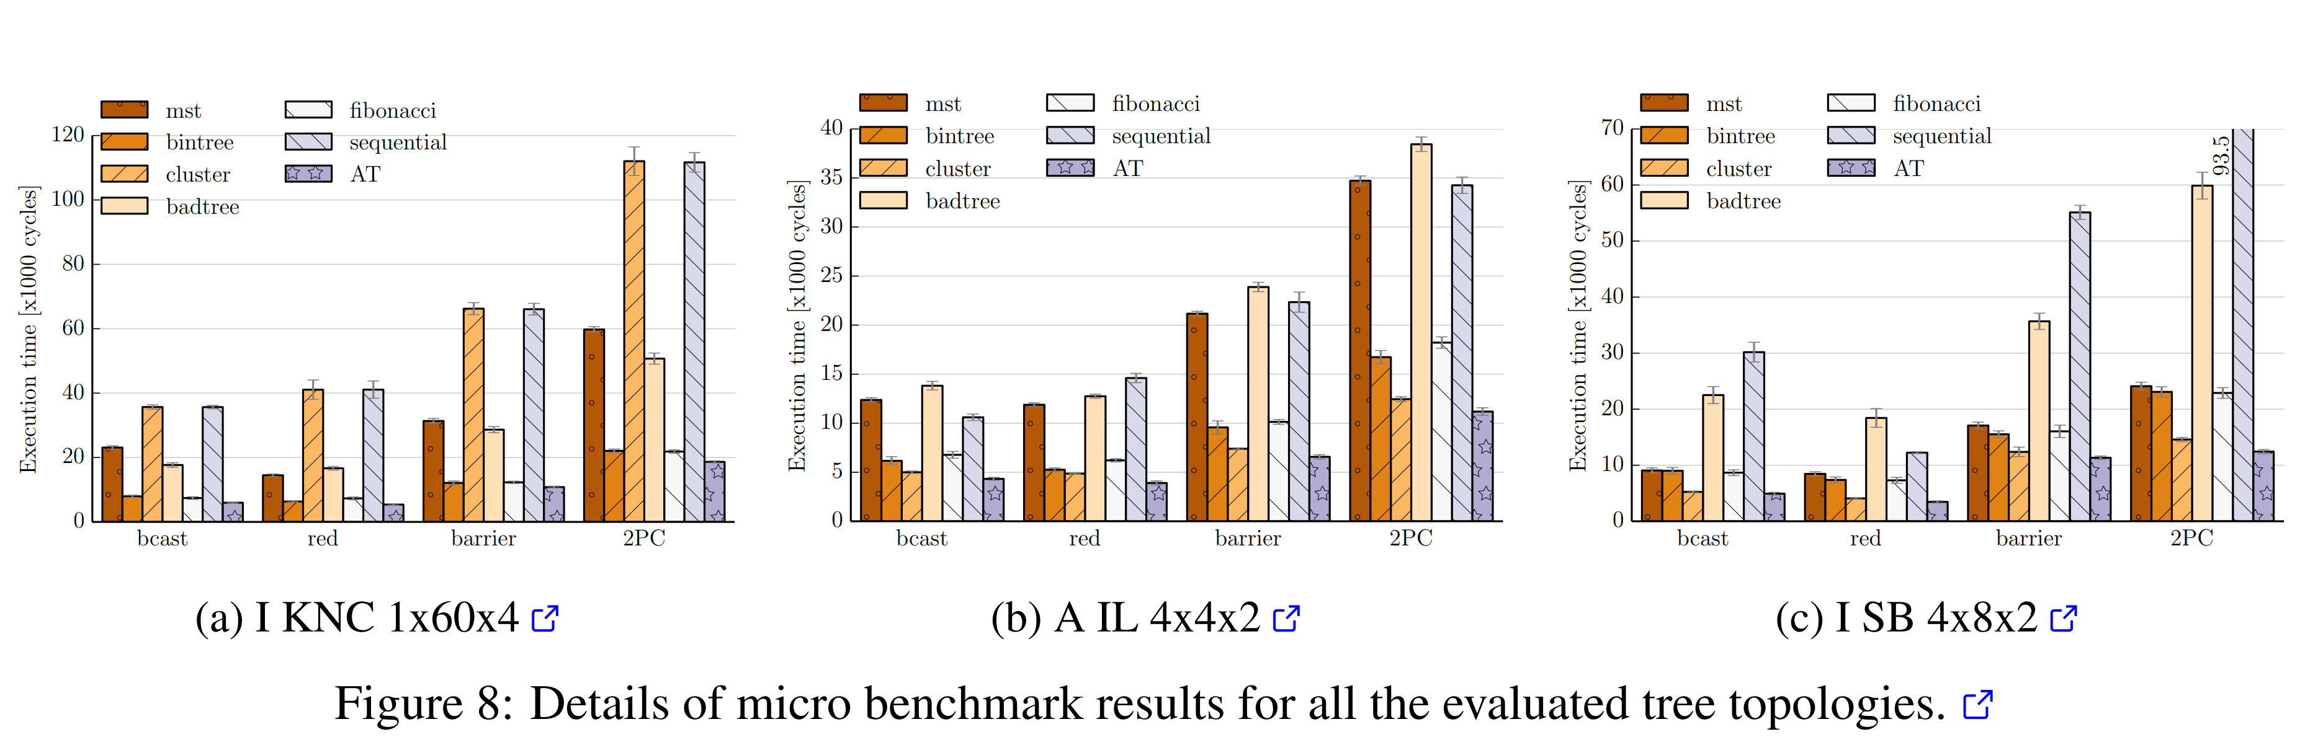
Breakdown for selected machines

Slide 29
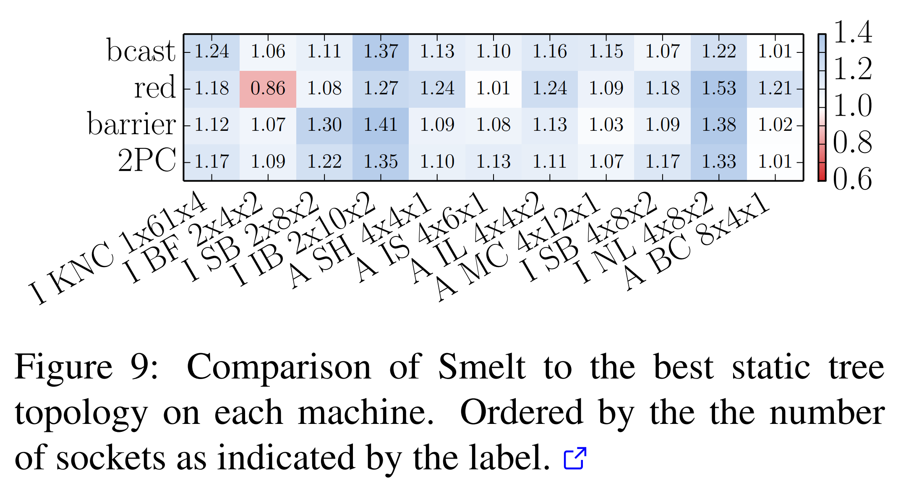
Comparison with best other topologies

Slide 30
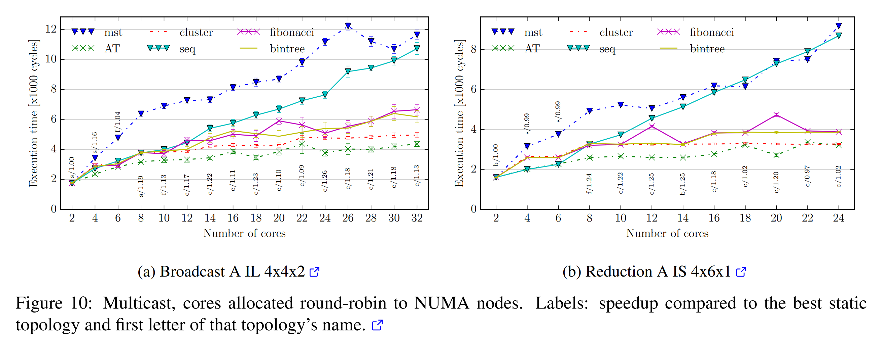
Multicast topologies

Slide 31
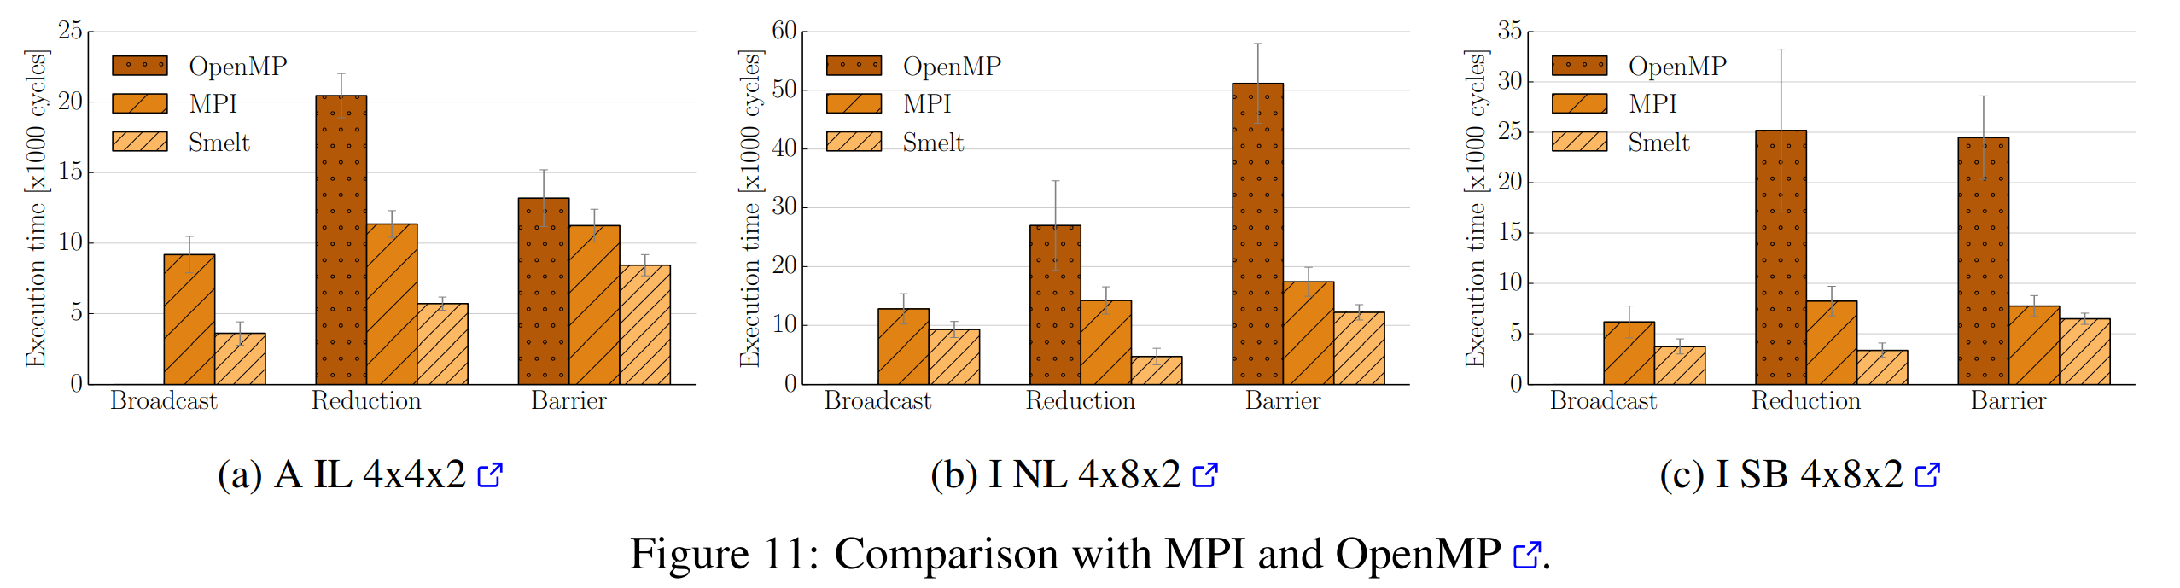
Comparison with MPI and OpenMP

Slide 32
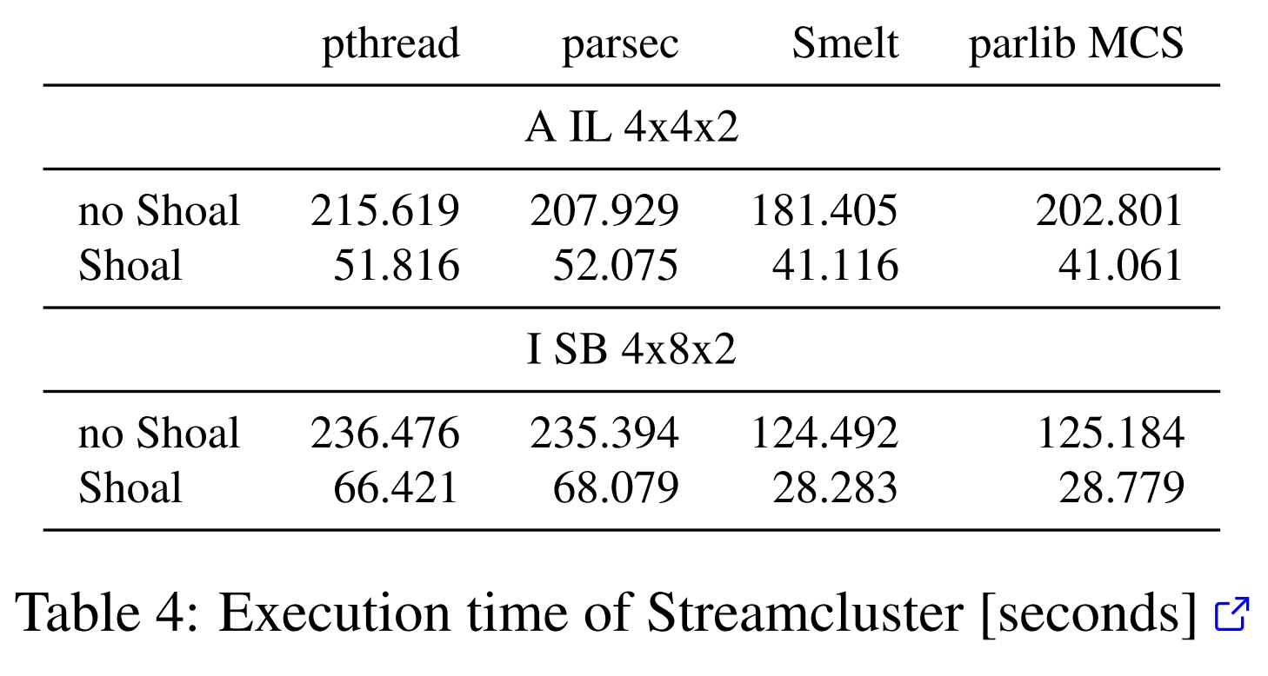
Streamcluster

Slide 33
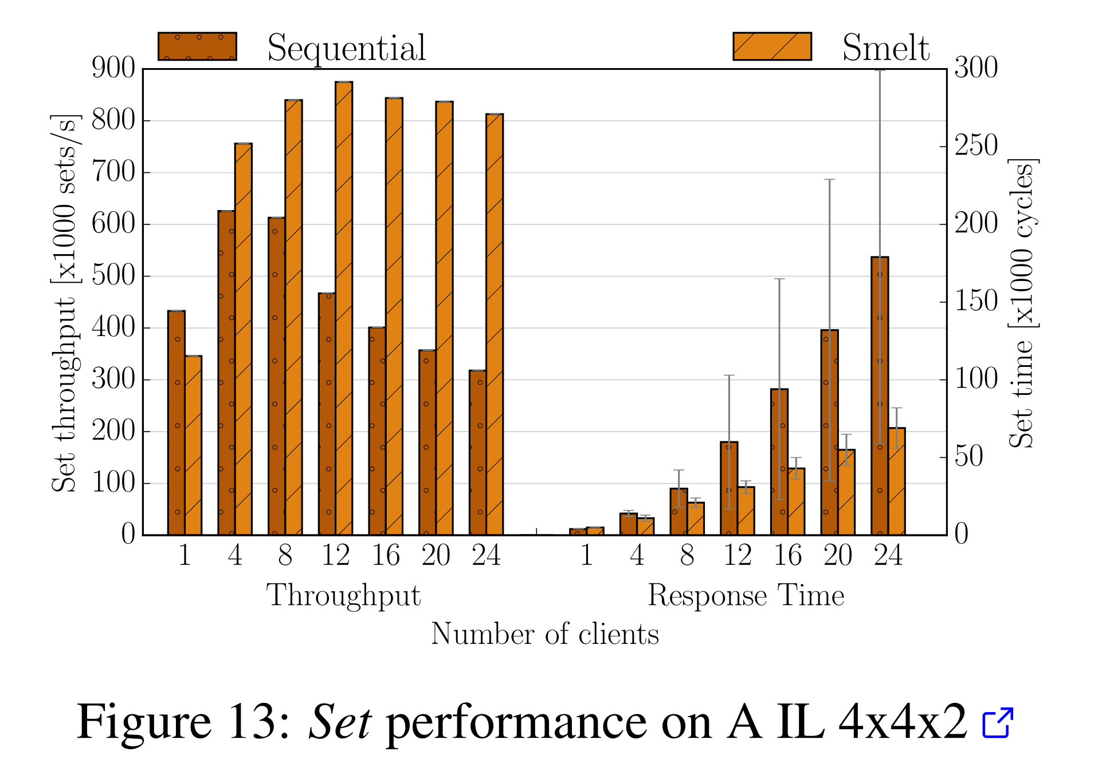
Key-value Store
Nearest replica responds to clients request.
Supports a get/set interface.
Get results are omitted as they are served locally.

Slide 34
Challenges and limitations?
Complexity: Compared to other broadcast algorithms, the MABT method is relatively sophisticated, which could make it challenging to develop and maintain in a practical environment.
Scalability: It is unclear how well the MABT algorithm will function in larger.
Resource needs: In contexts with limited resources, the MABT algorithm may be difficult to implement due to its high memory and computing resource requirements.

Slide 35
Future Work
Performance assessment: Additional performance analysis of the MABT algorithm is required to fully comprehend its capabilities and constraints in practical settings.
Scalability: In order to make sure that the MABT algorithm can handle huge and complicated networks, its scalability needs to be assessed and enhanced.
Implementation in the real world: The MABT algorithm should be implemented in the real world to verify its efficacy and to uncover any extra difficulties or constraints.

Slide 36
Thank You

