Slide 1
Machine-Aware Atomic Broadcast Trees for Multicores
Presented By
Anvesh Muppeda

Slide 2
Problems addressed
This paper addressed the problem of efficiently communicating between cores on modem multi-cores machines.
The performance of parallel programs on multicore machines are mostly hardware dependent.
Important to address because parallel programming with message-passing used widely.
Different machines show radically different optimal layouts.

Slide 3
Smelt
Smelt, a software library which builds efficient multicast trees without manual tuning.
Smelt servers as a fundamental building block for higher-level operations such as atomic broadcast, barriers and consensus protocols.

Slide 4
Motivation

Slide 5
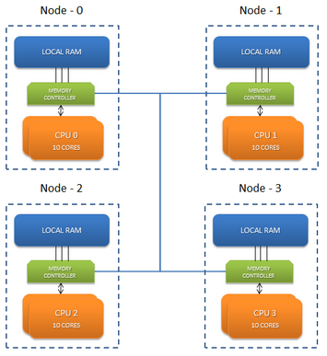
NUMA (Non-uniform memory access)
Modem high-end servers are large NUMA multiprocessors.
Accessing local memory is faster than accessing remote memories.
NUMA message passing mechanisms uses chache coherency.

Slide 6
Group Communication Primitives
Message passing – building block for higher-level distributed operations like atomic broadcast, reductions, barriers or agreement.
Messages to be sent to different cores and becomes critical for complex memory hierarchy.
Both the topology and the ordere to send messages to a node’s children are critical for performance.
It is beneficial to involve other cores quickly in the broadcast and exploit the inherent parallelism available.

Slide 7
Group Communication Primitives (cont.)
Cost of sending message between cores of different nodes is high.
Parellelism should be exploited during message passing.

Slide 8
Common tree topologies(cont.)
Binary trees
Each node connected to at most 2 nodes
Here, cross NUMA links exists resulting in
unnecessary traffic interconnect Low fanout.
Fibonacci trees
Unbalanced binary trees, low fanout,
Parellelism not extracted fully.

Slide 9
Common tree topologies(cont.)
Sequential trees
Root sends message to each of the nodes sequentially Not parallelized
Minimum Spanning Trees
Uses Prim’s algorithm to find out the edges and keep the minimum weight edge as cross-NUMA link but still doesn’t optimise fanout.
Cluster
Message sent sequentially but doesn’t use parallelism.

Slide 10
Design

Slide 11
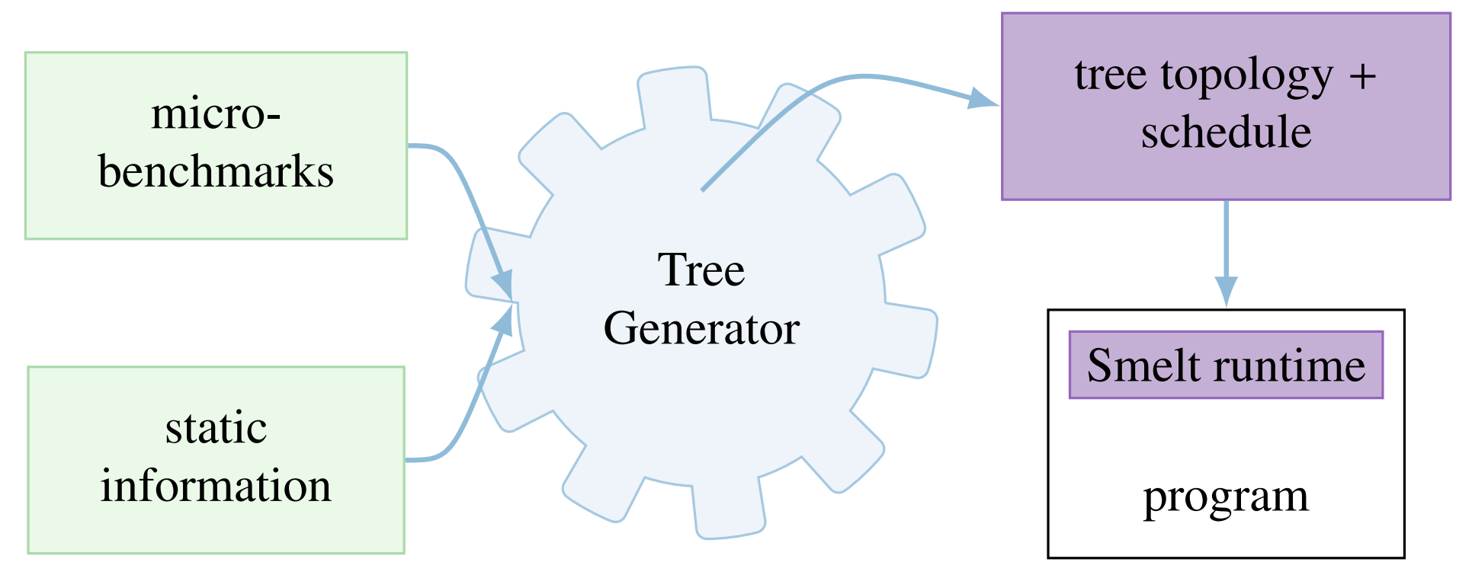
Basic Design

Slide 12
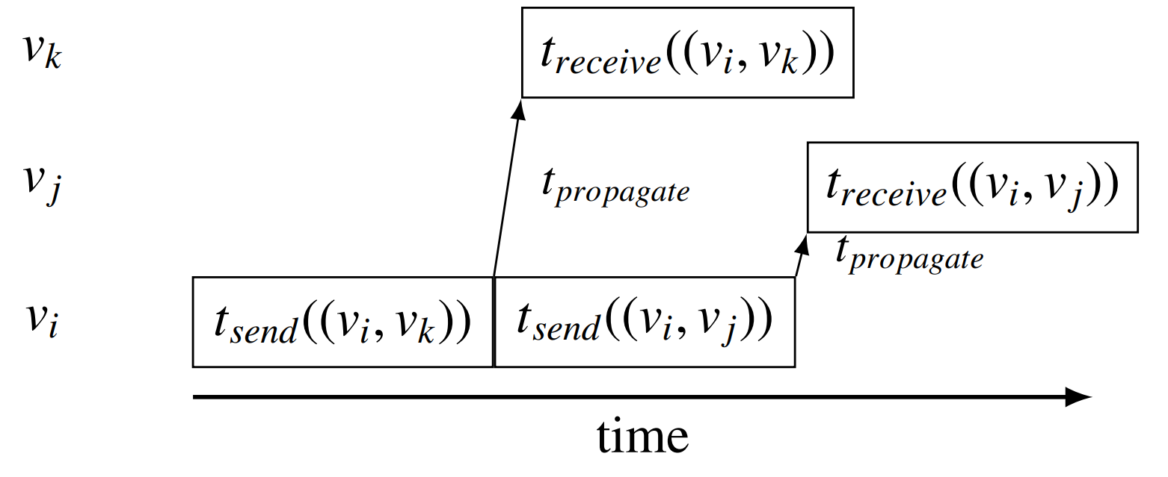
Send Operation

Slide 13
Modelling Broadcast on Multicores
Commucation modelled as a fully connected graph G(V,E) –
Vertices v correspond to threads(cores).
Edges e = (v , v ) model communication between threads v and v
Edge Weight as a tiple w(e) = (t , t )
Desired Output –
A root v
A tree T = (V ,E ) with E E. where T is a spanning tree of G
Edge priorities w(v) representing the order in which a vertex v sends messages to its children
T is to be chosen such that the latency lat(T) is minimal

Slide 14
Populating the machine model
The pairwise send (t ) and (t ) latencies are measured for all hardware threads in the system
A batch of 8 messages is sent for each pair and the average ocst is taken to compensate for the possible existence of a hardware write buffer
This allows to predict the time a core is busy sending or receiving a message and when it will becomes idle again

Slide 15
Tree generation: adaptive Tree
The Heuristics for the Base Algorithms are –
Remote cores first – Local commucation can be done later
Avoid expensive commucation links
No redundancy – both core and node does not receive a message twice
Parallelism – Preferring unbalanced trees with appropriate ardering
Classification-
A core is active if it has received the message , otherwise inactive
A node is active if any of its core is active ,otherwise inactive.

Slide 16
Algorithm 1 Smelt’s Adaptive tree
C_{all} //Set of cores
A_{nodes} ← node_of(c_{root}) //Active nodes
A_{cores} ← c_{root} //Active cores
function PICK_MOST_EXPENSIVE(C, i)
return arg max_{x∈C}(t_{send}(i, x) + t_{receive}(i, x))
end function
function PICK_CHEAPEST(C, i)
return arg min_{x∈C}(t_{send}(i, x))
end function
function ADAPTIVE_TREEE //Run for core c_{self}
while C_{all} ∩ A_{cores} != ∅ do
if c_{self} ∈ A_{cores} then
NODE_IDLE(c_{self})
else
WAIT_MESSAGE
end if
end while
end function

Slide 17
Algorithm 1 Smelt’s Adaptive tree(cont.)
function NODE_IDLE(i) //Executed for active idle node i
C_{inactive} ← C_{all} ∩ (A_{cores} - CORES_OF(A_{nodes}) )
c_{next} ← PICK_MOST_EXPENSIVE(C_{inactive}, i)
if SAME_NODE(i, c_{next}) then //Local
SEND(c_{next})
A_{cores} ← A_{cores} ∪ c_{next} // Mark core active
else
C_{eligible} ← NODE_OF(c_{next}) //All cores on node
c_{next} ← PICK_CHEAPEST(C_{eligible}, i)
SEND(c_{next}) //Send remotely
A_{nodes} ← A_{nodes}∪ NODE_OF(c_{next})
A_{cores} ← A_{cores} ∪ c_{next}
end if
end function

Slide 18
Incremental Optimization
Reordering sends according to most expensive subtree
Shuffling
Some threads already terminate the broadcast and become idle
Adding extra cross-NUMA links from these threads can reduce global latency
V is a thread that has terminated and v is an inactive thread in another node
T is the time taken after v’s termination for v to become active
T + t is the cost of cross-NUMA link between v and v
If tsend + treceive < tslack cross-NUMA link is added between v and v

Slide 19
Implementation

Slide 20
SmeltRT
The Smelt runtime (SmeltRT) is available as a open source C++ library.
Easy to implement machine optimized higher level protocols
Available at
https://github.com/libsmelt/libsmelt

Slide 21
Layers
Structured in two layers
Transport layer
Provide send/receive functionality
Collective layer
Supports group communication like broadcast and reduce

Slide 22
Transport layer
Point to point message passing
Responsible for send() , receive() and OS independent controls
Uses bi-directional queuepair for message passing.

Slide 23
Queuepair
Properties:
Reliability:
Message sent over a queuepair is never lost or corrupted and will be received eventually
Ordering :
Two messages send over the same queuepair will be received in the same order
A queuepair can hold a pre-defined number of messages.

Slide 24
Interface
val_t smlt_queuepair_send(struct smlt_qp *qp, message and its length is encapsulated using
struct smlt_msg *msg); Smelt-messages and sent over the queuepair
errval_t smlt_queuepair_recv(struct smlt_qp *qp, The send and receive operations may block
struct smlt_msg *msg); if the queuepair is fully or empty respectively
The state of a queuepair can be queried to
to avoid unnecessary blocking.

Slide 25
Collecting Layer
Built upon transport layer
Provides machine aware, optimized group communication primitives such as broadcast() and reduce()
It rely on core concepts of topologies and contexts.

Slide 26
Topology:
It is the communication structure for collective operation.
It defines which participants are part of the communication group(multicast)
Each topology has a root node where all broadcasts are initiated and all reductions end.
Required topology can be generated on the fly.
Contexts
The context identifies the location in the tree of the calling thread and defines the operations being executed
Smelt takes topology as input and creates the required transport links which are encapsulated in a context.

Slide 27
Collective operations
errval_t smlt_broadcast(struct smlt_context *ctx,
struct smlt_msg *msg);
errval_t smlt_reduce(struct smlt_context *ctx,
struct smlt_msg *input,
struct smlt_msg *result,
smlt_reduce_fn_t op);
The reduction takes an operation argument which is a function pointer to implement the reduction operation
In reduction , the resukt parameter at the root contains the gathered value.

Slide 28
Barriers
void smlt_barrier(struct smlt_context *ctx)
{ smlt_reduce(ctx); smlt_broadcast(ctx);
Using basic reduce and broadcast with zero payload , barrier can be implemented
Despite its simplicity ,the above barrier outperforms or it comparable to state-of-the-are implementations.

Slide 29
Evaluation
Evaluate performance of smelt’s adaptive tree against the tree topologies.
Motivate that no single static topology works well across all machines.
Understand why smelt matches/improves over performance of best static topology known
Compare performance of Smelt with well known and widely used run-times.

Slide 30
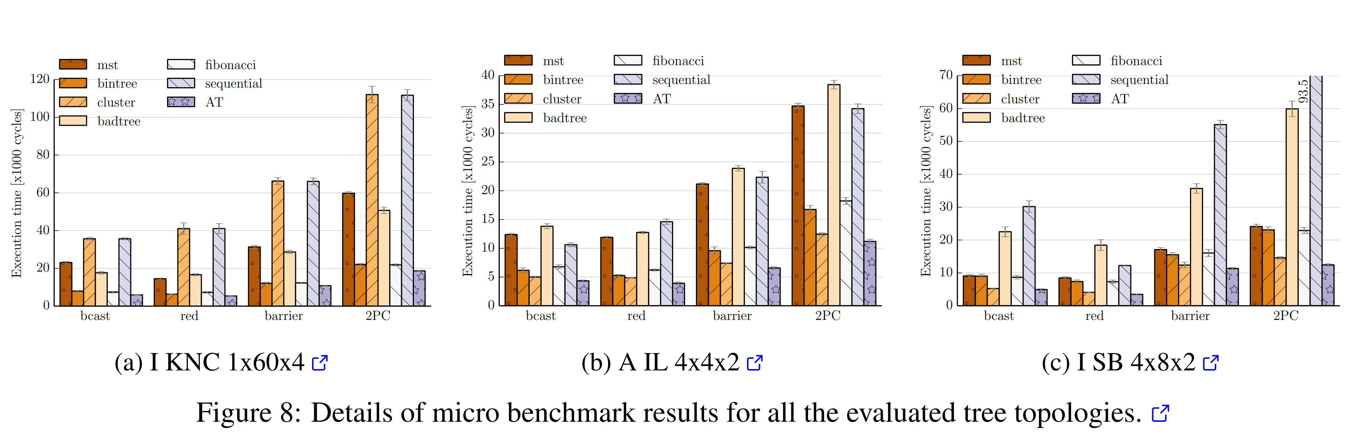
Breakdown for selected machines

Slide 31
Observations
Best static topology depends upon the machine, No clear winner.
Sequential sending results in significant slow down.
Hardware oblivious trees suffer from cross-NUMA links.
Cluster topology relies on machine’s hierarchy
Static send order and low fanout are detrimental to performance
MST does not exploit machine’s parallelism.

Slide 32
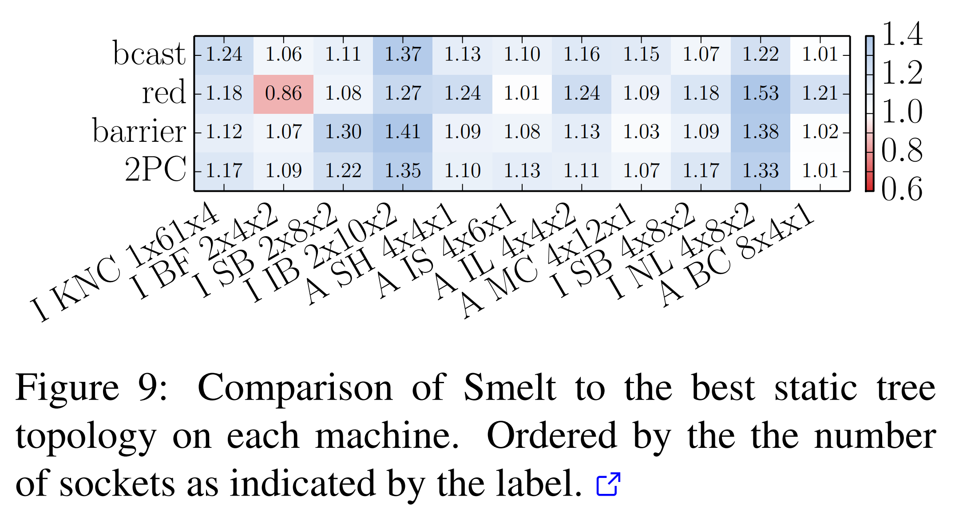
Comparison with best other topologies

Slide 33
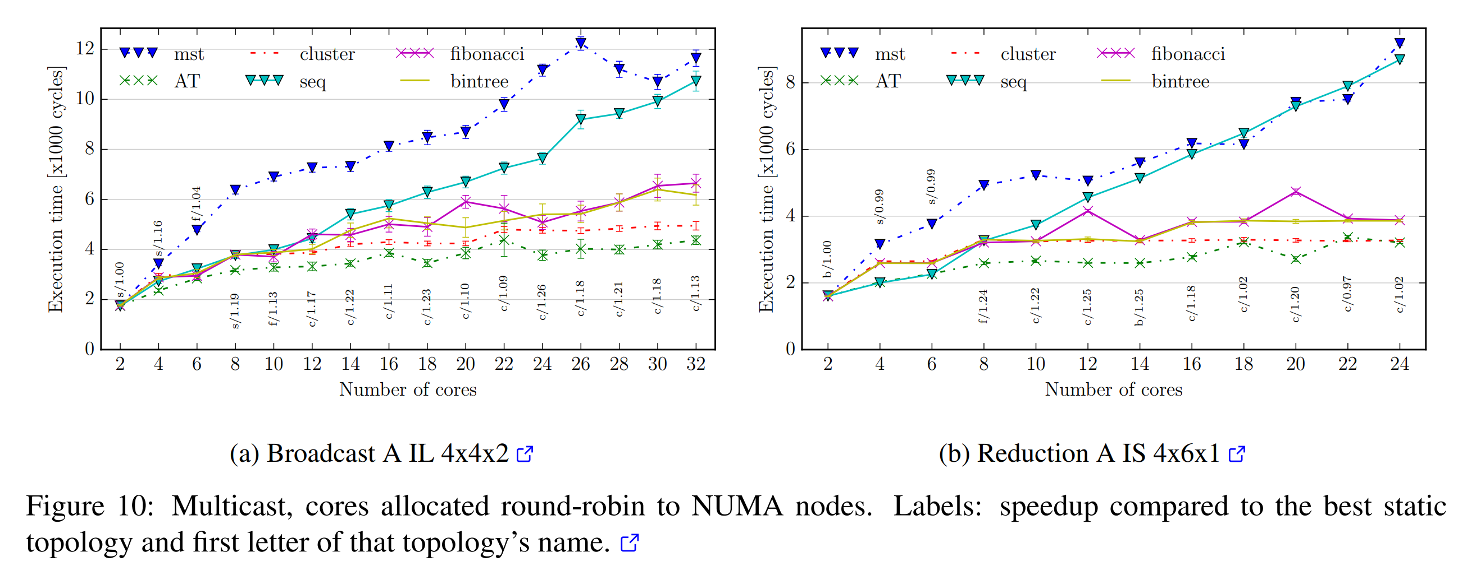
Multicast topologies

Slide 34
Observations
Low number of cores, updates to replicated data, sequential trees better.
Cluster approach starts performing well with increase in number of cores.
Hence, performance is also dependant on multicast group used.
Performance benefit with Smelt is higher in intermediate configurations.

Slide 35
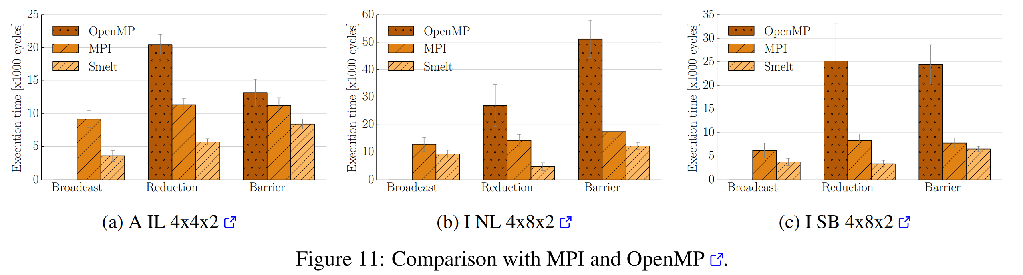
: Comparison with MPI and OpenMP

Slide 36
Observations
In broadcasts and reductions Smelt outperforms MPI with speedups
Between 1.6x and 2.6x

Slide 37
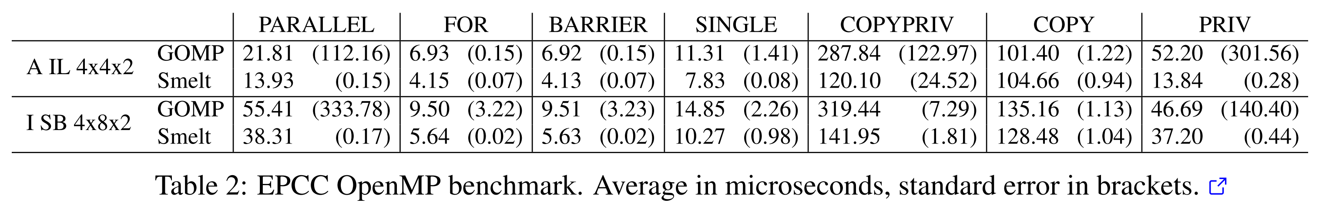
Replacing GOMP Barrier

Slide 38
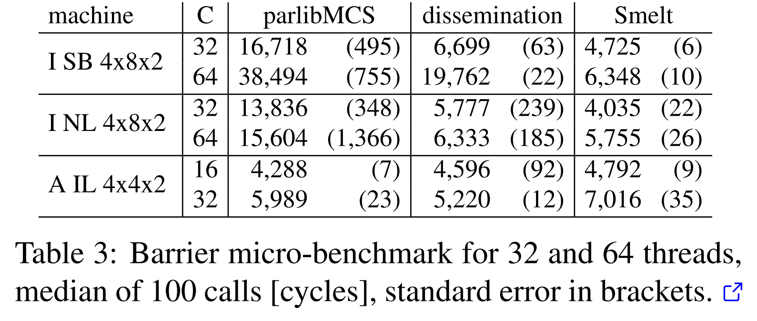
Barrier Micro Benchmarks

Slide 39
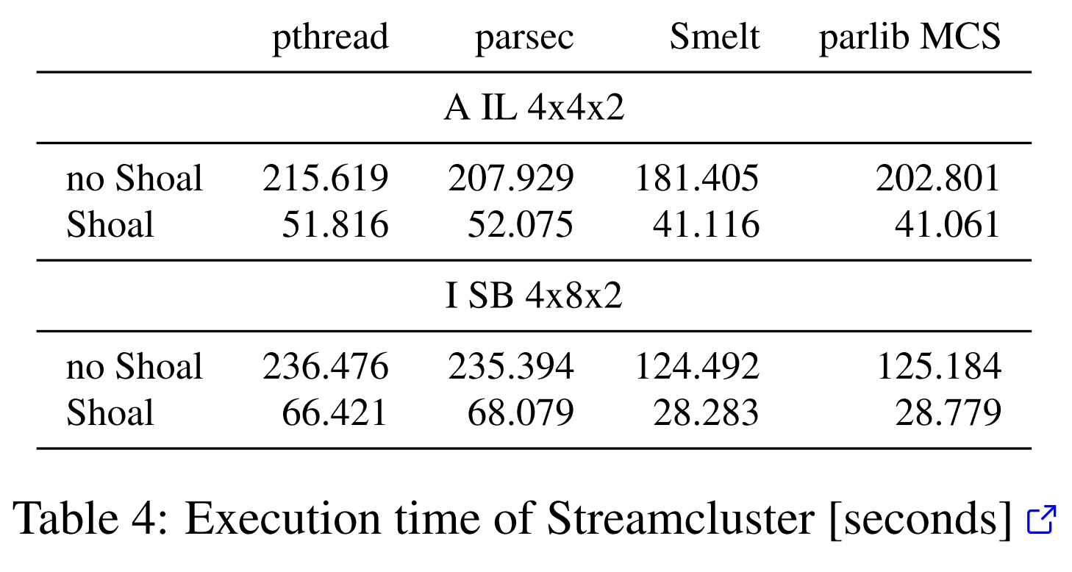
Streamcluster

Slide 40
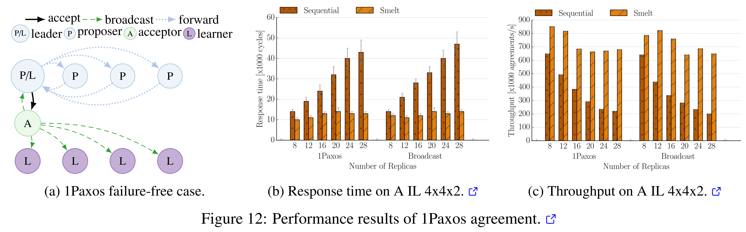
Agreement

Slide 41
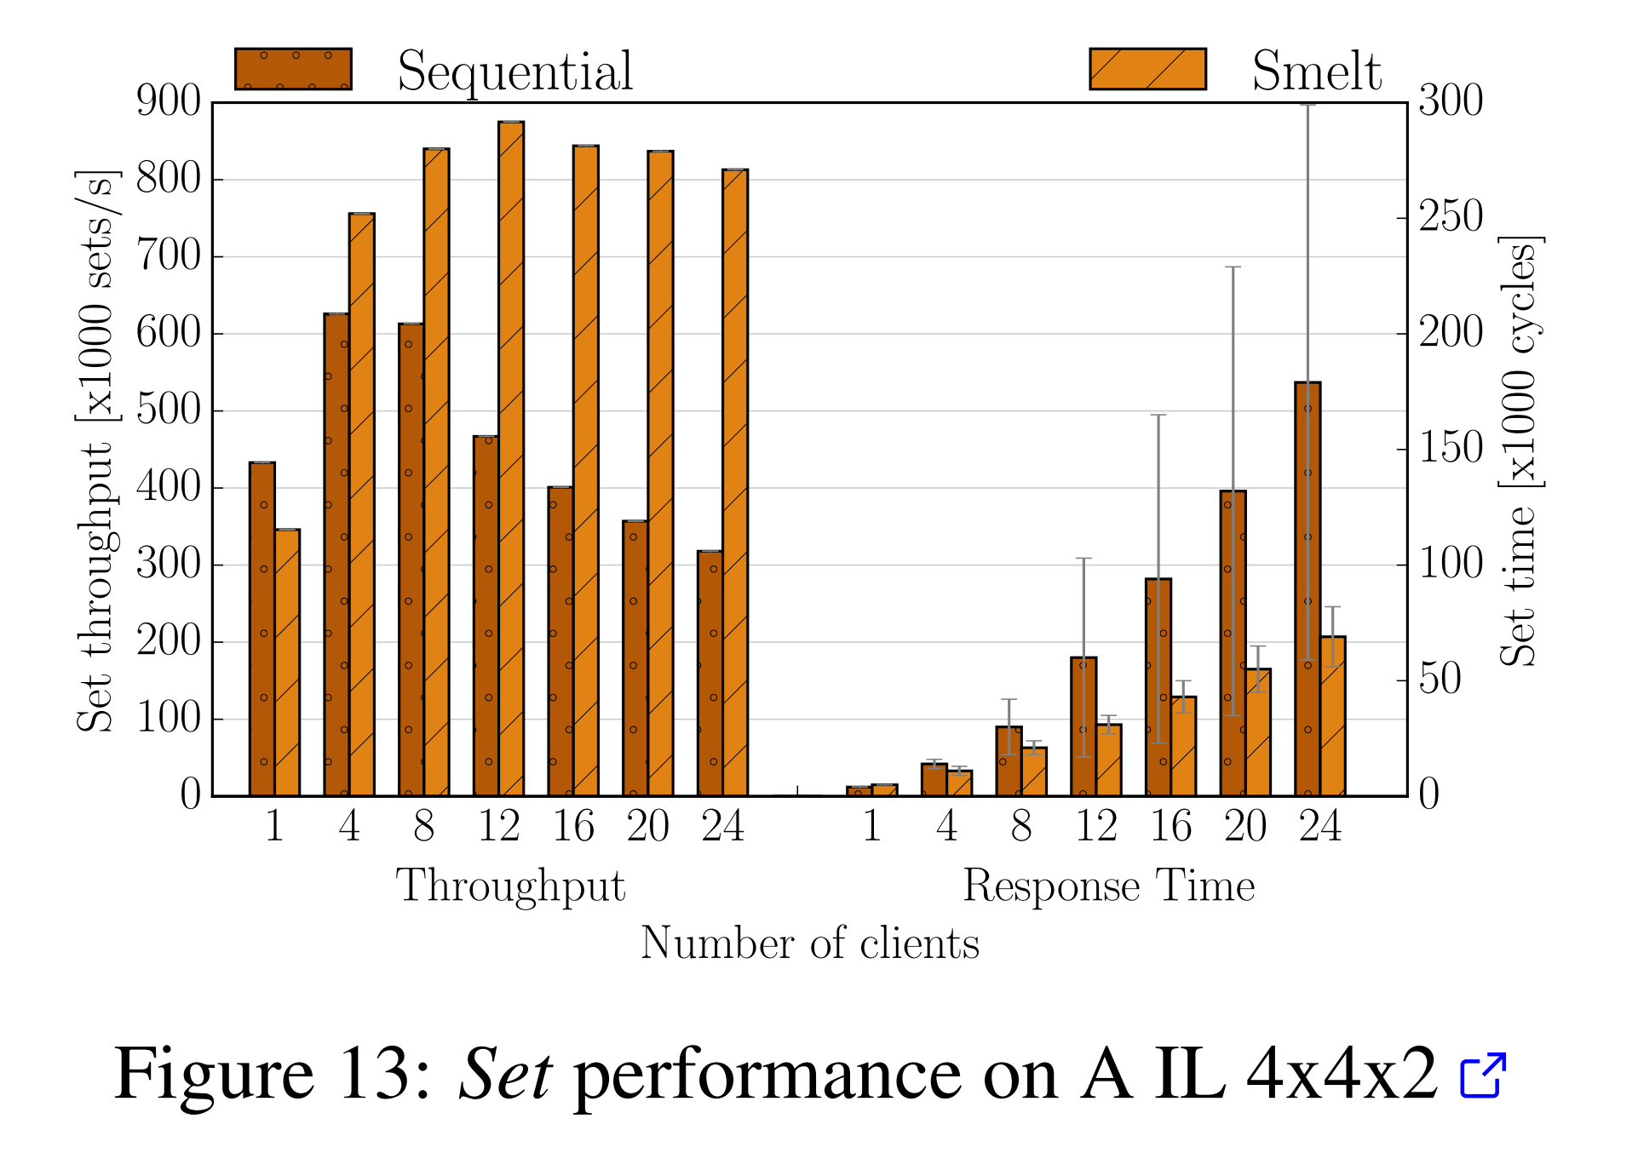
Key-value Store

