Slide 1
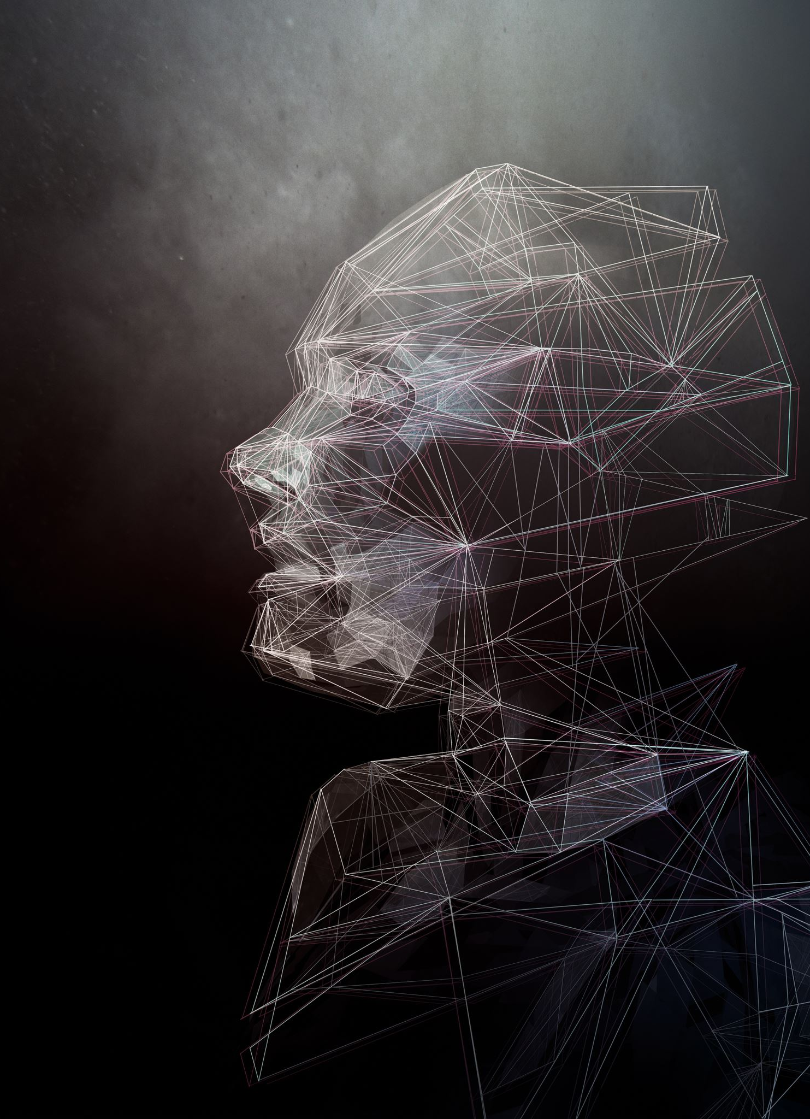
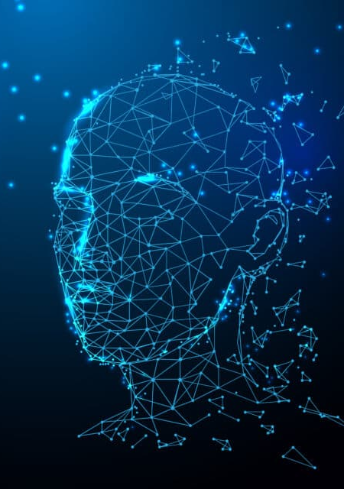
Face Recognition Using PCA
Sai Manasa Kota(R11863589)
Anvesh Muppeda(R11840667)
Vinith Pathapati(R11847380)
Sarat Kamandula(R11904533)
Abhishek Kombathula(R11905401)
Revanth Chilukuri(R11902758)

Slide 2

What is PCA?
Principal Component Analysis
PCA is a dimensionality reduction algorithm which is used to reduce the dimensionality of large data by transforming into smaller one that still contains most of the info in the large set.
Applications:
Data Visualization
Image Compression
Noise Reduction
Face Recognition

Slide 3
Variants of PCA
1D PCA:
One Dimensional Principal Component Analysis.
It aims to find the projection direction that maximizes the variance of the projected data.
2D PCA:
Two Dimensional Principal Component Analysis.
It aims to find the optimal projection directions that captures the most significant variations of data.

Slide 4
Face Recognition Program
Face Detection
Preprocessing and normalization of image.
Feature Extraction
Extraction of the useful features for face patches.
Face Recognition
Comparison between the features of input image and the extracted features of the image.

Slide 5
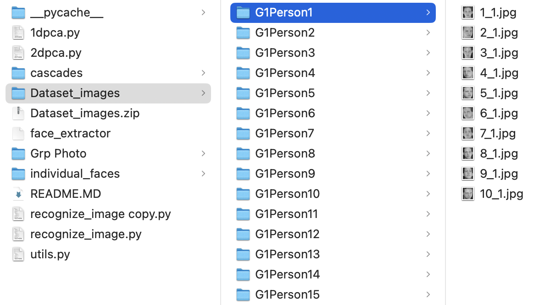
Dataset
Dataset Used: ORL Dataset
Number of persons: 41
Number of images per person: 10
Number of total images: 410
Image pixels: 80x70

Slide 6
1D PCA Key Components
Steps to implement face recognition using 1D-Principal Component Analysis (PCA).
Loading face images dataset.
Preprocessing face images.
Applying PCA for feature extraction.
Evaluating recognition performance.

Slide 7
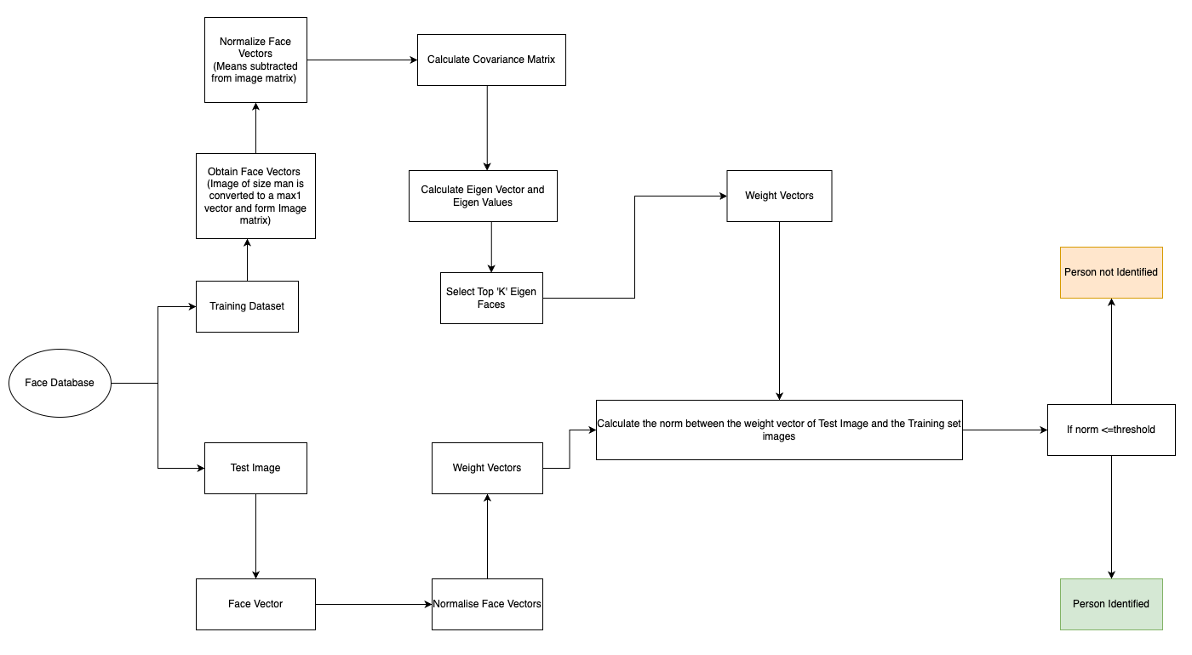
1D PCA Flowchart

Slide 8
1D PCA Algorithm
Data Loading and Preprocessing
Principal Component Analysis (PCA)
Compute mean face and mean-subtracted matrix.
Calculate covariance matrix.
Perform eigen decomposition.
Select principal components based on user input.
Face Recognition
For each test image:
Compute query weight using eigenfaces.
Iterate over training images
Calculate Euclidean distance between query and training weights.
Determine best match based on minimum distance.
Evaluation and Statistics

Slide 9
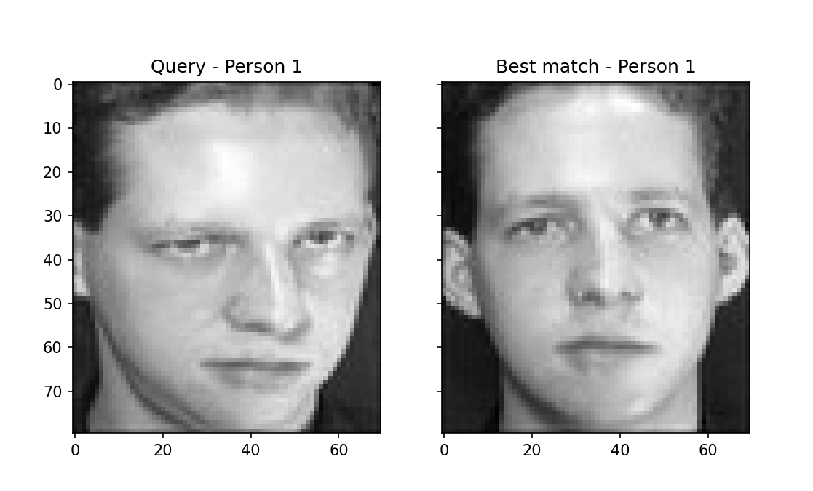
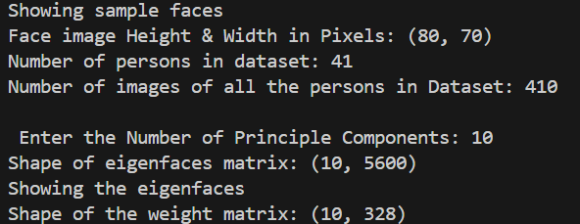
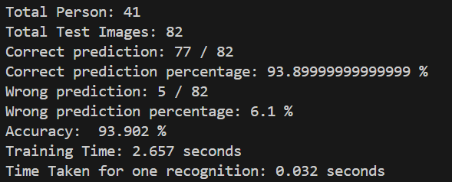
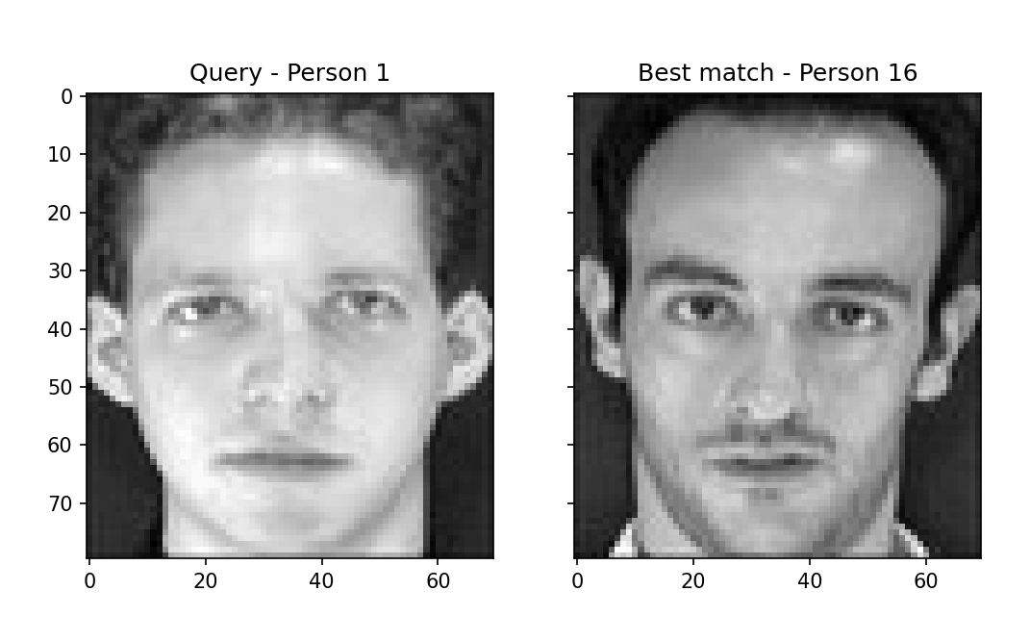
Results for 1D PCA
Correct prediction
Wrong prediction

Slide 10
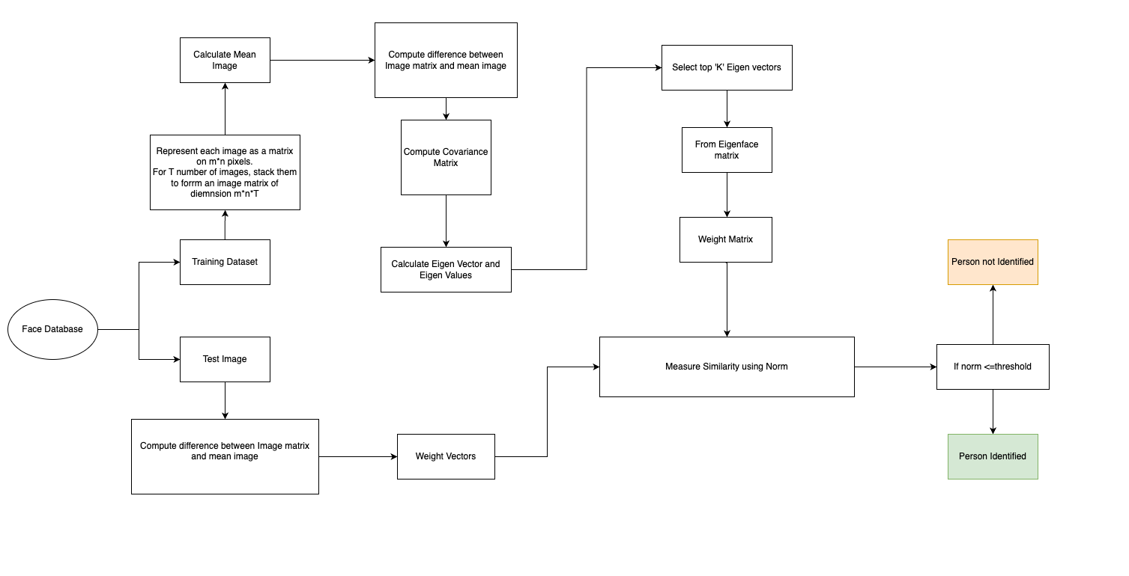
2D-PCA Flowchart

Slide 11
2D PCA Algorithm
Data Loading and Preprocessing
Principal Component Analysis (PCA)
Compute mean face and mean-subtracted matrix.
Calculate covariance matrix.
Perform eigen decomposition.
Select principal components based on user input.
Face Recognition
For each test image:
Compute query weight using eigenfaces.
Iterate over training images:
Compute training weight.
Calculate Euclidean distance between query and training weights.
Determine best match based on minimum distance.
Evaluation and Statistics

Slide 12
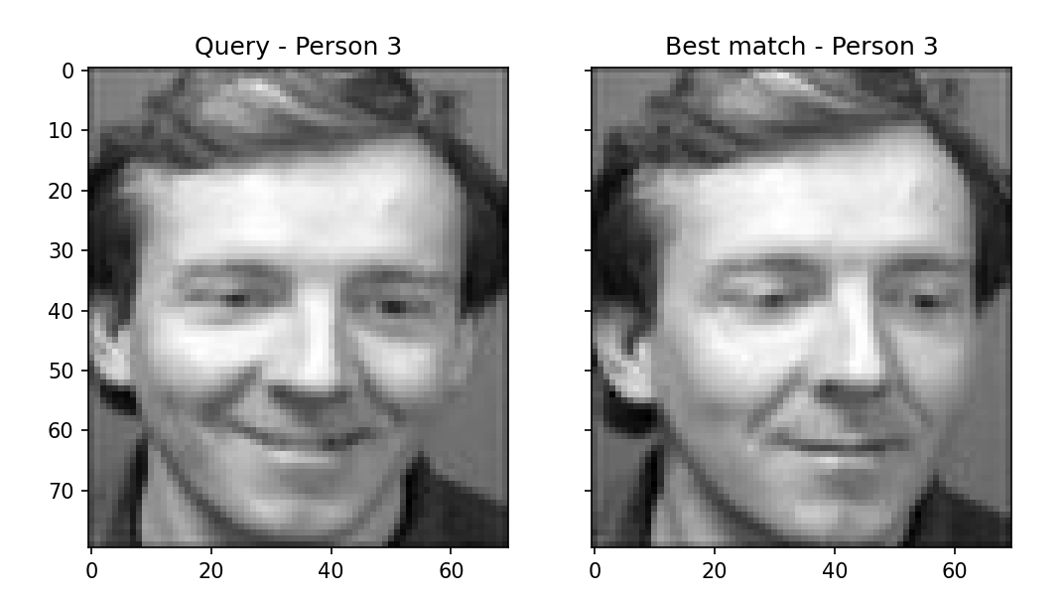
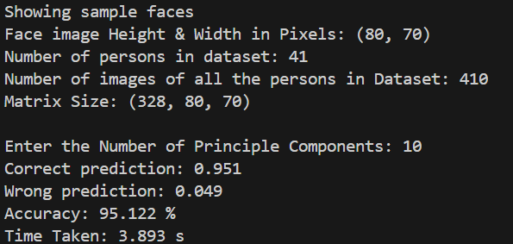
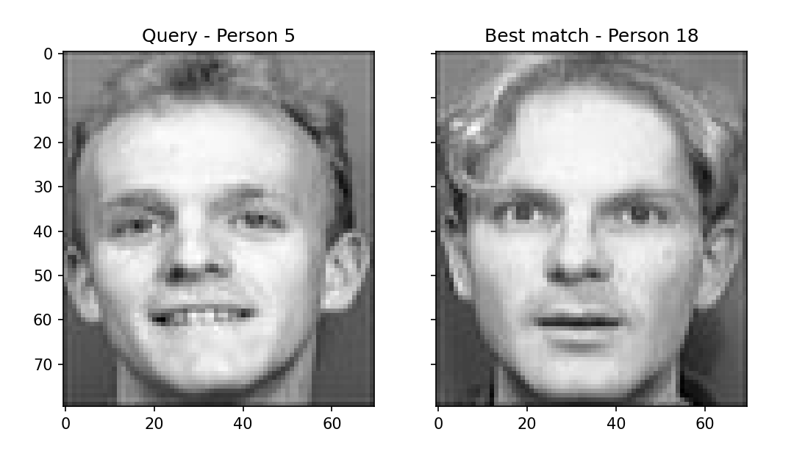
Results for 2D PCA
Correct prediction
Wrong prediction

Slide 13
1DPCA vs 2DPCA
1DPCA
Pros:
Computational efficiency: It's faster because it deals with simpler one-dimensional vectors.
Simple implementation: Easier to understand and code.
Cons:
May lose spatial information: Treating images as straight lines might miss important details in how pixels relate to each other.
Limited representation: One-dimensional projections might not fully capture all the differences between face images.
2DPCA
Pros:
Preserves spatial information: It looks at both rows and columns of face images, capturing details better.
Enhanced performance: Considering the two-dimensional structure can improve recognition accuracy.
Cons:
Higher computational complexity: More calculations are needed, making it slower.
Implementation complexity: It's harder to code and understand compared to 1DPCA.

Slide 14
Role of Number of Principal Components (N)
When you increase the Number of Principal Components (N) used in PCA
Increased Dimensionality Reduction
Improved Discriminative Power
Increased Computational Complexity
Feature Overfitting
Diminishing Returns

Slide 15
Time Comparison
1DPCA
2DPCA

Slide 16
Accuracy Comparison
1DPCA
2DPCA

Slide 17
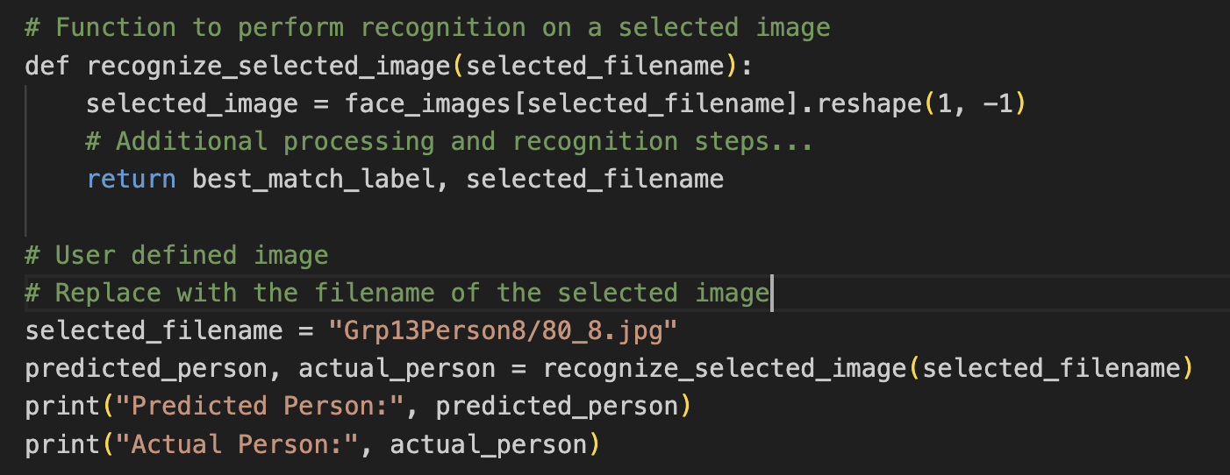
User-defined image prediction
Our code implements user-defined image recognition through PCA on a face image dataset, pinpointing the closest match to a selected image. By leveraging PCA, the code distills facial features from the dataset, facilitating the recognition of user-defined images by determining the optimal match using similarity within the feature space.

Slide 18
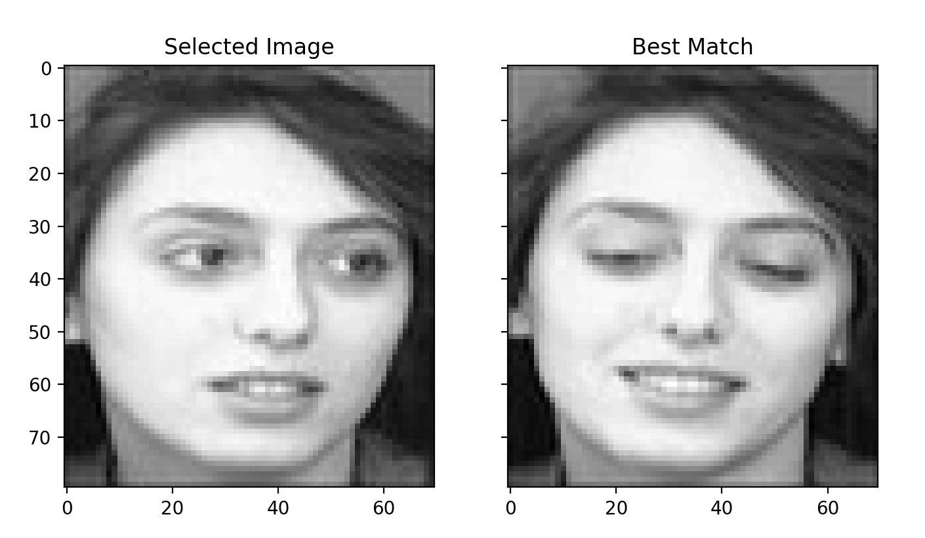
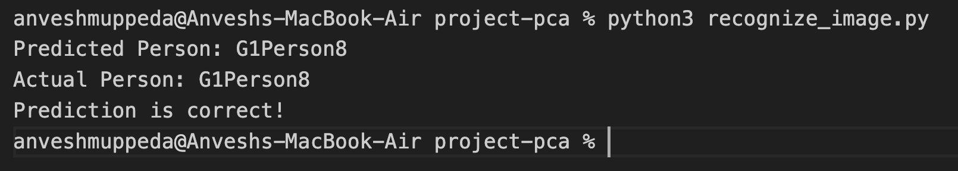
User-Defined image prediction Results

Slide 19
Face Extraction from Group Photos
Objective: Utilize OpenCV to extract individual faces from a group photo.
Steps:
Load the group photo.
Detect faces using the Haar Cascade classifier.
Save each detected face as a separate image.
Key Points:
OpenCV simplifies face detection.
Extracted faces are saved for further analysis.
Customization:
Compatible with various group photos.
Adjustable parameters enhance detection accuracy.
Outcome & Conclusion:
Number of faces detected and saved is provided.
Offers a straight approach for face extraction, enabling versatile uses.

Slide 20











Output

Slide 21
Conclusion
We have implemented the facial recognition using 1DPCA and 2DPCA variants of PCA.
In 1D PCA, images are converted to 1-dimensional vectors.
And in 2D PCA, the images are converted to 2D matrix.
We can also conclude that 1D PCA takes less time to execute whereas 2D PCA takes more time to execute.
But, 2D PCA gives us the more accurate results.
In case of face extraction methos, we implemented to recognize the individual face from the group pics.

Slide 22
Thank You

