Slide 1
Operating Systems Review

Slide 2
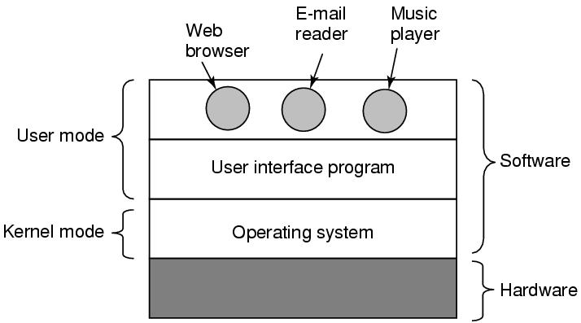
What Is An Operating System
Figure 1-1. Where the operating system fits in.

Slide 3
Roles of An Operating System
What are the two main functions of an operating system?

Slide 4
Roles of An Operating System
Perform two basic functions:
Providing application programmers a clean abstract set of resources instead of the messy hardware ones (“extended machine”)
Managing hardware resources (“resource manager”)

Slide 5
Operating System as a Resource Manager (1)
A top-down view: OS as providing abstractions
A bottom-up view: OS manages all the pieces of resources
Processors, memories, timers, disks, networks, printers, etc.
Provide an orderly and controlled allocation for competing apps
E.g. a printer shared by multiple programs
E.g. memory and disks shared by multiple users

Slide 6
Operating System as a Resource Manager (2)
Managing and sharing (multiplexing) resources in two different ways
In time – time multiplexing
Multiple programs share a single CPU
In space – space multiplexing
Main memory and hard disks shared by multiple programs/users

Slide 7
What is multiprogramming?
Executing the more than one program in shared manner using the single processor (One after the other)
Notes:
Multiprogramming is the rapid switching of the CPU between multiple processes in memory. It is commonly used to keep the CPU busy while one or more processes are doing I/O.

Slide 8
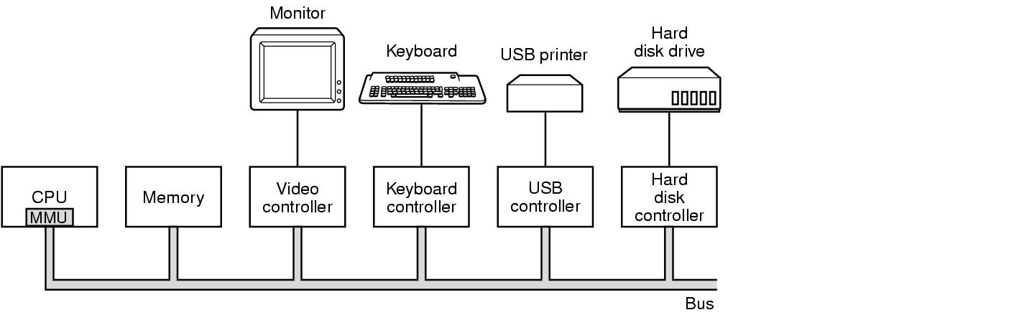
Computer Hardware Review
Figure 1-3. Some of the components of a simple personal computer.

Slide 9
Processors, Instruction Set and Registers
Processors: fetch, decode, and execute instructions
Instruction Set
Each processor has a specific set of instructions that it can execute
“Architecture”, e.g. X86 v.s. SPARC, CISC v.s. RISC
Registers
Most registers are a type of “memory”
Hold instructions, key variables, and temporary results to bridge gap b.t. processors and main memory
Notes:
Terms: “Processor”, “Core”, “CPU”, “Chip”, “Node”

Slide 10
Special Registers
Program Counter (PC) ?
Contains the memory address of the next instruction to be fetched
“instruction address”
Stack Pointer (SP) ?
Points to the top of the current stack in memory
Memory divided into three segments “text” “data (heap)” “stack”
Program Status Word (PSW) ?
Contains the condition code bits, e.g. CPU priority, mode (user/kernel)
Needed in system calls and I/O
Managed by software (OS):
“context switch” for time multiplexing
Need to save/restore all these registers

Slide 11
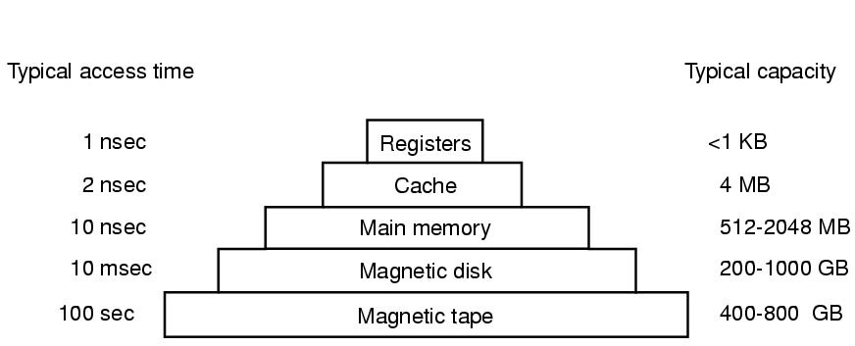
Memory Hierarchy
Closer to processor: faster, smaller, and more expensive
Figure 1-9. A typical memory hierarchy. The numbers are very rough approximations.

Slide 12
Registers and Cache Memory
Registers
Part of CPU (internal), nearly no delay
Typically 32x32-bits for a 32-bit CPU/64x64-bits for a 64-bit CPU
Cache (memory)
Principle of ?
Store temporary data/instructions to explore programs’
Cache hit, cache miss, average memory access time (example?)
(software)
Principle of Locality!(Access the most recent one)
(hardware, for ex to check cache hit)
— The principle of temporal locality says that if a program accesses one memory address, there is a good chance that it will access the same address again.
— The principle of spatial locality says that if a program accesses one memory address, there is a good chance that it will also access other nearby addresses.

Slide 13
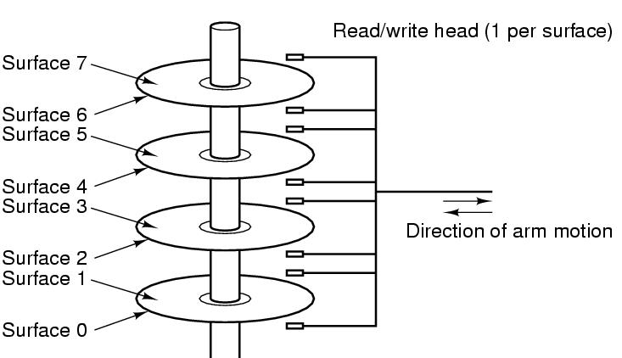
Disks (Hard Disk Drives)
90% of data stored in HDDs
Platter, surface, arm, head
Track, sector (fixed size, e.g. 512B)
Cylinder
Physical addressing (CHS)
Cylinder, Head, Sector
Flash-memory based storage will eventually replace
Figure 1-10. Structure of a disk drive.

Slide 14
Virtual Memory
Allow programs larger than physical memory to be run
Give programmers a “virtual address space” to code programs with memory requirement larger than physical memory
Managed by OS, hide details to programmers
Placing part of programs on disks and use main memory as a “cache”
Requires remapping memory addresses on the fly
To convert the addr the program generated (virtual address) to the physical address in RAM
An MMU (Memory Management Unit), part of CPU, specifically handles this

Slide 15
I/O Devices
I/O devices heavily interact with OS (in addt. to CPU & memory)
Generally consist of
A controller: a chip/a set of chips controlling the device (can be complex)
The device itself, e.g. disks, NIC (network interface card)
Device Driver
The software that talks to the controller
Part of OS (can run kernel mode), manage devices and hide dirty hardware details

Slide 16
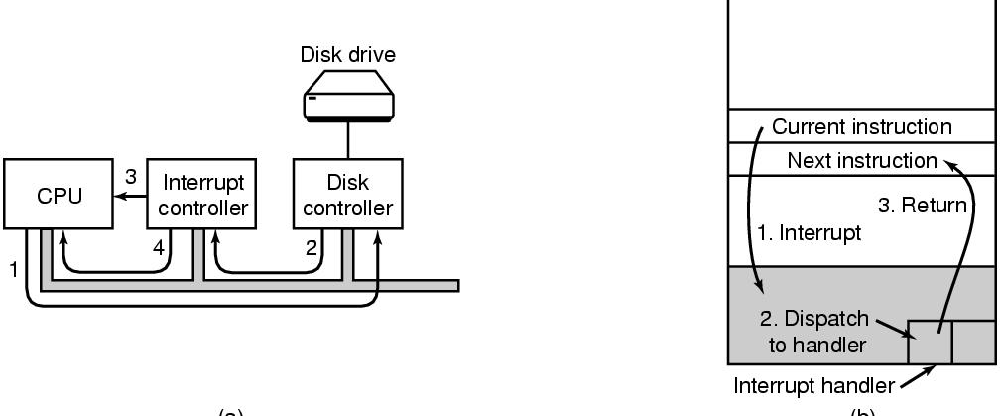
I/O Methods
Busy waiting: CPU sits waiting for I/O to be completed, very low CPU utilization
Interrupt driven: I/O device signal CPU (interrupt) at completion, critical & complex OS design
Figure 1-11. (a) The steps in starting an I/O device and getting an interrupt. (b) Interrupt processing involves taking the interrupt, running the interrupt handler, and returning to the user program.

Slide 17
Booting the Computer
Starting from executing a BIOS program on a parentboard/motherboard
BIOS: Basic Input Output System
Scanning and checking hardware devices
Determines boot device and load
Notes:
Have you ever tried setup BIOS?

Slide 18
Processes/Threads
Processes: running programs
Associated with an Address Space
text/program, data, stack
“core image”: content of address space
Associated with registers
Including PCs, SPs
Associated with other resources
List of open files, signals, related processes
Threads: lightweight processes, without own address space
A process is fundamentally a container that holds all the information needed to run a program
Notes:
Example: vide editor, web browser, email receiver.
Switch
Keep the same state it was stopped
Information explicated stored somewhere
Store in process table,
Core image for text, data, stack; process table for registers, other resources.

Slide 19
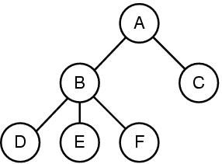
Process Tree and IPC
A process can create other processes
Root/Child processes, process tree
In Unix, an “init” process is the root of all other processes with PID=1 usually
Interprocess Communication (IPC)
Figure 1-13. A process tree. Process A created two child processes, B and C. Process B created three child processes, D, E, and F.
Notes:
1. Command interpretator shell, take command, create new process to run compiler, finish then terminate
2. Sometime processes need to collaborate and synchronize with each other, so they need interprocess communication
Virtual memory
Paging/Page replacement

Slide 20
Protection and Security
User management (UID: User ID)
A superuser “root” with UID=0 in Unix
Protection mechanisms exist in OS for security
E.g. files in Unix are protected with a 9-bit binary code
Three 3-bit fields, for owner, group members, and everyone else
A 3-bit field: rwx bits, indicate the privilege of read/write/execute
E.g. rwxr-x—x. How to change permission?
What are rwx for a directory?
Notes:
The first character is file type: - is for regular file, d is for directory, and so on.
For directory, x is for searching the content

Slide 21
Shell
Shell: a command-line interface between the user and OS
Many shells exist, e.g. csh, bash
GUI can be another interface, e.g. Gnome on Linux or Windows Explorer
“prompt”: a character telling user waiting to accept a command
E.g. “$” for bash, “%” for csh
Examples
$ date
$ date > file
$ sort < file1 > file2
Notes:
⟨ ⟩ — pointy brackets, angle brackets, triangular brackets, diamond brackets, tuples, or chevrons
< > — inequality signs, pointy brackets, or brackets.

Slide 22
Common Unix/Linux Commands
ls (directory) list your files ls src
ls -a (file/dir) hidden files ls -a
ls -l (file/dir) list size/detail ls -l mpi.c
mkdir (dir) create a directory mkdir src
cd (directory) change to directory cd src;cd ../bin
cd (blank) to your home dir cd
rm (file) delete a file rm a.out
rm -r (dir) delete a directory rm -r src
vi (file) terminal text editor vi mpi.c
mv (file/dir) move/rename mv src src1
man command display help info man ls
Learn to use online help with “man” or “info” command, or search on the Internet

Slide 23
Shell Programming/Shell Scripting (3)
Why write shell scripts ?
To avoid repetition:
If you do a sequence of steps with standard Unix/Linux commands over and over, why not do it all with just one command?
Or in other words, store all these commands in a file and execute them one by one.
To automate difficult tasks:
Many commands have subtle and difficult options that you don’t want to figure out or remember every time .

Slide 24
Environmental Variables
Environmental variables hold special values.
Environmental variables are set by the system on initial login
/etc/profile, /etc/profile.d/ and ~/.bash_profile or ~/.profile.
If you want to know what the variable holds call it with a "$" sign:
$ echo SHELL
SHELL
$ echo $SHELL
/bin/bash
$ echo $HOME
/cchome/arodrigu1
$ echo $PATH
/usr/X11R6/bin:/usr/local/bin:/bin:/usr/bin
env command

Slide 25
More Environmental Variables
PATH: The search path for commands
LOGNAME: contains the user name
HOSTNAME: contains the computer name.
MACHTYPE: system hardware
PWD: current path you are at
Please note unless you add current directory “.” into the PATH variable, otherwise you need to use like “./a.out” to a program called “a.out” in the current directory. It is NOT recommended to add current directory “.” into the PATH for security reason.

Slide 26
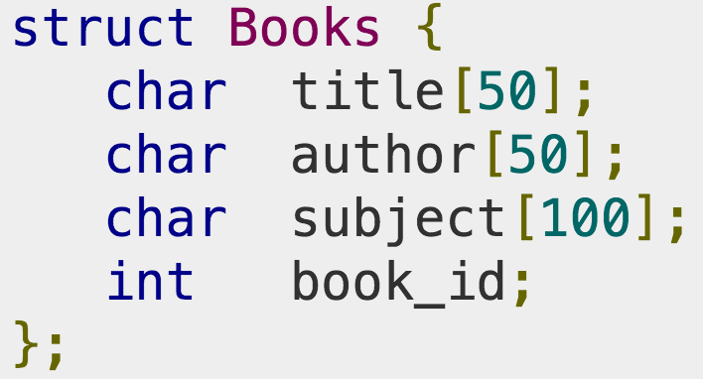
C Language Review
OS are large C/C++ programs
The C language
Pointer (example on page 74),
Struct
Explicit memory management (malloc, free), …
Header files
Declarations, definitions, macros
Large programming projects
Preprocessor
Compiler
Linker
Notes:
The model of run time

Slide 27
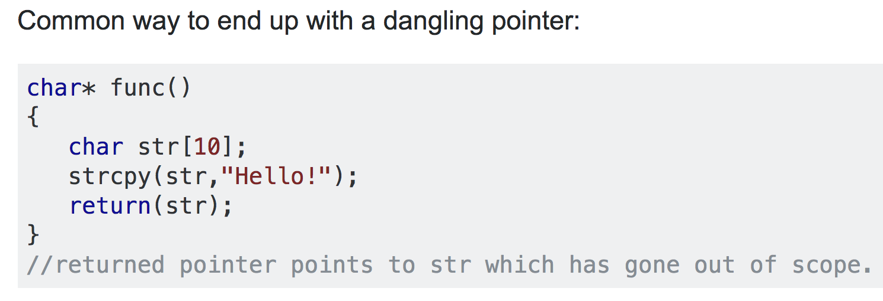
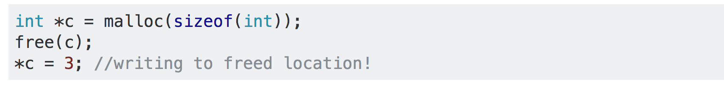
C Language Review
Dangling pointer
Notes:
Another common dangling pointer example is an access of a memory location via pointer, after free has been explicitly called on that memory.

Slide 28
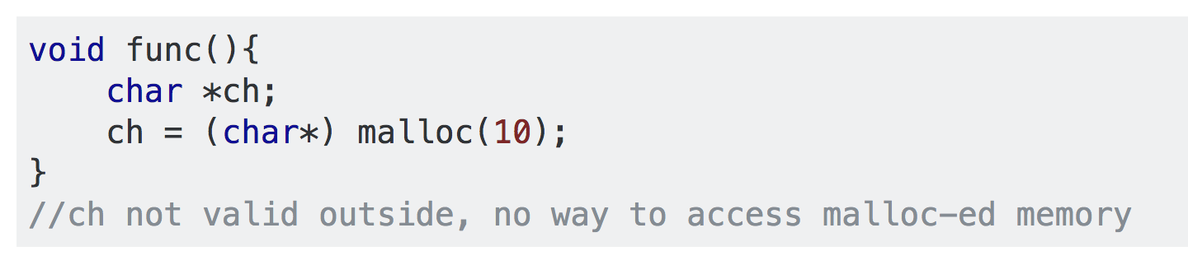
C Language Review
Memory leak
Notes:
Another common dangling pointer example is an access of a memory location via pointer, after free has been explicitly called on that memory.

Slide 29
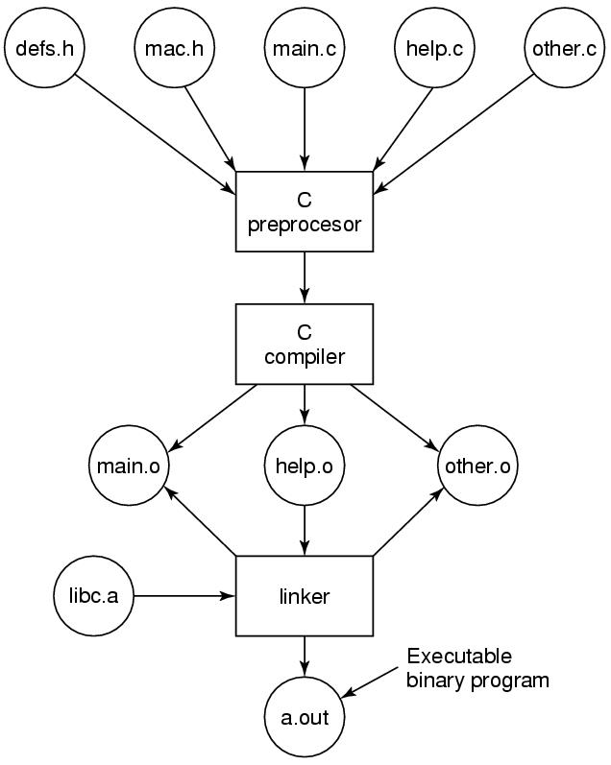
C Project Review
Figure 1-30. The process of compiling C and header files to make an executable.

Slide 30
System Calls
Interface between user programs and OS
Vary among operating systems
POSIX (Portable Operating System Interface)
A family of standards specified by the IEEE
Defines system calls API (Application Program Interface), command line shells, and utility interfaces
POSIX has about 100 procedure calls (some examples are listed in the Fig. 1-18) on page 54.

Slide 31
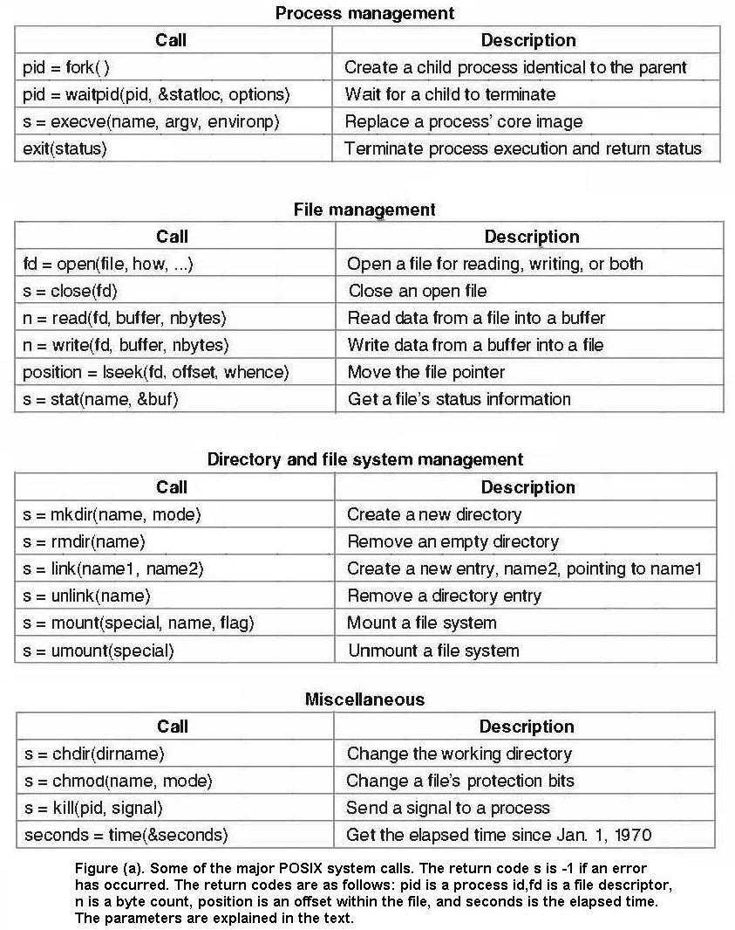

Slide 32
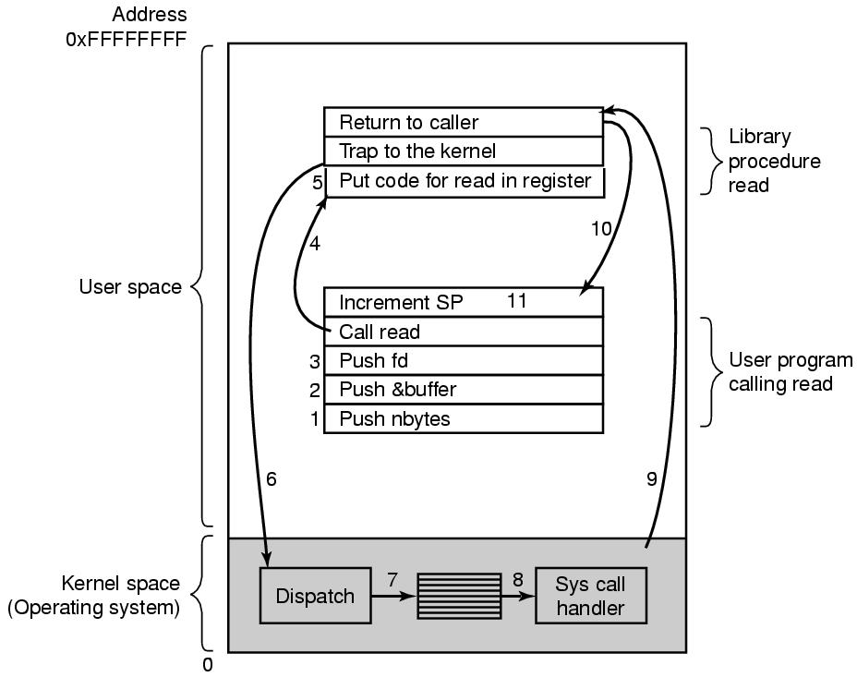


Steps of System Calls
https://unix.stackexchange.com/questions/641003/can-read-return-value-exceed-the-count-value
read system call
count=read(fd, buffer, nbytes)
(count can be smaller than nbytes. Why?)
If an error occurs, count is set to -1 and the error number is put in errno (a global variable)
(The program should always check)
Figure 1-17. The 11 steps in making the system call read(fd, buffer, nbytes).
Notes:
fd and nbytes are by values while buffer is passed by reference
Why the system call parameters are pushed to the stack in the reverse order? -> Historical reason.

Slide 33
A Simple Shell
Figure 1-19. A stripped-down shell.
Notes:
Status is the status of the child process.
-1: Wait for any child

Slide 34
Memory Layout
Figure 1-20. Processes have three segments: text, data, and stack.
Notes:
A text segment is also known as a code segment, a text segment is placed below the heap or stack in order to prevent heaps and stack overflows from overwriting it.
The text segment is read-only and sharable so that only a single copy needs to be in memory for frequently executed programs, such as text editors
Data segment is not read-only.

Slide 35
Figure 1-20. Processes have three segments: text, data, and stack.
Notes:
The stack grows the opposite direction of heap
When the stack pointer met the heap pointer, free memory was exhausted. What happen?
Each time a function is called, the address of where to return to and certain information about the caller’s environment, such as some of the machine registers, are saved on the stack. The newly called function then allocates room on the stack for its automatic and temporary variables.
Heap is the segment where dynamic memory allocation usually takes place.
The heap area begins at the end of the BSS segment and grows to larger addresses from there. The Heap area is managed by malloc, realloc, and free

Slide 36
System Calls for File Management
Figure 1-18 (b). Some of the major POSIX system calls.

Slide 37
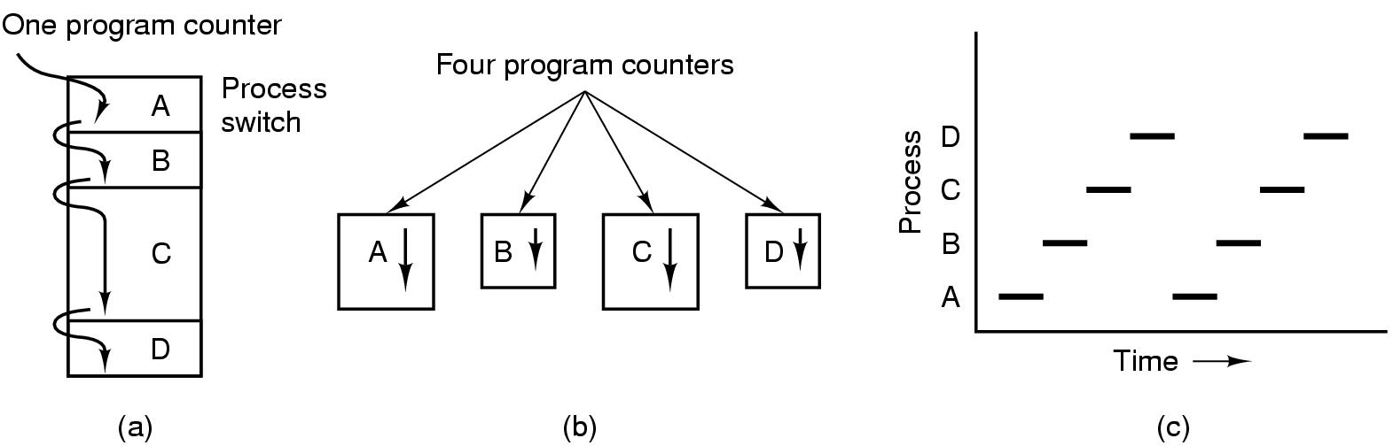
The Process Model
Here CPU usage is 100% always busy
Figure 2-1. (a) Multiprogramming of four programs. (b) Conceptual model of four independent, sequential processes. (c) Only one program is active at once.
Notes:
(c): Vertical line meet only 1 line. How about the case of multicore?

Slide 38
All these are with single core
CPU_Utlization = 1 – p^n
Here p = percentage of I/O
N = Number of processes
If (p==0) then CPU_Utlization = 100%
If (p==0) then CPU_Utlization = 100%
P = 0.5 n =4 then CPU_Utlization = 1-0.5^4 = 0.9375

Slide 39
Process Creation
What are the primary events causing processes to be created?

Slide 40
Process Creation
Four primary events causing processes to be created
System initialization
Execution of a process creation system call by a running process
A user request to create a new process
Technically a new process is created by having an existing process execute a process creation system call
Unix: fork()
Windows: CreateProcess()
foreground processes
background processes (daemons)
$ ps

Slide 41
Process Termination
Conditions
Normal exit (voluntary)
Error exit (voluntary)
Fatal error (involuntary)
Killed by another process (involuntary)
Unix: kill() with SIGKILL
Windows: TerminateProcess()

Slide 42
Process States
What are different states of a process?
Please explain the transitions between process states.

Slide 43
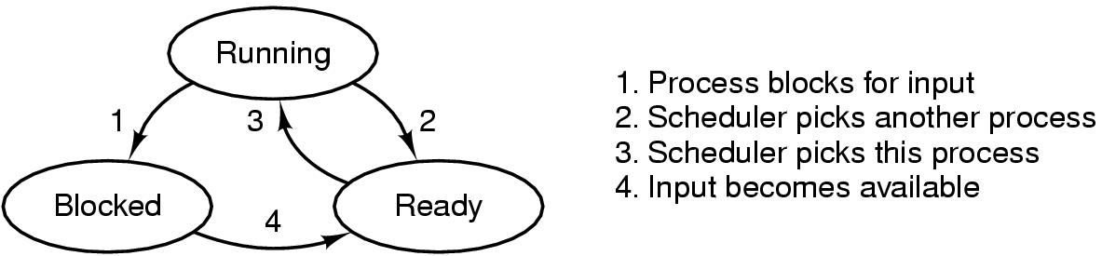
Process States
Write an example of chrome music player and PP
Process scheduler
Figure 2-2. A process can be in running, blocked, or ready state. Transitions between these states are as shown.
Scheduler always picks from queue not from any where so it won't come from Blocked to Running
And it won’t go to the Blocked state from Ready bcoz without CPU it won't go to Blocked Ref: 32 Slide
Notes:
From Running, what is the difference between 1 and 2
Can we go from Blocked to Running?
Can we go from ready to blocked?

Slide 44
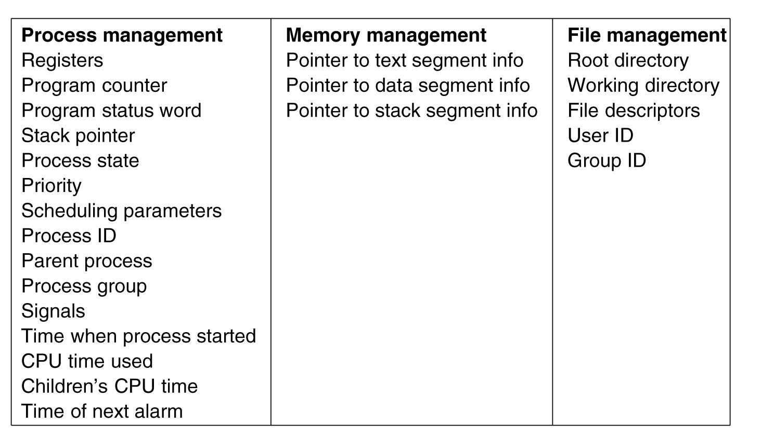
Implementation of Processes
Process table or Process Control Blocks (PCB) table
Figure 2-4. Some of the fields of a typical process table entry.

Slide 45
Modeling Multiprogramming (2)
Approximate predictions about CPU utilization, e.g.
A computer has 512 MB of memory, with OS taking up 128 MB and each user program also taking up 128 MB
3 user programs to be in memory at once
With an 80% average IO wait, a CPU utilization of 1 - 0.8³ or ~49%
Adding another 512 MB allows the system to go from three-way multiprogramming to seven-way multiprogramming, CPU: ~79% 1-0.8 ^7
Adding yet another 512 MB would only increase CPU utilization from 79% to 91% (only 12%)
1-0.8 ^11

Slide 46
CPU Utilization = 1 – p ^n
Process 1 = 10s
Here 50% by I/O time and 50% by CPU utilization
Process 2 = 10s
Here 50% by I/O time and 50% by CPU utilization
Here two processes took 20s total
Here 10s for CPU util and 10s for I/O time
So here based on this it'll take 50% for CPU utili
From Formula
CPU Utili = 1 – p^n {here p=0.5 and n=2}
= 1 – p^2
= 1 – 0.5 ^ 2
= 75%
Here the diff b/w both results due to the, formula based on computer i.e. multi programming but first one is diff which is based on washing machine example

Slide 47




WORST CASE IN System
Best Case
CPU. I/O
I/O
I/O. CPU
I/O
CPU
CPU utlization = 66%
CPU Utlization = 100%
Here CPU took 10s and 5s for I/O
Here CPU alwasys in use 10s

Slide 48
If we have both processors diff I/O
Then we can use below formula
CPU Utlization = 1 - {(P1 I/O) * (P2 I/O)}
CPU Time. = CPU Time / Total Time
= (Total time – CPU Idle time) / Total Time
= (Total Time / Total Time) – (CPU Idle Time / Total Time)
= 1 - % CPU Idle Time
75% of x =10sec
=10 sec / 75%
= 10/0.75
= 13.3 sec
Avg Total time = CPU Time / AVG % from formula
= 10s / 75%
= 13.3 sec

Slide 49
Increasing N Value
By increasing the n value we can get the 100% CPU but the starvation may increase(Increase the waiting time)
CPU Util = 1 – p ^ n
Here if we increase n to infinite then we can get the 100% CPU but there arwe some issues like starvations(waiting time)

Slide 50
Outline
Questions?
Processes
Process model
Process creation, termination, hierarchy, states
Implementation of processes
Modeling multiprogramming
Threads
Thread usage
Thread model
POSIX Threads

Slide 51
Threads
Threads: lightweight processes
Multiple threads of control but share an address space
Why threads are desired?
Ability of share an address space and data
Lightweight and easier to create and destroy (creating a thread is 10 to 100 times faster than creating a process)
Performance gain for mixed computing and I/O (higher degree of parallelism)
Map to multithreaded/multicore processors

Slide 52
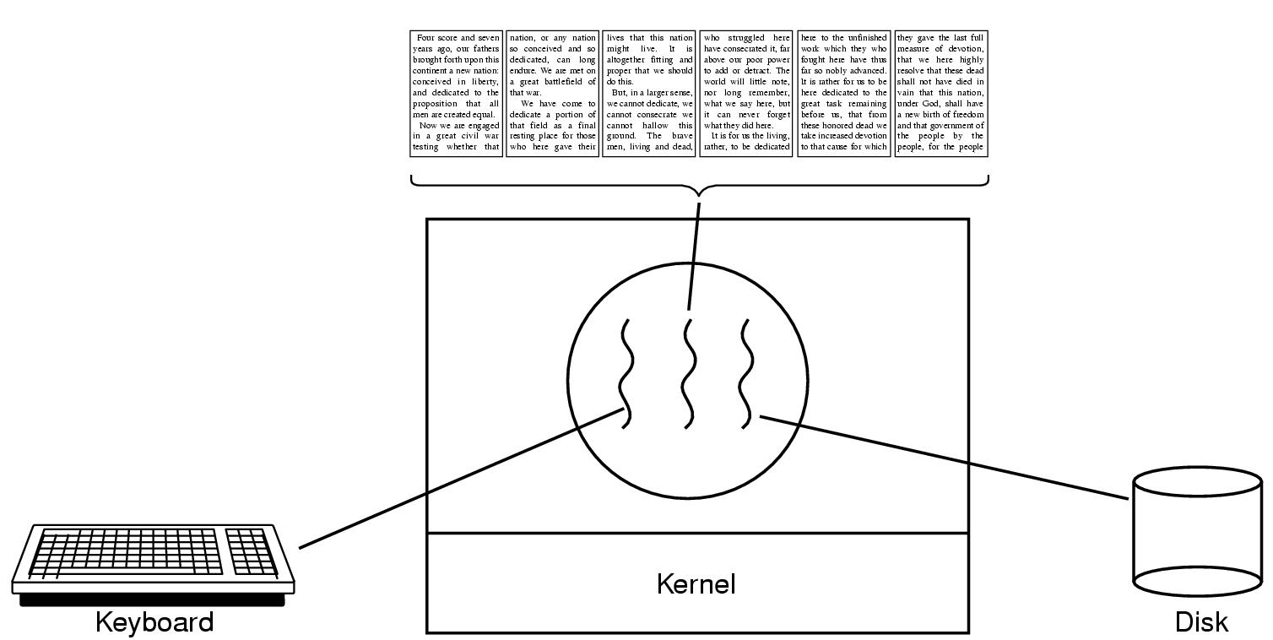
Thread Usage (1)
Figure 2-7. A word processor with three threads.

Slide 53
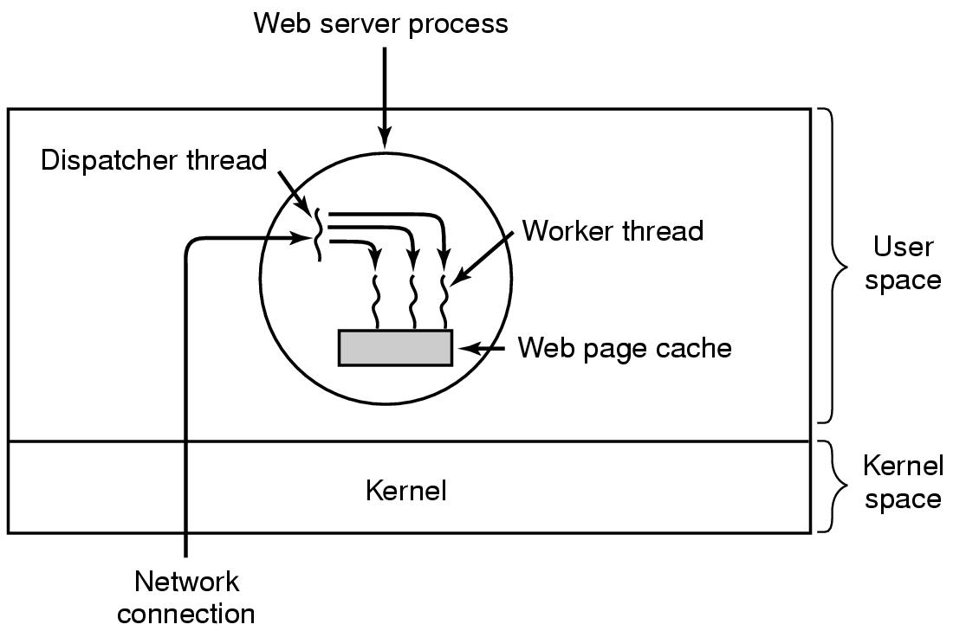
Thread Usage (2)
Figure 2-8. A multithreaded Web server.
Notes:
Why do we need cache?
Multiple threads can share global variables. For ex, number of accepted html requests.

Slide 54
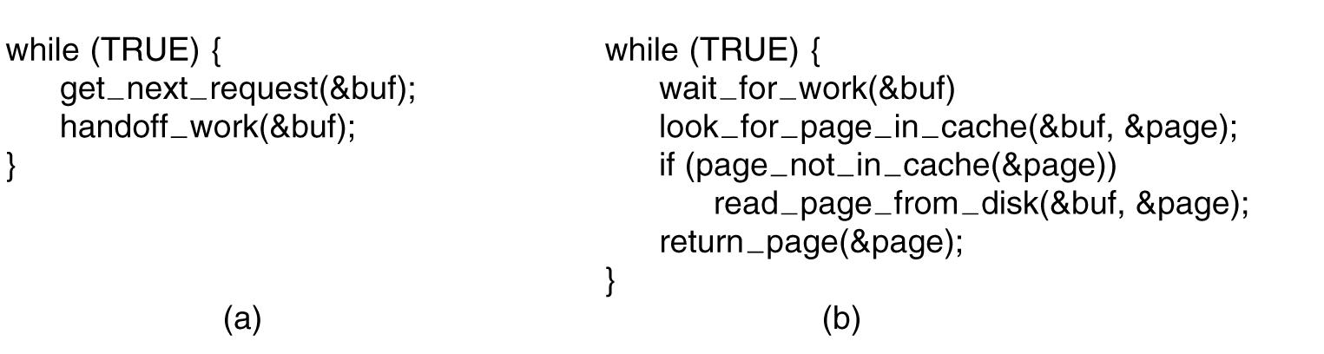
Thread Usage (3)
Figure 2-9. A rough outline of the code for Fig. 2-8. (a) Dispatcher thread. (b) Worker thread.

Slide 55
Implementation of Threads
Ways of implementing threads
In user space
In kernel
Advantages, disadvantages

Slide 56
Implementing Threads in User Space (1)
In user space
Entirely in user space, kernel knows nothing
Kernel manages ordinary single-threaded processes
User-level threads can be implemented on an operating system that does not support threads (in kernel)

Slide 57
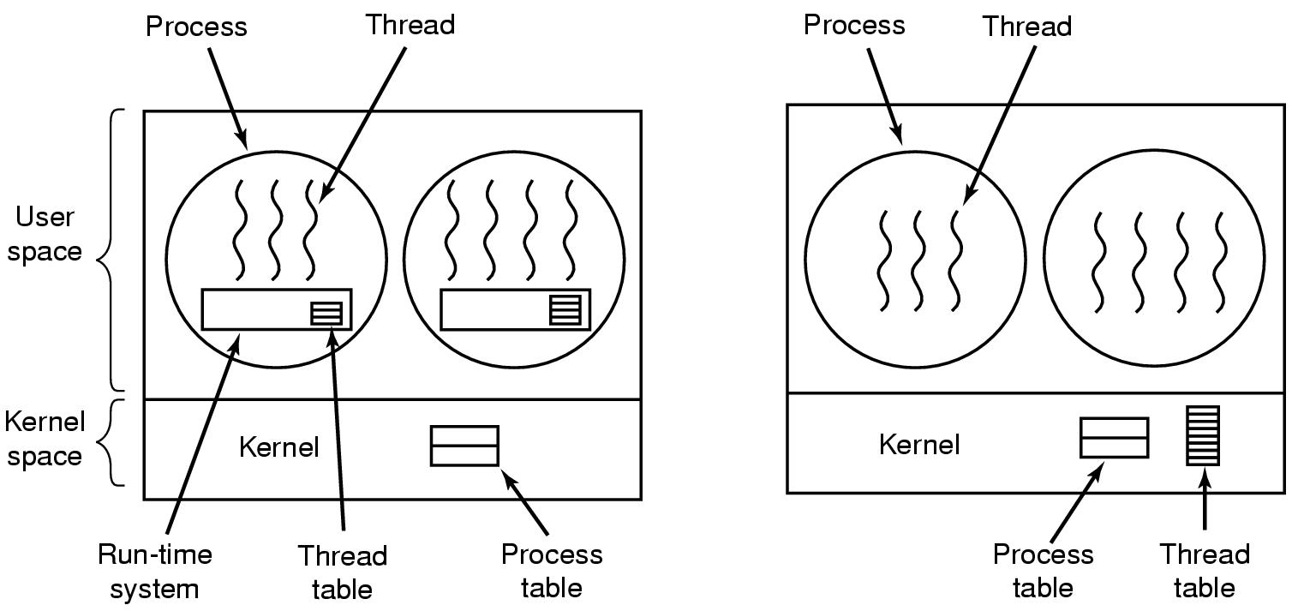
Implementing Threads in User Space (2)
Figure 2-16. (a) A user-level threads package

Slide 58
Implementing Threads in User Space (3)
Advantages
Fast thread switching than trapping to the kernel (an order of magnitude faster normally)
Each process can have its own customized scheduling algorithm
Disadvantages
Blocking system calls
Page faults (detailed discussion when studying chapter 3)
Limited performance gain (system calls block threads)
Notes:
Fast thread switching because no trap, not context switching, no cached memory flushed.

Slide 59
Implementing Threads in Kernel Space (1)
In kernel space
No run-time system and thread table needed in each process
Kernel manages a thread table keeping track of threads
Thread table holds the same info as with user-level threads

Slide 60
Implementing Threads in Kernel Space (2)
Figure 2-16. (b) A threads package managed by the kernel.

Slide 61
Implementing Threads in Kernel Space (3)
Advantages
When a thread blocks, the kernel can schedule another thread from the same process (if ready) or a thread from a different process to run
No new nonblocking system calls required (including dealing with page faults)
Performance gain
Disadvantages
Higher cost of creating/destroying threads (system calls)
Notes:
Other issues remain, e.g. multithreaded process forks/signals

Slide 62
Interprocess Communication
InterProcess Communication (IPC)
How one process passes information to another
How to avoid conflicts/contention
How to ensure proper sequencing when dependencies are present
Apply to threads too (though threads share the address space and data naturally)
Notes:
Conflicts: Threads for booking tickets online and only one left.
InterProcess Communication (IPC)
E.g. pipe

Slide 63
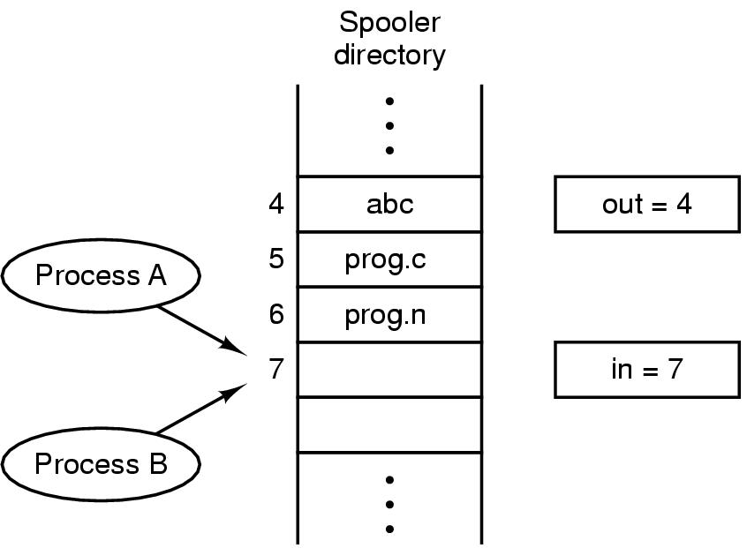
Race Conditions
In IPC, where two or more processes read/write some shared data, if the final result depends on who runs precisely when, such a situation is called race conditions
Figure 2-21. Two processes want to access shared memory at the same time.

Slide 64
Critical Regions (1)
Mutual exclusion needed to avoid race conditions
Applies to shared memory, shared files, and shared everything else
Part of the program where shared resources are accessed is called the critical region or critical section
No two processes may be simultaneously inside their critical regions.
No assumptions may be made about speeds or the number of CPUs.
No process running outside its critical region may block other processes.
No process should have to wait forever to enter its critical region.
Notes:
Mutual exclusion make sure that if 1 process use a shared file/variable, other processes will be excluded from doing the same thing.

Slide 65
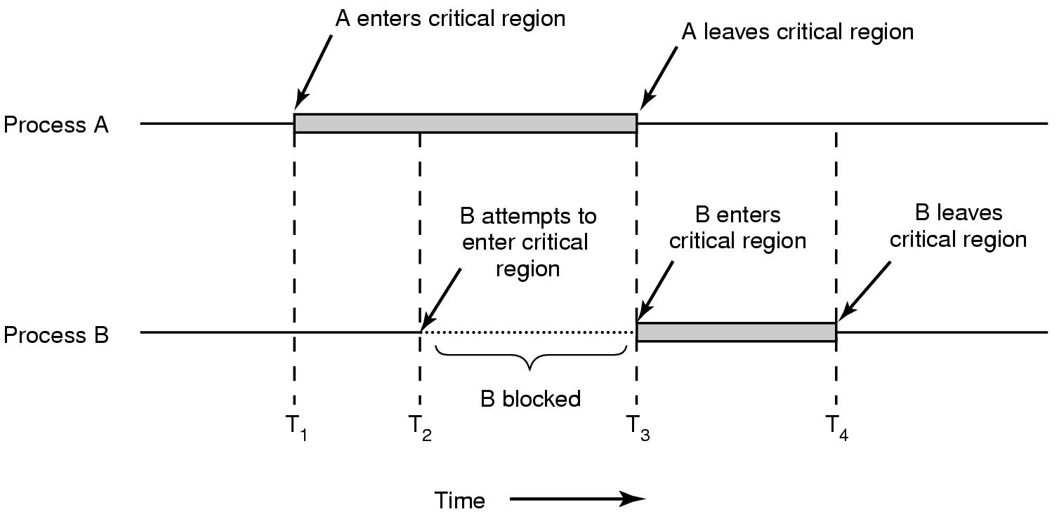
Critical Regions (2)
Figure 2-22. Mutual exclusion using critical regions.

Slide 66
Mutual Exclusion with Busy Waiting
Proposals for achieving mutual exclusion:
Disabling interrupts (doesn’t work for multicore chips. Why?)
Lock variables (set the lock variable to 1 when after entering. What problem?)
Strict alternation
Peterson's solution
The TSL/XCHG instruction
Notes:
Disabling interrupts: unattractive to give control to user processes? Since it can disable interrupts and run forever.
Disabling interrupts can be used in OS, for example to save data to a process table.
Disable interrupt Is from the process view.
Non-preemtive if from scheduler view

Slide 67
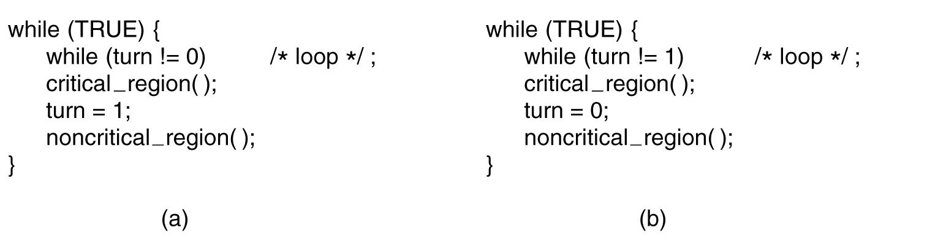
Strict Alternation
Here after critical_region() already that process is completed with 5s and the turn variable not able to update hence the second one waiting for turn variable to set 1 for 5s, in next 5s the the process 1 update the turn variable
Busy waiting
Spin lock
while (turn != 0) { /*loop*/;}
Figure 2-23. A proposed solution to the critical region problem. (a) Process 0. (b) Process 1. In both cases, be sure to note the semicolons terminating the while statements.
Notes:
This is called bus waiting. This should be avoid since wasting CPU.
This also violate condition 3. Why?

Slide 68
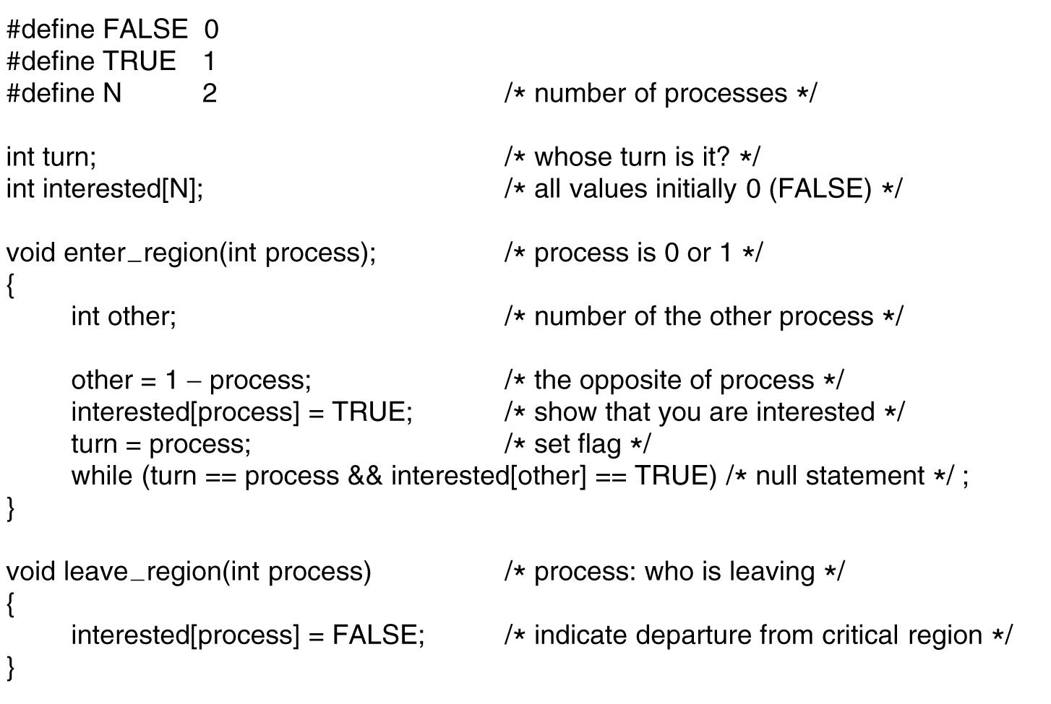
Peterson's Solution
Figure 2-24. Peterson’s solution for achieving mutual exclusion.
Notes:
If one process enter region -> fine
If both enter the region? -> fine why?

Slide 69
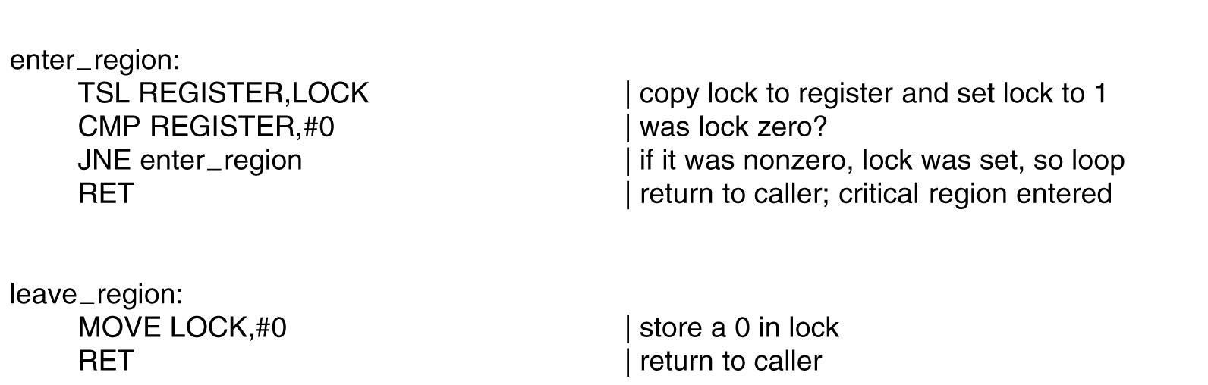
The TSL Instruction
Figure 2-25. Entering and leaving a critical region using the TSL instruction.
Notes:
TSL is indivisible. No other processor can access until the instruction is finish.

Slide 70
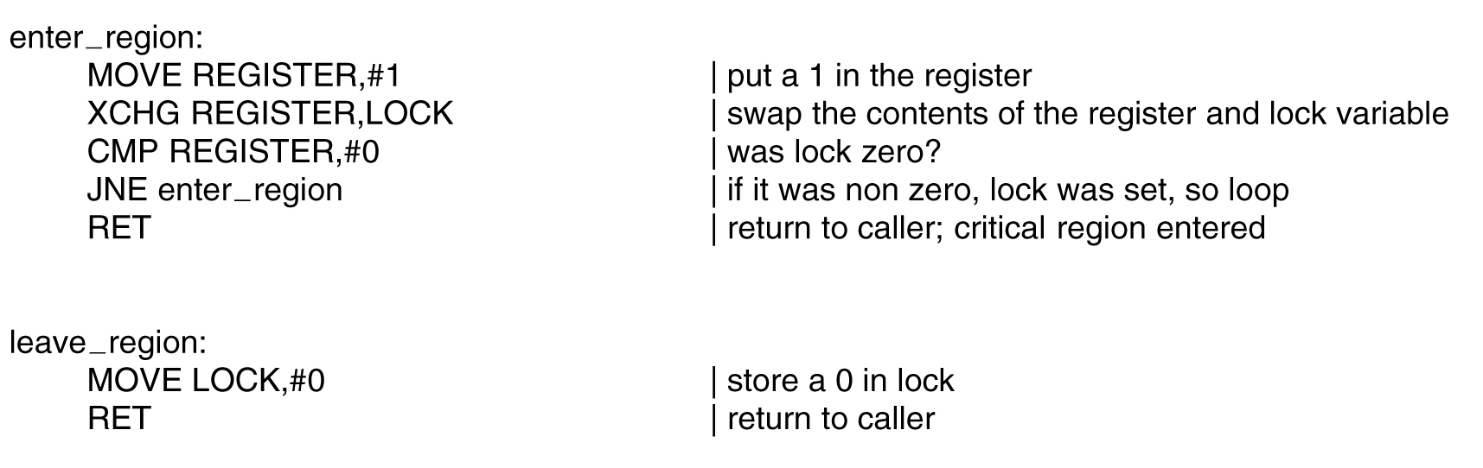
The XCHG Instruction
Figure 2-26. Entering and leaving a critical region using the XCHG instruction.
Notes:
Similar to TSL but swap memory content

Slide 71
Sleep and Wakeup
Previous solutions have the defect of requiring busy waiting
If an entry not allowed, sits in a tight loop waiting until it is
Wastes CPU cycles
IPC primitives block (and release CPU) instead of wasting CPU cycles
Sleep: a system call causes the caller to block and release CPU until another process wakes it up
Wakeup: a system call wakes up another process
Notes:
Sleep and wakeup are not part of standard C, but presumably we have these system calls

Slide 72
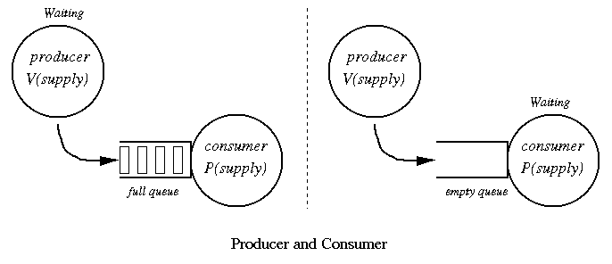
The Producer-Consumer Problem

Slide 73
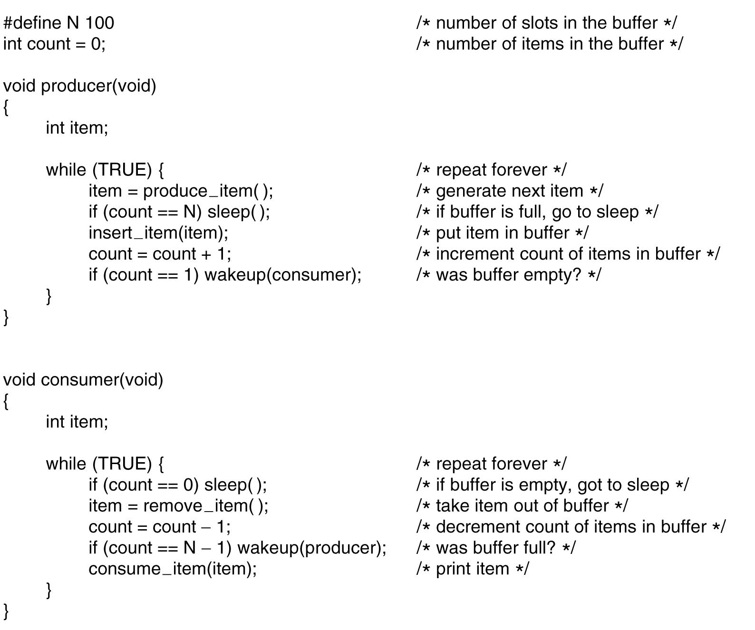
The Producer-Consumer Problem
Figure 2-27. The producer-consumer problem with a fatal race condition.
Notes:
What problem? When count==0 then consumer decide to sleep, but before he sleeps the producer try to wake him up -> he still sleep since he did not know.
Sooner or later, the producer will fill up the buffer and got to sleep as well -> both will sleep forever.
Solution? Waken bit. This works like a note from producer to consumer.

Slide 74
Semaphores (1)
Introduced by E. W. Dijkstra in 1965
A variable type semaphore (integer) to count # of wakeups
“down” operation: decrements if greater than 0 (uses one stored wakeup) or sleep if the value is 0
“up” operation: increments the value and one of sleeping processes waken up to complete its down
Both operations completed as a single indivisible atomic action
Also referred as P and V operations
P: Proberen (try), V: Verhogen (raise, make higher)

Slide 75
Semaphores (2)
“up” and “down” are usually implemented as system calls
With the OS briefly disabling all interrupts while testing the semaphore, updating, putting the process to sleep if needed
Notes:
Check the value of semaphore, change it, and possibaly go to sleep is on single atomic action

Slide 76
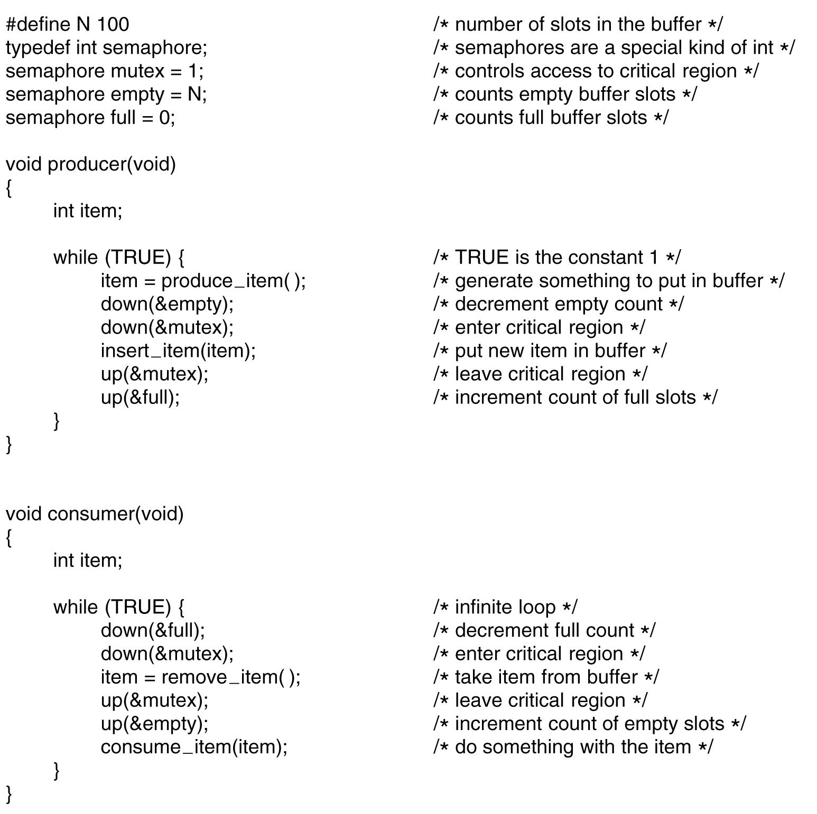
Three semaphores, full, empty, and mutex
full and empty are used for synchronization
mutex used for mutual exclusion
Can cause “deadlock” if the order switched
Figure 2-28. The producer-consumer problem using semaphores.

Slide 77
Outline
Questions?
InterProcess Communication
Mutexes, Monitors
Message passing, Barriers
Scheduling
Process behavior and when to schedule
Categories of scheduling algorithms and goals
Scheduling in batch systems and interactive systems
Policy v.s. mechanism, thread scheduling

Slide 78
Scheduling
Whenever two or more processes/threads compete for the CPU to run, we need a form of “scheduling”
Scheduler: the OS component makes the scheduling decision
Scheduling algorithm: the algorithm the scheduler uses
Process/thread scheduling share similar issues, but with subtle difference too

Slide 79
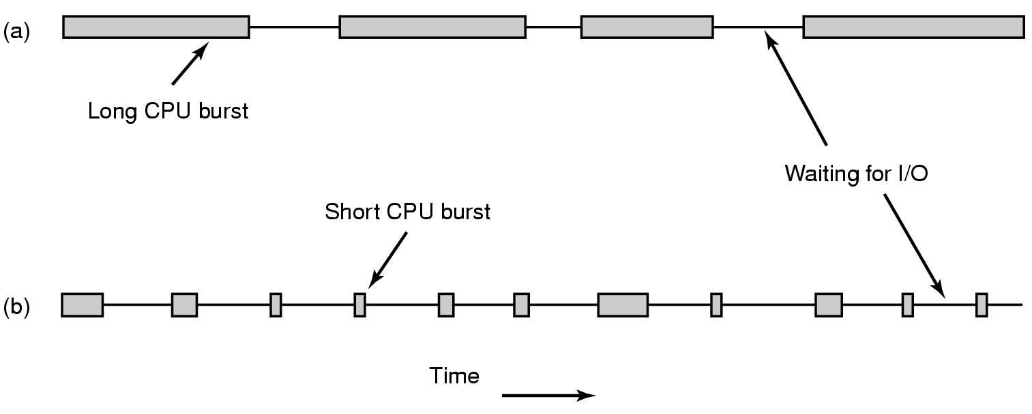
Process Behavior (1)
Figure 2-38. Bursts of CPU usage alternate with periods of waiting for I/O. (a) A CPU-bound process. (b) An I/O-bound process.

Slide 80
Process Behavior (2)
Compute-bound: spend most time computing
I/O-bound: spend most time waiting for I/O

Slide 81
When to Schedule
When a new process created
When a process exits
When a process blocks on I/O, on a semaphore, etc.
When an I/O interrupt occurs
Nonpreemptive
Preemptive
Notes:
Preemtive: 5ms
Nonpreemptive (run until completion): process will volenteer to give up CPU on its I/O

Slide 82
Scheduling in Batch Systems (1)
First-Come First-Served (FCFS)
Nonpreemptive
Processes are assigned CPU in the order they request it
Single queue of ready processes
When a blocked process becomes ready, put on the end of queue
Easy-to-implement, fair, but low throughput, high turnaround time

Slide 83
Scheduling in Batch Systems (2)
Shortest Job First (SJF)
Nonpreemptive
Assumes run times are known
Scheduler picks the shortest job first
(a) has average turnaround times of 14 mins
(b) has average turnaround times of 11 mins
Figure 2-40. An example of shortest job first scheduling. (a) Running four jobs in the original order. (b) Running them in shortest job first order.

Slide 84
Scheduling in Batch Systems (2)
Shortest Job First (SJF)
Counter example on page 158

Slide 85
Scheduling in Batch Systems (3)
Shortest Remaining Time Next (SRTN)
Preemptive
Assumes run times are known
Scheduler picks the process whose remaining run time shortest
Newly arrived jobs are compared to current processes remaining time

Slide 86
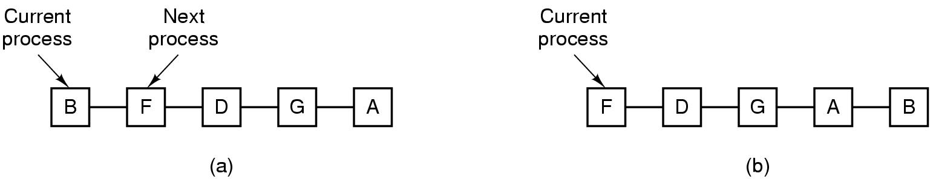
Scheduling in Interactive Systems (1)
Round-Robin (RR) Scheduling
Each process assigned a time interval, quantum
Preempted & switched (process switch/context switch) to other processes when quantum elapsed
Granularity of quantum: tradeoff, overhead & response time
Figure 2-41. Round-robin scheduling. (a) The list of runnable processes. (b) The list of runnable processes after B uses up its quantum.
Notes:
For example, processes need 1ms for context switching and 4ms for processing. Overhead =20%
Another example of 1ms and 99ms. Overhead = ? . Is this good for bus waiting?
Conclusion on page 159

Slide 87
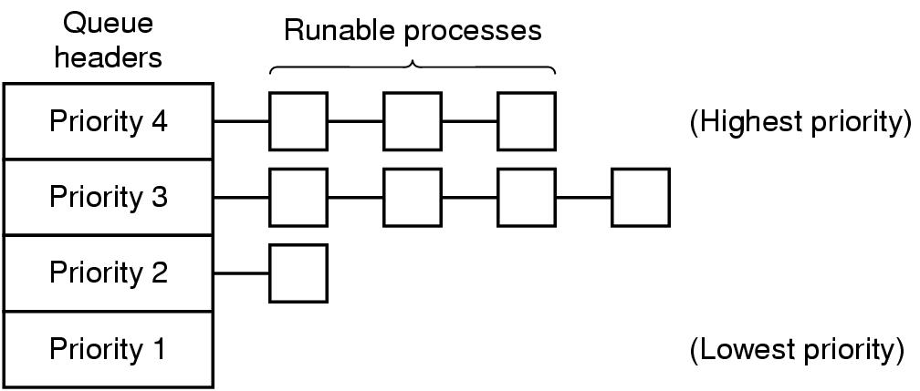
Scheduling in Interactive Systems (2)
Priority Scheduling
Each process assigned with a priority
Runnable process with highest priority allowed to run
Often combined with RR: priority among classes and RR in each class
Multiple Queues (MQ)
Figure 2-42. A scheduling algorithm with four priority classes.
Notes:
For example daemon process sending emails should be lower priority than music player.
To prevent higher priority process to run forever, we can decrease their priority, change priority dynamically.

Slide 88
Scheduling in Interactive Systems (3)
Lottery Scheduling
Processes given “tickets”
Scheduler picks a “ticket” randomly
Important processes can be given extra tickets
Fair-share Scheduling
Considers owners of processes
Each owner allocated portions of CPUs

Slide 89
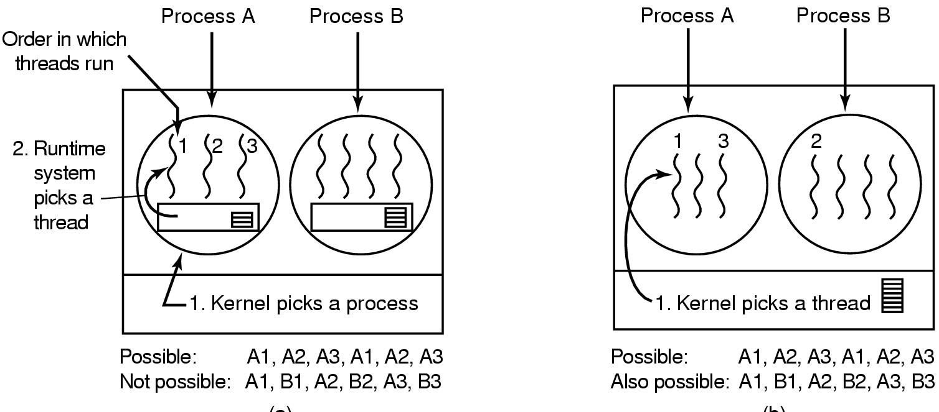
Thread Scheduling (1)
Differ depending on user-level/kernel-level threads
User-level:
OS scheduler only schedules processes
Thread scheduler determines threads scheduling
“application-specific” thread scheduling possible
Figure 2-43. (a) Possible scheduling of user-level threads with a 50-msec process quantum and threads that run 5 msec per CPU burst.

Slide 90
Thread Scheduling (2)
Kernel level:
OS scheduler aware of threads and schedule threads directly
Can also consider the process a thread belongs to
Performance: a kernel-level thread switch requires a full context switch
E.g. schedules a thread belonging to the same process v.s. another thread
Figure 2-43. (b) Possible scheduling of kernel-level threads with the same characteristics as (a).

Slide 91
Memory Management
Programmers desire private, infinitely large, infinitely fast, nonvolatile memory
Memory hierarchy
Memory manager
Memory abstractions
Keep track memory usage
Memory allocation and deallocation

Slide 92
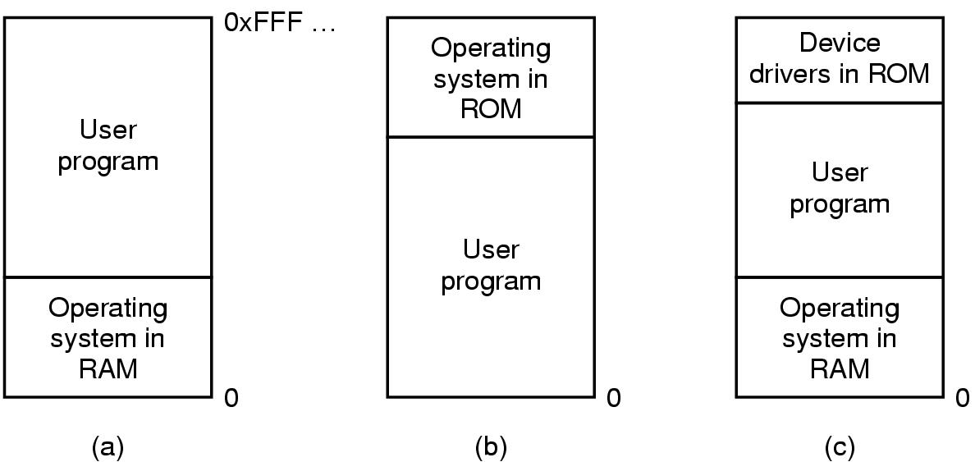
No Memory Abstraction
Each program access physical memory directly
MOV REGISTER1, 0x1000
BIOS
Figure 3-1. Three simple ways of organizing memory with an operating system and one user process.
Notes:
Since this is physical memory, not able to handle more than 1 program at a time. Since they can read/write on the same physical memory.
Multithreading can get some parallelism but can not have unrelated programs at a time.
problems with (a) and c): a bug in user program can wipe out OS.
b) Is still used for embeded system. Since microwaves, radios, washing machines, all programs are known in advance.

Slide 93
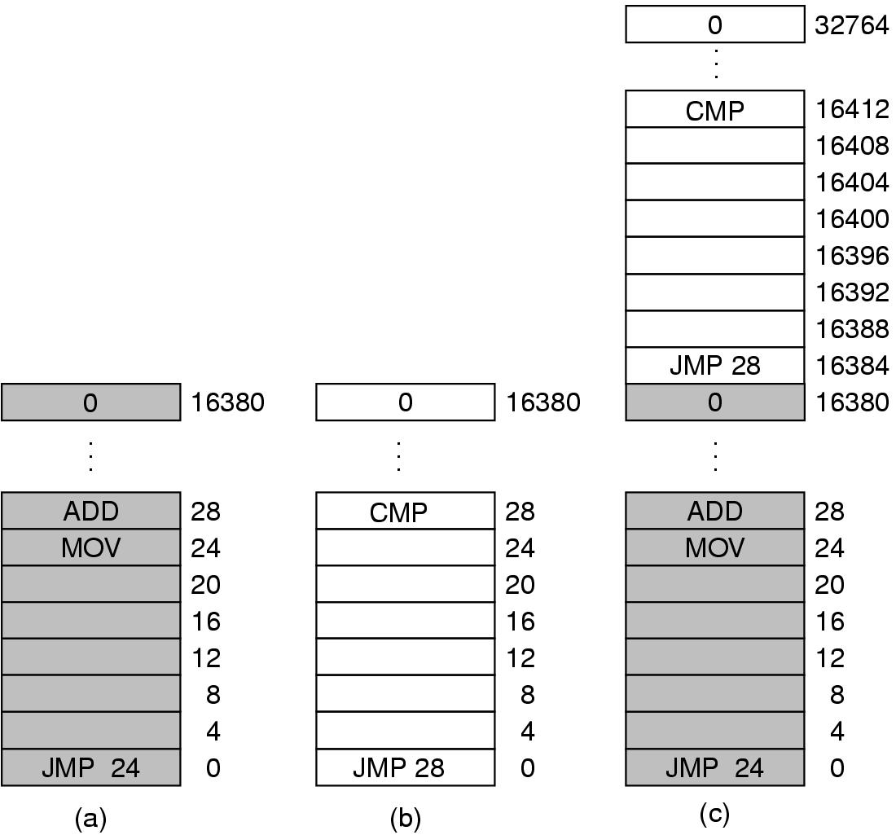
Multiple Programs Without Memory Abstraction
Static relocation (slow loading)
Requires programs smaller than physical memory
Figure 3-2. Illustration of the relocation problem.
Notes:
1) Possible with swapping (discussed later) but might be overhead.
2) Possible with static relocation to resolve the problem in Figure 3-2. -> this slow down the loading.

Slide 94
Memory Abstraction: Address Space
Major drawbacks without memory abstraction:
User programs address physical memory directly and can damage the operating system (intentionally/by accident)
Difficult to have multiple programs running at once

Slide 95
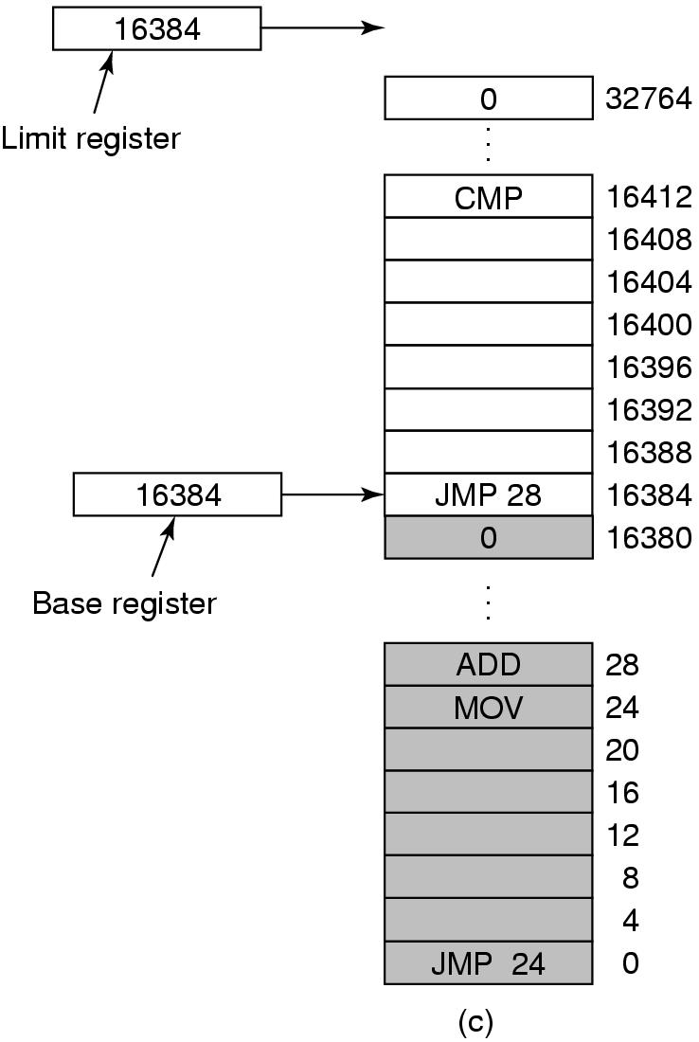
Notion of an Address Space
An abstraction of memory
A set of addresses that a process reference memory
Independent from each other
A simple solution with base and limit registers
“dynamic relocation”
Need an addition for each memory reference
Figure 3-3. Base and limit registers can be used to give each process a separate address space.
Notes:
“dynamic relocation”: map process address space to physical memory

Slide 96
When Physical Memory Not Enough…
When physical memory not large enough to hold all processes
Swapping: bringing in each process in entirety when running and bringing out to disks when not
E.g. idle processes stored on disk
Virtual memory: allows programs to run even when they are only partially in main memory

Slide 97
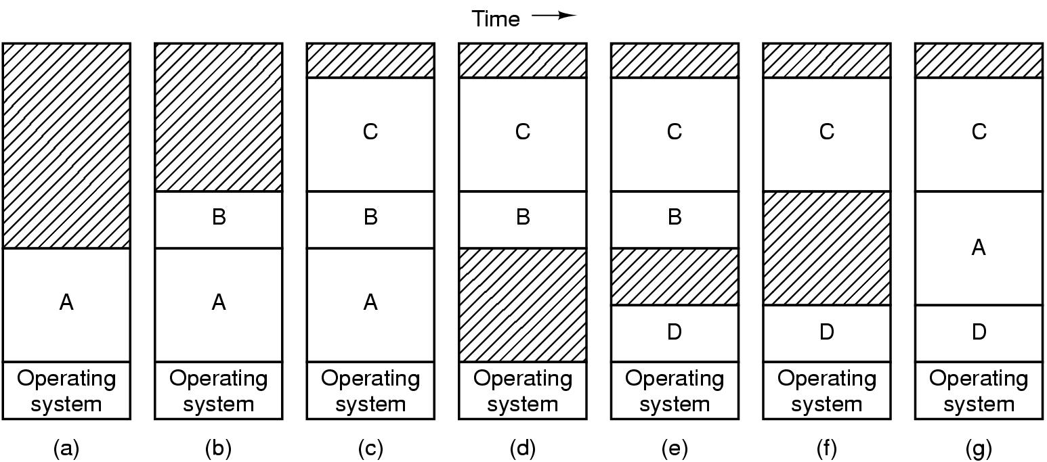
Swapping (1)
Figure 3-4. Memory allocation changes as processes come into memory and leave it. The shaded regions are unused memory.
Need hardware/software solution for relocating addresses
E.g. base and limit registers
Notes:
Memory compaction: combine multiple hole to create a big one.

Slide 98
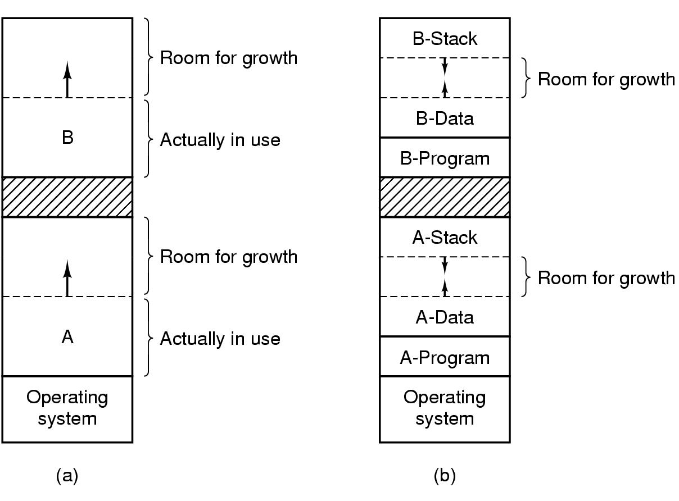
Swapping (2)
Extra memory can be allocated if processes grow
Instead of moving processes around (find large enough “holes”)
Figure 3-5. (a) Allocating space for growing data segment. (b) Allocating space for growing stack, growing data segment.

