Slide 1
A Scheduling System for Big Data Hybrid Computing Workflow
By
Keerthana Katamneni
R11840516

Slide 2
Introduction
Big data - Combination of structured, semi-structured and unstructured data generated by various sources that needs to be processed to extract valuable insights.
Characterized by 3V’s.
Hybrid Computing – architecture that integrates multiple computing resources by optimizing them which makes the analysis of data faster and more efficient.

Slide 3
Background
Need for scheduling
Method previously employed to schedule the tasks – Crontab
Drawbacks of the mentioned method :
  To unify the submission methods of different big data tasks like Hive, Spark, PySpark, SparkSql etc.
  Configuring the upstream and downstream dependencies of the tasks.
Purpose of the big data hybrid scheduling system.

Slide 4
Proposed scheduling system
Principle of task submission
  Components of each task – taskId, type, code and config
  Integrate task submission methods in a module thus providing unified submission interface.
  To submit the task, other modules need to provide taskId to interface
Configuring upstream and downstream dependencies
  Solution – Directed Acyclic Graph combined with Apache Airflow
  Users create workflows composed of task nodes connected by directed line.

Slide 5
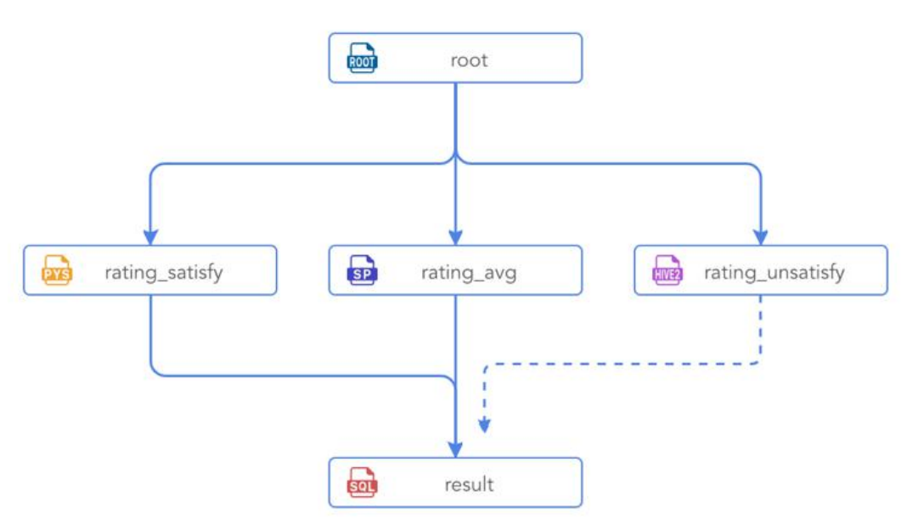
Example of workflow [1]

Slide 6
Principle of scheduling
  Scheduling module is based on Airflow
  Uses Python script to construct a workflow.
  Airflow takes care of scheduling tasks and executing on desired executor.
  Progress of task & state of DAG is available to view on the interface.

Slide 7
Architecture design
Includes 4 modules
Task development module
Task submission module
Task scheduling module &
Task execution module

Slide 8
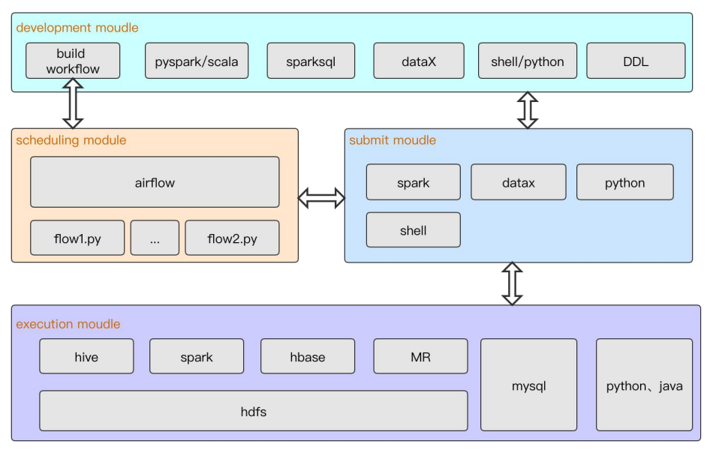
Hybrid Scheduling System Architecture [1]

Slide 9
Task development module
Involve steps like task creation, task development and workflow construction
Tasks are developed using WebIDE and stored in MySQL database.
For workflows, corresponding Python script is generated and saved in the directory.

Slide 10
Task submission module
Main purpose is to encapsulate different task submission methods to provide unified interface.
Different tasks can be submitted by providing the taskId to interface.
Construct job based on task information provided. Returns jobId to submitter.
Can obtain execution log and task execution status.

Slide 11
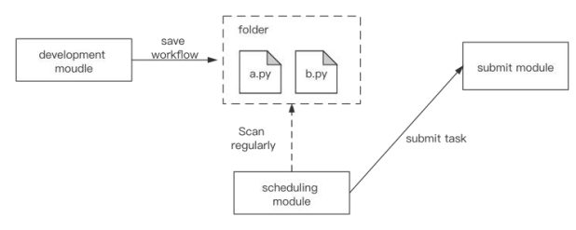
Task scheduling module
[1]
Interacts with development and job submission module
Periodically scans script files and submit them to submission module.

Slide 12
Task execution module
Execution of tasks occur here
independent from the other modules in the system
Uses a Hadoop cluster and DataX environment to provide the necessary computing power for the system

Slide 13
Experiment
Environment – 4 machines each with 8 core processor , 32GB memory
Used movie rating dataset having 27 million rating data
Tasks – 4
  to calculate the average movie score (spark-scala), calculate the movie satisfaction rate (spark-python), and calculate the movie dissatisfaction rate (Hive), output result table (SparkSql)
These tasks are run in two ways – independently and based on workflow
Time taken to execute is recorded in both cases

Slide 14
Observed that the tasks independently took 99s to finish
While in a workflow, it took 110s for completion
This delay is because of the polling interval and is almost negligible.

Slide 15
Conclusion
Traditional system cannot configure dependencies between the tasks
Using the proposed method, one can monitor the execution status of big data tasks
Workflows can be built by dragging and dropping
The proposed method is a solution for big data tasks hybrid scheduling

Slide 16
References
[1]Y. Zhu, E. Haihong and M. Song, "A Scheduling System for Big Data Hybrid Computing Workflow," 2020 IEEE 11th International Conference on Software Engineering and Service Science (ICSESS), Beijing, China, 2020, pp. 102-106, doi: 10.1109/ICSESS49938.2020.9237729
Soualhia M, Khomh F, Tahar S. Task scheduling in big data platforms: a systematic literature review[J]. Journal of Systems and Software, 2017, 134: 170-189

Slide 17


