Slide 1
Network Security
CS 4331/CS 5342
Spring 2023
Lecture 1
Instructor: Ying Liu

Slide 2
About me
Name: Ying Liu
Assistant professor
Email: Y.Liu@ttu.edu
Office: EC 306I
Office hour: 3:00 pm - 4:00 pm or by appointment

Slide 3
TA
TA Name: TBA
TA Office: TBA
TA Email: TBA
TA Office Hours: TBA

Slide 4
Questions
How many students have learned computer networks?
How many students have learned network security?
How many students have learned cryptography?
How many graduate students?
How many undergraduate students?
How many Ph.D. students?

Slide 5
Course Prerequisites
at least 2.5 TTU GPA
C or better in CS 1382 (Discrete Computational Structure)
ECE 3308 (Probability, Statistics, & Discrete Math)
CS 4392 (Computer Networks) – really important

Slide 6
Expected prior knowledge and skills
Students should have basic knowledge of discrete math, probability, and network protocols such as OSI, TCP/IP, routing, and basic programming skills in C or python, etc.

Slide 7
Classroom
Chemistry Room 0049
Class Hours: 09:00 AM – 9:50 AM Mon., Wed. & Fri.

Slide 8
Course description
This course studies security issues and defense strategies in networks. It covers the basic security topics, including symmetry and public key cryptography, hash function, digital signature, secret key distribution, secret sharing, SSL, TLS, etc.. Students will learn security protocols and potential attacks in TCP/IP and OSI network security and discuss and propose corresponding defense strategies. The course targets senior undergraduate students and graduate students.

Slide 9
Textbooks
Stallings, William, “Network Security Essentials: Applications and Standards”, 6th or Global Edition Pearson, 2016
Charlie Kaufman, Radia Perlman, Mike Speciner, “Network Security: Private Communication in a Public World”, 2nd Edition Prentice Hall, 2002
James F. Kurose, Keith W. Ross, “Computer Networking: A Top-down Approach”, 8th Edition Pearson, 2021

Slide 10
Course Objectives:
The primary objective of this course is to introduce students the fundamental principles of network security and its related techniques in infrastructure-based network

Slide 11
Learning Outcomes
Have the knowledge of typical cryptographic tools used in a computer network
Understand and analyze basic network security algorithms and communication protocols
Identify and analyze potential network attacks
Able to design a safe network protocol and to prove its security

Slide 12
Grading policy:
Projects: 35%
A Team-based project will be given. The contribution of each team member to a project will be evaluated by other members in the same team at the end of each project (peer evaluation) – You will receive your individual project grade based on your contribution to the project.
Assignments: 30%
Homework must be submitted to blackboard by the due date. Late submission may not be allowed and graded. – Late submission will not be accepted due to your computer crash or lost backup. You must email your homework to TA with CC to instructor immediately if you cannot submit your homework to blackboard because of blackboard’s technical problems. – Check if you uploaded your homework to blackboard successfully after your submission. Review your homework with TA in a designated period if you have any questions
Midterm exam: 15%, tentatively on March 10th (Thursday) in class
Final exam: 15%, May 9 (Monday) 7:30 a.m. to 10:00 a.m. in classroom, no make-up exam
Miscellaneous (Quiz/Review, etc.): 5%
The usual grading scale will be used: A (90-100), B (80-89), C (70-79), D (60-69), F (0-59). This scale may be subject to class performance.

Slide 13
Miscellaneous (Quiz/Review, etc.)
Attendance is highly required. If a student misses a class, the student should not expect individual instruction what was missed. This will be effective from the beginning of semester
Quiz/Review will be announced in advance, and there will be no make-up quiz/review

Slide 14
Late Work
Assignments and Projects are due when specified but will be accepted late (with a 10-20% penalty) until graded work is returned. If you know you will be absent ahead of time, turn your assignment in early

Slide 15
Missed Exam Policy
there are NO make-up exams. If you miss the first exam, your score on the next exam will count double.
For example, you missed the Midterm exam, and took the Final exam with a score of 70/100. Then your score on the Midterm exam is 70/100 and the score on the Final exam is 70/100. However, the Midterm exam score cannot be counted as double for the Final exam.
To avail yourself of the option to miss one test and have the next test count as double, you must provide one of the following documents:
a documented proof of a hospitalization or emergency (i.e., a doctor’s note that specifies that you were unable to take the exam on the specific test date). ***Your doctor saying you are sick, or you email me saying you feel sick IS NOT A VALID EXCUSE.
the relevant official documentation (i.e., flight tickets) noting your absence for official business, such as a business trip, a team activity, or a family visit (i.e., marriage, funeral). And you must contact the instructor a week before an exam.

Slide 16
Ethical Conduct
Although students are encouraged to discuss ideas and problems with the TA, instructor, and other students, academic dishonesty will not be tolerated. Unless stated otherwise by the instructor, you are not allowed to share code or answers. https://www.depts.ttu.edu/opmanual/op34.12.php

Slide 17
Class Policies: Collaboration
Asking questions and helping others is encouraged
Discussing course topics with other is welcome!
Limits of collaboration
Don’t share solutions with each other (except project partners)
You should never see or have possession of anyone else’s solutions

Slide 18
A tentative schedule
Week 1 (01/11 – 01/15): Course Overview
Week 2 (01/16 – 01/22): Introduction of network security, Symmetric encryptions principle
Week 3 (01/23 – 01/29): Symmetric encryptions principles, Block encryption, 3DES & AES
Week 4 (01/30 – 02/05): Stream ciphers, Public-key cryptography principles
Week 5 (02/06 – 02/12): RSA, Message authentication
Week 6 (02/13 – 02/19): Secure Hash Function, Message authentication codes & HMAC
Week 7 (02/20 – 02/26): Digital signature, remote user authentication
Week 8 (02/27 – 03/05): Symmetric key distribution, Kerberos
Week 9 (03/06 – 03/12): Review, Midterm (chapters 1-3), Diffie-Hellman key exchange
Week 10 (03/20 – 03/26): Asymmetric key distribution, X.509
Week 11 (03/27 – 04/02): PKI, DoS attack, Firewall
Week 12 (04/03 – 04/9): Intrusion detection, Web security, HTTPS
Week 13 (04/10 – 04/16): TCP & UDP attacks, SSL/TLS (RFC 8846)
Week 14 (04/17 – 04/23): IP security
Week 15 (04/24 – 05/02): Wireless network security

Slide 19
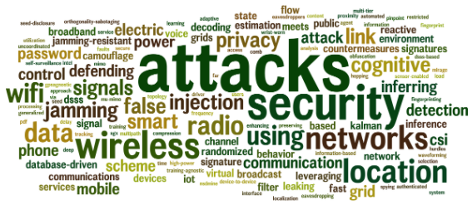
In general course outline
Introduction to Security
What are some general philosophies when thinking about security?
Cryptography
How do we securely send information over an insecure channel?
Network Security
What are some attacks on the Internet, and how do we defend against them?
Miscellaneous Topics
Useful, interesting, or fun applications of topics

Slide 20
Ethics
In this class, you will learn a lot about attacks out of necessity
To be able to defend against the attacker, you must learn the techniques that attackers use
It is usually okay to break into your own systems
This is a great way to evaluate your own systems
It is usually okay to break into someone else’s systems with their explicit permission
It is grossly unethical and exceedingly criminal to break into someone else’s systems without their permission

Slide 21

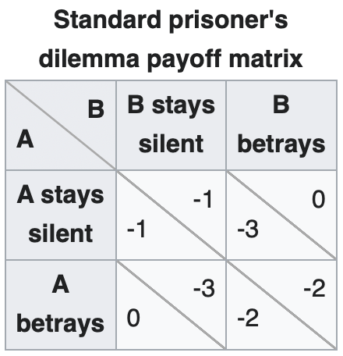
One Other Thing…
There exists a classic game theory problem called the Prisoner’s Dilemma.
For single-round Prisoner’s Dilemma, the optimum strategy is “always-defect.”
Life is multi-round: So be excellent to each other!
Making things hostile for others makes the world worse for all.
Stopping things from being hostile to others makes the world better for you.

Slide 22
Form assignment Groups
Some network security course assignments will be assigned as group assignments
Find your partner
Each group contains two students (students may also work alone if they wish).
Please provide group members details in the following form
https://forms.gle/BHkgkSnuPk5x59ws7
Deadline to submit the form is 11:59PM on Jan 17th , 2023

Slide 23
Thank you!

