Slide 1
Memory Hierarchy—
Reducing Miss Penalty
Reducing Hit Time
Main Memory
Professor Alvin R. Lebeck
Computer Science 220 / ECE 252
Fall 2006

Slide 2
Admin
Work on Projects
Read NUCA paper

Slide 3
Review: Summary
Ave Mem Acc Time =
Hit time + (miss rate x miss penalty)
3 Cs: Compulsory, Capacity, Conflict
Program transformations to reduce cache misses
1. Reduce the miss rate,
2. Reduce the miss penalty, or
3. Reduce the time to hit in the cache.

Slide 4
1. Reducing Miss Penalty: Read Priority over Write on Miss
Write back with write buffers offer RAW conflicts with main memory reads on cache misses
If simply wait for write buffer to empty might increase read miss penalty by 50% (old MIPS 1000)
Check write buffer contents before read;
if no conflicts, let the memory access continue
Write Back?
  Read miss replacing dirty block
  Normal: Write dirty block to memory, and then do the read
  Instead copy the dirty block to a write buffer, then do the read, and then do the write
  CPU stall less since restarts as soon as read completes

Slide 5
2. Subblock Placement to Reduce Miss Penalty
Don’t have to load full block on a miss
Have bits per subblock to indicate valid
(Originally invented to reduce tag storage)
100
1
1
1
0
200
0
1
0
1
300
0
0
0
1
Valid Bits

Slide 6
3. Early Restart and Critical Word First
Don’t wait for full block to be loaded before restarting CPU
  Early restart—As soon as the requested word of the block arrrives, send it to the CPU and let the CPU continue execution
  Critical Word First—Request the missed word first from memory and send it to the CPU as soon as it arrives; let the CPU continue execution while filling the rest of the words in the block. Also called wrapped fetch and requested word first
Generally useful only in large blocks,
Spatial locality a problem; tend to want next sequential word, so not clear if benefit by early restart

Slide 7
4. Non-blocking Caches to reduce stalls on misses
Non-blocking cache or lockup-free cache allowing the data cache to continue to supply cache hits during a miss
“hit under miss” reduces the effective miss penalty by being helpful during a miss instead of ignoring the requests of the CPU
“hit under multiple miss” or “miss under miss” may further lower the effective miss penalty by overlapping multiple misses
  Significantly increases the complexity of the cache controller as there can be multiple outstanding memory accesses
  But important for large window processors (WIB / CFP)
  Memory level parallelism

Slide 8
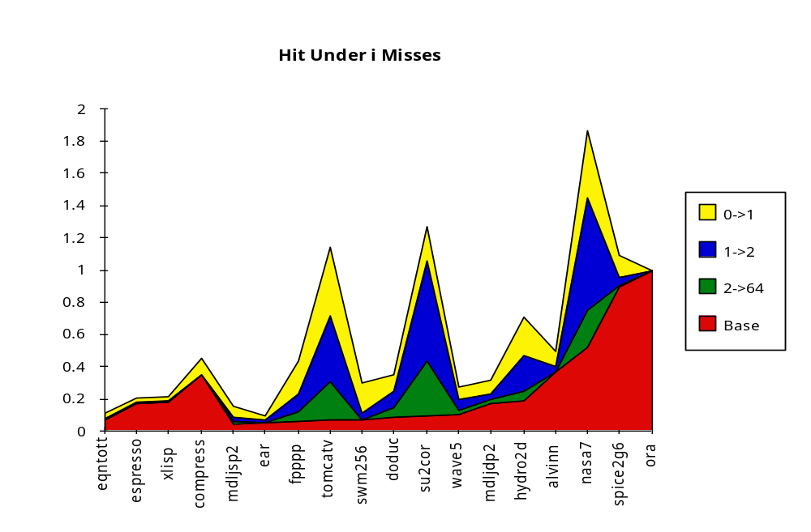
Value of Hit Under Miss for SPEC
“Hit under i Misses”
Integer
Floating Point
FP programs on average: AMAT= 0.68 -> 0.52 -> 0.34 -> 0.26
Int programs on average: AMAT= 0.24 -> 0.20 -> 0.19 -> 0.19
8 KB Data Cache, Direct Mapped, 32B block, 16 cycle miss

Slide 9
5th Miss Penalty Reduction: Second Level Cache
L2 Equations
AMAT = Hit Time_{L1} + Miss Rate_{L1} x Miss Penalty_{L1}
Miss Penalty_{L1} = Hit Time_{L2} + Miss Rate_{L2} x Miss Penalty_{L2}
AMAT = Hit Time_{L1} + Miss Rate_{L1} x (Hit Time_{L2} + Miss Rate_{L2} + Miss Penalty_{L2})
Definitions:
  Local miss rate— misses in this cache divided by the total number of memory accesses to this cache (Miss rate_{L2})
  Global miss rate—misses in this cache divided by the total number of memory accesses generated by the CPU
  (Miss Rate_{L1} x Miss Rate_{L2})

Slide 10
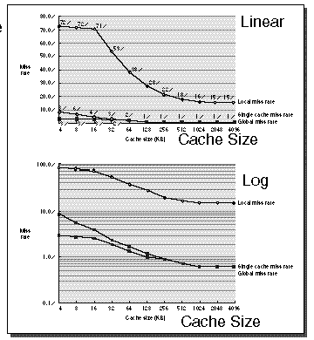
Comparing Local and Global Miss Rates
32 KByte 1st level cache;
Increasing 2nd level cache
Global miss rate close to single level cache rate provided L2 >> L1
Don’t use local miss rate
L2 not tied to CPU clock cycle
Cost & A.M.A.T.
Generally Fast Hit Times and fewer misses
Since hits are few, target miss reduction

Slide 11
Reducing Misses: Which apply to L2 Cache?
Reducing Miss Rate
  1. Reduce Misses via Larger Block Size
  2. Reduce Conflict Misses via Higher Associativity
  3. Reducing Conflict Misses via Victim Cache
  4. Reducing Conflict Misses via Pseudo-Associativity
  5. Reducing Misses by HW Prefetching Instr, Data
  6. Reducing Misses by SW Prefetching Data
  7. Reducing Capacity/Conf. Misses by Compiler Optimizations

Slide 12
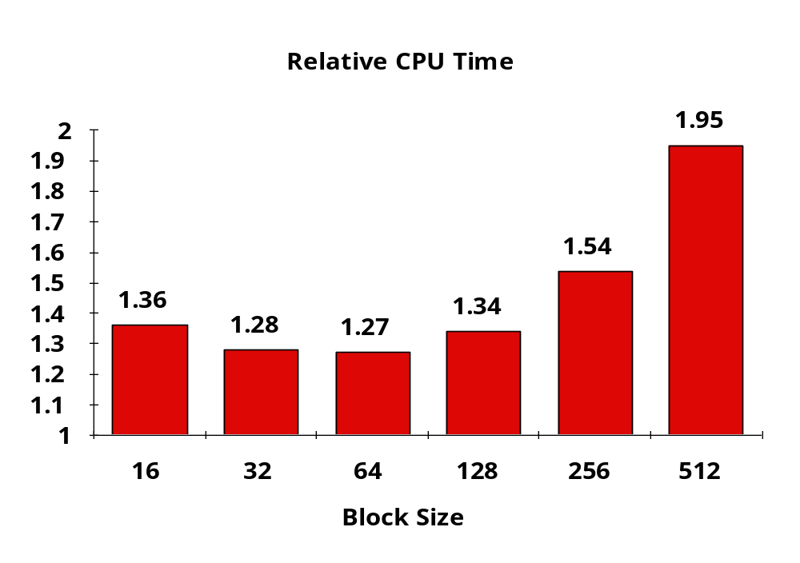
L2 cache block size & A.M.A.T.
32KB L1, 8 byte path to memory

Slide 13
Summary: Reducing Miss Penalty
Five techniques
  Read priority over write on miss
  Subblock placement
  Early Restart and Critical Word First on miss
  Non-blocking Caches (Hit Under Miss)
  Second Level Cache
Can be applied recursively to Multilevel Caches
  Danger is that time to DRAM will grow with multiple levels in between

Slide 14
Review: Improving Cache Performance
Ave Mem Acc Time =
Hit time + (miss rate x miss penalty)
1. Reduce the miss rate,
2. Reduce the miss penalty, or
3. Reduce the time to hit in the cache.

Slide 15
1. Fast Hit times via Small and Simple Caches
Why Alpha 21164 has 8KB Instruction and 8KB data cache + 96KB second level cache
Direct Mapped, on chip
Impact of dynamic scheduling?
  Alpha 21264 has 64KB 2-way L1 Data and Inst Cache

Slide 16
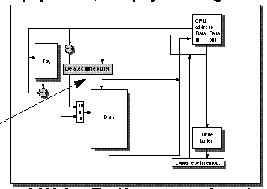
2. Fast Hit Times Via Pipelined Writes
Pipeline Tag Check and Update Cache as separate stages; current write tag check & previous write cache update
Only Write in the pipeline; empty during a miss
Shaded is Delayed Write Buffer; must be checked on reads; either complete write or read from buffer

Slide 17
3. Fast Writes on Misses Via Small Subblocks
If most writes are 1 word, subblock size is 1 word, & write through then always write subblock & tag immediately
  Tag match and valid bit already set: Writing the block was proper, & nothing lost by setting valid bit on again.
  Tag match and valid bit not set: The tag match means that this is the proper block; writing the data into the subblock makes it appropriate to turn the valid bit on.
  Tag mismatch: This is a miss and will modify the data portion of the block. As this is a write-through cache, however, no harm was done; memory still has an up-to-date copy of the old value. Only the tag of the address of the write and the valid bits of the other subblock need be changed because the valid bit for this subblock has already been set
Doesn’t work with write back due to last case

Slide 18
5 & 6 ??
Why are loads slower than registers?
How can we get some of the advantages of registers for caches?
How can we apply basic ideas of branch prediction to loads?

Slide 19
5. Multiport Cache
Allow more than one memory access per cycle
Replicate the cache (2 read ports, 1 write port)
Dual port the cache (2 ports for either read or write)
Multiple Banks (different addresses to different caches)
NUCA: many banks for cache & placement should move around the blocks so frequently touched blocks move closer to processor core

Slide 20
6. Load Value Prediction
Predict result of load
Use PC to index value prediction table

Slide 21
Cache Optimization Summary
Technique MR MP HT Complexity
Larger Block Size + – 0
Higher Associativity + – 1
Victim Caches + 2
Pseudo-Associative Caches + 2
HW Prefetching of Instr/Data + 2
Compiler Controlled Prefetching + 3
Compiler Reduce Misses + 0
Priority to Read Misses + 1
Subblock Placement + + 1
Early Restart & Critical Word 1st + 2
Non-Blocking Caches + 3
Second Level Caches + 2
Small & Simple Caches – + 0
Avoiding Address Translation + 2
Pipelining Writes + 1
Multiple Ports + 2
Load Value Prediction + 2

Slide 22
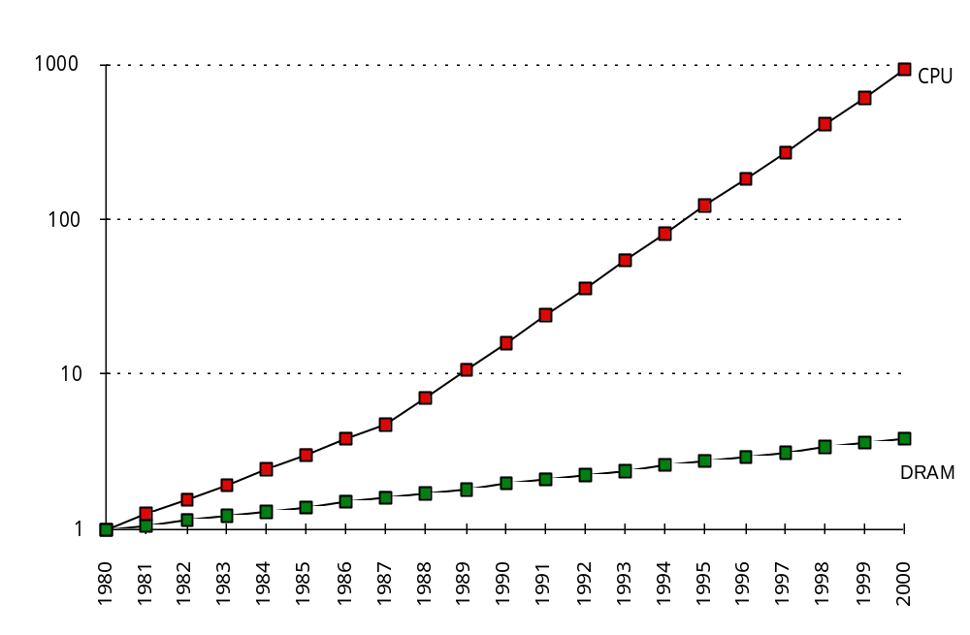
What is the Impact of What You’ve Learned About Caches?
1960-1985: Speed
= ƒ(no. operations)
1997
  Pipelined
  Execution &
  Fast Clock Rate
  Out-of-Order
  completion
  Superscalar
  Instruction Issue
1998: Speed =
ƒ(non-cached memory accesses)
What does this mean for
  Compilers?,Operating Systems?, Algorithms?, Data Structures?

Slide 23
Memory Hierarchy—
Main Memory and Enhancing its Performance

Slide 24
Main Memory Background
Performance of Main Memory:
  Latency: Cache Miss Penalty
    Access Time: time between request and word arrives
    Cycle Time: time between requests
  Bandwidth: I/O & Large Block Miss Penalty (L2)
Main Memory is DRAM: Dynamic Random Access Memory
  Dynamic since needs to be refreshed periodically (8 ms)
  Addresses divided into 2 halves (Memory as a 2D matrix):
    RAS or Row Access Strobe
    CAS or Column Access Strobe
Cache uses SRAM: Static Random Access Memory
  No refresh (6 transistors/bit vs. 1 transistor/bit)
  Address not divided
Size: DRAM/SRAM ­ 4-8,
Cost/Cycle time: SRAM/DRAM ­ 8-16

Slide 25
Main Memory Performance
Simple:
  CPU, Cache, Bus, Memory same width (1 word)
Wide:
  CPU/Mux 1 word; Mux/Cache, Bus, Memory N words (Alpha: 64 bits & 256 bits)
Interleaved:
  CPU, Cache, Bus 1 word: Memory N Modules
  (4 Modules); example is word interleaved
CPU
CPU
Mux
$
$
Bus
Bus
Memory
Mem
CPU
$
Mem
Mem
Mem
Mem

Slide 26
Main Memory Performance
Timing model
  1 to send address,
  6 access time, 1 to send data
  Cache Block is 4 words
Simple M.P. = 4 x (1+6+1) = 32
Wide M.P. = 1 + 6 + 1 = 8
Interleaved M.P. = 1 + 6 + 4x1 = 11
Address
Bank 0
Address
Bank 1
Address
Bank 2
Address
Bank 3
0
1
2
3
4
5
6
7
8
9
10
9
12
13
14
15

Slide 27
Independent Memory Banks
Memory banks for independent accesses vs. faster sequential accesses
  Multiprocessor
  I/O
  Miss under Miss, Non-blocking Cache
Superbank: all memory active on one block transfer
Bank: portion within a superbank that is word interleaved
Superbank Number
Bank Number
Bank Offset

Slide 28
Independent Memory Banks
How many banks?
number banks >= number clocks to access word in bank
  For sequential accesses, otherwise will return to original bank before it has next word ready
DRAM trend towards deep narrow chips.
=> fewer chips
=> harder to have banks of chips
=> put banks inside chips (internal banks)

Slide 29
Avoiding Bank Conflicts
Lots of banks
int x[256][512];
for (j = 0; j < 512; j = j+1)
for (i = 0; i < 256; i = i+1)
x[i][j] = 2 * x[i][j];
Even with 128 banks, since 512 is multiple of 128, conflict
  structural hazard
SW: loop interchange or declaring array not power of 2
HW: Prime number of banks
  bank number = address mod number of banks
  address within bank = address / number of banks
  modulo & divide per memory access?
  address within bank = address mod number words in bank (3, 7, 31)
  bank number? easy if 2^{N} words per bank

Slide 30
Fast Bank Number
Chinese Remainder Theorem
As long as two sets of integers a_{i} and b_{i} follow these rules
and that a_{i} and a_{j} are co-prime if i != j, then the integer x has only one solution (unambiguous mapping):
  bank number = b₀, number of banks = a₀ (= 3 in example)
  address within bank = b₁, number of words in bank = a₁ (= 8 in example)
  N word address 0 to N-1, prime no. banks, # of words is power of 2

Slide 31
Prime Mapping Example
Seq. Interleaved Modulo Interleaved
Bank Number:
0 1 2 0 1 2
Address
within Bank:
0 0 1 2 0 16 8
1 3 4 5 9 1 17
2 6 7 8 18 10 2
3 9 10 11 3 19 11
4 12 13 14 12 4 20
5 15 16 17 21 13 5
6 18 19 20 6 22 14
7 21 22 23 15 7 23

Slide 32
Fast Memory Systems: DRAM specific
Multiple RAS accesses: several names (page mode)
  64 Mbit DRAM: cycle time = 100 ns, page mode = 20 ns
New DRAMs to address gap;
what will they cost, will they survive?
  Synchronous DRAM: Provide a clock signal to DRAM, transfer synchronous to system clock
  RAMBUS: reinvent DRAM interface (Intel will use it)
    Each Chip a module vs. slice of memory
    Short bus between CPU and chips
    Does own refresh
    Variable amount of data returned
    1 byte / 2 ns (500 MB/s per chip)
  Cached DRAM (CDRAM): Keep entire row in SRAM

Slide 33
Main Memory Summary
Big DRAM + Small SRAM = Cost Effective
  Cray C-90 uses all SRAM (how many sold?)
Wider Memory
Interleaved Memory: for sequential or independent accesses
Avoiding bank conflicts: SW & HW
DRAM specific optimizations: page mode & Specialty DRAM, CDRAM
  Niche memory or main memory?
    e.g., Video RAM for frame buffers, DRAM + fast serial output
IRAM: Do you know what it is?

Slide 34
Review: Reducing Miss Penalty Summary
Five techniques
  Read priority over write on miss
  Subblock placement
  Early Restart and Critical Word First on miss
  Non-blocking Caches (Hit Under Miss)
  Second Level Cache
Can be applied recursively to Multilevel Caches
  Danger is that time to DRAM will grow with multiple levels in between

Slide 35
Review: Improving Cache Performance
1. Reduce the miss rate,
2. Reduce the miss penalty, or
3. Reduce the time to hit in the cache
Fast hit times by small and simple caches
Fast hits via avoiding virtual address translation
Fast hits via pipelined writes
Fast writes on misses via small subblocks
Fast hits by using multiple ports
Fast hits by using value prediction

Slide 36
Review: Cache Optimization Summary
Technique MR MP HT Complexity
Larger Block Size + – 0
Higher Associativity + – 1
Victim Caches + 2
Pseudo-Associative Caches + 2
HW Prefetching of Instr/Data + 2
Compiler Controlled Prefetching + 3
Compiler Reduce Misses + 0
Priority to Read Misses + 1
Subblock Placement + + 1
Early Restart & Critical Word 1st + 2
Non-Blocking Caches + 3
Second Level Caches + 2
Small & Simple Caches – + 0
Avoiding Address Translation + 2
Pipelining Writes + 1

Slide 37
Next Time
Memory hierarchy and virtual memory

