Slide 1
OpenDataVal: a Unified Benchmark for Data Valuation
Group 3
Anvesh Muppeda
Sai Manasa Kota
Yoshitha Thanguturi
Prathyuusha Chowdary Karapakula
Bhavagna Ravilla

Slide 2
Data Valuation: Understanding the Worth of Your Data
Data Valuation: The strategic assessment of data assets' worth based on quality, relevance, and potential applications, assigning a dynamic monetary value reflecting market demand, technology advancements, and evolving business requirements.
What's Your Data Really Worth?
Splunk & ESG Study: Investigated the correlation between an organization’s data utilization and business success through insights from 1,350 IT and business decision-makers on data collection, management, and usage.
Key Findings:
Effective data utilization led to an increase in revenue and a reduction in operational costs.
Boosted profitability by around $38.2 million, equivalent to about 12.5% of total gross profit.
Average revenue increase of 5.32% and a decrease in operational costs by 4.85% annually.
97% met or exceeded customer retention targets, with 60% surpassing goals.
93% believed they made better and faster decisions compared to competitors.

Slide 3
Data Monetization: Unlocking the Value of Data
Data monetization is the process of converting data into revenue or other tangible benefits.
It involves extracting value from data through analysis, insights, and innovative applications.
Airlines frequently capitalize on data by using weather forecasts to anticipate flight delays, adjusting schedules and travel plans accordingly. However, the true value of data emerges when these adjustments result in measurable advantages, such as decreased overtime expenses and refunds, or increased ticket sales due to enhanced customer satisfaction.
Retailers understand customer preferences and optimize inventory.
Healthcare providers provide proactive patient care and reduce costs.
Manufacturers optimize production and minimize downtime.
Financial institutions manage risk and detect fraud.
Transportation companies optimize routes and fuel efficiency.
Media companies personalize content and advertising.

Slide 4
OpenDataVal: Revolutionizing Data Analysis
OpenDataVal, an easy-to-use and unified benchmark framework that enhances the model performance on evaluating data quality and impact.
- Provides a diverse collection of datasets and implementations of 11 state-of-the-art data valuation algorithms.
- Offers four downstream machine learning tasks for evaluating data value quality(noise label detction, noise feature detection, point addition, point removal).
- This is publicly available with comprehensive documentation and a leaderboard for algorithm evaluation.

Slide 5
Why only OpenDataVal?
Sim et al. did a survey on data valuation methods, but it lacked real-world comparisons. Our framework fixes that by creating an easy-to-use system to compare these methods in practice.
Valda3 is another package with data valuation methods, but OpenDataVal has more methods and is easier to use.
OpenDataVal provides a simple way to compare data valuation methods, rather than creating tasks and competitions.

Slide 6
Why it is best for you?
OpenDataval is an integratede environment with the implementations of 11 different state-of-the-art data valuation algorithms.
LOO - each data point is removed from the dataset one at a time, and the model is trained on the remaining data points to evaluate its performance.
DataShapley - quantifies the value of individual data points by measuring their contribution to the model's performance
KNNShapley - computes the Shapley values for individual data points in a dataset using a K-nearest neighbors approach
Volume-based Shapley - calculates the Shapley values for individual data points based on the volume of the region formed by the data points
DataBanzhaf - computes the Banzhaf power index for individual data points to quantify their influence on model's output
AME - calculates the average change in the predicted outcome for a model
InfluenceFunction - measures the effect of removing individual data points on the model's parameters
LAVA - adjusts the values of individual data points to evaluate their impact on the model's predictions
DVRL - uses reinforcement learning to assign values to individual data points
Data-OOB - estimates the value of individual data points by analyzing their out-of-bag performance in a random forest model

Slide 7
Noise Label Detection
Objective: Identify mislabeled or noisy data points in a dataset.
Method:
Synthetically generate mislabeled dataset.
Use data valuation algorithm to compute values for each data point.
Divide data values into clusters using k-means.
Assume cluster with lower mean contains mislabeled data.
F1-Score Calculation:
Measure alignment between predicted mislabeled set and ground-truth annotation.
F1-score balances precision and recall.
Interpretation:
Quantifies how well predicted mislabeled set aligns with ground truth.
Essential for improving model performance and reliability.

Slide 8
Noise Feature Detection
Objective: Identify data points with perturbed features in a dataset.
Method:
Synthetically generate a perturbed dataset by randomly choosing a percentage of the training dataset and adding Gaussian random errors to every original feature.
Evaluation with Data Valuation Algorithm (ϕ):
For each data valuation algorithm ϕ, compute a set (low)S(low)ϕ representing low-valued data points.
Evaluate the alignment between (low)S(low)ϕ and (perturbed)S(perturbed) using the F1-score metric.
Interpretation:
Measure how well the low-valued data points predicted by ϕ align with the perturbed data points.
Essential for detecting and assessing the impact of noisy features on model performance and reliability.

Slide 9
Point Removal Experiment
We wanted to see how data valuation methods could help identify important or influential data points. To test this, we conducted two experiments: point removal and point addition.
Data points were removed from the training dataset based on their importance determined by data valuation methods.
A model was trained using the remaining data and evaluated on a separate test dataset.
While most methods performed better than random guessing, the Data-OOB method was found to be less effective in this scenario.

Slide 10
Point Addition Experiment
Data points were added to the training dataset based on their importance determined by data valuation methods.
The model was then trained using the augmented data and its performance was evaluated.
Adding low-quality data points first was expected to reduce model accuracy, revealing problematic points.
Data-OOB consistently displayed the lowest accuracy, indicating its effectiveness in identifying low-quality data, while other methods like DVRL, DataShapley, and BetaShapley also performed well in this regard.

Slide 11
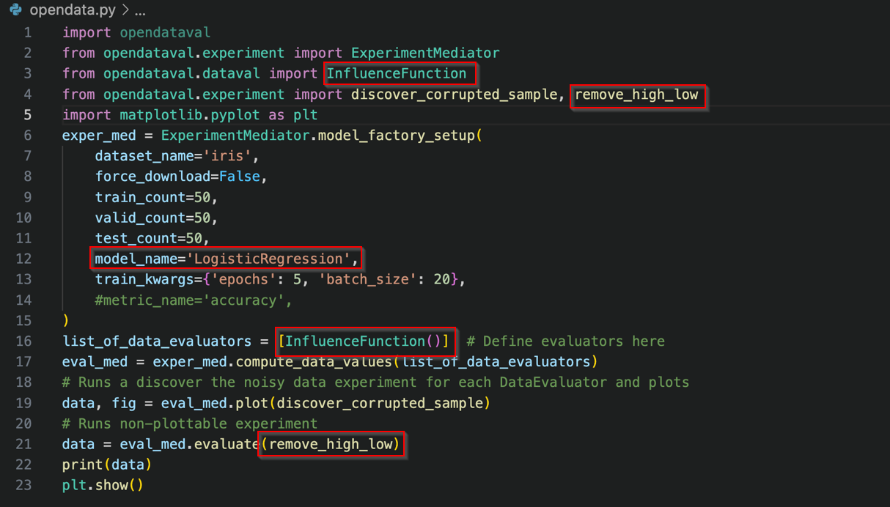
Example Usage

Slide 12
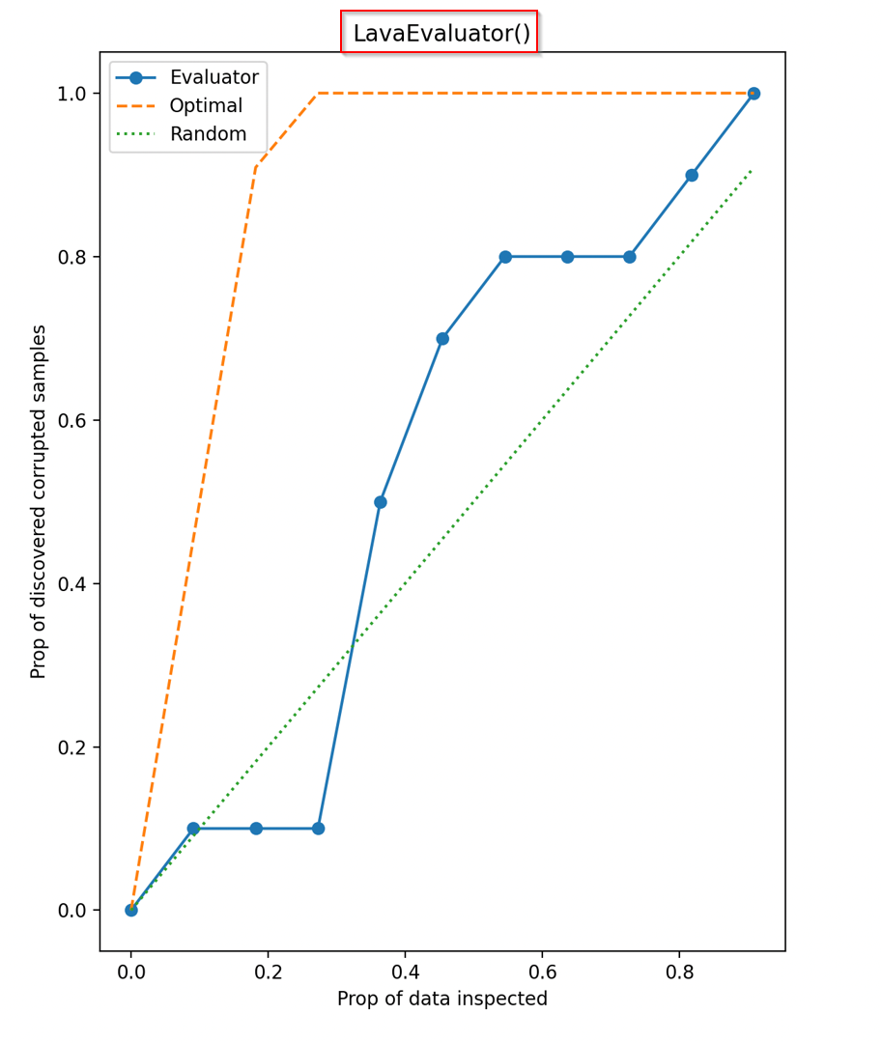
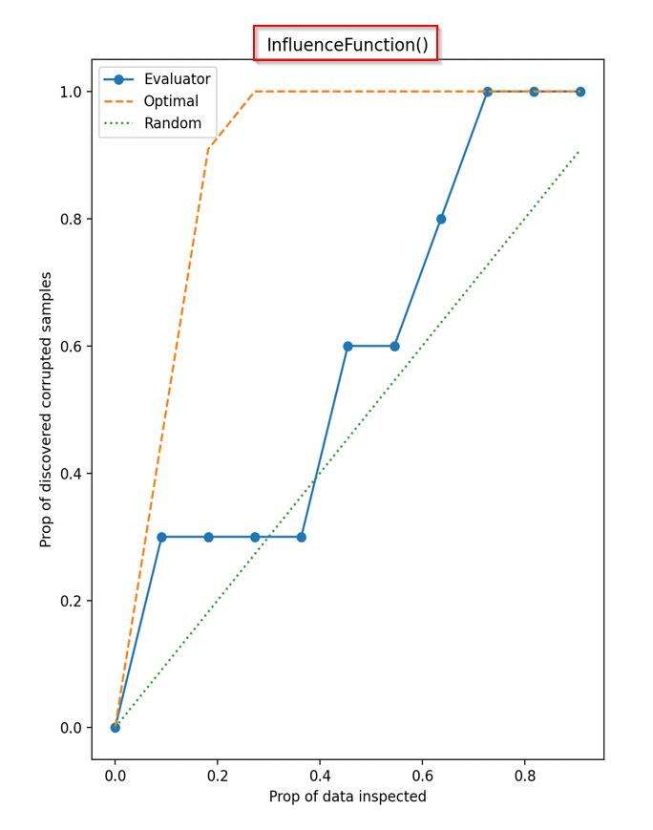
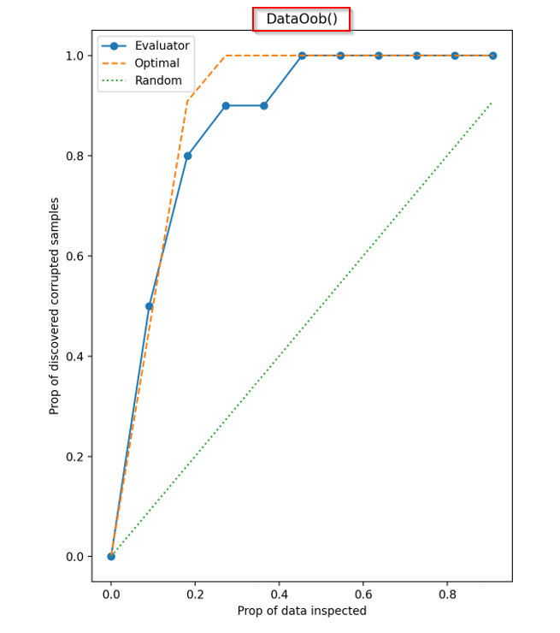
Results

Slide 13
Future Work
Model Exploration & Issue Identification
Explore XGBoost and LightGBM models to understand their intricacies and version-specific requirements, aiming to resolve compatibility issues for seamless integration with Opendataval (version 1.3.0).
Multi-Algorithm Experimentation:
Enable users to concurrently select and execute multiple algorithms for experimentation on a chosen dataset.
Streamline the process of running experiments across diverse algorithms to expedite analysis.
Performance Evaluation & Suitability Determination:
Implement robust evaluation metrics to assess the performance of each algorithm on the dataset.
Develop mechanisms to automatically identify the algorithm that best suits the dataset characteristics based on performance results.

Slide 14
Future Work
Benefits:
Efficiency:
Streamlined experimentation process saves time and resources by allowing simultaneous evaluation of multiple algorithms.
Informed Decision-Making:
Comprehensive comparative analysis enables users to make informed decisions regarding algorithm selection.
Enhanced Performance:
Identification of the most suitable algorithm leads to improved model performance and better outcomes for data-driven tasks.

Slide 15
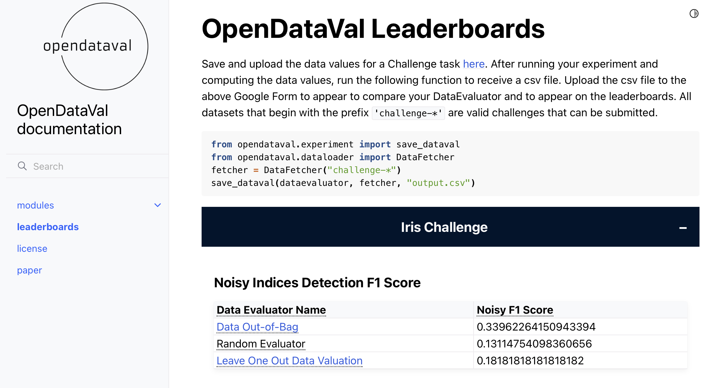
Future Work

Slide 16
Conclusion
OpenDataVal is a user-friendly tool that lets researchers and practitioners easily apply and compare different data valuation methods using just a few lines of Python code.
It offers a wide range of datasets and eleven state-of-the-art valuation algorithms, along with tasks like noisy label data detection, noisy feature data detection, point removal experiment, and point addition experiment. Our analysis shows that no single algorithm is best for every task, so users should pick the one that suits their needs.

Slide 17

THANK YOU

