Slide 1
OPENDATAVAL: A UNIFIED BENCHMARK FOR DATA VALUATION
Published in 37th Conference on Neural Information Processing Systems (NeurIPS 2023) Track on Datasets and Benchmarks.
Group 3
Anvesh Muppeda(R11840667)
Sai Manasa Kota(R11863589)
Yoshitha Thanguturi(R11899049)
Prathyuusha Chowdary Karapakula(R11899048)
Bhavagna Ravilla(R11902857)

Slide 2

Unlocking the Value of Data: Understanding Data Valuation and Monetization
Data Valuation: Assessing the value of data assets strategically involves evaluating their quality, relevance, and potential uses, while dynamically assigning a monetary worth that adapts to market demand, technological progress, and evolving business needs.
Data monetization: Data monetization is the process of converting data into revenue or other tangible benefits. It involves extracting value from data through analysis, insights, and innovative applications.

Slide 3
What do the Studies tell ?
Deloitte’s 2023 Global Technology Leadership Study , this focuses on the topic of monetizing data and technology.
It explores how organizations are approaching the process of converting their data and technology assets into revenue-generating opportunities.
The study examines the strategies, challenges, and opportunities involved in monetizing data and technology, as well as the evolving roles of technology leaders in driving these initiatives forward.
1,179 global leaders, including CIOs, chief technology officers, and other senior technology decision-makers. Additionally, qualitative interviews were conducted with more than 100 technology executives spanning a range of sectors.

Slide 4
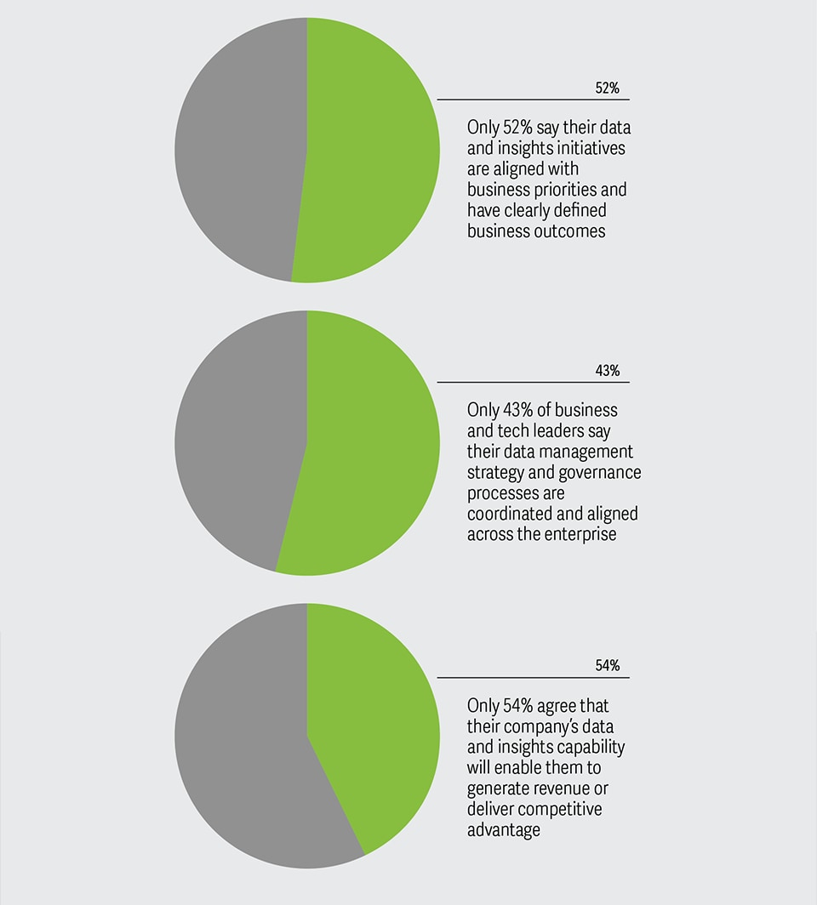
Tech leaders see the opportunities in data and tech

Slide 5
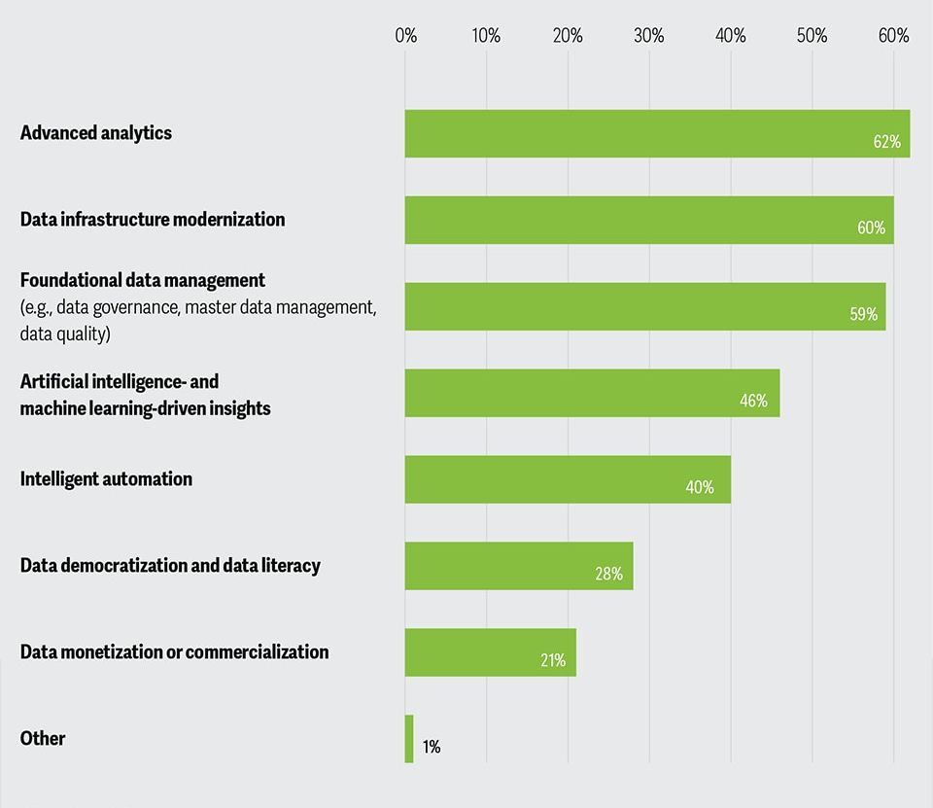
Insights on business priorities

Slide 6
Experiments
Noisy Label Data Detection and Noisy Feature Data Detection
What is noise??
Two types of Synthetic Noise:
Label Noise: Flipping the original value to its opposite.
Feature Noise: Adding the Gaussian Random Errors to the original feature.
Process:
Type of noise is selected
Noise proportion level is selected
K-means clustering model:
Beneficial Group
Detrimental Group
All the lower average values --> Detrimenatl Group (Noisy Samples)
F1 score --> Detrimental group and Ground-truth annotation
Higher the F1 score, then that algorithm is more efficient.

Slide 7
Experiments Cont...
Point Removal:
The data points are removed in the descending order of the data values.
Logistic Regression Model
Accuracy of the data valuation algorithms should decrease.
Point Addition:
Process is similar to the Point Removal.
The data values are added in the ascending order.
All these four experiments can be done easily using OpenDataVal.

Slide 8
Data sets in OpenDataVal
1.Electricity dataset: It is a collection of information about how much electricity is used over time, including details like the date, time of day, and maybe even weather conditions.
• Neural Network Use: With neural networks, we can use this dataset to teach computers to predict future electricity usage. They learn from past patterns in electricity consumption and other related data. These predictions help in planning and managing electricity resources more efficiently.
2.2D planes dataset: It is just a bunch of points on a flat surface, like dots on a map.
• Machine Learning Use: In machine learning, we can use these datasets to teach computers to find patterns or group these points together based on their positions. This helps in tasks like organizing data or recognizing similarities in images.
3.Pol dataset: It is data about politics, like information on elections, parties, or voters.
• Machine Learning Use: With machine learning, we can use this data to make predictions about political trends or understand how voters behave. It helps in tasks like predicting election results or analyzing patterns in political behavior.

Slide 9
Data sets Cont...
4. MiniBooNE dataset : It is data collected from experiments studying neutrinos in particle physics.
•Neural Network Use: With neural networks, scientists can use this data to identify different types of particle interactions or separate signal events from background noise, helping to understand the behavior of fundamental particles.
5.Nomao dataset: It contains information or images used for teaching computers to recognize objects, scenes, or people.
•Neural Network Use: With neural networks, this dataset helps train models to identify and classify objects, scenes, or faces in images accurately.
6.BBC-embedding dataset: It contains news articles or headlines from the BBC.
•Neural Network Use: With neural networks, this dataset helps train models to understand and analyze text, which can be useful for tasks like sorting news articles into categories or detecting sentiment in headlines.

Slide 10
Data sets Cont...
7.IMDB-embedding dataset: It is a collection of movie reviews from the Internet Movie Database (IMDB).
•Neural Network Use: With neural networks, this dataset helps train models to understand and analyze the sentiment of movie reviews, distinguishing between positive and negative feedback.
8.CIFAR10-embedding dataset: It consists of 60,000 small images categorized into ten different classes, like animals or vehicles.
•Neural Network Use: With neural networks, this dataset helps train models to recognize objects in images, teaching computers to identify whether an image contains a specific object, like a bird or a car.
9.Adult dataset: using this dataset we are performing some experiments which includes both training and test data.

Slide 11
Data sets Cont..
Data Preprocessing:
It reads the data into pandas DataFrames.
It combines the training and test data.
It assigns column names.
It converts the income labels into binary form (0 for <=50K and 1 for >50K).
It converts certain columns to float data type.
It applies one-hot encoding to categorical columns.
It renames the income column and converts it to integer data type.
It resets the index and drops unnecessary columns.
Return: It returns the preprocessed data as NumPy arrays, consisting of features and corresponding labels.
Overall, this function downloads, processes, and prepares the Adult dataset for use in machine learning tasks.

Slide 12
Training Models
Torch Model:
Torch models are employed for data valuation tasks such as preprocessing, feature extraction, building valuation models, anomaly detection, and model interpretation. Torch provides modules and functions to create and train neural networks, making it suitable for implementing models like LeNet.
BERT Classifiers (for Text Data):
BERT processes input text by tokenizing it into sub words, encoding each token, and then passing them through multiple layers of transformer blocks to learn contextual representations. This allows the model to leverage pre-trained knowledge to achieve high performance on various text classification problems.
Gradient Model (for Image Data):
This model learns from a dataset where the value of the data is known, using a process that adjusts the model's parameters to minimize the difference between predicted and actual values. This optimization helps the model make better predictions about the value of new, unseen data based on its features.

Slide 13
Why XGBoost and LightGBM??
XGBoost (Extreme Gradient Boosting):
•The XGBoost model is used to evaluate the value of data by analyzing its features and predicting outcomes.
•It works by combining many decision-making "trees".
•This method is great for understanding which features are most important in the data and can handle large amounts of information efficiently.
•This makes it useful for tasks like deciding which data is most valuable based on its characteristics and how it relates to other data.
•
LightGBM(Light Gradient Boosting Machine):
•LightGBM is like a smart tool that helps figure out how valuable data is.
•It works by building a series of decision trees, where each tree corrects the mistakes of the previous ones.
•It is efficient because it grows trees in a smart way, focusing on the parts of the data that are most important for making good predictions.
•It can handle large amounts of data quickly and can even work with different types of data, like categories.

Slide 14
11 Algorithms in OpenDataVal
LOO (Leave One Out):
Data Shapley:
KNN Shapley:
Volume based Shapley
Beta Shapley
Data Banzhaf
AME (Attribute Marginal Effect)
Influence Function
LAVA (Local Attribution for Valuing Assets)
DVRL(Data Valuation using Reinforcement Learning)
Data OOB

Slide 15
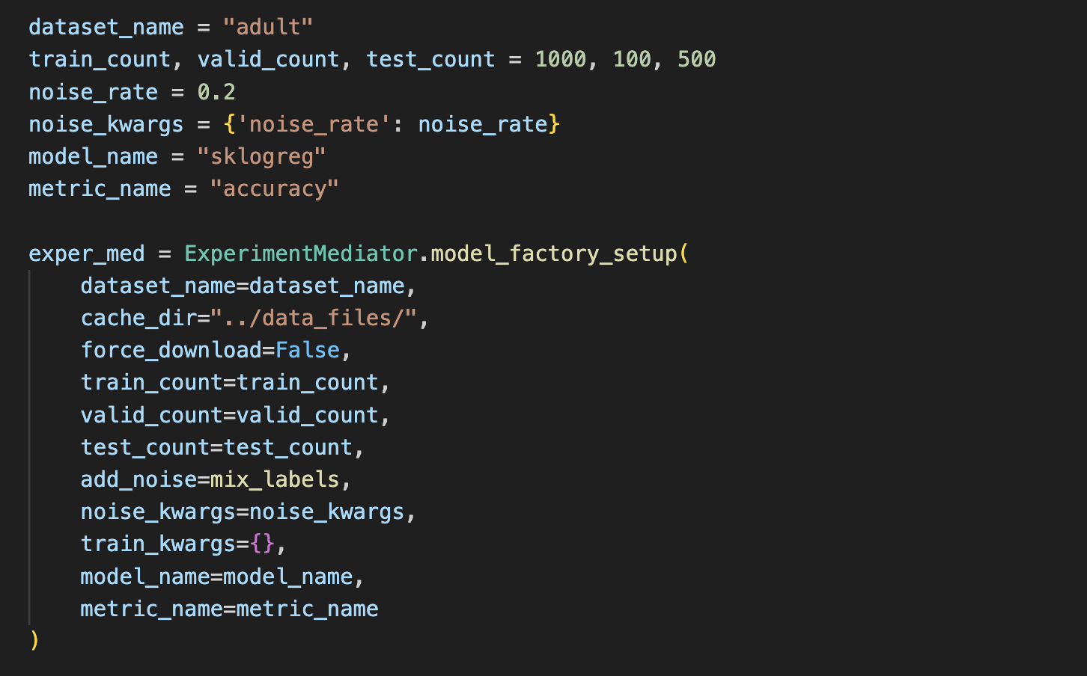
[Step 1] Set up an Environment
Example Usage

Slide 16
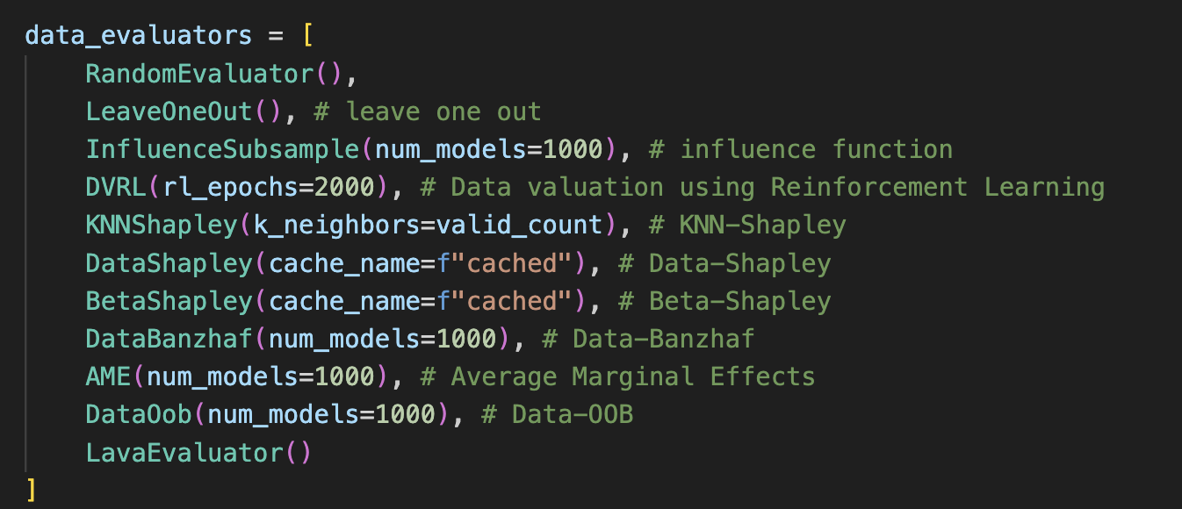
[Step 2] Compute Data Values
Example Usage

Slide 17
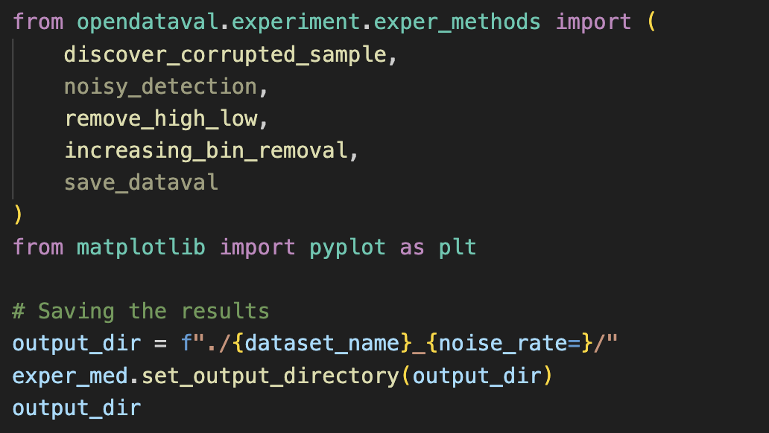
[Step 3] Evaluate Data Values
Example Usage

Slide 18
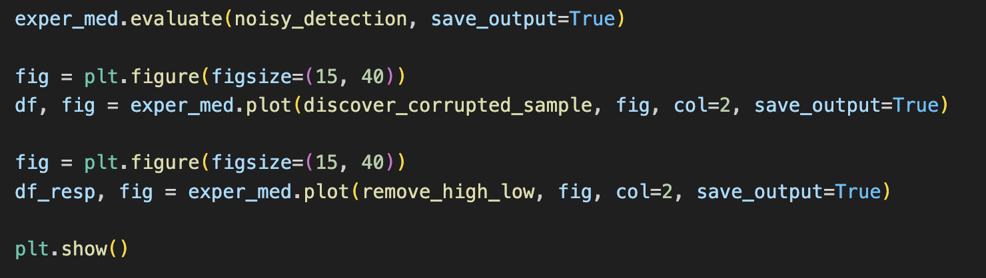
[Step 4] Visualizes The Results
Example Usage

Slide 19
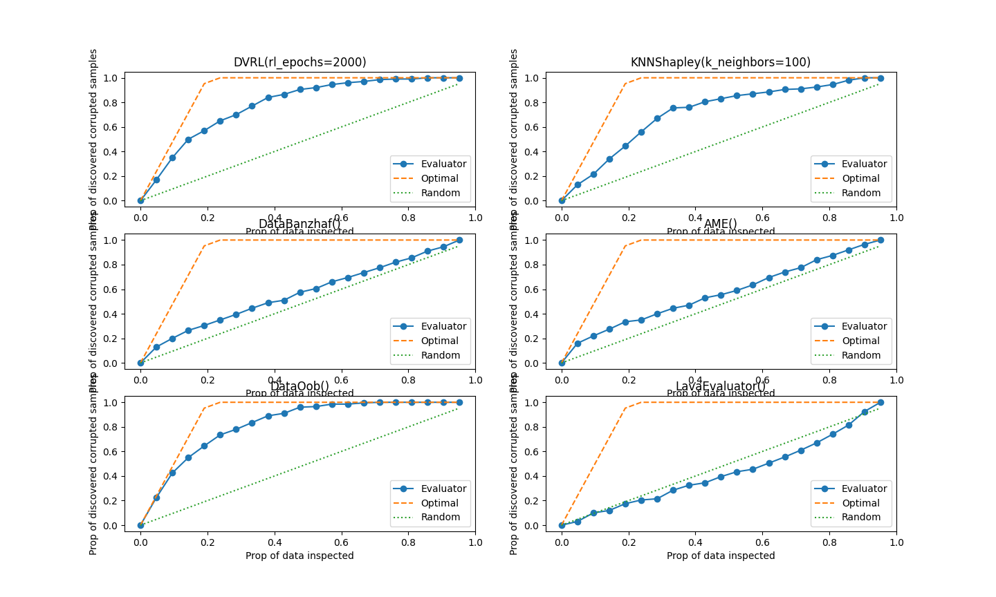
Results

Slide 20
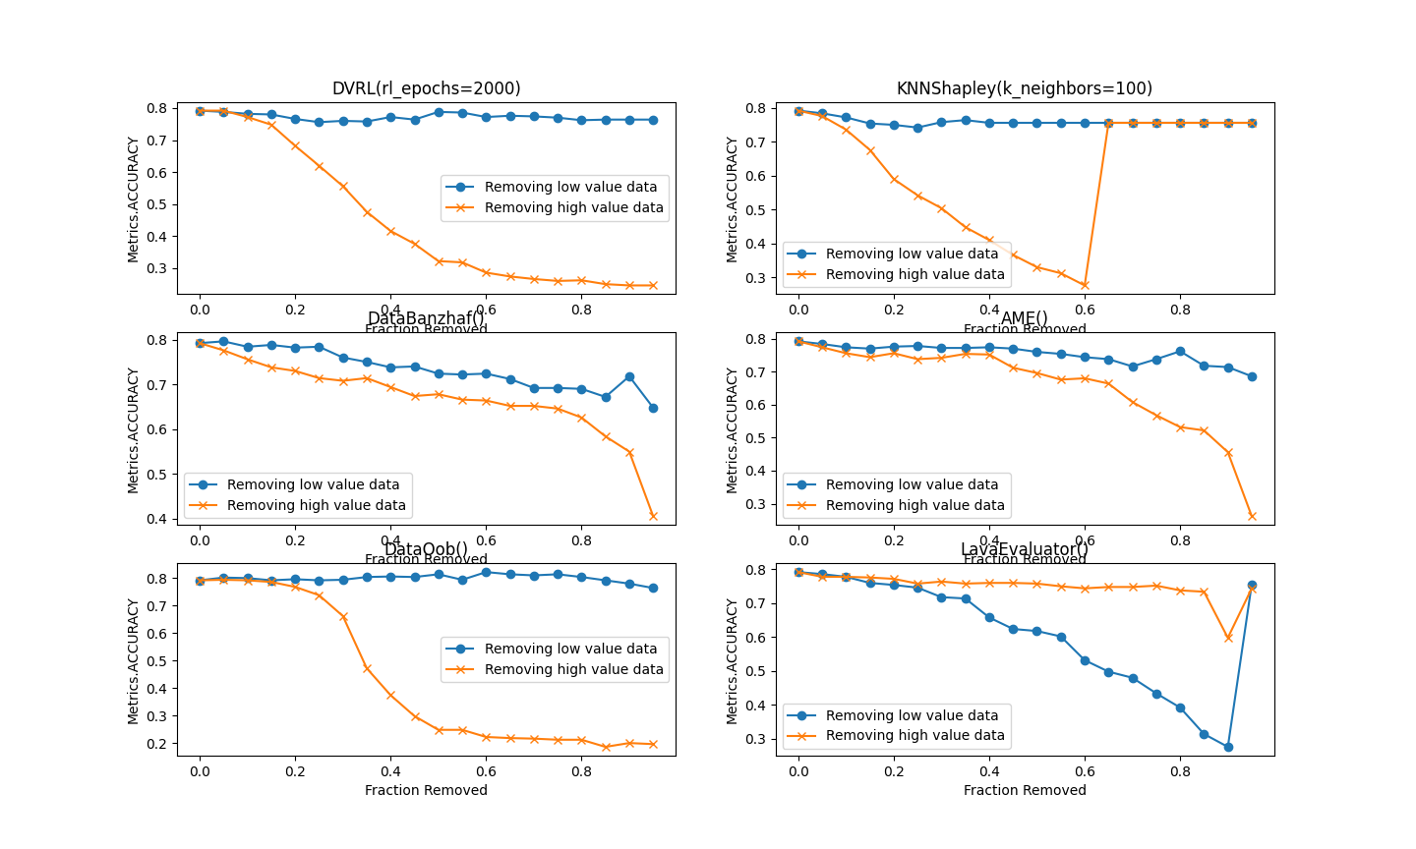
Results Cont..

Slide 21
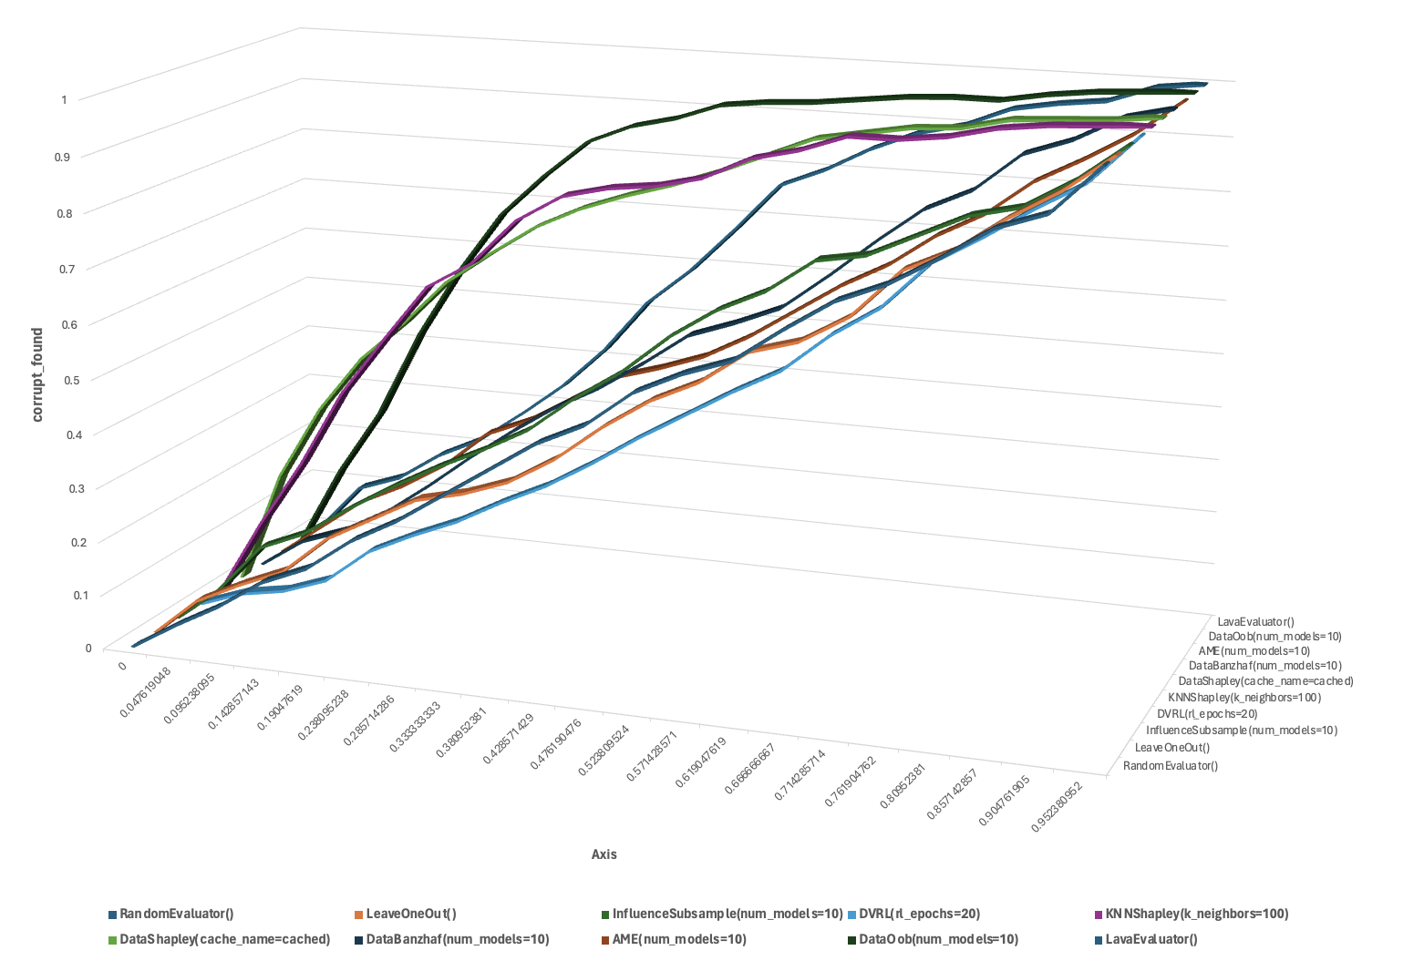
Results Cont..
The graph illustrates how the F1-score of various algorithms changes with different levels of noise. Notably, only the "DataOob" algorithm consistently maintained a high F1-score across all noise levels, indicating its robustness in handling noisy data compared to the other algorithms tested. Further exploration into this performance gap could offer valuable insights for algorithm selection and its effectiveness in noisy data scenarios.

Slide 22
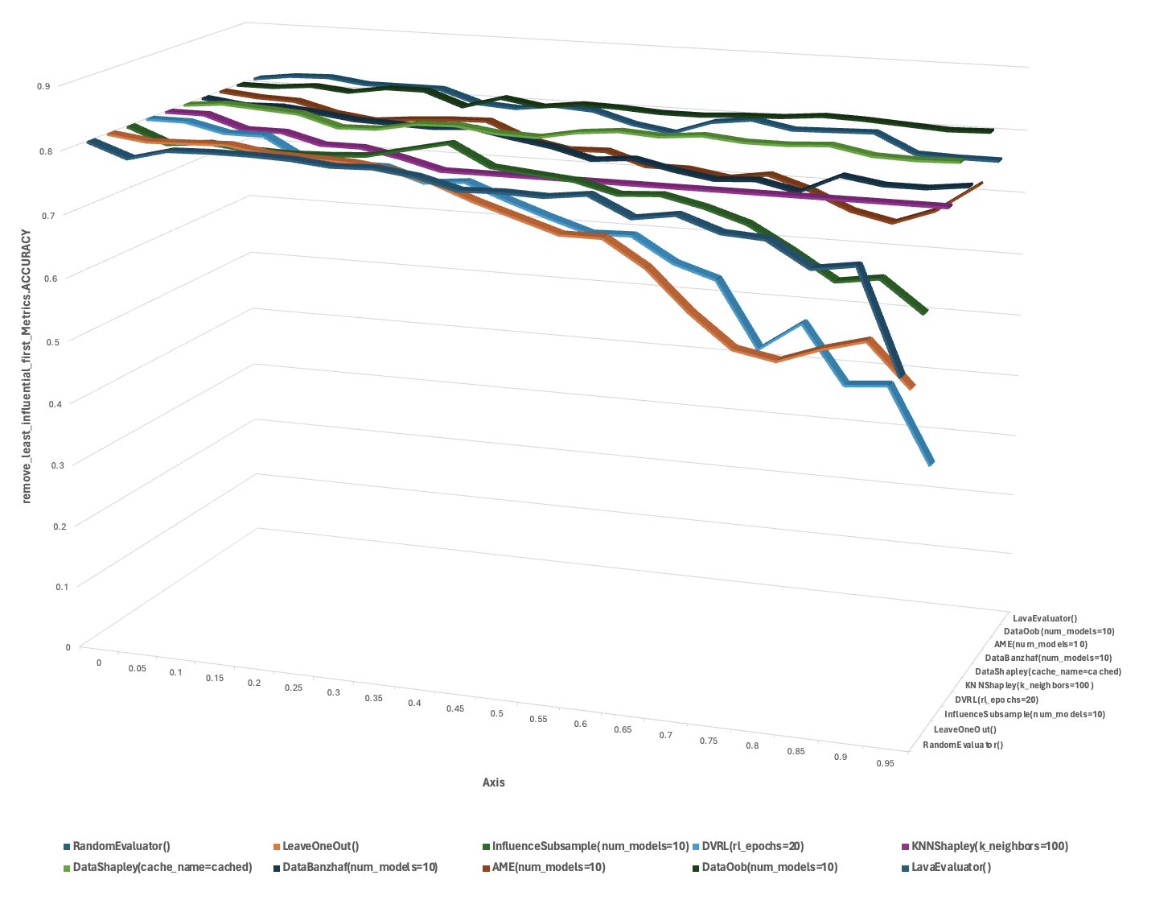
Results Cont..
The graph depicts how the accuracy of different algorithms changes with varying levels of friction removal. While most algorithms performed adequately under these conditions, "DVRL" and "LeaveOneOut" stood out for their consistent high accuracy, indicating their robustness and suitability for our application. Further exploration into the factors driving their superior performance could offer valuable insights for algorithm selection and system optimization.

Slide 23
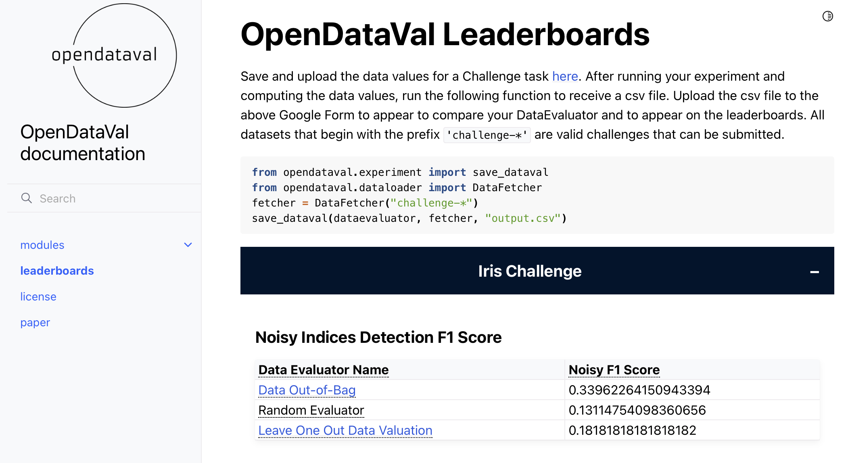
Challenges

Slide 24
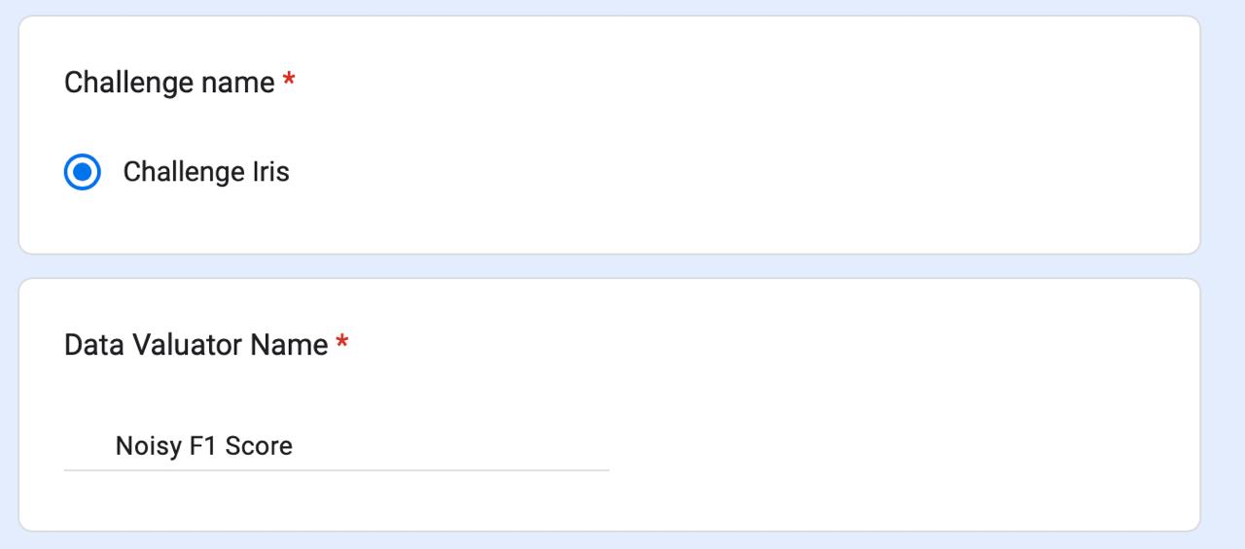
Challenge Accepted

Slide 25
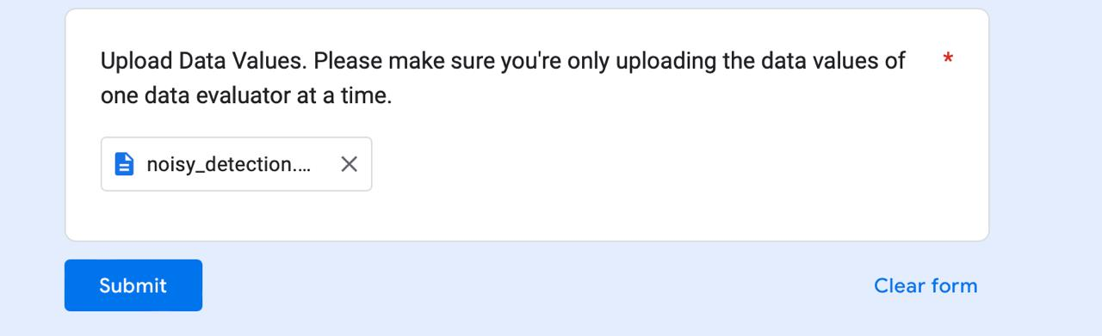

Slide 26
Conclusion
OpenDataVal is a user-friendly tool that lets researchers and practitioners easily apply and compare different data valuation methods using just a few lines of Python code.
It offers a wide range of datasets and eleven state-of-the-art valuation algorithms, along with tasks like noisy label data detection, noisy feature data detection, point removal experiment, and point addition experiment. Our analysis shows that no single algorithm is best for every task, so users should pick the one that suits their needs.

Slide 27
References
Joao Gama, Pedro Medas, Gladys Castillo, and Pedro Rodrigues. Learning with drift detection.In Advances in Artificial Intelligence–SBIA 2004: 17th Brazilian Symposium on Artificial Intelligence, Sao Luis, Maranhao, Brazil, September 29-Ocotber 1, 2004. Proceedings 17, pages 286–295. Springer, 2004.
P Roe Byron, Yang Hai-Jun, Zhu Ji, Liu Yong, Stancu Ion, and McGregor Gordon. Boosted decision trees, an alternative to artificial neural networks. Nucl. Instrum. Meth. A, 543:577–584, 2005
Laurent Candillier and Vincent Lemaire. Design and analysis of the nomao challenge active learning in the real-world. In Proceedings of the ALRA: active learning in real-world applications, workshop ECML-PKDD, pages 1–15. Citeseer, 2012.
Derek Greene and Pádraig Cunningham. Practical solutions to the problem of diagonal dominance in kernel document clustering. In Proceedings of the 23rd international conference on Machine learning, pages 377–384, 2006.
Andrew Maas, Raymond E Daly, Peter T Pham, Dan Huang, Andrew Y Ng, and Christopher Potts. Learning word vectors for sentiment analysis. In Proceedings of the 49th annual meeting of the association for computational linguistics: Human language technologies, pages 142–150, 2011.
Alex Krizhevsky et al. Learning multiple layers of features from tiny images. 2009.
Joaquin Vanschoren, Jan N. van Rijn, Bernd Bischl, and Luis Torgo. Openml: networked science in machine learning. SIGKDD Explorations, 15(2):49–60, 2013. doi: 10.1145/2641190. 2641198. URL http://doi.acm.org/10.1145/2641190.264119.

Slide 28

THANK YOU

