Slide 1
Lead Scoring Case Study
By
Anusha
Shilpa Patil.
Somasundar

Slide 2
PROBLEM STATEMENT
X Education is an organization which provides online courses for industry professional. The company marks its courses on several popular websites like google.
X Education wants to select most promising leads that can be converted to paying customers.
Although the company generates a lot of leads only a few are converted into paying customers, wherein the company wants a higher lead conversion. Leads come through numerous modes like email, advertisements on websites, google searches etc.
The company has had 30% conversion rate through the whole process of turning leads into customers by approaching those leads which are to be found having interest in taking the course. The implementation process of lead generating attributes are not efficient in helping conversions.

Slide 3
GOALS OF THE CASE STUDY
The company requires a model to be built for selecting most promising leads.
Lead score to be given to each leads such that it indicates how promising the lead could be. The higher the lead score the more promising the lead to get converted, the lower it is the lesser the chances of conversion.
The model to be built in lead conversion rate around 80% or more.

Slide 4
STRATERGY
﻿Import data.
Clean and prepare the acquired data for further analysis
Exploratory data analysis for figuring out most helpful attributes for conversion
Scaling features
Prepare the data for model building
Build a logistic regression model
Assign a lead score for each leads
Test the model on train set
Evaluate model by different measures and metrics
Test the model on test set
Measure the accuracy of the model and other metrics for evaluation

Slide 5
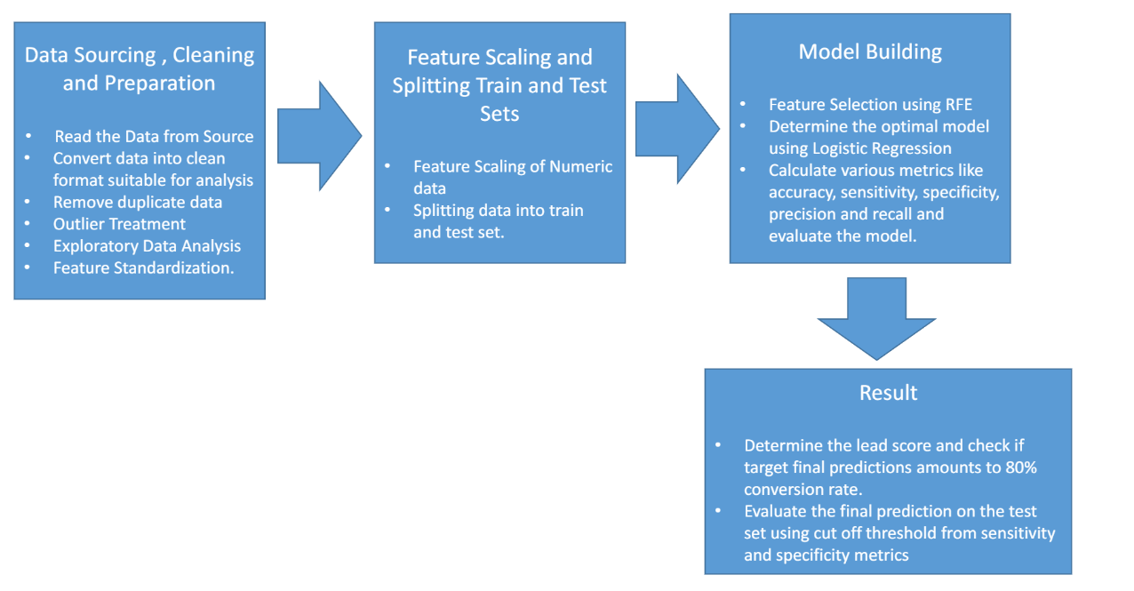
PROBLEM SOLVING METHODOLOGY

Slide 6
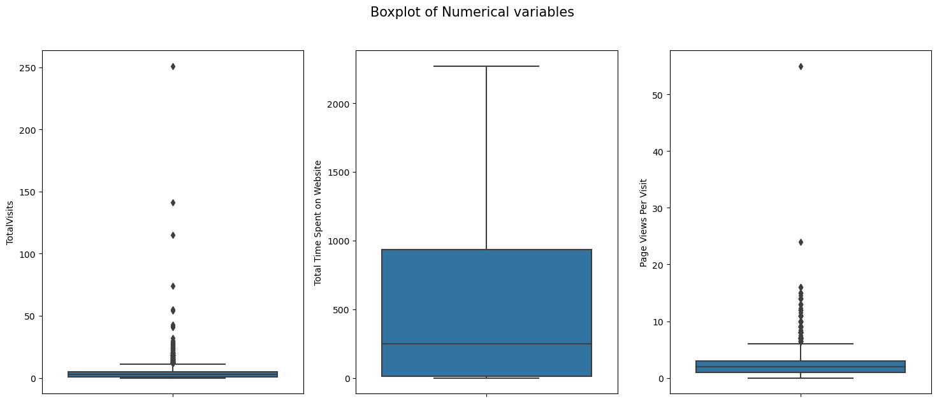
OITLIERS
Total visits , Total time spent on website and page views per page have outlier
TotalVisits and Page Views Per Visit has outliers
Total Time Spent on Website has min value at 0 and most of values lies below 1000
TotalVisits has most values lies between 1 and 5
Page Views Per Visit has most values lies below 5 and above upper whisker at around 8 are outliers

Slide 7
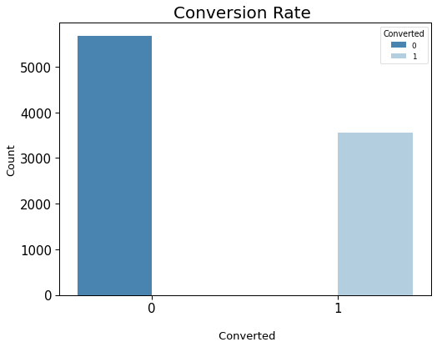
ANALYSIS OF TARGET VARIABLE

Slide 8
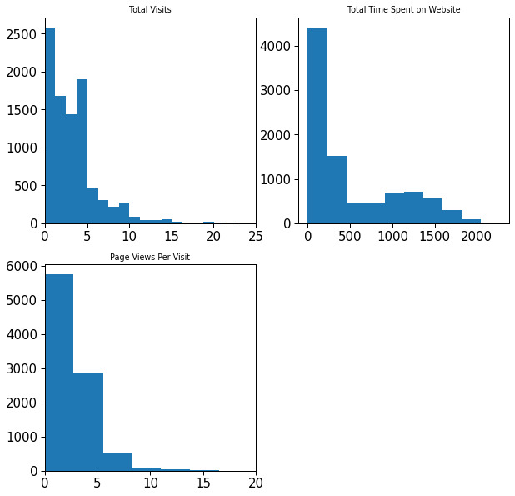
NUMERICAL COLUMNS

Slide 9
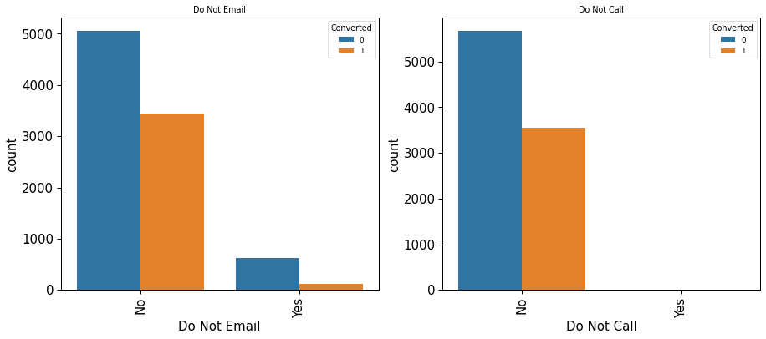
CATEGORICAL VARIABLES VS CONVERTED
Do not Call is imbalanced as almost all customers are in category 'No'. So this column cannot be used for further Analysis
Do not Email has more conversion rate for customers who responded 'No'

Slide 10
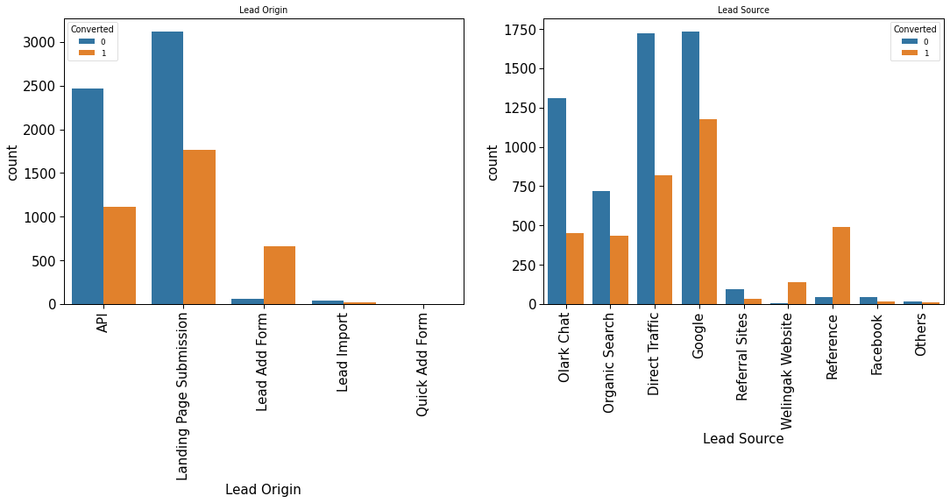
Conversion is mostly from Landing Page Submission and API. Lead Ad form has more converted leads than nonconverted
Google and Direct Traffic generated more leads and high in conversion also
Reference and welingak Website has high conversions

Slide 11
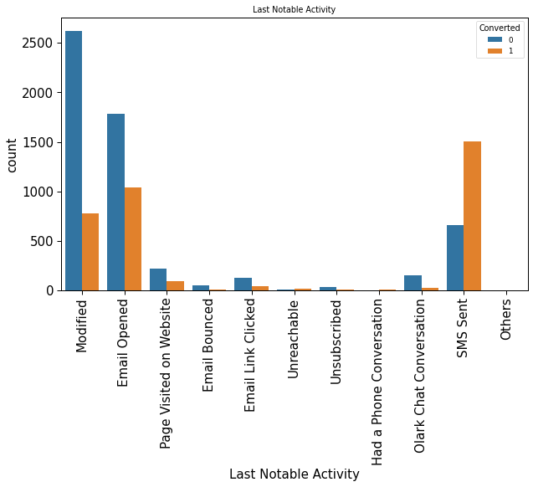
SMS sent followed by Email opened and Modified has high conversion rate than others.

Slide 12
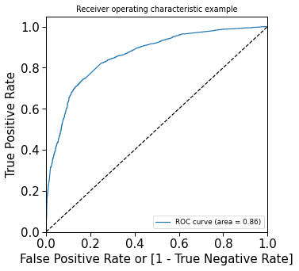
ROC CURVE
we got a ROC curve area of 0.86 which indicates a good model

Slide 13
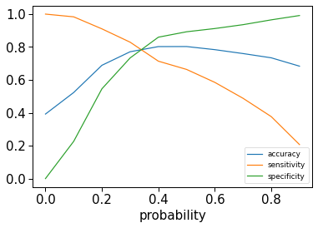
OPTIMAL CUTOFF POINT
From the curve above, 0.3 is the optimum point, we can take it as a cutoff probability.
Confusion matrix
[ [3498 421]
[852 1679]]

Slide 14
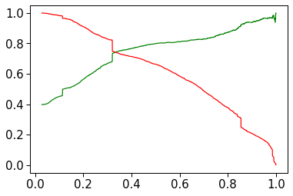
PRECISION AND RECALL

Slide 15
MODEL EVALUATION
The model appears to be working well with an ROC curve of area 0.86
We have following Metrics for Train dataset
Accuracy:77%
Sensitivity:83%
Specificity:73%
We have following Metrics for Test dataset
Accuracy:77.4%
Sensitivity:84.8%
Specificity:73.11%

Slide 16
CONCLUSION
The test set's values for accuracy, sensitivity, and specificity are around 77%, 84%, and 73.11% which are closer to the corresponding figures derived using the training set.
We should be able to give the CEO confidence in making wise decisions based on the model since it appears to predict the Conversion Rate quite accurately.
Important features that contribute most to the likelihood of a lead being converted or those that have a high conversion rate are:
What is your current occupation_Working Professional
Lead Origin_Lead Add Form
Lead Source_Welingak Website

