Slide 1

RESEARCH
PROJECT
GPU APPLICATION IN
OPTION TRADING
BY:
ABHISHEK L
ANVI GUPTA
20 MAY 2025

Slide 2




Option Trading
A FINANCIAL CONTRACT GIVING THE BUYER THE RIGHT (BUT NOT THE OBLIGATION) TO BUY OR SELL AN UNDERLYING ASSET AT A PREDETERMINED PRICE WITHIN A SPECIFIED TIME.
TYPES OF OPTIONS:
CALL OPTION: RIGHT TO BUY
PUT OPTION: RIGHT TO SELL
TERMINOLOGY
Strike Price: The fixed price at which the option can be exercised
In the Money (ITM): Profitable if exercised
Premium: Price paid to purchase the option
Out of the Money (OTM): Not profitable if exercised
Expiration Date: Last date the option can be exercised
At the Money (ATM): Strike = Market Price

Slide 3
MONTE CARLO SIMULATION
Monte Carlo simulation is a numerical method that uses random sampling to estimate complex mathematical problems — in this case, option pricing.
It’s especially useful for pricing European options where analytical formulas (like Black-Scholes) may be too restrictive or inapplicable (e.g., for path-dependent options)*.
Monte Carlo Option Pricing – Key Inputs (Concise)
Current Asset Price (S₀)
Strike Price (K)
Time to Expiration (T)
Risk-Free Rate (r)
Historical Volatility (σ)
Process (Brief):
Simulate random future prices using σ.
Compute option payoffs at expiration.
Discount average payoff to today’s value.
*A PATH-DEPENDENT OPTION IS ONE WHERE THE PAYOFF IS INFLUENCED BY THE SEQUENCE OF PRICES THE UNDERLYING ASSET FOLLOWS, RATHER THAN ONLY ITS FINAL PRICE.

Slide 4
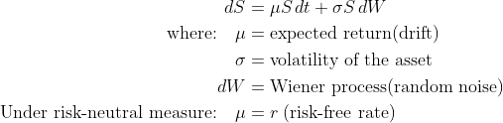
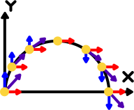
MONTE CARLO SIMULATION
We’ll estimate the value of a European Call Option, which gives the right to buy a stock at a strike price K on expiry date T.
Assumptions:
The stock price follows Geometric Brownian Motion:

Slide 5
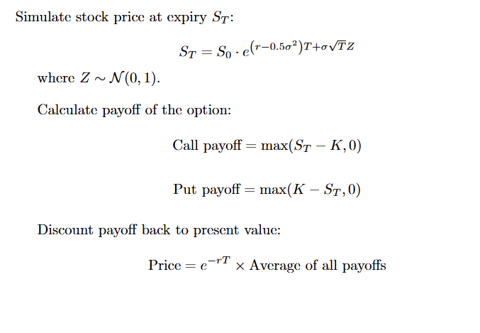
MONTE CARLO SIMULATION

Slide 6
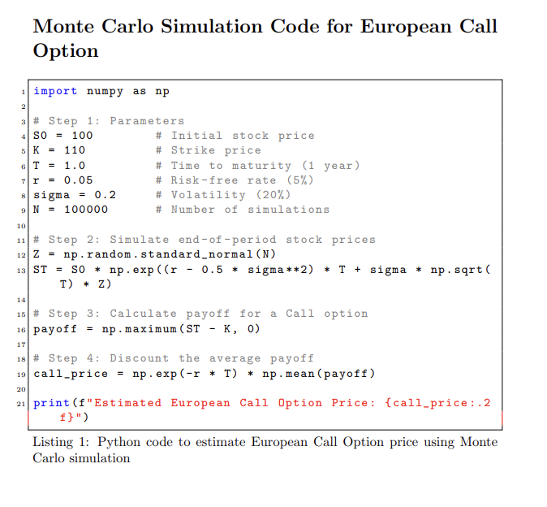
MONTE CARLO SIMULATION
Accuracy increases with higher N (simulations).
Works well for non-linear or path-dependent options.
Can also simulate multiple steps to price Asian options, barrier options, etc.

Slide 7
RESEARCH REVIEW
ACCELERATING MONTE CARLO OPTION PRICING USING GPU ON LAMBDA.AI CLOUD
We saw monte carlo simulation earlier. What we realised is, Monte Carlo simulations, while effective, are computationally intensive, often requires millions of iterations for accuracy. Leveraging GPU acceleration via platforms like Lambda.ai Cloud can significantly reduce computation time.
Goal: Evaluate the effectiveness of GPU acceleration for pricing a European Call Option using Monte Carlo simulation.
Context: Quantitative finance faces escalating computational demands, especially in derivative pricing and risk analysis.
Challenge: Monte Carlo simulations, while effective, are computationally intensive, often requiring millions of iterations for accuracy.
Solution: Leveraging GPU acceleration via platforms like Lambda.ai Cloud can significantly reduce computation time.
Approach: Compare performance between standard CPU implementation and GPU-accelerated version using Numba with CUDA backend.

Slide 8

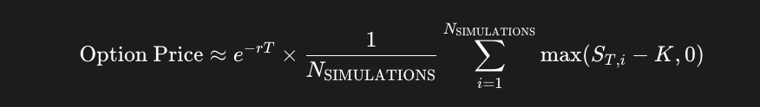
The Monte Carlo simulation method involves simulating random paths for the underlying asset's price over time and averaging the discounted payoffs of the option at maturity.
Stock Price Simulation: The stock price is modelled using Geometric Brownian Motion (GBM), a standard assumption in financial modelling. The price at the next time step (St+Δt) is calculated based on the current price (St), risk-free rate (r), volatility (σ), time step size (Δt), and a random variable (Z) drawn from a standard normal distribution
The payoffs from all simulated paths (N_SIMULATIONS) are averaged, and this average payoff is then discounted back to the present value using the risk-free rate (r) to obtain the estimated option price

Slide 9
CPU COMPUTATION
Standard Python with NumPy
Sequential processing of simulations
GPU COMPUTATION
Utilizes Numba's CUDA backend.
Parallel processing with each GPU thread handling an independent simulation path
PARAMETERS:
The simulation was conducted using the following parameters
Start Price (S0): 100.0
.Strike Price (K): 100.0
Risk-free Interest Rate (r): 0.02
Volatility (σ): 0.20
Time to Maturity (T): 1.0 years
Number of Time Steps (N_STEPS): 100
Number of Simulations (N_SIMULATIONS): 1,000,000
The large number of simulations (1,000,000) was chosen to ensure convergence of the Monte Carlo estimate and, critically, to provide a sufficient workload to utilize the GPU's parallel capabilities effectively.

Slide 10
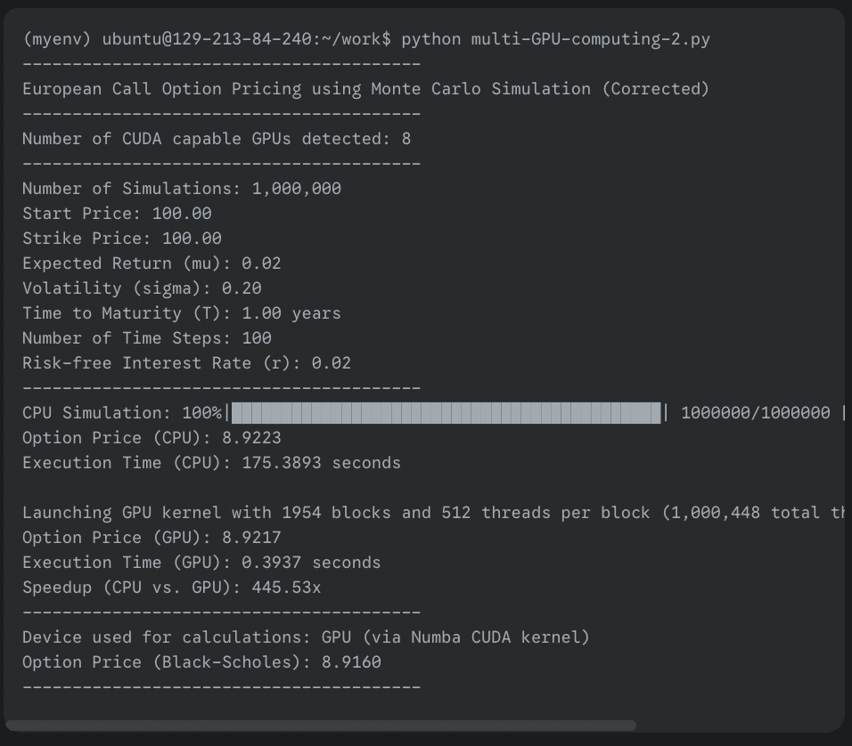
OUTPUT
The accuracy and reliability of the Monte Carlo results were validated against the Black-Scholes formula, a widely accepted model for option pricing in the financial industry. This comparison serves as a crucial validation of the Monte Carlo simulation's accuracy and reliability in pricing European Call Options, reassuring
Execution time was measured for both the CPU and GPU implementations using Python's time module. The speedup was calculated as the ratio of CPU time to GPU time.

Slide 11
RESULTS:
When tasked with running 1 million simulation paths, the CPU implementation required approximately 175 seconds to complete.
the GPU-accelerated implementation completed the identical 1 million simulations in a mere 0.3937 seconds. This corresponds to an impressive speedup factor of over 445 times compared to the CPU execution
High parallelism of GPUs makes them ideal for large-scale simulations.
Enables timely analysis and decision-making in financial contexts.
The calculated option prices from both implementations are in close agreement, as is the Black-Scholes price, validating the accuracy and convergence with 1 million simulations. This validation provides a strong reassurance about the accuracy of the simulations and the effectiveness of GPU utilization, overcoming previous issues with insufficient workload.

Slide 12



RESEARCH PAPER REVIEW
EFFICIENT MONTE CARLO-BASED OPTIONS PRICING ON GRAPHICS PROCESSORS AND ITS OPTIMIZATIONS
We saw how Monte Carlo simulations are good to be used in GPU. This paper discusses about what are the challenges in utilizing GPU and how to optimaize accordingly.
Challenges in GPU Implementation of Monte Carlo Simulations
Challenge 1: Memory Usage and Bank Conflicts
More price paths → Higher accuracy
But: Higher memory usage
When shared memory exceeds → global memory → slower access
Optimization: Compress the working set to minimize global memory use
Shared memory divided into banks (16 threads per half-warp)
If numSteps is multiple of 16 → massive bank conflicts
Optimization: Prime-interval layout to prevent shared bank access overlap

Slide 13
RESEARCH PAPER REVIEW
Challenge 2: Global Memory Coalescing Issues
CUDA prefers grouped memory requests
In MC simulation: threads access independent path data
Global memory accesses can’t be coalesced
Optimization: Reorganize layout to encourage neighboring thread access
Challenge 3: Low Multiprocessor Occupancy
Defined as: active warps / max supported warps
Higher occupancy → better overlap of compute & memory
MC-based solution uses many registers per thread-> Only ~50% occupancy
Optimization:
Reduce register usage to 20–30%
Minimize local memory spills

Slide 14
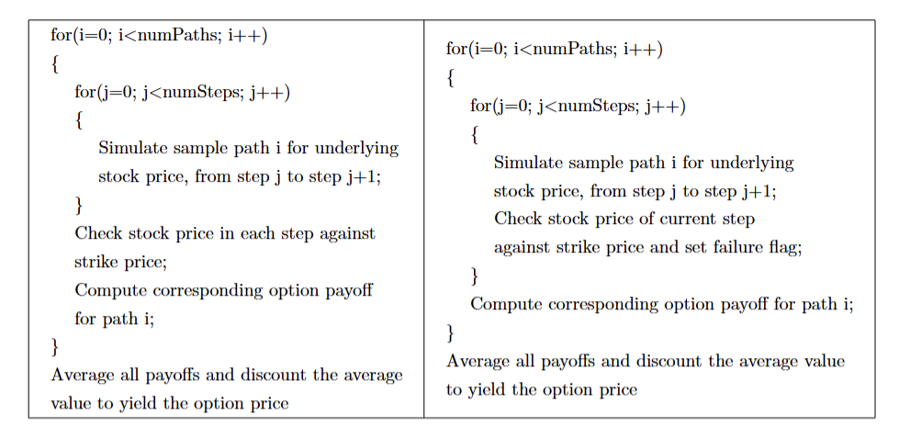
RESEARCH PAPER REVIEW
OPTIMIZATION METHODS
Working Set Compression
Optimization:
Move strike price check to simulation phase.
Only store two elements per path using alternating indices: (j % 2) and (j+1 % 2).
Mark invalid paths early; reduces memory needs.

Slide 15
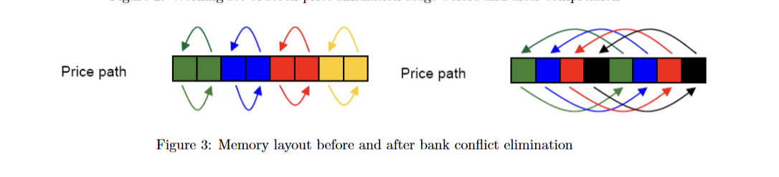
RESEARCH PAPER REVIEW
OPTIMIZATION METHODS
Bank Conflict Elimination
Optimization:
Apply "crossing path" memory layout:
Store first elements of all paths contiguously.
Follow with all second elements, and so on.

Slide 16
RESEARCH PAPER REVIEW
OPTIMIZATION METHODS
Global Memory Coalescence
In slice mode, each thread processes all paths for one step before moving to the next.
This means we need to store 2 values per path, using more memory than path mode.
When shared memory is full, we switch to global memory, which is slower.
To improve speed, we use the same “crossing path” layout as in shared memory.
This layout helps:
Avoid memory access conflicts
Access global memory efficiently (coalesced access)

Slide 17
RESEARCH PAPER REVIEW
OPTIMIZATION METHODS
Multiprocessor Occupancy Maximization
Optimization:
Split kernel into smaller sub-kernels.
Lower register usage per kernel.
Store intermediate results in global memory between kernels.
Trade-off:
Increased global memory usage, but:
Higher occupancy.
Less local memory access.
This found significant results and helped in speed up of processes.

Slide 18
Uses of monte carlo simulation in Portfolio Management
Monte Carlo simulation is widely used in portfolio management to assess potential investment outcomes under uncertainty. It generates thousands of possible future scenarios by simulating random variables like asset returns, inflation, and interest rates. This allows financial analysts to estimate the probability of achieving a target portfolio value, helping investors understand the risks and variability associated with different investment strategies.
To estimate these probabilities, the analyst runs thousands of simulations—each representing a different combination of market behavior and client decisions. For every scenario, the analyst computes the final portfolio value and checks if it meets or exceeds the financial goal. By comparing the number of successful outcomes to the total simulations, the analyst calculates the probability of success. This approach offers a comprehensive and dynamic view of future financial possibilities, helping clients and advisors make better-informed investment and spending decisions.
Let's consider an example of a young working couple. They have a retirement objective of spending $170,000 per year (approx. $14,000/month) and leaving a $1 million estate to their children
An analyst runs a simulation and finds that their savings-per-period is insufficient to build the desired portfolio value at retirement; however, it is achievable if the allocation to small cap stock is doubled (up to 50% to 70% from 25% to 35%), which will increase their risk considerably
.The analyst delays their retirement by two years and decreases their monthly spend post-retirement to $12,500. The resulting distribution shows that the desired portfolio value is achievable by increasing allocation to small-cap stock by only 8%.

Slide 19
Market risk management
VaR is a statistical measure that calculates the maximum potential loss a portfolio could experience over a given time period at a certain level of confidence. So, a VaR of 95% suggests that there is a 95% chance that the portfolio would not lose more than the calculated amount over the given time period.
Monte Carlo simulation uses computational models to simulate projected returns over hundreds or thousands of possible iterations. Then, it estimates the chances that a loss will occur to compute the VaR—say, what the maximum loss would be 5% of the tim
The variance-covariance method, also called the parametric method, does not look backward but instead assumes that gains and losses are normally distributed. Potential losses are framed in terms of the number of standard deviations from the mean.
The historical method for computing VaR looks at one’s prior returns history and orders them from worst losses to greatest gains—following from the premise that past returns experience will inform future outcomes

Slide 20

Monte Carlo Simulation – Key Points
Fetches historical stock prices using Yahoo Finance.
Calculates daily log returns to assess stock performance.
Generates 10,000 random portfolios with different asset weightings
Computes for each portfolio:
1.Expected annual return
2.Expected volatility (risk)
3.Sharpe Ratio (return per unit of risk)
4.Identifies optimal portfolio with the highest Sharpe Ratio
5.Visualizes results in a scatter plot (risk vs. return)
Helps make informed, risk-adjusted investment decisions
HTTPS://COLAB.RESEARCH.GOOGLE.COM/DRIVE/141PHRQP-J9OXENBT7UP78MXUNJZLO6M5?AUTHUSER=1#SCROLLTO=C5HYQS6IZ_YK
HTTPS://COLAB.RESEARCH.GOOGLE.COM/DRIVE/141PHRQP-J9OXENBT7UP78MXUNJZLO6M5?AUTHUSER=1#SCROLLTO=C5HYQS6IZ_YK

Slide 21
THANK
YOU

