Slide 1
IBM Z DATATHON 2026 · TEAM CHINESE CAN FLY
Real-Time Transfer Scam Guard
Stopping scam-driven transfers inside the bank's authorisation path —
before the money leaves.
Track: Real-Time AI for Critical Decisions · Core principle: data analysed immediately → AI influences decisions while it matters
APPROVE
CONFIRM
BLOCK
release
pause + alert the family
hold + audit record
Runs on IBM LinuxONE (s390x) · Telum on-chip AI · pervasive encryption · container native

Slide 2
THE PROBLEM
Older people send the money themselves
Victim tricked
Transfer authorised
Funds cleared
Bank / family notice
›
›
›
phone scam, hours of pressure
valid PIN, valid device
irreversible
too late
The only effective intervention point is the few seconds BEFORE authorisation.
It looks normal to the bank
Existing systems target card fraud
The family is never involved
Valid credentials, valid device, correct PIN. Nothing in the payment itself is anomalous.
They detect misuse after the fact. They are not built for a customer being talked into paying right now.
The people who could actually stop it — the adult children — have no way in.
Real-Time Transfer Scam Guard · Chinese Can Fly
2 / 9

Slide 3
THE SOLUTION
Three outcomes, decided in the authorisation path
APPROVE
CONFIRM
BLOCK
Release immediately
Pause · message the holder · alert the family
Hold and record
Risk below 0.55.
No friction added to normal payments.
Risk 0.55–0.95.
The holder gets plain language.
If the amount exceeds the guardian limit,
a linked relative is alerted too.
Risk above 0.95.
Transfer held; an auditable record is written
with reason codes.
The part nobody else does
Every decision is auditable
CONFIRM is not just a block. It recruits the one person
who can actually stop the scam: the family.
Nine reason codes (R01–R09) travel with each decision,
so a case can be reviewed and the model audited later.
Real-Time Transfer Scam Guard · Chinese Can Fly
3 / 9

Slide 4
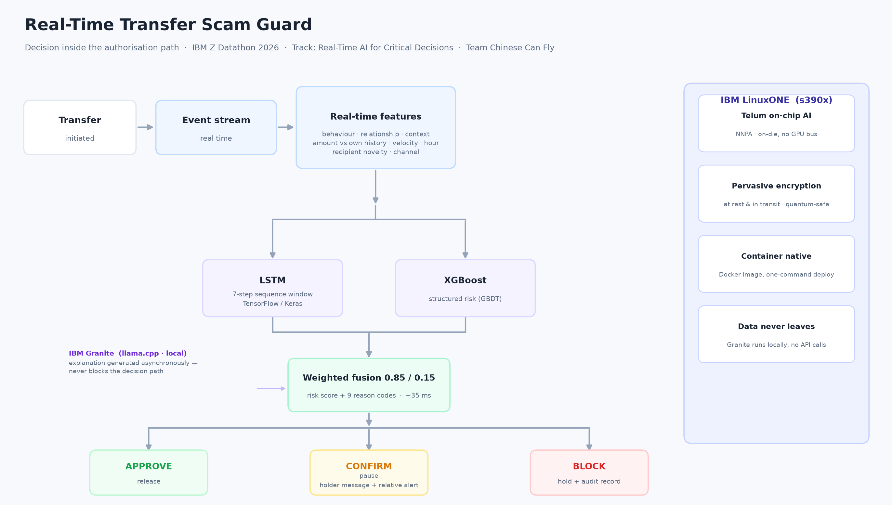
ARCHITECTURE
Two models, one decision, ~22 ms
Decision and explanation are decoupled: the decision returns in ~22 ms, while IBM Granite explains asynchronously.
Real-Time Transfer Scam Guard · Chinese Can Fly
4 / 9

Slide 5

THE CONSOLE
This is the screen, running on LinuxONE
Real-Time Transfer Scam Guard · Chinese Can Fly
5 / 9
Every row is a live decision. Right lane: the plain-language message the holder sees, and the alert the linked relative receives.

Slide 6
WHY IBM Z / LINUXONE
Not an x86 app ported over
Telum on-chip AI
Pervasive encryption
Both models and the Granite LLM run on the same processor.
The accelerator sits on-die, not behind a GPU bus — which is why
the decision stays fast even while the LLM generates.
Data encrypted at rest and in transit by the platform,
quantum-safe. Scam detection must read sensitive transfer
and identity context, so this is a prerequisite.
Data never leaves
Container native
Granite is served locally by llama.cpp with the zDNN/NNPA
backend. No external API calls. No customer data leaves the
enterprise perimeter.
Shipped as a Docker image built on IBM's s390x AI/ML base image.
One command to deploy; health-checked and restart-safe.
Real-Time Transfer Scam Guard · Chinese Can Fly
6 / 9

Slide 7
RESULTS
Measured on the LinuxONE instance
65.2 %
96.7 %
22 ms
$18,418
fraud recall
precision on stops
median decision
amount recovered
Offline model quality (held-out test, 0.11 % positives)
Why fusion
Model | PR-AUC | ROC-AUC | Best F1
LSTM only | 0.3829 | 0.9293 | 0.478
XGBoost only | 0.0765 | 0.9411 | 0.161
Fusion (0.85 / 0.15) | 0.4277 | 0.9654 | 0.506
Every single model leaves money on the table:
· XGBoost alone catches few frauds at usable precision
· LSTM alone misses structured signals such as amount
versus the account's own history
· The fusion beats both on PR-AUC and on F1, which is
exactly why two frameworks are used rather than one.
587 replayed transfers (single reproducible pass) · 3 vCPU + 1 AI accelerator · 587-transfer curated stream including 271 labelled frauds
Real-Time Transfer Scam Guard · Chinese Can Fly
7 / 9

Slide 8
WHO BENEFITS
Four audiences, in order of directness
1
Older adults targeted by scams
They act alone and often cannot stop themselves in time. The system pauses the transfer and
offers a plain way to say "I am not sure" instead of losing their savings.
2
Adult children living away
They cannot watch every transfer. They set a guardian limit and get an actionable alert,
turning distant worry into a decision they can make from their phone.
3
Banks and payment providers
Fewer scam losses and complaints, plus a defensible audit record for regulators. The engine
sits in the authorisation path, so it cuts loss without slowing genuine payments.
4
Anti-fraud teams and regulators
Every decision carries reason codes. Cases can be reviewed later and the model audited
over time — a requirement in most regulated markets.
Real-Time Transfer Scam Guard · Chinese Can Fly
8 / 9

Slide 9
SCOPE
What this prototype is — and is not
What it does
What it does not do (yet)
· Streams transfers and scores each one in ~22 ms
· No live bank core integration — the stream is historical replay
· Three-way decision with reason codes
· Guardian notification is simulated, not a real SMS gateway
· Plain-language message for the holder
· No production load testing at peak volume
· Guardian alert when the limit is exceeded
· Age and guardian fields are a synthetic scenario overlay
· Fully containerised, runs on LinuxONE
· onnxruntime has no s390x wheel, so ONNX is export-only
· Granite explanations generated locally, no API calls
Next 30 days: swap the replay for the bank's authorisation feed, connect a real notification provider, and run IEEE-CIS + PaySim as the production corpus with time-drift and fairness checks.
Real-Time Transfer Scam Guard · Chinese Can Fly
9 / 9

