Slide 1


PAIR-WISE COMPONENT COMPATIBILTY TESTING KCSE 2016
Anvika and Ilchul Yoon
Dated: 28.01.2016

Slide 2
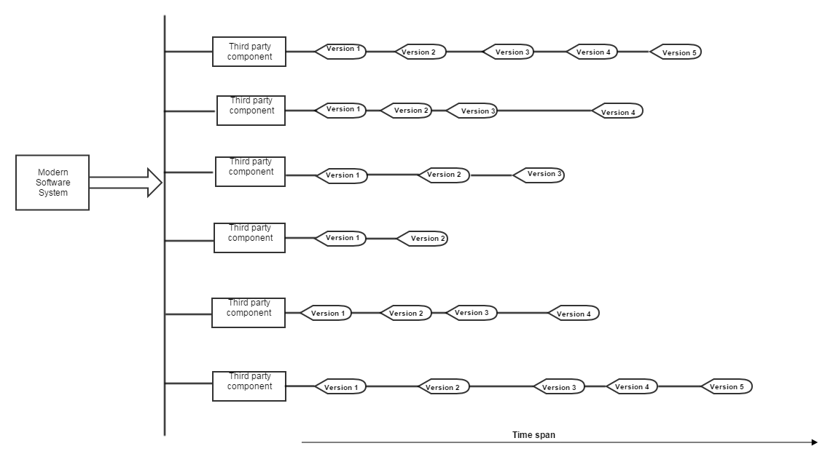
Modern Software Systems

Slide 3
Problems
Complex interdependencies
Varying temporal changes
Huge combination space
Heterogeneous build and execution environment
Infeasible to test all possible configurations

Slide 4
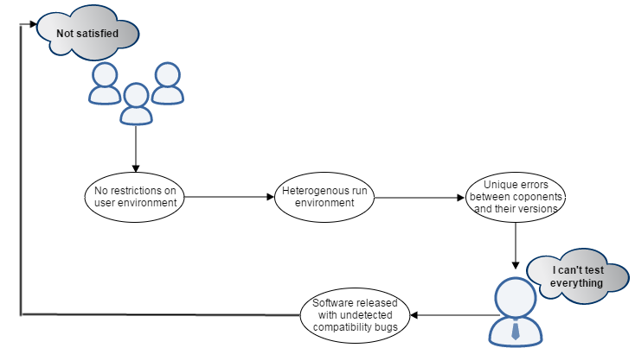
Scenario

Slide 5
Background
Previous Work
Modelling the entire configuration space of a multi-component software system
Testing direct inter-component dependencies
Issues
Compatibility bug between indirectly dependent components cannot be detected
Not enough to test the correct behavior of components at runtime

Slide 6
Objectives
Extend configuration sampling strategy to include indirect dependencies
Indirect dependencies affect the functionality of the system
Small number of sampled configurations
Assumption: Majority of compatibility bugs arise from a mismatch between two components.
Pair-wise test case generation strategy

Slide 7
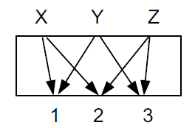
Pair-wise testing
Pairwise bugs represent the majority of combinatorial bugs
Selects a subset of test cases that covers all the possible combinations
Reduced number of test cases with improved coverage
http://4.bp.blogspot.com/_EKQsh4p7Qpo/TTmoq05c85I/AAAAAAAAACk/GrPzbvGMYOQ/s1600/input-output+diagram.png

Slide 8
Pair-wise Testing Strategies
IPO (In-Parameter-Order)
Lesser space and time complexity.
Deterministic in nature.
Comparable results to other methods.
Free to use.

Slide 9
In-Parameter-Order: Steps
Horizontal Growth
Vertical Growth

Slide 10
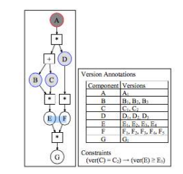
Horizontal Growth
Pair-wise test set between parameters A and B :
(A₁,B₁), (A₁,B₂) and (A₁,B₃)
Horizontal Growth
Add C
Test set after adding component C:
(A₁,B₁,C₁) and (A₁,B₂,C₂)
Uncovered pairs :
(B₁,C₂), (B₂,C₁) (B₃,C₁) and (B₃,C₂)

Slide 11
Vertical Growth
Vertical Growth
Cover test cases that are not covered by horizontal growth
Cover (B₁,C₁) by adding the configuration (_,B₁,C₁) and then setting a version for A, to give (A₁, B₁,C₁).
Generated configurations are:
(A₁, B₂,C₁), (A₁, B₃,C₁),
(A₁, B₃,C₂)
For the pairs(B₂,C₁) (B₃,C₁) and (B₃,C₂)

Slide 12
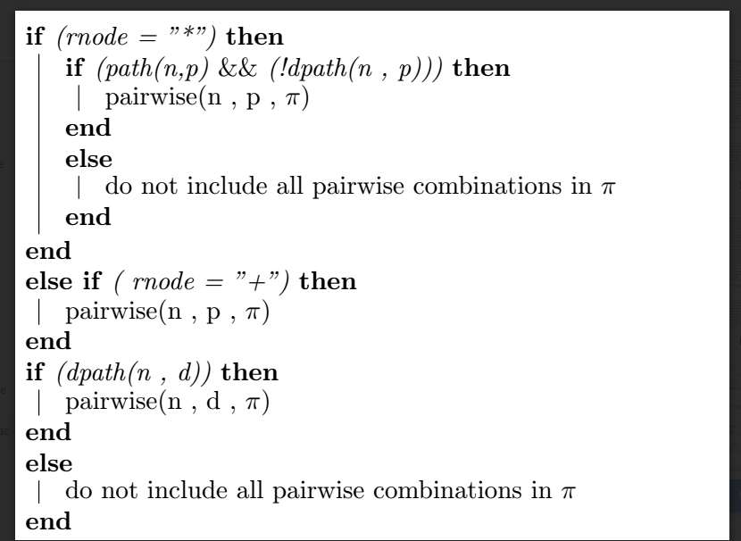
Configuration sampling Method

Slide 13

Horizontal and Vertical Growth

Slide 14
Conclusion
Initial approach to systematically generate configurations between components
Find a configuration that covers the maximum number of uncovered version pairs
Ensure build and functionality of components
Reduced number of generated test cases

Slide 15
Future Work
Further revision of the algorithm for it to scale real world environment
Evaluate its benefits with real-world software systems

Slide 16
PAIR-WISE COMPONENT COMPATIBILTY TESTING KCSE 2016
Anvika and Ilchul Yoon
Dated: 28.01.2016

