Slide 1
HANDLING TEXT DATA
#PROJECT 2

Slide 2
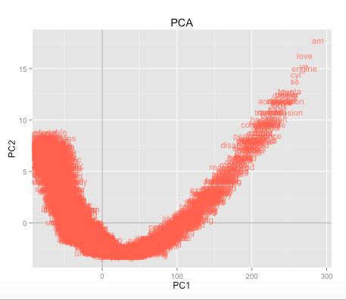
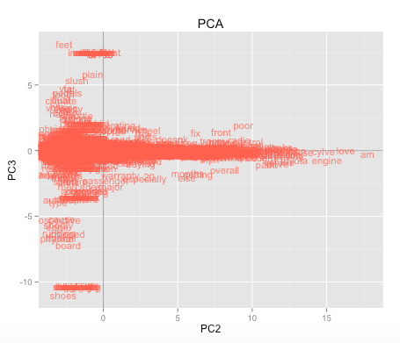
Principal Component Analysis

Slide 3
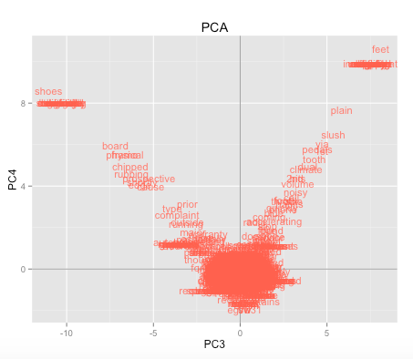
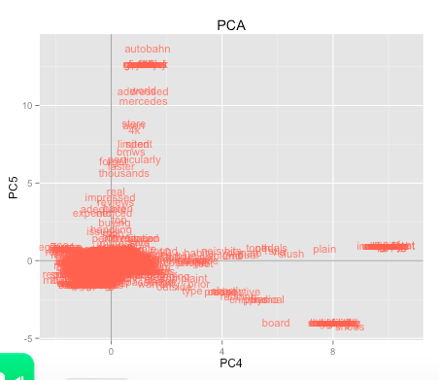

Slide 4
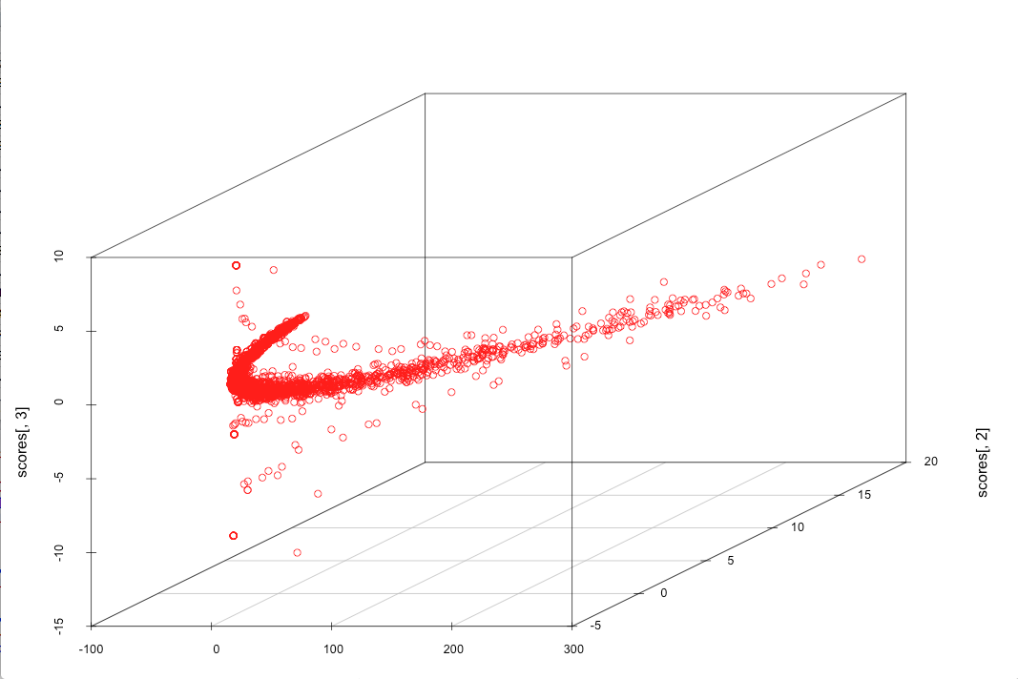
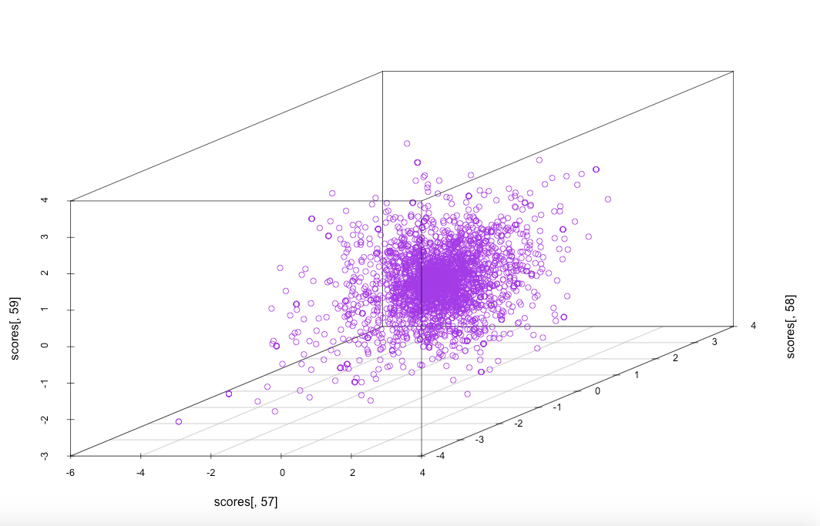
PCA in 3 dimensional space

Slide 5
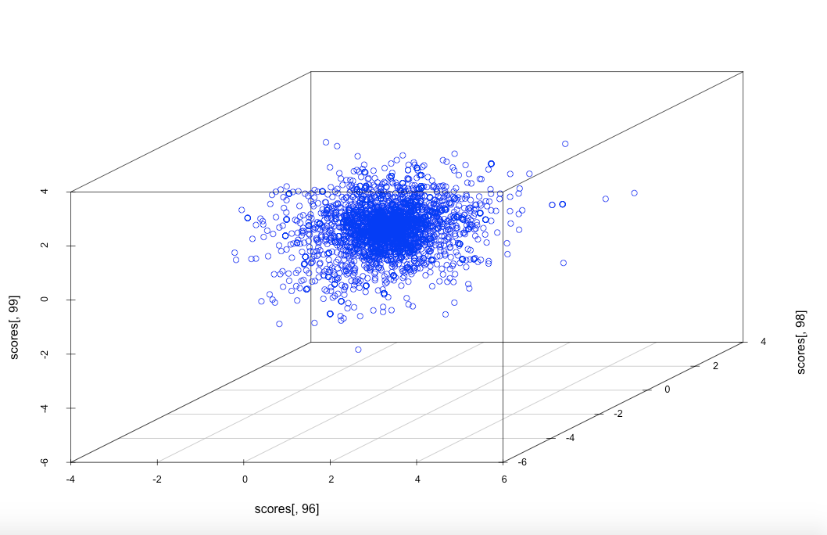

Slide 6
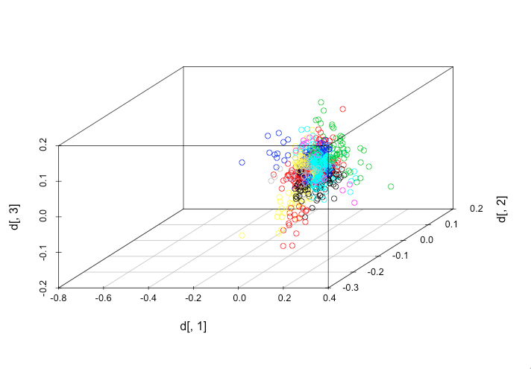
LSA on the document term matrix

Slide 7
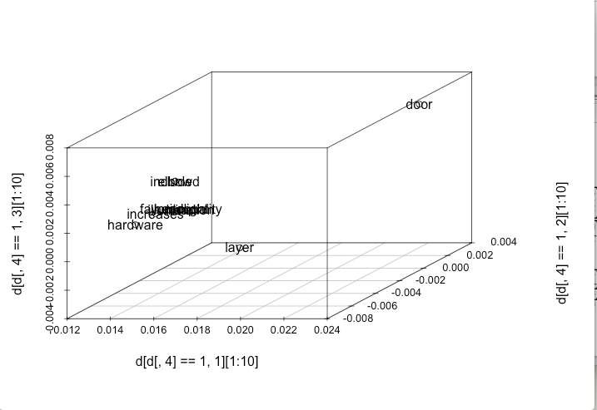
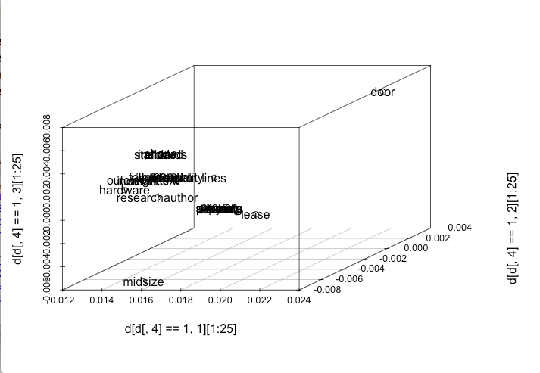

Slide 8
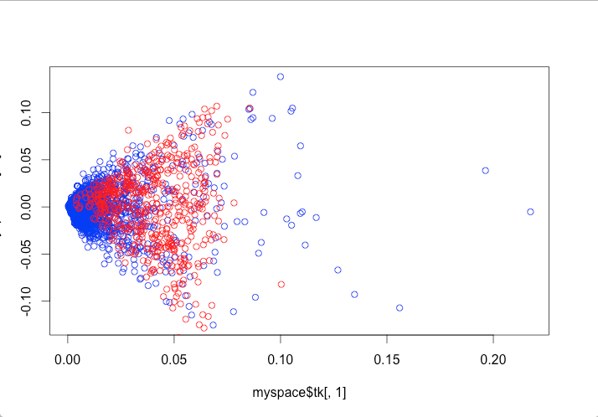
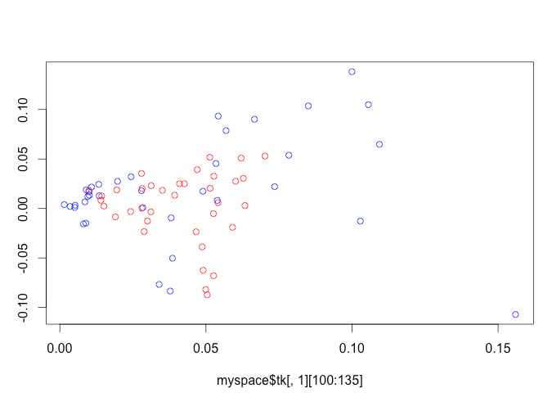
Plot of terms and documents in LSA

Slide 9
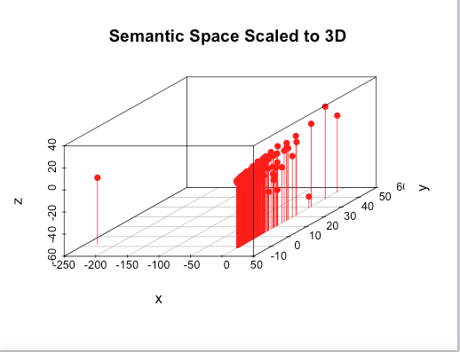
MDS(Multi-dimensional scaling)

Slide 10
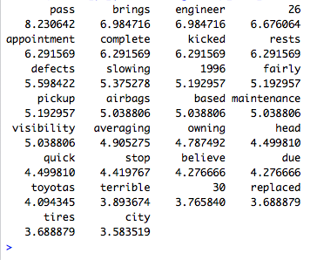
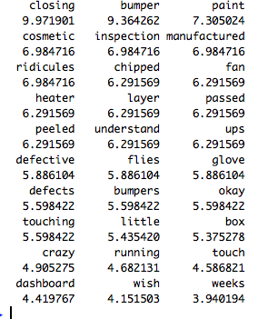
Weighted matrix
T2
T10

Slide 11
LDA on the matrix to get data clusters
F1 ride (0.3540853) free(0.3549965 ) excellent (0.3550521) trying(0.3551015) acceleration(0.3559409) steering( 0.3563100)
F2: owned (0.3973318) engine(0.3908838) driver(0.3876220) noise(0.3784019) smooth(0.3769933 ) looks (0.3762233) style(0.3618135)
F3: system (0.4870837) navigation(0.2721903) sound (0.2472952) camera (0.1664482)
These are the probabilities of terms occurring in clusters f1 , f2 and f3. SO these terms might indicate what the cluster is about. For example the cluster 3 is focused towards the different systems in the car like the sound system or navigation system.

Slide 12
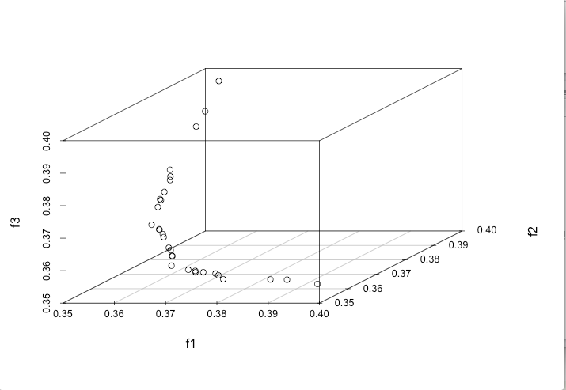
LDA

Slide 13
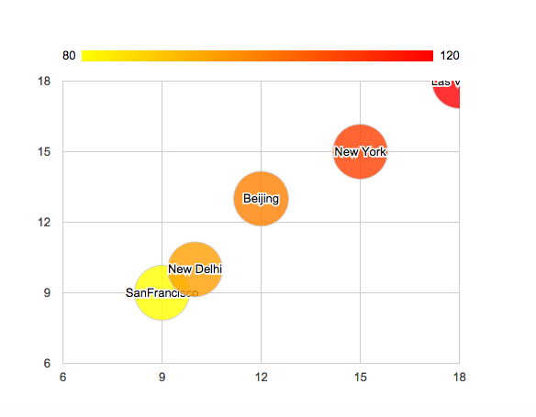
Text Mining on around 100 sets of hotel data to determine review was overall positive or negative
Color intensity shows represents degree of positivity

Slide 14
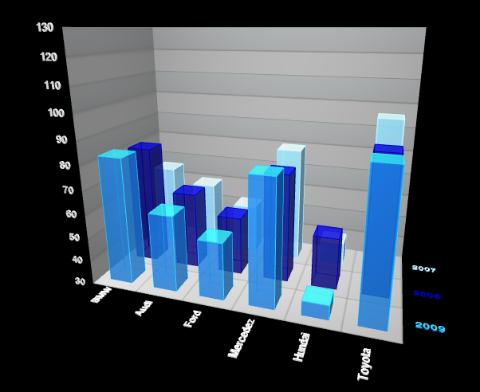
Popularity of cars over the years

Slide 15
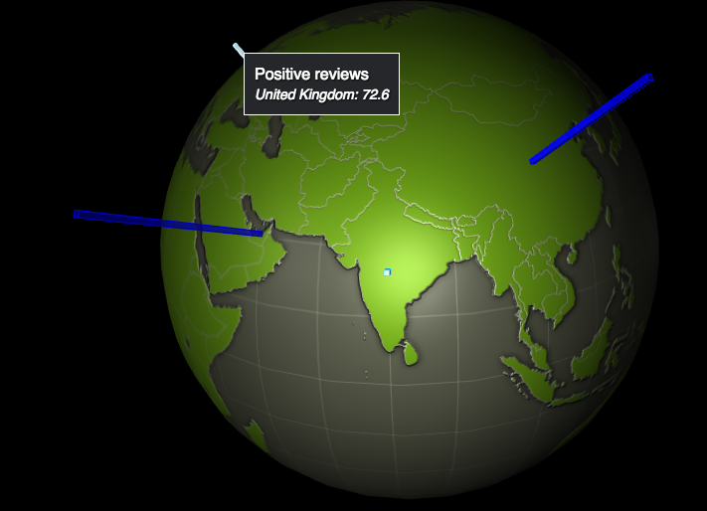
Positive and negative reviews of countries
Notes:
Get an opinionated dataset for training. I used Polarity Data 2.0, an open source dataset of movie reviews by Pang and Lee.

