Slide 1

Purpose & Structure
  Explore, within an active clinical setting, the application of genomic sequence data to the care of patients.
    Generation of genomic sequence data,
    Interpretation and translation of data for the physician
    Communication to the patient
  Three (3) Project Teams per Site
    Practice: clinical setting being studied and what medical outcomes measured
    Lab: sequencing and reporting of genome-scale results to clinicians/EMR
    ELSI: ethical and psychosocial implications of bringing broad genomic data into the clinic
Plon: Overview of CSER, Fall 2012

Slide 2
The Big Questions
  What are the best practices in moving whole genome sequencing, using Next Generation technologies, from medical science to the clinical practice?
  What are the patient characteristics that signal potential utility (or lack thereof) for applying genome-scale sequencing?
  What are the best approaches to analyzing data?
  Are there special considerations in different populations?
  How should relevant information be best represented in the EMR?
  What criteria are most useful in guiding which results should be returned (and how) to the patient and physician?
  How should we deal with the plethora of highly heterogeneous “non-target” data generated when performing sequencing?
Evans: Overview of CSER, Fall 2013 and NHGRI staff

Slide 3
Working Groups & Steering Committees | Leadership
CSER Steering Committee | Gail Jarvik
CSER Coordinating Center | Gail Jarvik | Lucia Hindorff
ELSI Steering Committee | Barbara Koenig | Gail Henderson
Actionable Variants & ROR | Wendy Chung
Electronic Medical Records | Brian Shirts
Genetic Counselors | Sarah Scollon | Julia Wynn
Informed Consent & Governance | Paul Appelbaum | Joon Ho-Yu
Pediatrics | Kyle Brothers | Ben Wilfond
Outcomes & Measures | Stacy Gray | David Veenstra
Sequencing Standards | Bradford Powell | Will Salerno
Practitioner Education | Sharon Plon | Kelly East
As of 01/05/2017

Slide 4
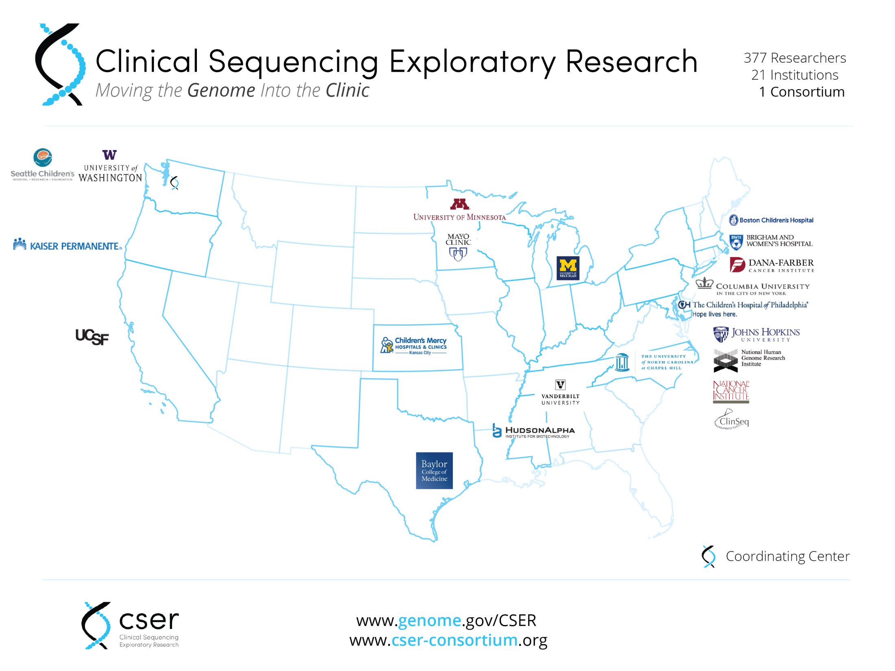
Notes:
Subcontracts not reflected on this map.

Slide 5


Full Logo
Mark
Logo Font: Sofia Pro Light
Website Font: Open Sans
Notes:
To save to your computer, right click on the logo or mark and select “Save as Picture”
Both fonts can be downloaded from free online:
Sofia Pro Light: http://www.fontsquirrel.com/fonts/sofia-pro
Open Sans: http://www.google.com/fonts/specimen/Open+Sans

Slide 6
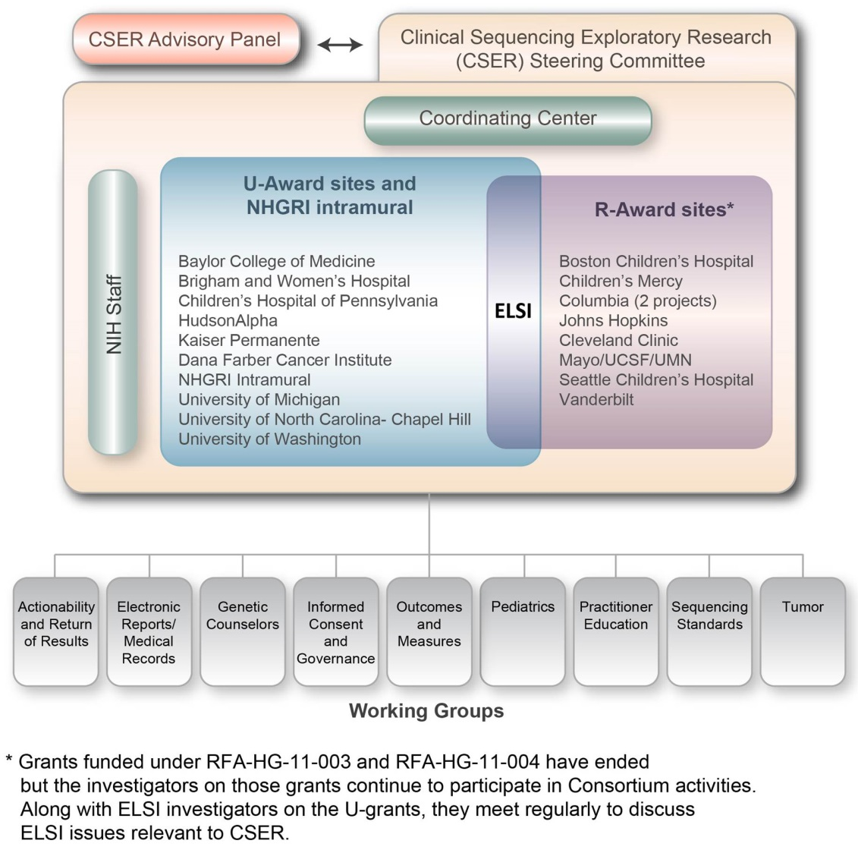
Notes:
To save to your computer, right click on the logo or mark and select “Save as Picture”

Slide 7
CSER Site (U-Award) | Patient Focus
Baylor College of Medicine | WES in tumor/germline childhood cancers
Brigham & Women’s Hospital | WGS in adults, healthy and w. cardiomyopathy
Children’s Hospital of Philadelphia | WES/WGS in children w. pediatric disease
Dana-Farber Cancer Institute | WES in tumor/germline in lung, colorectal cancers
HudsonAlpha Institute | WES in children with intellectual, developmental disability
Kaiser Permanente | WGS in preconception carrier screening
University of Michigan | WES in adults & children with advanced rare cancer
University of North Carolina | WES in adults & children with genetic disease
University of Washington | WES in adults with colorectal cancer
ClinSeq (NHGRI Intramural) | WGS in healthy adults and adults with heart disease
Evans: Overview of CSER, Fall 2013

Slide 8
CSER Site (U-Award) | PI(s)
Baylor College of Medicine | Sharon Plon & Will Parsons
Brigham & Women’s Hospital | Robert Green
Children’s Hospital of Philadelphia | Ian Krantz
Dana-Farber Cancer Institute | Pasi Janne & Eliezer van Allen
HudsonAlpha Institute | Greg Cooper
Kaiser Permanente | Katrina Goddard & Ben Wilfond
University of Michigan | Arul Chinnaiyan, Kenneth Pienta, Scott Roberts
University of North Carolina | Jim Evans, Jonathan Berg & Gail Henderson
University of Washington | Gail Jarvik
ClinSeq (NHGRI Intramural) | Leslie Biesecker
Coordinating Center (UW) | Gail Jarvik, Wylie Burke, Debbie Nickerson, & Peter Tarczy-Hornoch
Notes:
RFAs
---
http://grants.nih.gov/grants/guide/rfa-files/RFA-HG-10-017.html
http://grants.nih.gov/grants/guide/rfa-files/RFA-HG-12-008.html
http://grants.nih.gov/grants/guide/rfa-files/RFA-HG-12-009.html
GRANT NUMBERS
---
Baylor College of Medicine | Sharon Plon & Will Parsons
U01 HG006485
Brigham & Women’s Hospital | Robert Green
U01 HG006500
Children’s Hospital of Philadelphia | Ian Krantz & Nancy Spinner
U01 HG006546
Dana-Farber Cancer Institute | Pasi Janne & Eliezer van Allen
U01 HG006492
HudsonAlpha Institute | Greg Cooper
UM1 HG007301
Kaiser Permanente | Katrina Goddard & Ben Wilfond
UM1 HG007292
University of Michigan | Arul Chinnaiyan
UM1 HG006508
University of North Carolina | Jim Evans
U01 HG006487
University of Washington | Gail Jarvik
U01 HG006507
Coordinating Center (UW) | Gail Jarvik
U01 HG007307

Slide 9
CSER Site (R-Award) | PI(s)
Boston Children’s Hospital | Ingrid Holm
Columbia University | Paul Appelbaum
Columbia University | Wendy Chung
Children’s Mercy Hospital | Jeremy Garrett
Johns Hopkins University | Michelle Lewis
Mayo Clinic | Rich Sharp
Seattle Children’s Hospital | Holly Tabor
UC - San Francisco, Mayo College of Medicine, & University of Minnesota | Barbara Koenig, Gloria Peterson, & Susan Wolf
Vanderbilt University & McGill University | Ellen Clayton & Bartha Knoppers
Coordinating Center (UW) | Gail Jarvik, Wylie Burke, Debbie Nickerson, & Peter Tarczy-Hornoch
Notes:
RFAs
---
http://grants1.nih.gov/grants/guide/rfa-files/RFA-HG-11-003.html
http://grants1.nih.gov/grants/guide/rfa-files/RFA-HG-11-004.html
GRANT NUMBERS
---
Boston Children’s Hospital | Ingrid Holm
R01 HG006615
Columbia University | Paul Appelbaum
R21 HG006596
Columbia University | Wendy Chung
R01 HG006600
Children’s Mercy Hospital | Jeremy Garrett
R21 HG006613
Johns Hopkins University | Michelle Lewis
R21 HG006594
Mayo Clinic | Rich Sharp
R01 HG004500
Seattle Children’s Hospital | Holly Tabor
R01 HG006618
UC - San Francisco, Mayo College of Medicine, & University of Minnesota | Barbara Koenig, Gloria Peterson, & Susan Wolf
R01 CA154517
Vanderbilt University & McGill University | Ellen Clayton & Bartha Knoppers
R21 HG006612
Coordinating Center (UW) | Gail Jarvik
U01 HG007307

