Slide 1
Predicting Instagram Likes
Can a model guess how many likes a post will get, using its photo and a few basic details?
Interview Mini Project – Anvit Mirjurkar

Slide 2



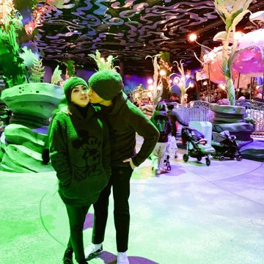
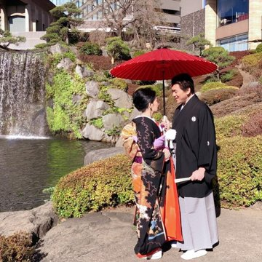
Dataset overview
3,785
2017–2020
0
124K
Instagram posts
time covered
missing or duplicate rows
typical (median) likes
Time-based split by date: the oldest 60% to train, the next 20% to tune and the newest 20% to test. This way the model only predicts posts that come after the ones it learned from.

Slide 3
Likes are heavy-tailed; followers explain little
Most posts get around 100K likes, but a few go viral and get millions
Log of likes is used to even out the spread
Followers alone say little about likes (correlation of only 0.15)
No rows dropped: values are all valid, and the log target tames outliers
Comments were left out, since they only appear after posting

Slide 4
Approach: five steps, selected on validation only
1
2
3
4
5
Clean and Split
Metadata (8)
CLIP ViT-B/32
Visual clusters
Models
Checks, then 60/20/20 split by time
Followers, hour, weekday, month and time
Frozen encoder, 512-d image embedding
KMeans (k=9) on CLIP vectors, one-hot
Linear, Ridge and Random Forest, compared with a simple guess
Main score: MAE in likes (also RMSE, RMSLE, R², Spearman).

Slide 5
Metadata: only a non-linear model beats the baseline
−20%
Random Forest vs baseline (100K vs 126K)
Straight-line models are no better than guessing the median
Random Forest finds patterns that lines miss, like the effect of posting time

Slide 6
CLIP helps most when compressed into visual clusters
Cluster | Posts | Median likes
0 | 343 | 102K
1 | 218 | 87K
2 | 129 | 57K
3 | 180 | 122K
4 | 228 | 199K
5 | 346 | 133K
6 | 260 | 137K
7 | 312 | 209K
8 | 255 | 164K
Using all 512 image numbers made things worse. Grouping them into 9 clusters worked the best.
Clusters from images alone span 57K to 209K median likes.

Slide 7
Final test: error cut by 46% vs the baseline
67.7K
Test MAE (baseline 124.6K)
0.656
R² (baseline −0.01)
Final models are refit on train + validation, then scored once on the test set.

Slide 8
Where it works, where it fails
Successful example: 8192.jpg
114,786
107,815
6,971
Predicted likes
Observed likes
Absolute error (6.5%)
Normal posts: off by about 34K to 50K likes
Very popular posts are underpredicted. One had 1.0M likes and we guessed 450K
Typical posts: within about 7K to 50K
Splitting likes into low, medium and high, it picks the right class 64.7% of the time

Slide 9
Conclusions, limits and next steps
Findings
Limitations
Next steps
Image clusters improved the predictions
Followers alone are not enough
Normal posts are predicted well
Only one date split and no cross-validation
Viral posts are missed here
Number of clusters (k=9) chosen on validation
Fine-tune CLIP or use a different vision transformer
Add captions, hashtags and account ids
Test on more and different time windows

