Slide 1
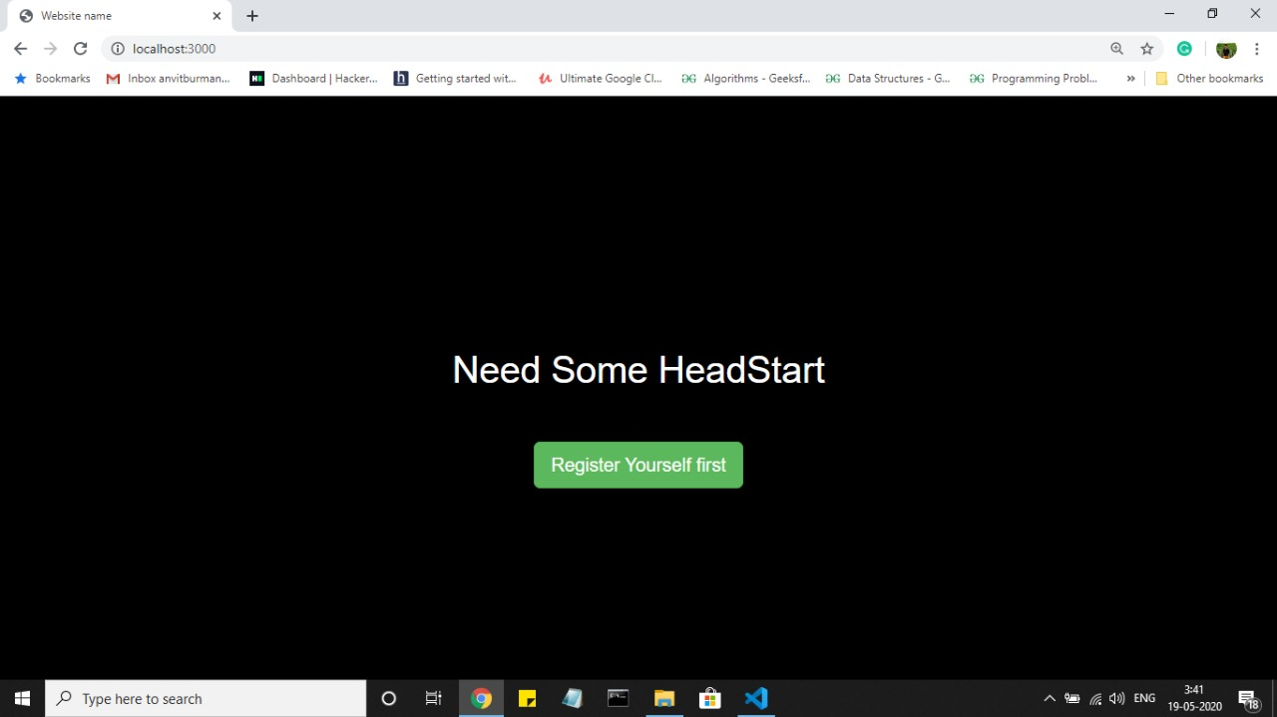
Entry page

Slide 2
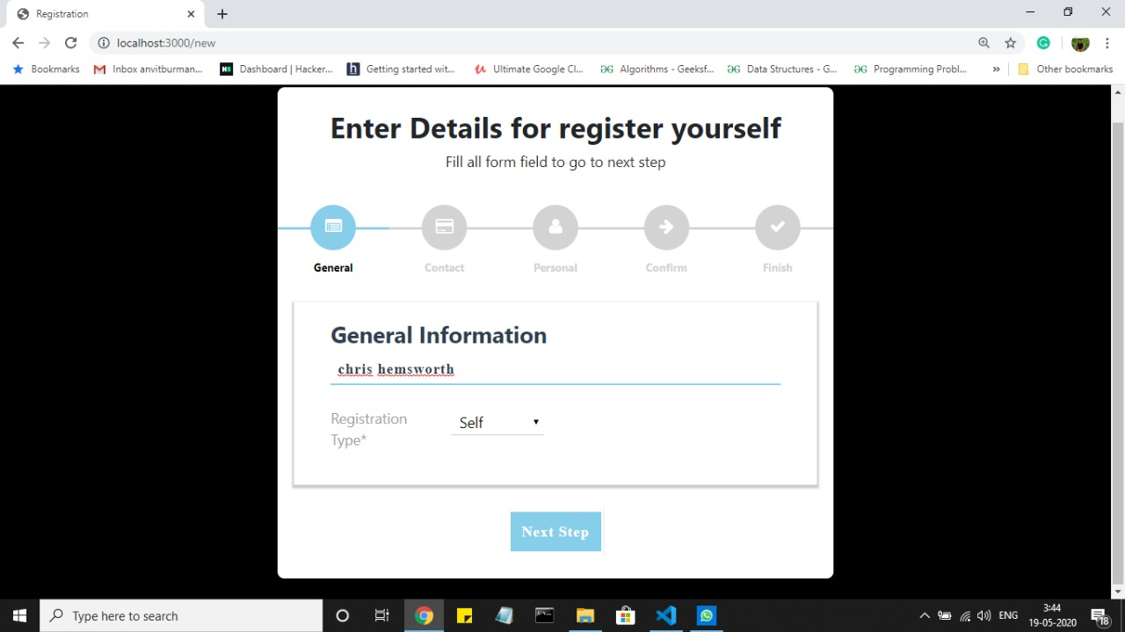
Notice Reg. type

Slide 3
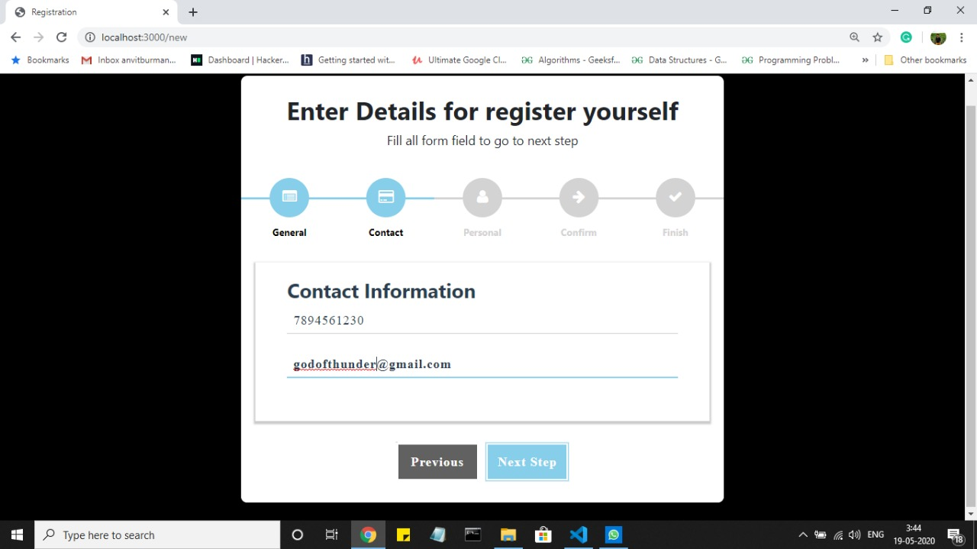

Slide 4
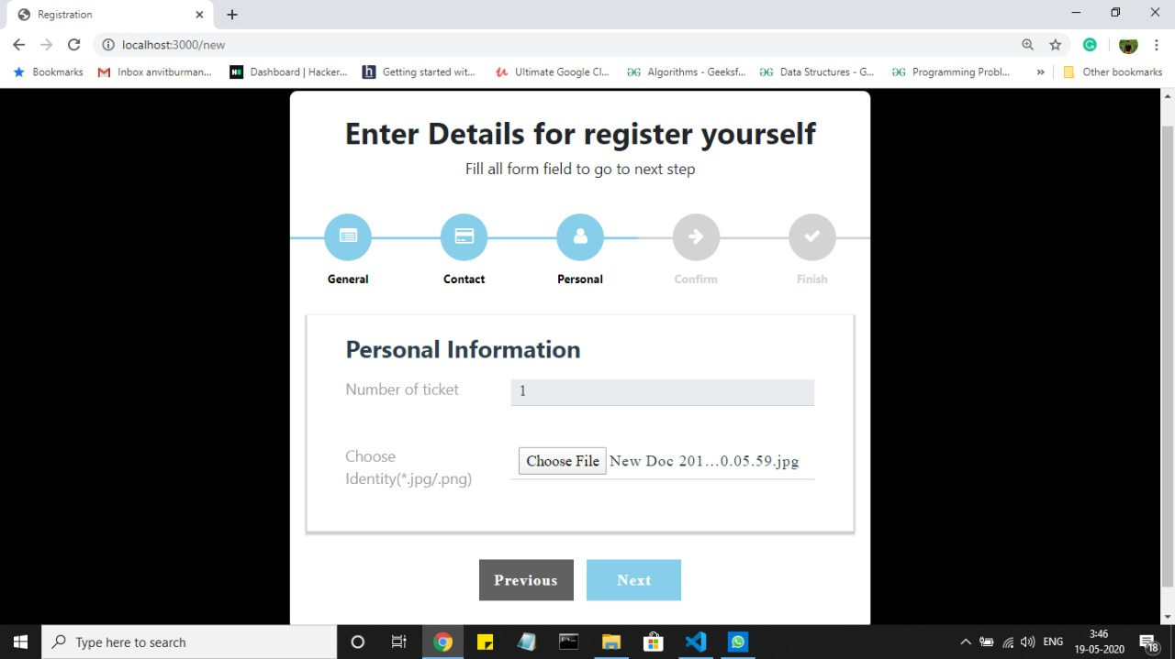
Since self auto filled to : 1

Slide 5
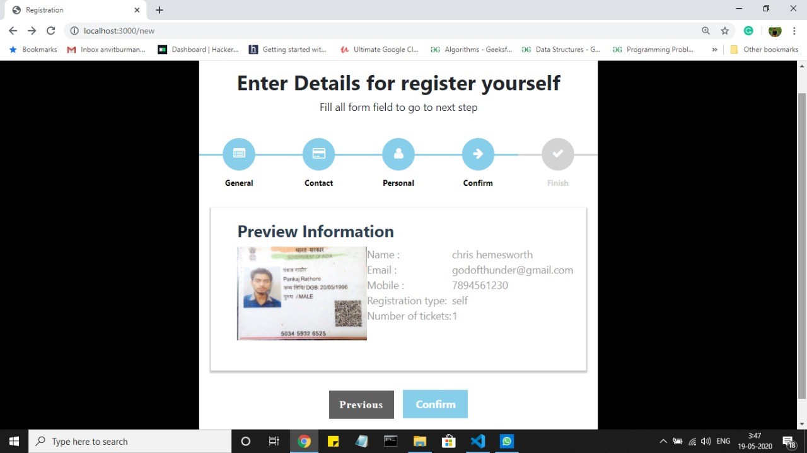
Well defined preview along with ID

Slide 6
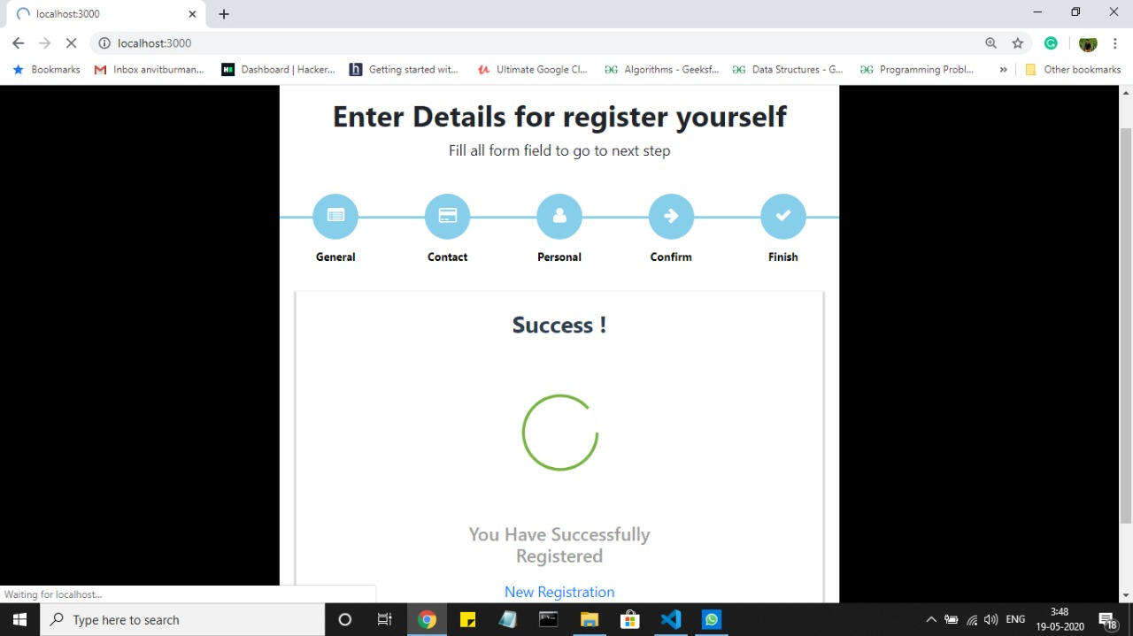
Generating Reg. ID

Slide 7
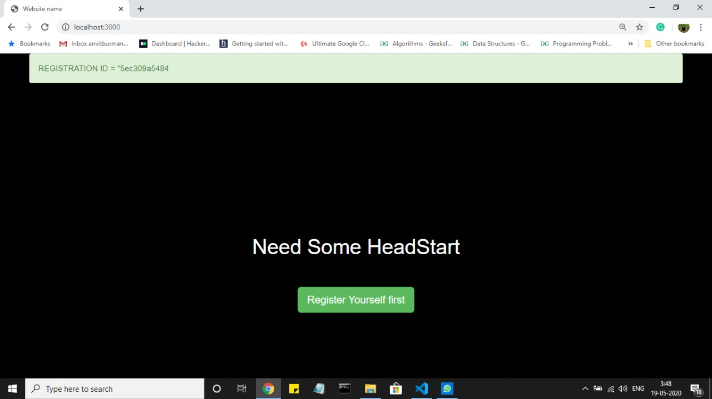
Reg. Id generated

Slide 8
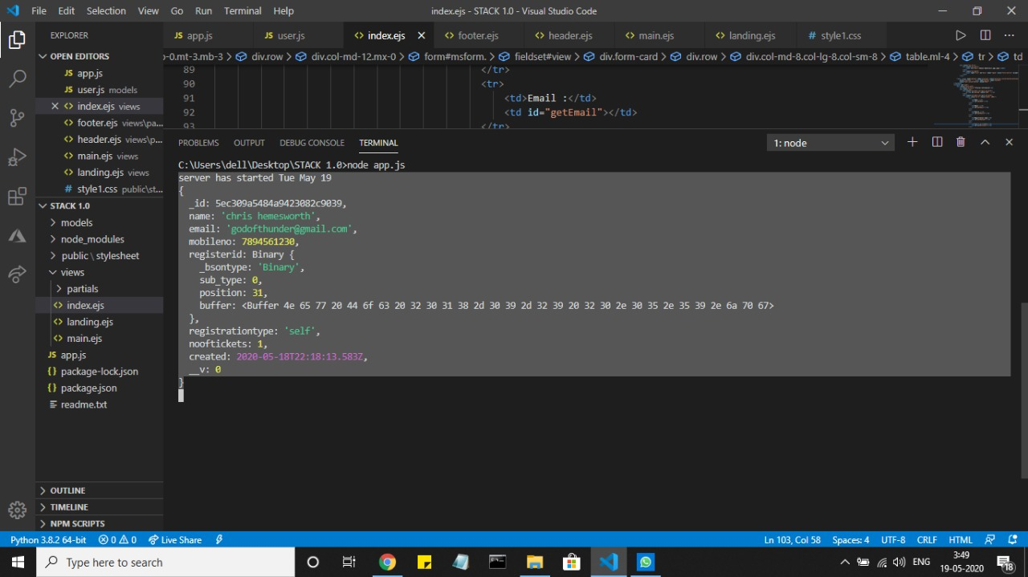
Info. Stored in DB
With date when it is created

