Slide 1
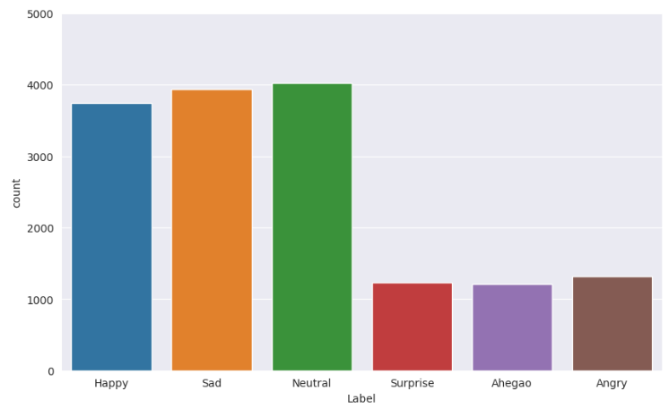

Slide 2
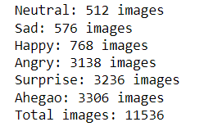
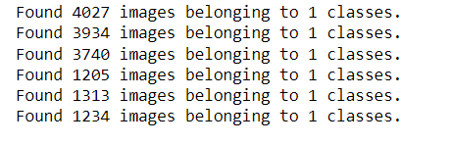
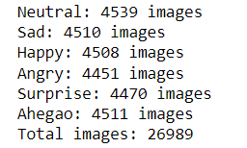

Slide 3

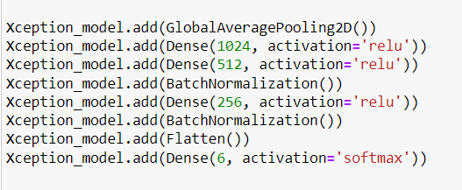
Write all the layers names, adam oprimizer and categorical crossentropy

Slide 4
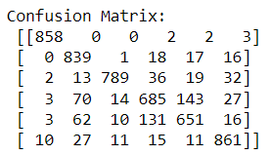
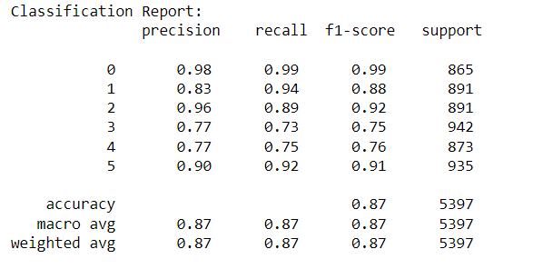
Efficient Net :
Training Accuracy: 0.9850372672080994
Validation Accuracy: 0.8677042722702026
Training Loss: 0.04497692361474037
Test Loss: 0.5824671387672424
Precision: 0.8677731957447891
Recall: 0.867704280155642
F1-score: 0.8667519127440374

Slide 5
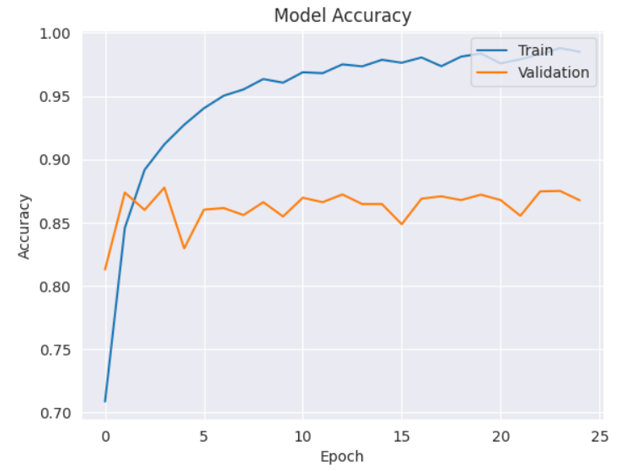
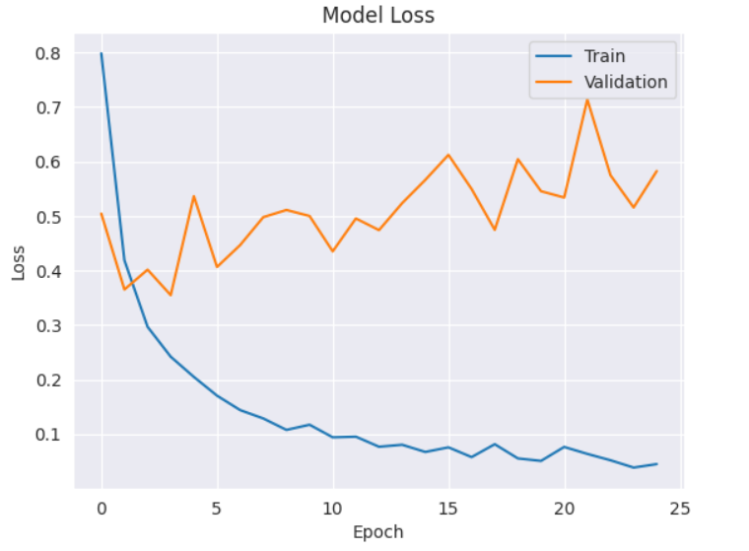
Efficient Net :

Slide 6
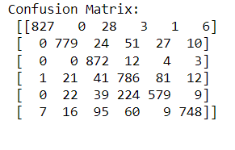
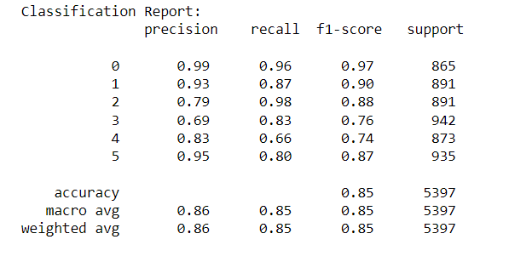
Xception Net :
Training Accuracy: 0.9869
Validation Accuracy: 0.8507
Training Loss: 0.0434
Test Loss: 0.6611
Precision: 0.8620
Recall: 0.8506
F1-score: 0.8508

Slide 7
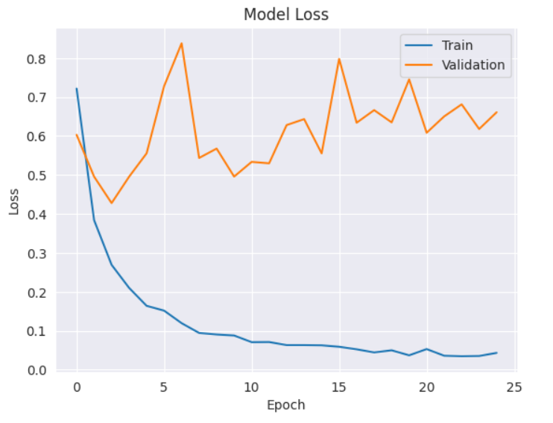
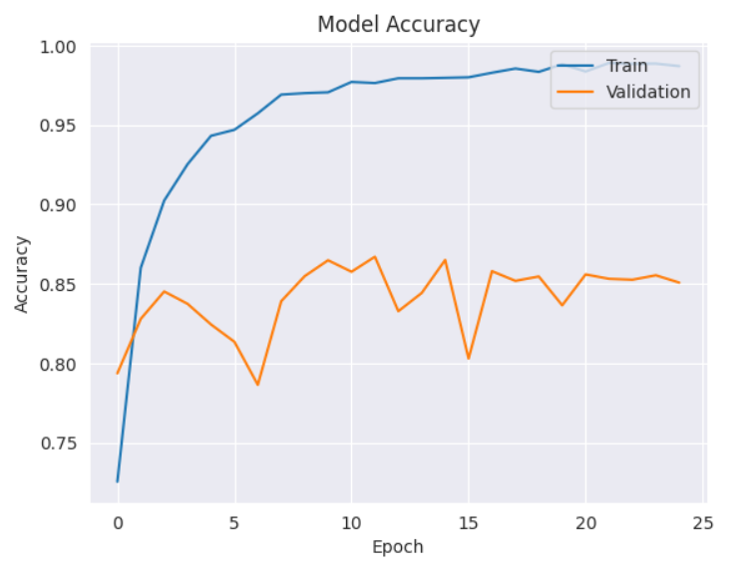
Xception Net :

Slide 8
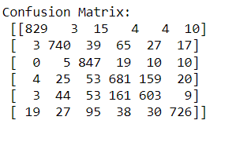
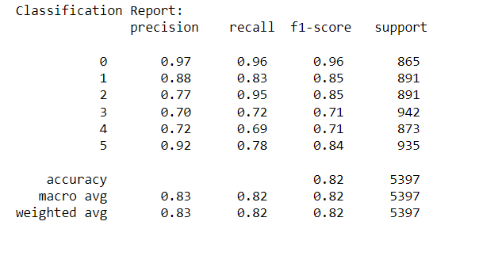
Mobile Net :
Training Accuracy: 0.9775791168212891
Validation Accuracy: 0.8200852274894714
Precision: 0.8251888810830302
Recall: 0.8200852325365944
F1-score: 0.8198489062497557

Slide 9
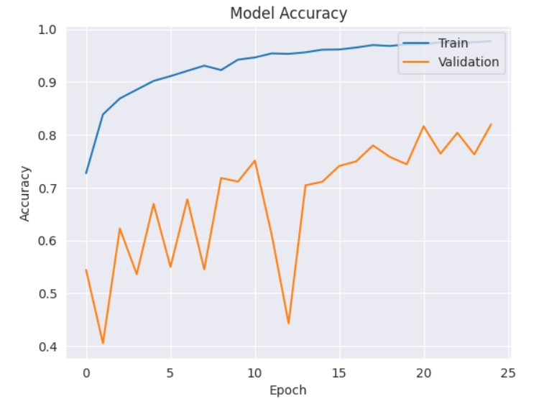
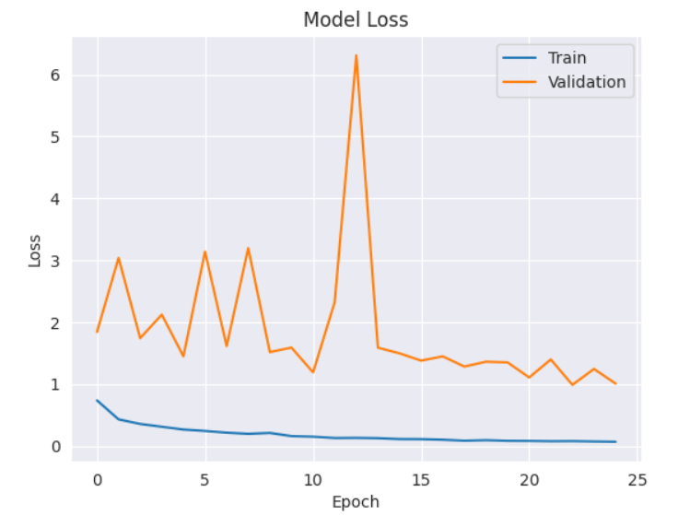
Mobile Net :

Slide 10
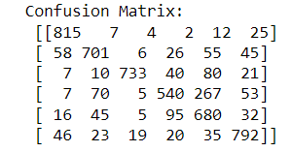
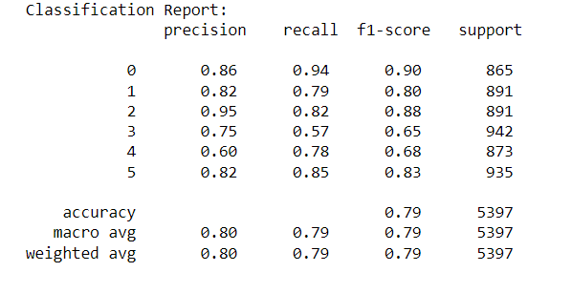
Res Net :
Training Accuracy: 0.9878630638122559
Validation Accuracy: 0.7895126938819885
Training Loss: 0.03773659095168114
Test Loss: 1.06276535987854
Precision: 0.7991273944452539
Recall: 0.7895126922364276
F1-score: 0.7893451442556976

Slide 11
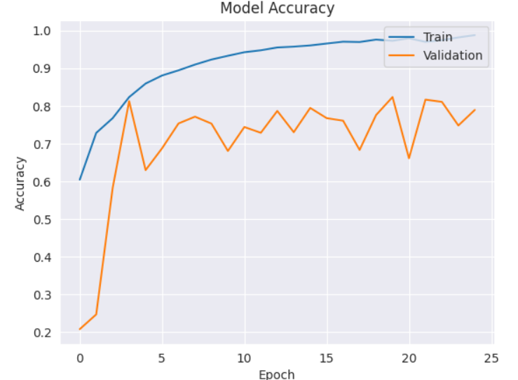
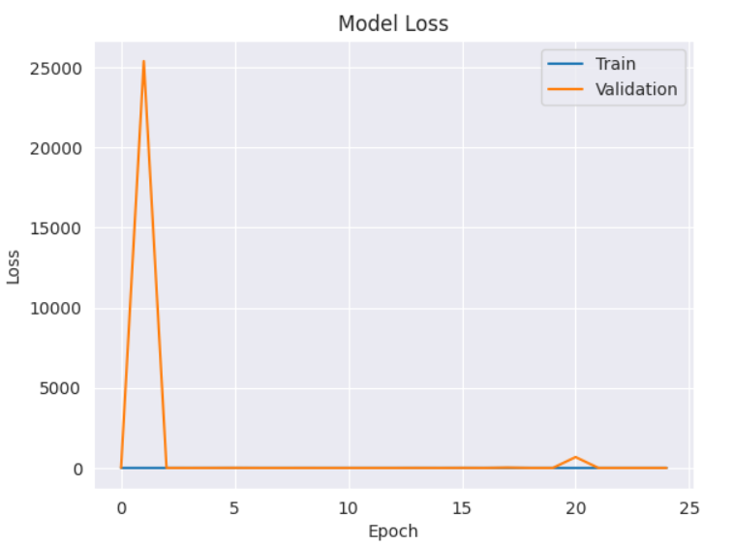
Res Net :

Slide 12
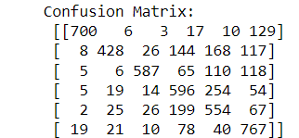
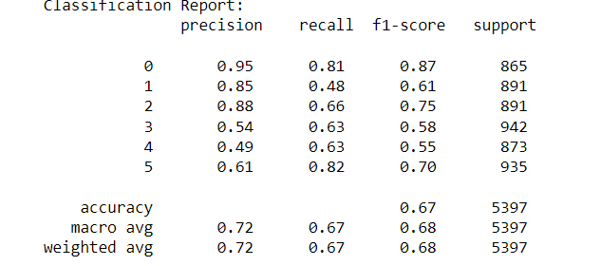
Alex Net :
Training Accuracy: 0.9111502170562744
Validation Accuracy: 0.672966480255127
Training Loss: 0.2336495816707611
Test Loss: 1.2973182201385498
Precision: 0.7169174911406823
Recall: 0.6729664628497314
F1-score: 0.6782680190556309

Slide 13
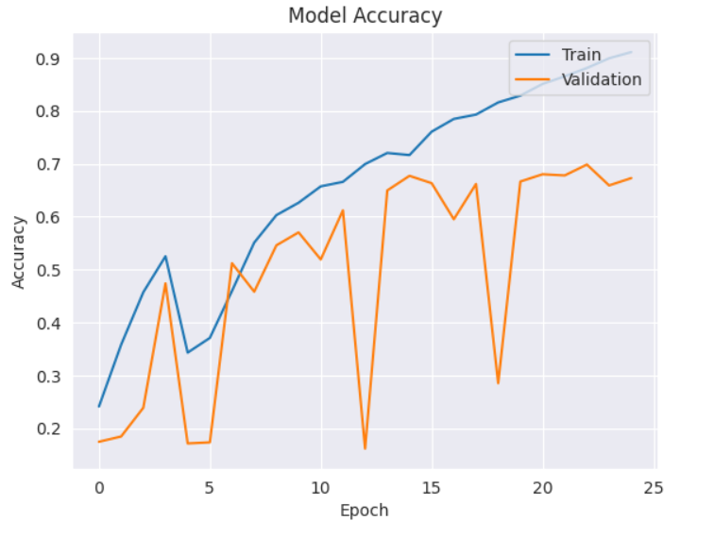
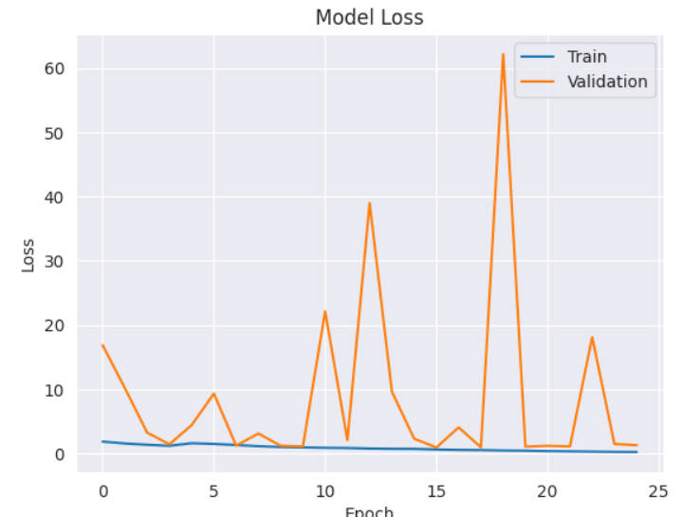
AlexNet :

