Slide 1
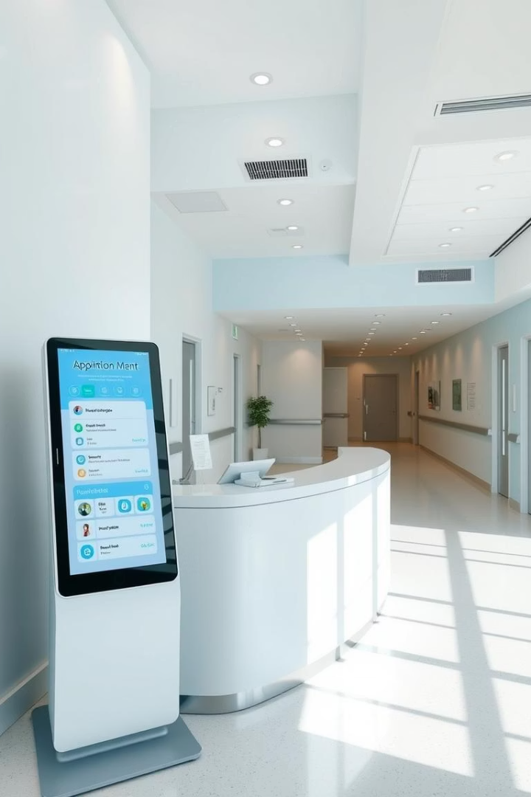
Hospital Appointment Booking & Management System
This presentation outlines a comprehensive Hospital Appointment Booking & Management System built with Flask. It streamlines appointment scheduling for patients, provides robust management tools for administrators, and ensures seamless communication through integrated email notifications.
By,
Anvitha G Rao
SAP ID: 52308042
1

Slide 2

Technologies Used
Flask
Web framework for routes and HTTP requests.
SQLAlchemy
ORM for object-oriented MySQL interaction.
MySQL
Relational database for all data storage.
HTML/CSS
Front-end for templates and user interaction.
SMTP (Gmail)
Sends appointment confirmation and cancellation emails.
pytz
Handles time zones, specifically IST.
2

Slide 3
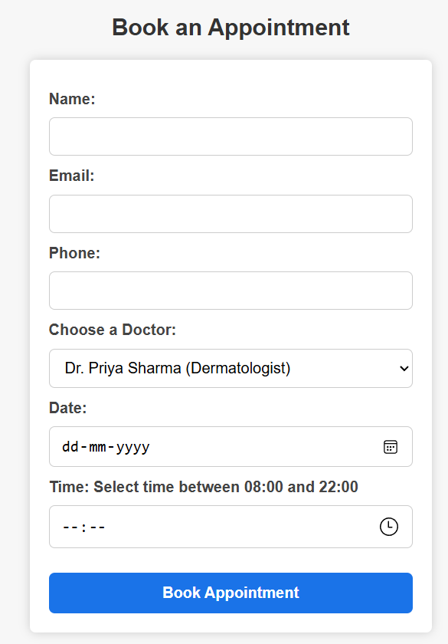
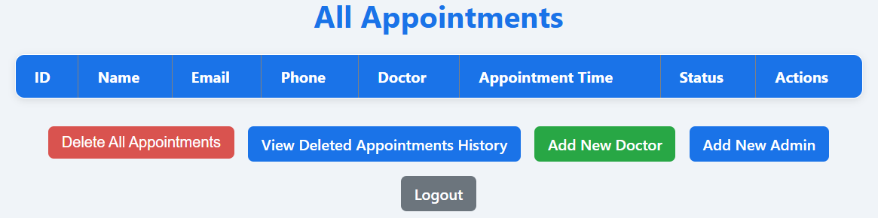
Key Features for Patients and Admins
Patient Features
Admin Features
Book appointments with active doctors.
Admin Login & Logout Dashboard.
Smart duplicate booking detection.
Doctor Management (add, toggle, delete).
Time conflict management with waiting list.
Admin Management (add, remove).
Email confirmation with cancel link.
Appointment Management (cancel, delete, archive).
Client-side validation for inputs.
Doctor’s Corner
View appointment history with filters.
3

Slide 4

Doctor’s Corner
Active Doctors Display
Appointment Listing
Organized Data View
Shows all active doctors with their specializations.
Lists patient names, times, and statuses in a clear table.
Data is grouped by doctor for easy tracking and efficiency.
4

Slide 5
Database Structure and Models
Appointment
Admin
Doctor
Stores confirmed or waiting appointments with fields like id, name, email, phone, doctor, appointment_time, and status.
Manages admin credentials including id, username, and password for secure access.
Contains doctor information such as id, name, specialization, and is_active status.
AppointmentHistory
ContactQuery
Logs all cancelled or deleted appointments, including a deleted_at timestamp for tracking.
Stores submissions from the contact form, allowing the hospital to respond to general queries.
5

Slide 6




Secure Session Management and Authentication
Secure Secret Key
Admin Login
Protected Routes
Flask sessions utilize os.urandom(24) to generate a random, secure secret key for each session, enhancing security.
Admin authentication is handled via a static method that queries the Admin table for matching username and password.
All administrative routes are protected, redirecting unauthorized users to the login page if 'admin_logged_in' session variable is not set.
6

Slide 7





Integrated Email Notifications via SMTP
SMTP_SSL with Gmail
The system uses SMTP_SSL with Gmail's server at port 465 for secure email communication.
HTML Email Format
Emails are formatted in HTML using MIMEText, ensuring rich and readable content for notifications.
Authentication & Sending
Secure server login and sendmail functions handle the dispatch of various email types, including confirmations and cancellations.
Reply-To for Queries
Contact form messages include a 'Reply-To' header, allowing the hospital to directly respond to patient queries.
7

Slide 8
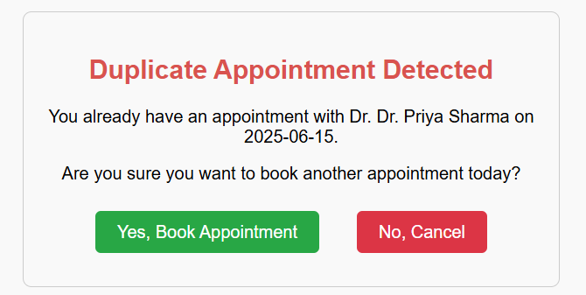
Intelligent Appointment Handling Logic
1
Time Slot Availability
Appointments are accepted between 08:00 and 22:00, with a 30-minute duration for each slot.
2
Conflict Resolution
If a requested slot is busy, the system automatically assigns the next available slot and marks the appointment as 'waiting'.
3
Duplicate Booking Prevention
The system checks for duplicate bookings based on name, email, phone, doctor, and date, flagging requests with less than 30 minutes proximity.
8

Slide 9




Core Concepts Driving the System
ORM with SQLAlchemy
1
Models are Python classes mapped to SQL tables, enabling object-oriented database interaction.
Form Validation
2
Robust validation ensures data integrity for email, phone numbers, and prevents past date appointments.
Time Zone Handling
3
pytz.timezone('Asia/Kolkata') ensures all timestamps and appointment times are accurately managed in Indian Standard Time.
Dynamic URL Generation
4
Cancel links in emails are dynamically generated using url_for, ensuring correct routing for appointment cancellations.
9

Slide 10




Comprehensive Admin Panel Functionalities
Login/Logout & Dashboard
Secure admin access with a dashboard to view all appointments.
Doctor Management
Admins can add, delete, and toggle the availability of doctors.
Admin Management
Ability to add and remove multiple administrative users securely.
Appointment History & Mass Delete
View cancelled/deleted appointments and archive all appointments with a single action.
10

