Slide 1

Utility Usage Year‑Over‑Year Dashboard
Prepared by Anvitha

Slide 2
1. Project Overview
Objective: Analyze year‑over‑year utility usage trends.
Focus: Building types, regions, total utility usage.
Deliverable: Single‑page Power BI dashboard (3–4 visuals).

Slide 3
2. Dataset Summary
The dataset included building-level utility information with fields like building type, region, utility category, and usage values.
I worked with the cleaned version provided and structured it for trend analysis.
Preprocessed using Alteryx: summarization, joins, YoY calculations.

Slide 4
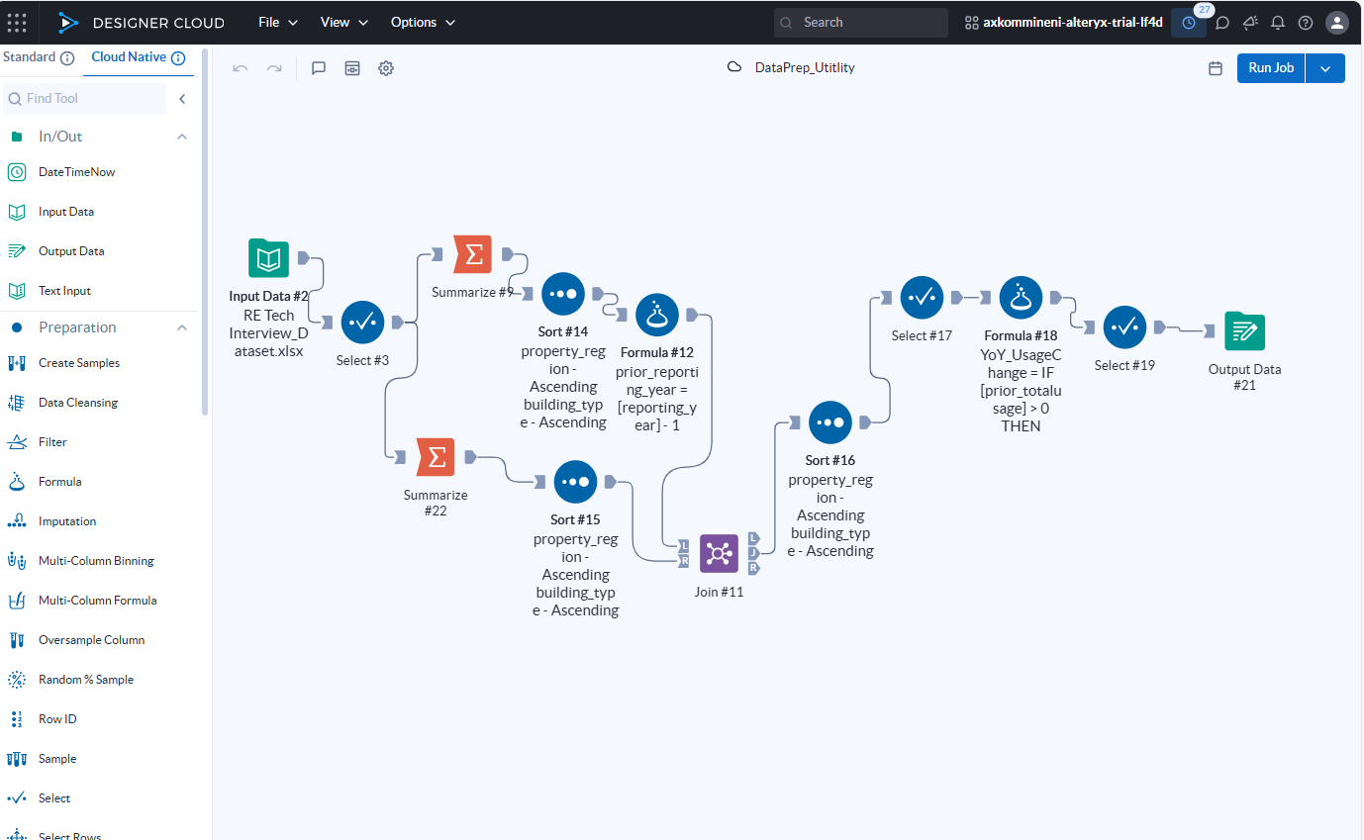
3. Data Preparation Workflow
My goal was to create a dataset that supports trend analysis.
So I summarized usage by building, region, year, and utility type.
Then I created prior-year references to calculate year-over-year change, which helps reveal growth, decline, or anomalies.

Slide 5
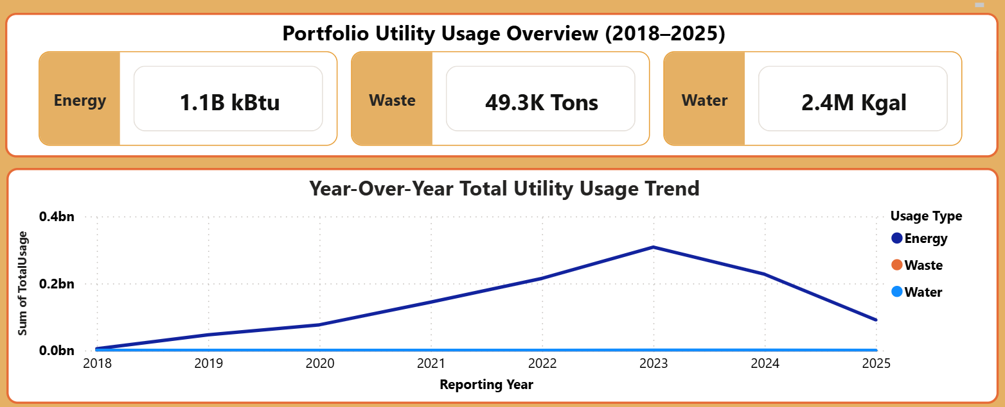
4. Power BI Dashboard Design
KPIs: Total Usage.
Total Usage Represents the total annual utility consumption (Energy in kBtu, Water in kGal, and Waste in Tons) across the portfolio.
Visual 1: Year‑over‑Year Usage Trend Chart.
This line chart shows how utility usage has changed over time (2018–2025).
Key points this visual supports:
  Identifies overall portfolio consumption patterns
  Shows increases or decreases in usage year by year
  Helps spot unusual trends or anomalies
  Allows users to compare usage trends across Energy, Water, and Waste

Slide 6
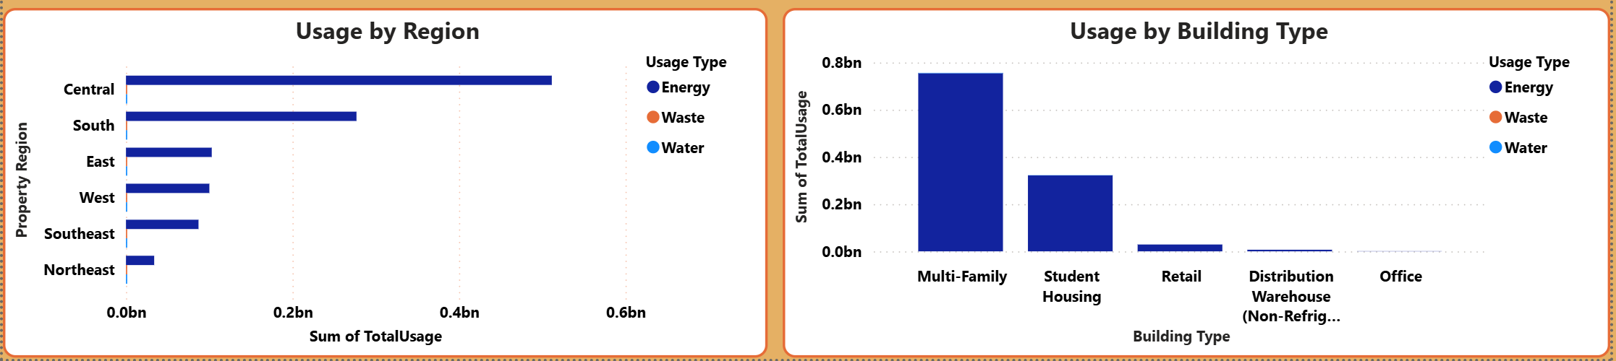
Power BI Dashboard Design
Visual 2: Usage by Region.
A horizontal bar chart displaying utility usage by region (e.g., Central, South, East, etc.).
  Regions with the highest resource consumption
  Geographic patterns in utility usage
  Areas where operational improvements or sustainability efforts may be needed
Visual 3: Usage by Building Type.
A bar chart comparing total usage across different building categories (e.g., Multi-Family, Office, Retail, Student Housing).
  Which building types consume the most utilities
  Usage concentration across the portfolio
  Priority areas for efficiency or cost-management

Slide 7
5. Insights Identified
1. Energy usage dominates significantly higher than water and waste.
2. Utility usage increased steadily and peaked in 2023.
3. The Central region is the higher consumption that other building types.
4. Multi-Family properties are the highest consumers among building types.
5. Downswing in 2024–2025 indicates potential efficiency improvements or operational changes.

Slide 8
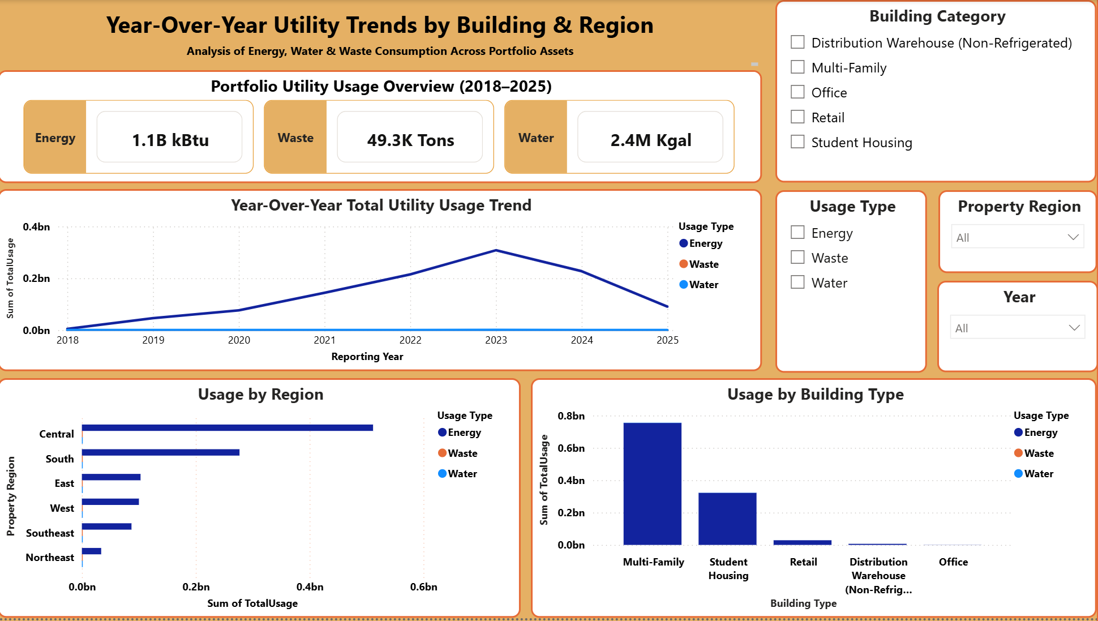
8. Final Dashboard

Slide 9
Thank You

