Slide 1

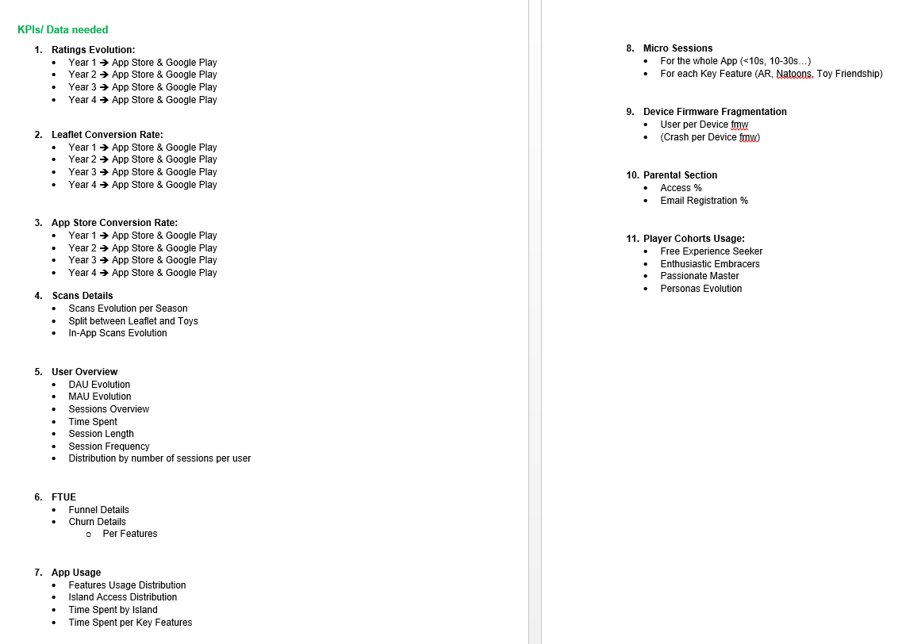

KPI REQUEST SIMILAR TO AAF

Slide 2


DONE
1.User Feedbacks: Ratings & Review
4.24
4.6
Main Negative Reviews
SCAN ISSUE:
Not able to unlock the good toy
NO CAMERA ROTATION:
Added in Season 5
GAME’S STABILITY:
Freezes
Crashes
Performances on Low End devices
APP SIZE
STARS (Out of 5)
STARS (Out of 5)
Action Plan
Continue enhancing control sensitivity and camera rotation.
Lower ANR from 0.4% to 0.2%.
Reduce the app size with DLC from 336MB to under 200MB.
Decrease the crash rate from 0.77% to less than 0.5%.
VERSION | Android Average Rating | iOS Average Rating
1 | 4.27 | NA
2 | 4.32 | NA
3 | 4.22 | 4.6*
4 | 3.73 | 4.6**
*Rating for version 3.0.4, 3.0.7, 3.1.0, 3.12
**Rating for version 4.0.0, 4.1.0
Notes:
Quality of the App is not a real concern as rating have always been above 4 stars
Some of the most significant feedback we received revolved around the navigation mechanics, particularly the desire to transition to landscape orientation, the jump function, and more responsive controls. These aspects have been enhanced in Season 4.
We also received critical feedback regarding the absence of camera rotation, which has been addressed and improved in Season 5.
The most pressing and frustrating issues pertain to the game's stability, with reports of crashes and freezing. While we have made some improvements to address these concerns, we continue to work on resolving them.

Slide 3
DONE
1.User Feedbacks: Ratings & Review
4.24
Lifetime Rating
STARS (Out of 5)
Main Negative Reviews
SCAN ISSUE:
Not able to unlock the good toy
NO CAMERA ROTATION:
Added in Season 5
GAME’S STABILITY:
Freezes
Crashes
Performances on Low End devices
APP SIZE
Key Countries | V3: 01/09/2022 - 30/10/2022 | V4: 24/08/2023 - 22/10/2023
Worldwide | 4.30 | 3.78
Brazil | 4.48 | 4.46
India | 4.29 | 4.27
Italy | 4.29 | 4.25
Russia | 4.15 | 4.15
United States | 4.25 | 4.24
Action Plan
Continue enhancing control sensitivity and camera rotation.
Lower ANR from 0.4% to 0.2%.
Reduce the app size with DLC from 336MB to under 200MB.
Decrease the crash rate from 0.77% to less than 0.5%.
Notes:
Quality of the App is not a real concern as rating have always been above 4 stars
Some of the most significant feedback we received revolved around the navigation mechanics, particularly the desire to transition to landscape orientation, the jump function, and more responsive controls. These aspects have been enhanced in Season 4.
We also received critical feedback regarding the absence of camera rotation, which has been addressed and improved in Season 5.
The most pressing and frustrating issues pertain to the game's stability, with reports of crashes and freezing. While we have made some improvements to address these concerns, we continue to work on resolving them.

Slide 4
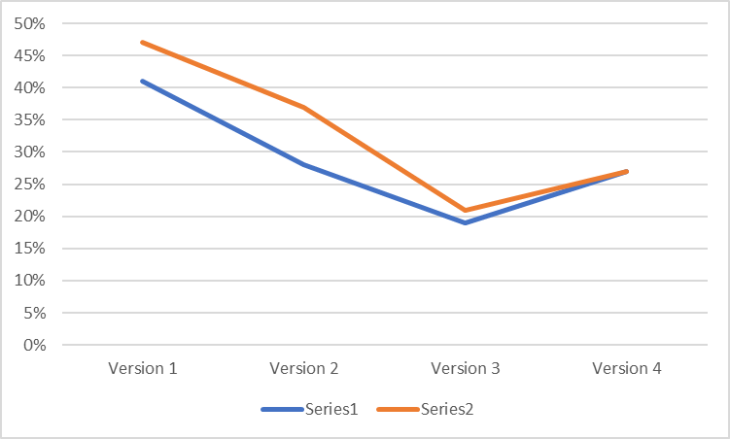
3.Conversion KPIs: Store Page Conversion
DONE
The conversion rate Leaflet of Applaydu is robust, and it has shown significant improvement over the past two seasons. While there is always room for enhancement, it is currently a consistently strong performance on a global scale
APD Average Conversion Rate per Season and Platform is:
Season 1: Android 47%, iOS 41%
Season 2: Android 37%, iOS 28%
Season 3: Android 21%, iOS 19%
Season 4: Android 30%, iOS 27%
Conversion Rate Benchmark is 27% in the Market for all the Apps
Season | Conversion Rate iOS | Conversion Rate Android | Conversion Rate Android (Leaflet)
Season 1 (Aug20-Aug21) | 41% | 47% | 58.41%
Season 2 (Aug21-Aug22) | 28% | 37% | 49.60%
Season 3 (Sep22-Aug23) | 19% | 21% | 46.46%
Season 4 (Sep23-Nov23) | 27% | 30% | 44.56%
* iOS conversion rate = First-time downloads/ Product Page Views

Slide 5
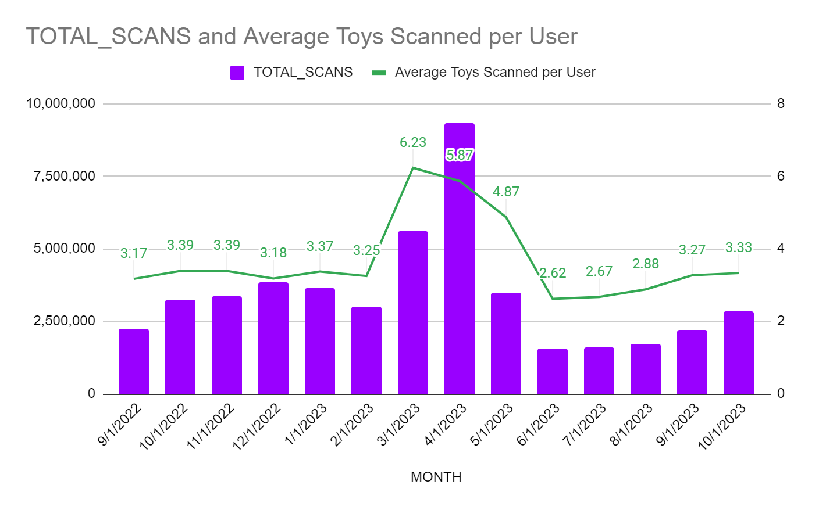
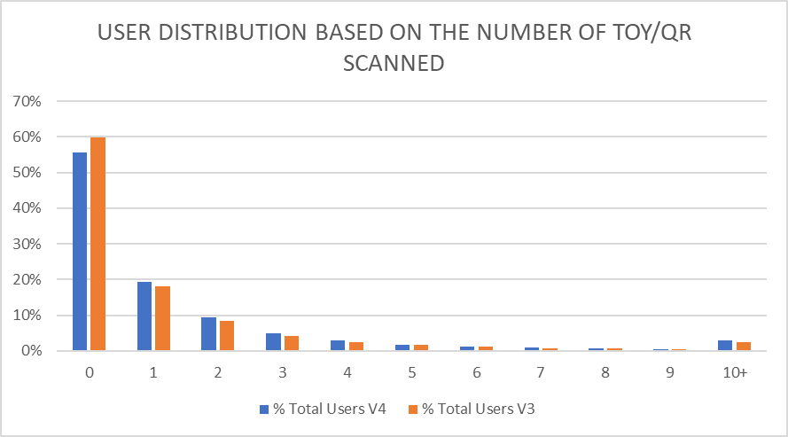
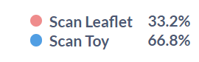

4.Conversion KPIs: Number of Scans
3.56
3.61
Period: 01/09/2022 - 31/10/2023
Period: v3: 01/09/2022 - 30/10/2022
v4: 24/8/2023 - 22/10/2023
V3
V4
TOYS SCANNED:
AVERAGE SCANS
NO SCAN:

Slide 6
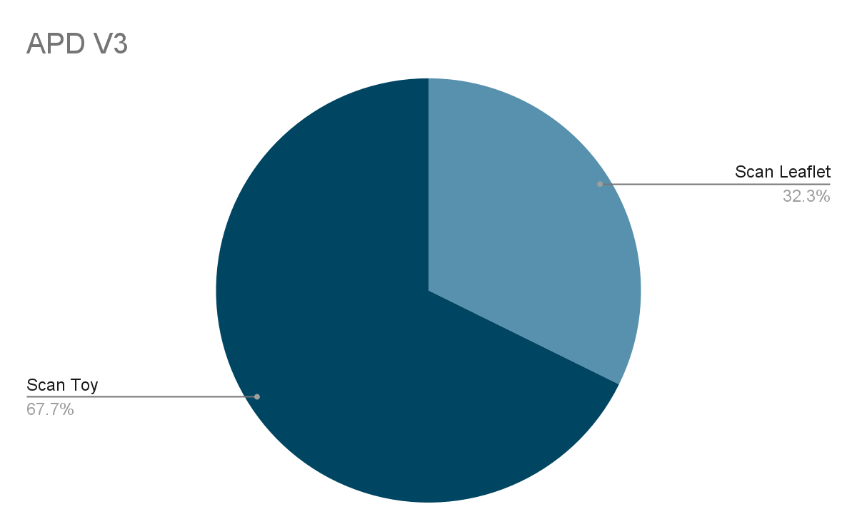
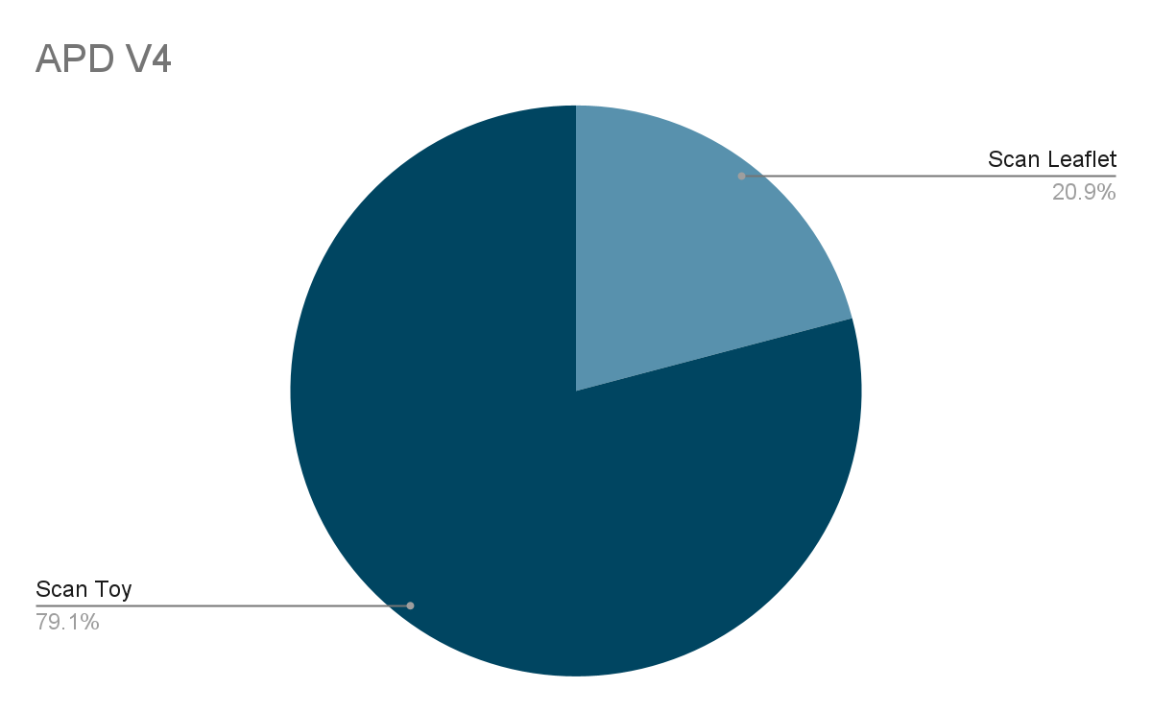
4.Scan KPIs: Global Evolution
Done
Scan distribution evolution between V3 to V4
2022: From 10 Sep to 30 Oct
2023: From 24Aug to 22Nov
…
Notes:
+11.5 % More users decide to scan toy

Slide 7
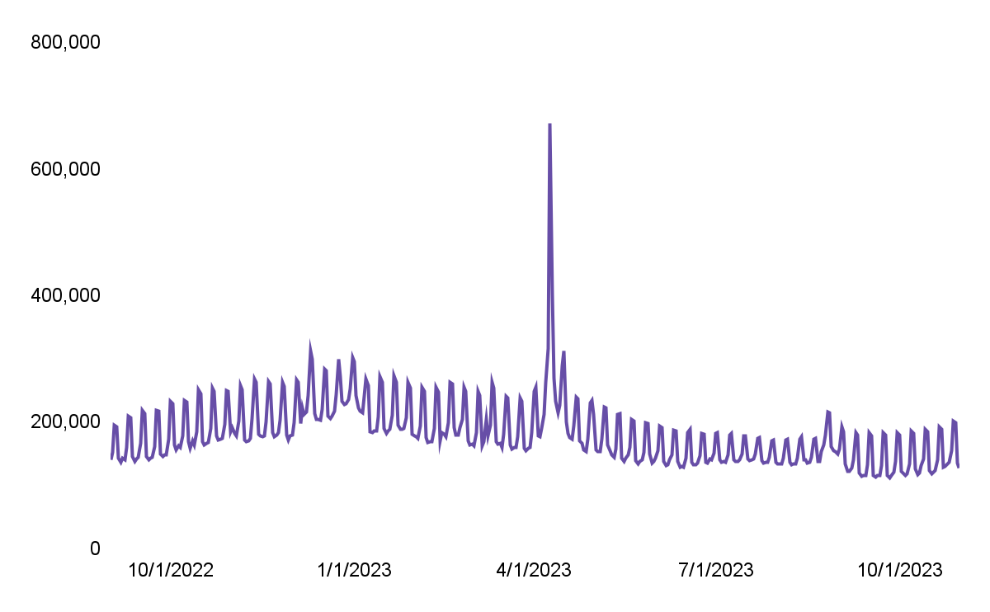
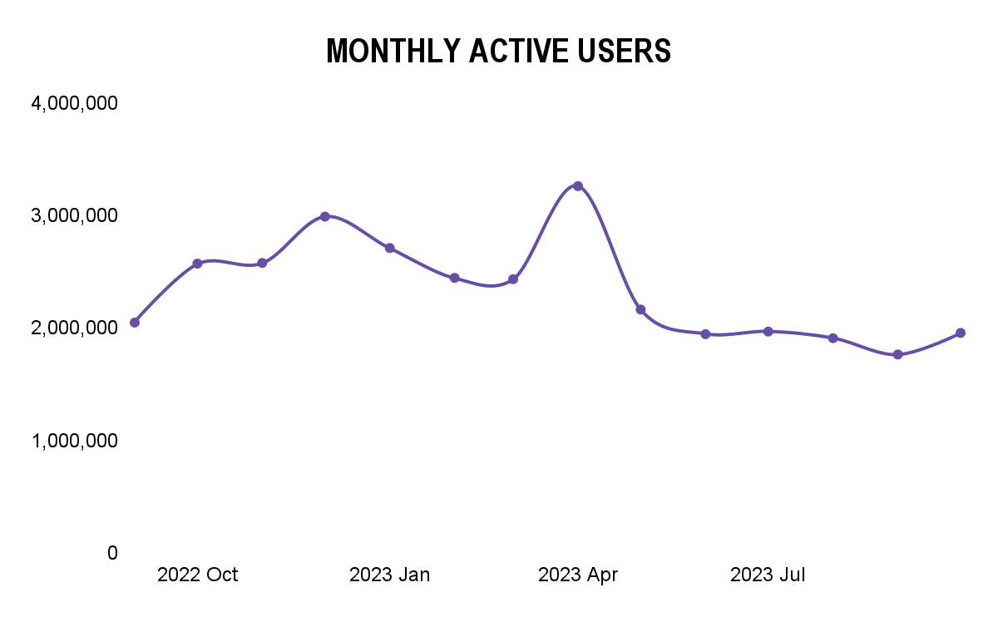
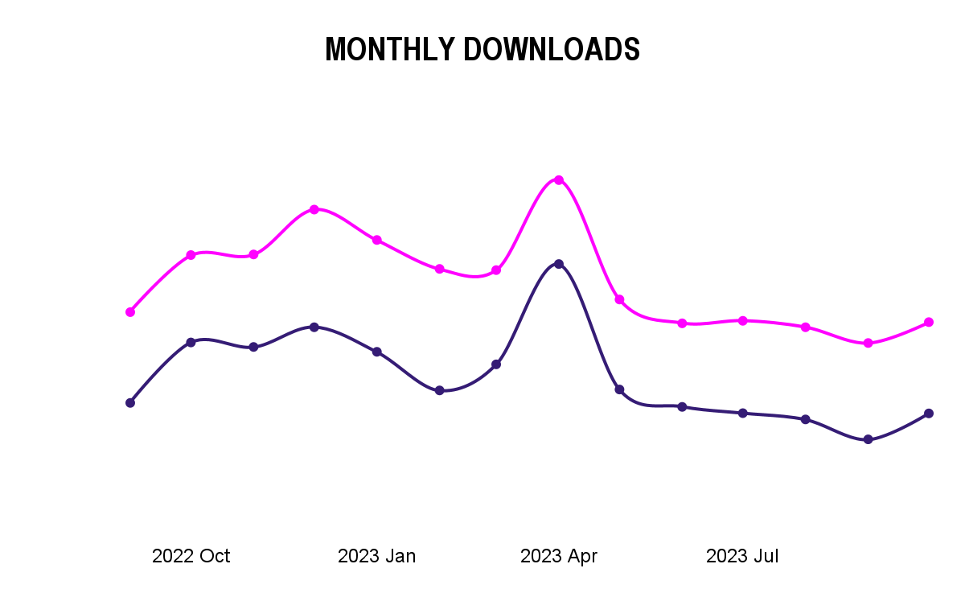
5.Engagement KPIs: Users Overview
DONE
AVG MAU
2,338,582
AVG DAU
182,108
34%
16%
-9%
26%
0.22%
-10%
59%
10%
-0.45%
-34%
-10%
MAU
46%
1%
-3%
-8%
11%
MONTHLY DOWNLOADS
-2%
-12%
18%
27%
-21%
-46%
-12%
-5%
-5%
-17%

Slide 8
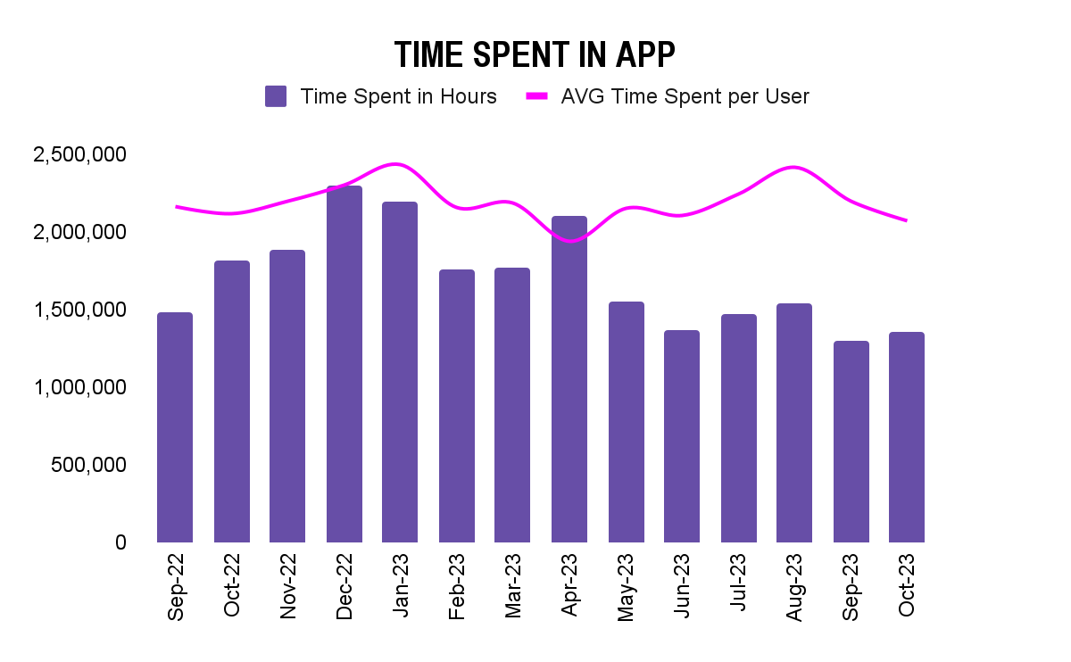
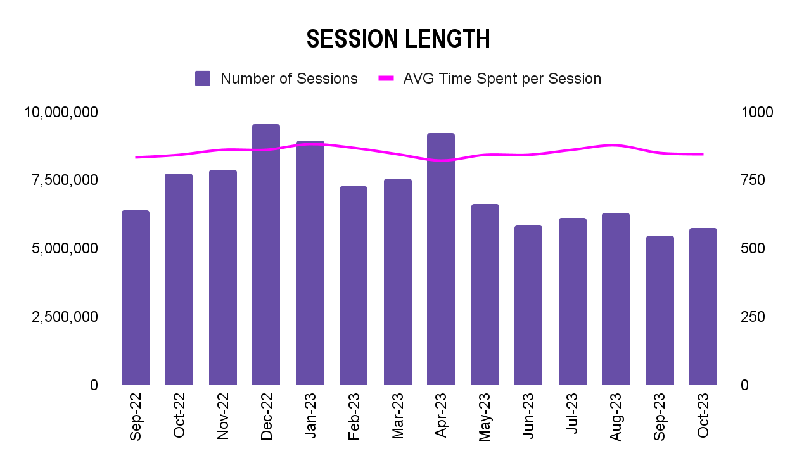
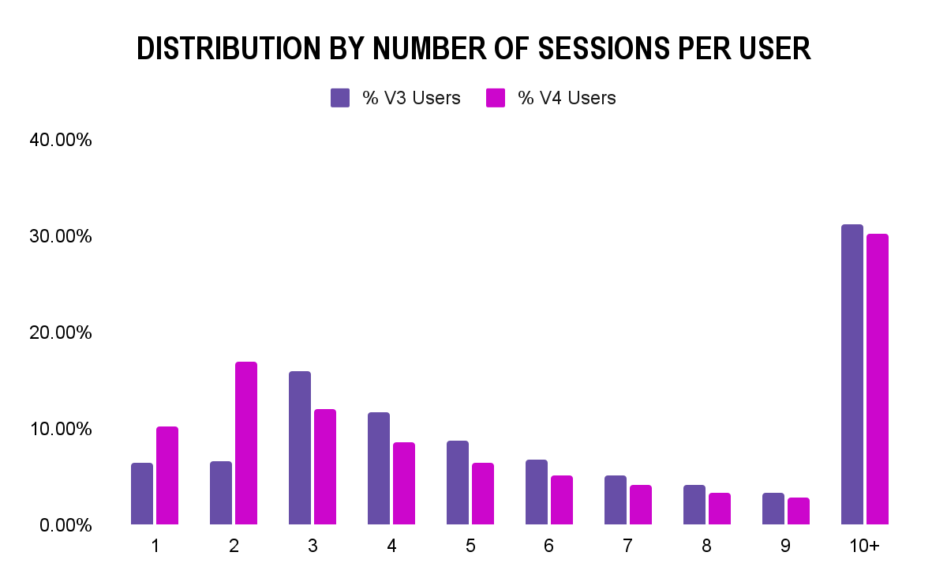
5.Engagement KPIs: Sessions Overview
DONE
48min 36sec
48min 14sec
14min 42sec
14min 36sec
38min 42sec
14min 3sec
3.66
3.74
Version | AVG DAU | AVG Time Spent per User | AVG Time Spent per Session
Version 3 | 178,878 | 51min 6sec | 13min 59sec
Version 4 | 146,326 | 53min 21sec | 14min 17sec
Period: v3: 01/09/2022 - 30/10/2022
v4: 24/8/2023 - 22/10/2023
Period: 01/09/2022 - 31/10/2023

Slide 9
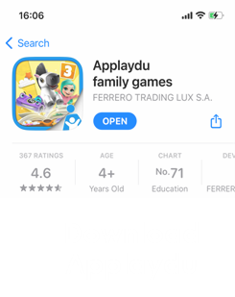

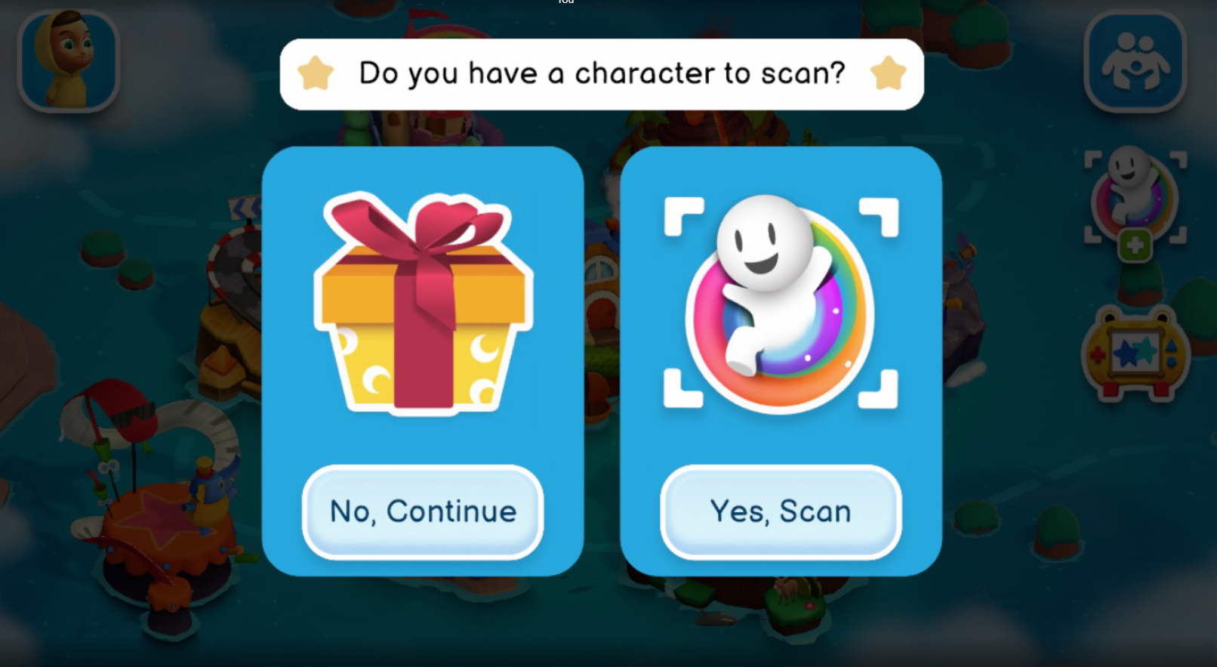
6.Conversion KPIs: DL to Launch the APP for New.U
908,715 New Users
DL the APP for the 1st time
886,333 New Users Launch the APP for the 1st time
823,904 New Users Reached the End of the FTUE
GP: 644,220
iOS: 264.495
GP:590.762
iOS: 295.571
Numbers between Users DL the APP and Users launched the APP can sometime be different since Users could:
Download but not open the APP
Downloaded before the APP and ONLY open it later during the selected period.
24Aug to 30Sep
Notes:
https://play.google.com/console/u/1/developers/5120711382017088645/app/4975524349012685341/reporting/acquisition/details?dimension=TRAFFIC_SOURCE&selected=QE9WRVJBTExA&dateRange=2023_08_24-2023_09_30&peersetKey=3%3Abec6e236a060ae68&benchmarkDisplay=QE9WRVJBTExA&storePerformanceMetric=METRIC_ACQUISITION
https://dashboard.applaydu.com/dashboard/250-consumer-data-v4?date_range=2023-08-24~2023-09-30
https://appstoreconnect.apple.com/analytics/app/r:20230824:20230930/1476035637/metrics?annotationsVisible=true&chartType=singleaxis&groupDimensionKey=source&measureKey=totalDownloads&zoomType=day

Slide 10
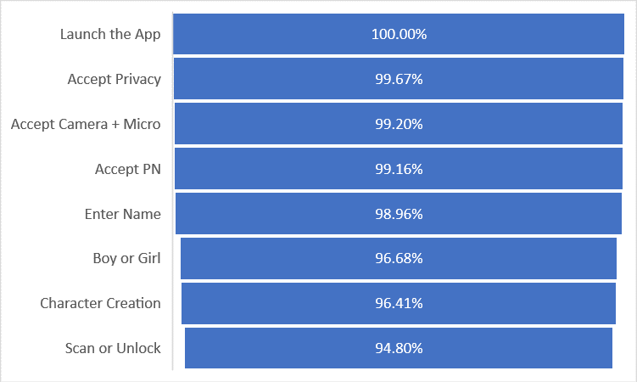
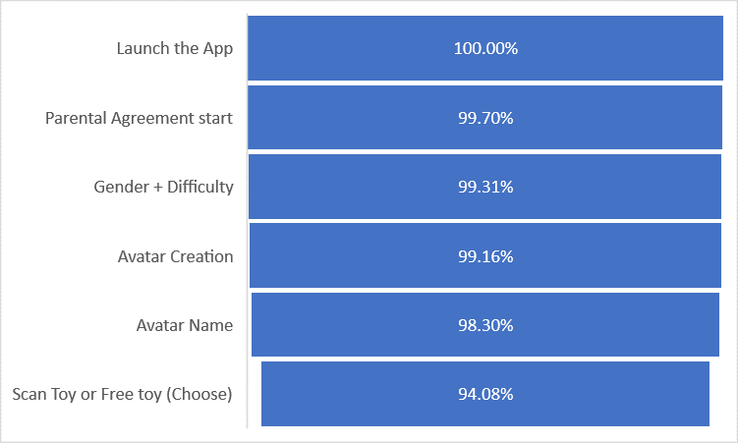
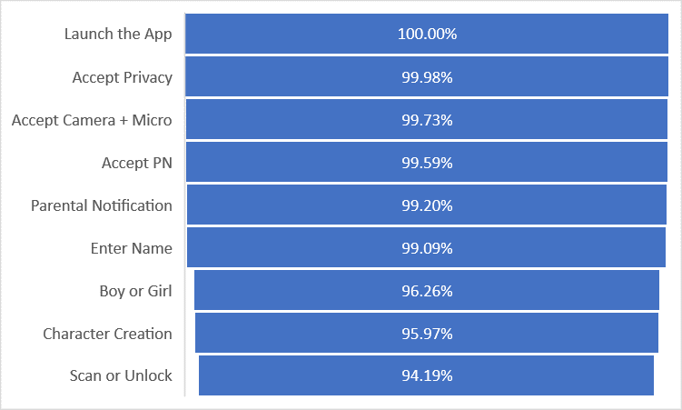
6.FTUE Completion Rate: Current Results
V3 Launch (include the free toy)
V4 Launch (include the free toy)
Done
End V3 (include the free toy)
24Aug to 30Sep

Slide 11
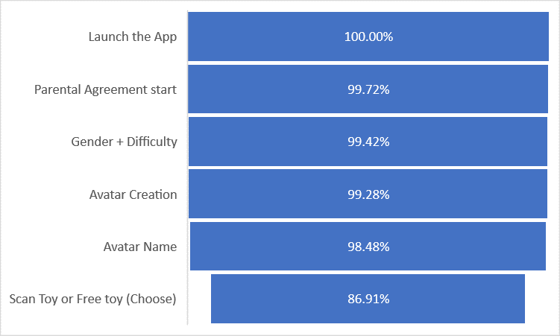
6.FTUE Completion Rate: Current Results
V3 Launch (include the free toy)
V4 Launch (include the free toy)
Done
End V3 (include the free toy)
24Aug to 22Oct

Slide 12
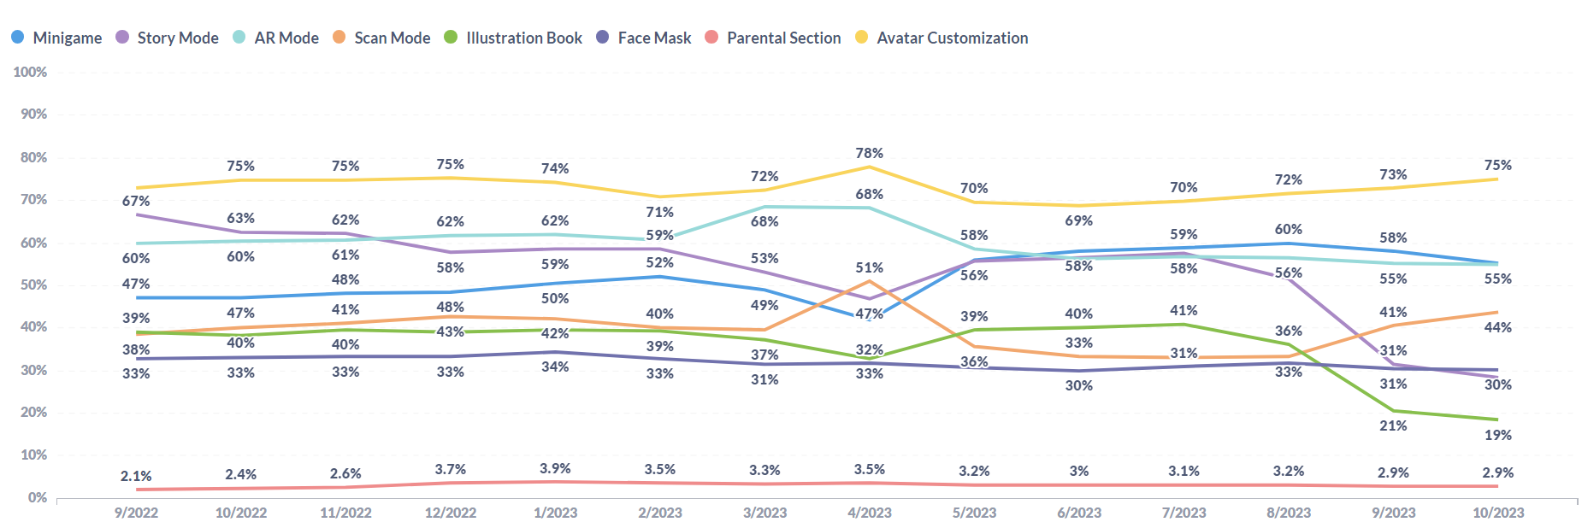
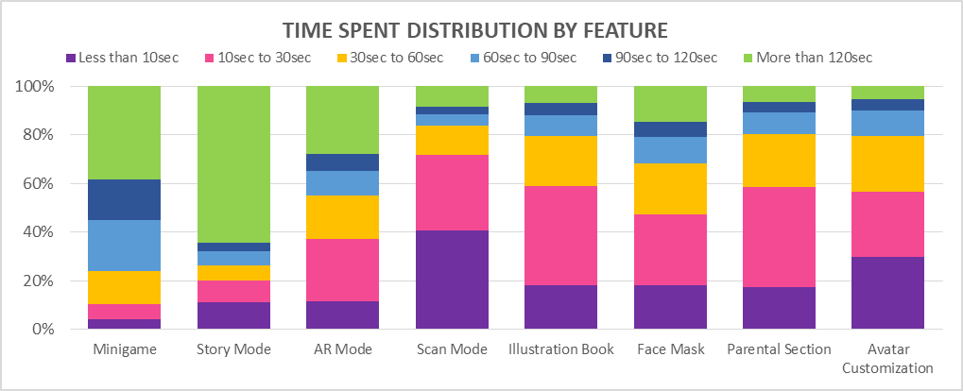
7.Engagement KPIs: Usage Overview
Done
FEATURE USAGE DISTRIBUTION BY USERS
Period: 01/09/2022 - 31/10/2023

Slide 13
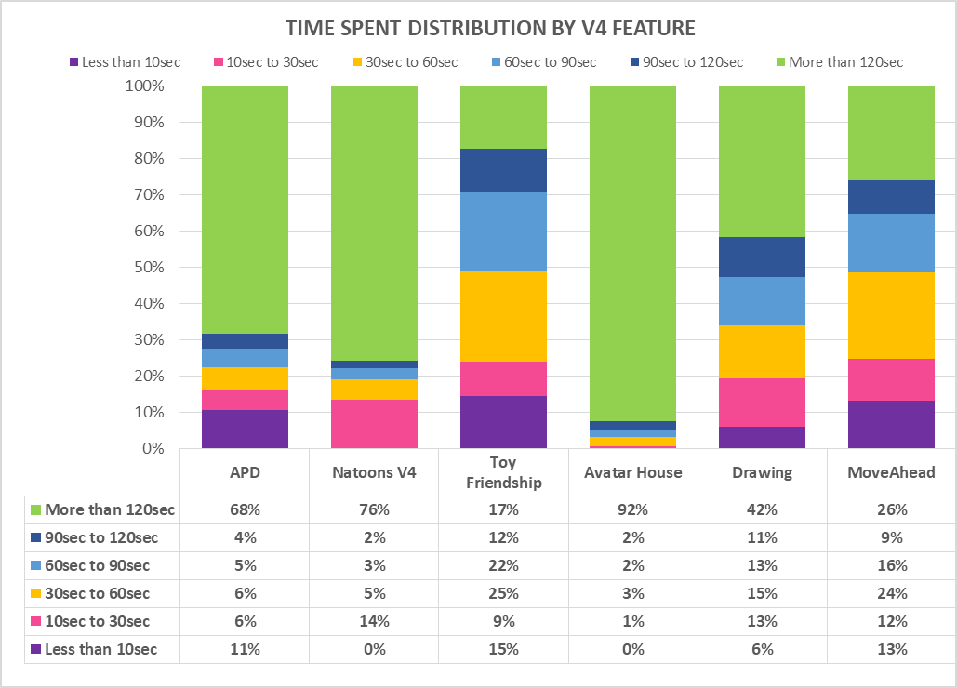
7.Engagement KPIs: Micro Session Analysis
Done
Period: 24/08/2023 - 31/10/2023

Slide 14
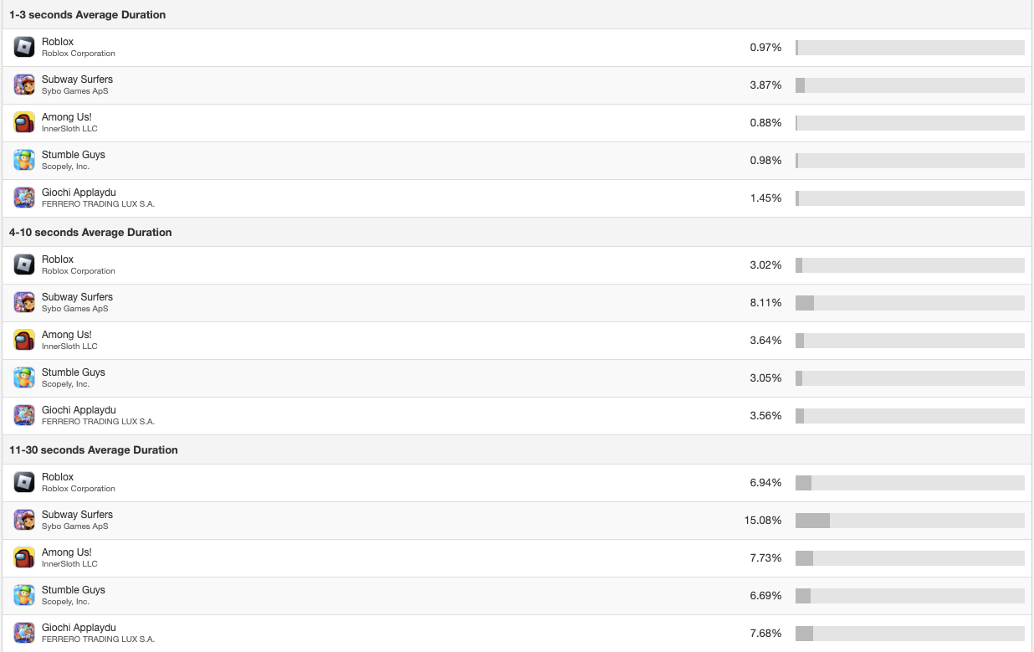
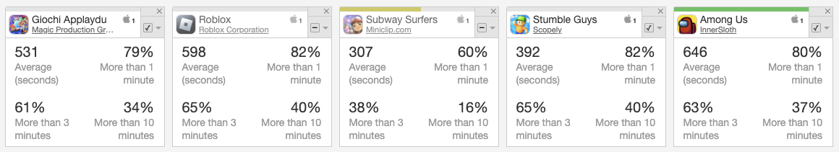
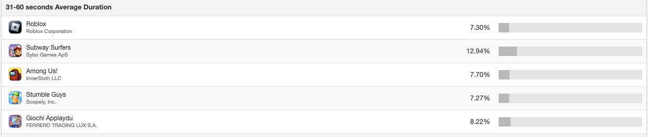
8.Conversion KPIs: Micro Sessions Analysis & Benchmark
In September 2023, 61% of A&F users stay more than 3mns which is close to our key Competitors and better than Subway Surfer.
Average time spent in September is 531s (8mns51s) which is better than Stumble Guy.
Micro Sessions (=Sessions below 10s) represent 5.01% of the Sessions. We also lost 20.91% of our users within the 1st minute which is not great but on par with our Competitors (Roblox = 18.2%, Subway Surfer = 40%, Stumble Guys = 18%, Among Us = 19,46%)
Source: Sensor Tower – Period: September 2023

Slide 15
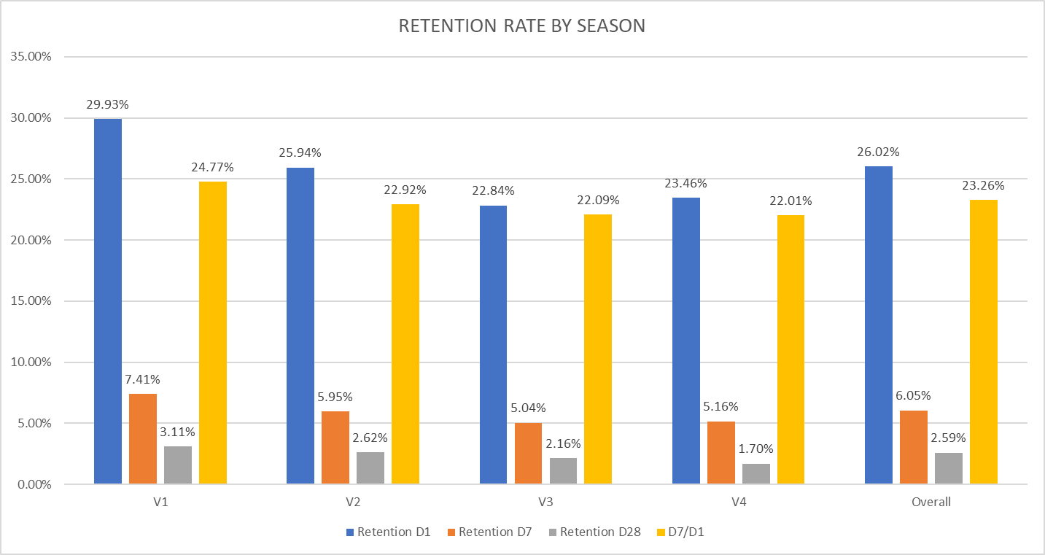
Retention KPIs: Retention Overview
Done
Retention KPIs are recovering slowly but remains below the benchmark.
A strong focus must be made on the variety of the experience and other game design mechanisms to boost engagement
Our Retention Targets should be:
D1 = 30%
D7 = 10%
D30 = 3%
Period: lifetime until 31/10/2023
Fri, Sat Key countries

Slide 16
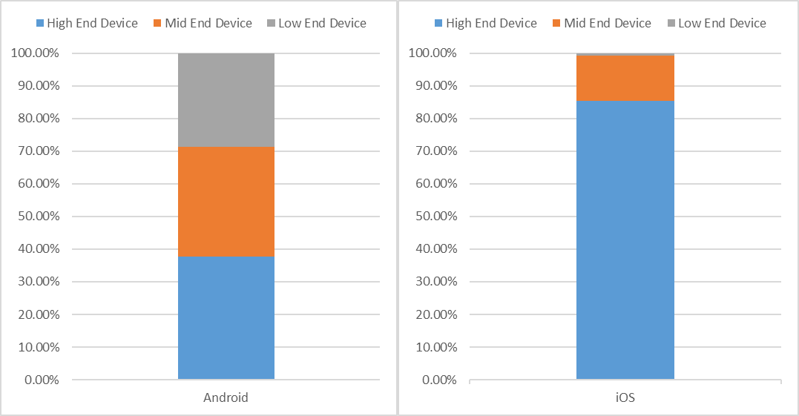
V4 Device: WW distribution
Platform | Device Type | Devices
Android | Low End Device | 153,376
Android | Mid End Device | 180,954
Android | High End Device | 201,908
iOS | Low End Device | 2,699
iOS | Mid End Device | 46,776
iOS | High End Device | 290,149
Done
Country | Android | IOS
Russia | 123,673 | 57,457
Brazil | 107,567 | 20,239
India | 134,330 | 8,398
Mexico | 146,215 | 20,239
Indonesia | 29,121 | 5,561
Italy | 49,178 | 4,339
United States | 51,755 | 62,795
Germany | 44,720 | 25,582
Turkey | 11,878 | 5,561
Other Countries | 492,158 | 173,511
Total | 1,190,595 | 383,682
28% of Android Users are using LOW-END DEVICE (6GB RAM for both)
Example on Android:
Android 10, upgradable to Android 13, One UI 5
Chipset
Qualcomm SDM730 Snapdragon 730 (8 nm) - Global
Qualcomm SDM730 Snapdragon 730G (8 nm) - Philippines
CPU
Octa-core (2x2.2 GHz Kryo 470 Gold & 6x1.8 GHz Kryo 470 Silver)
GPU
Adreno 618
Example on iOS:
iOS 6, upgradable to iOS 10.3.4
Chipset
Apple A6 (32 nm)
CPU
Dual-core 1.3 GHz Swift (ARM v7-based)
GPU
PowerVR SGX 543MP3 (triple-core graphics)

Slide 17
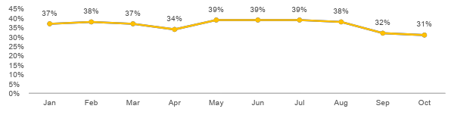

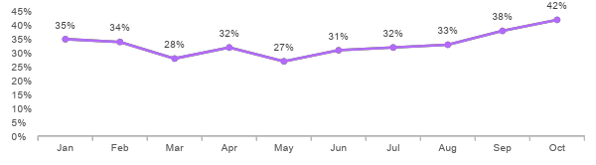
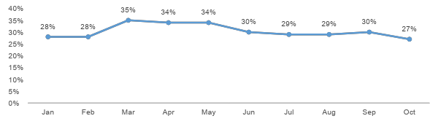
Personas evolution until Nov 2023
Done
Persona #1
THE “FREE”
EXPERIENCE SEEKERS
-3%
-3%
-4%
-2%
-2%
-2%
-2%
-2%
-2%
-1%
+5%
Most of the evolution are THE ENTHUSIASTIC EMBRACERS converting to THE PASSIONATE MASTERS overtime.
0 Toy Scanned
Persona #2
THE ENTHUSIASTIC EMBRACERS
–3%
-3%
-1%
0%
0%
-1%
-1%
0%
-1%
0%
OVERVIEW
1 to 3 Toys Scanned
*Ferrero Definition
Example: we checked on July for data of Apr-June, we see that now x% more of users in Jan-Mar have scanned more toys and move up to Persona2/Persona 3.
Every time we check, the % will be different.
Persona #3
+6%
+6%
THE PASSIONATE MASTERS
+5%
+2%
+2%
+3%
+3%
+2%
+3%
+1%
3+ Toys Scanned
*Persona: scan and active
data taken 11/10/2023 11:30 vnt

Slide 18
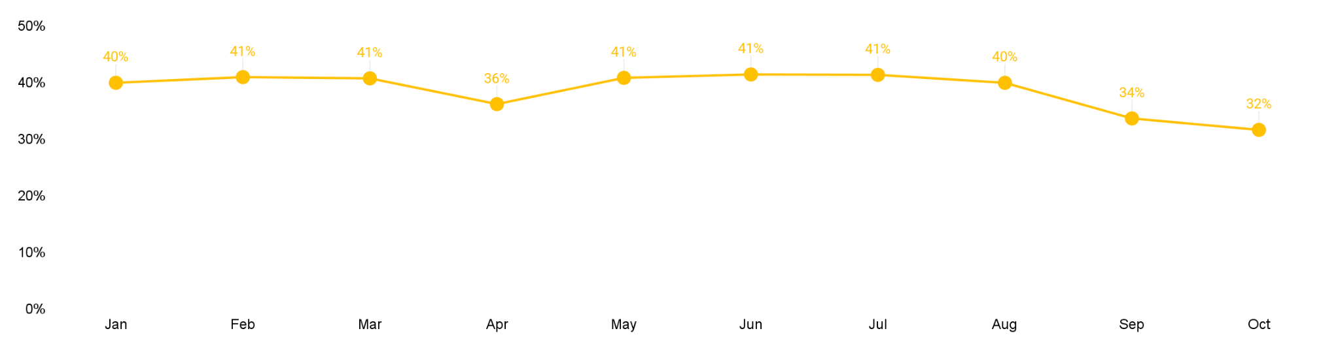
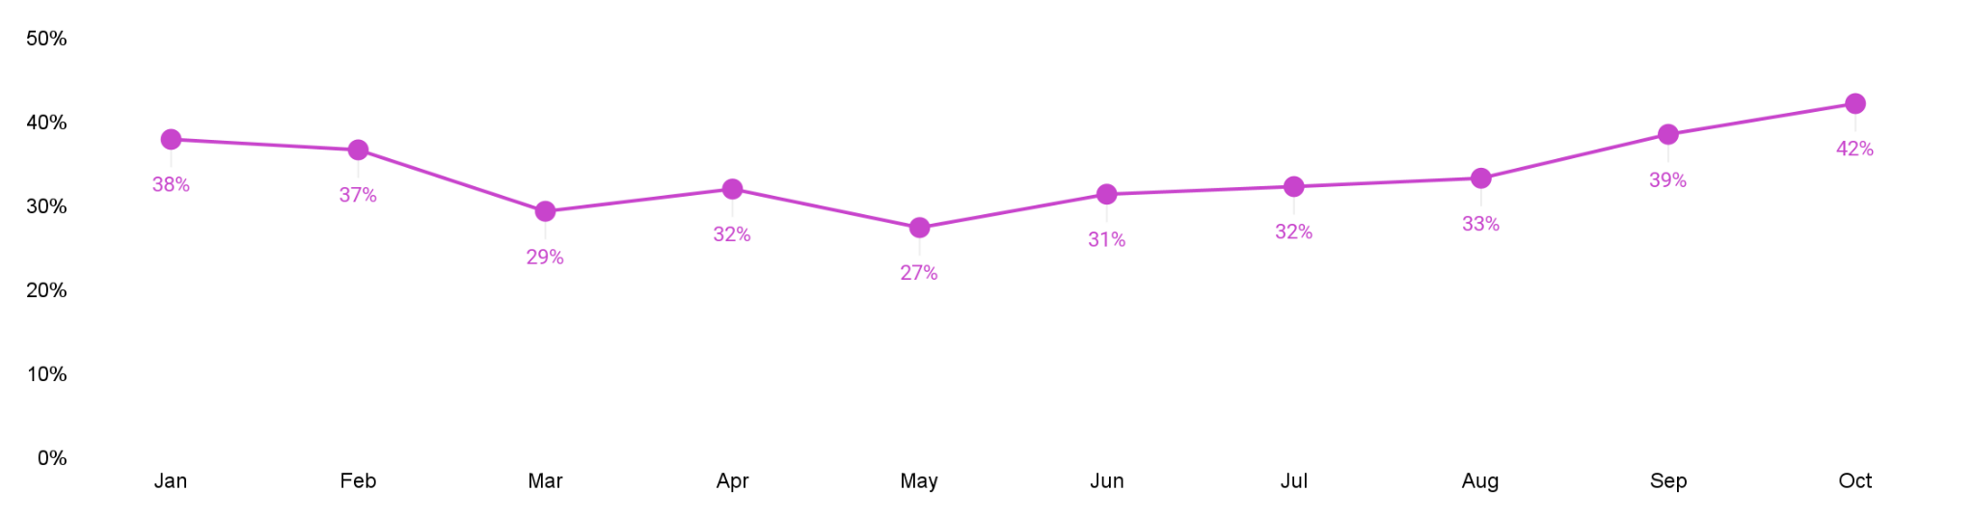
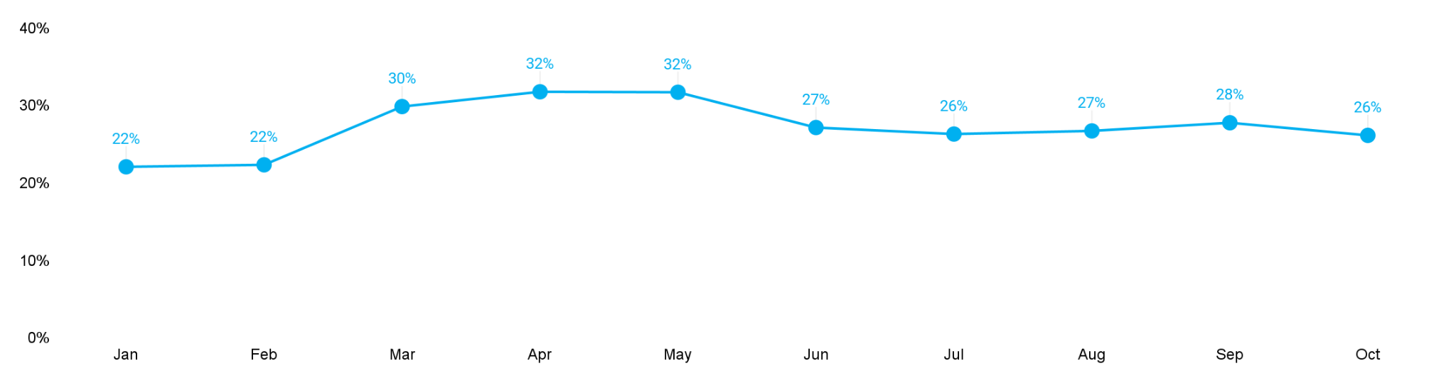
Personas base 2023
Done
Persona #1
THE “FREE”
EXPERIENCE SEEKERS
0
Toy Scanned
Persona #2
THE ENTHUSIASTIC EMBRACERS
1 to 3 Toys Scanned
Persona #3
THE PASSIONATE MASTERS
3+ Toys Scanned
*Persona: scan and active

