Slide 1
TRAINEDNETWORK 0
TRAINEDNETWORK 1
QCNN
PLOTTING
QCNN
SORT SHAPE OF TRAIN & VAL
GENERATE DATA
SORT SHAPE OF TEST
FORMATING DATA
QCNN CLASSIFICATION
(TRAINEDNETWORK)

Slide 2
HERE IS HOW THE CODE WORKS
Generate data from GenerateData
Use Classification Layer to learn Shape (trainedNetwork)
Use the trainedNetwork to sort Shape in Test data into (Test0, Test1)
Sort Shape in Val and Train normally into (Val0, Val1) & (Train0, Train1)
Use R.L on (Train0, Val0) to get trainedNetwork0
Use R.L on (Train1, Val1) to get trainedNetwork1
Use (trainedNetwork0, trainedNetwork1) on (Test0, Test1) to get (predY0, predY1)
Concatenate predY0 and predY1 to get predY
Plot results

Slide 3
Some changes in the training network
Adding a third convolution2dLayer improves accuracy (from 77.67% to 90.19%)
Replacing maxPooling2dLayer by averagePooling2DLayer boosts up the learning
Adding dropoutLayer in every convolution2dLayer helps with overfitting

Slide 4
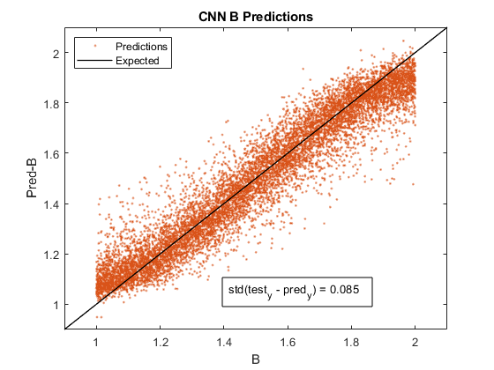
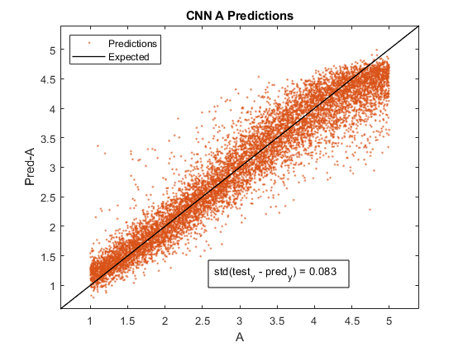
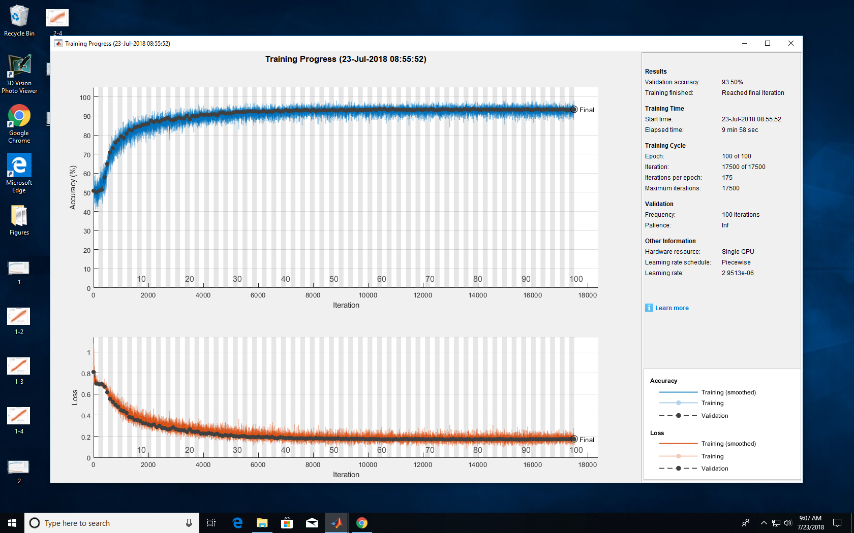
Data50k_AB
1 5 amplitude
1 2 magnetic field
8 8 energy
200 200 smo
2 2 nu
0 1 Kap
40 40 ld
Classification:
Accuracy = 93.07%
Regression:
StdA = 0.083
StdB = 0.085

Slide 5
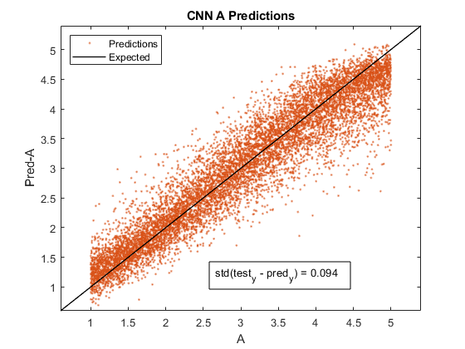
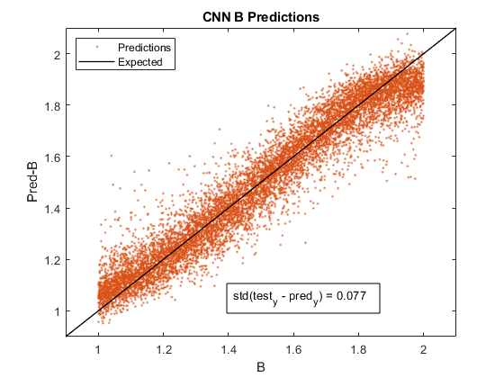
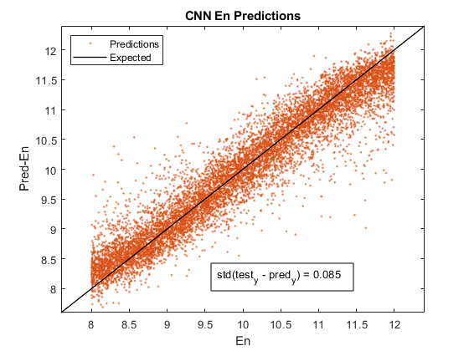
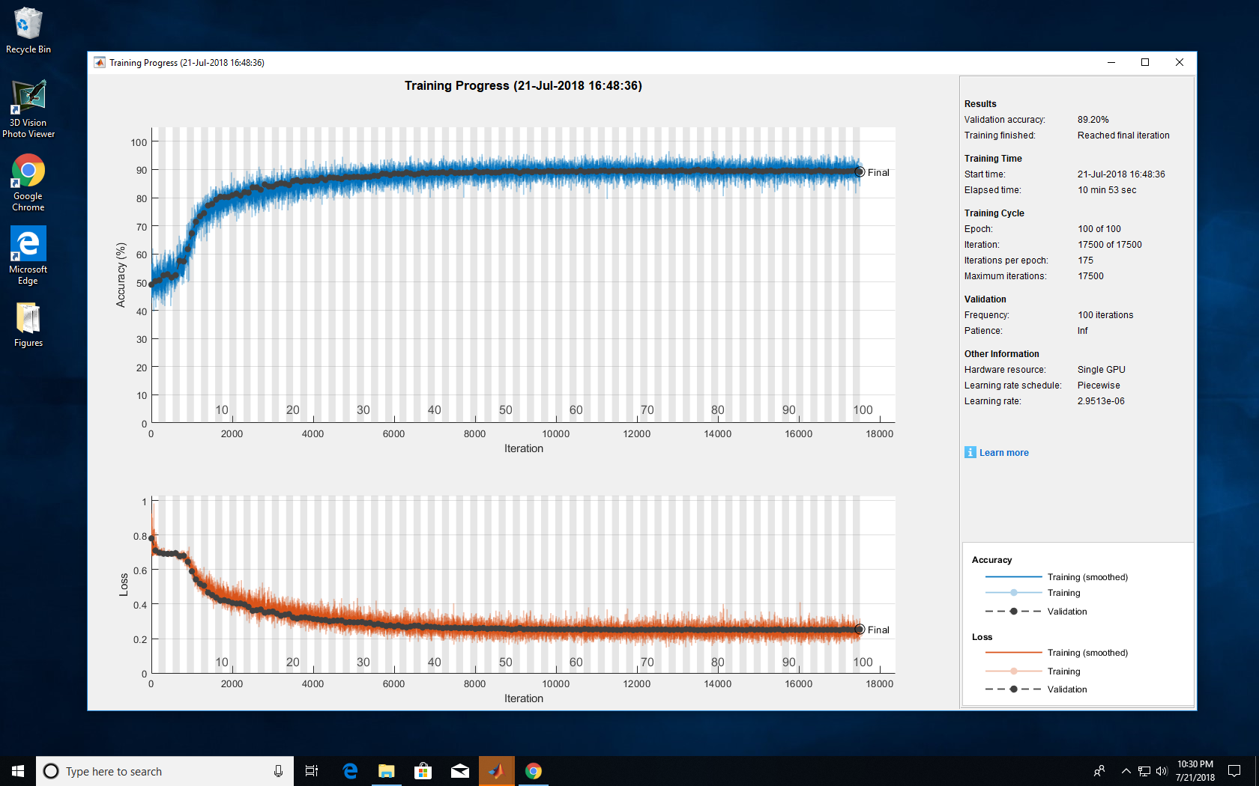
Data50k_ABE
1 5 amplitude
1 2 magnetic field
8 12 energy
200 200 smo
2 2 nu
0 1 Kap
40 40 ld
trainedNetwork
Classification:
Accuracy = 90.19%
Regression:
StdA = 0.094
StdB = 0.077
StdE = 0.085

Slide 6
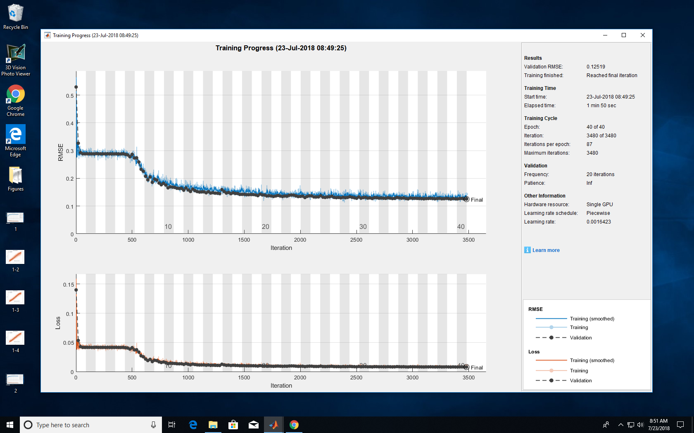
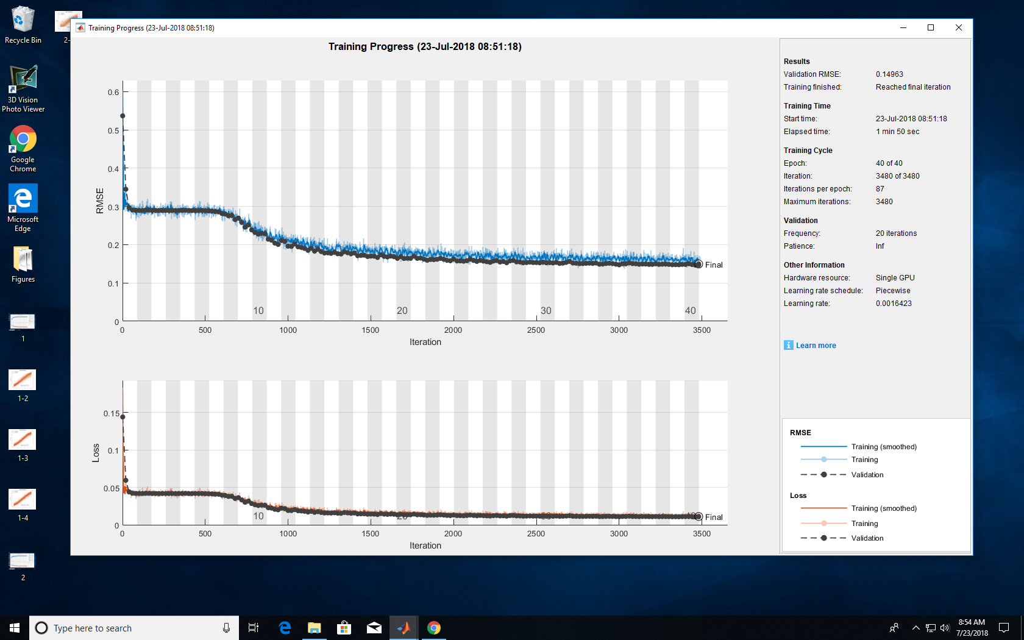
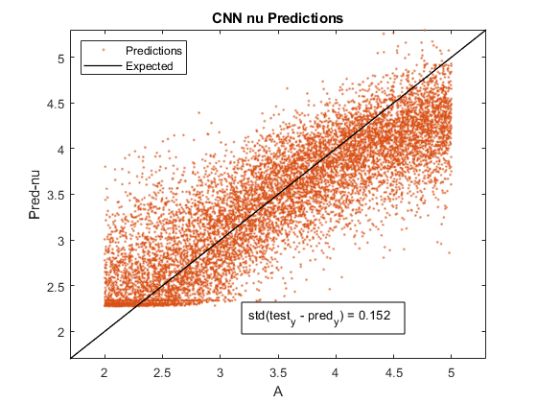

trainedNetwork0
trainedNetwork1
Data50k_Nu
5 5 amplitude
1 1 magnetic field
8 8 energy
200 200 smo
2 3 nu
0 1 Kap
40 40 ld
trainedNetwork
Classification:
Accuracy = 88.79%
Regression::
Std = 0.152

