Slide 1
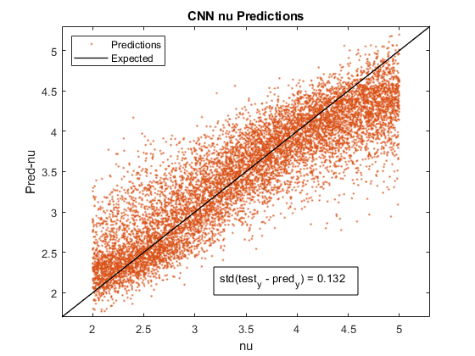
50k data ABENu
A = [0 5]
B = [0.5 2]
E = [8 12]
Nu = [2 5]
StdA = 0.067
StdB = 0.048
StdE = 0.069
StdNu = 0.132

Slide 2
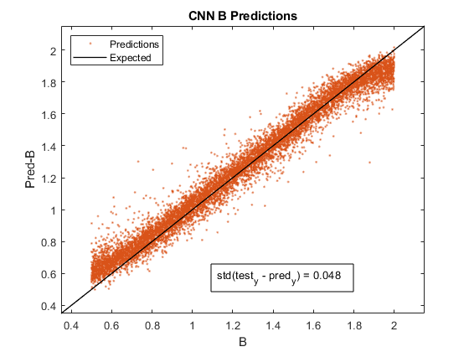
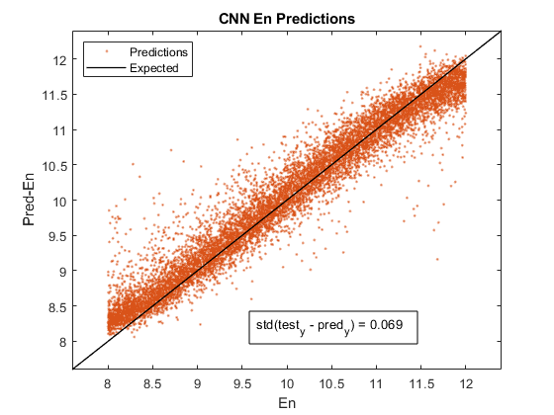
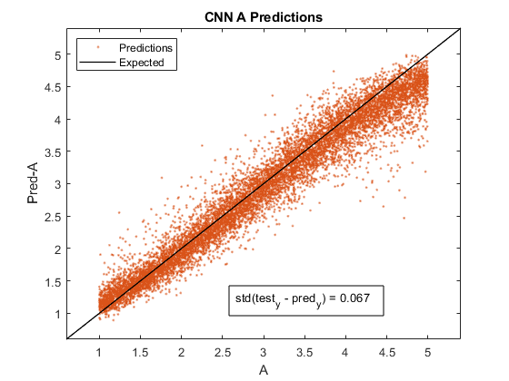

Slide 3
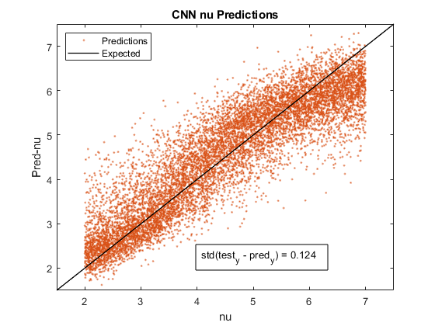
50k data ABENu
A = [0 5]
B = [0.5 2]
E = [8 12]
Nu = [2 7]
StdA = 0.066
StdB = 0.047
StdE = 0.066
StdNu = 0.124

Slide 4
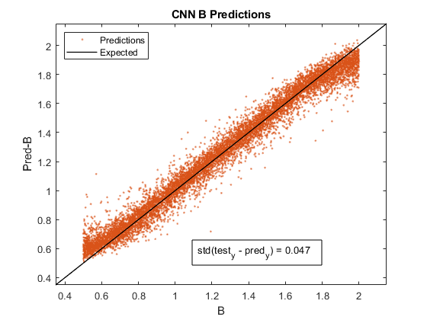
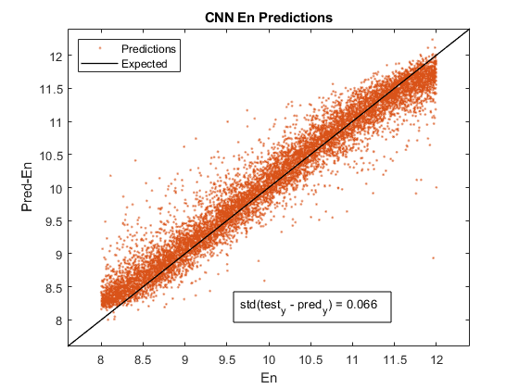
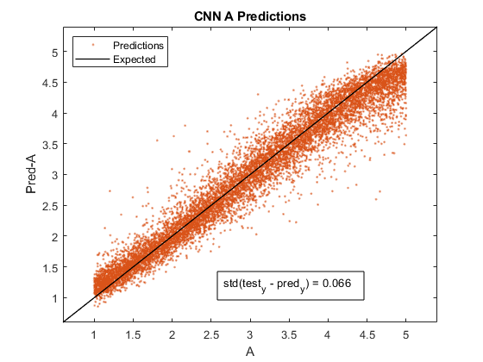

Slide 5
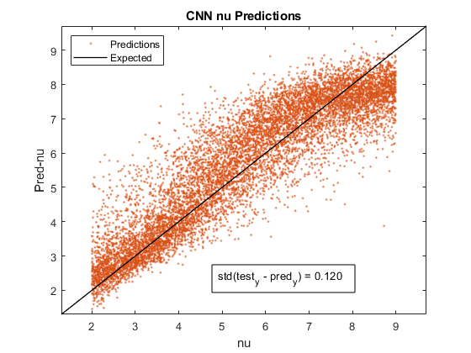
50k data ABENu
A = [0 5]
B = [0.5 2]
E = [8 12]
Nu = [2 9]
StdA = 0.064
StdB = 0.045
StdE = 0.065
StdNu = 0.120

Slide 6
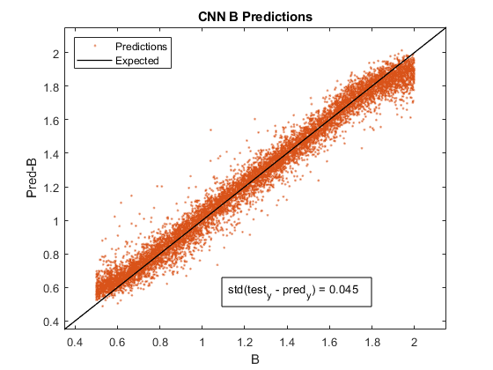
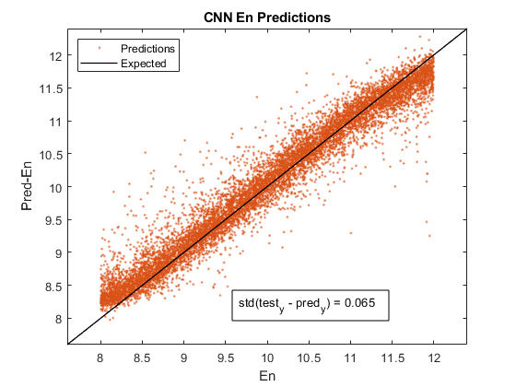


Slide 7
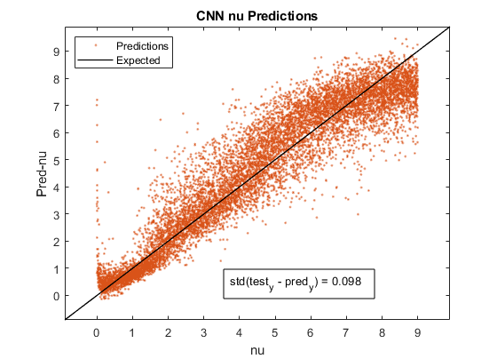
50k data ABENu
A = [0 5]
B = [0.5 2]
E = [8 12]
Nu = [0 9]
StdA = 0.098
StdB = 0.052
StdE = 0.070
StdNu = 0.098

Slide 8
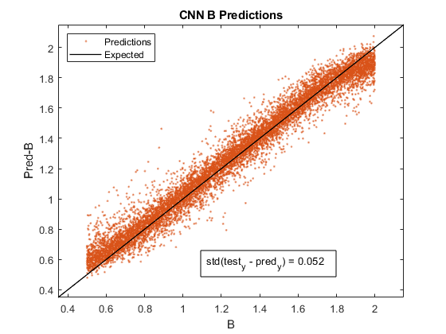
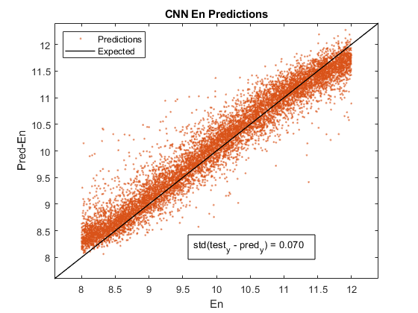
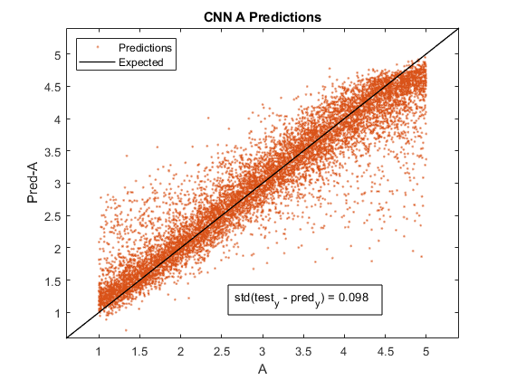

Slide 9
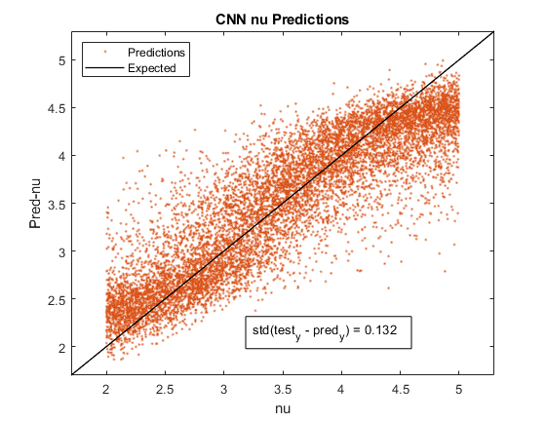
50k data ABENuLd
A = [0 5]
B = [0.5 2]
E = [8 12]
Nu = [2 5]
Ld = [10 40]
StdA = 0.066
StdB = 0.045
StdE = 0.093
StdNu = 0.132
StdLd = 0.167

Slide 10
